Slide 1
Developing Student Inquiry
Using Hydroponics and Plant growth
Grow with us!

Slide 2
Background Information

Slide 3
Who’s Involved:
Katie Warren-
Grade 6 teacher. I have been teaching for 14 years. I began my teaching career as a core French teacher, which is my ultimate passion. For the last 6 or so years, at CC Loughlin, my teaching assignments have moved away from French and have focused on the overall grade 5 and 6 curriculum. I always enjoy teaching ‘outside the box’, and thought that this research project would be the perfect fit for my challenging and diverse group of students.
Dulcie Skinner-
Grade 3 teacher,teaching for almost 10 years, was approached by a colleague to be a part of this project and considering the curriculum connections to my science curriculum decided to do this, I enjoy trying new things and I felt this project would truly benefit the learning experience for my students
Brigitte White-
Vice- Principal/ Literacy Numeracy Support Teacher. I have been teaching for 24 years, mainly in French Immersion. I was a part of another STEM project last year in a supporting role - Flipped Classroom. I became part of this group as I run the after school environment group and school garden and greenhouse. My role was minimal in the day to day setup of this project.

Slide 4
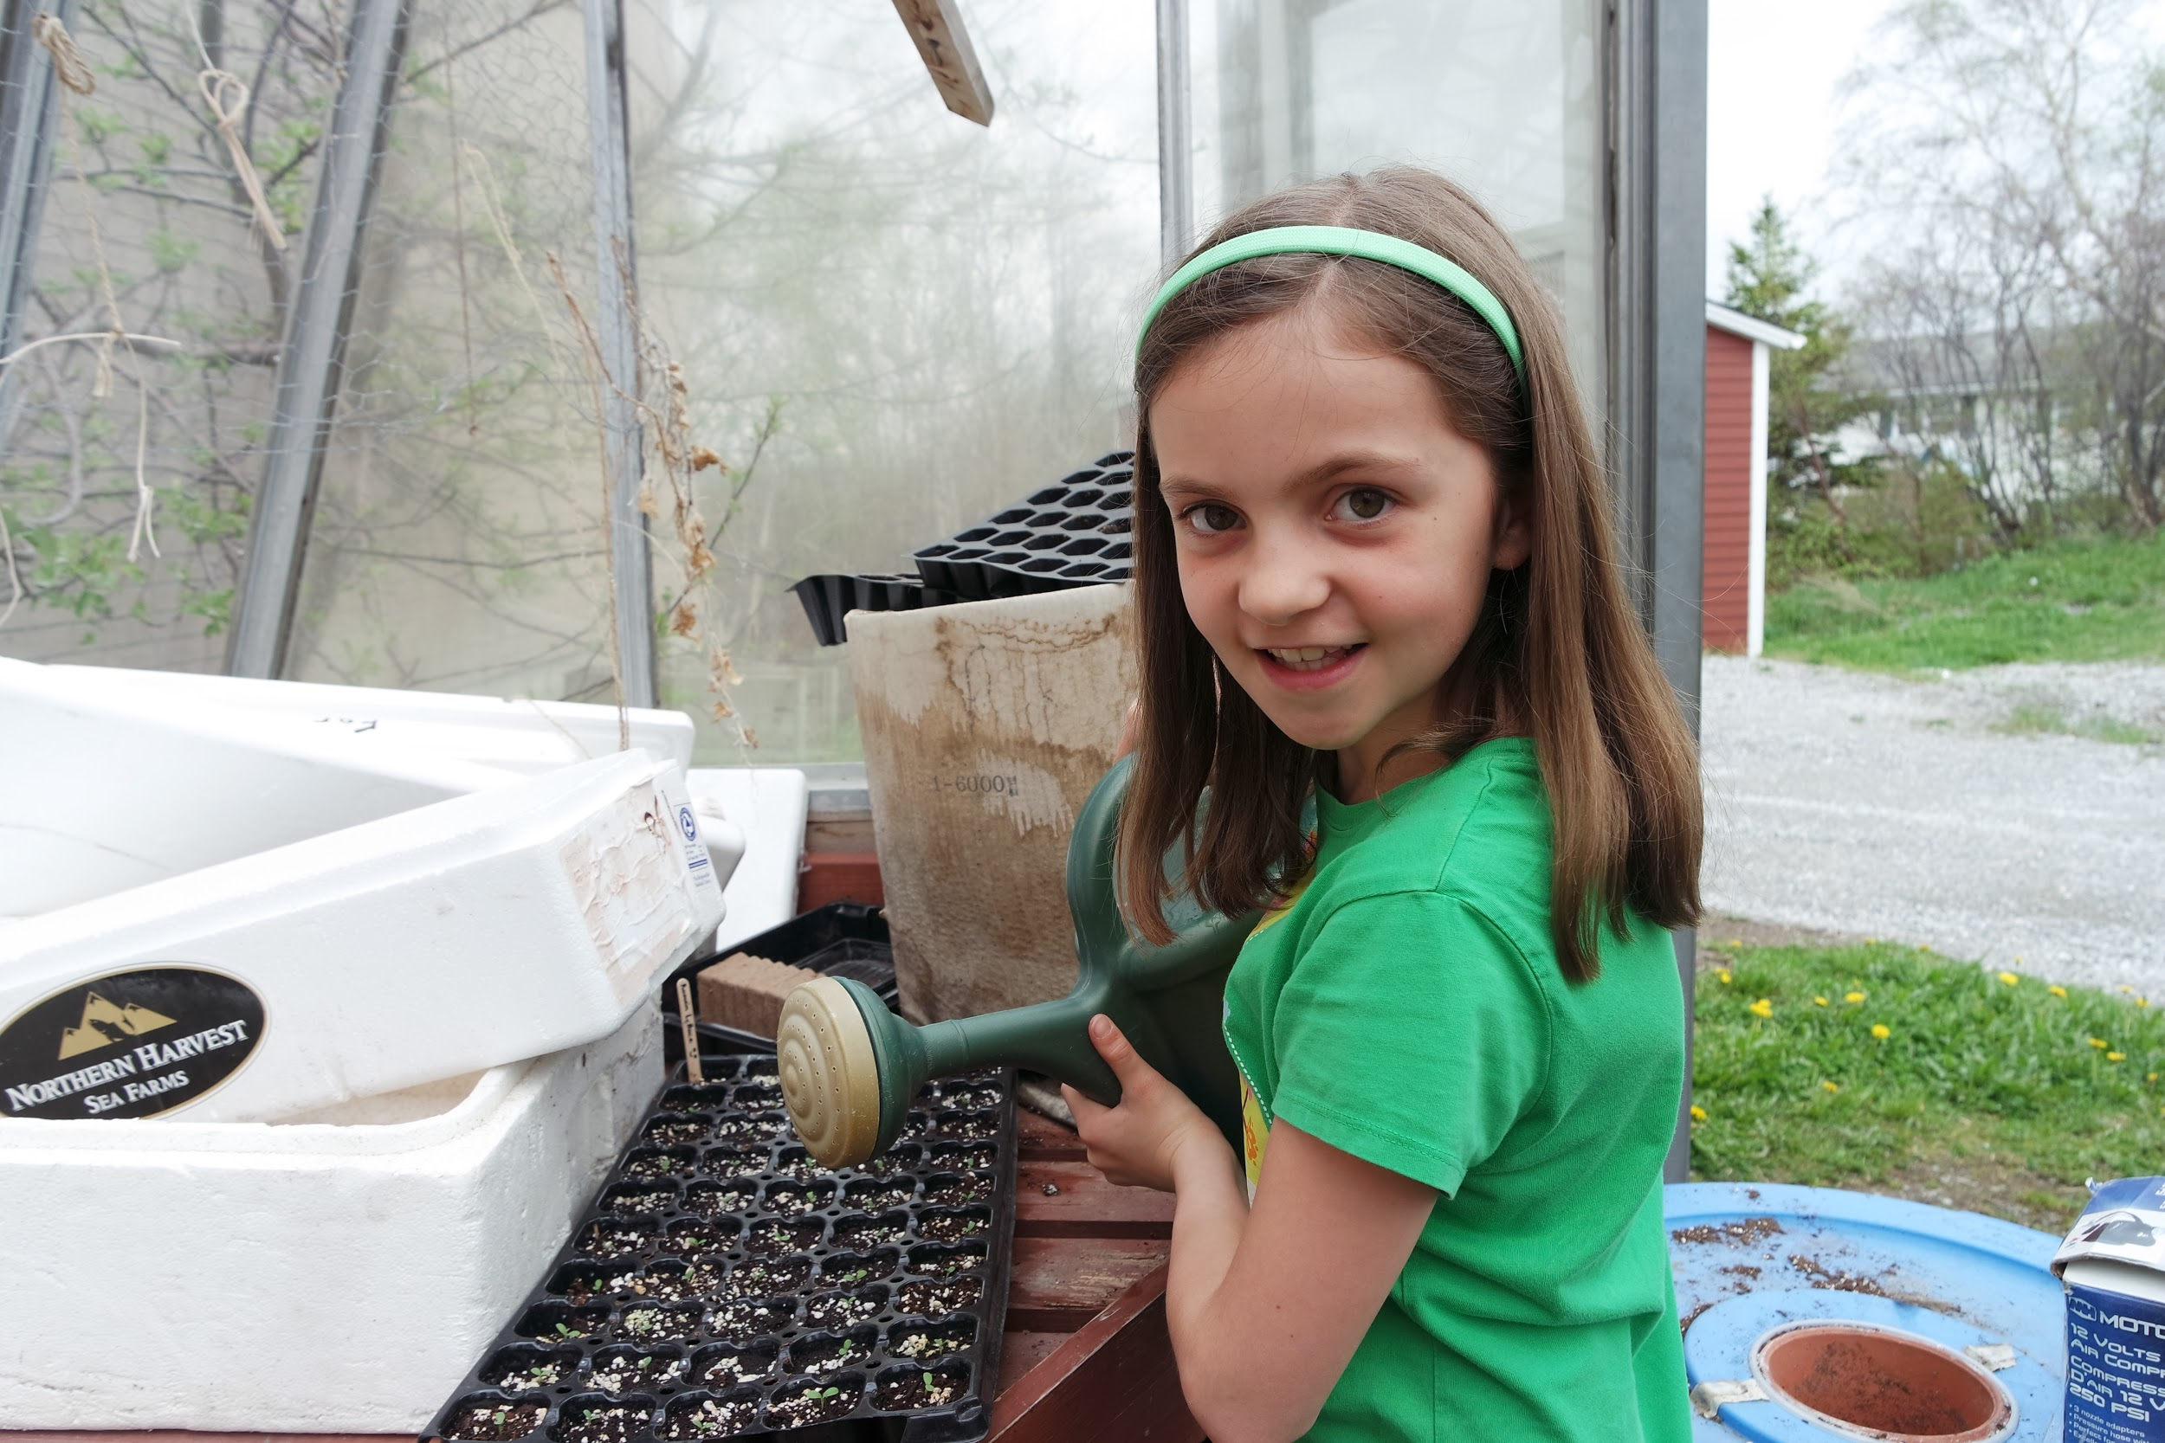
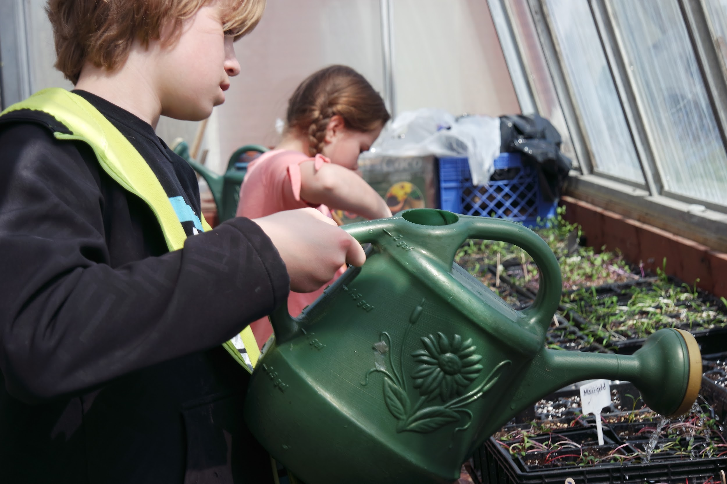
Green Thumbs
Our school has had a greenhouse and outdoor garden for over 13 years. Many students in the elementary grades participate in our planting and other environmental initiatives. Through this, students learn many leadership skills and responsibilities as well as an understanding of food sustainability and a love for fresh food! I approached teachers on staff to see who wanted to try using the hydroponics unit in their classroom.

Slide 5
Focus………...
Honestly, why not? Opportunities to help develop skills in our students are invaluable and not always easy to ascertain!!
Hydroponics - how cool is that? That was my first thought. Not only was there a potential for student learning but for me too. Everyone is connected to food. Not all students have access to fresh healthy food options.
Luckily I was able to find a co-worker who was eager to jump on board so that we could implement the use of hydroponics in our classes.

Slide 6
Curriculum Integration
In grade 3, plant growth and changes is a part of our Science curriculum and the use of a hydroponics unit was just an extension to that. I hoped it would make the learning experience more valuable and engaging for my students and it did! As well, we began our measurement unit when we started measuring the plants using a ruler and journalled regularly about the development of the plant growth and the students’ wonderings.

Slide 7
Grade 6 - Where does it fit?
Anything can be integrated into the curriculum if you plan and implement it properly. The focus for this project was inquiry based learning in the science field. The first unit of Science, in grade 6, is Variety of Life. So the learning of plant growth and different vegetation fits in there well. The aspect of critically thinking and applying it in an authentic situation is throughout the program.
The learning from this project has extended past the Science curriculum. There are links to the Math curriculum with regards to measurement and volume. Social Studies objectives were met through aspects of culture and how different regions have restricted growing opportunities. Links were also present in Language Arts through regular communication via discussions and journal writing.

Slide 8
Teacher Question:
What is my role in encouraging an inquiry based project with hydroponics?
Subquestions: What is hydroponics? What grows well in hydroponic unit versus soil?
As teachers we strive to help our students grow and through the use of hydroponics we were able to engage our students to want to grow, to want to learn and to know more. This led to inquiry!
We just gave them the tools they needed to get started!

Slide 9
Student Question
How will scientific inquiry enhance student motivation?
Subquestions: Will reluctant/disengaged learners participate?
Knowing the group of students coming into our classrooms, we were well aware of all the needs, academically and socially, that were going to be present. This project gave us another means to try to engage and motivate all students. And to help us out too.
Despite the various learning abilities all students participated and showed enthusiasm throughout the project.

Slide 10
Research suggests that using inquiry-based learning with students can help them become more creative, more positive and more independent. Inquiry-based learning provides opportunities for students to:
• develop skills they will need all their lives
• learn to cope with problems that may not have clear solutions
• deal with changes and challenges to understandings
• shape their search for solutions, now and in the future.
(Focus on Inquiry: A Teacher’s Guide to Implementing Inquiry-based Learning [Edmonton, AB: Alberta Learning, 2004])

Slide 11
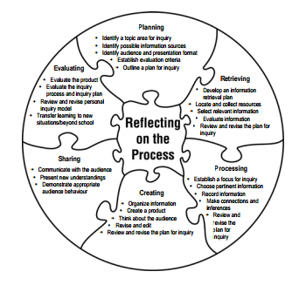
Focus on Inquiry: A Teacher’s Guide to Implementing Inquiry-based Learning [Edmonton, AB: Alberta Learning, 2004])

Slide 12
Mindset ----- The beginning!!
Hands on learning!!!! Teaching outside the box!!!! Teaching life skills and social development!!!!
This is how we need to teach to engage and motivate our students.
The use of hydroponics in our science class will help us implement strategies that we already use in the classroom.

Slide 13
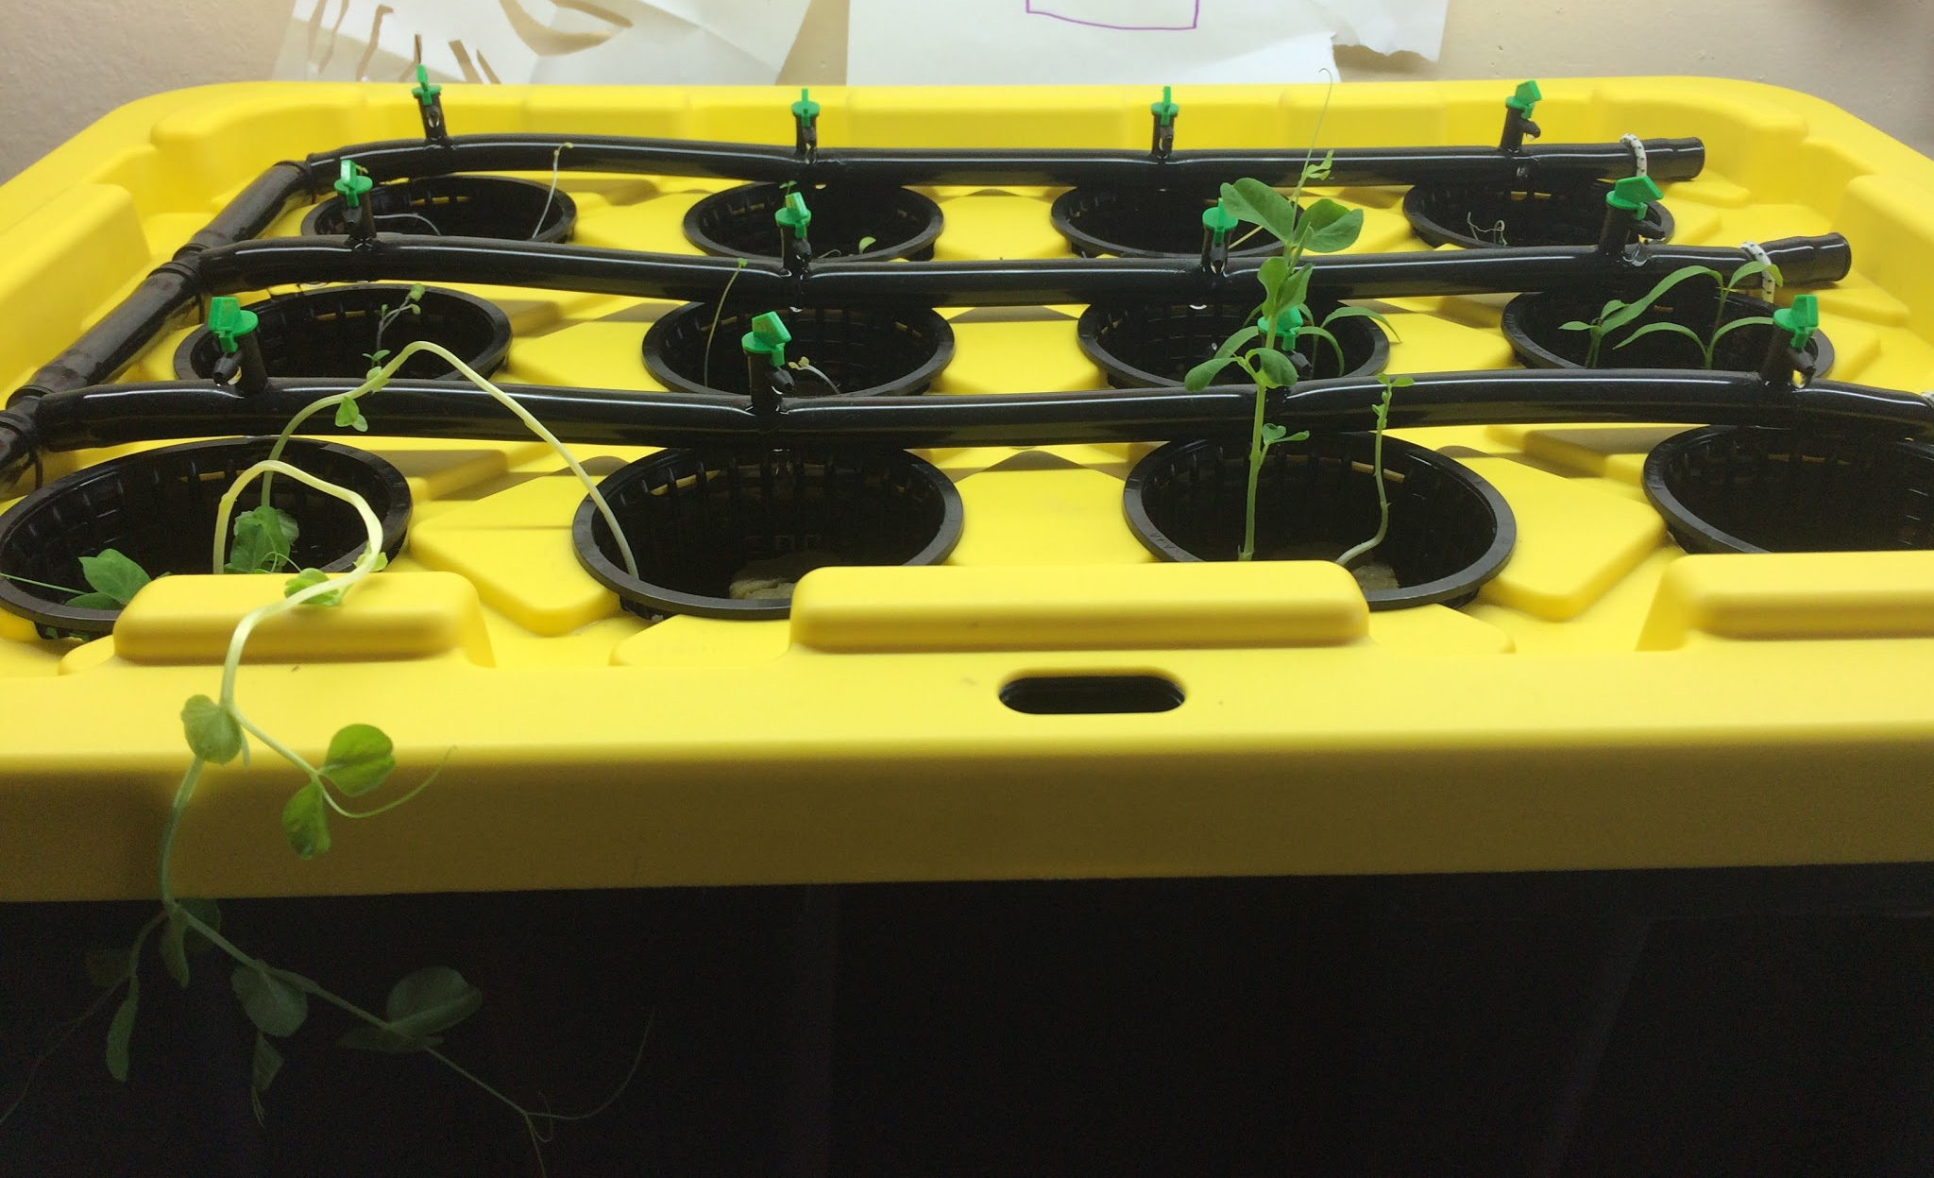
Planning
Ordered our hydroponics unit- it didn’t arrive until late December!

Slide 14
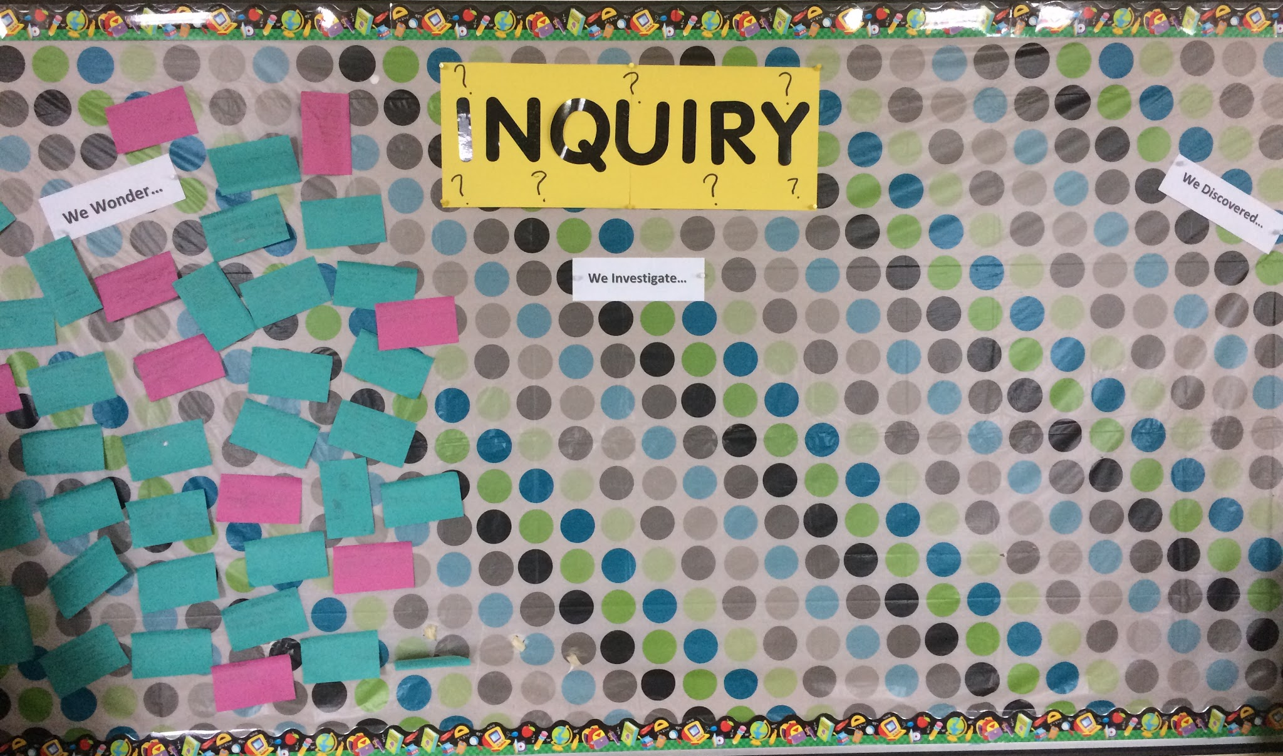
Set up a Wonder Wall to bring interest to the project and encourage inquiry and guide our instruction

Slide 15
As teachers, we had big plans and a lot of ideas………...
Wanted to do a blog to incorporate student journals…..
Wanted to start growing crops right away……..

Slide 16
Reality …….
We didn’t have enough time to learn how to use the blog site and allow students to use it.
The hydroponics unit did not arrive until the day before Christmas holidays.
When we looked at it after Christmas, we learned that the seeds needed to sprout before going into the unit which further delayed the use of the unit
Communicated the project- during curriculum night, Class Dojo photos,
Media release forms
Collected articles

Slide 17
Waiting...
In anticipation of our farm visit we had a corn boil.
Students learned how to use vegetable waste in a creative way. They loved making corn husk dolls.
We also harvested some kale and tomatoes that were growing in the school greenhouse and garden behind the school.
We discussed food preservation and different reasons why it is necessary and how do it. Students participated in cultivating and dehydrating vegetables.

Slide 18
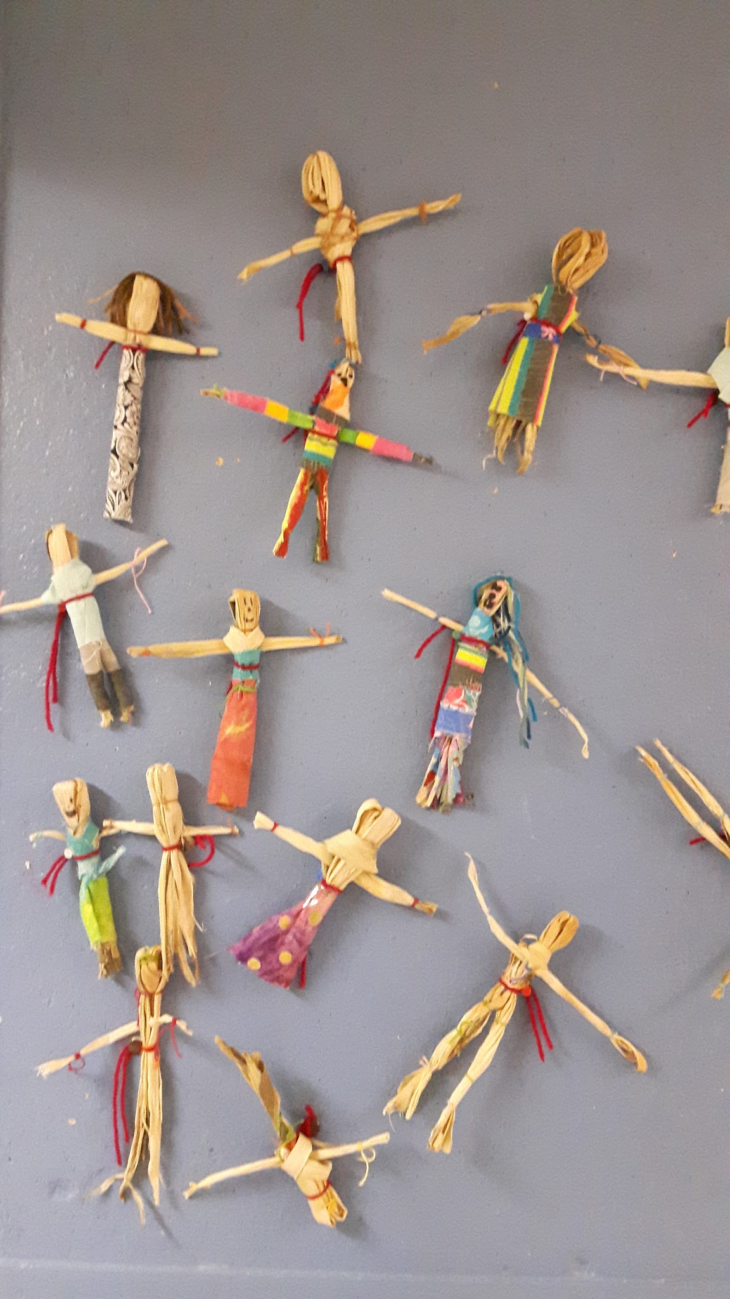
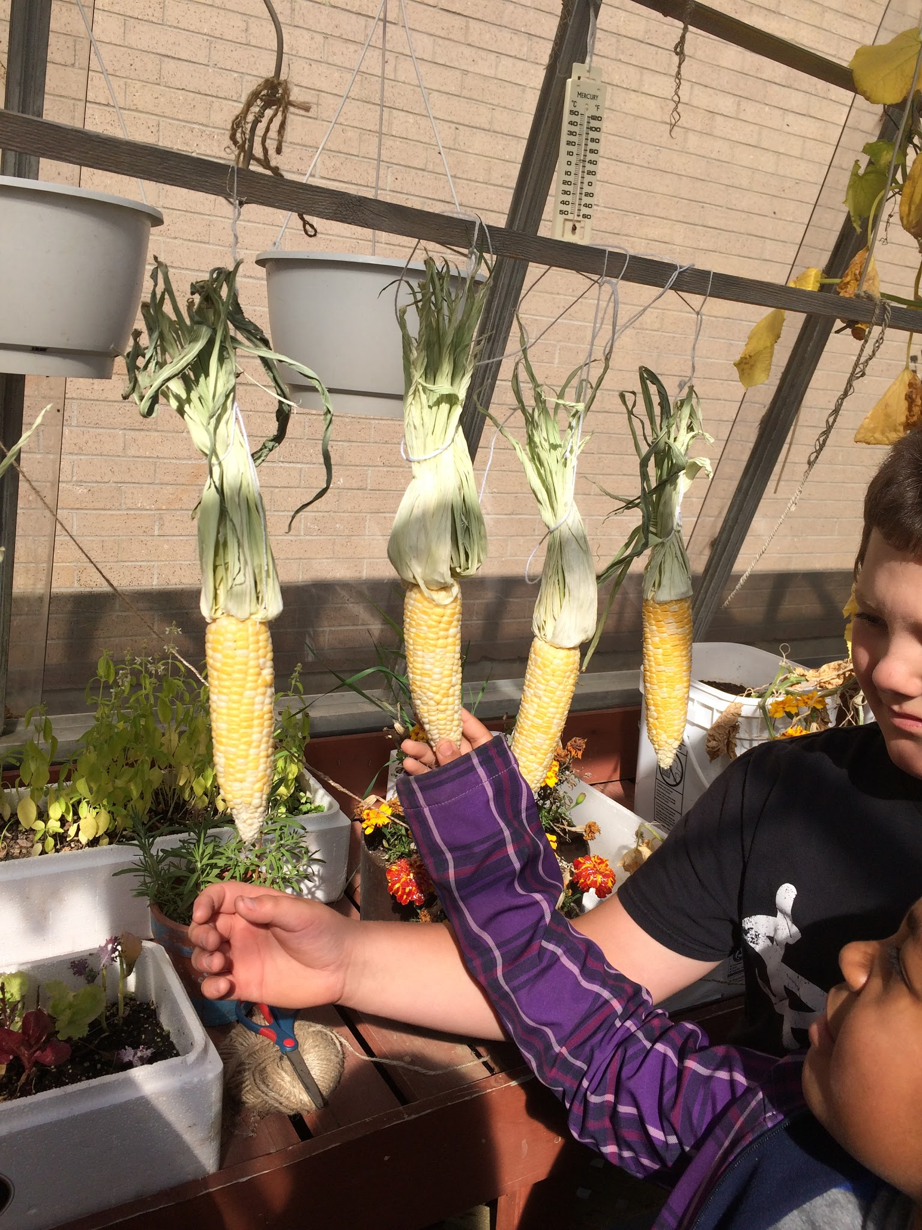
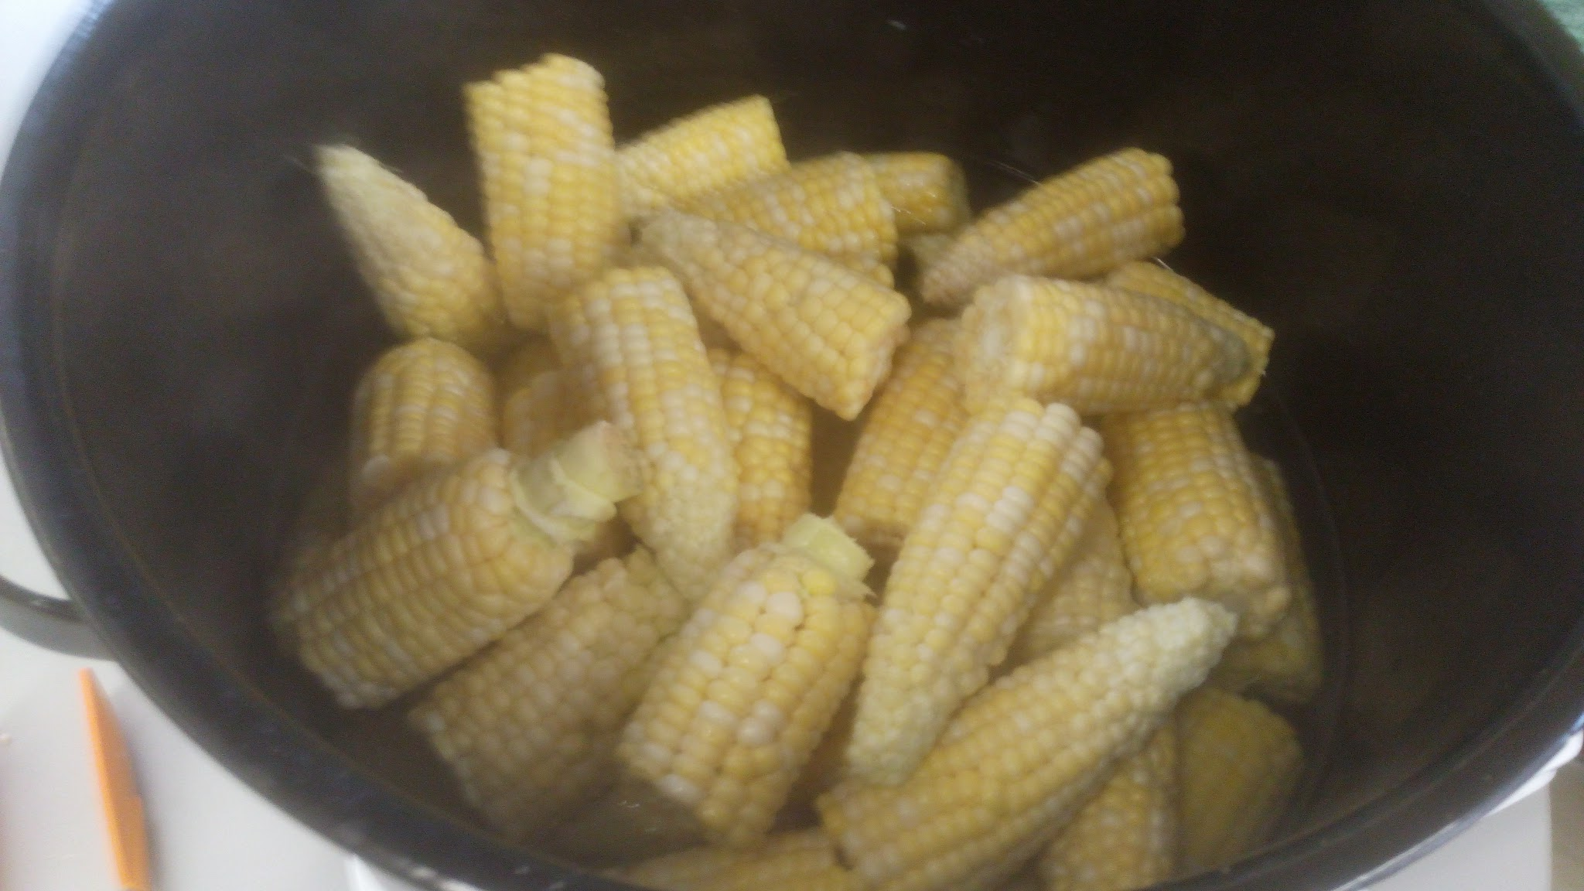
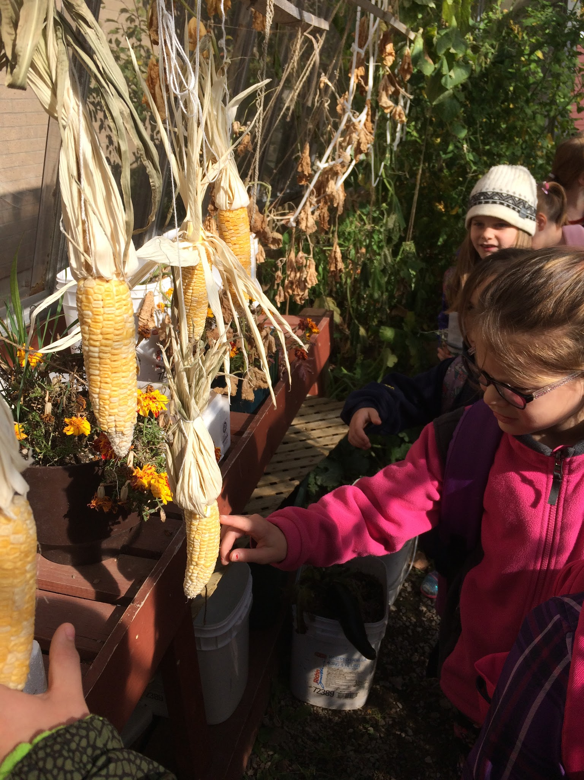
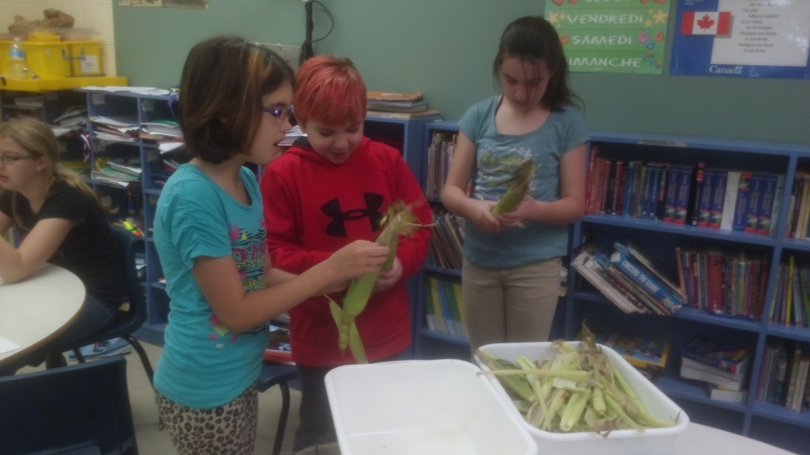
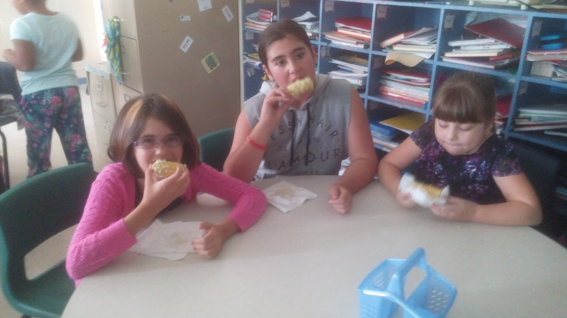

Slide 19
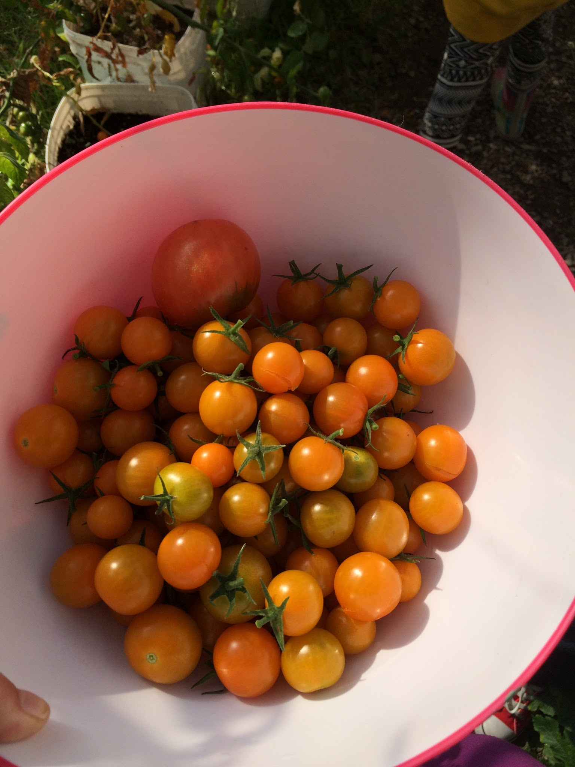
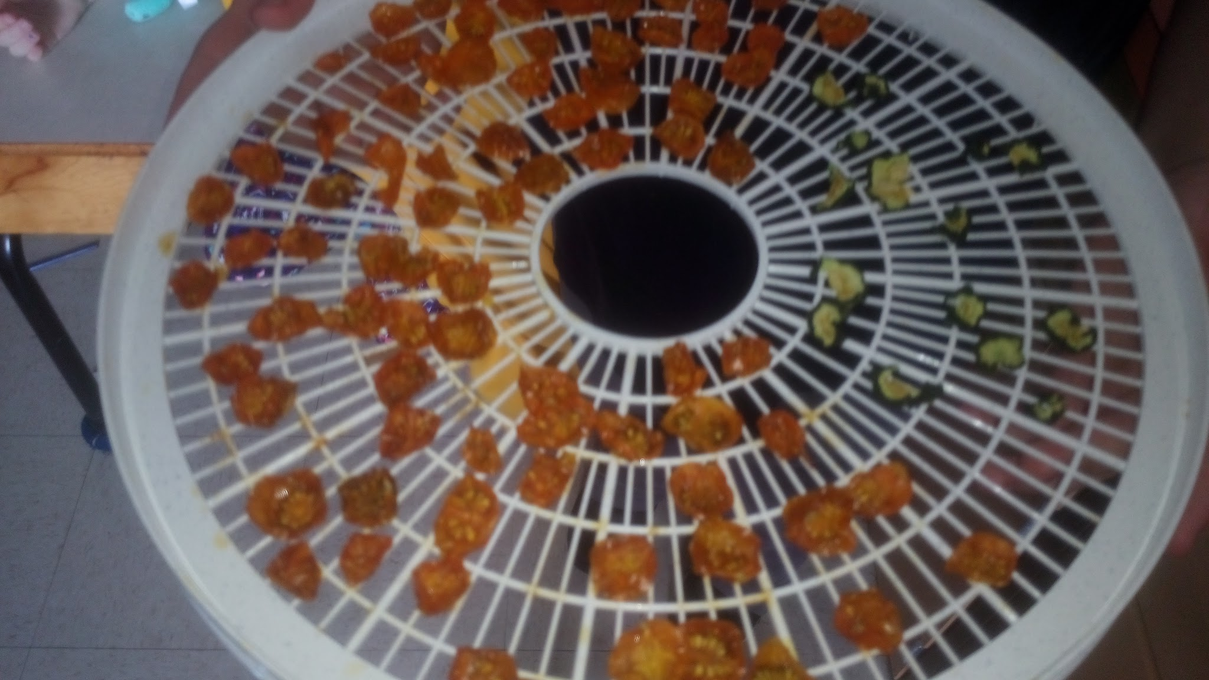
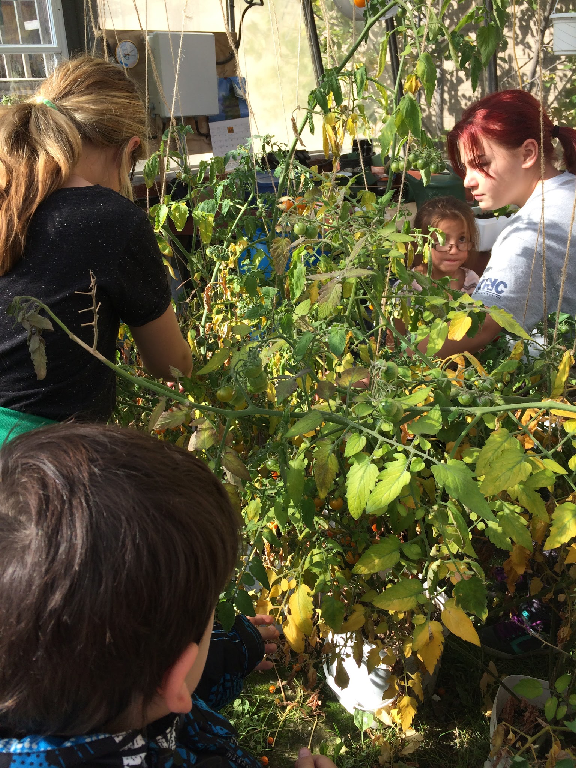
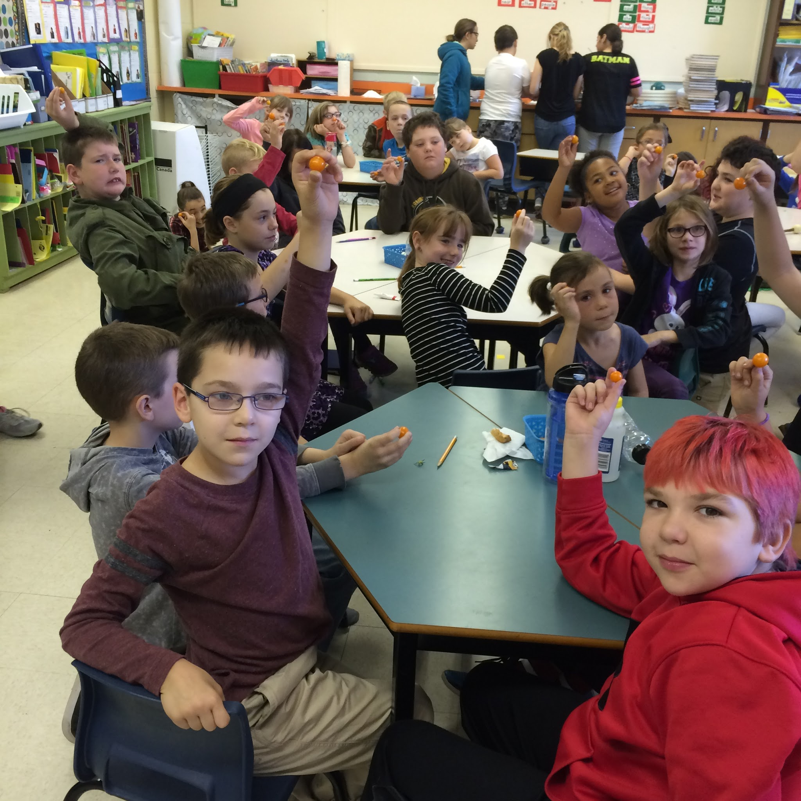
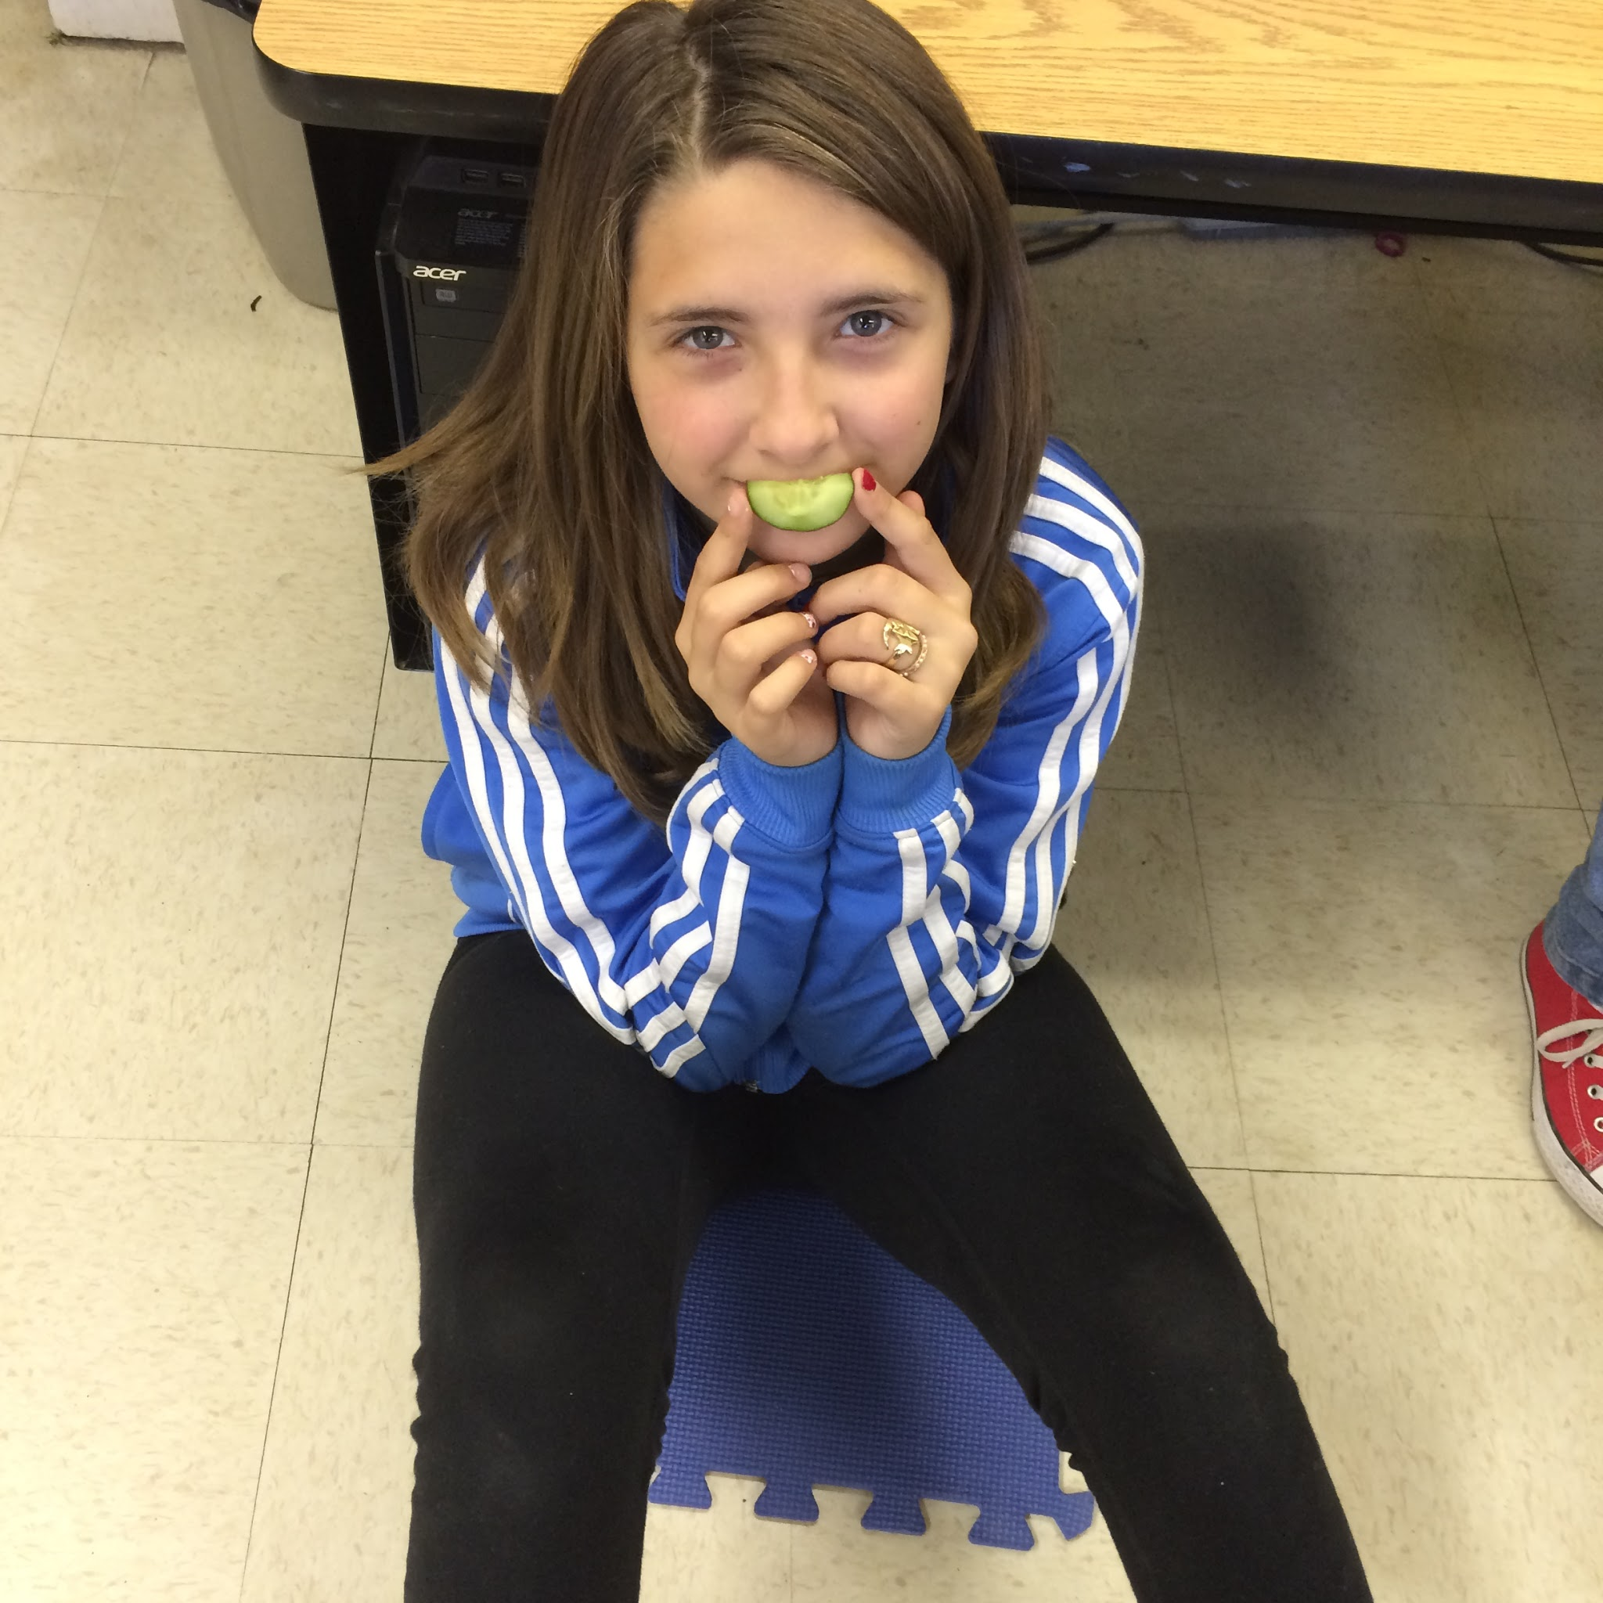
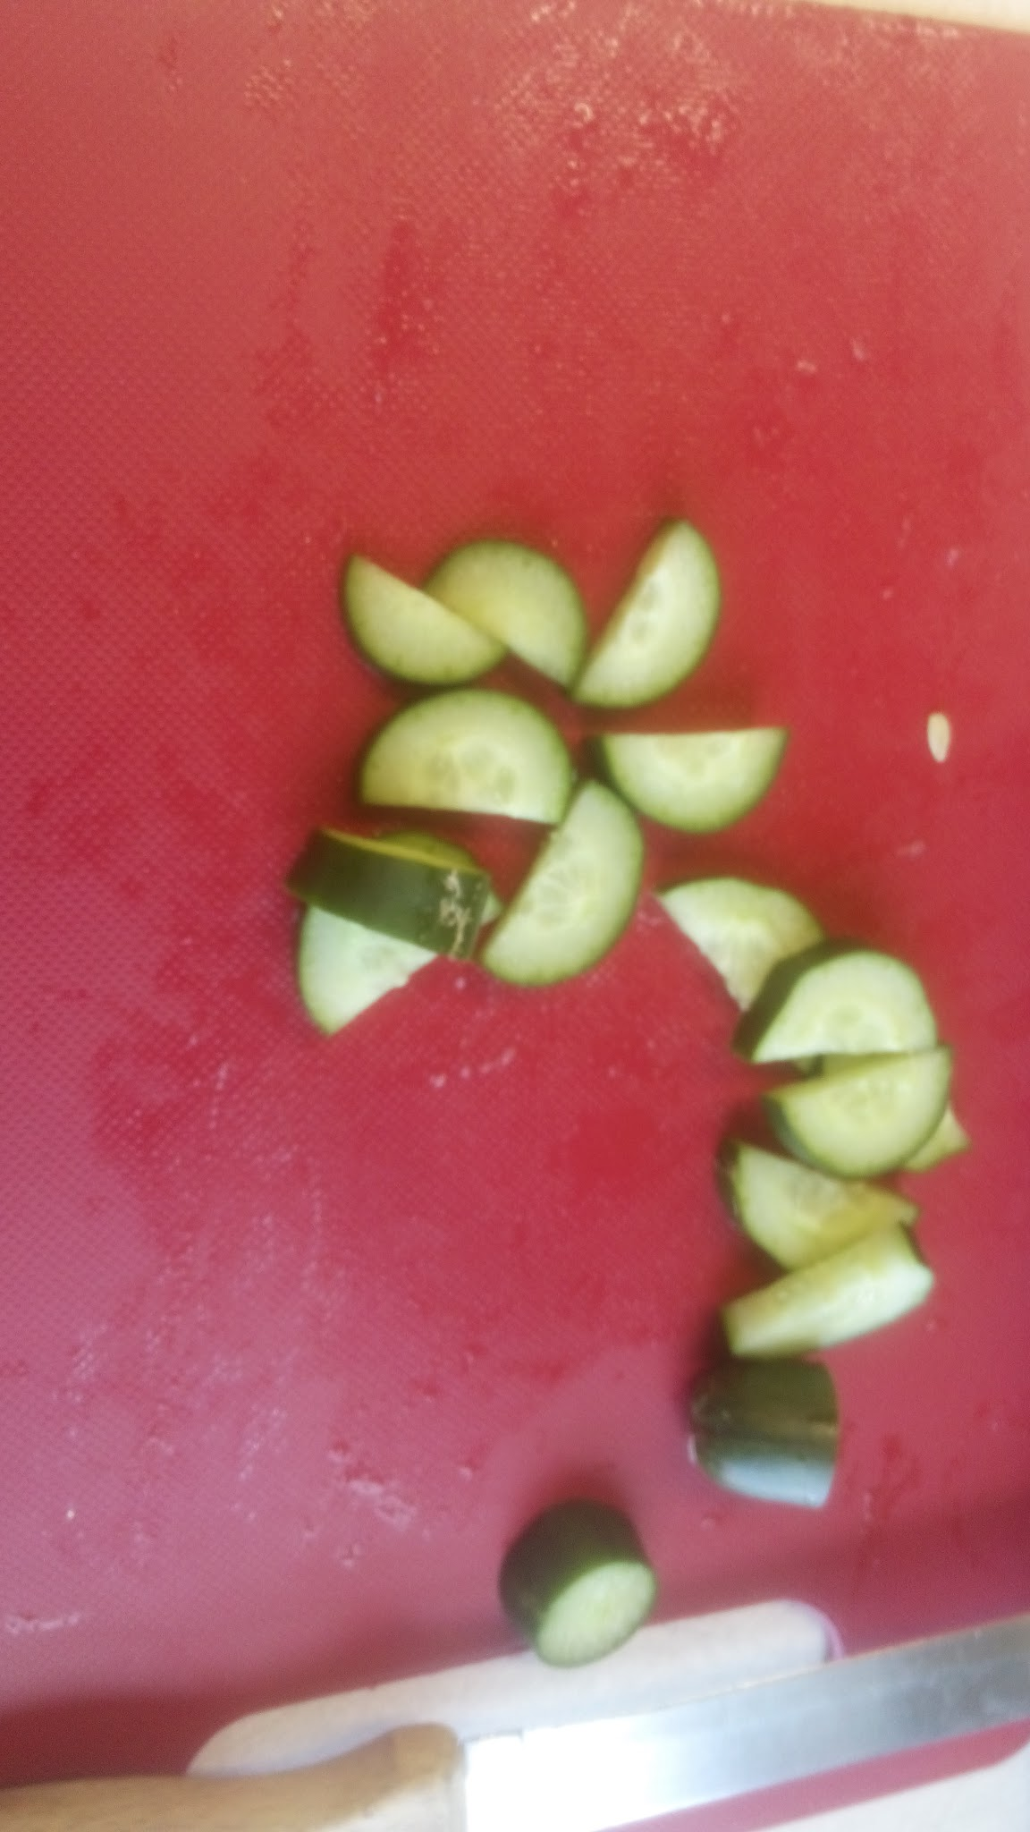
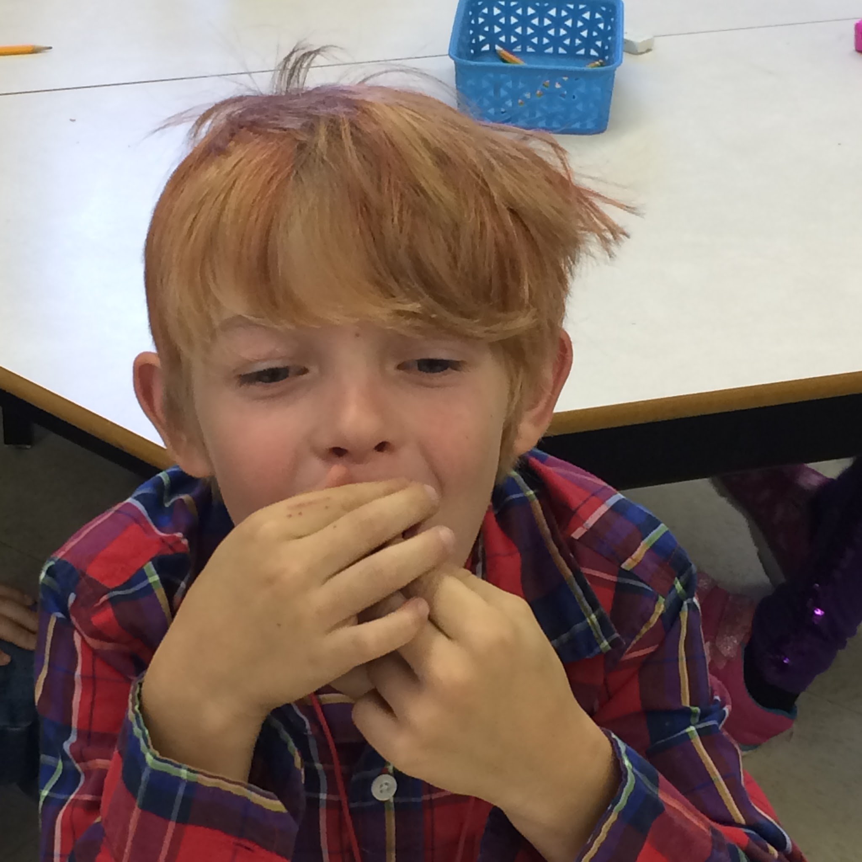
Dehydration

Slide 20
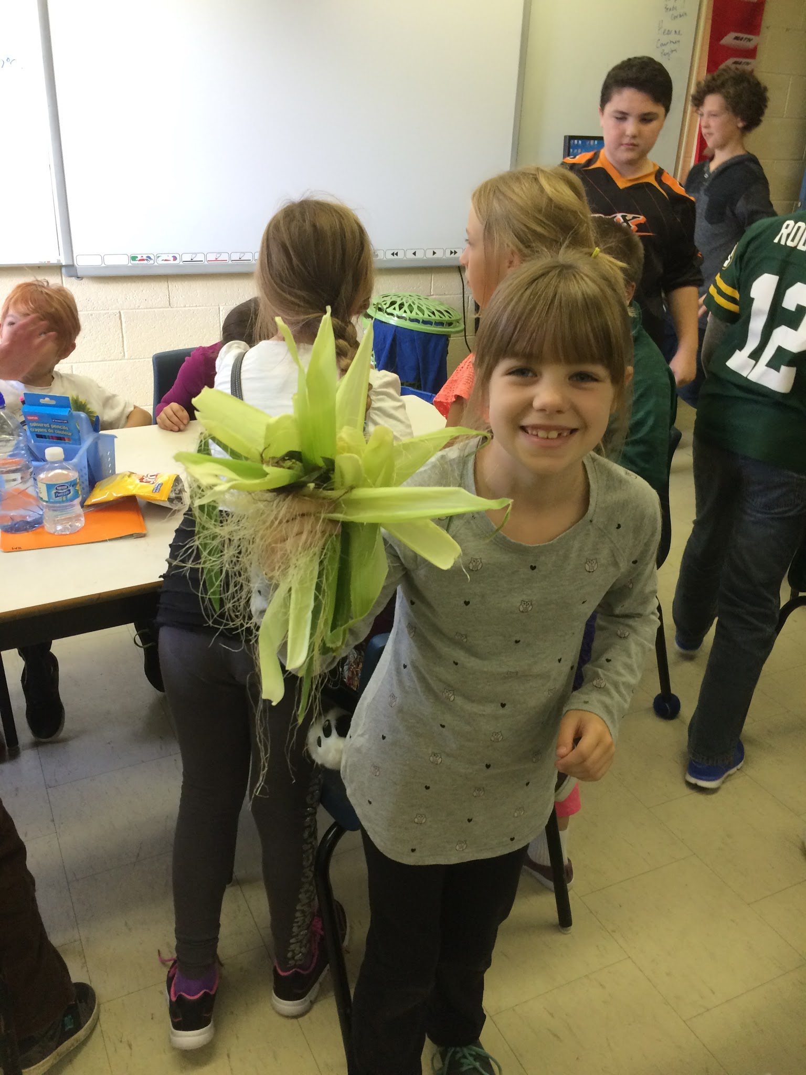
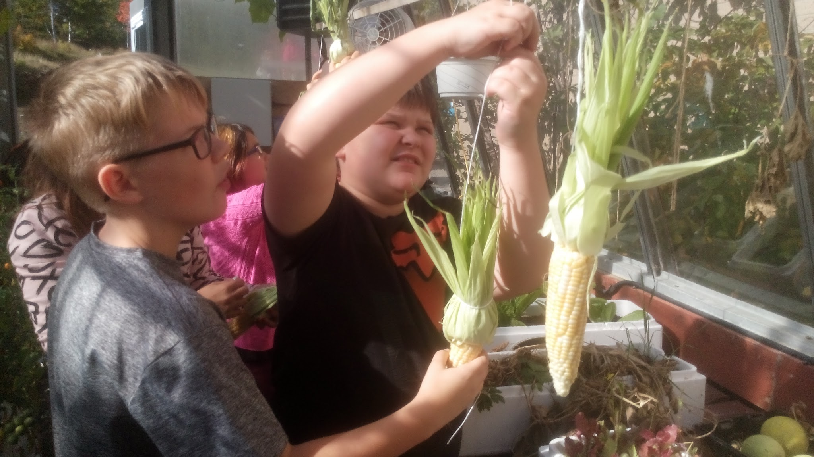
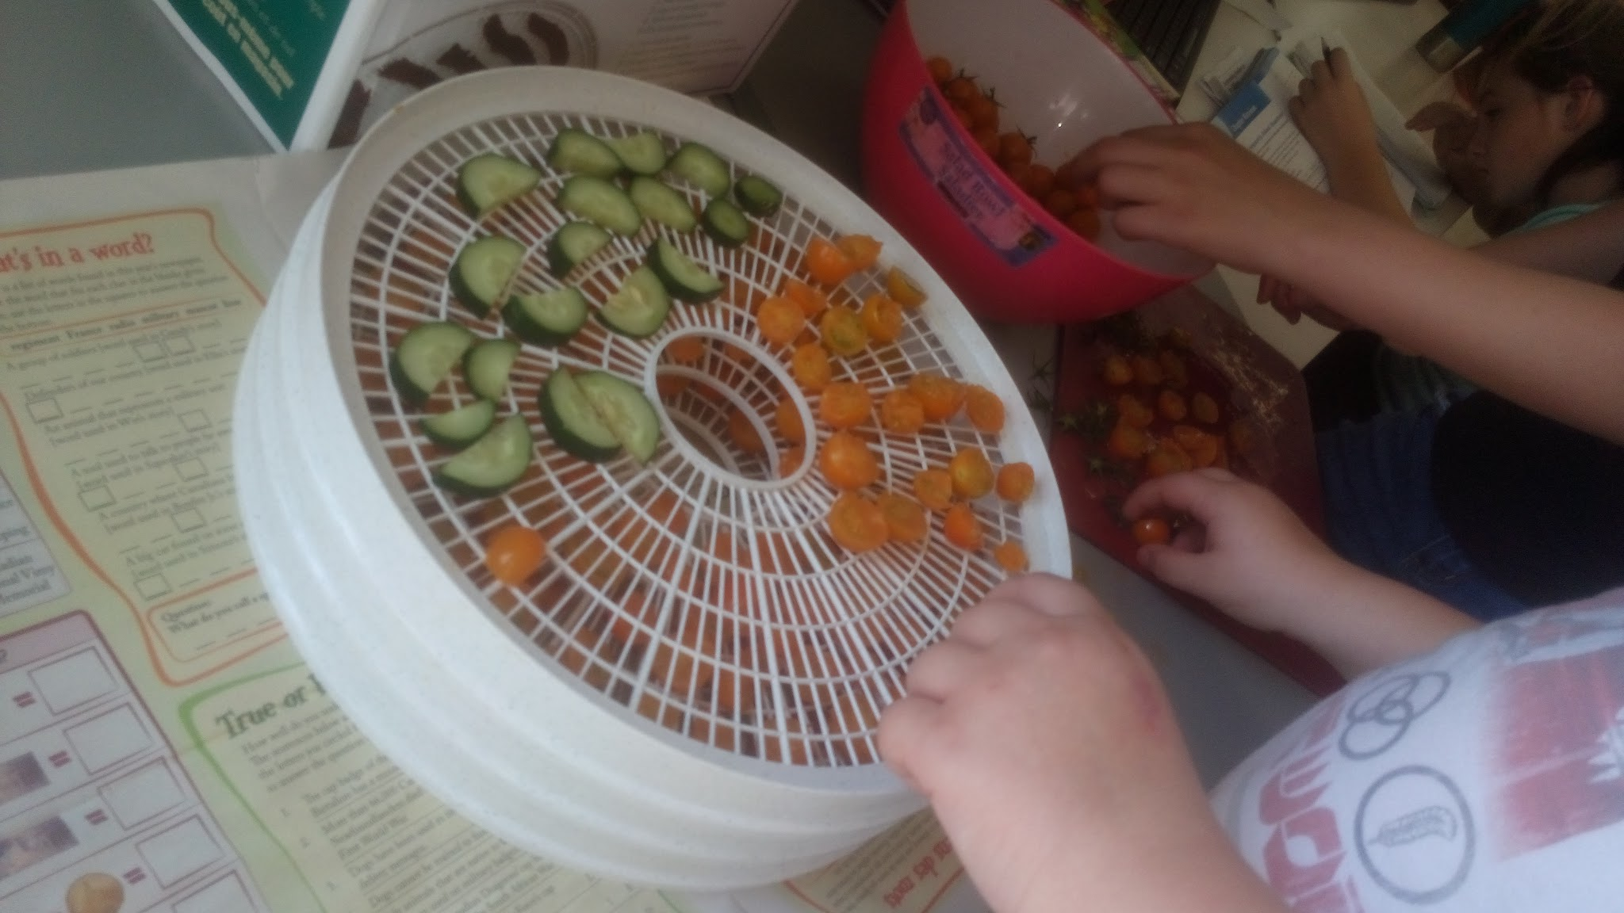
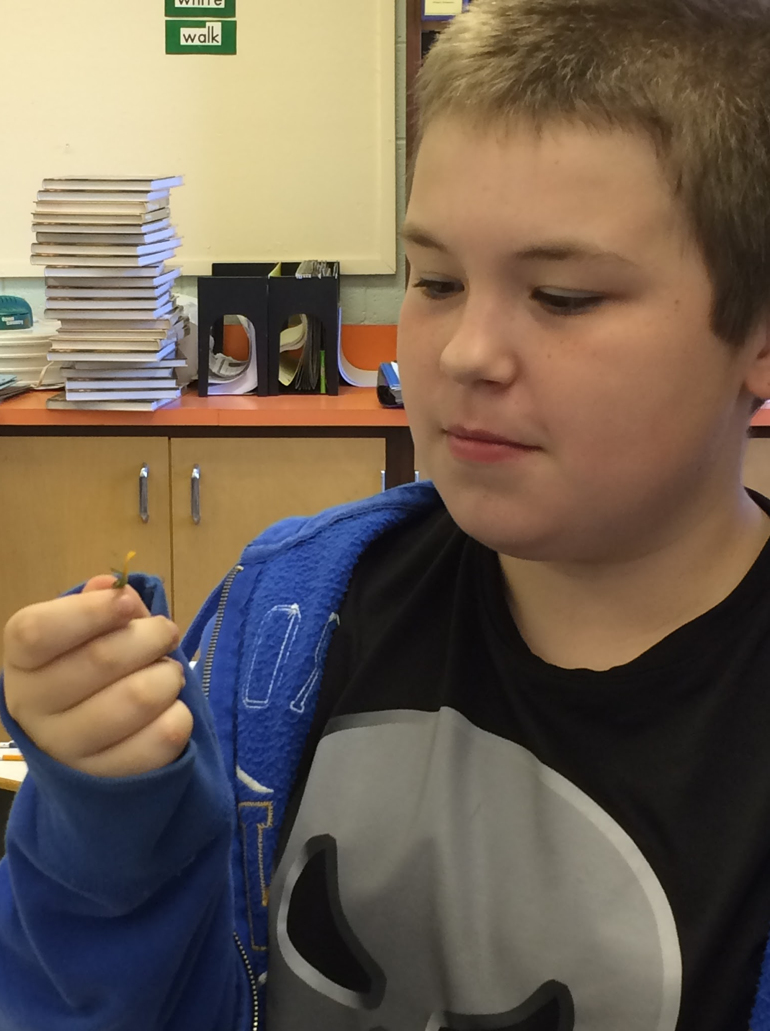
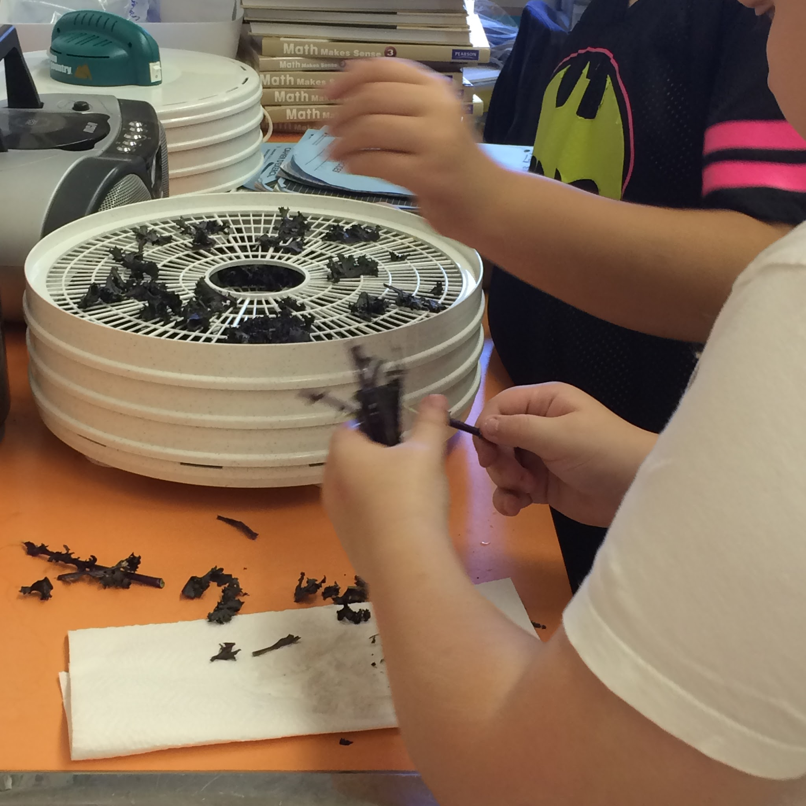
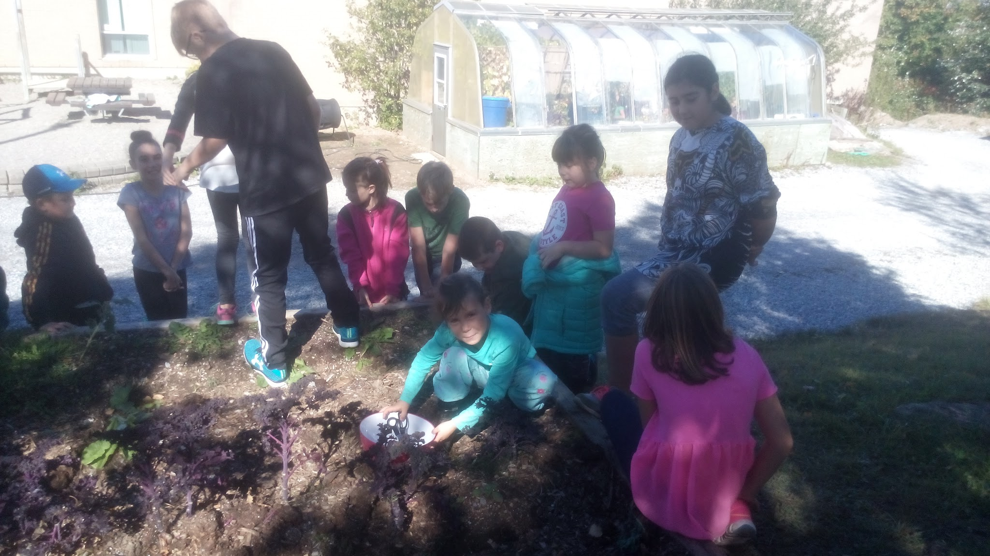
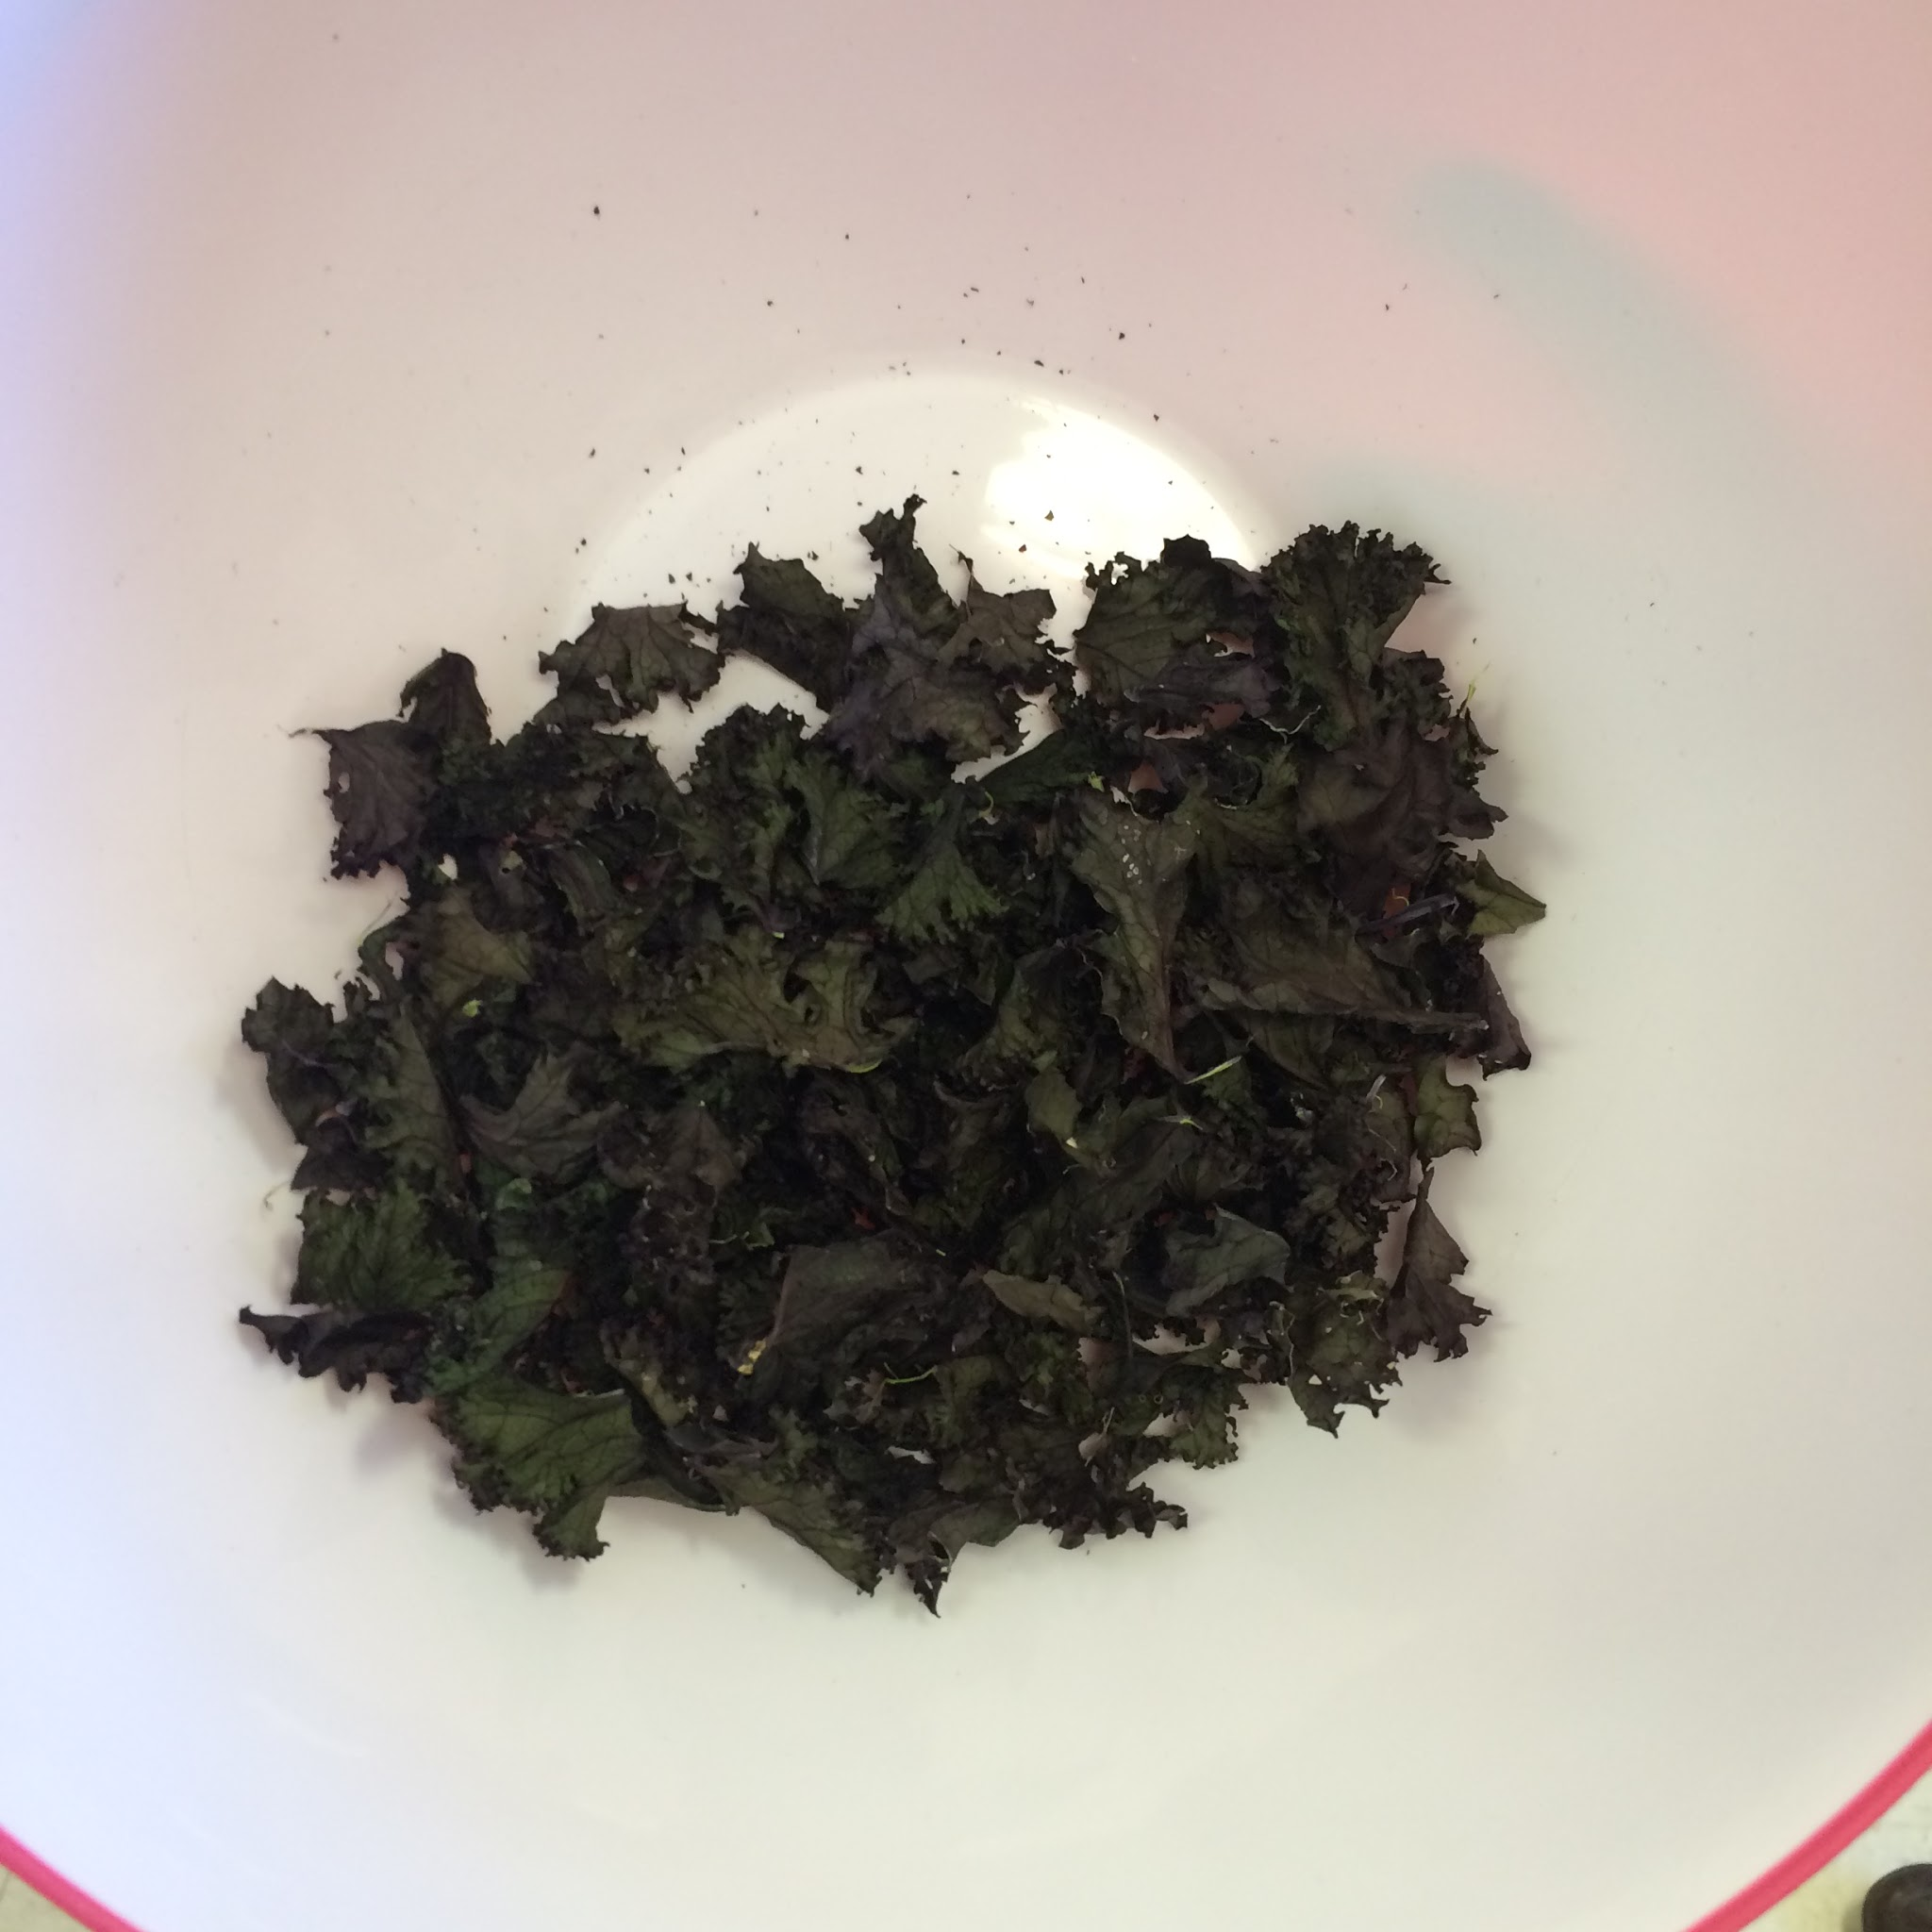

Slide 21
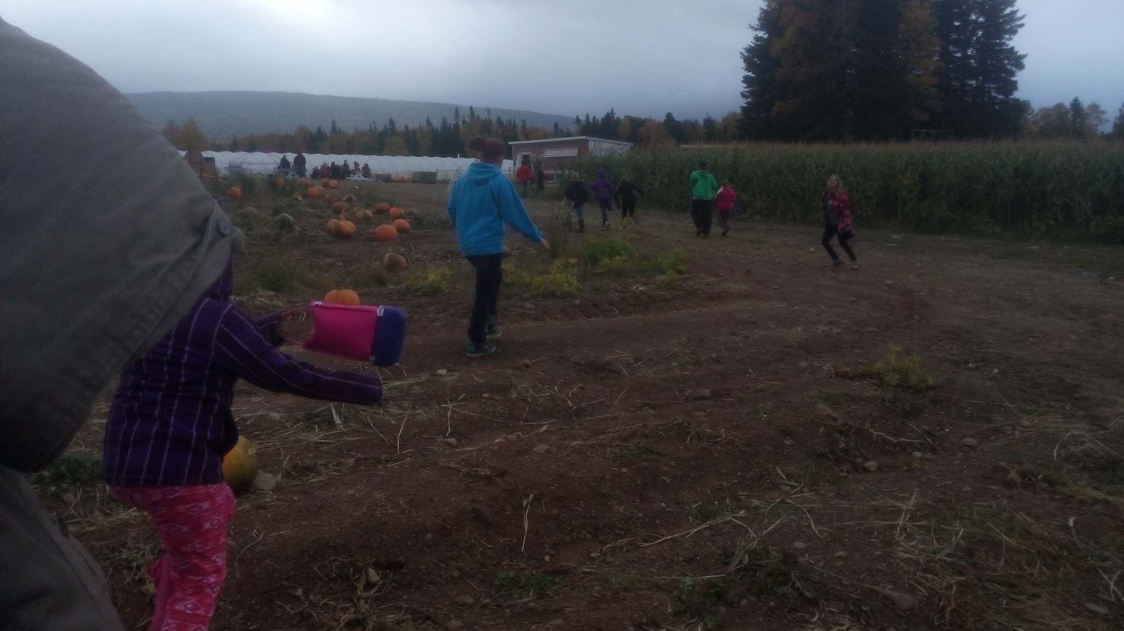
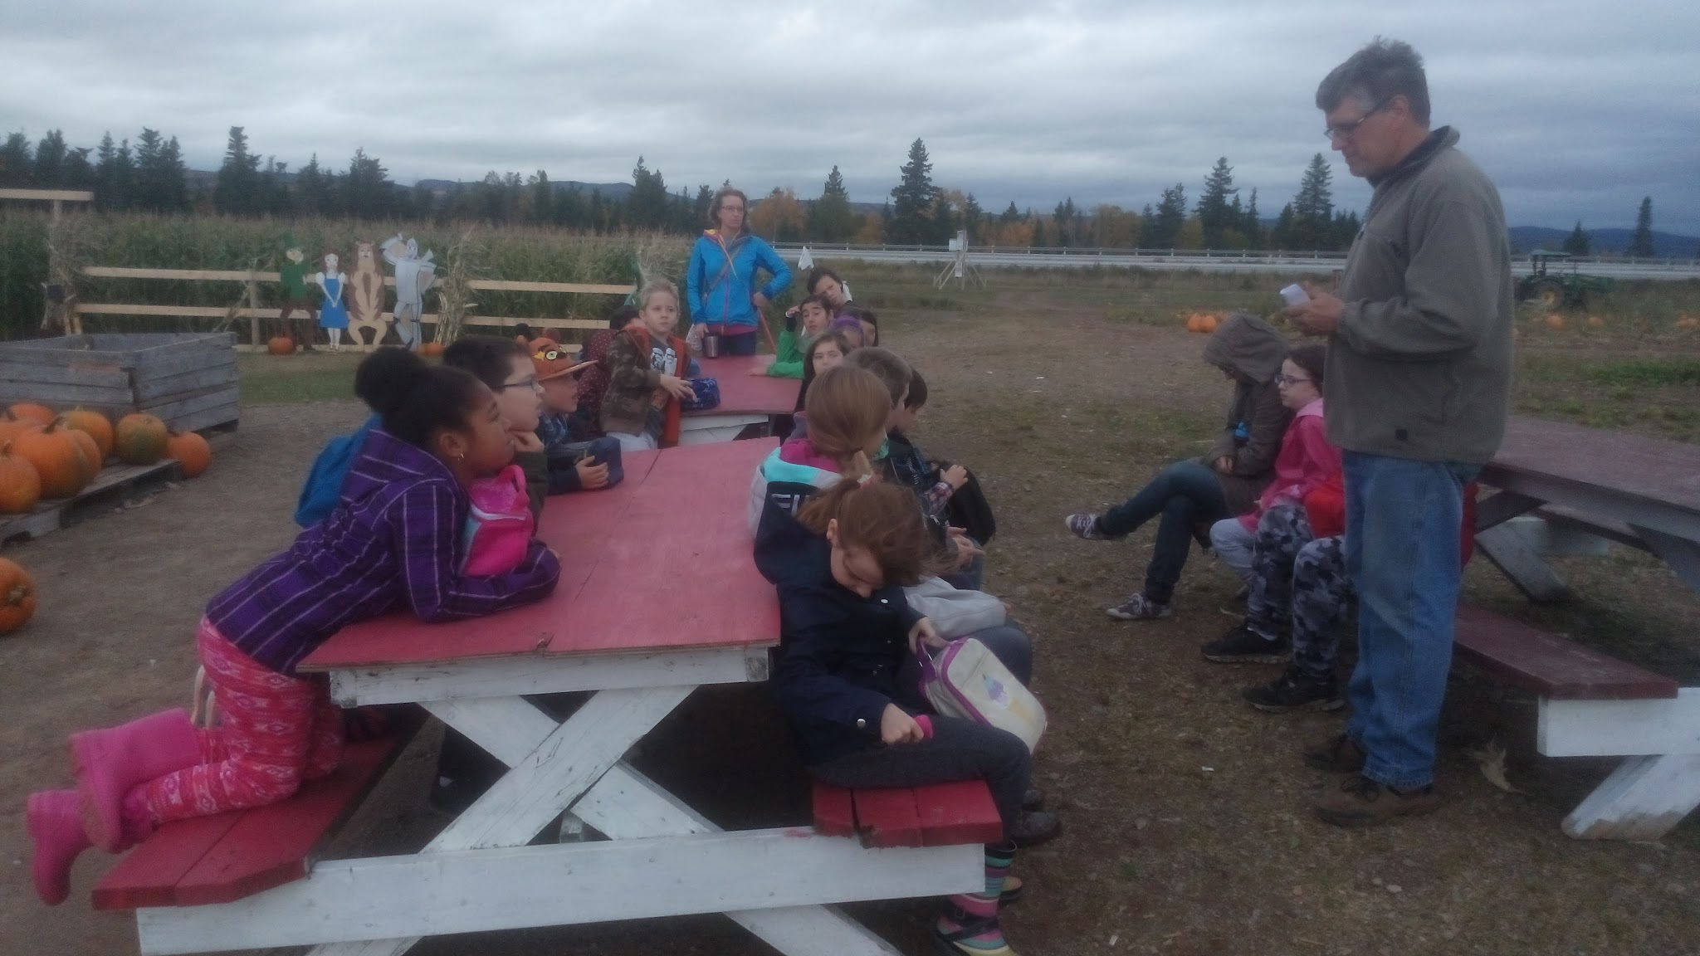
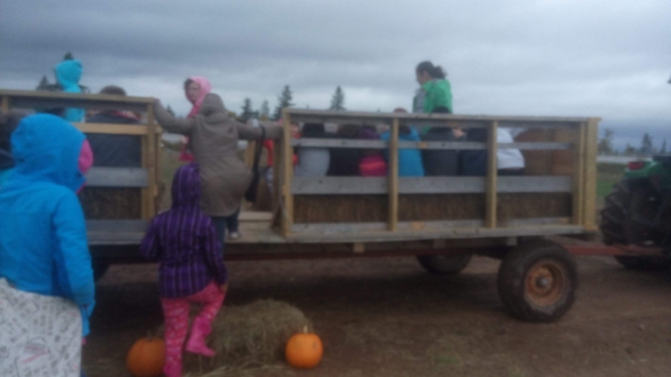
Visit to Wright’s Family farm
Since we weren’t able to start our inquiry with the hydroponics unit, we began with farming and planting in general. This led us to brainstorming activities with what we knew about agriculture. We had a corn boil up as a means to get them excited with the project.

Slide 22
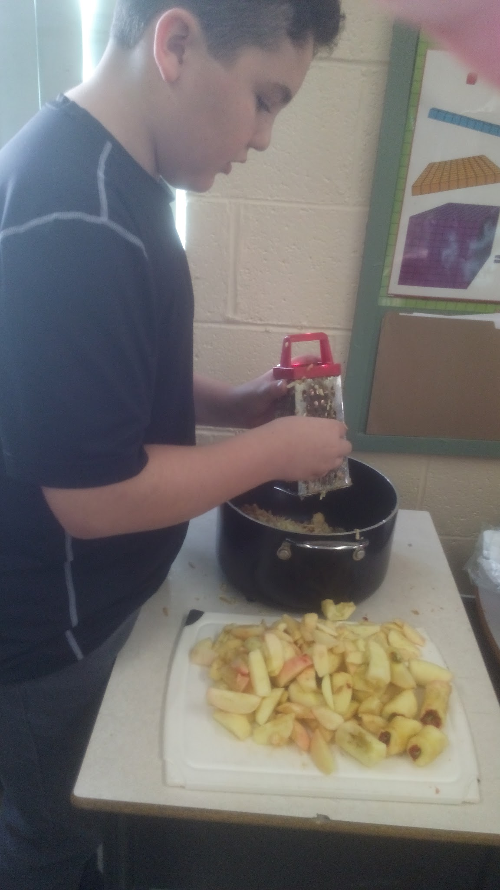
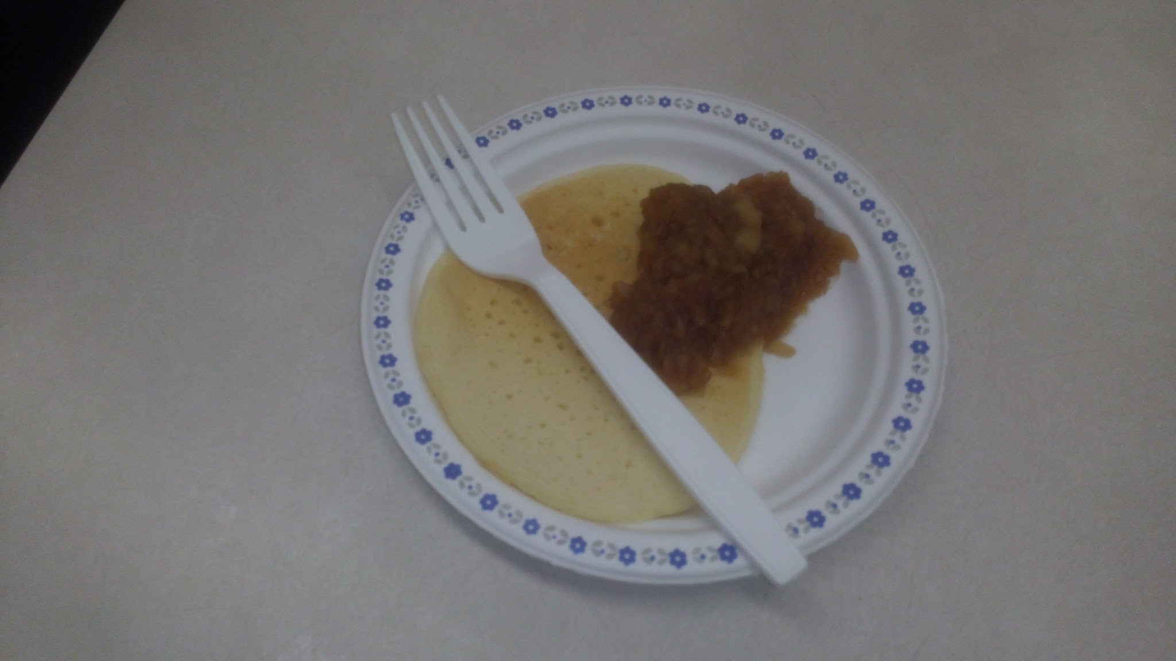
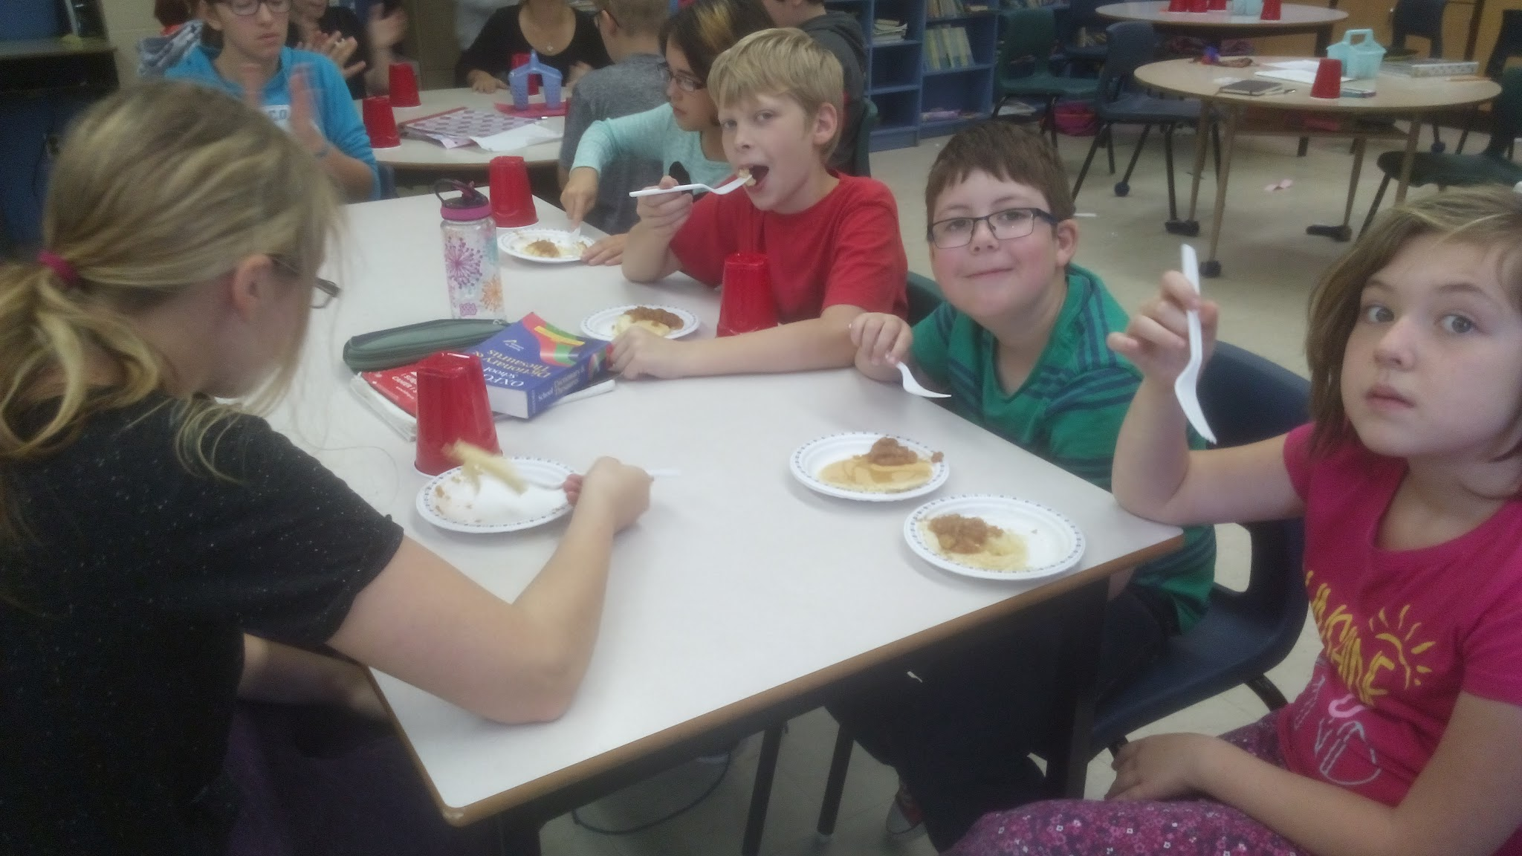
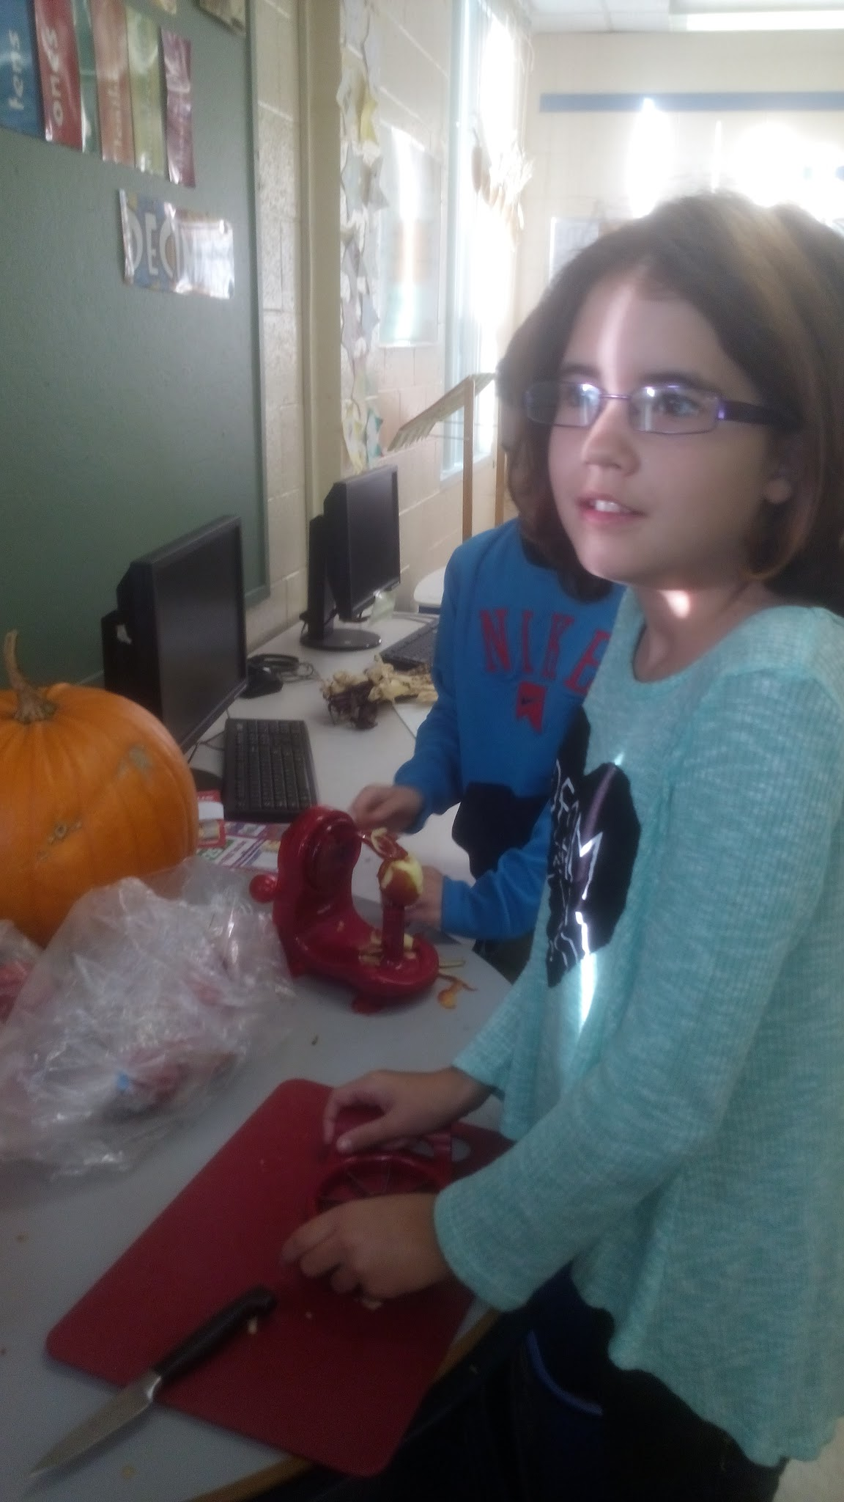
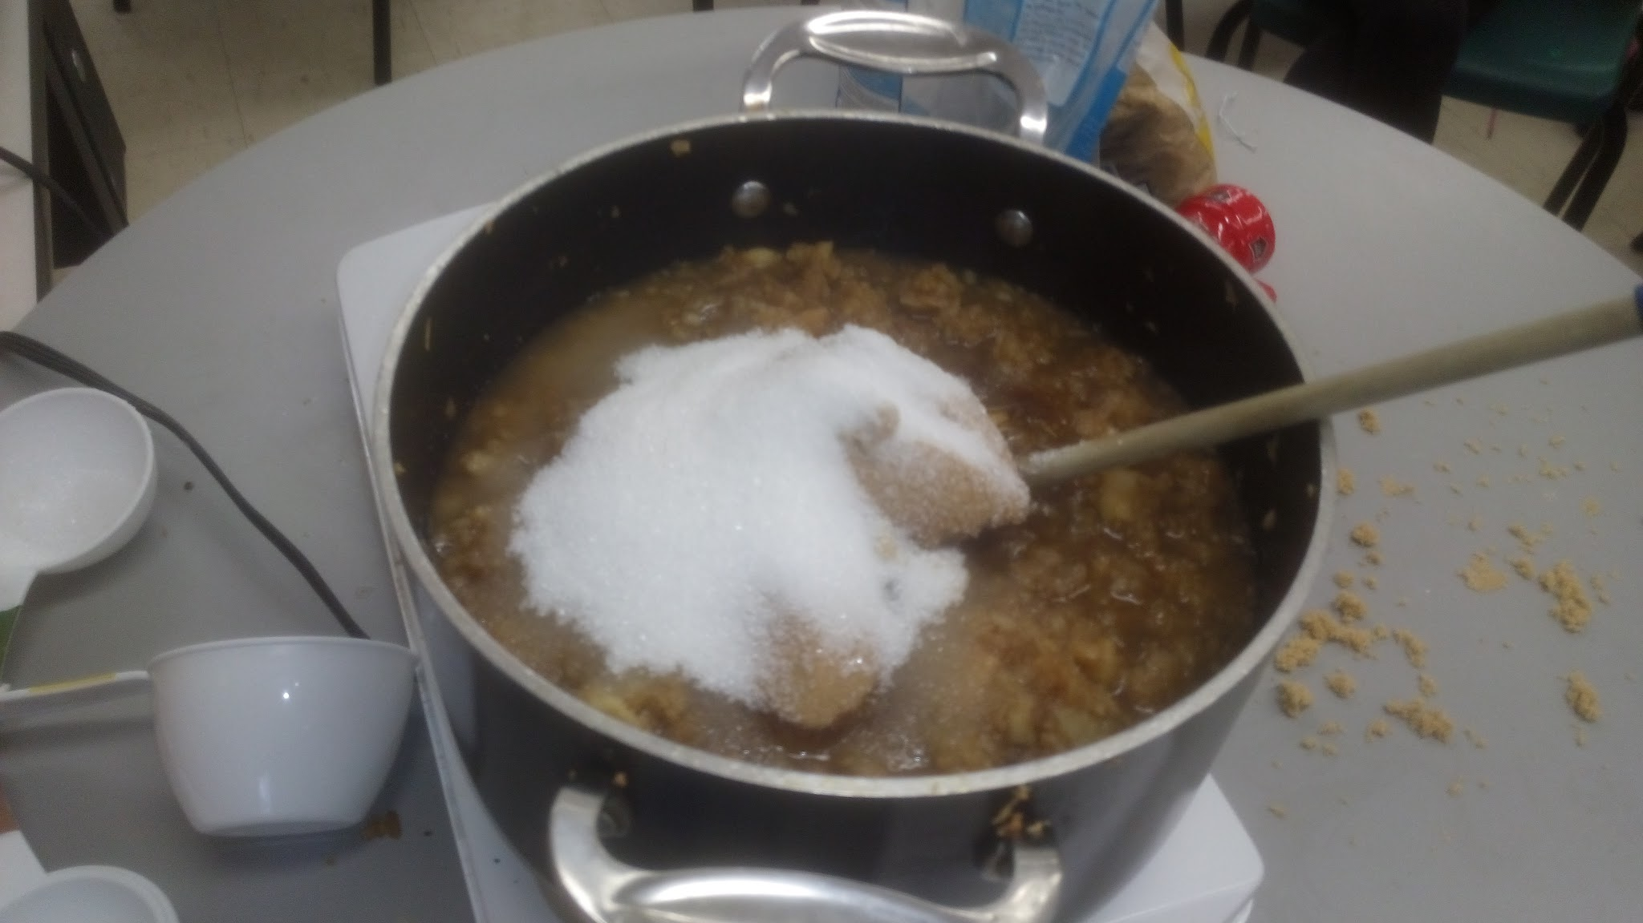
Apple Butter ….. How crops can be used
Apples from Wright’s Family Farm….. Mmmmmm delicious!!!

Slide 23
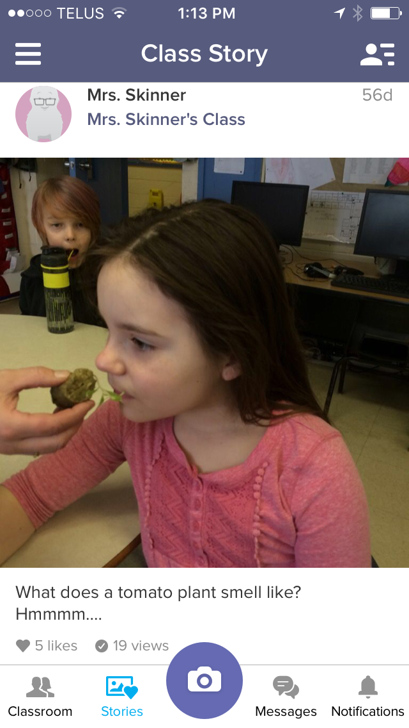
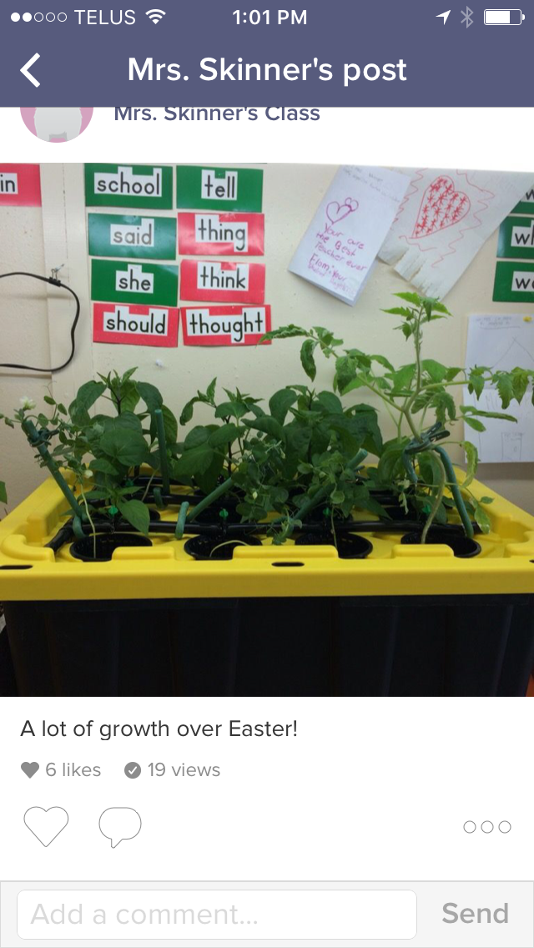
Data Collection
Class Dojo
I would periodically update parents on
the growth of our plants and my students were so
excited that their parents could see the growth.

Slide 24
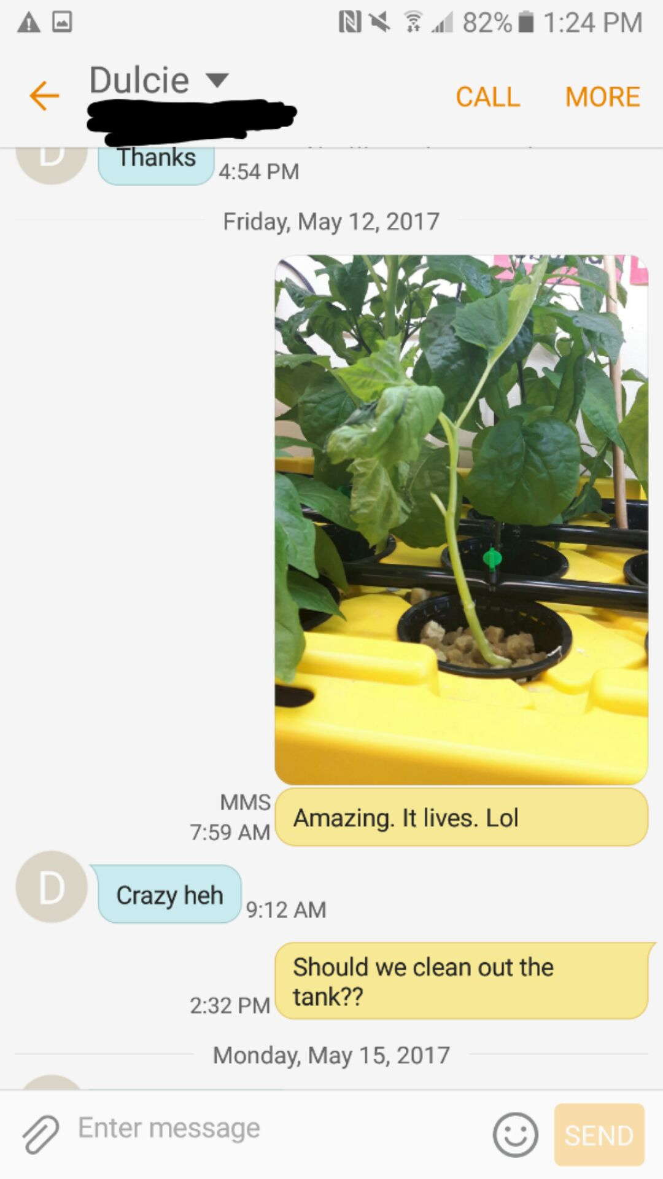
The evolution of the inquiry based mind…..
Student Data:
Numerous photos of students and plant growth over the school year
Student journals documenting observations
Observation of participation during discussions and tasks
Teacher Data:
Regular meetings with all involved in project
Updates, via texts, outside school hours about the project
Collaboration, willingness to work with each other and reach out to others for help
The smiles, questions, and enthusiasm displayed by the students

Slide 25
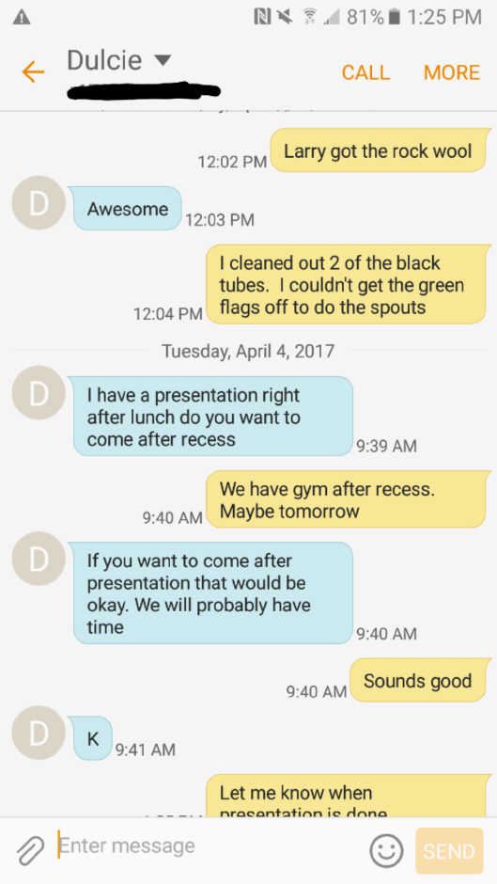
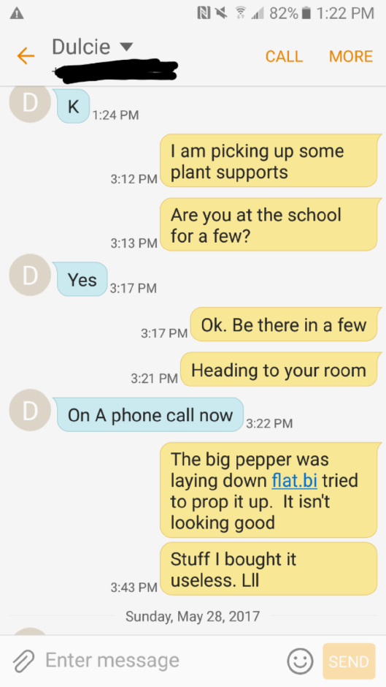
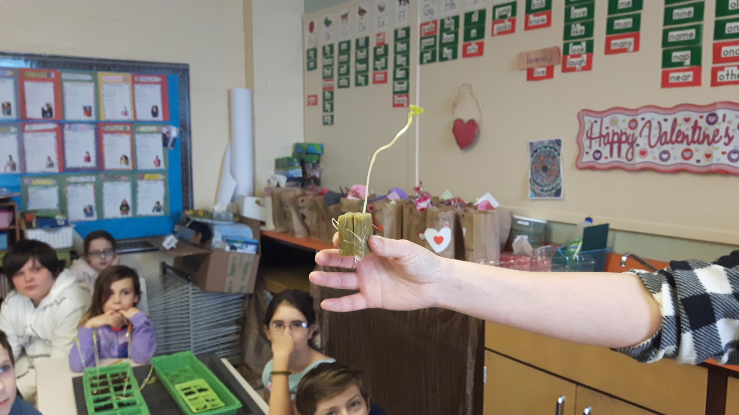
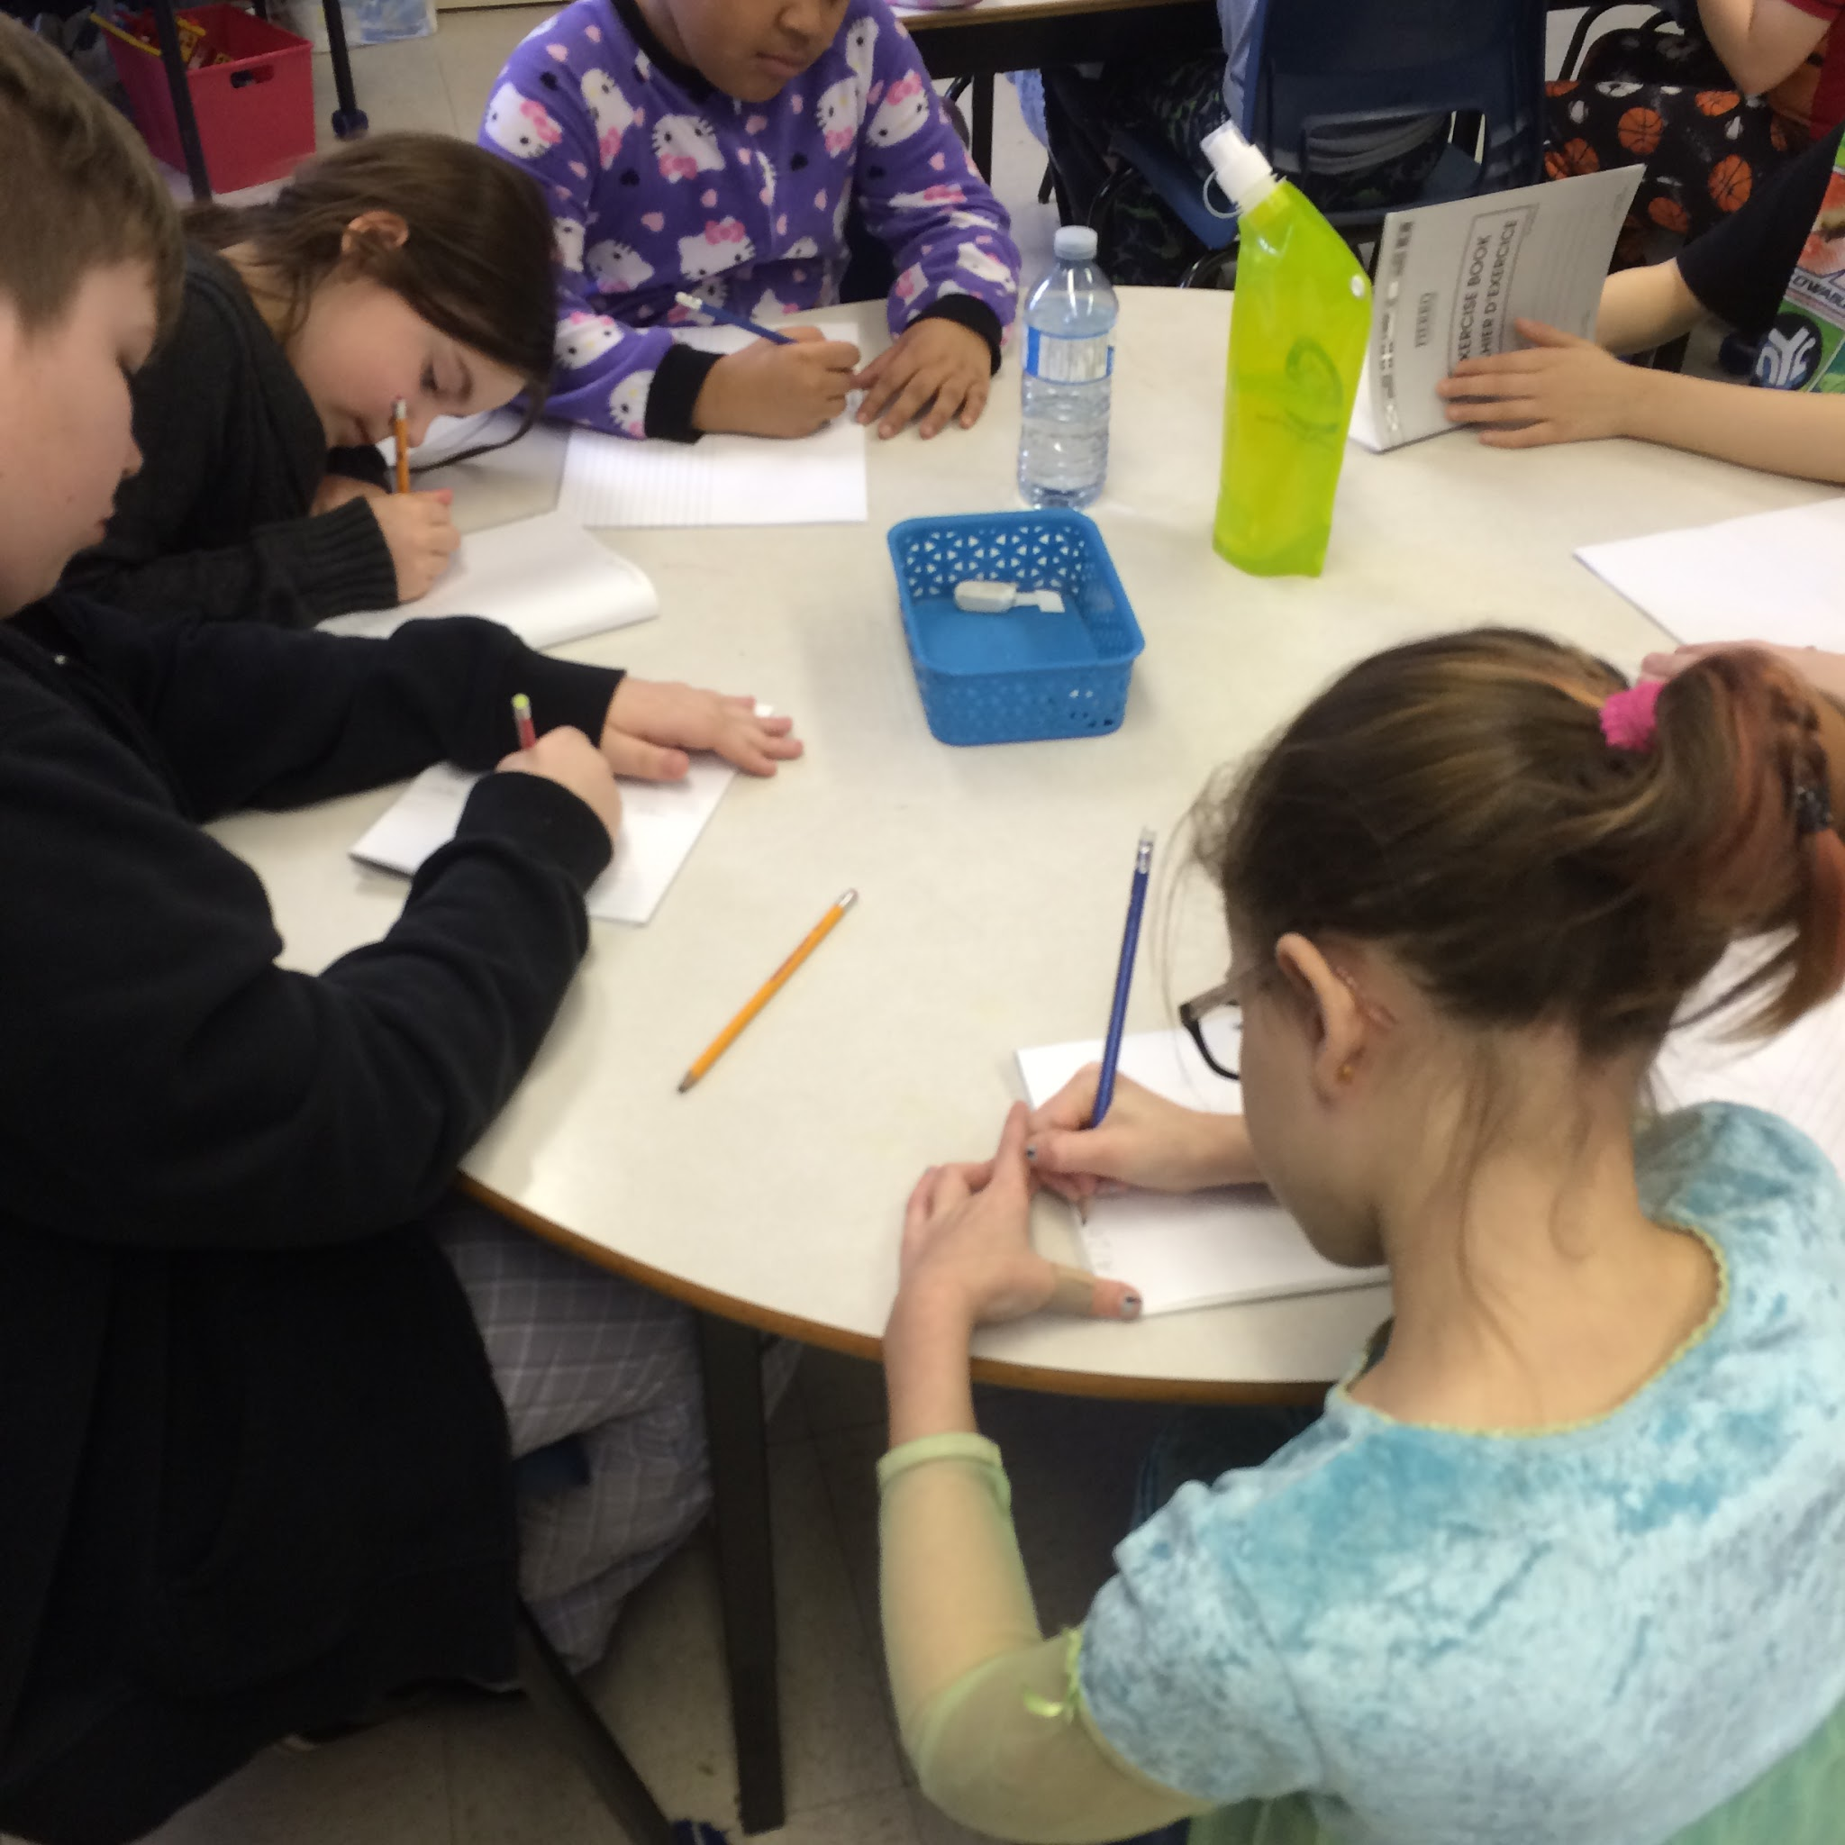
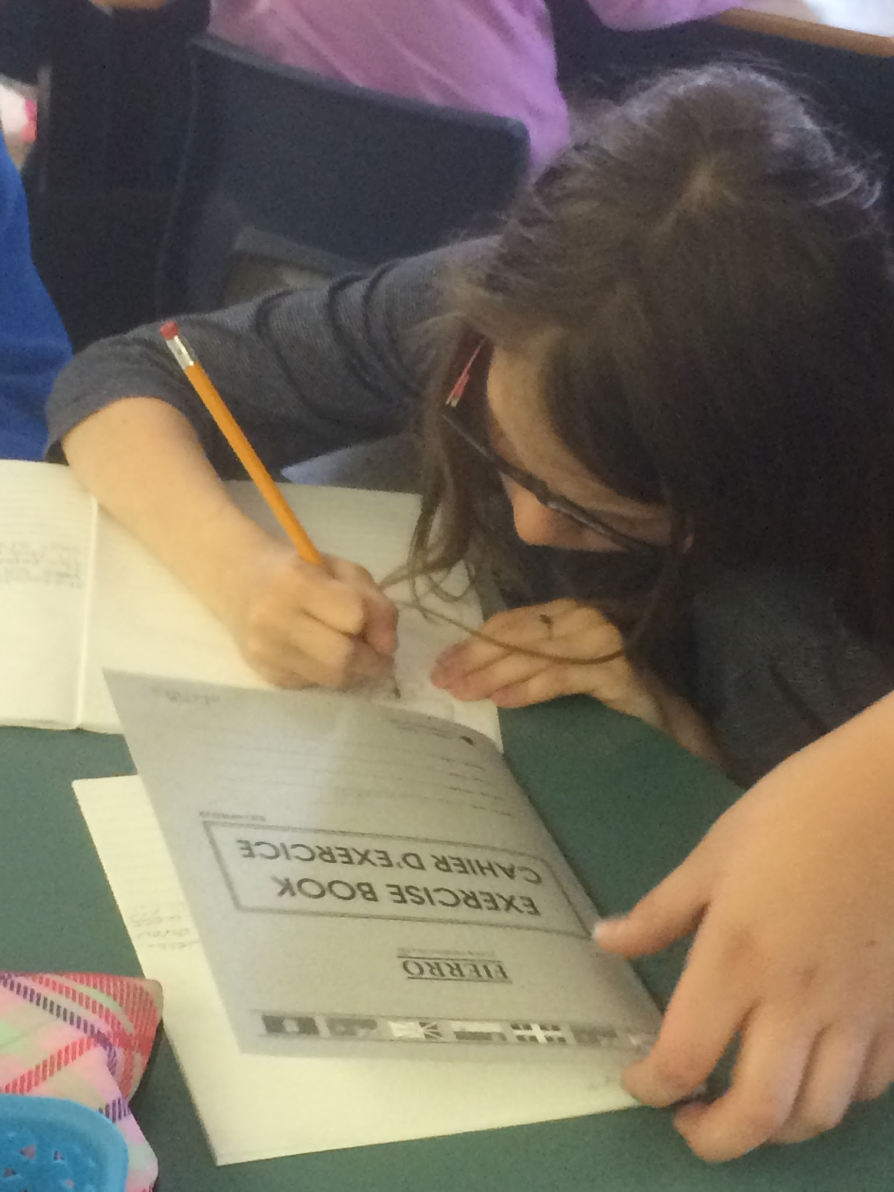
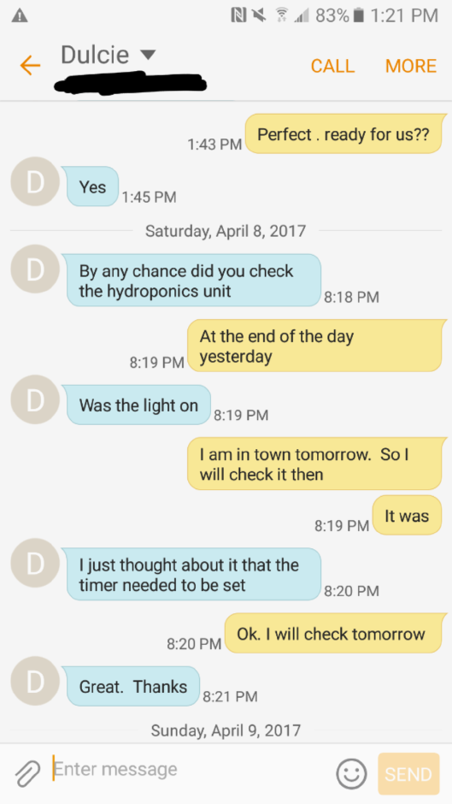
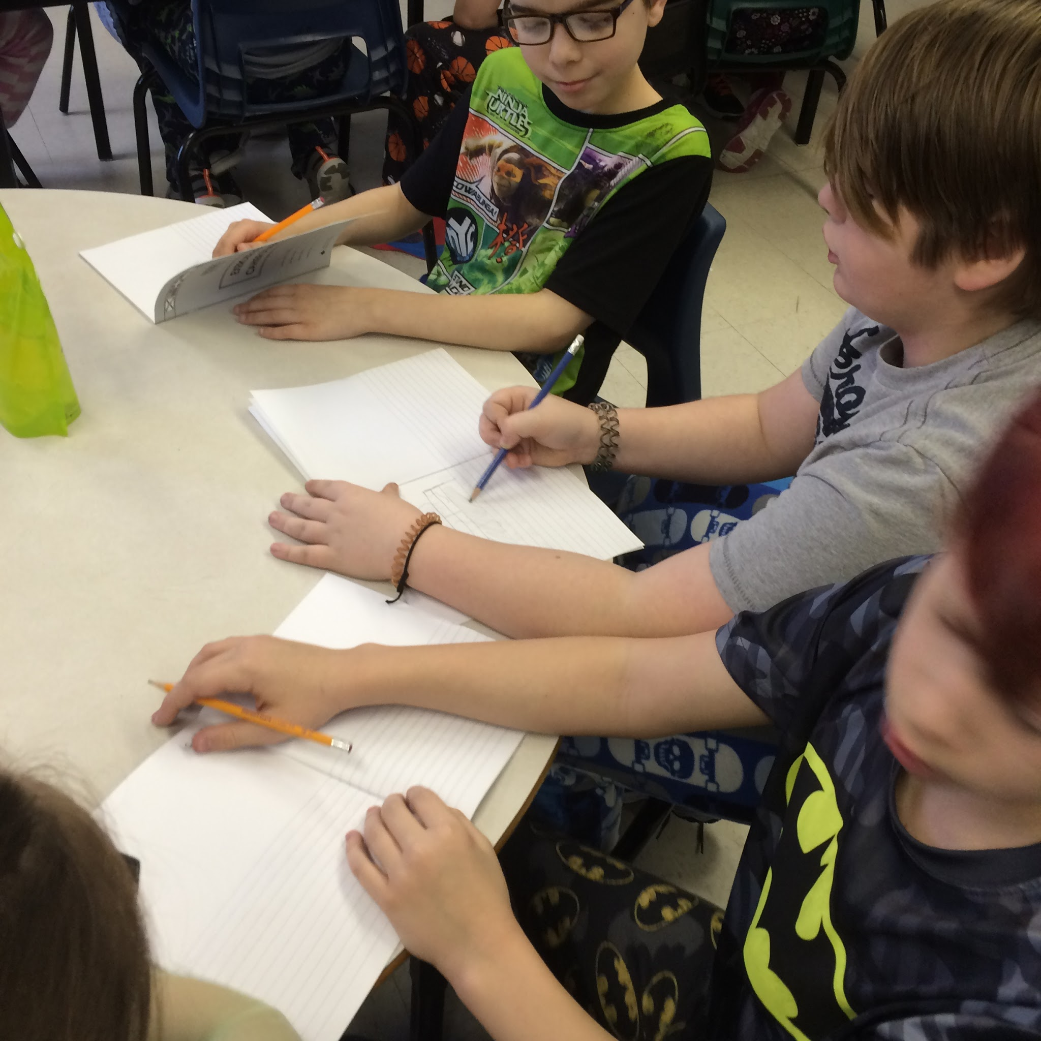
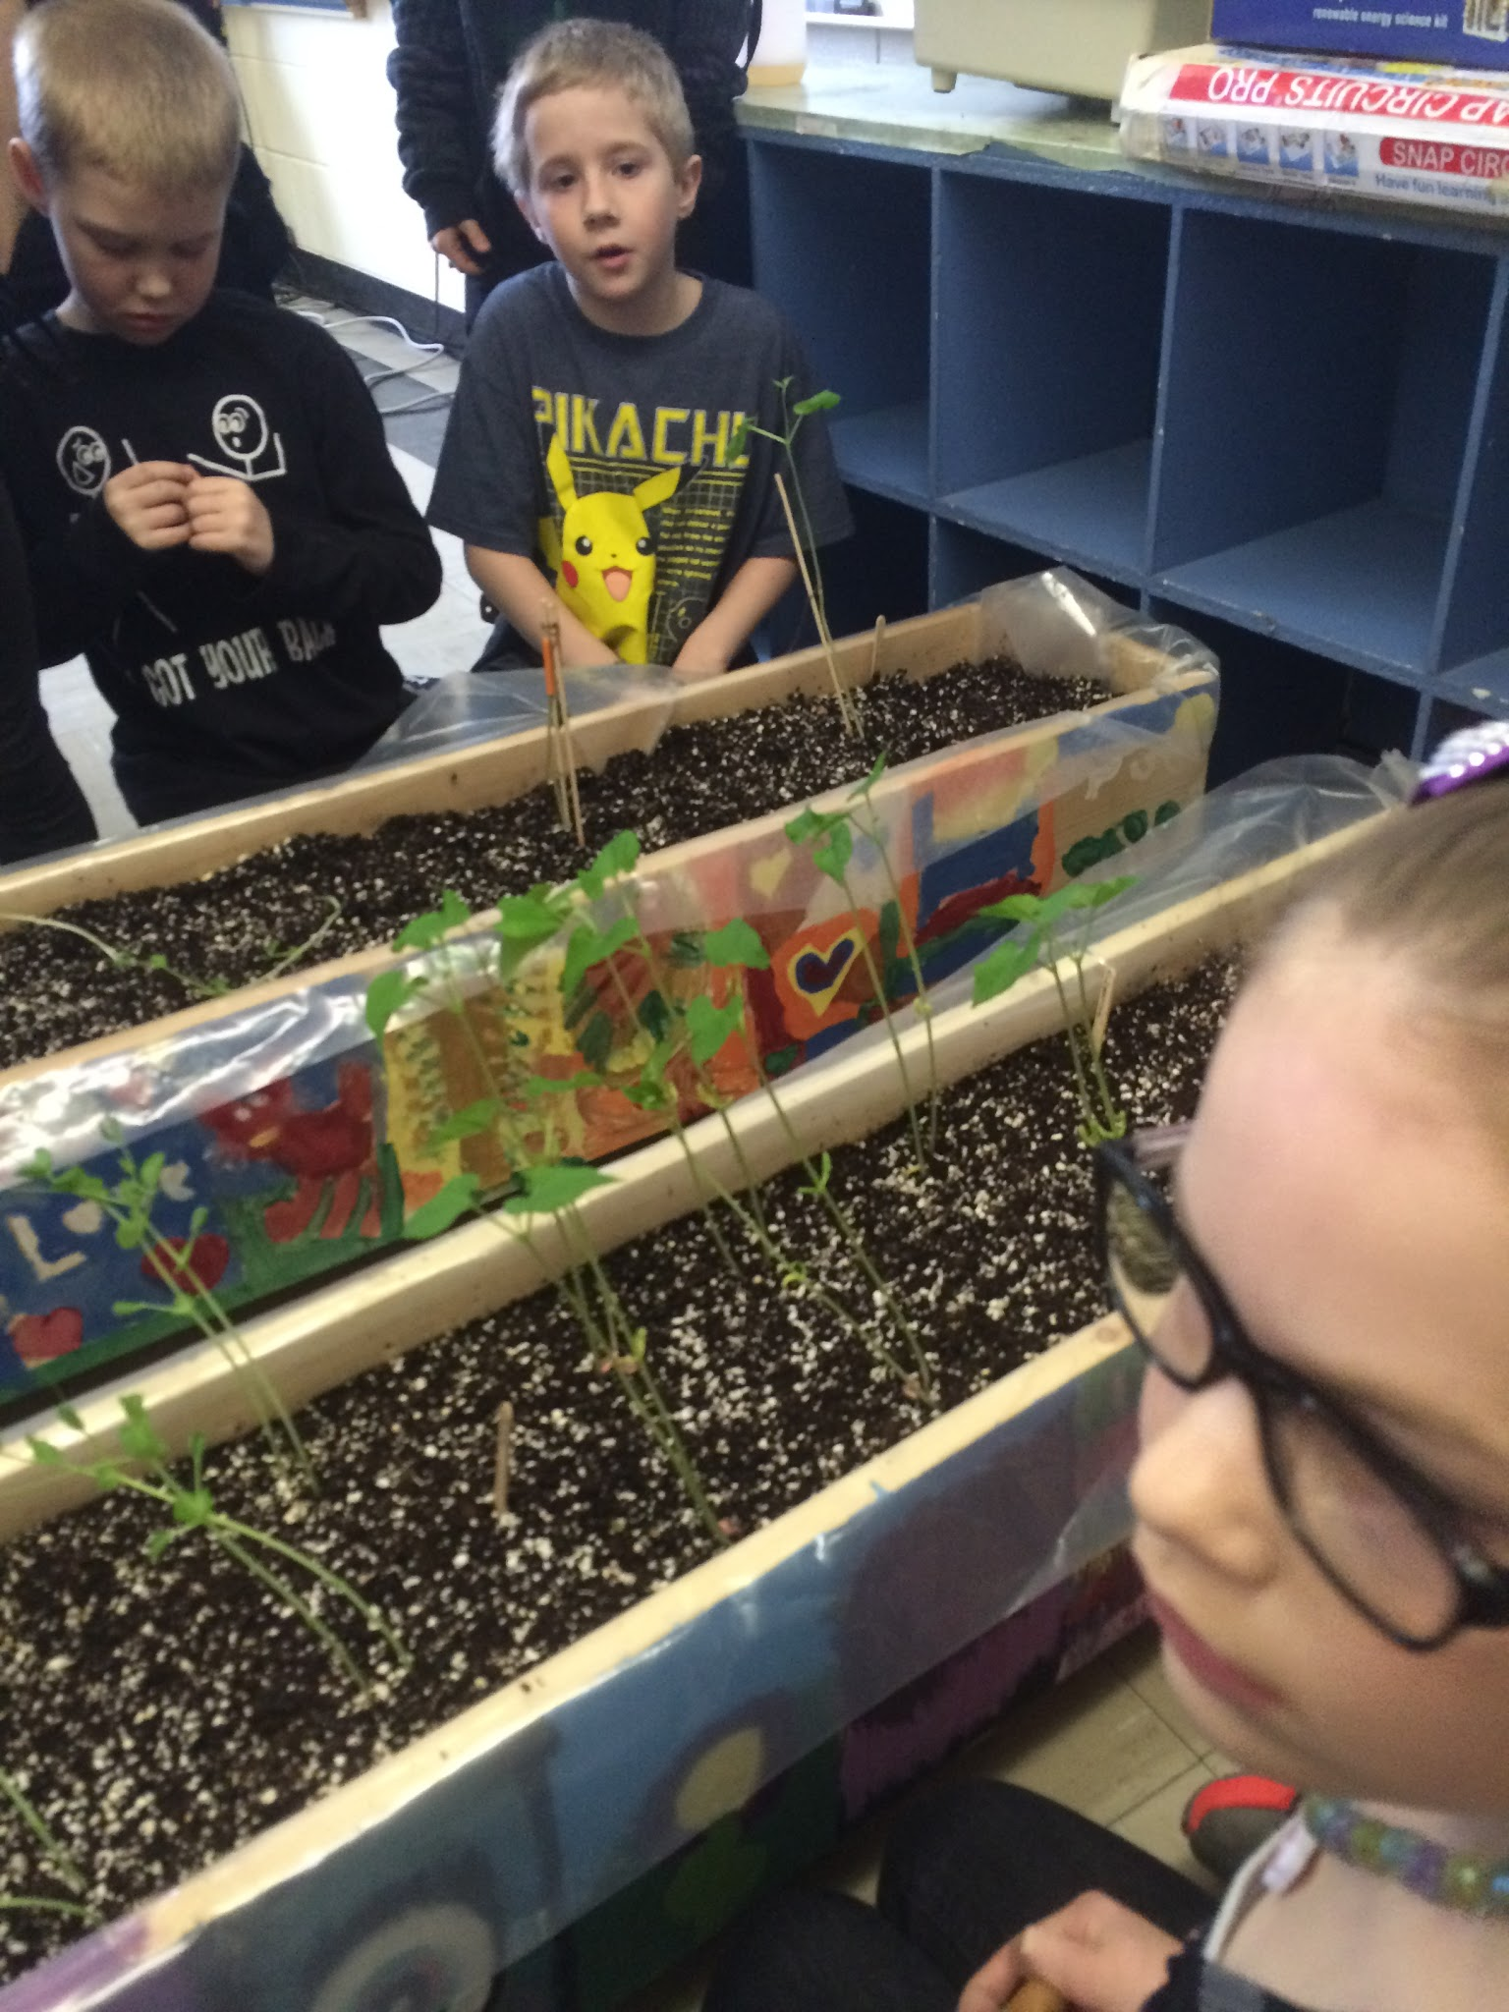
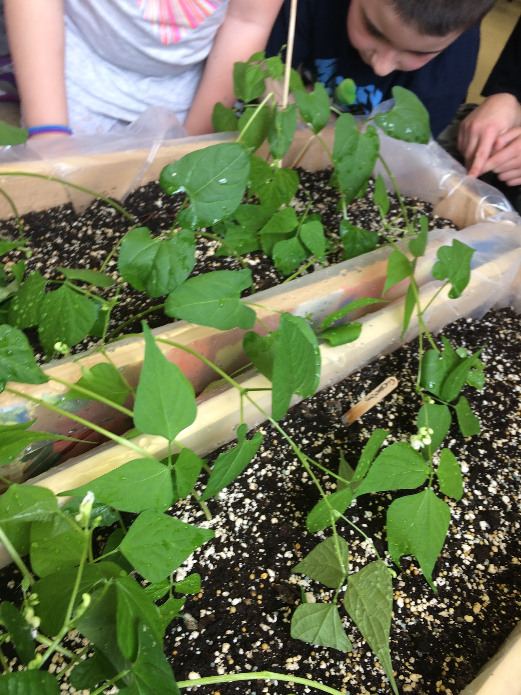
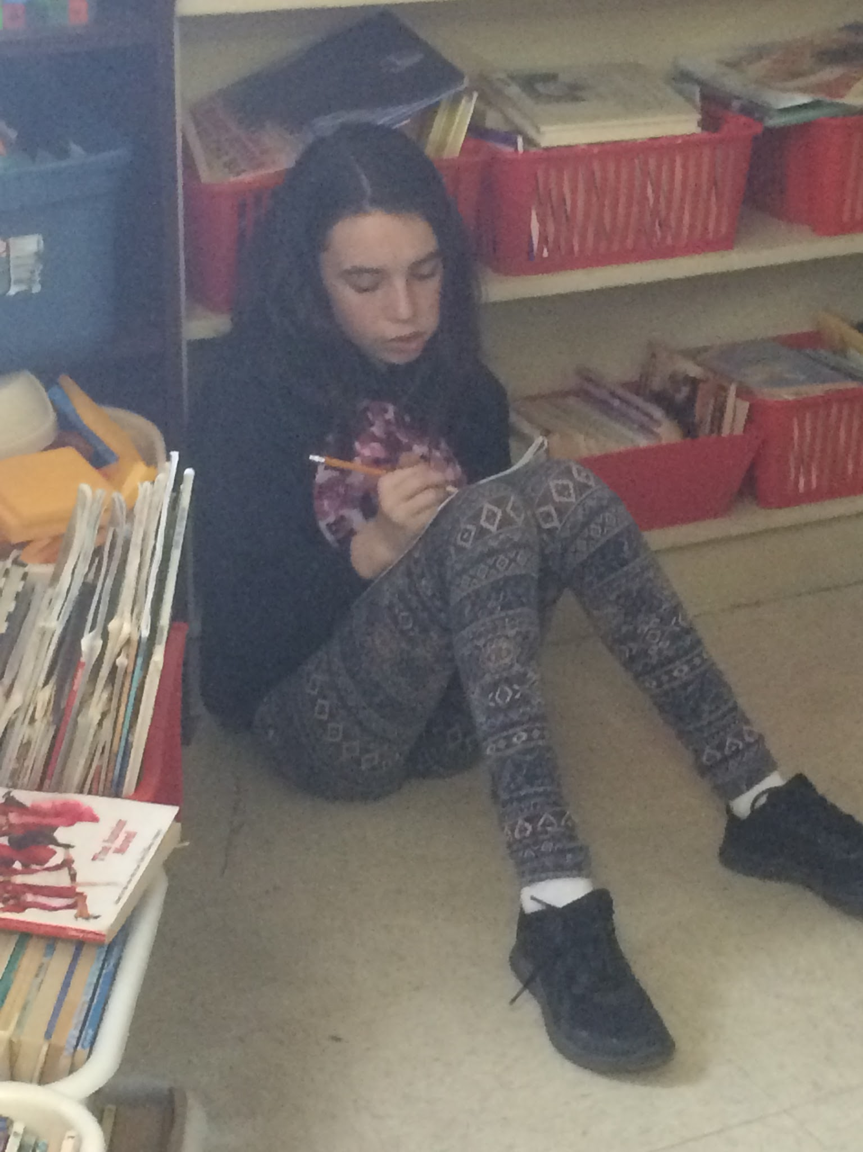
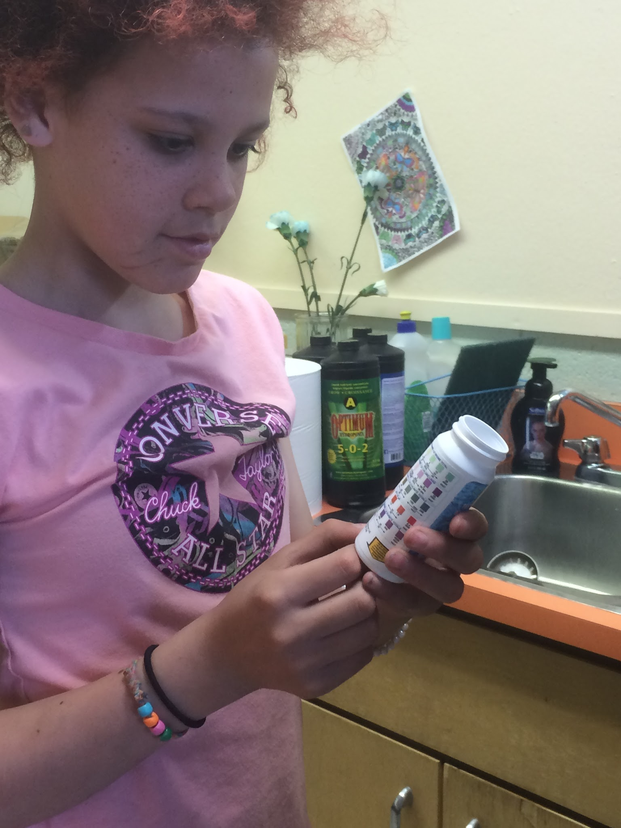

Slide 26
Teacher Inquiry now- Reflecting
Inquiry-based learning has been praised for requiring the student to do more than just report on a topic. The student must go beyond the simple memorization of facts and regurgitation of information and into the realm of creating new and deeper understanding through identification and subsequent application of solutions to a specific topic (Owens, Hester, & Teale, 2002).
Our philosophy of teaching hasn't changed, however, we have become more aware of the information we present to our class. We are now more conscious of allowing the students to discover, to promote, and decide their own path of learning and wondering.

Slide 27
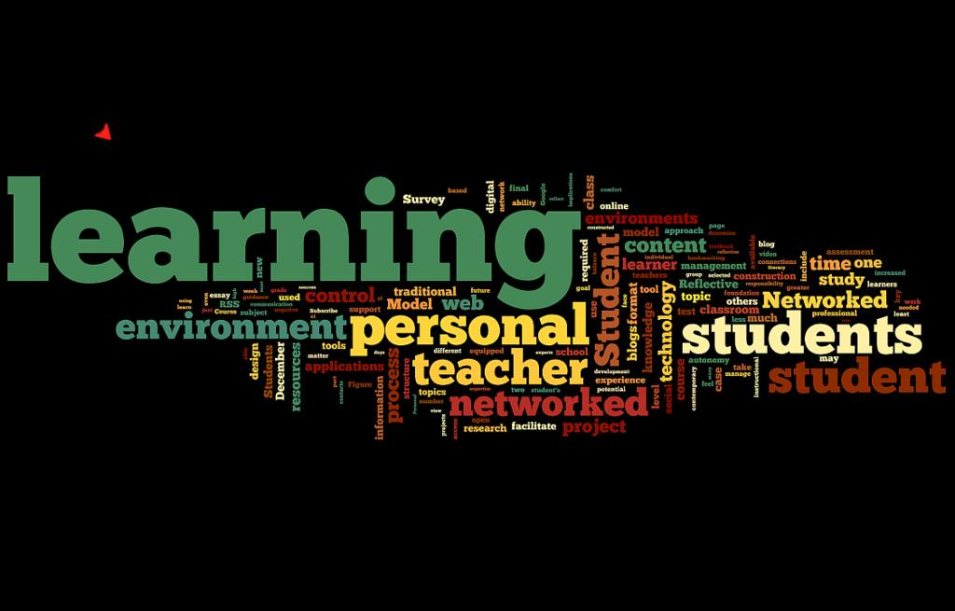
We further established that …
it is okay, as a professional/teacher, to be the facilitator and not the presenter.

Slide 28
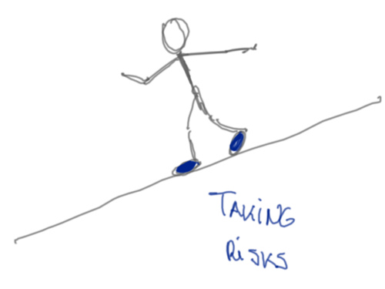
The students need to see …...
that teachers do not ‘know it all’. It is necessary for them to see teachers, take risks, make mistakes, and start over.

Slide 29
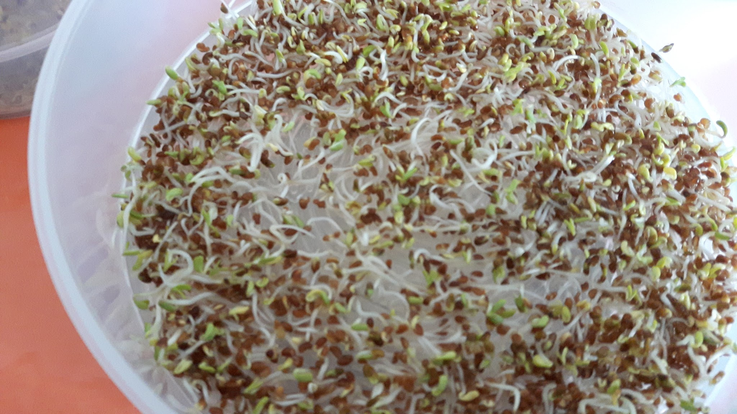
Progression of Plant growth
Sprouts - February 5-8

Slide 30
Planting seeds - February

Slide 31
Ready to transplant into hydroponics unit and soil boxes

Slide 32
February 27

Slide 33
March 2

Slide 34
March 3

Slide 35
March 10

Slide 36
March 14
Planting our herbs

Slide 37
March 19

Slide 38
March 22

Slide 39
April 3

Slide 40
April 4

Slide 41
April 9

Slide 42
April 11

Slide 43
April 17

Slide 44
April 19

Slide 45
April 21

Slide 46
April 24

Slide 47
April 28

Slide 48
May 1

Slide 49
May 4
May 10

Slide 50
May 12

Slide 51
May 19 - second unit started up

Slide 52
May 29

Slide 53
June 5

Slide 54
June 12

Slide 55
Thank you, MUN, Teachers in Action and all involved in this STEM project. It was an invaluable experience.

