Slide 1
Making Sense
of
Number Sense
An Inquiry Based Approach to Teaching Number Sense in the Primary Classroom (K-3)
Melinda Osbourne, Colleen Power, Florrie Reid and Shannon Taylor

Slide 2
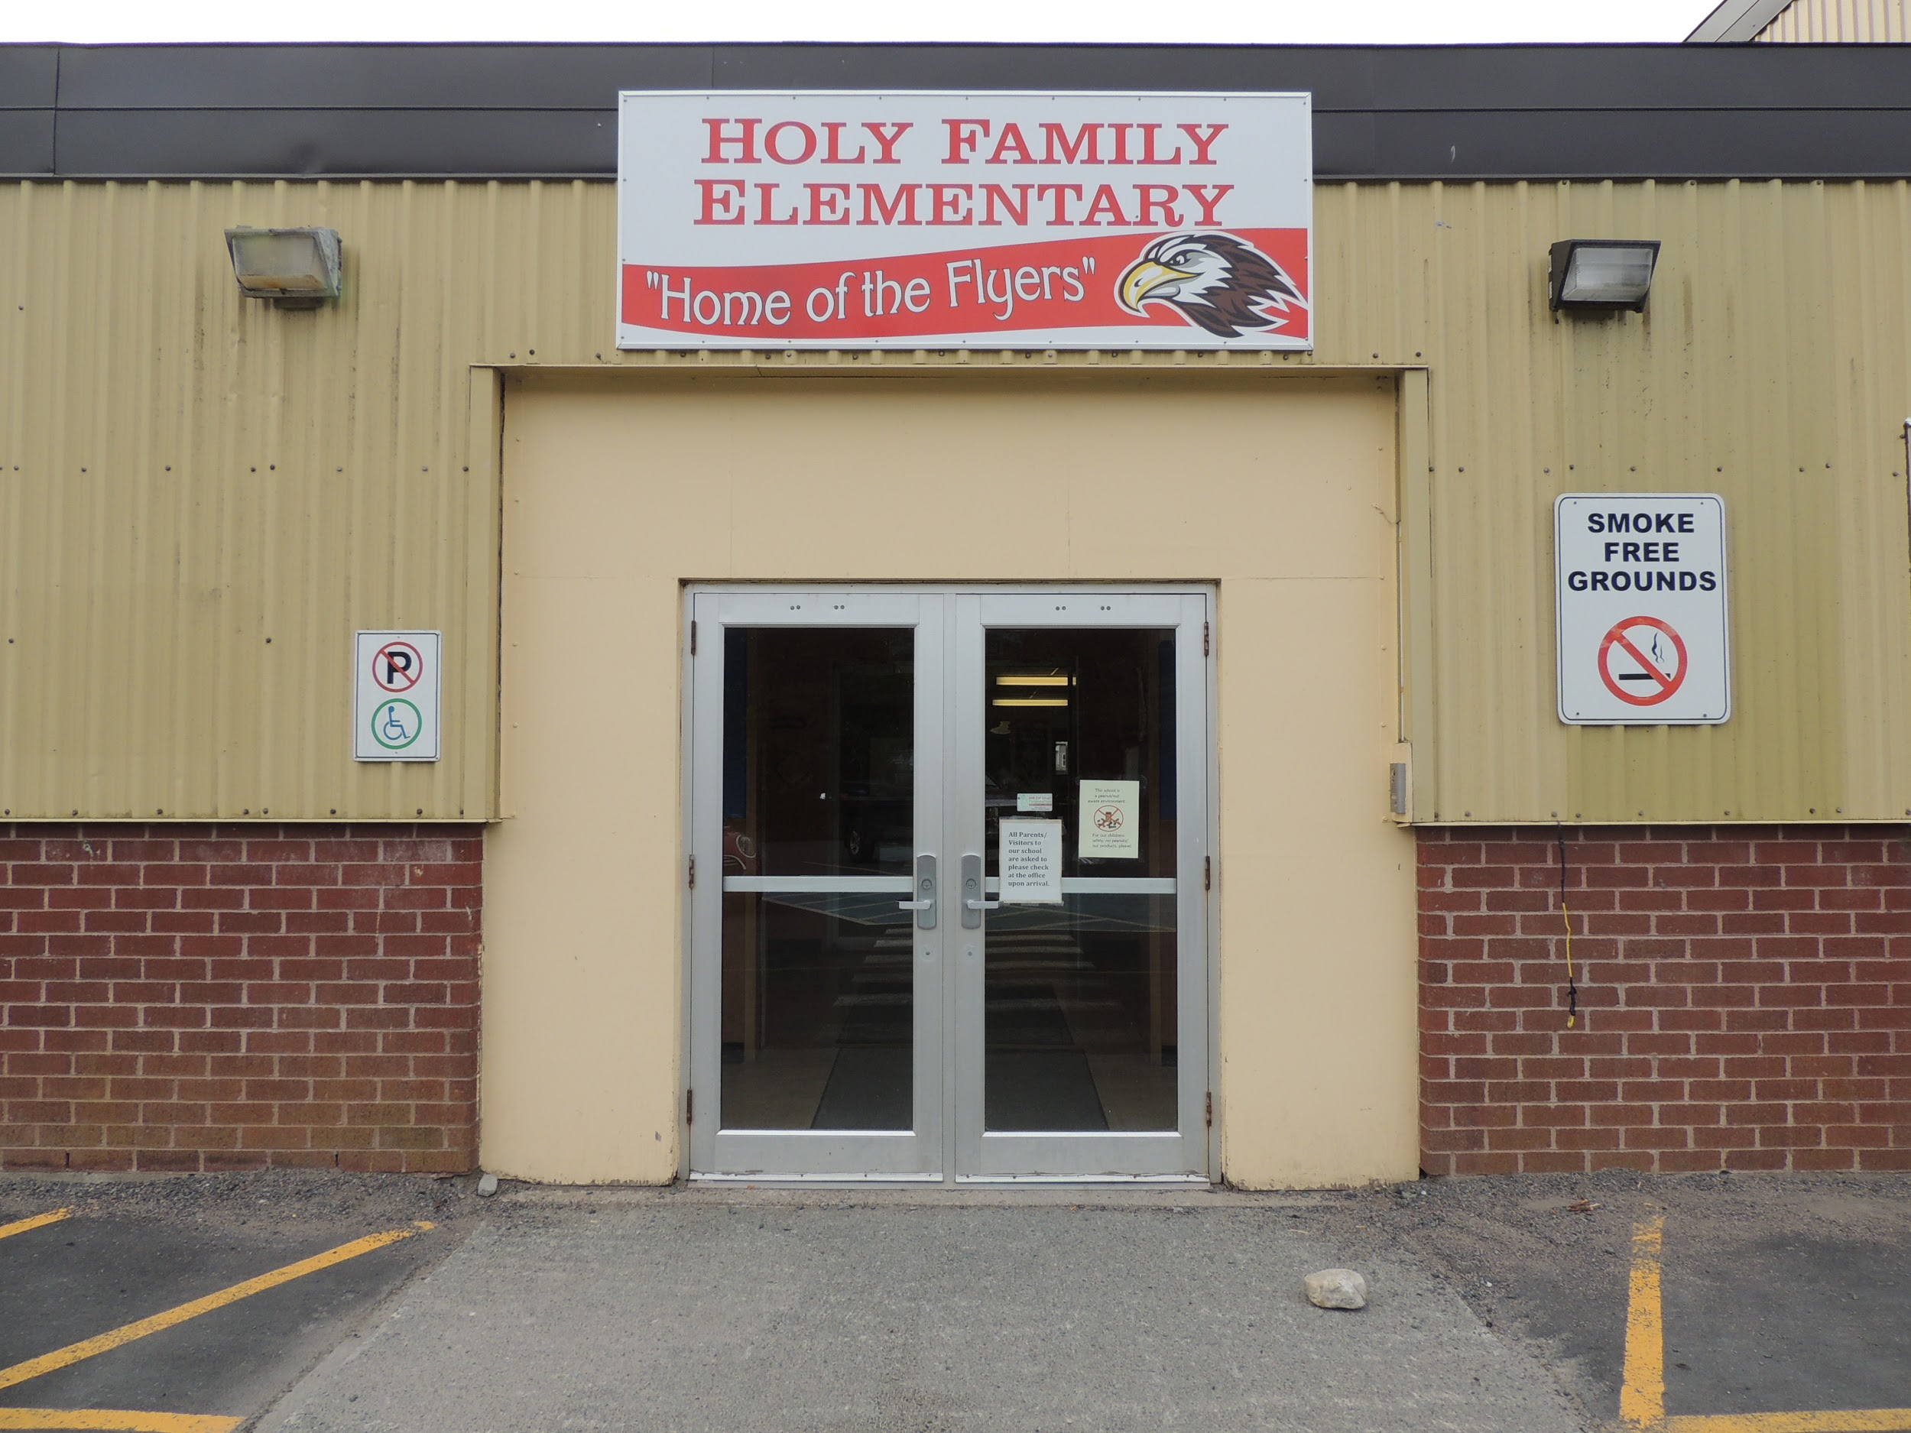
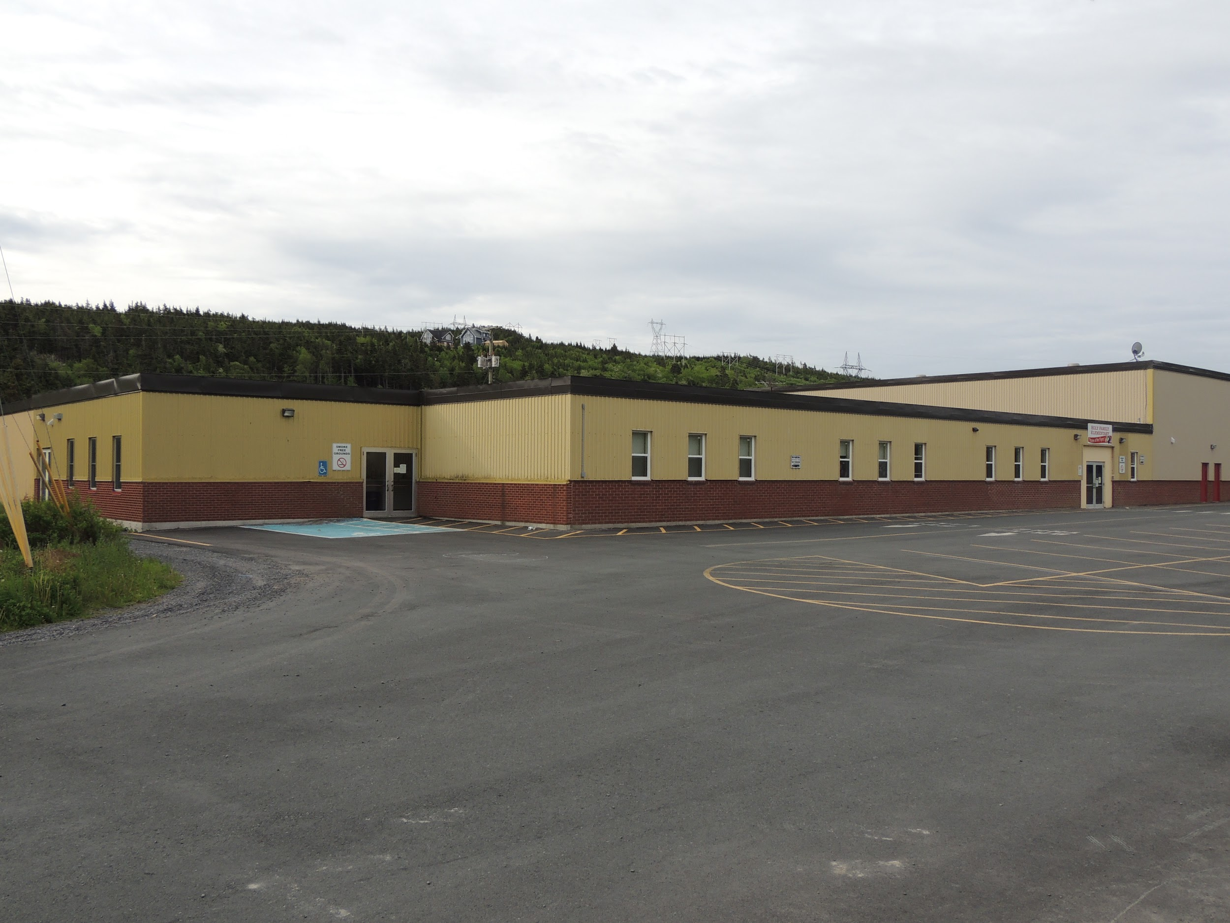
Background Information
Our School
Holy Family Elementary School is a K-6 school with 91 students. We are nestled in the beautiful community of Chapel Arm with 8 other communities feeding into our population.

Slide 3
Team Members
Colleen Power has been teaching for 29 years in the Primary Classroom. She is currently teaching grade 3 with 15 students - 7 girls and 8 boys.
All children have the ability to learn at their own pace. I believe my role is to be a resource in the classroom to help students reach their full potential academically and socially.
Teaching for me is not just about teaching but also about learning so that all students feel valued and safe. This then helps them learn about their full potential and be excited about reaching it.

Slide 4
Team Members
Florrie Reid has been teaching for 19 years in the Primary Classroom. She is currently teaching grade 2 with 10 students - 4 girls and 6 boys.
I am passionate about learning and becoming more in love with Math! I believe ALL children can succeed. I believe teachers are facilitators. I believe in inquiry and I love teaching in a student centered environment.

Slide 5
Team Members
Shannon Taylor has been teaching for 11 years in the Primary Classroom. She is currently teaching grade 1 with 14 students - 5 girls and 9 boys.
I believe all students are unique and bring something special to our world. Our students are our future and it is our job as facilitators to impact students lives in a positive way. I believe all students can learn and together we inspire each other to be the best that we can be.

Slide 6
Team Members
Melinda Osbourne has been teaching for 11 years in the Primary Classroom. She is currently teaching kindergarten with 8 students - 2 girls and 6 boys.
My goal is for my students to be present and active participants in their own learning. I believe a student-centered, inquiry based approach to teaching allows me to create a classroom environment to make this goal a reality.

Slide 7
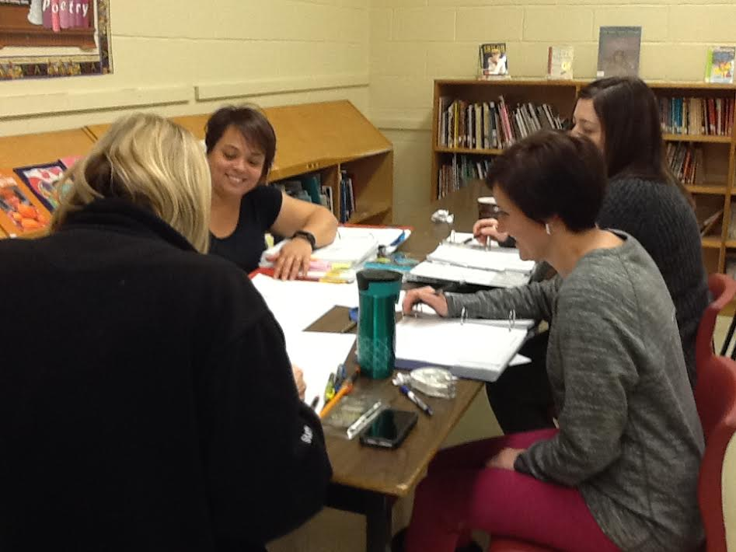
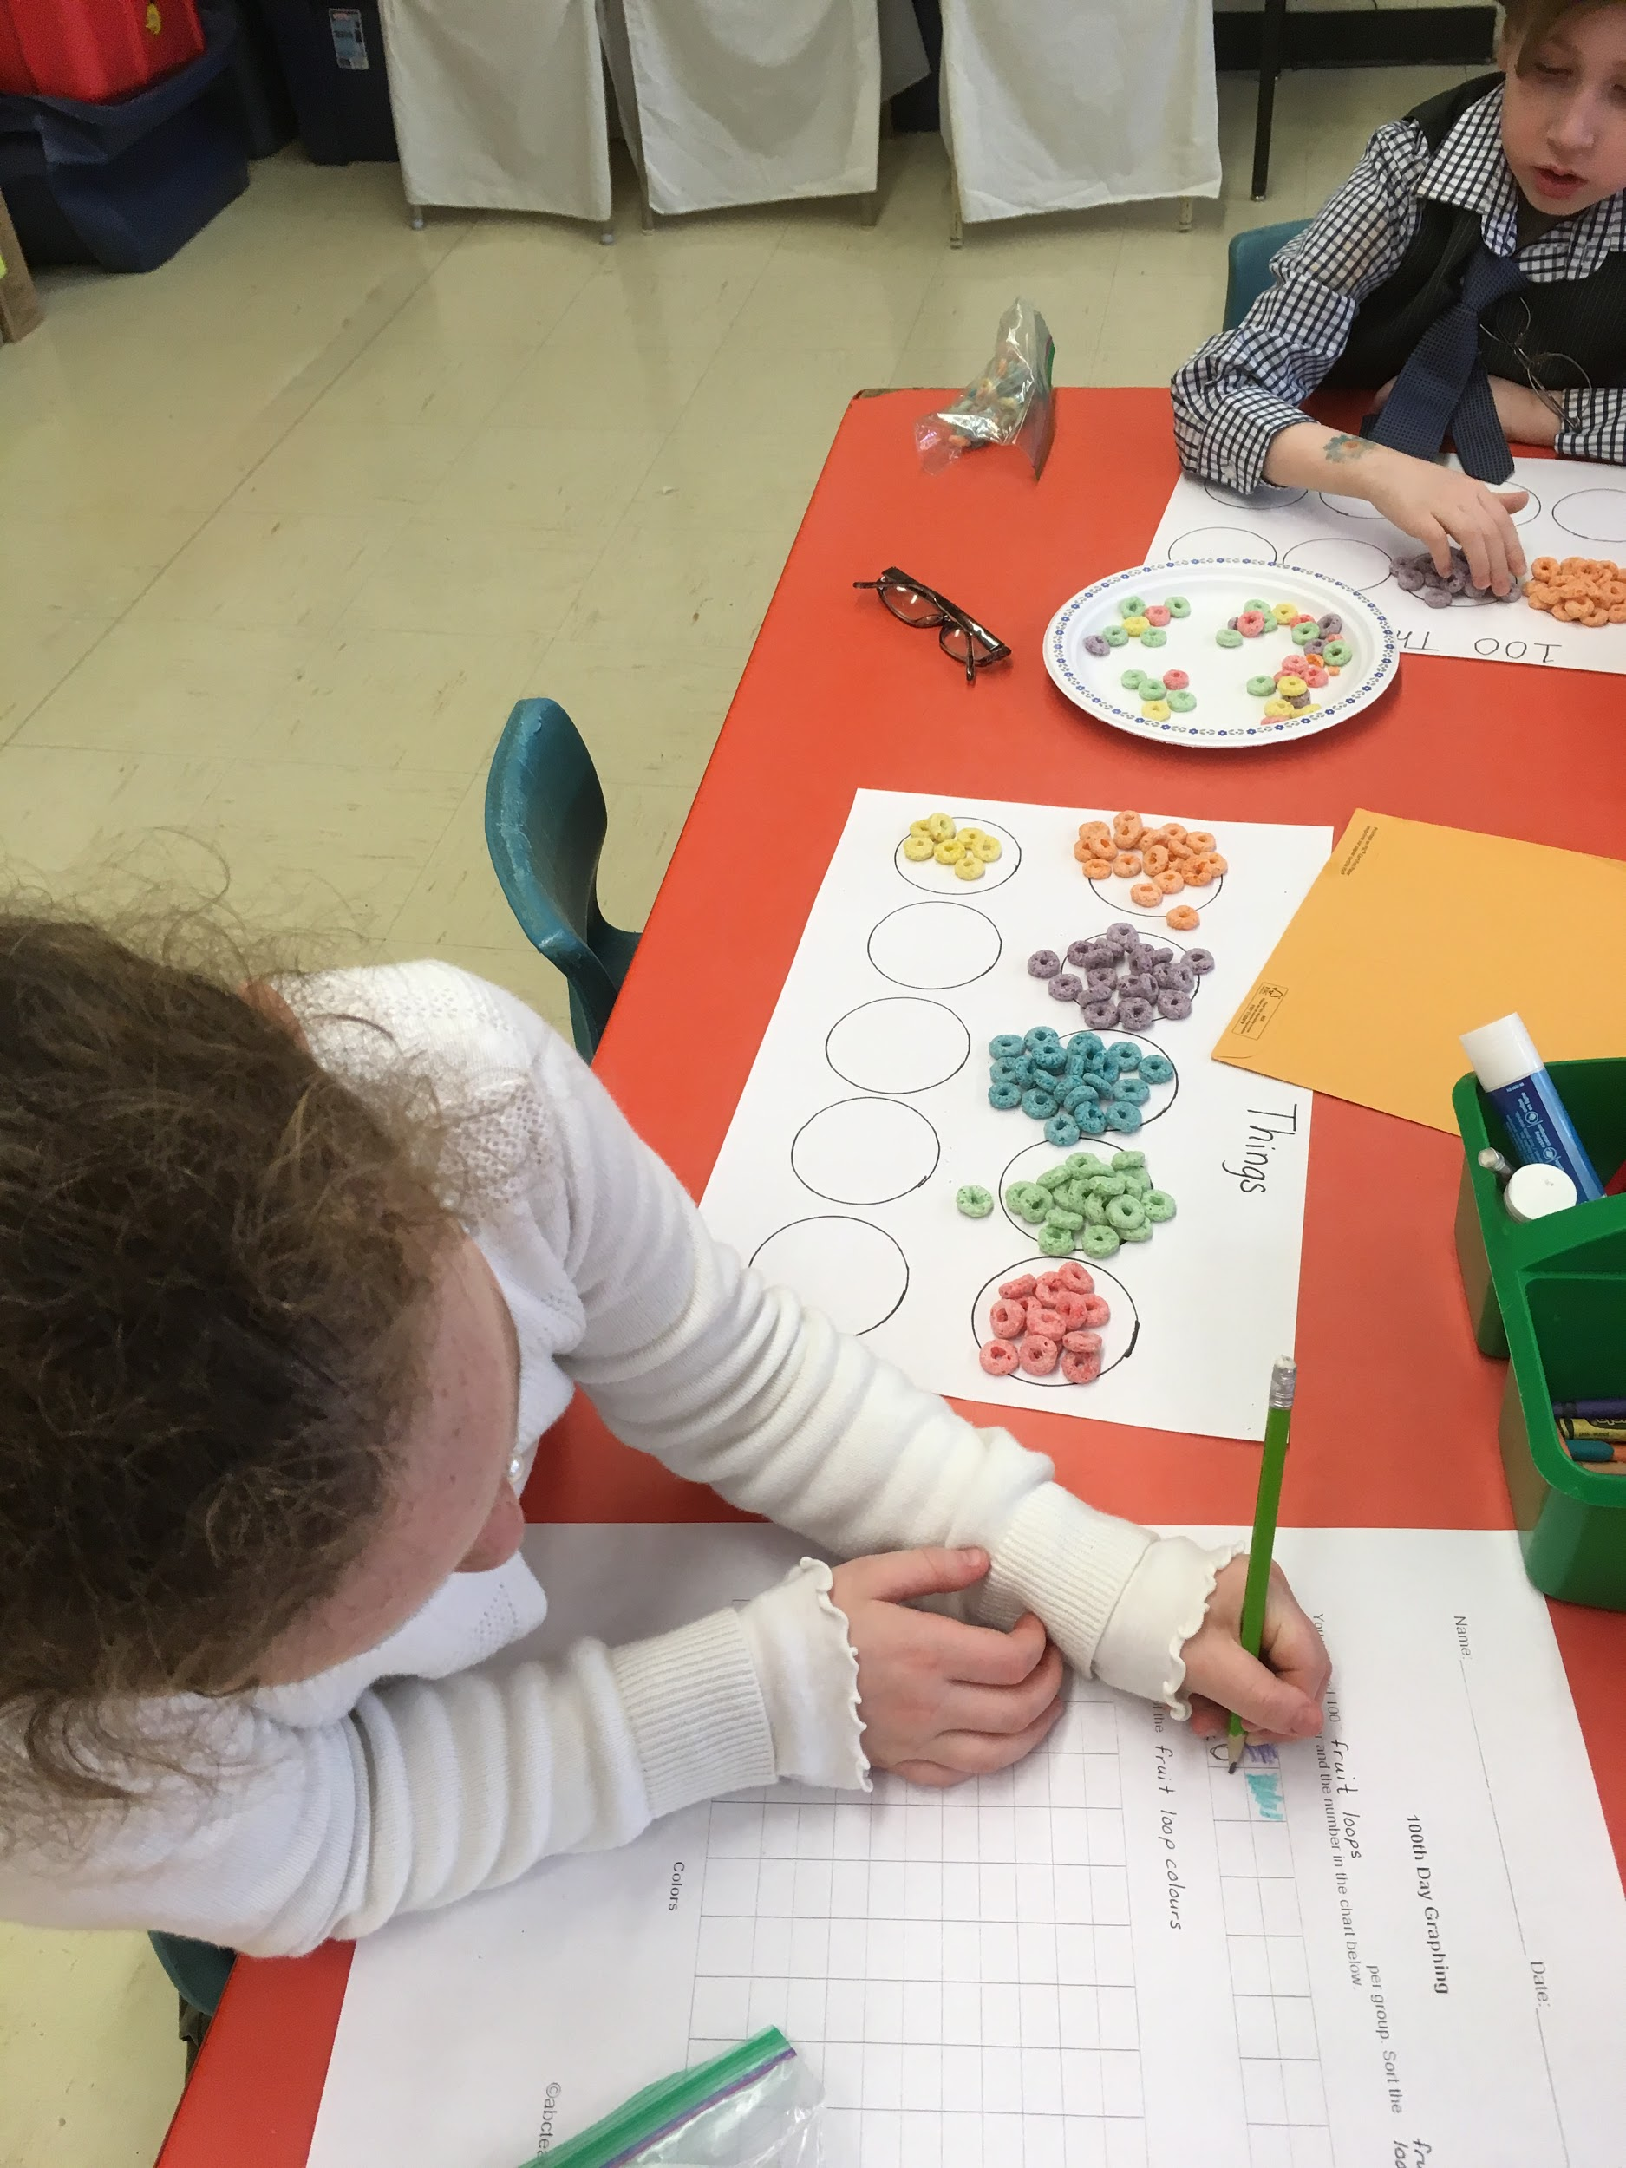
Focus Area - MATH - Number Sense
Our focus area was in the area of Math and more specifically in the Number Sense strand.
Our focus was also on our own teacher collaboration as a primary division.

Slide 8
Research Questions
Student Question
Will Inquiry Based Learning (IBL) in mathematics increase student reasoning and communication in Number Sense?
Teacher Questions
What is my role in increasing IBL in my classroom?
How will collaboration between K-3 teachers help increase IBL in the primary curriculum?
What does IBL look like at each grade level?

Slide 9
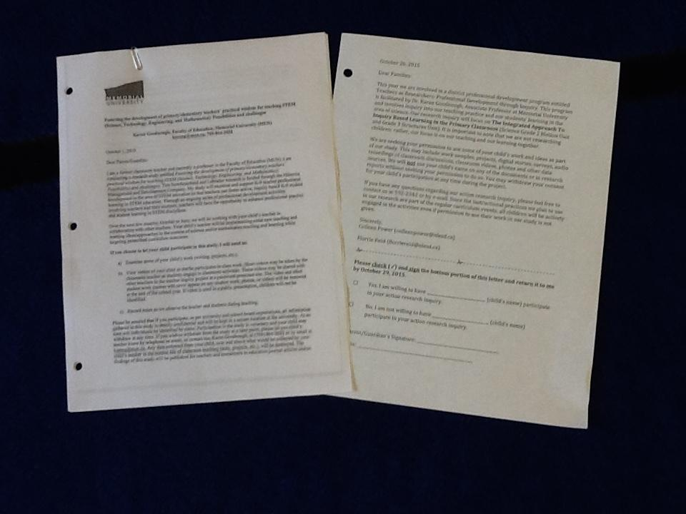
Ethical Considerations
We sent two forms home to the families informing them of the project and asking permission to use children’s work and ideas as part of our study. One form was from our school Holy Family Elementary and the other was from Memorial University of Newfoundland.

Slide 10
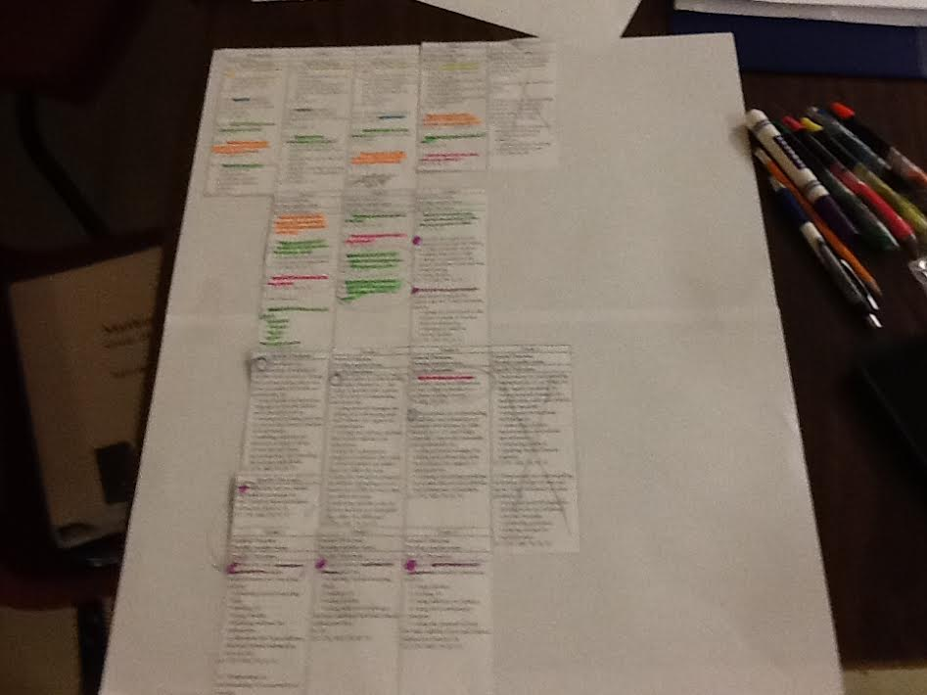
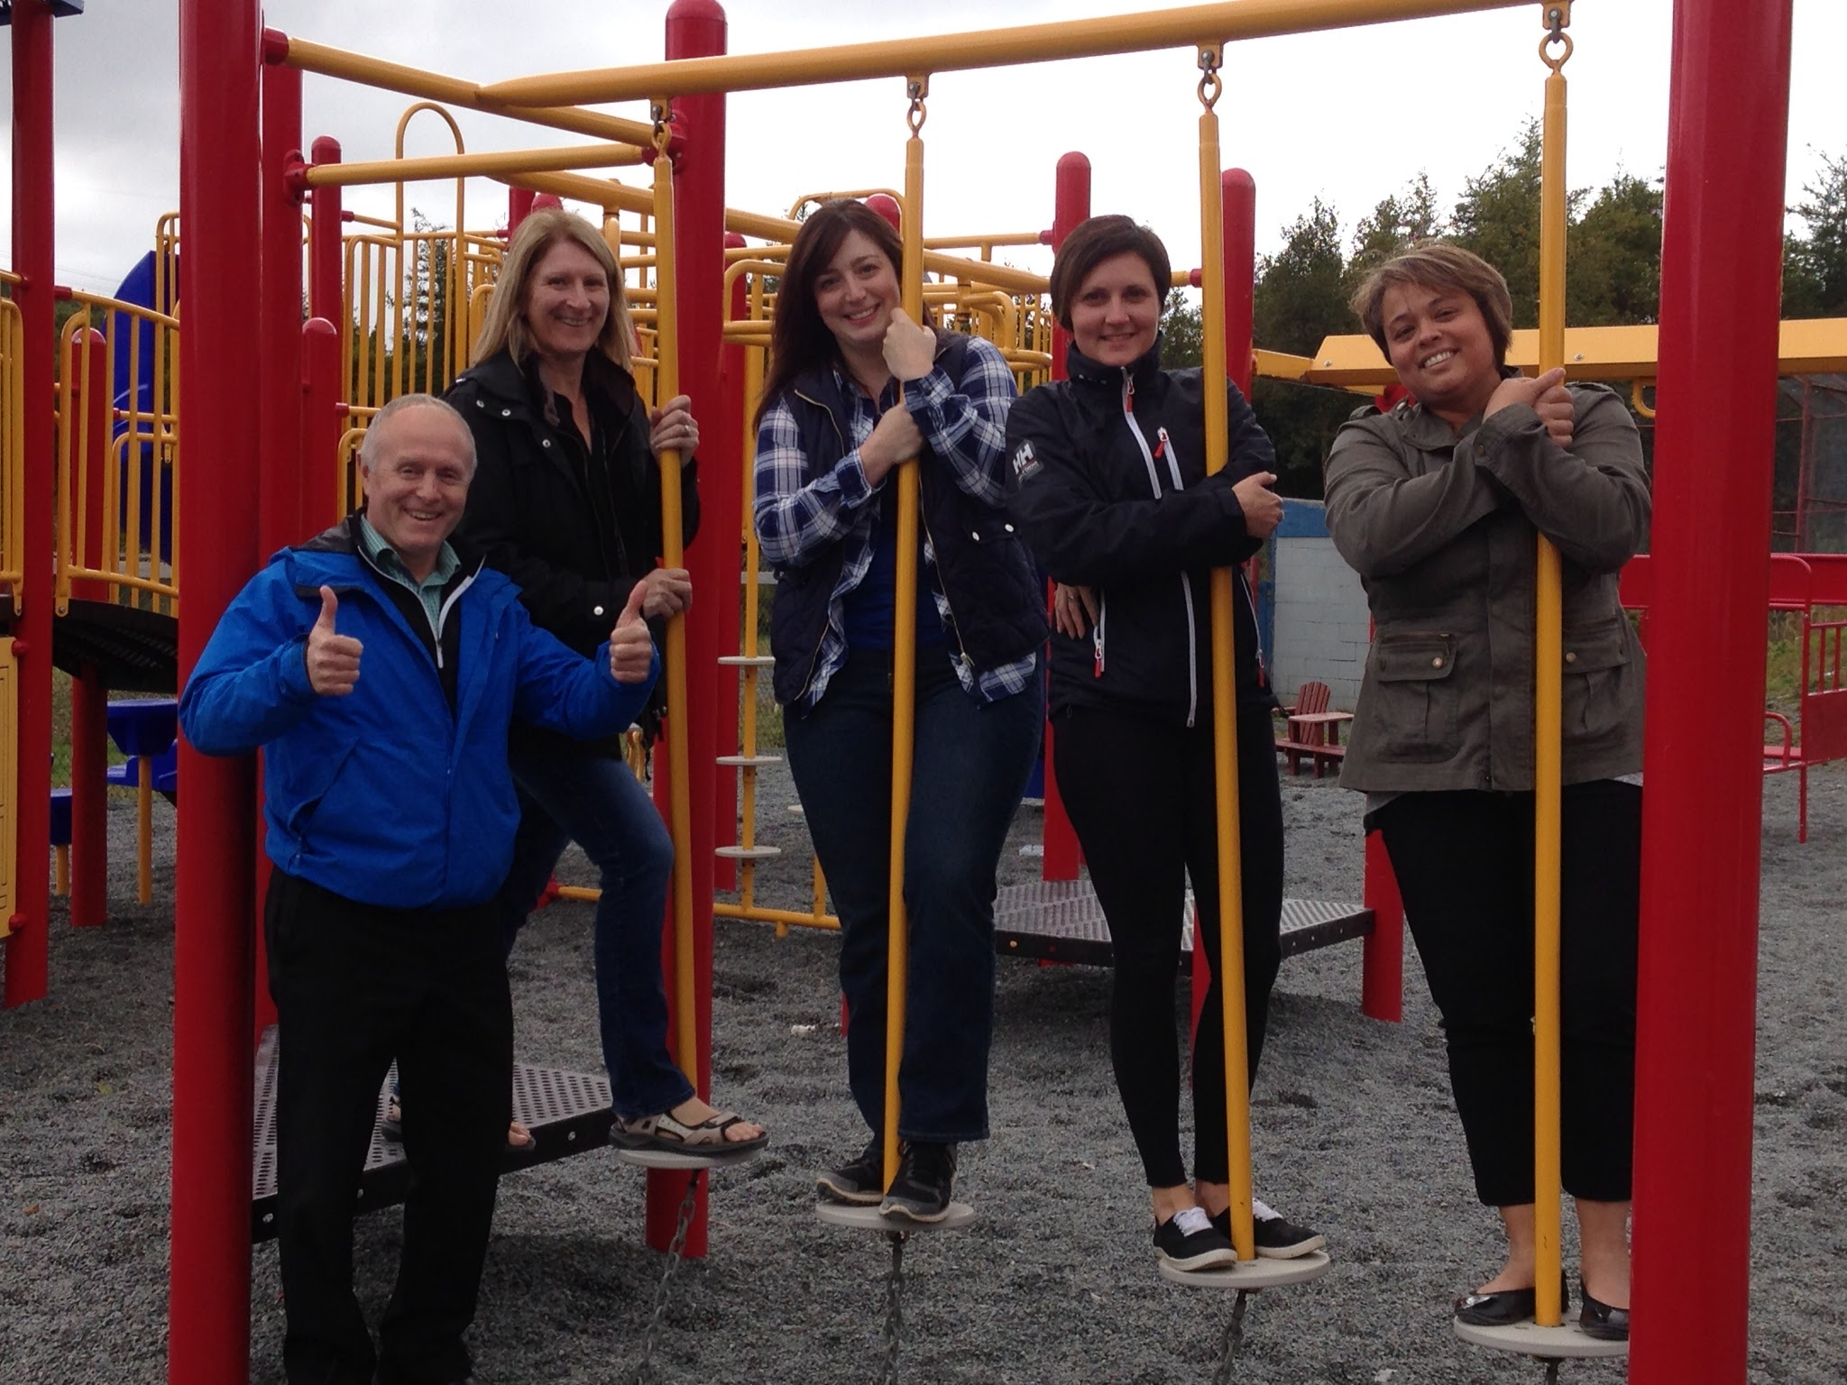
Planning
We attended a two day institute held in August at MUN with other TIA participants
We had four meetings with Tom Walsh from September to January to discuss our planning
We also met several times to collaborate on ideas, plan our lessons and activities, and prepare and gather materials.

Slide 11
What is NUMBER SENSE?
NOT a set of skills
It grows and develops over time
It means having a good intuition about number
A gradual process through exploring
Visualizing number in different contexts
4 number sense ideas we used:
Spatial relationship (subitizing)
Concept of more and less +1, +2, -1, -2…+10, -10… (rekenrek)
Benchmarks of 5 and 10 (math beads)
Part- part-whole (math balance, beads)

Slide 12
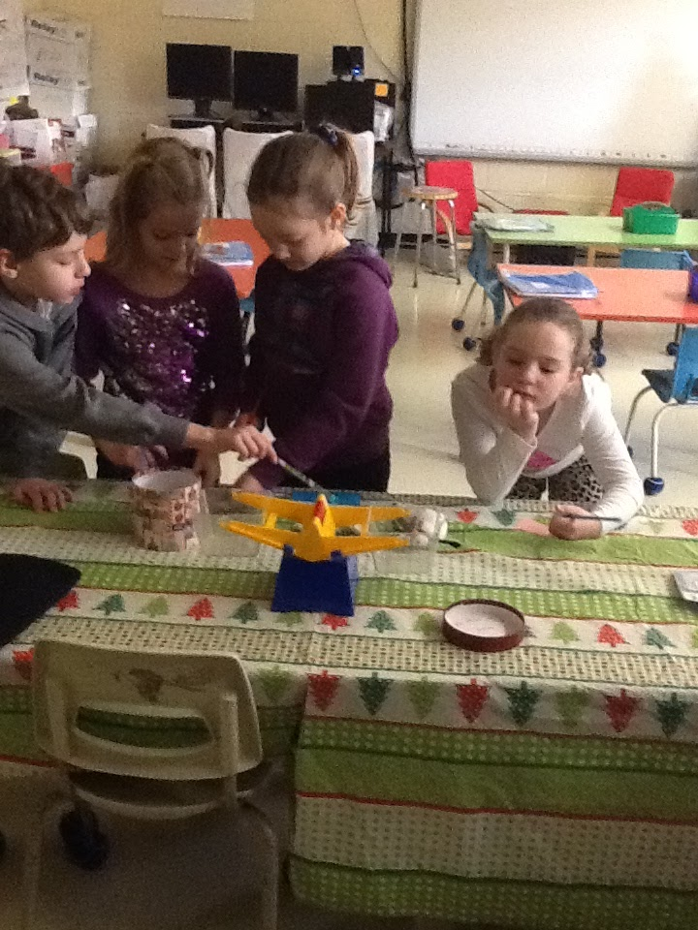
Our Approach To Teaching Number Sense
Inquiry Based Learning
Flexible teaching
Students develop questions
Students make generalizations
Small group, whole group and guided learning
Teachers and students take responsibility of learning

Slide 13
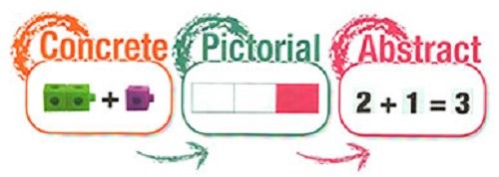
Our Approach To Teaching Number Sense
The Concrete, Pictorial and Abstract
Concrete
The concepts are introduced through hands on experiences with manipulatives. This can be used with young children who think in concrete terms, or older students who are new to concept.
Abstract
Students use abstract numbers and symbols when they have enough context to understand what they mean. They are able to relate the concepts together.
Pictorial
This involves images or other visuals to represent the concrete situation enacted in the first stage. One way of doing this is to draw images of the objects on paper or to use diagrams or graphs

Slide 14
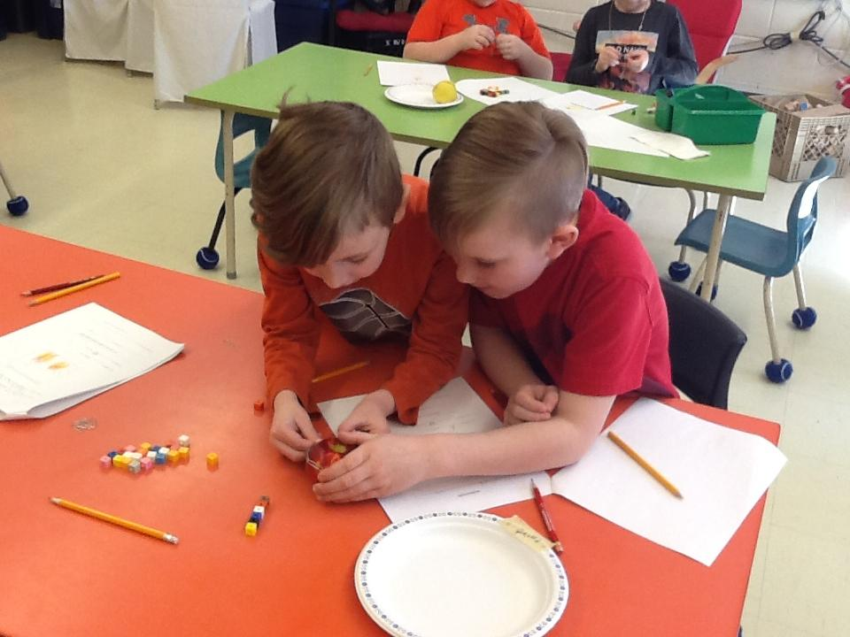
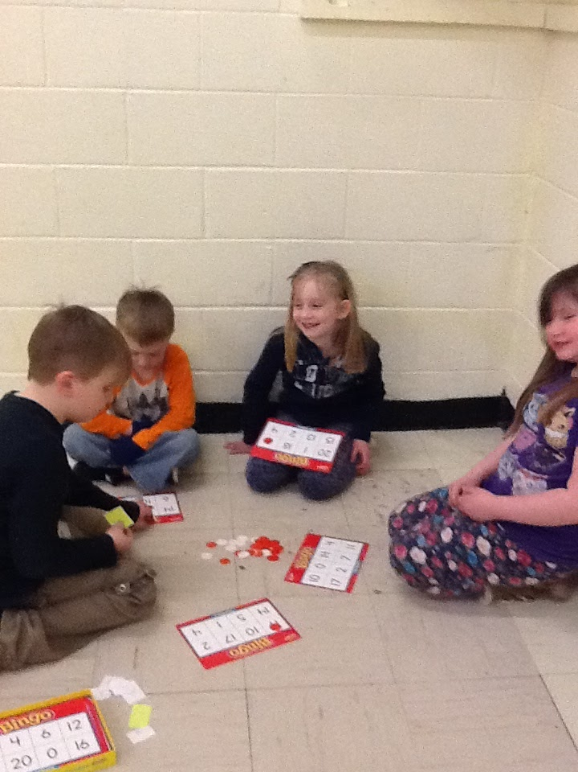
Our Approach To Teaching Number Sense
Collaboration
We have realized that through our own collaborative work our students’ learning has and will continue to increase.

Slide 15
Inquiry Instruction
Explore the concept or skill.
Model how it works
Extend Practice (apply knowledge)
More Modelling, Explanation and Elaborating (until the students become skilled in applying the concept or skill)
The
Teacher will

Slide 16
Inquiry learning
The student will
Form math concepts and generalizations
Formulate and Test the concepts and generalizations
Engage in higher order thinking

Slide 17
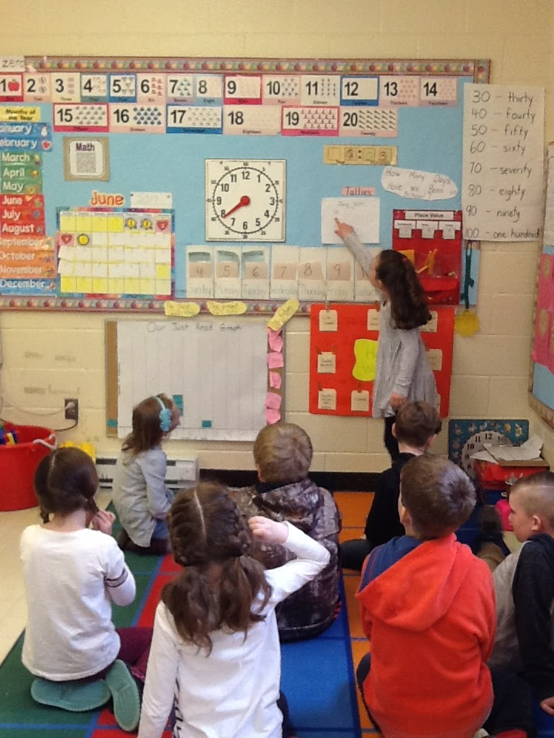
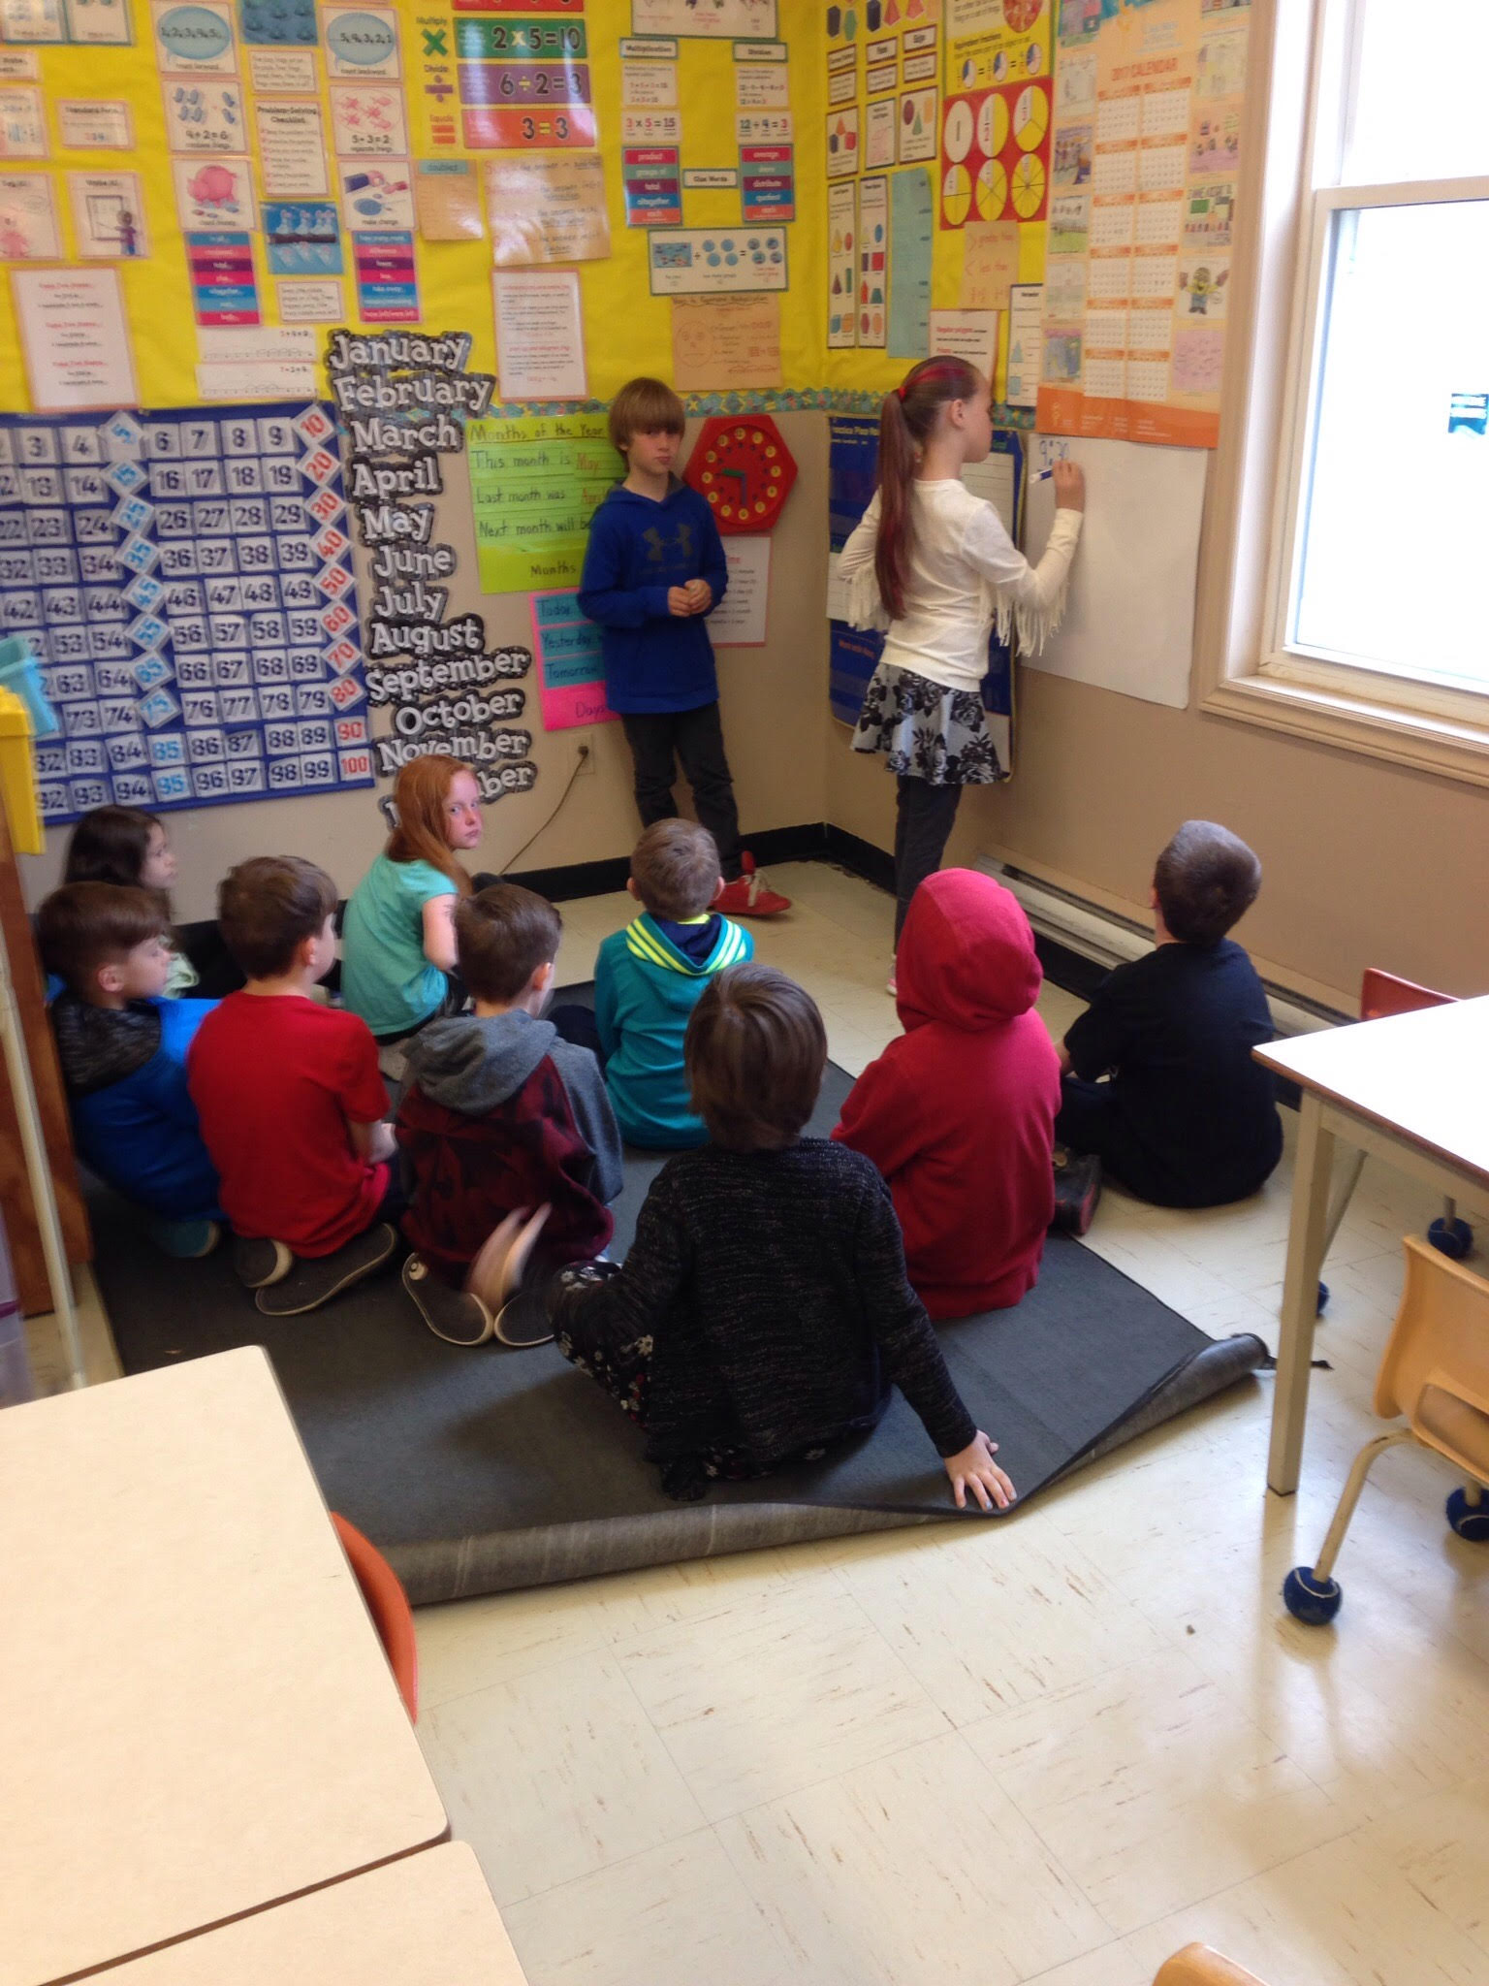
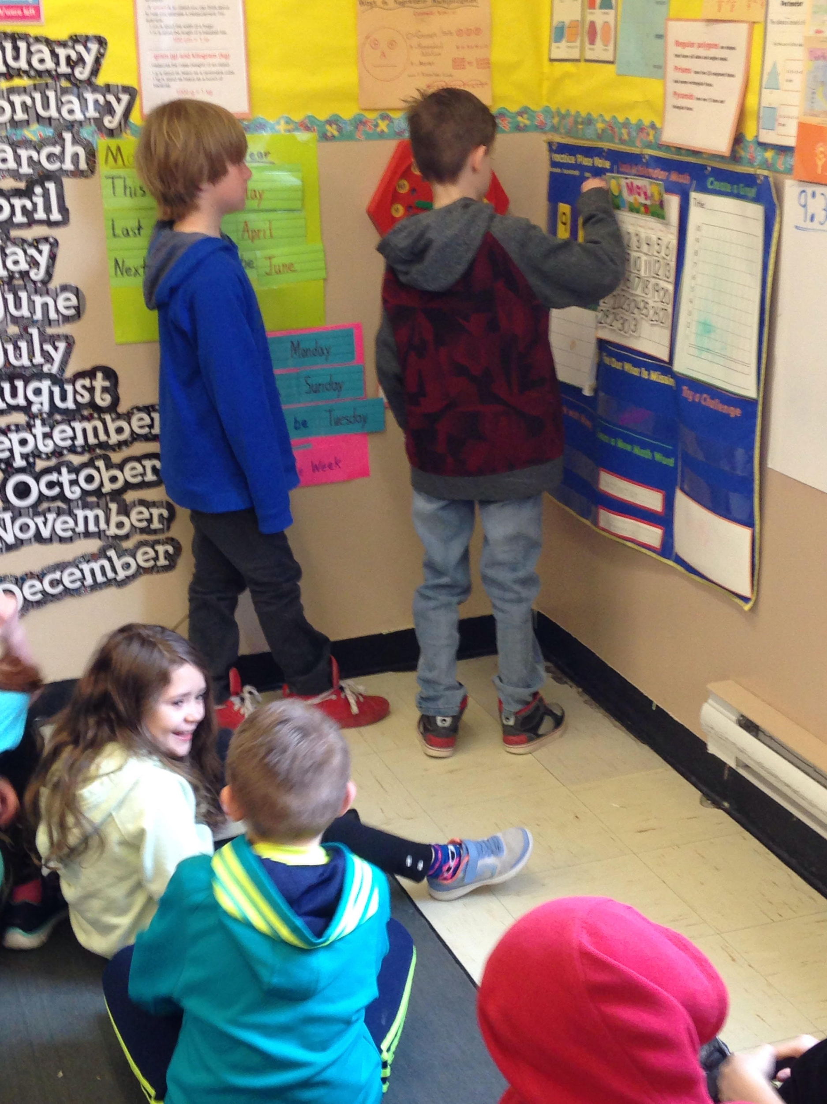
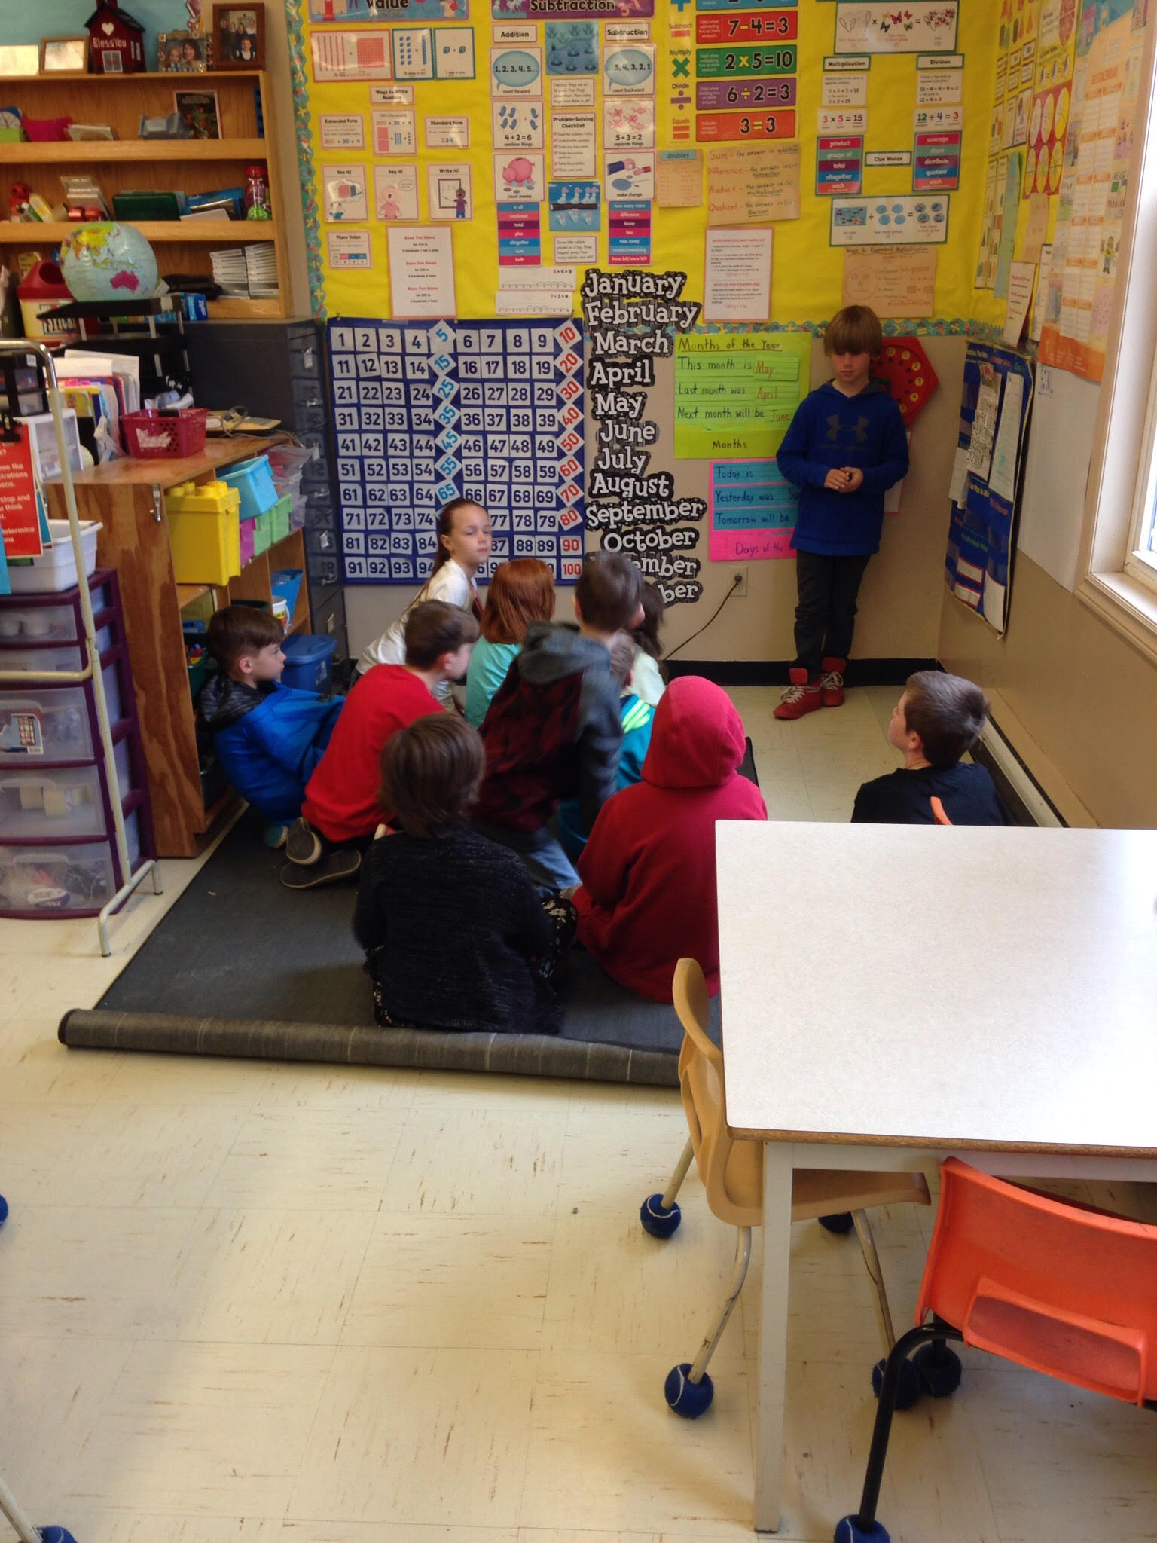
Implementation-Calendar Math
During calendar math we integrate all strands of math. We use questioning, flexible teaching, problem solving etc.

Slide 18
Implementation - Questioning
We went from teacher lead questions (and giving answers too soon) to knowing how much to tell and not to tell.
We followed the three phase structure for lessons (Teaching Student-Centered Mathematics, Jan A. Van de Walle)
Before
Activate prior knowledge
Children need to understand what the problem is about
Establish clear expectations
During
LET GO!!
Notice students mathematical thinking
Provide appropriate support
Provide worthwhile extensions
After
Promote a community of learners
Listen actively without evaluation
Summarize main ideas and identify future problems

Slide 19
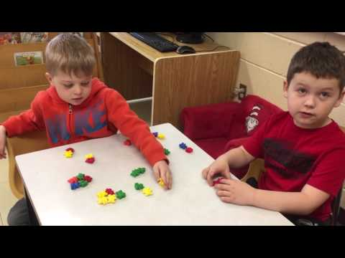
Video-questioning
Activate prior knowledge
LET GO!!
Listen actively without evaluation

Slide 20
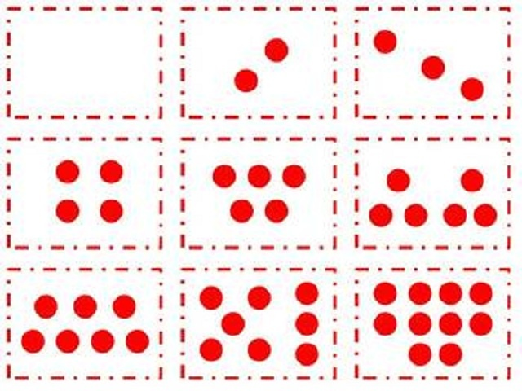
Implementation - Subitizing
Subitizing is crucial for number sense
It is a quick attention toward number sense
Individuals are shown a small set of patterned items and quickly state without counting how many they “see”
Encourages seeing number in a collection (group, set) rather than counting by ones
Links to part-part-whole and addition
Encourages mathematical fluency

Slide 21
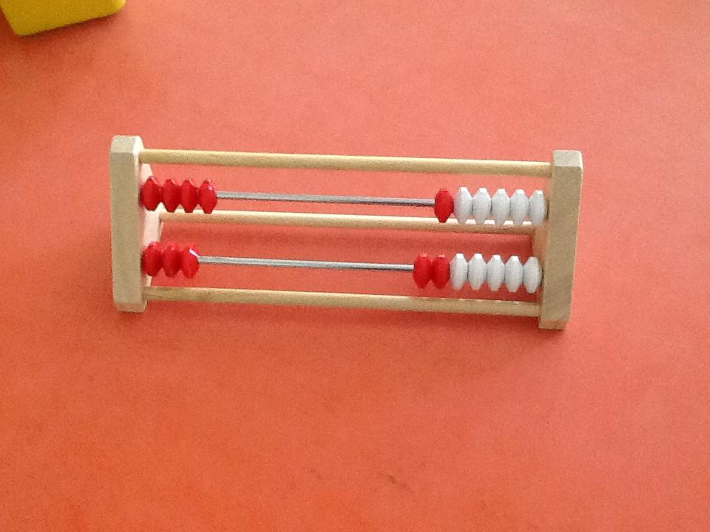
Implementation - Rekenrek
Supports the natural ways that children develop number sense and a variety of mathematical strategies
Develops a better sense of number relationships
Encourages mathematical fluency
App = Number rack
Notes:
Do a Rekenrek activity- What the heck is a rekenrek?

Slide 22
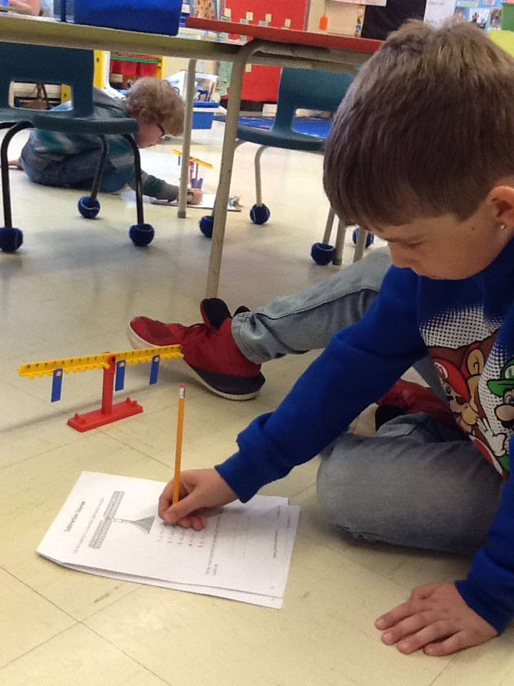
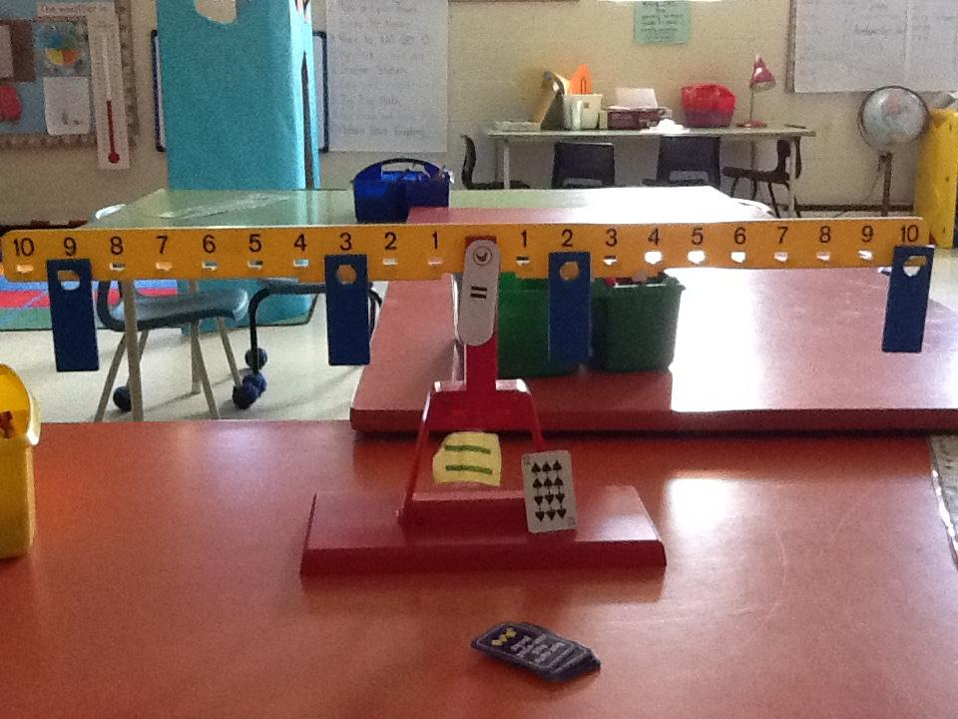
Implementation - Math Balance
Working with a Math Balance allows teachers to use one tool, yet teach many concepts!
Quantity
Composition and decomposition
Place value
Number sense
Addition, subtraction, multiplication, division
Inverse operations
Commutative and distributive properties
It fosters natural inquiry by allowing students to make generalizations
Using a math balance in the Primary grades can benefit students later in Elementary, Junior and Senior High
It supports a concrete, pictorial and abstract approach
It encourages INDEPENDENCE - allows students to self correct

Slide 23
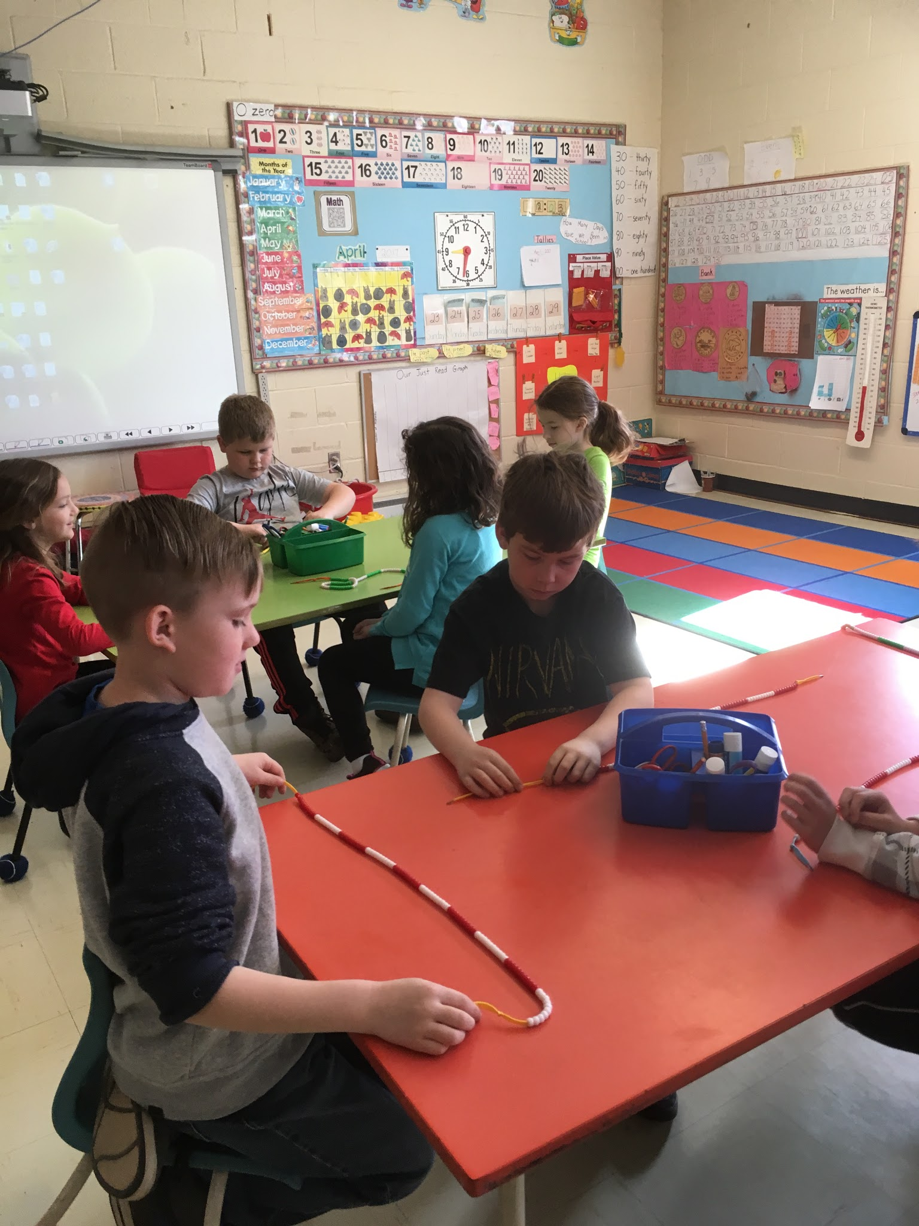
Implementation - Math Beads
Provides students with a concrete (visual) quantity of number
Relate that concrete to the abstract
Teachers consistently model how to record student thinking when using the bead string
Encourages identifying quantities of number (i.e. 5 or 10) rather than counting by ones
A concrete number line is introduction to the abstract number line
Notes:
Do a bead activity - Distribute bead strings and dice. Roll dice to add numbers

Slide 24
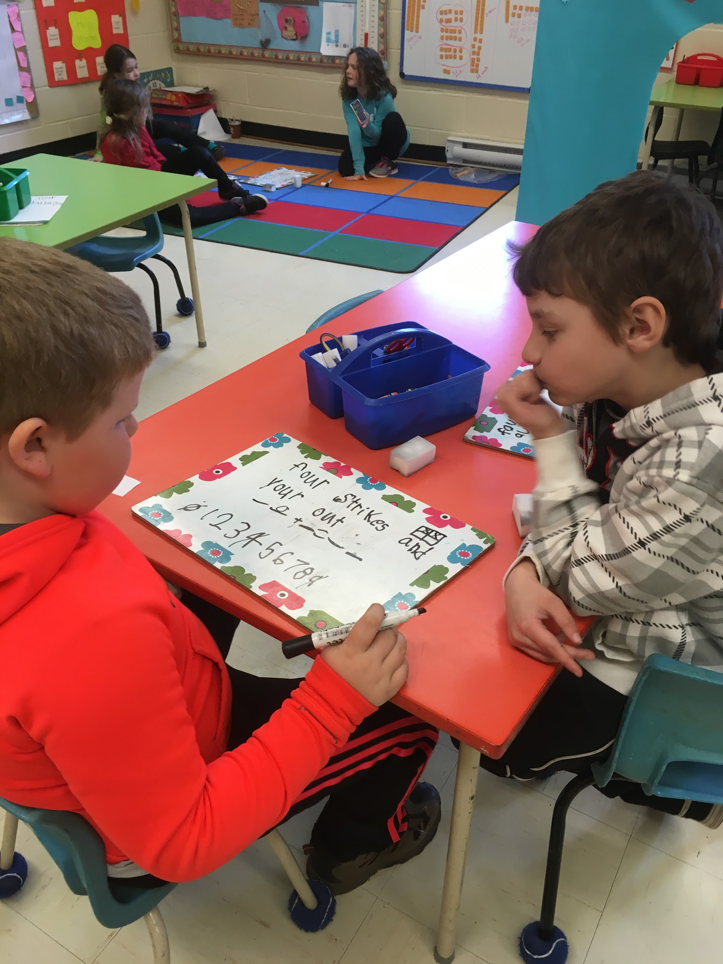
Implementation - Math Centers and Games
Math Centers/Games
Opportunity for teachers to work with small groups to teach or reinforce math concepts
Opportunity for teachers to float around room to listen to and observe student’s mathematical thinking
Opportunity for students to have fun while applying math skills and mental math

Slide 25
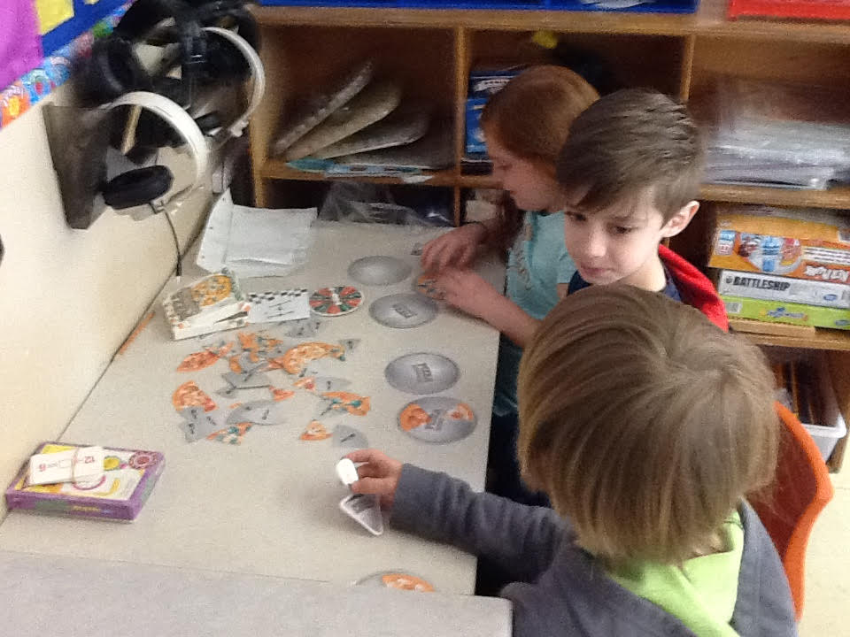
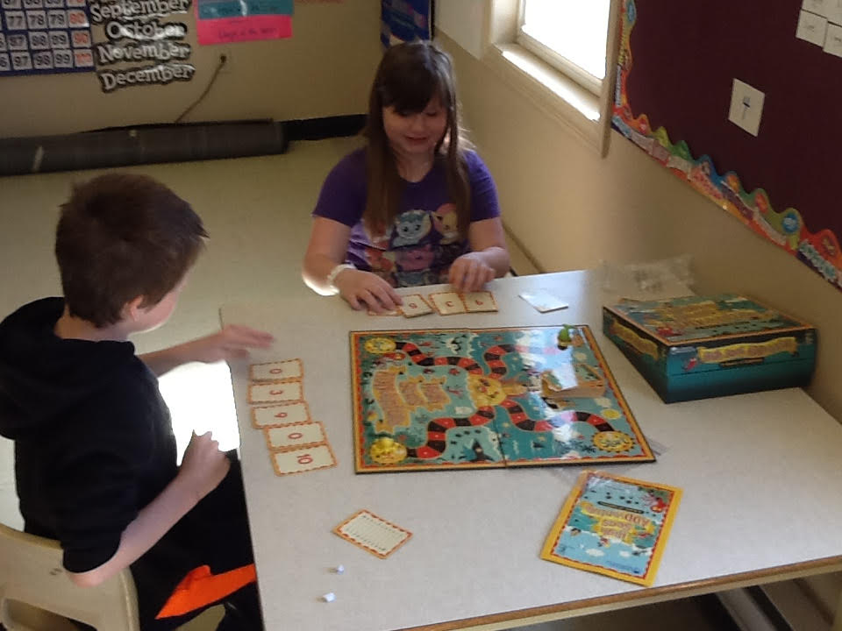
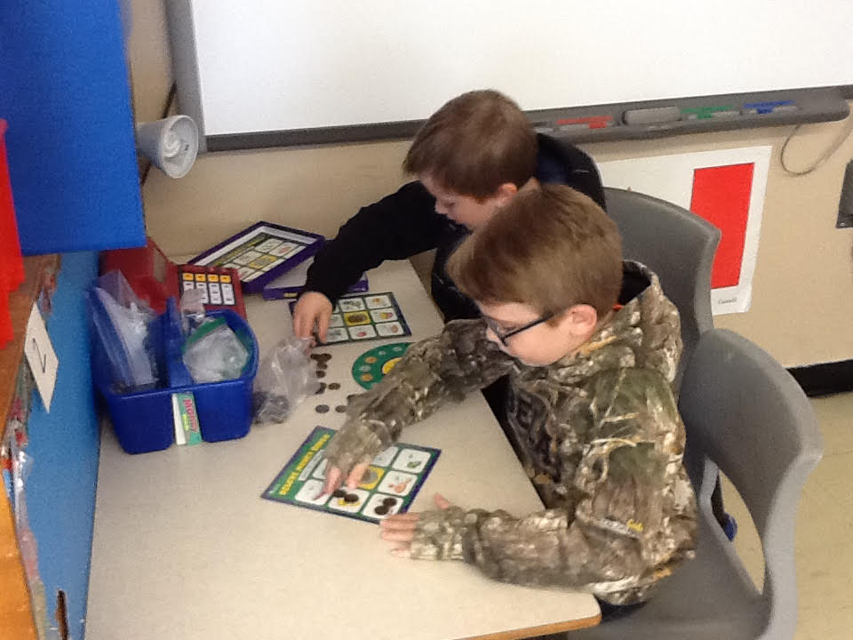
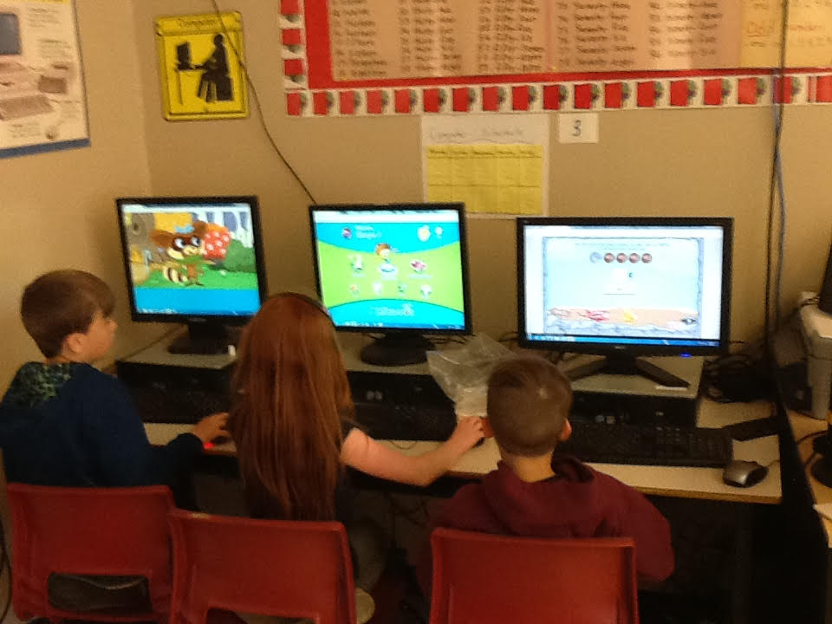
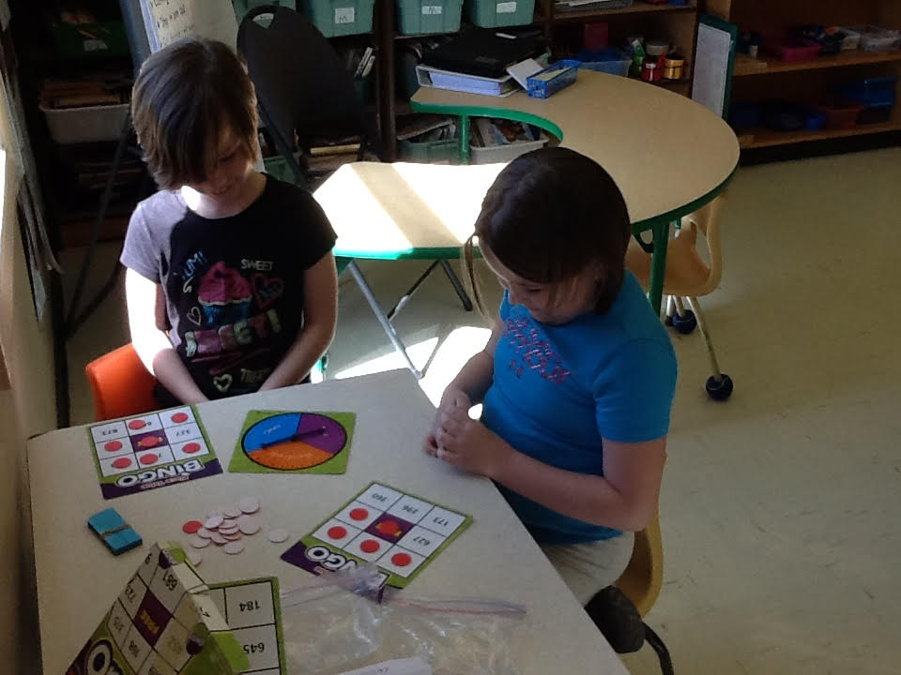
Math Centers

Slide 26
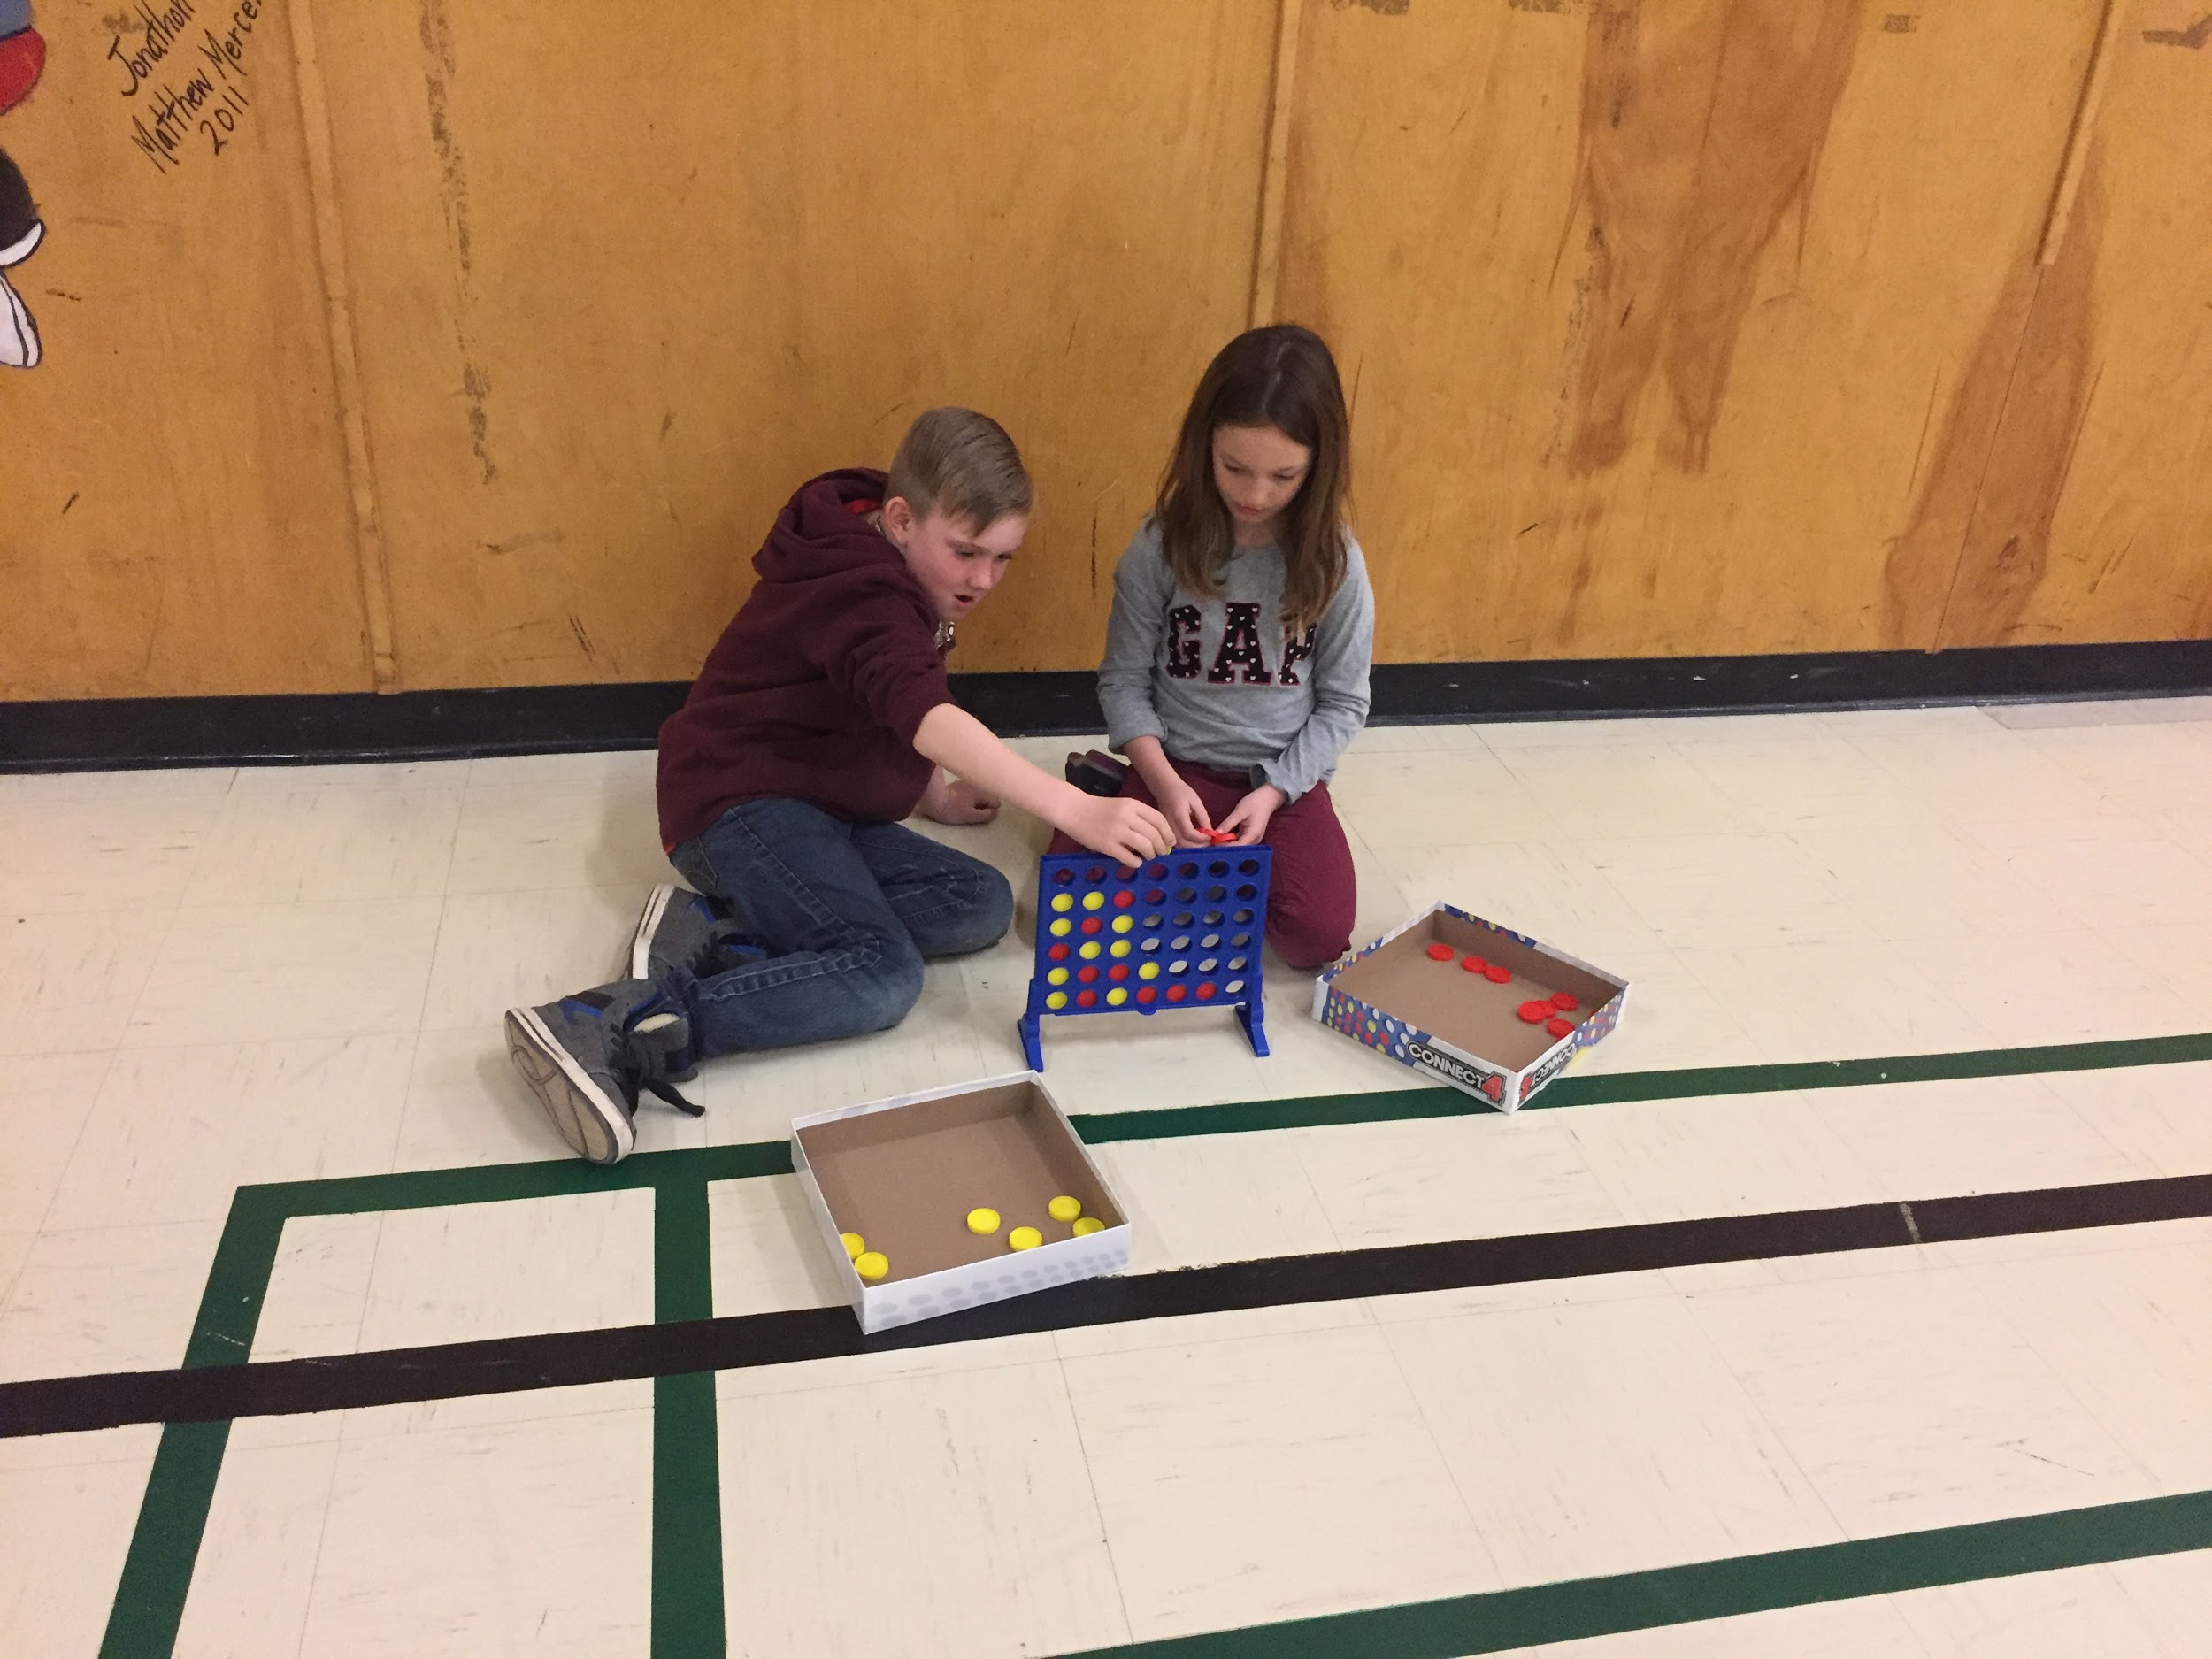
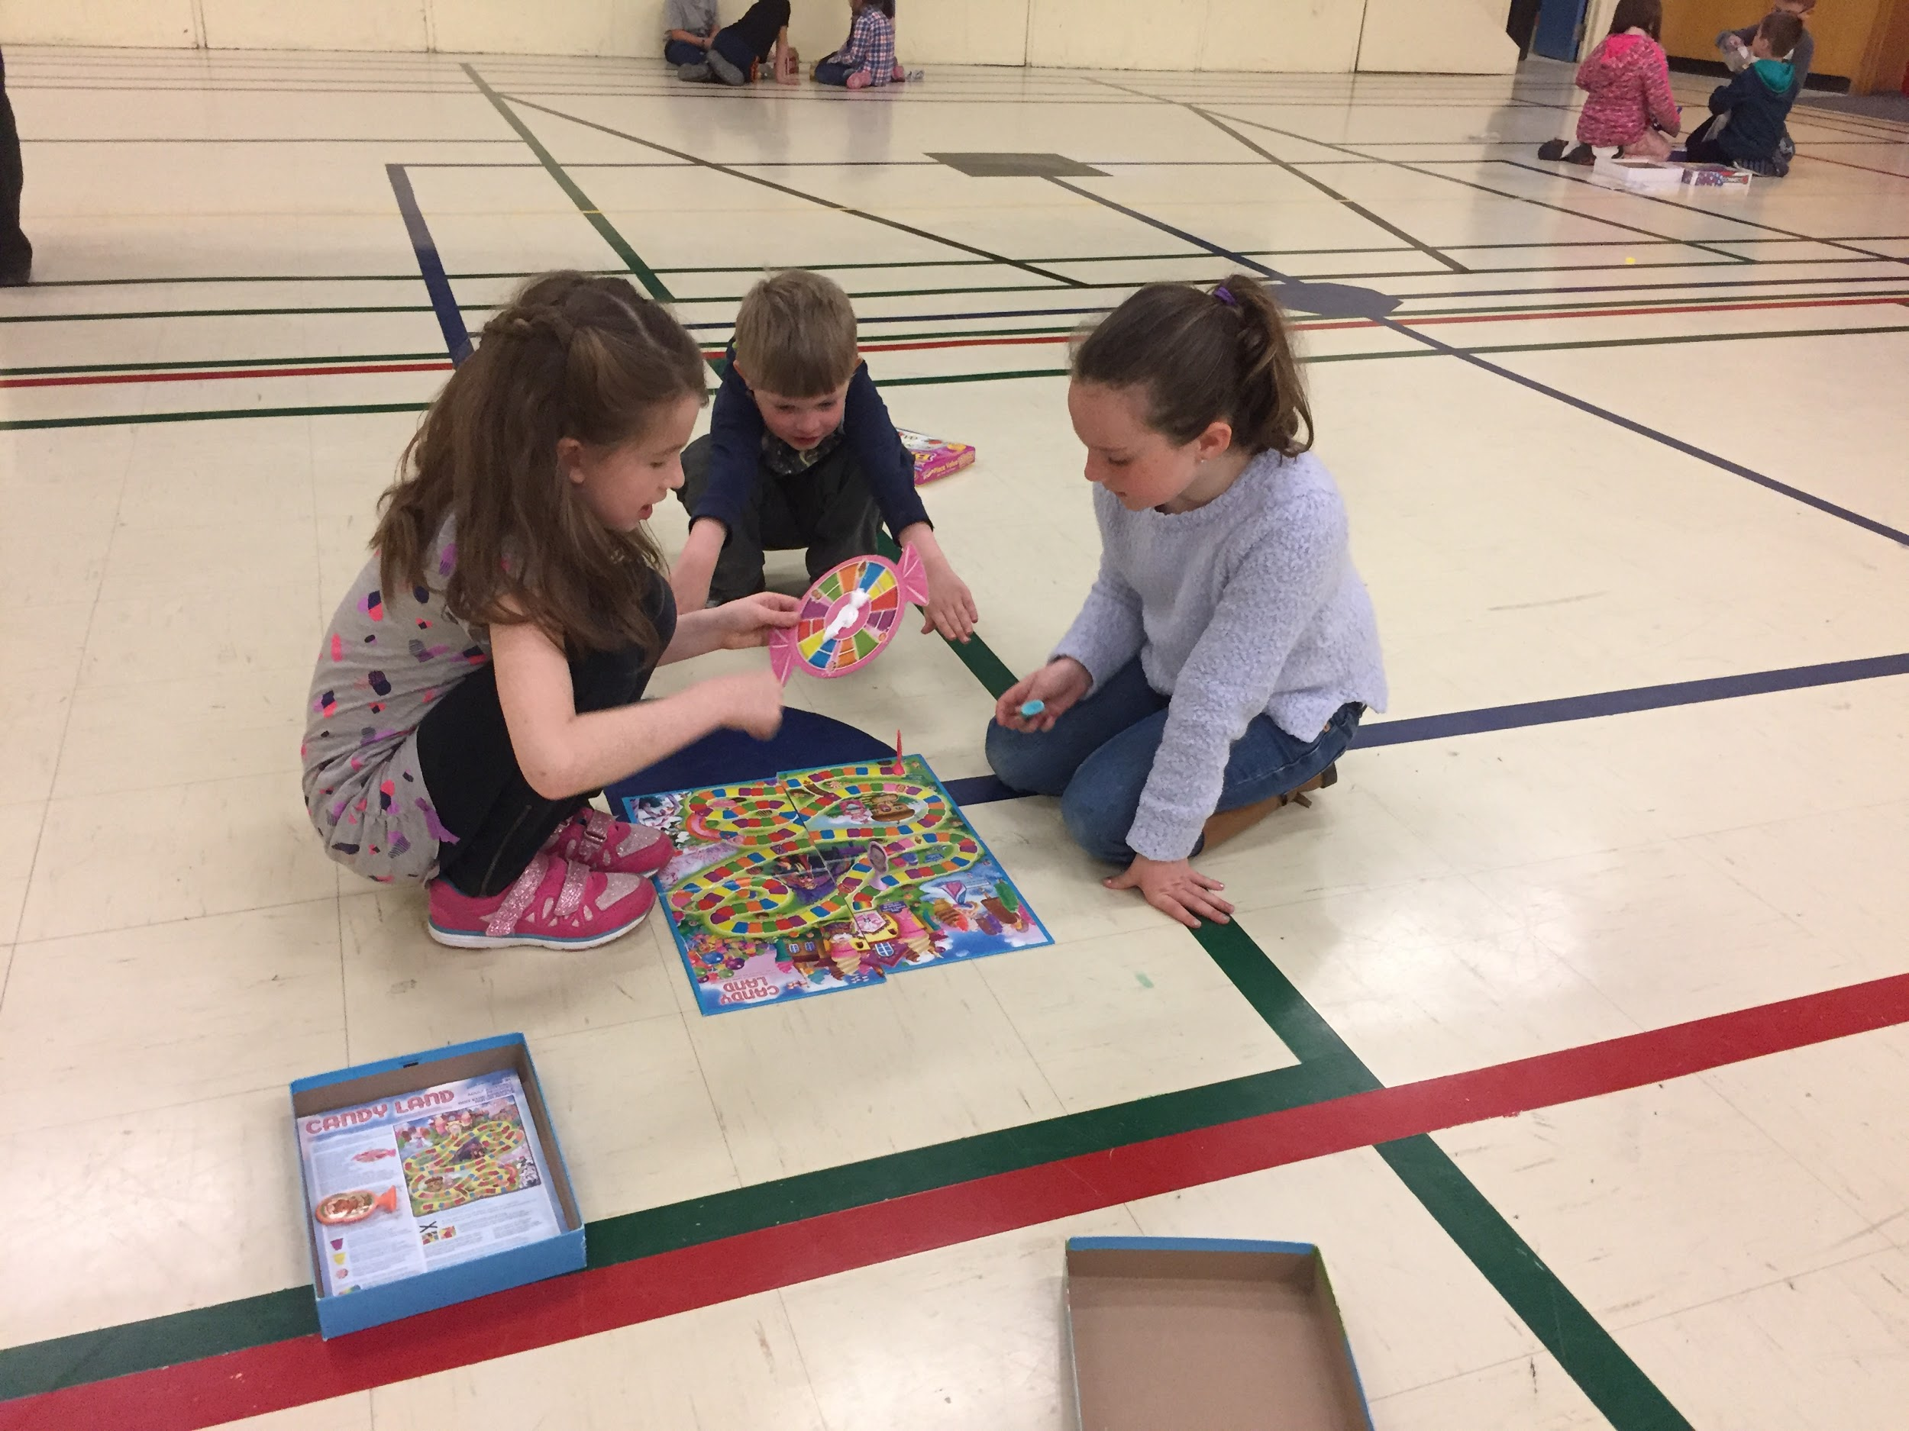
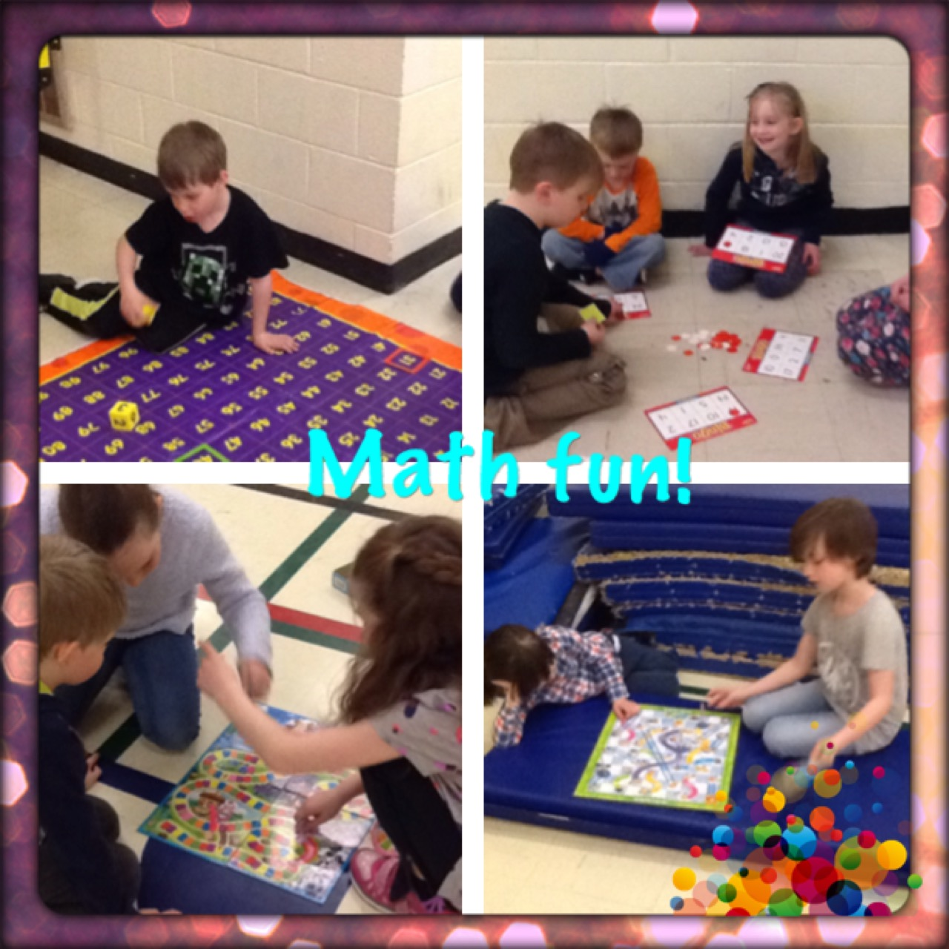
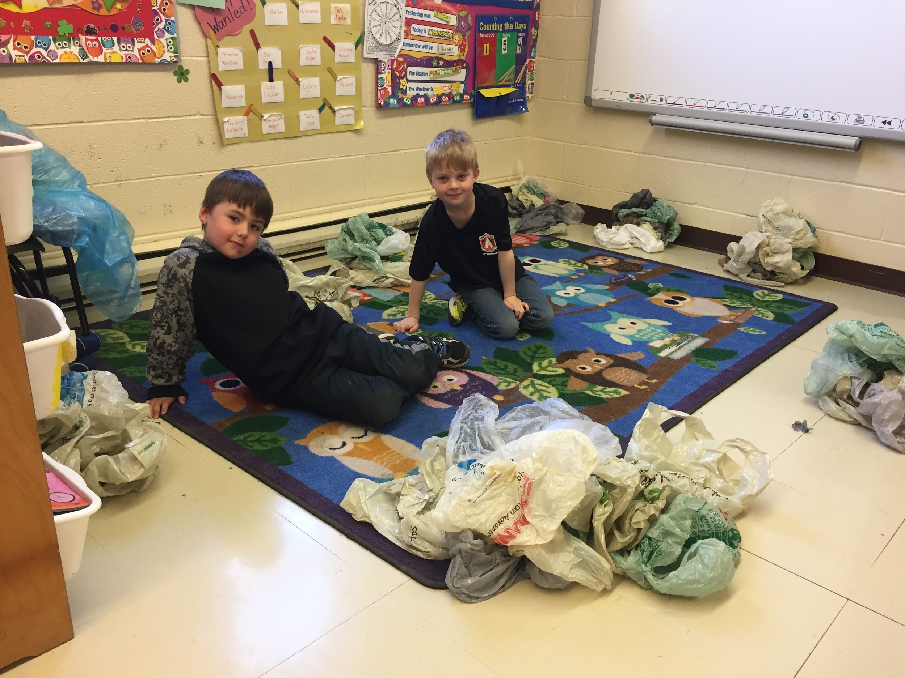
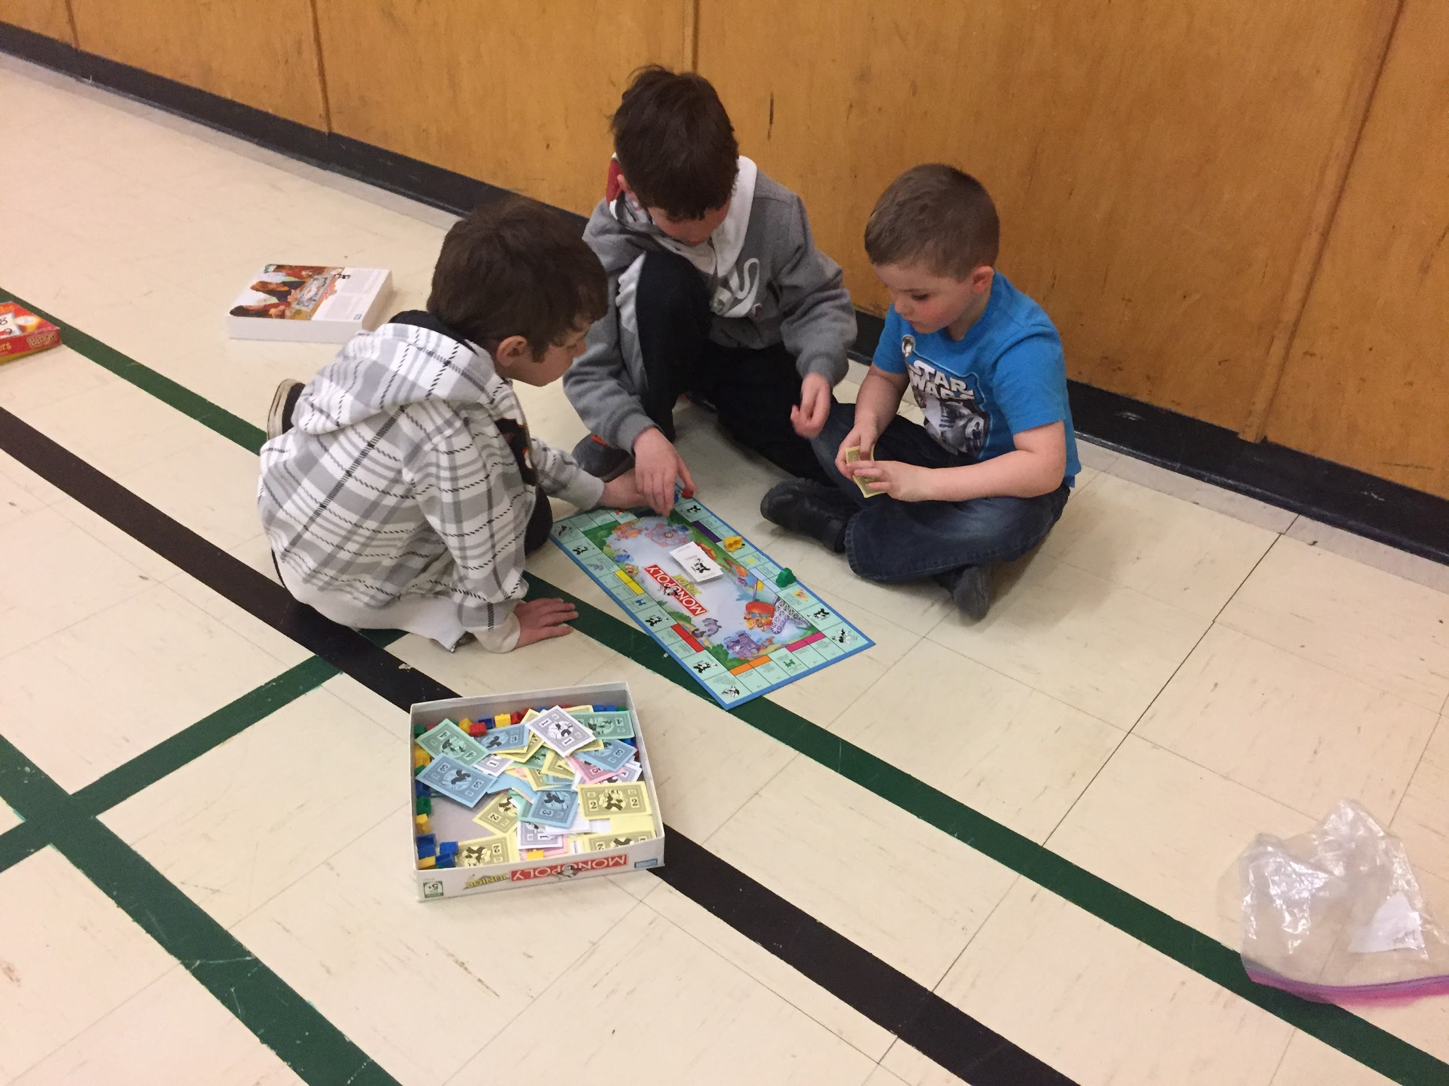
Math Games
Every Thursday afternoon K-3 students came together in the gym to play math games

Slide 27
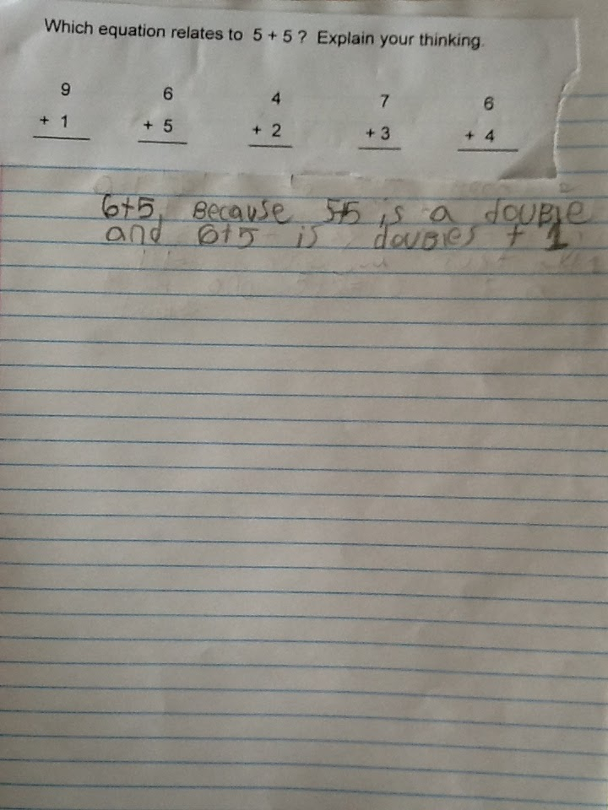
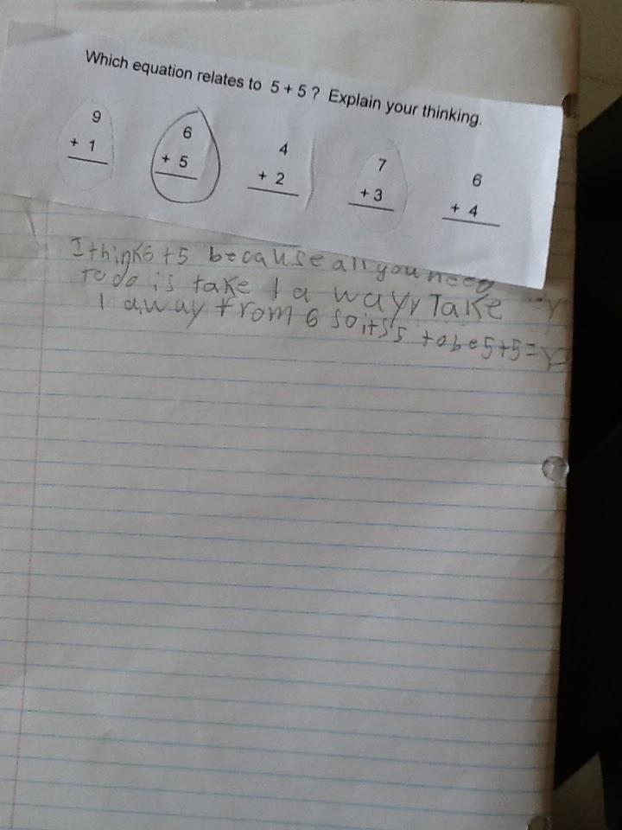
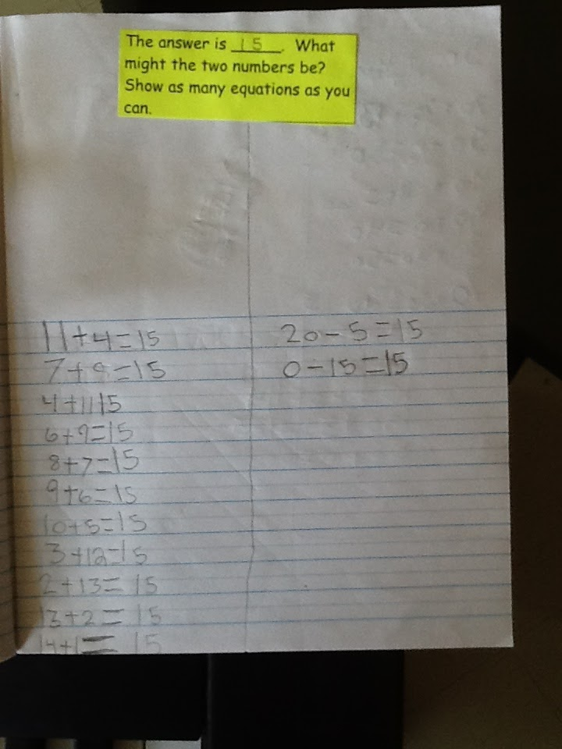
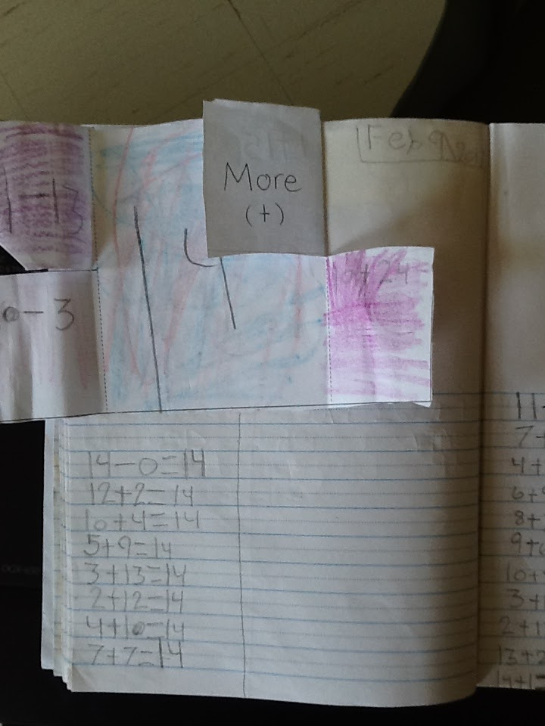
Student Work Samples
Journals

Slide 28
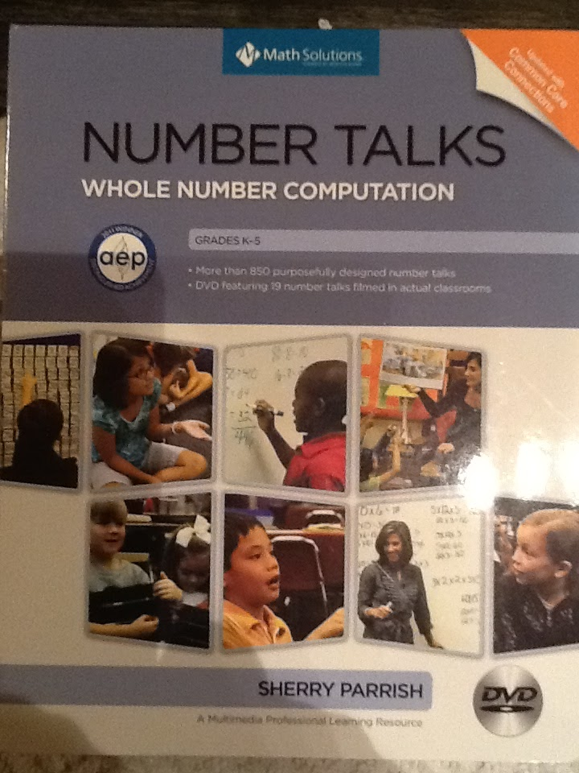
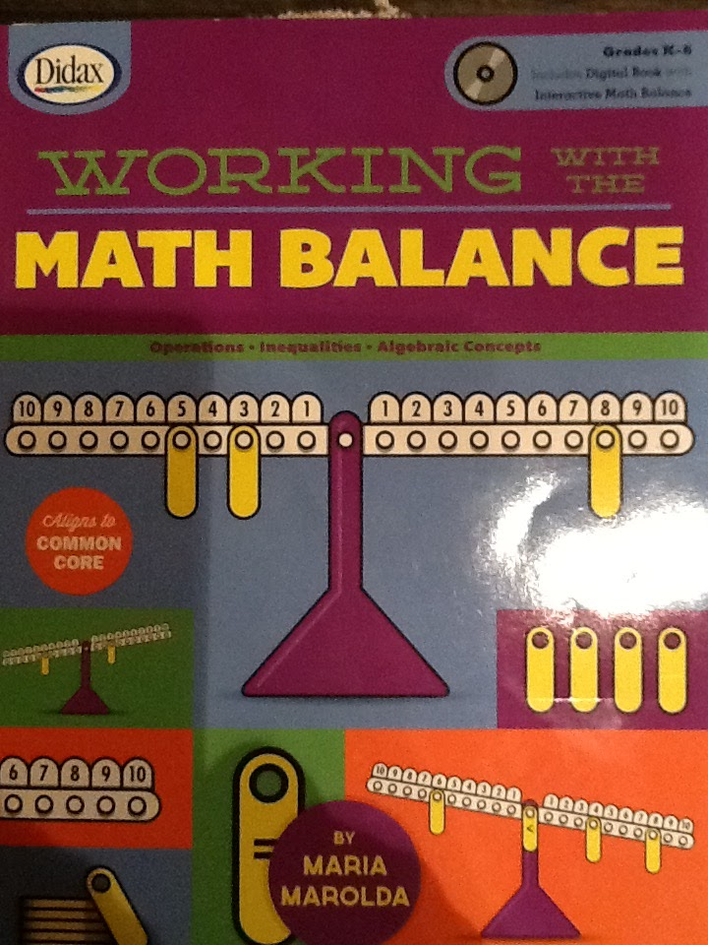
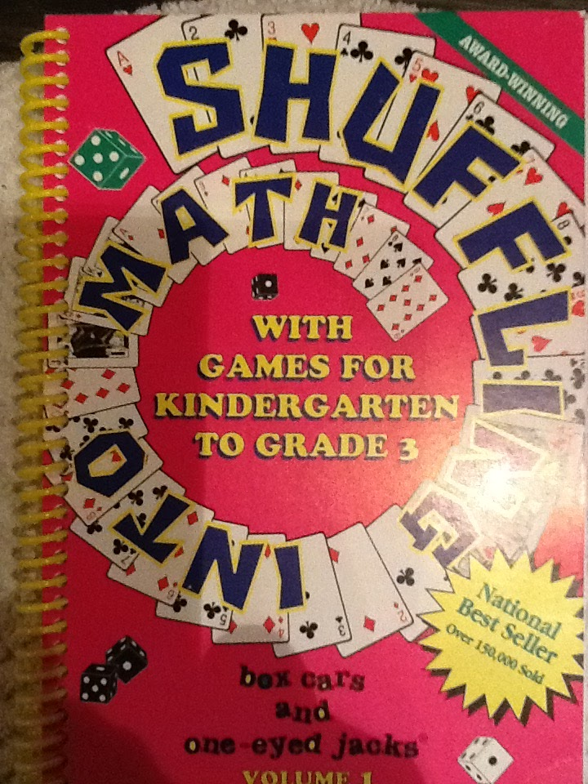
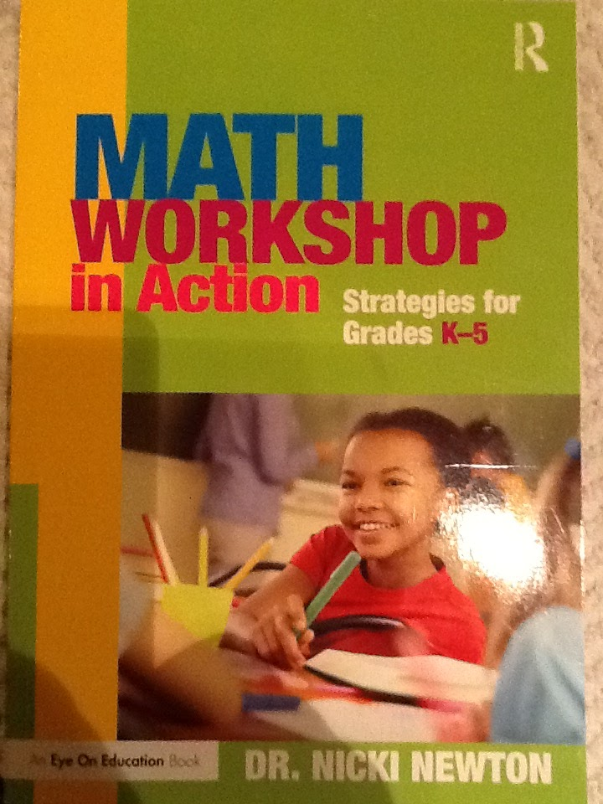
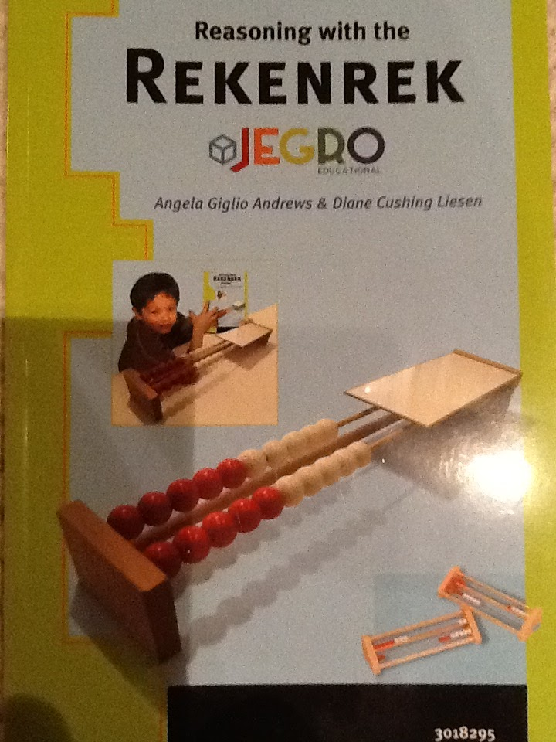
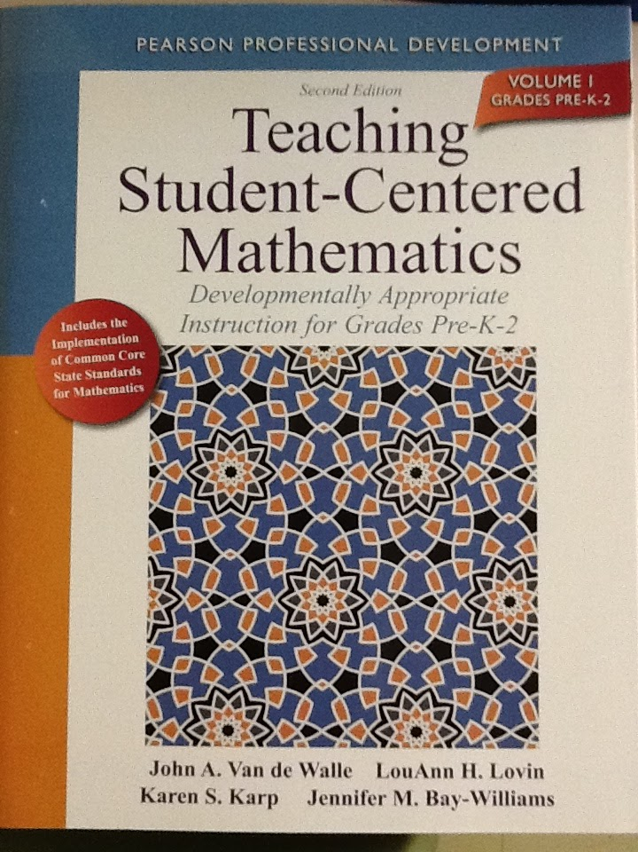
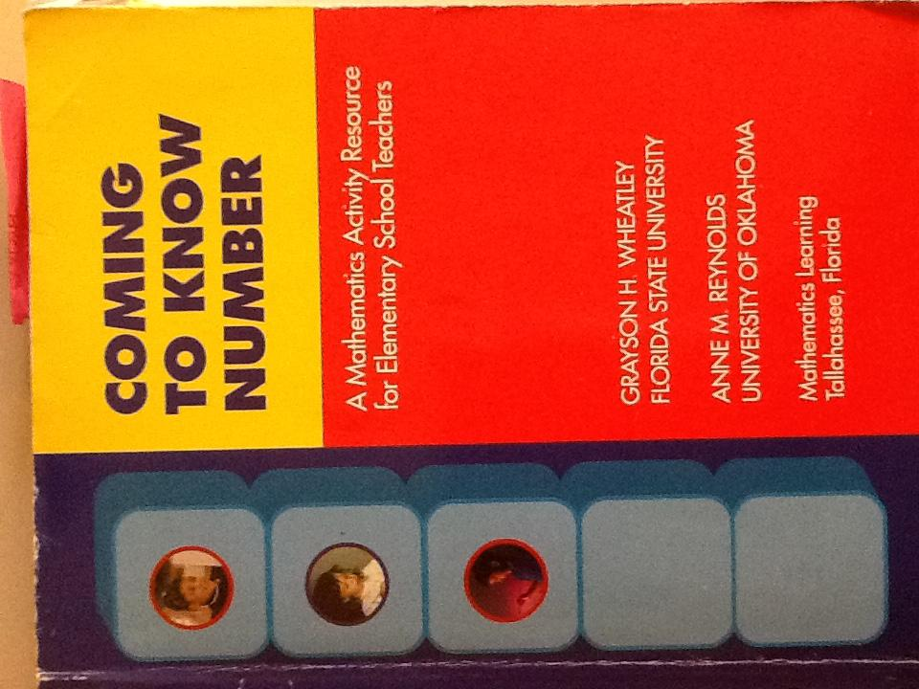
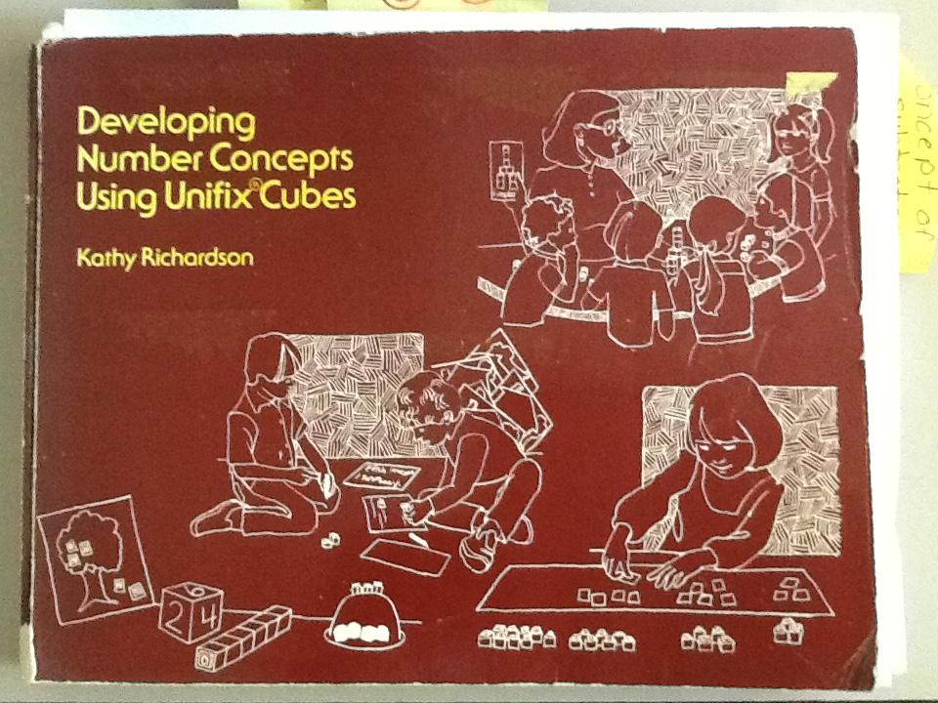
RESOURCES

Slide 29
Results
Quotes from students
It’s amazing because it’s really FUN! Grade 2 student
It’s awesome because I love ALL the games like 4 Strikes and You’re Out ! Grade 2 student
We learned easy ways to solve math!- Grade 2 student
Math is my favorite subject...I wrote it in my school yearbook. Grade 3 student
Math makes you SMART! Grade 3 student
Math is really interesting but I’m not a huge fan of it! Grade 3 student
I love NUMBERS! Grade 1 student
Math is fun...we get to play lots of games!! Grade 1 student
Math is good for your brain! Grade 3 student

Slide 30
Special Thanks To...
Thomas Walsh
Professor Karen Goodnough, Ph. D
Craig Adams
Memorial University Of Newfoundland
Hibernia Management and Development Company Ltd. (HMDC)
Holy Family Elementary School- Administration and Staff
Students and Families

