Slide 1
Inside Out Learning:
The Effects of Inquiry-Based Learning and Cloud Computing on Student Motivation

Slide 2
Introduction
This collaborative action research study focuses on the use of inquiry-based learning and the incorporation of cloud technology to increase student motivation. Two classes, from two different schools, collaborated online through Google Classroom and Skype to study the Newfoundland and Labrador grade 5 science unit - Life Science: Meeting Basic Needs and Maintaining a Healthy Body. A focus was placed on collaboration, hands-on activities and student inquiry in hopes to motivate and engage students in their learning.
By incorporating inquiry-based learning practices into our classrooms and encouraging students to discuss their ideas and share their wonderings by means of cloud technology (G-Suite applications), we hoped to increase student motivation towards science learning.

Slide 3
Teacher Research Questions
What is our role as facilitator in using G-Suite to enhance inquiry through student-centered learning?
What is inquiry-based learning?
What is the difference between engagement and motivation with respect to student learning?

Slide 4
Student Research Question
How can inquiry-based learning through G-Suite enhance student motivation?

Slide 5
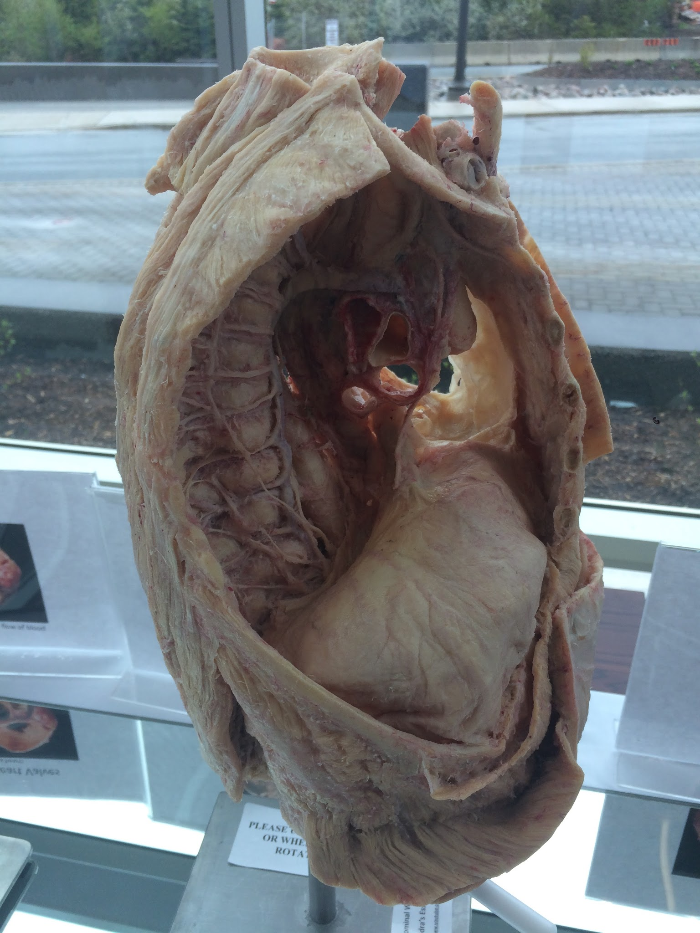
Rationale
Why Body Systems?
Students have struggled in the past with the Grade 5 Body Systems Unit as it is content heavy and hard for them to understand. Concepts were difficult to grasp as our topic of discussion was something they could not readily manipulate (the inside of their bodies). We, as teachers, struggled in finding a way to teach the unit in such a way that our students would be motivated and engaged in a hands-on learning environment.

Slide 6
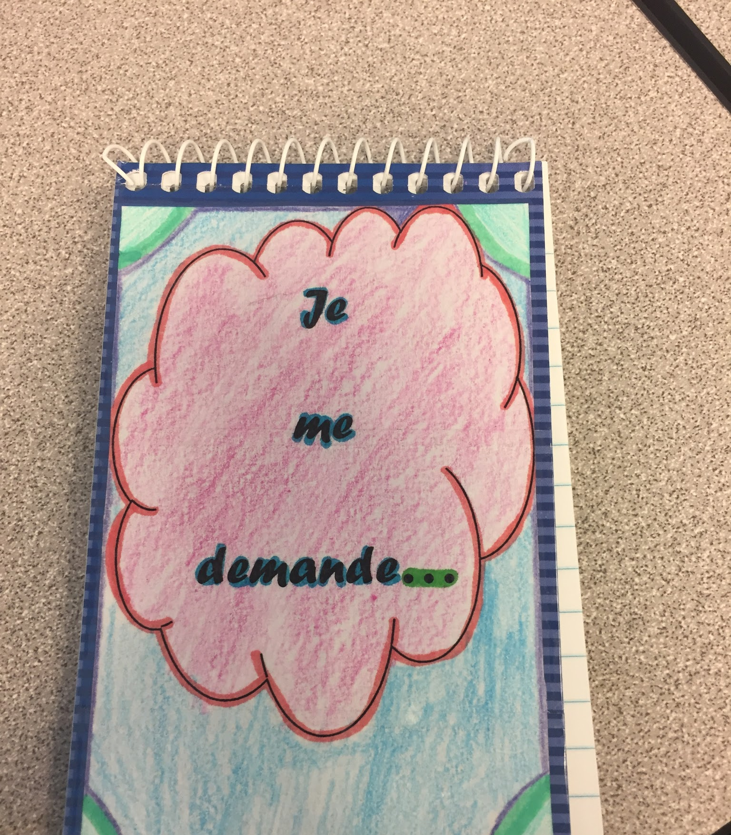
Rationale (Cont’d)
Why inquiry-based learning?
As teachers, we are continuously looking for ways to improve our teaching which will in turn improve the learning and experiences of our students. In our teaching experience, students have not been engaged or motivated in science learning. We chose to incorporate inquiry-based learning to allow the students the opportunity to be more hands-on in their learning and take ownership. This means that we, as teachers, must take on more of a guide role to student learning.

Slide 7
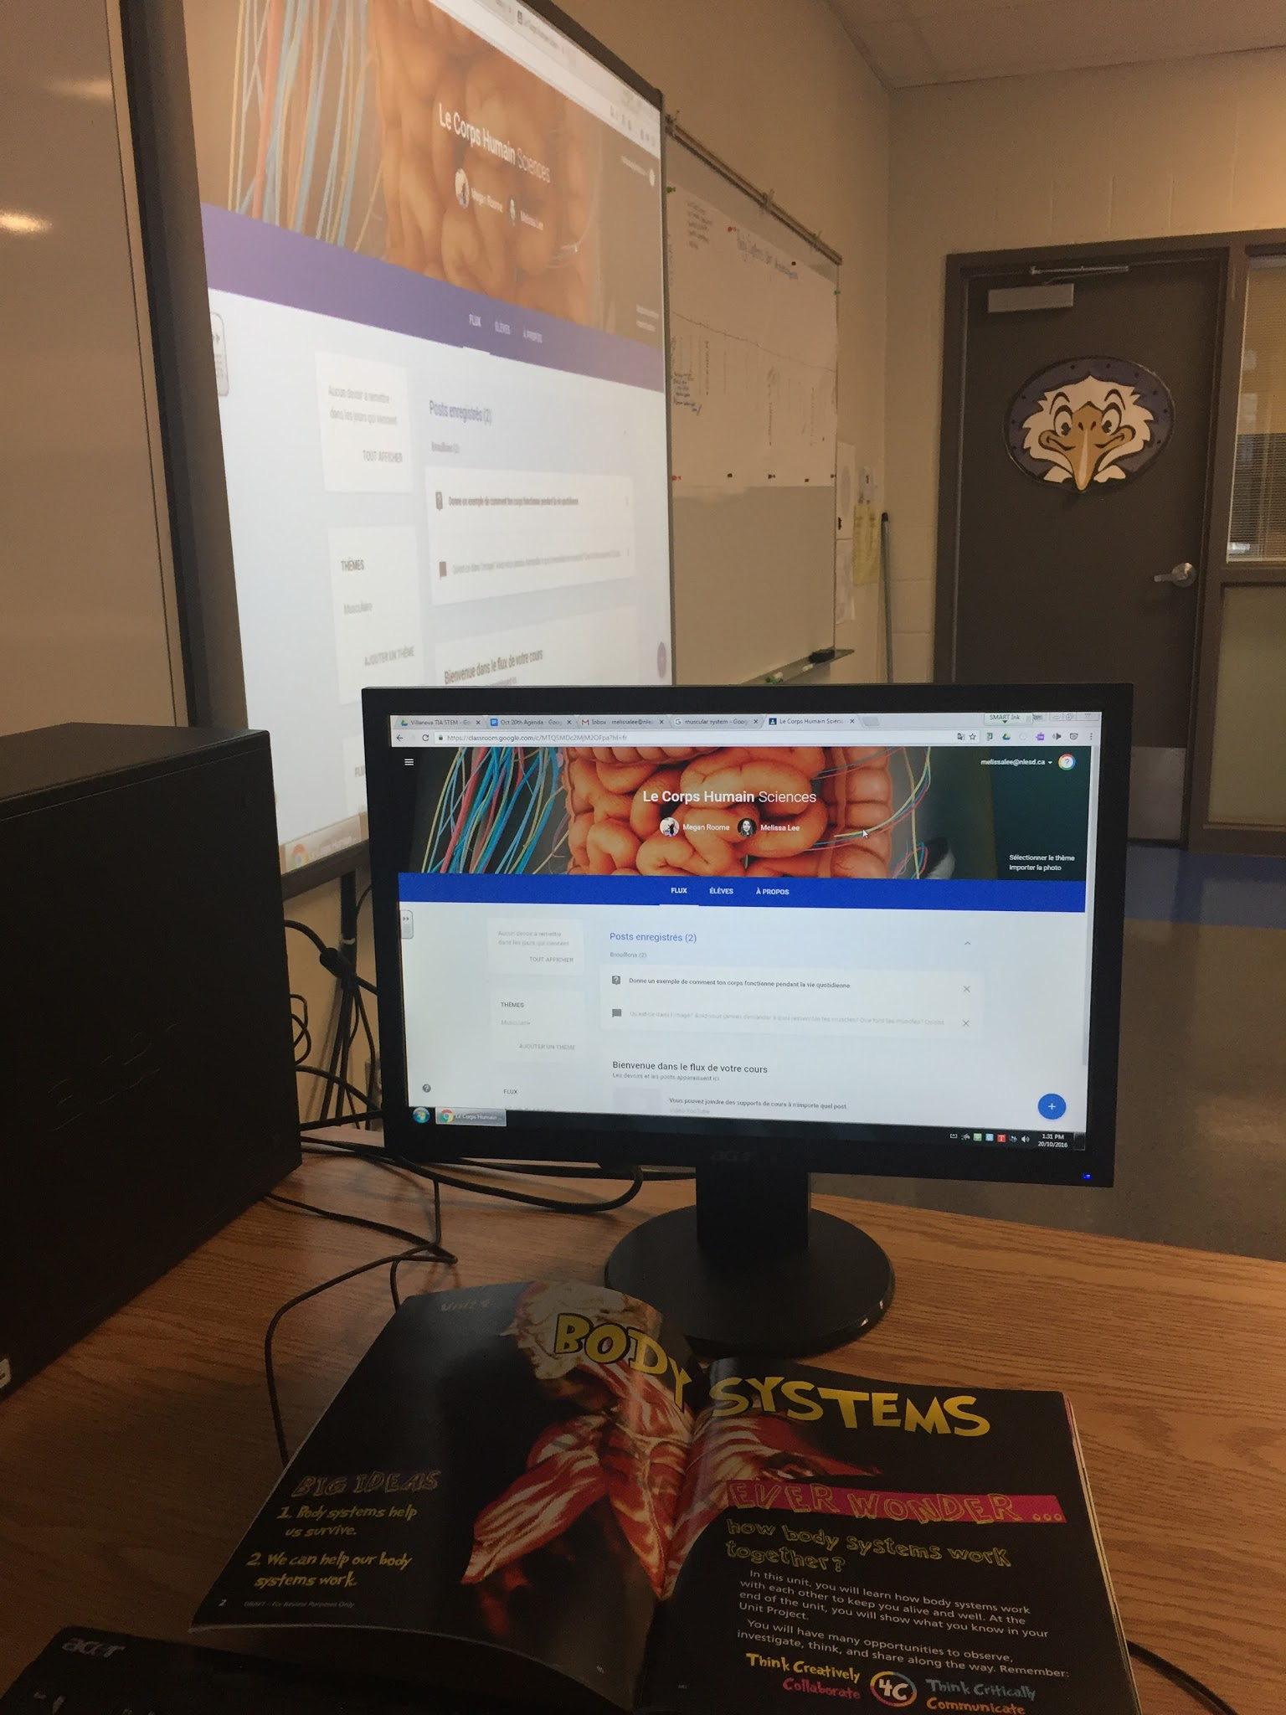
Rationale (Cont’d)
Why G-Suite?
G-suite provides tools that allow students to collaborate and communicate through the learning process. This was especially important to allow the students to work with one another even if they were not physically in the same classroom. It opened up the learning environment to create more authentic experiences with other individuals.

Slide 8
Methods
Qualitative
Interpretative
Collaborative action research
“In this type of collaborative action research, members of the group become engaged in collaborative dialogue in order to closely examine their current pedagogical practice and the assumptions or beliefs underlining their choice of teaching strategies” (Pellerin, 2011, p.1)

Slide 9
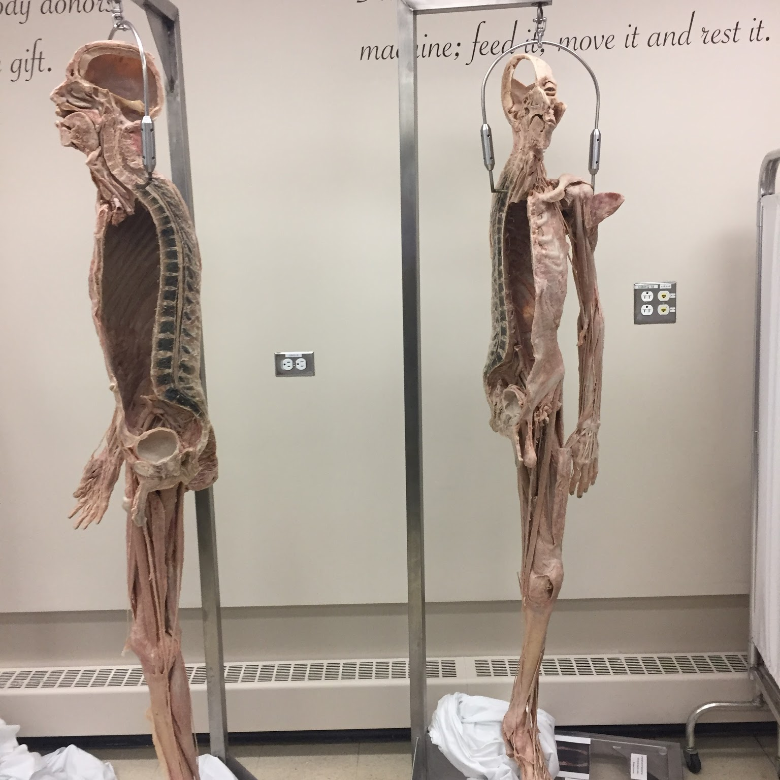
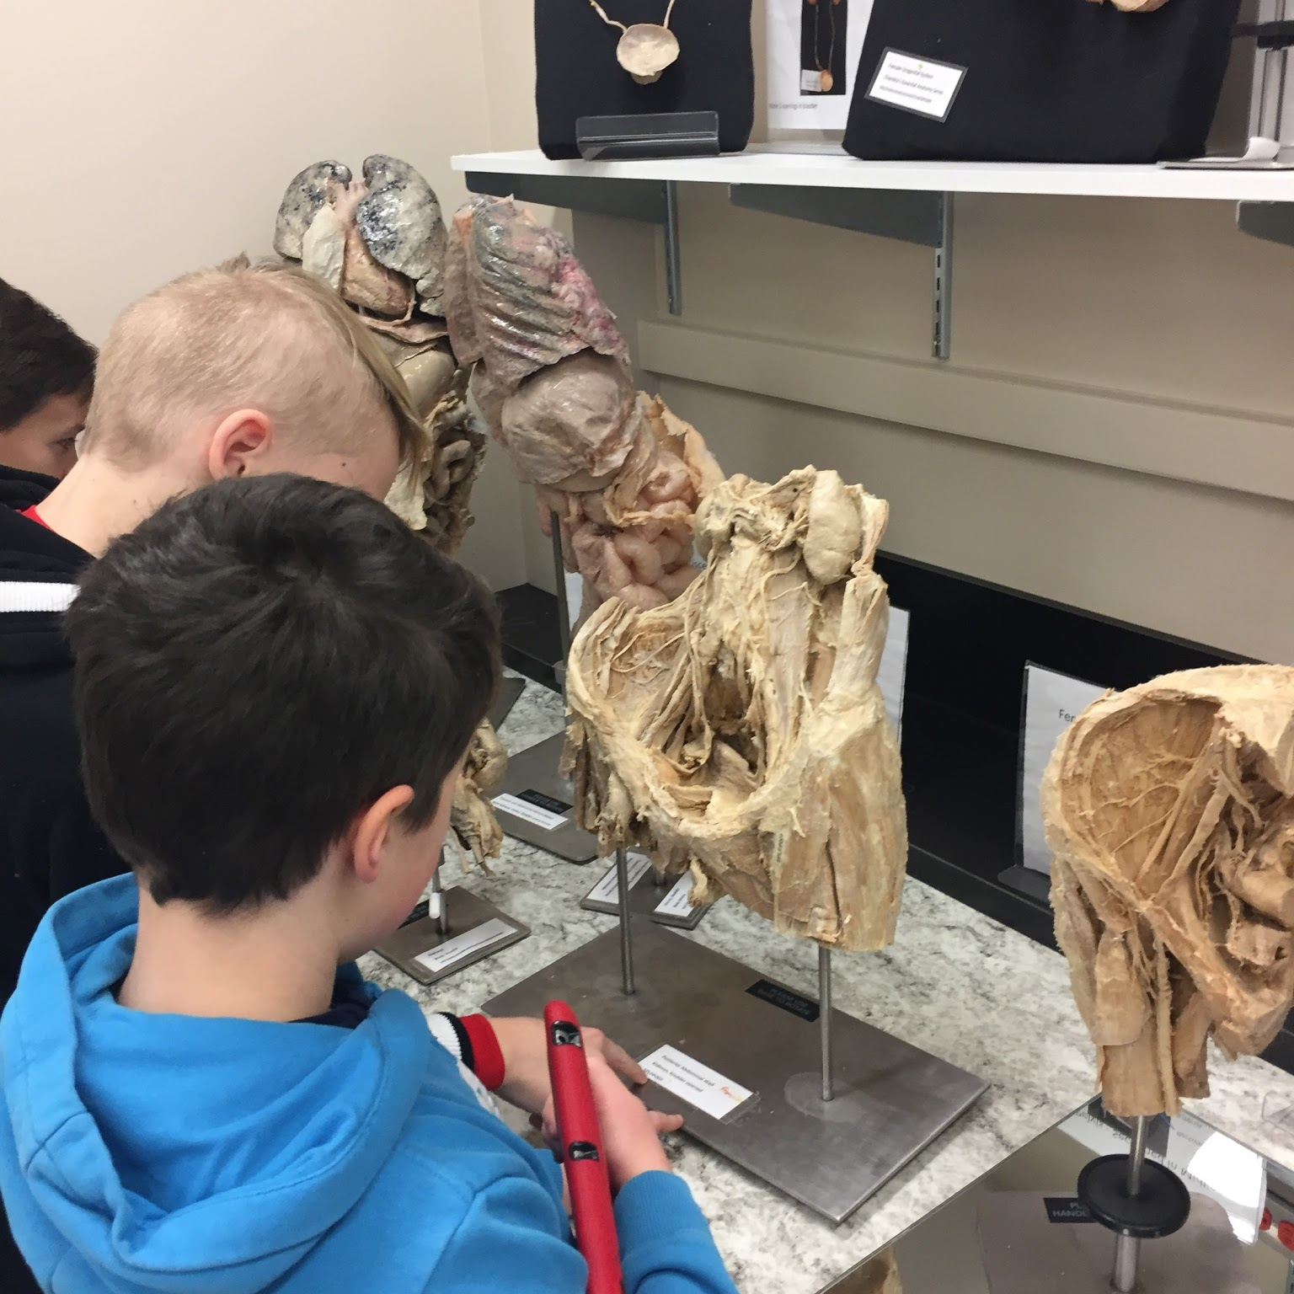
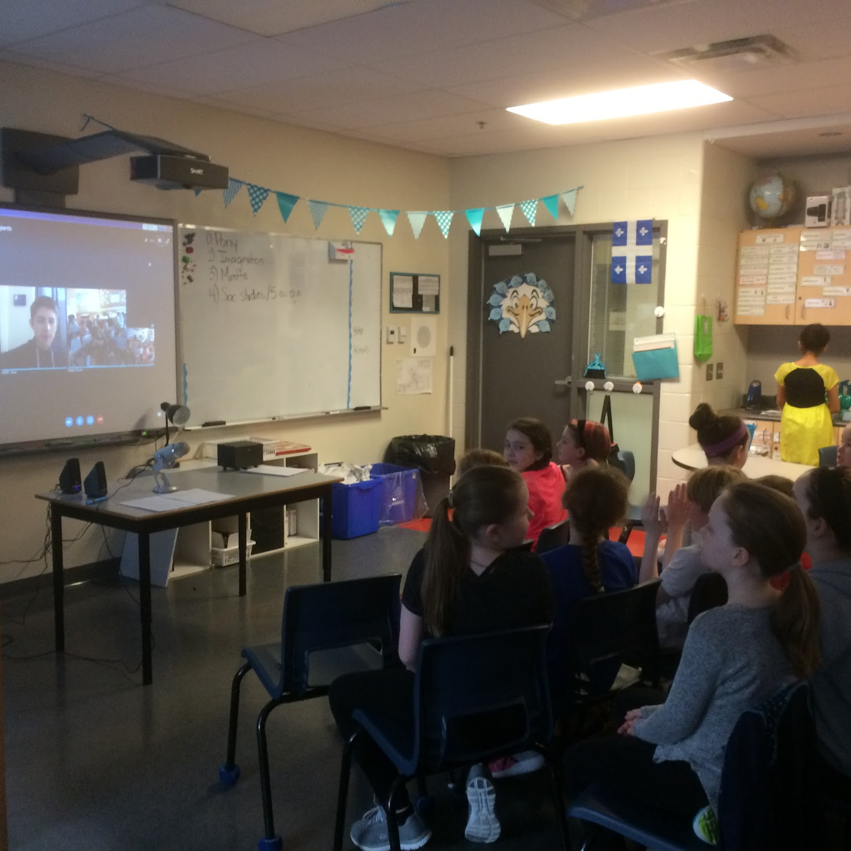
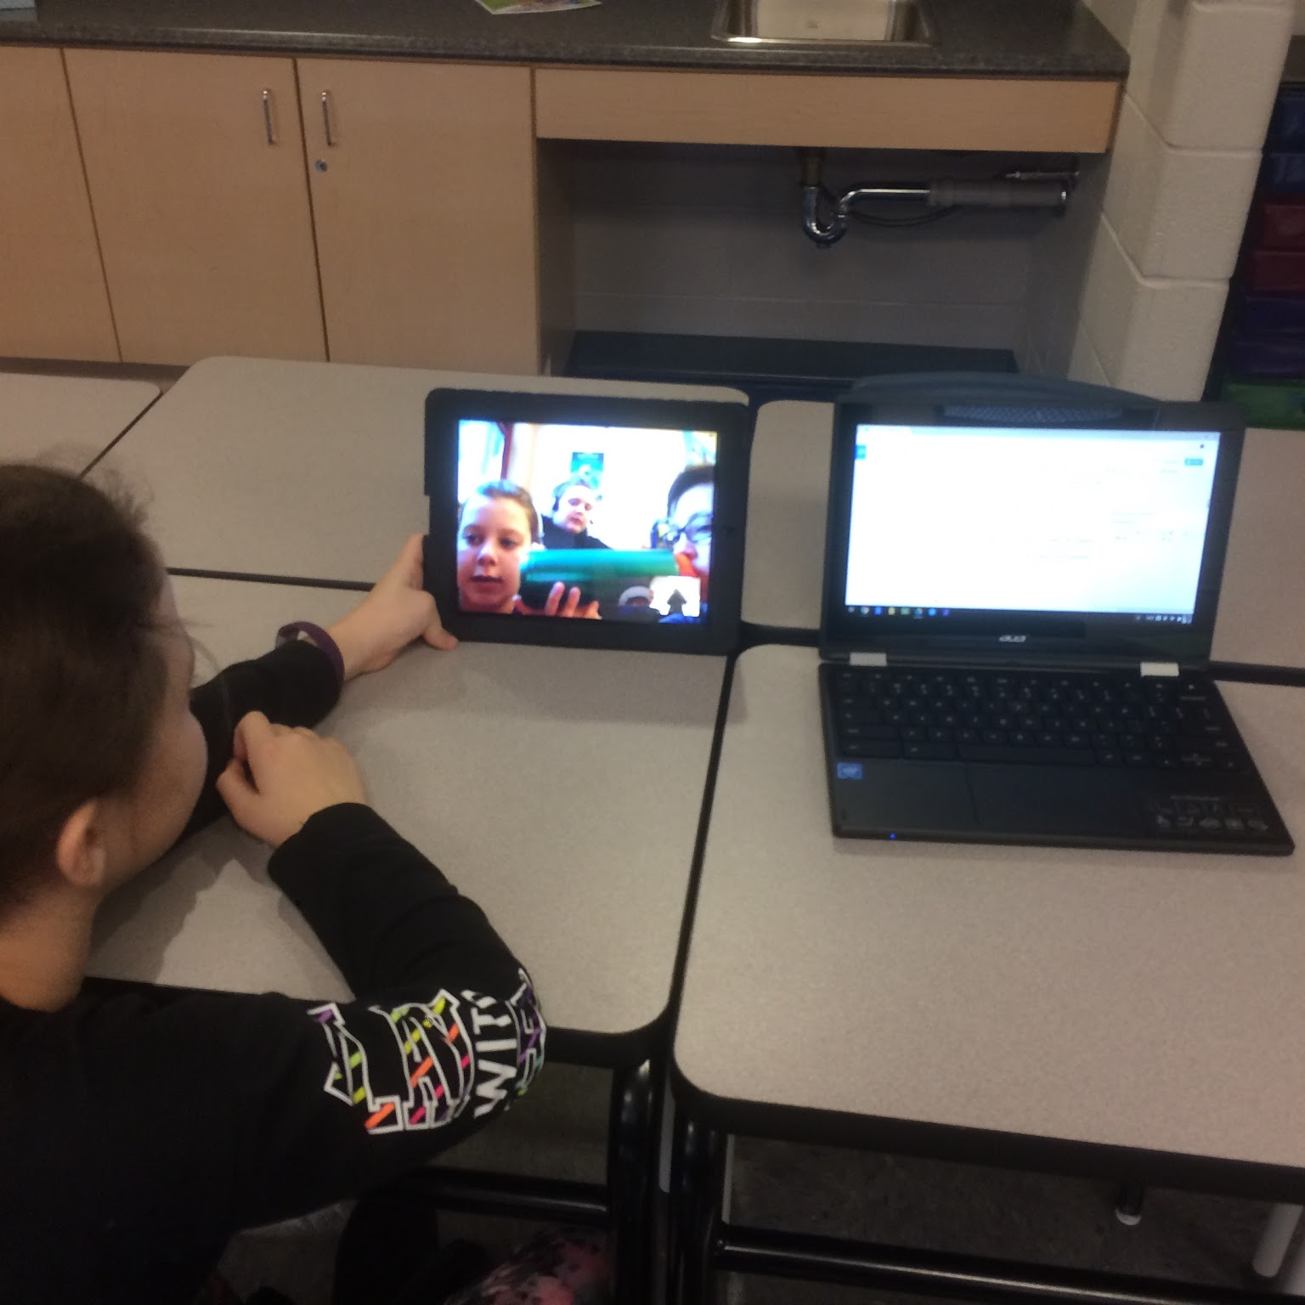
Population
The team
Answer the question, “Why are we the ones to solve the problem we identified?”
The student participants
Grade 5 Early French Immersion
Elizabeth Park Elementary, Paradise, NL
18 students
School population: approx. 600
Grade 5 Early French Immersion
Villanova Junior High, Conception Bay South, NL
20 students
School population: approx. 600

Slide 10
The team
Answer the question, “Why are we the ones to solve the problem we identified?”
Population
The teachers
Melissa Lee B.Ed
Grade 5 Early French Immersion
Elizabeth Park Elementary, Paradise, NL
5 years teaching experience
Megan Roome B.Ed., B.A.
Grade 5 Early French Immersion
Villanova Junior High, Conception Bay South, NL
4.5 years of teaching experience

Slide 11
Data Collection Tools
Digital data and traditional data collection methods used:
Teacher anecdotal notes
Photos
Videos
Pre-survey
Post-survey
Student Work Samples (journals, drawings, models/creations, online posts, digital presentations, etc.)
Student photos
Student videos

Slide 12
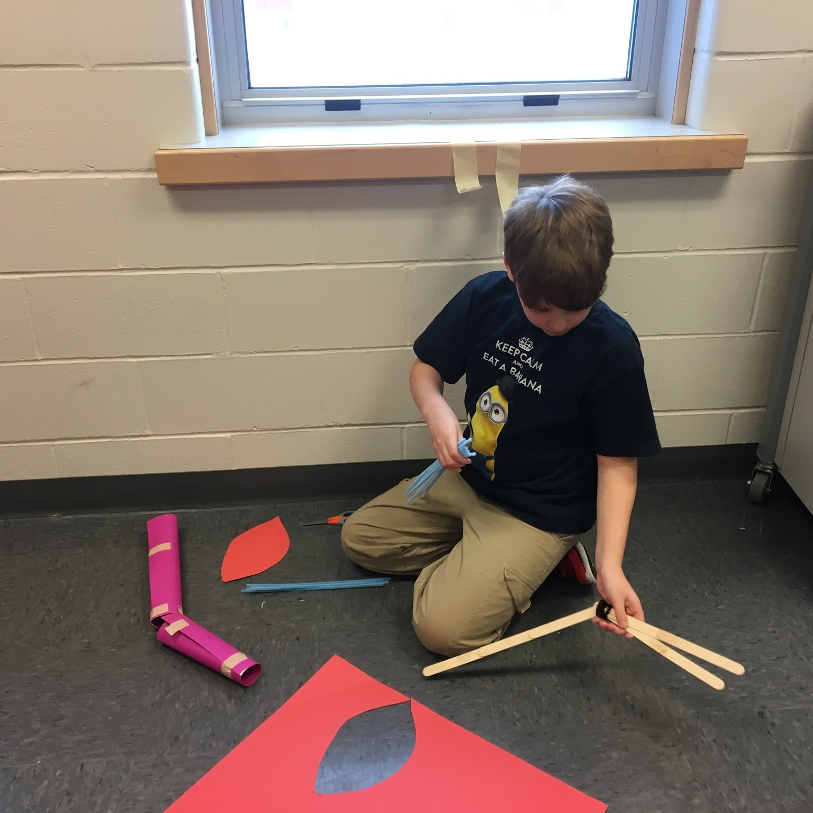
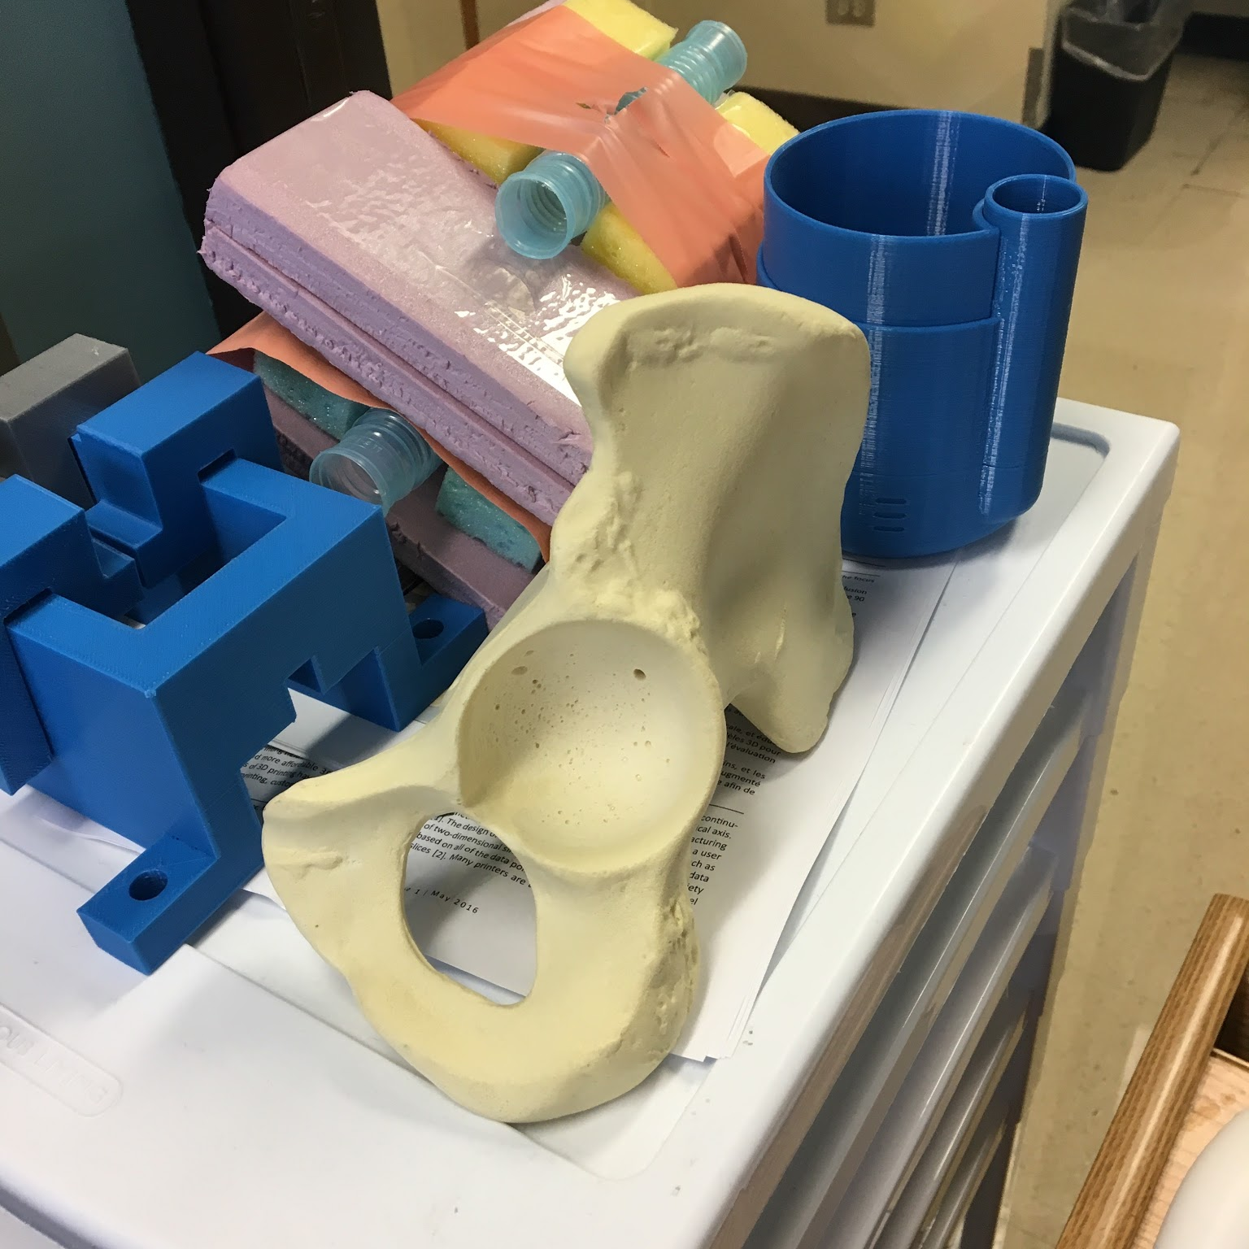
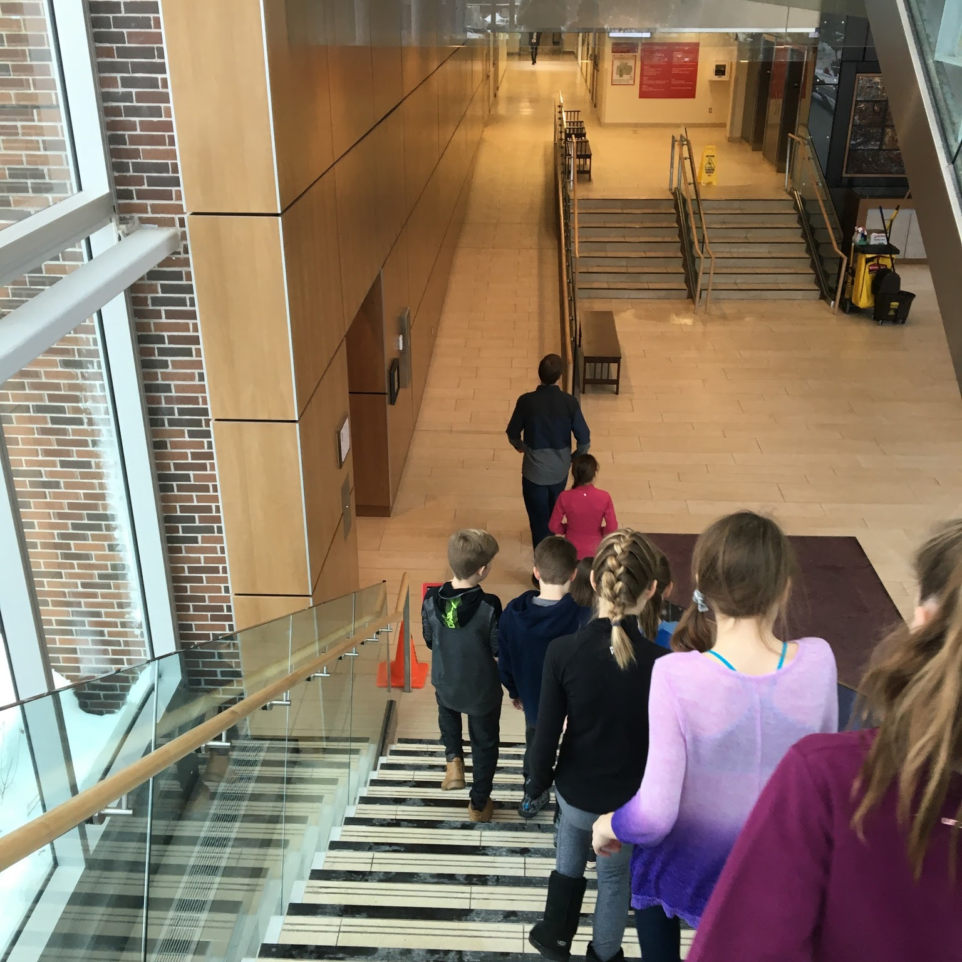
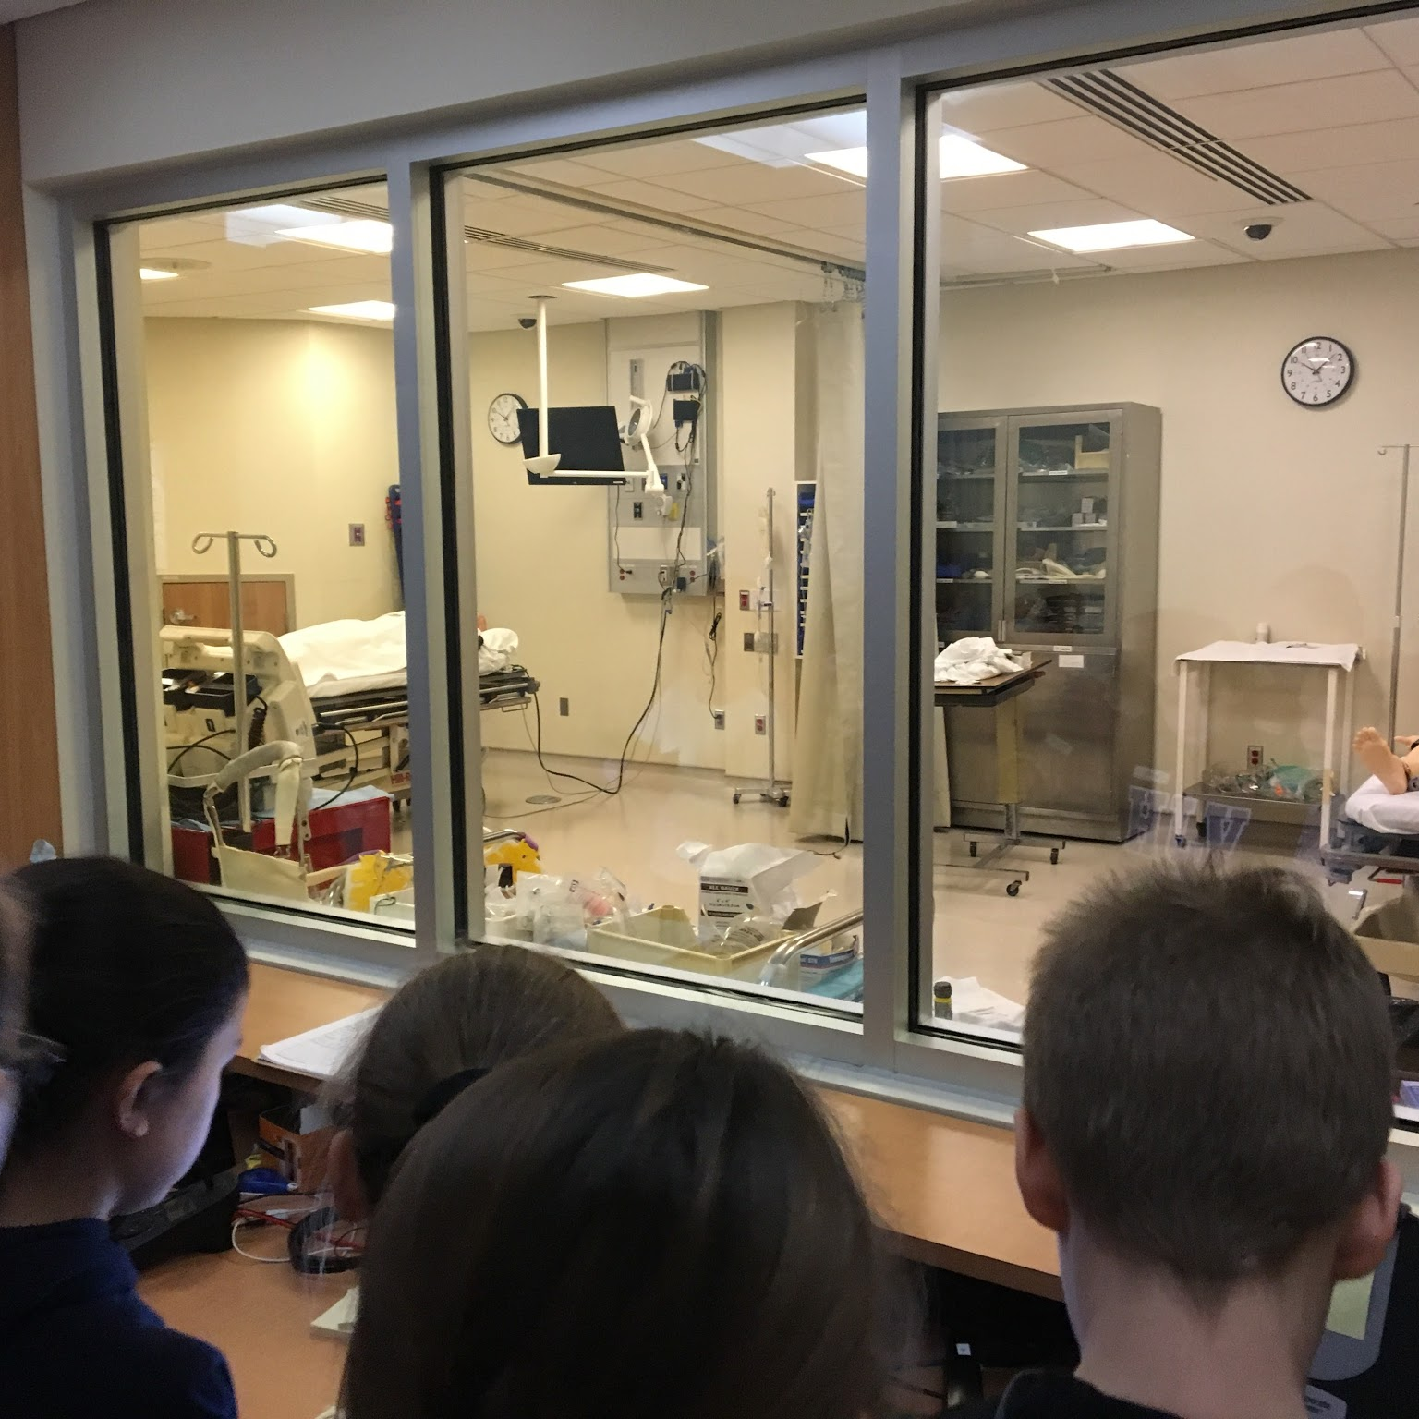
The team
Answer the question, “Why are we the ones to solve the problem we identified?”
Results
Student Learning-
Taking Ownership of their Learning
Students worked through frustrations, with one another, to solve real-life issues and problems. They were not used to having open-ended problems and initially struggled with so much freedom to express their learning and understanding. Students developed a stronger sense of responsibility and ownership during these processes.

Slide 13
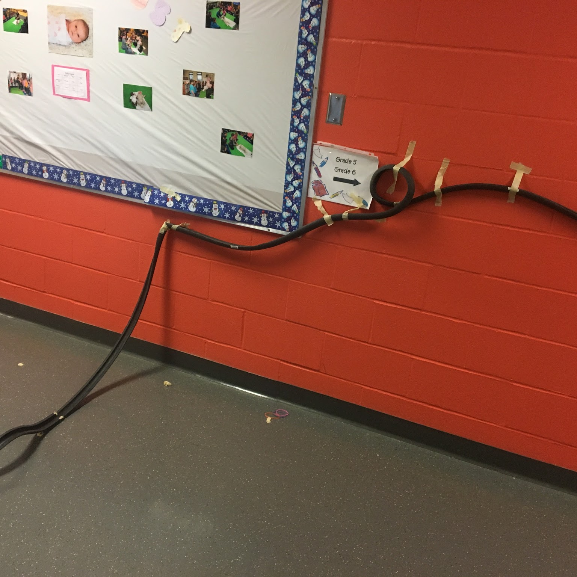
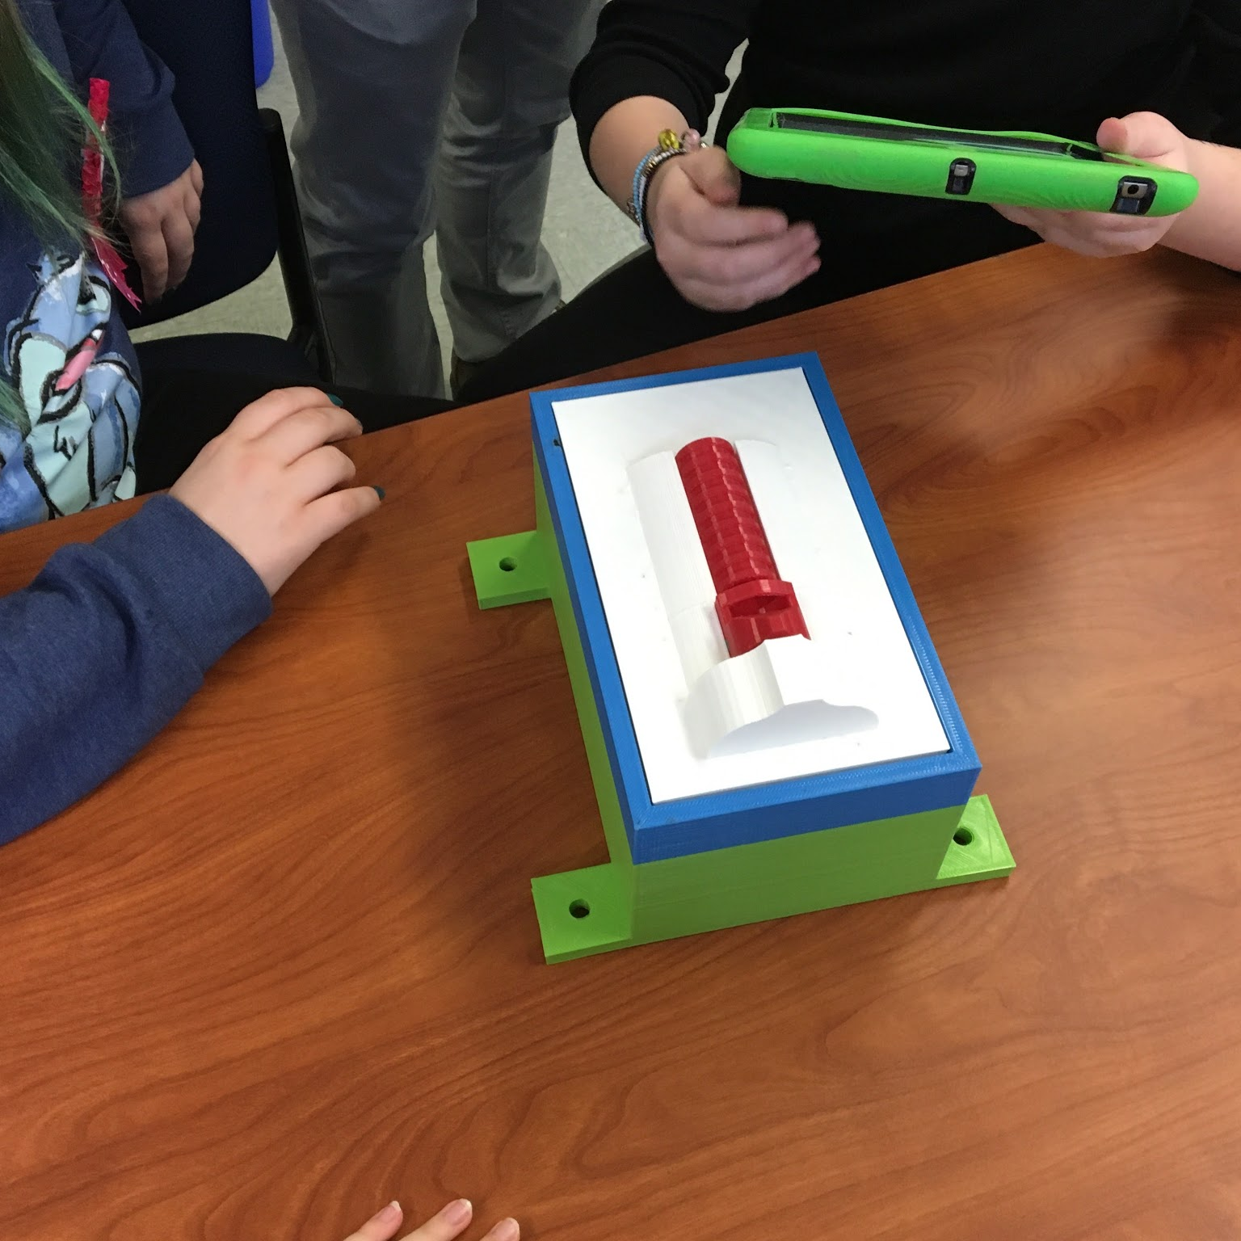
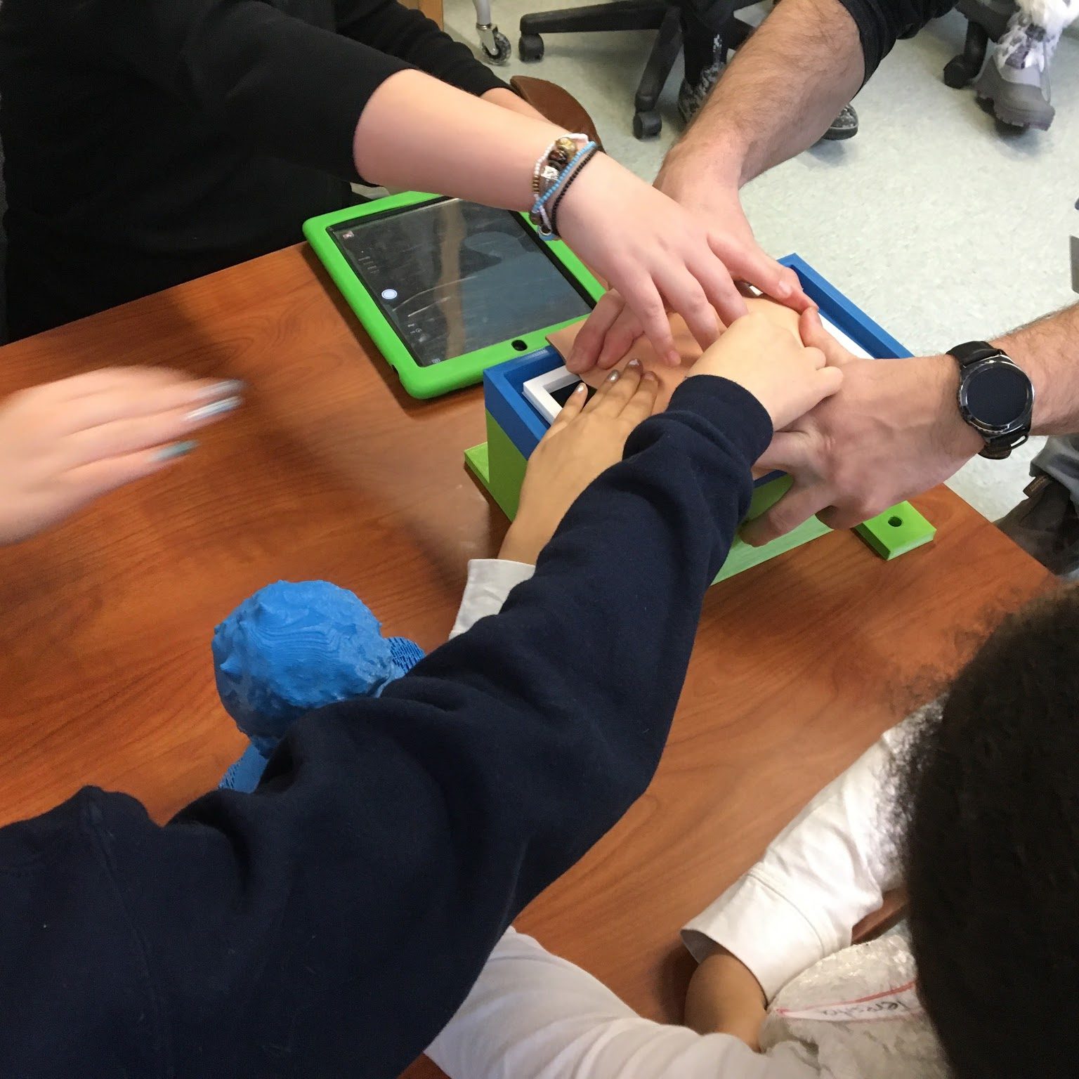
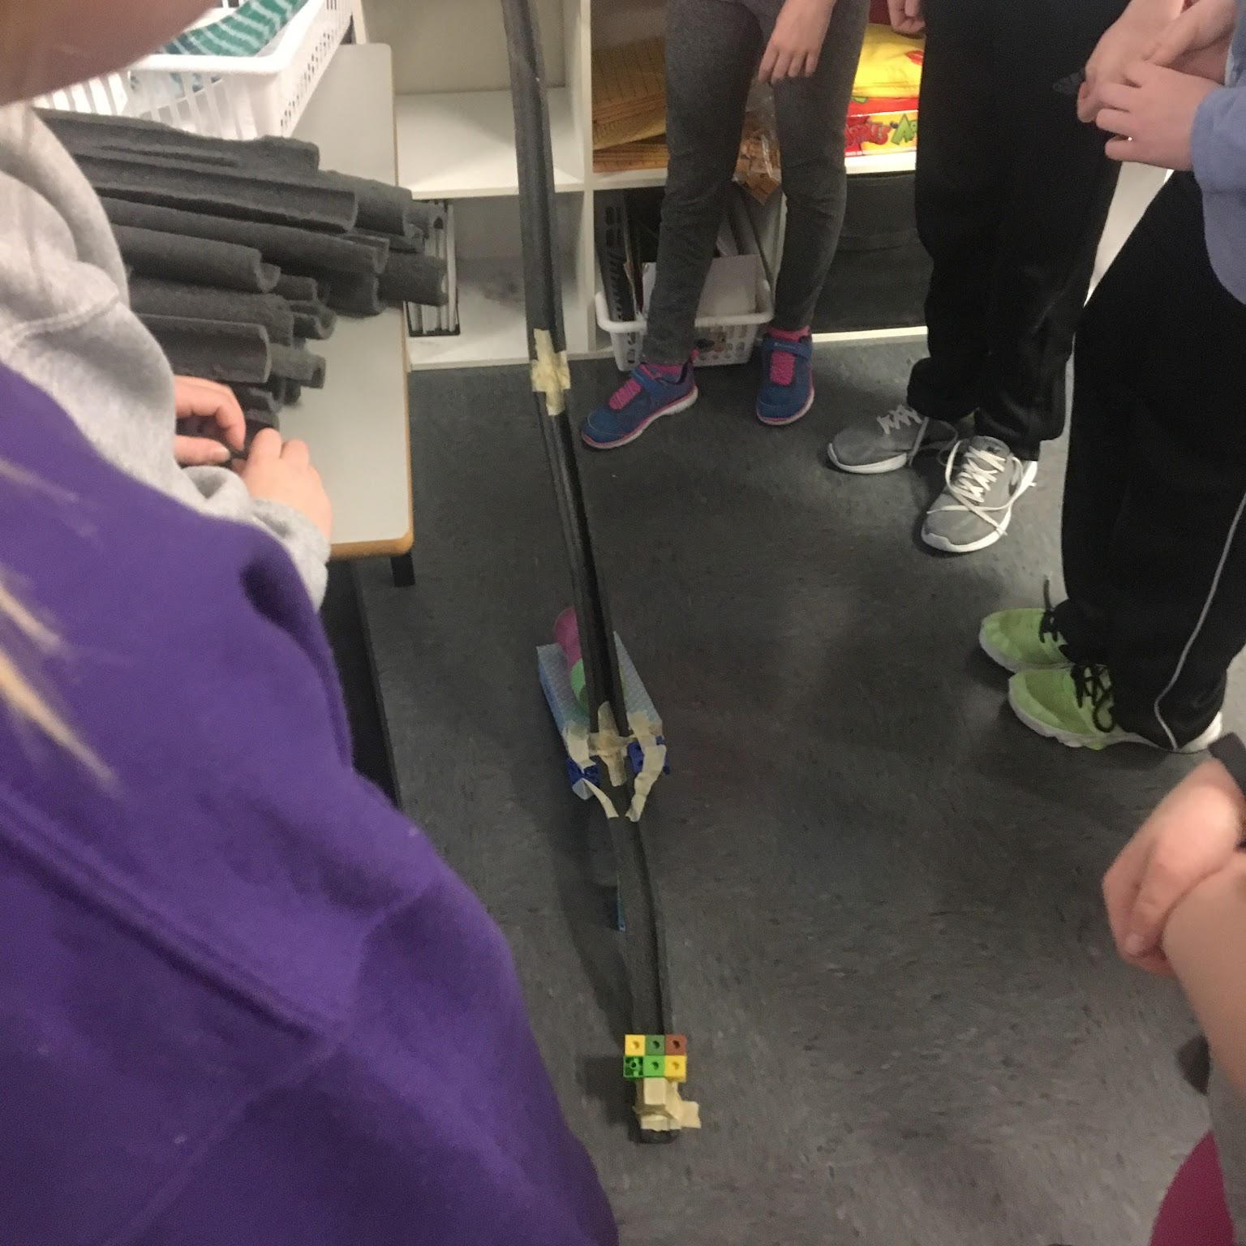
The team
Answer the question, “Why are we the ones to solve the problem we identified?”
Results
Student Learning- Problem Solving
An unexpected result of the increased student collaboration was that students developed more confidence in their own problem solving skills. If they experienced a road block during group work or other problem solving situations, they started to learn that they were very capable of attempting to “figure it out” rather than immediately seeking the help of the teacher.

Slide 14
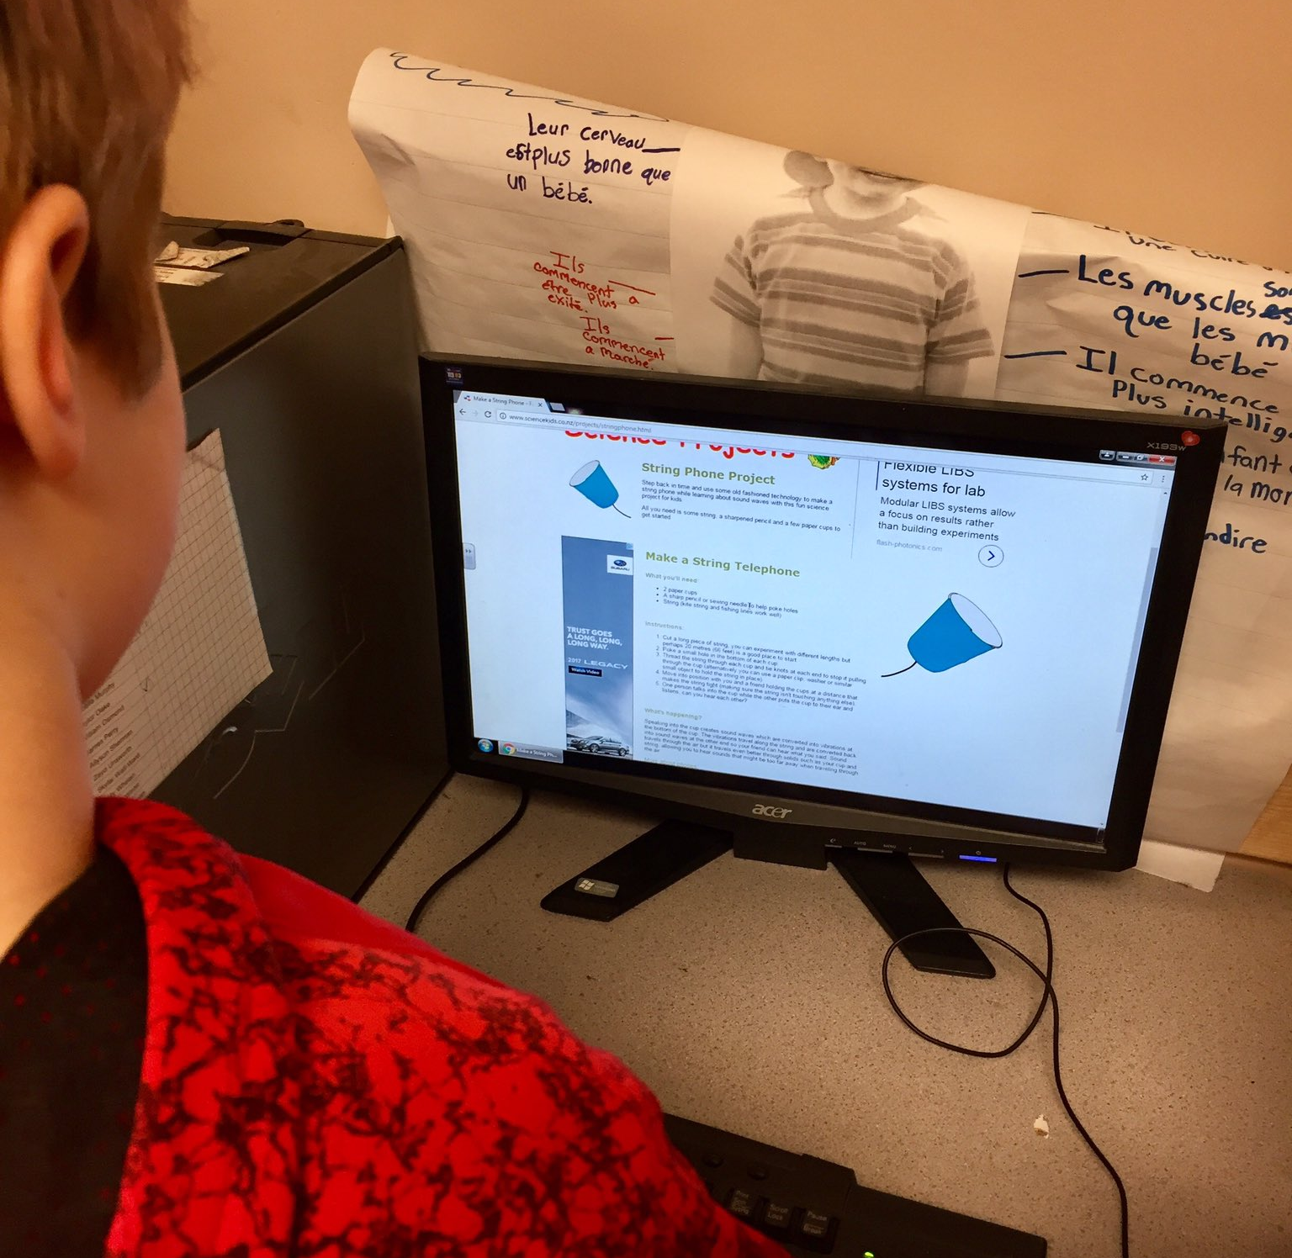
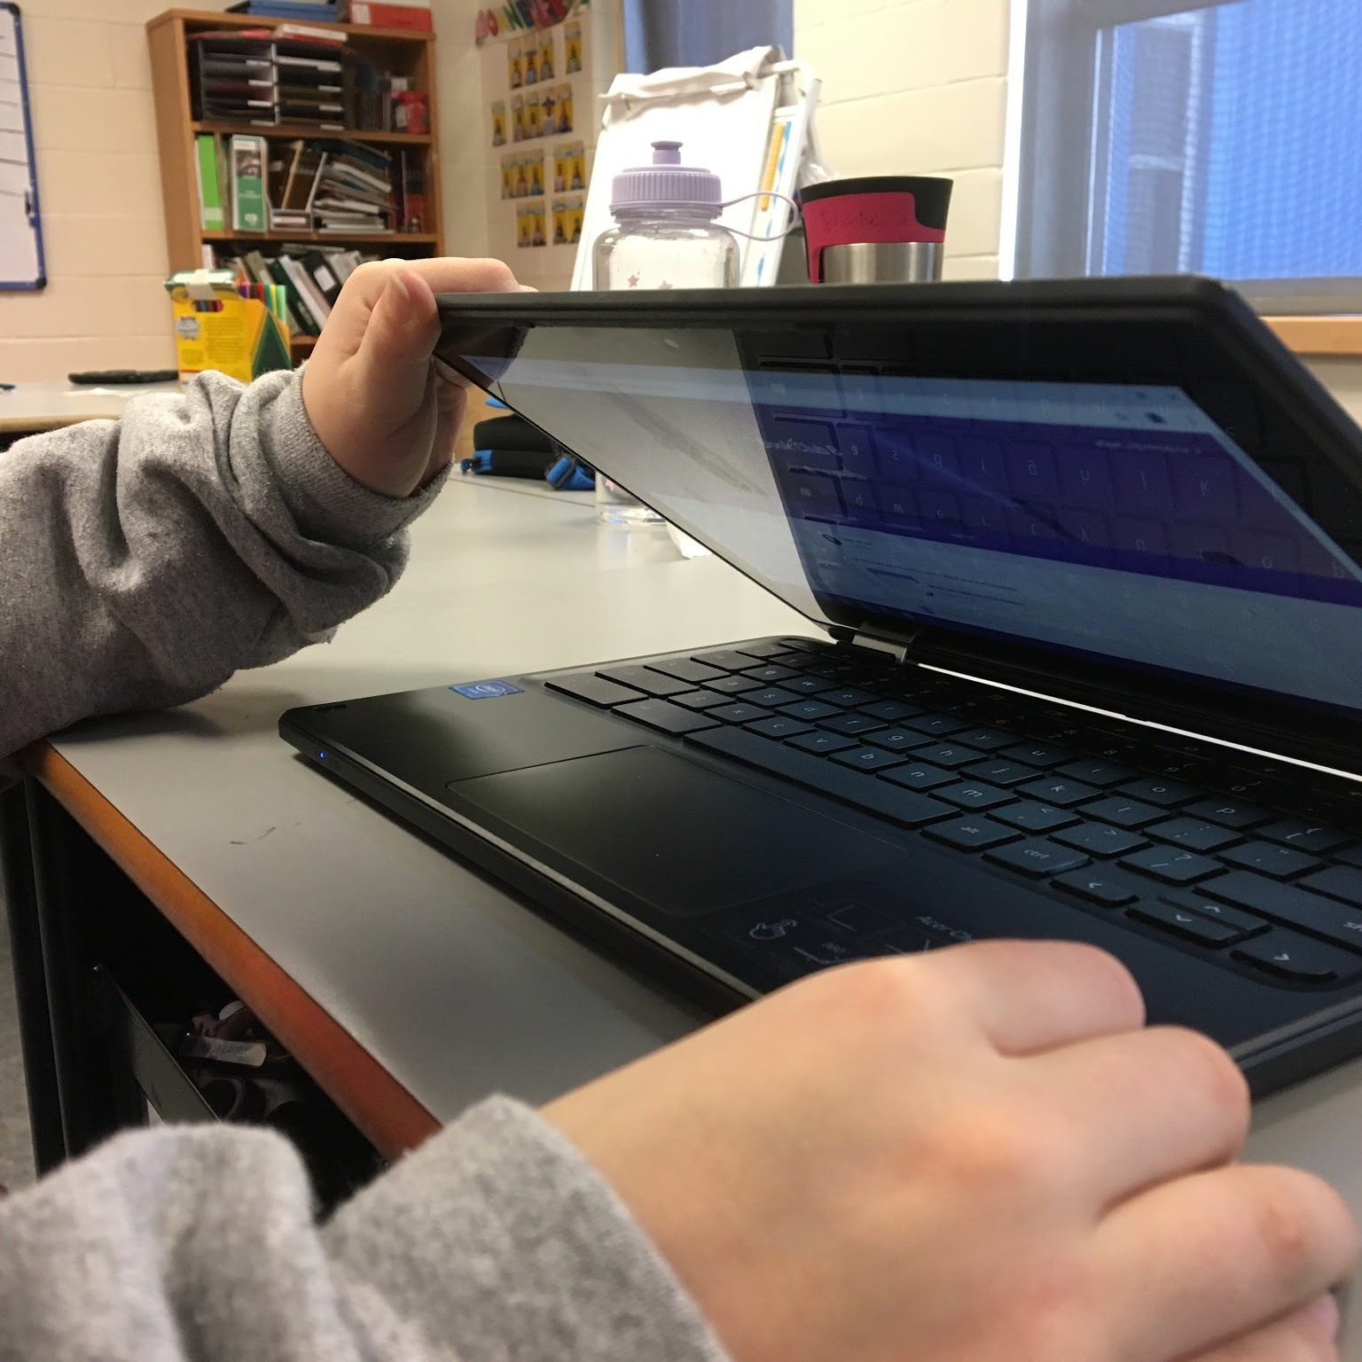
The team
Answer the question, “Why are we the ones to solve the problem we identified?”
Results
Student Learning- Perseverance
The project also helped foster student perseverance. With a device at their fingertips (usually Chromebooks) students were able to research and seek relevant information to feed their wonderings. Throughout the creation process of various projects students had to design, create, evaluate and redesign in order to best represent their understandings. Some students were overheard saying things such as, “I’m going to watch a whole bunch of videos about this, I could be wrong way more many times than I am right!”, and “I can find out the best materials to use online”.

Slide 15
Teacher Learning
Results
Allowing students to take on a higher level of responsibility and ownership in their learning was hard for us at first during the project, as it meant that we needed to give up the traditional control of their learning. After working through this feeling of being uncomfortable, students were showing higher levels of engagement which lead them to being more motivated. The objectives for the science unit are stretching to other areas of the curriculum and students who we would have considered to be academically weaker than the average student in traditional learning measures, are showing high levels of engagement and learning. Students in general are more engaged and motivated to learn.

Slide 16
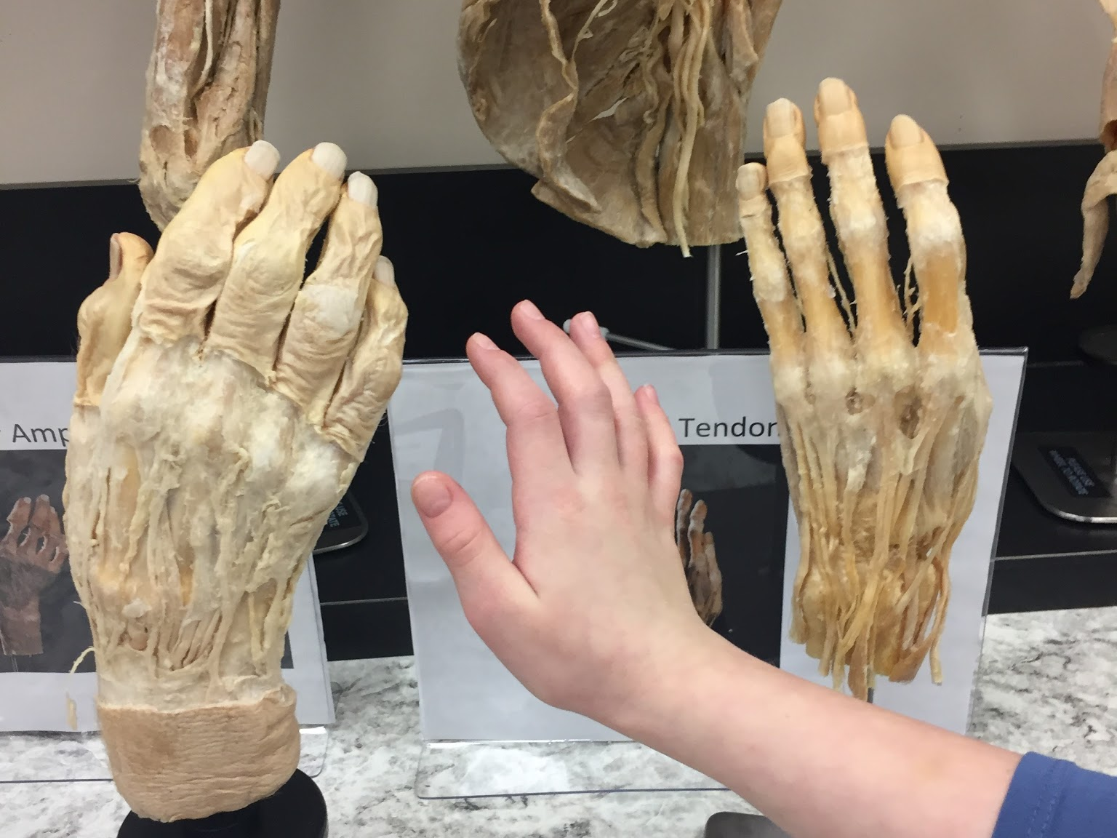
Discussion of the research
Student wonderings (I wonder…) developed throughout the study from more knowledge based questions (How many…, What is…, Where is…, etc.) to deeper analysis questions (How could…, Why might…, etc.).
Teacher modeling of question formulation was necessary in order for students to develop their own questioning skills.
Student participation in discussions grew with the use of Google Classroom and group collaboration.
Google Classroom and other G-Suite apps raised student engagement and focus as they had an outlet to showcase/share their work.
Authentic tasks increased student engagement and motivation.
Collaboration encouraged students to work past their frustrations and persist in problem solving situations.

Slide 17
Implications of the research
We intend to use the inquiry-based learning method and G-Suite applications in other areas of the Grade 5 curriculum. The higher level of engagement and motivation which resulted from the implementation was a positive change in the depth of learning in our classrooms and our students.
In the future, we will start the Body Systems unit by covering the nervous system, as the nervous system plays such a large role to all of the other body systems. Having a basic understanding of this system earlier in the unit will allow students to better formulate their understandings about the other body systems as they all link back to the nervous system. Establishing a common link between all the body systems at the beginning of the unit will hopefully incite more inquiry among the students as we progress throughout the rest of the unit.

Slide 18
Contact
Written by Melissa Lee:
The Effects of Inquiry-Based Learning and Cloud Computing on Student Motivation
Written by Megan Roome:
The effects of Inquiry-Based Learning and Cloud Computing on Student Motivation
Melissa Lee & Megan Roome
Grade 5 EFI Teachers
Elizabeth Park Elementary
Paradise, NL
Villanova Junior High
C.B.S, NL
melissalee@nlesd.ca
meganroome@nlesd.ca

Slide 19
References
Pellerin, M. (2011). University–school collaborative action research as an alternative
model for professional development through AISI. AISI Journal. 1(1). Retrieved
from https://www.uleth.ca/sites/default/files/AISI%20V1%201%201%20Fall%202011.pdf

