Slide 1
Increasing student engagement through online collaboration and a project based learning environment
Grade 7, 8 & 9
Holy Trinity High School

Slide 2
Why Code?

Slide 3
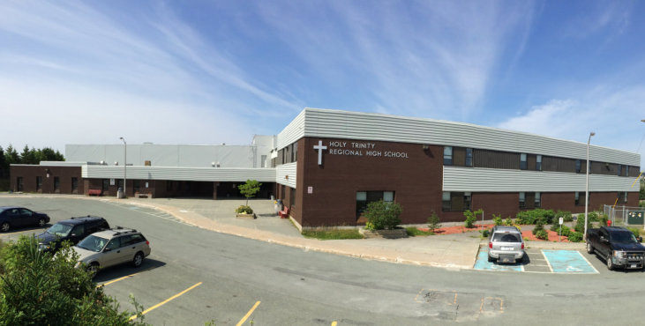
Holy Trinity High School
Notes:
Holy Trinity High School is located in Torbay,NL and serves the communities of the Bauline, Flatrock, Pouch Cove, and Torbay Currently, the school has a population of approximately 785 students with 48.5 teachers and 10 support staff. Our school offers a diversified educational program for students of all abilities from Grade 7 to Level III in both English and French Immersion streams.

Slide 4
Background information

Slide 5
Kerri Mercer
Began her teaching career in 2012
Joined HTH in 2014
Junior High French Immersion Science and Core French.
B.A (French Major, Math Minor) at Memorial University
B.Ed (Intermediate/Secondary) at Memorial University.
M.Ed in Curriculum Teaching and Learning at Memorial University.
Notes:
Began her teaching career in 2012 and joined HTH in 2014. Kerri has taught mostly Junior High French Immersion Science and Core French. Currently she teaches French immersion Science in Grade 8 & 9 as well as Core French (9, 1200). She completed a B.A (French Major, Math Minor) at Memorial University and went on to complete a B.Ed (Intermediate/Secondary). She recently completed M.Ed at Memorial in Curriculum Teaching and Learning.

Slide 6
Matthew Grant
Started teaching in 2010
Joined HTH in 2012
Was incorporated into the TIA 2017
Science, Robotics, Occupational Health & Safety and Calculus
B.Sc Math at Memorial University, D. Met at Dalhousie
B.Ed (Intermediate/Secondary) at Memorial University.
M.Ed in Information Technology at MUN/CBU

Slide 7
Glenn Normore
Started his teaching career in Nain, Labrador in 1979.
Junior High level most of career
Currently: Grade 8 Math and Science
Received Prime Minister’s Award for Teaching Excellence
Older that Matt and Kerri combined :-)
Notes:
Started his teaching career in Nain, Labrador in 1979. Most of his teaching career has been at the junior high level which he finds energizing. Currently he is teaching Grade 8 Math and Science and Robotics 3205.

Slide 8
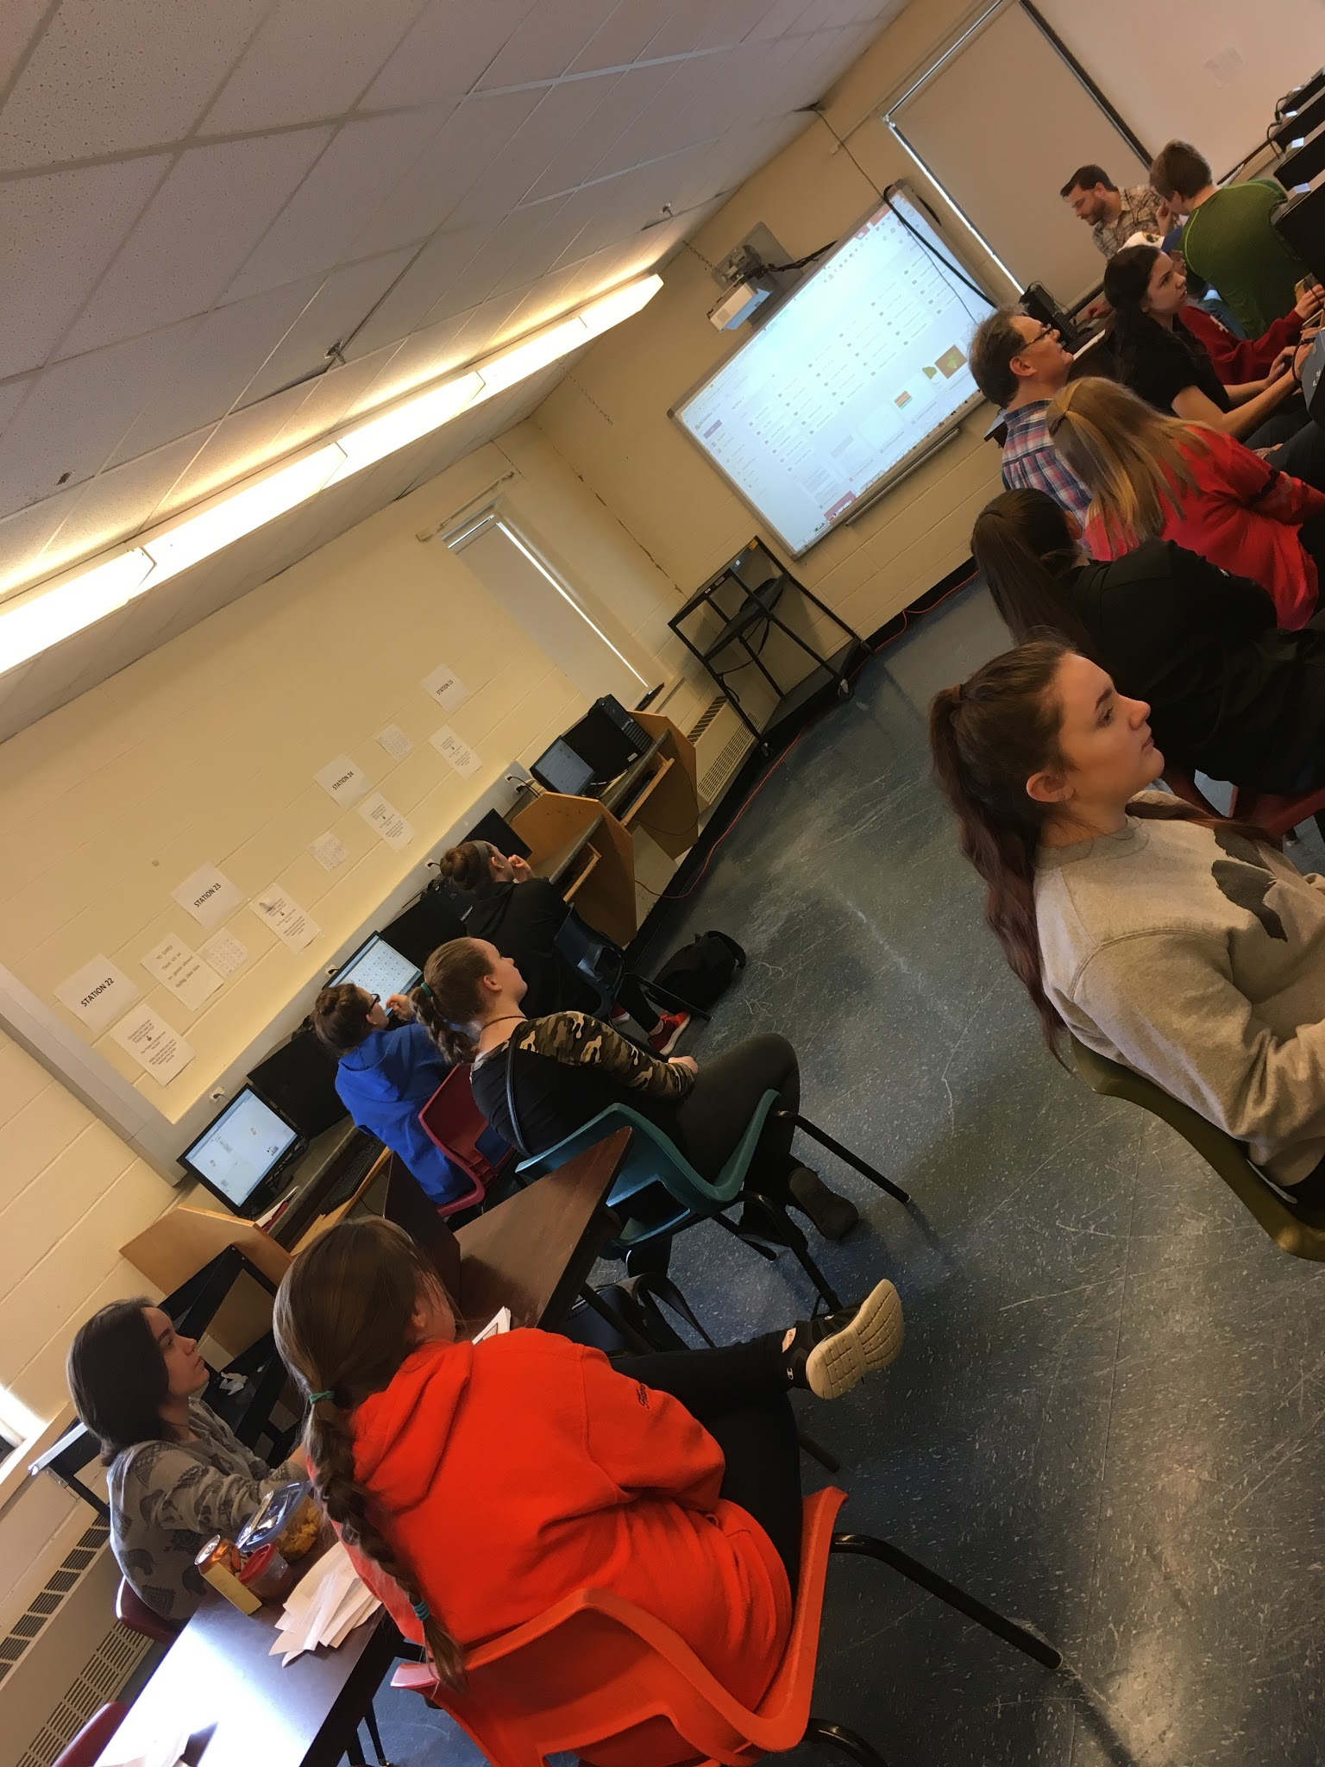
Our Classrooms
Students for our project came from our Grade 7, 8 and 9 Science and Math classes.
Group size : 20 students
Diverse backgrounds.
Notes:
Students from our grade 7, 8 and 9 science and math classes participated in this project. OUr groupd of students consisted of 20.
Students were of diverse backgrounds.

Slide 9
Our Beliefs
Learning should be fun for both the teacher and learner.
Success= finding meaning and purpose.
We believe in offering students authentic learning opportunities that can extend beyond the prescribed curriculum outcomes and create an interest in science and technology.
Notes:
Education can be fun for both the teacher and learner. As this can look like many different things depending on the student, it is often difficult to reach every student in the class (to keep them motivated). In order for successful learning to occur students need to find meaning and purpose in what they are doing in each subject.

Slide 10
Our Reasoning
We all share a common interest in creating a classroom where students explore and discover science collaboration and exploration.

Slide 11
Focus Area

Slide 12
Our Focus
To engage students, introduce them to and nurture interest in programming.
To scaffold learning toward more complex projects.
To use online learning communities for students to work collaboratively to grow and sustain interest in computer programming.
Notes:
Teacher outcomes: to engage students, introduce them and nurture and interest in programming. To scaffold learning toward more complex projects. To use online learning communities to grow and sustain interest in computer programming.

Slide 13
Our Focus and Why
Focus:
Engagement in online learning community and project based learning.
Why:
All three teachers involved are concerned with students not only being able to achieve in Science, but wanting to nurture interest and engagement in science for years to come.

Slide 14
“When students are invited to take part in the learning process from start to finish, they experience a sense of agency and responsibility for their learning, an approach that lends itself to greater student engagement and intrinsic motivation” (Ryan & Deci, 2000).

Slide 15
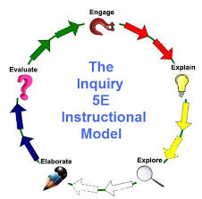
Resources that helped us narrow our focus
Science Scope : 5 E’s
Notes:
Science Scope which modelled the 5 E’s that we used in many of our activities. We also researched online, textbooks for ideas on interactive labs and especially for the aquaponics. We also gained ideas from previous projects on the TIA website and from our meetings with Tom Walsh which helped us understand and focus our ideas.

Slide 16
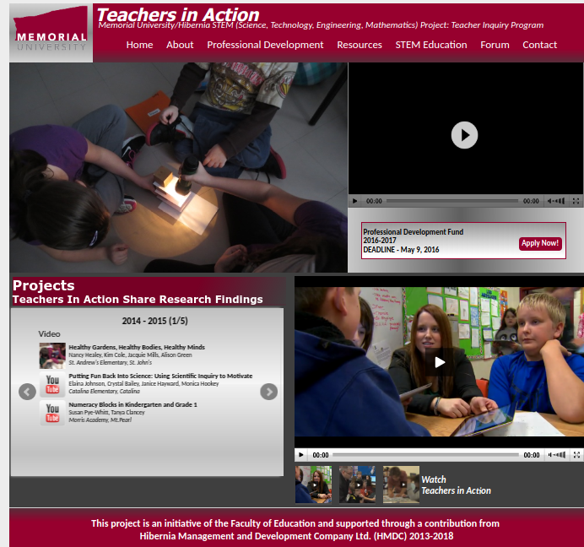
Resources that helped us narrow our focus
TIA website & meetings with Dana Griffiths
Notes:
We also gained ideas from previous projects on the TIA website and from our meetings with Tom Walsh which helped us understand and focus our ideas.

Slide 17
Aligning our project with school based work/research
Science curriculum
extended activities.
Sci: 211-2 communicate questions, ideas, intentions, plans, and results, using lists,notes in point form, sentences, data tables, graphs, drawings, oral language,and other means.
211-3 work cooperatively with team members to develop and carry out a plan, and troubleshoot problems as they arise
Notes:
The coding and online learning community allowed our students to develop strong collaborative skills by communicating their questions, ideas, results through Google classroom. They were given the opportunity to work cooperatively with team members to develop and carry out their projects.

Slide 18
Research Questions

Slide 19
Research Questions
Teacher: How can I engage students in science/coding and develop or nurture an interest in science/programming?
Student: How will student engagement develop during project-based learning?

Slide 20
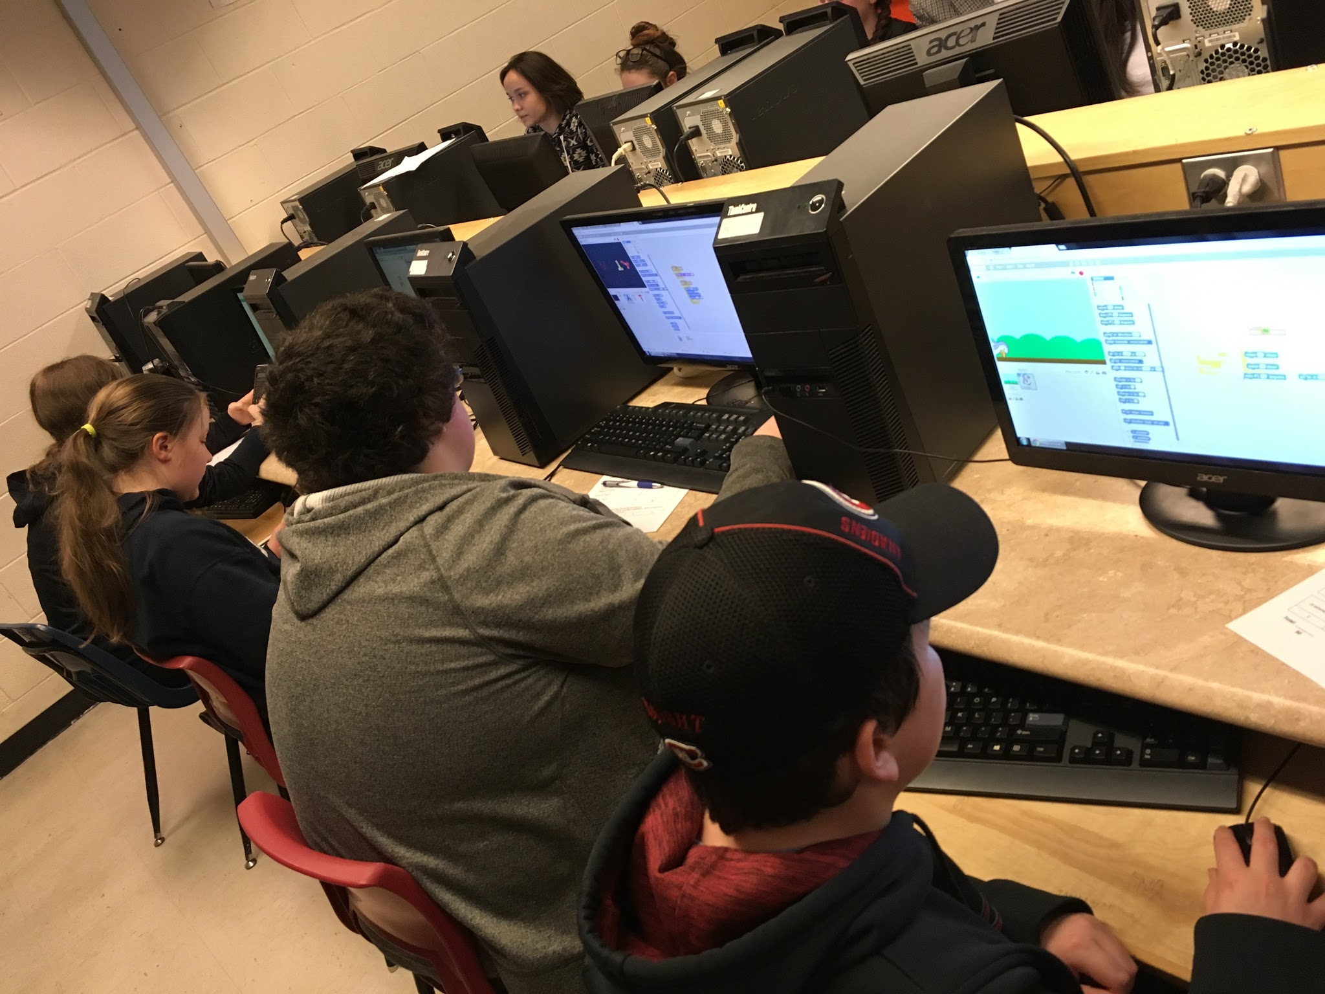
Research questions
Teacher sub-questions:
How will I structure my pedagogy to scaffold towards more complex project work while encouraging engagement using PBL in my learning environment?
How can community resources (parents, advisors, experts) partner with HTH to improve teaching and learning?
Will online learning communities (OLC) grow and sustain an interest in computer programing.
Notes:
While our research questions remained front and center throughout the project there were more questions that evolved from inquiry instruction that made us question the value and probably reach a deeper understanding of the pedagogy inherent in inquiry and its value in teaching and learning.
How will I structure my pedagogy to scaffold towards more complex project work while encouraging engagement using PBL in my learning environment?
How can community resources (parents, advisors, experts) partner with HTH to improve teaching and learning?
Will online learning communities (OLC) grow and sustain an interest in computer programing.
We did consider these questions but always returned to our goal as science teachers to develop thinkers, improve questioning techniques, help students explore their world rather than memorize facts. Believing that student centered learning environments and peer collaboration helps learner. Students have to engage to learn and if the activities relate to that exploration and support the learning then student interest and engagement will increase. ”

Slide 21
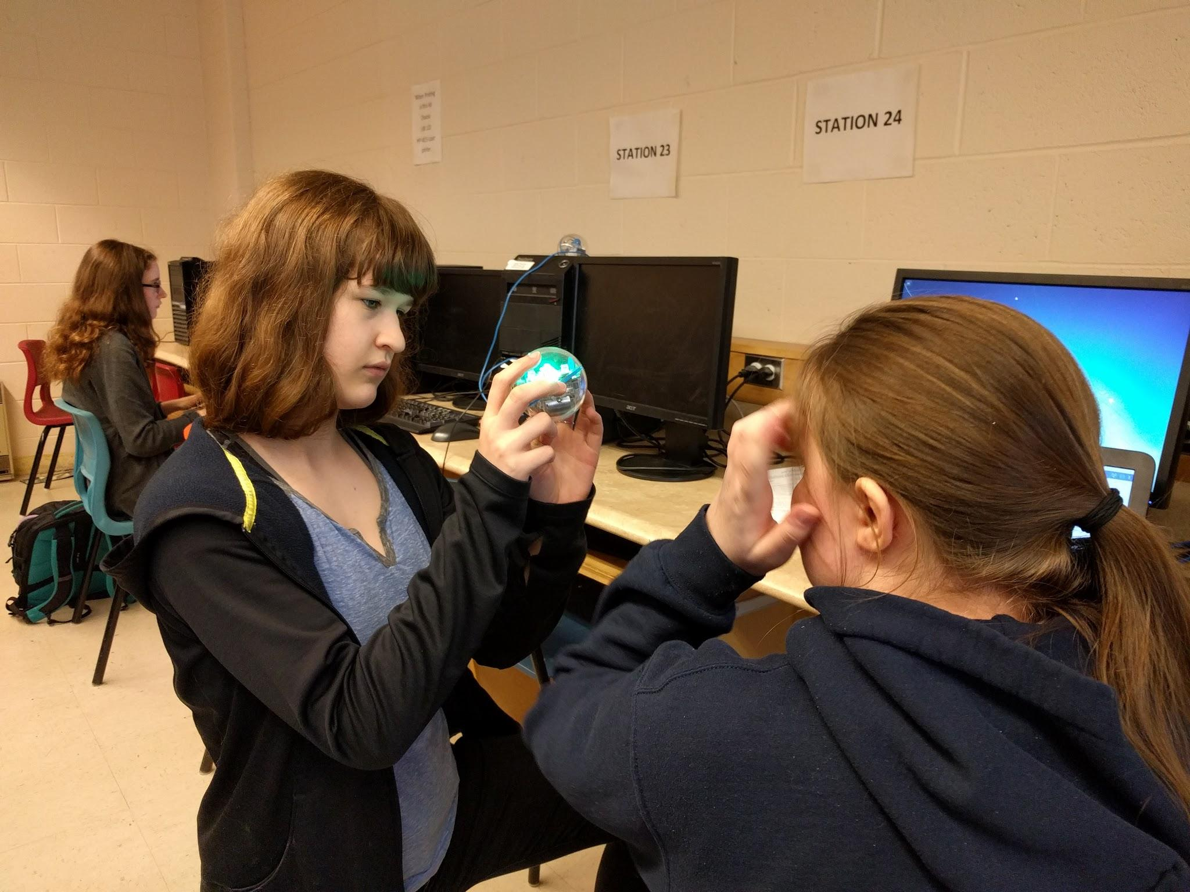
Research questions
Student sub-questions:
How will student engagement grow during coding activities as a member of an online learning community? (conversations, collaborations during activities; extensions)
Will the growth of student engagement lead to more interest/engagement in more complex coding projects?

Slide 22
Did Questions Change?
Questions evolved that made us question our pedagogy.

Slide 23
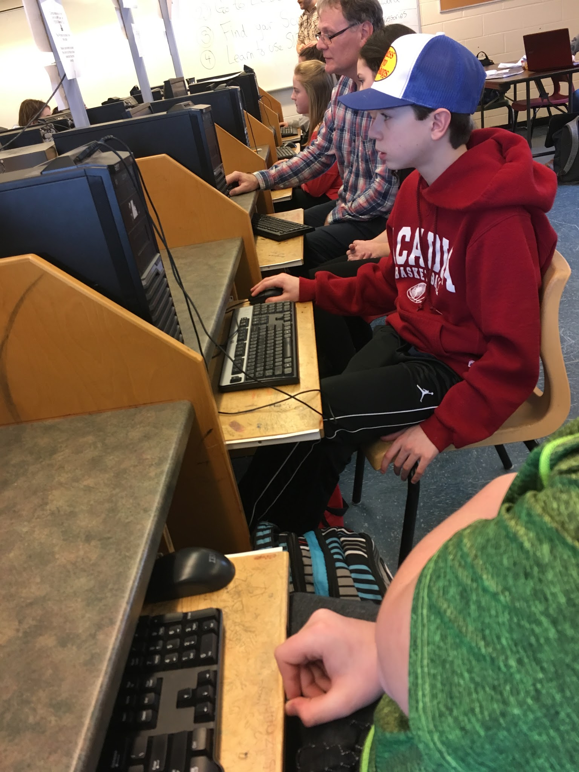
How can we encourage or promote more online collaboration between students?
Notes:
Online chatter improved by taking students to the lab and directing them to ask questions online...there seemed to be a greater fear than anticipated for asking questions online. Some students may have been afraid of seeming incompetent or risk-averse.
Practice practice practice….seems students have to be scaffolded - as expected but also rehearsed under supervision and praised for the behaviour…..encouraging students to THANK their online support was also a positive move
Scaffolded some communication procedures like posting by copying the project url in comments as well as linking the project’s url to the posting…..positive results
We also had them together but did not permit or at least encourage face-to-face chatter….students posted more and it was better

Slide 24
Do extended activities deepen understanding at the expense of meeting curriculum requirements?
Notes:
REMOVE?

Slide 25
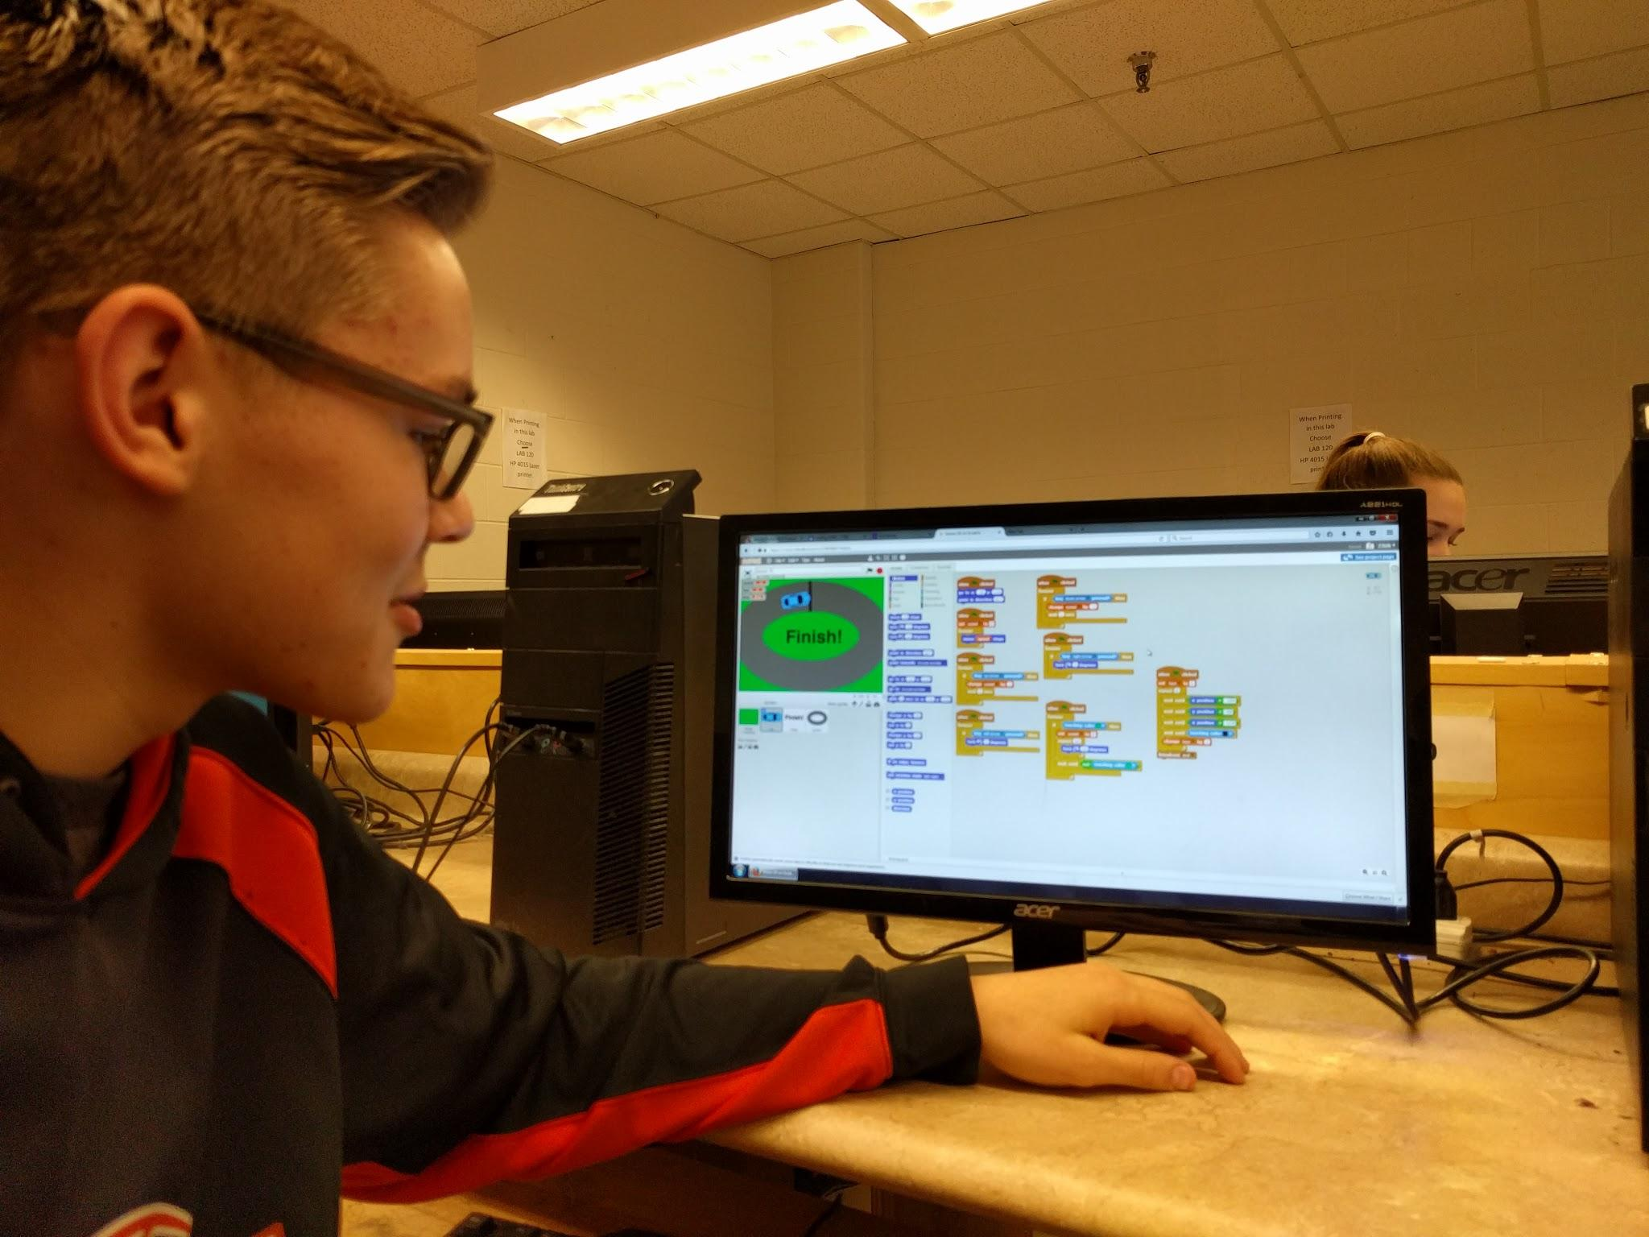
Will the project-based component of our research - coding - appeal to a wide range of students or just the students who see themselves as ‘science stars’?

Slide 26
Ethical Considerations

Slide 27
Introductions and communication
Parent teacher interviews
Emails
Consent forms
Personal websites,
Google Classroom
Twitter @sciencemercer , @GlennNormore, @MrGrantTweeting
Notes:
During parent teacher night at school we introduced parents to our plans and distributed consent forms to our parents. We extended an invite to our students to participate in this project. On our personal websites, Google Classroom and through Twitter we shared pictures and videos of students daily activities and learning. @sciencemercer , @GlennNormore,

Slide 28
Introductions and communication
Students joined both of our Google Classrooms.
One focused on “Lessons” and scaffolded lessons for students.
The other was “Coding Chat” where students could collaborate in the online learning community.

Slide 29
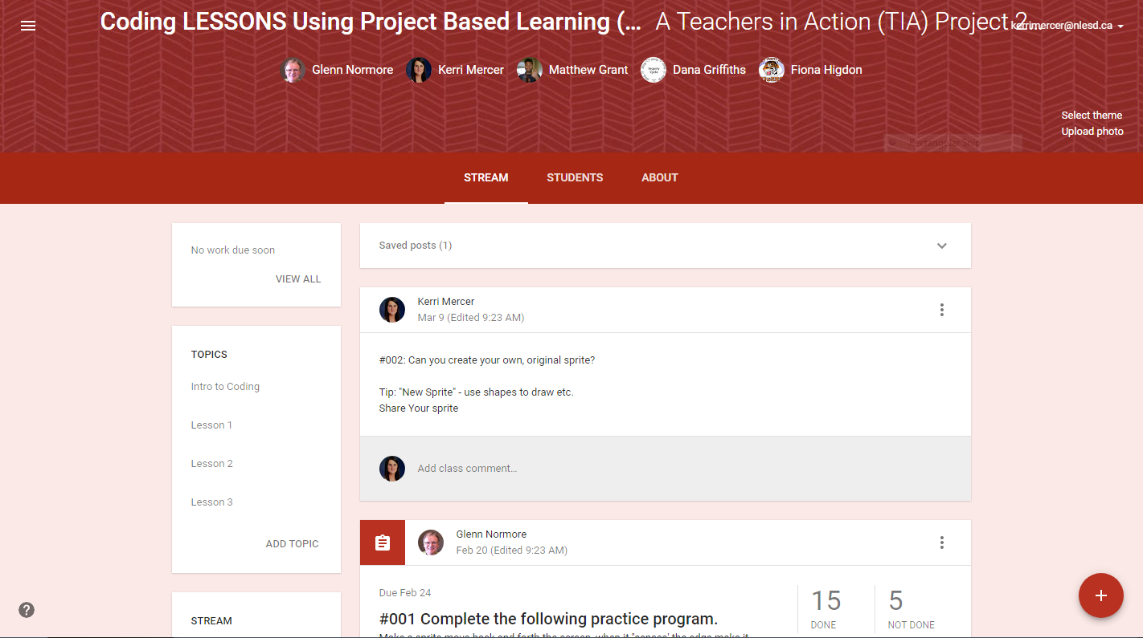
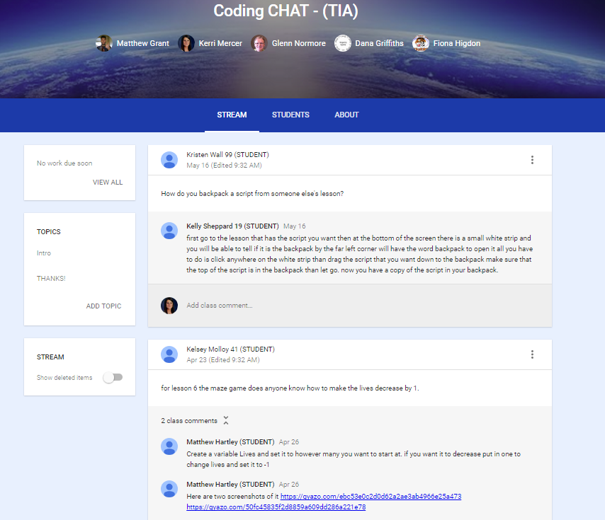

Slide 30
Permissions
Permissions forms
A parent information letter and consent
Notes:
Permissions forms were sent home for parents to sign, giving consent for their child to be interviewed and video recorded for Memorial University. A parent information letter and consent form was sent home to be signed giving permission for teachers to document students and their work.

Slide 31
Planning

Slide 32
Planning Activities
Dana Griffiths
Articles and websites
Discussions
Experiences and backgrounds throughout our careers.
Notes:
Met with Dana Griffiths to discuss our plan. She guided us through the planning and implementation process. We were provided articles and websites to visit and see how others have taken on such tasks. Discussions to ensure we met our goals or the project. Through our discussions we each had ideas and activities to share that we have experienced throughout our careers. Each of us have different backgrounds and experiences, these experiences allowed us to create scaffolded lessons and collaboration methods

Slide 33
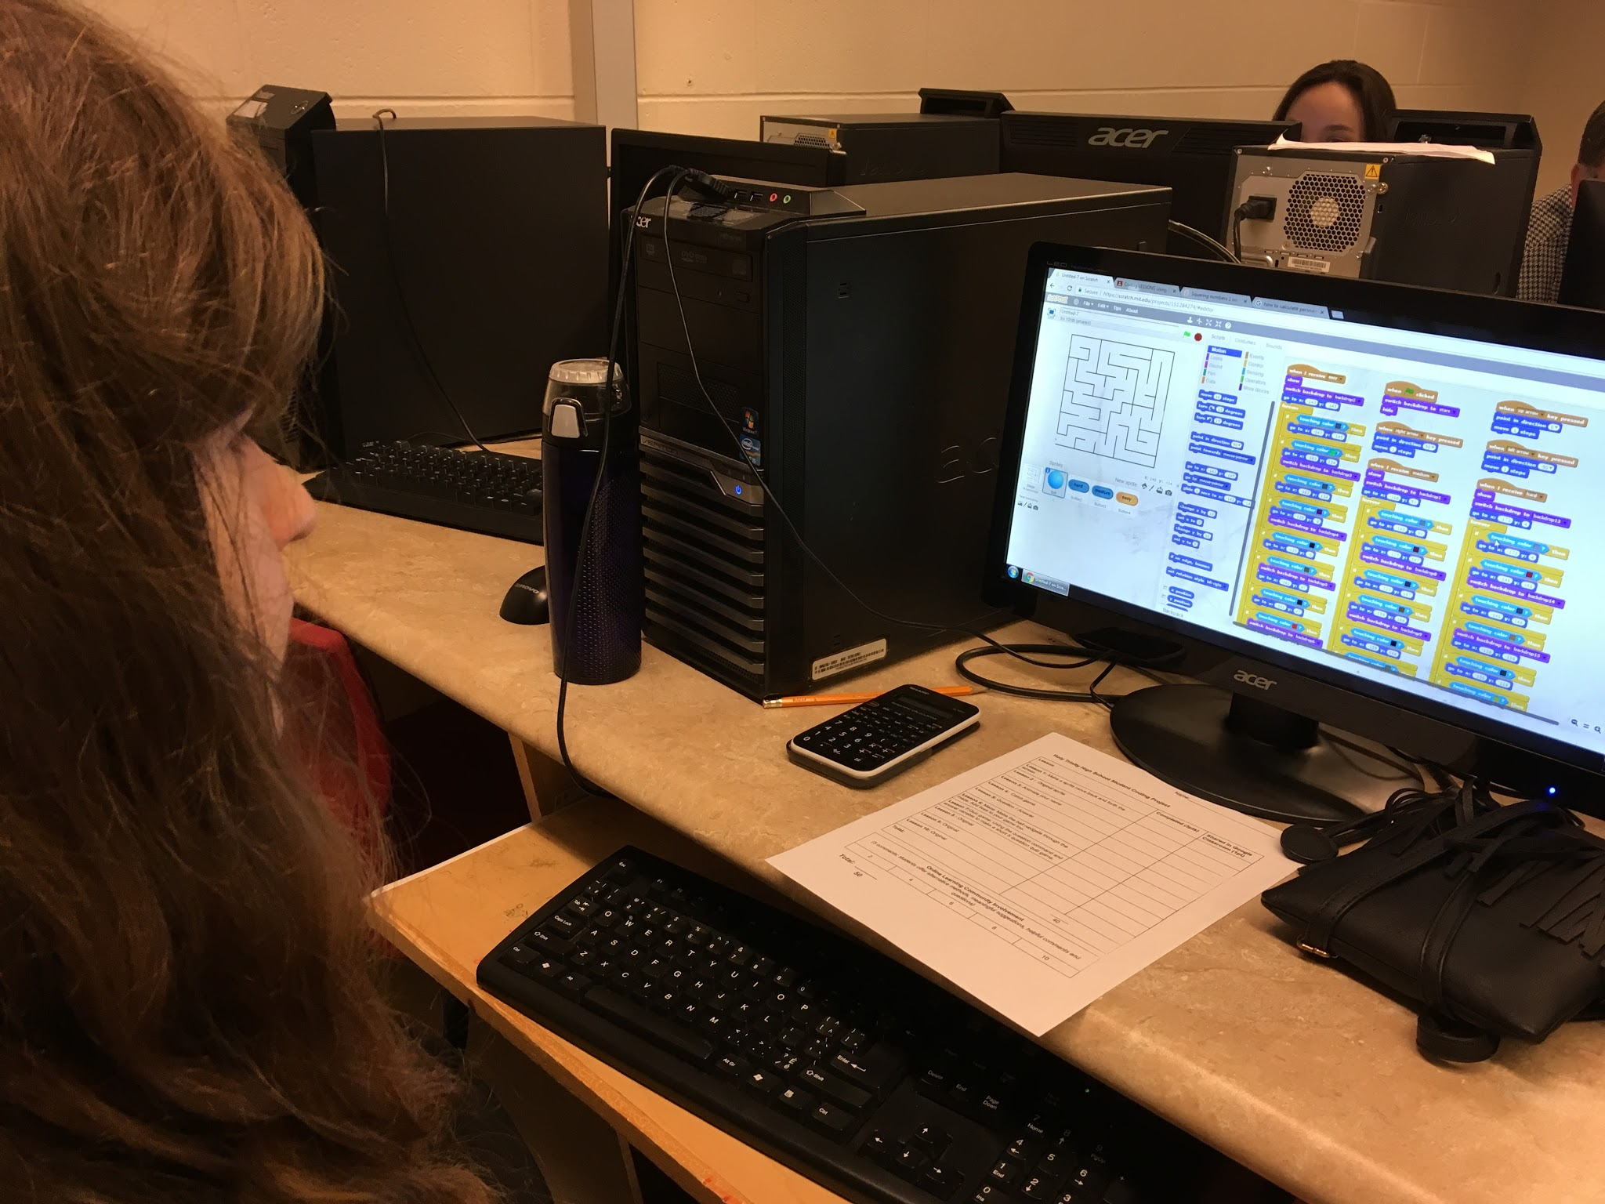
Literature guidance
Planning and implementation.
New ways of teaching and learning coding
Notes:
Guided us in our planning and implementation. Through our research and reading we discovered new ways of teaching and learning that other educators have tried in their classes.

Slide 34
Implementation

Slide 35
Basic Steps
Met with students to have them join our online community and discuss the project.
Provided students with an intro to coding, online collaboration and useful tools for sharing.
Organized our lessons to ensure scaffolding.
Gave them the basic tools they would need in order to continue working individually on their online projects.
Notes:
To begin we Met with students to have them join our online community and discuss the project.
We created an introductory slideshow to share with students to help guide them through a basic introduction to things such as snipping tool, Coding, Scratch and vocabulary necessary.
Our TIA team spent some time organizing our lessons and creating our online classroom structure to ensure easy access to all info. When students entered their online communities we would have their lessons and samples ready for them to continue their work.
Our Google classrooms were organized into 2 classes one titled “lessons” through which students could find teacher posted lessons, tips and suggestions.
Most lessons included students being given something to create using scratch. They were given little direction but worked as a team through the online community to explore.

Slide 36
Learning to Code process

Slide 37
Activity!
Learn to Code

Slide 38
Data Collection/Analysis

Slide 39
Research Methods
Videos
Interviews
Group discussion
Field notes
Reflections
Outside Observers
Pre and Post-Survey
Notes:
We used video, interviews, group discussion, teacher field notes during meetings, reflections after meetings, outside observers (principal, Dana Griffiths) to collect data.

Slide 40
Validity and Reliability
Triangulation
Multiple teachers
Multiple questioning time periods
Information from several sources (teachers/students/ TIA team)
Notes:
Triangulation included multiple teachers in different grade levels, multiple questioning time periods, and information from several sources including teachers, students,

Slide 41
Data Analysis
Teacher to teacher conversations
Inductively we wondered: Will online collaboration improve?
Notes:
Mostly through teacher to teacher conversations that followed an inductive reasoning reasoning process. This shared discussion was enhanced because we often did activities at slightly different times so we benefitted from observations made the ‘first time through’.
Inductively we wondered if the student making pancakes, dripping streams of fluids down a ramp or racing marble through various liquids, would lead to a better understanding of the concept of viscosity.

Slide 42
Results

Slide 43
Enhanced understanding in instruction
At first students often questioned and feared
Many looked for guidance and modelling
With time they gained confidence
Began to explore on their own.
Notes:
Instruction where we released the responsibility of learning to code to the students was an exciting and new way of teaching that led to many exciting results. At first and for some time students often questioned what they should do or feared that they were not doing lessons correctly. Students seemed to be avoiding asking questions in the online Google Classroom and often found a teacher to ask a question to or explain an issue that they were having. Many looked for guidance and modelling from the teacher, however, with time they gained confidence in themselves and began to explore their on their own and post questions and comments in the online classroom.

Slide 44
Enhanced understanding in student learning
Students can learn with little instruction/guidance but often struggle when it first begins
Released responsibility can enhance student confidence
Students were more likely to ask questions online after a few weeks.
Notes:
Old notes from last year:
Since we started inquiry based learning we realized that the students can learn a lot with very little instruction and guidance from us. THe students did resist at first entering a room to explore and come up with the ways that fluids work on their own, but soon they were confident in their own ability to discover the answers on their own. Students seemed more inclined to share their experiences from previous lessons when we would have a follow up discussion. Many students wanted to share what they explored and discovered and liked to elaborate on others ideas. It is made students formulate their thoughts and compare them with others’ views. By adding to constructs they already had instead of one's teacher presented it seemed to enhance their confidence and learning. It made sure that students wonder and do self-inquiry; students activate prior knowledge and present their views.

Slide 45
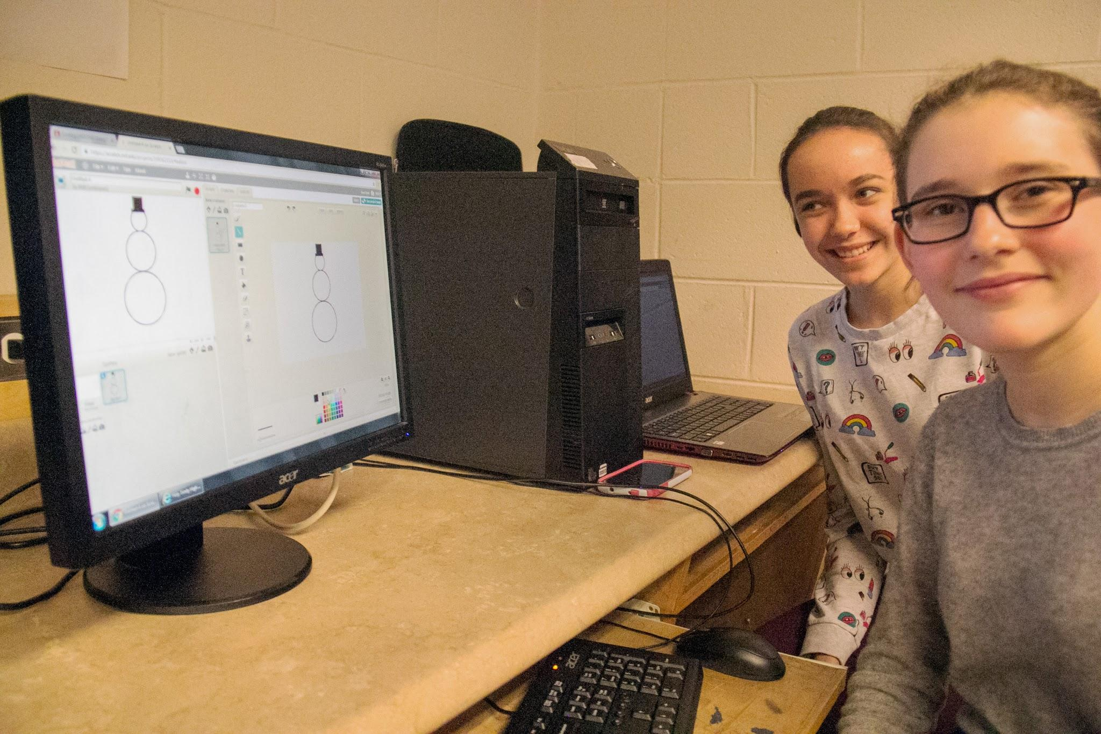
Patterns and Themes
“Expert” confidence
New volunteers
Confidence
Engagement
Notes:
Students who were familiar with coding before starting this project were the first and most comfortable with sharing their Scratch projects, asking questions and making comments in the online classroom.
Students who were often shy in class and were not open to volunteering or giving answers were slower to participate in the online community but some did improve over time. It seemed the fear of being incorrect had started to diminish towards the end since they knew that they had all tried to explore and discover on their own.
Students seemed to be exploring Coding more at the end than at the beginning they were becoming more confident in their abilities and proud of their work.

Slide 46
Changes in our classroom practice
More volunteers to share
Less fear
More open to explore.
Increased suggestions
Notes:
As the project progressed in our monthly meetings the number of volunteers to share what they created started to increase, there seemed to be less fear of asking peers for help both online and face to face and they were more open to explore and take on more challenging lessons for their originals. Student suggestions from students to “try this” next year for collaborating became more frequent.

Slide 47
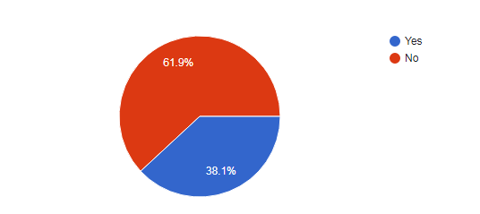
Have you used Scratch before?

Slide 48
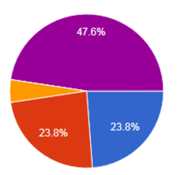
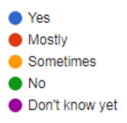
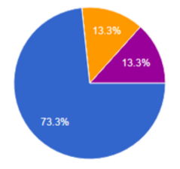
Do you enjoy coding?
Pre-survey Post-Survey

Slide 49
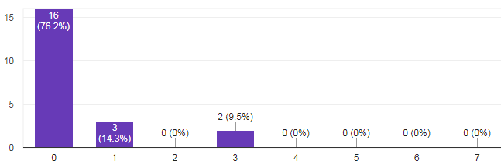
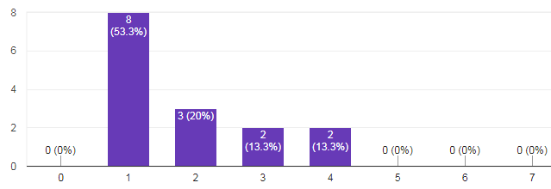
On average, how many days a week do you code?
Pre-survey
Post-survey

Slide 50
What did you find most challenging about the project?
“ Getting help from students”
“The wait that happened when people did not reply right away as they did not get an alert.”
“Not being able to always get a response from people as soon as you post”
“Figuring out what to do at first and posting to the chat”
“Learning how to do everything without teacher involvement and having to communicate online.”
“What i found most challenging in this project was learning all the different parts of coding.”

Slide 51
What was your favorite part of this project?
“Creating your own games.”
“Learning to use the Sphero”
“Creating whatever you want in the last 3 lessons.”
“Learning how to do the coding”
“We had to do these projects, but at the same time, also having the freedom to do what we want.”
“Being able to learn new things and meet new friends.”
“Finding out how to make cool things with Scratch.”
“Helping others with my knowledge.”

Slide 52
What parts of Google Classroom did you Like or Dislike?
“It sometimes took a long time for people to respond to questions”
“ I enjoyed being able to help others.”
“The ability that we are able to comment on other classmates work.”
“I liked how it was easy to share things.”
“I liked how others could comment and help us”
“Sometimes, I found it could be a little messy.”
“I liked being able to ask questions and get answers back, i wasn't very comfortable at the beginning of the coding lessons to ask questions but now i feel better with doing it.”
“I enjoyed the community aspect of it.”

Slide 53
How can we improve online collaboration?
“Make the comments anonymous.”
“Better communication system.”
“A better platform than google classroom.”
“Sometimes, when we asked questions on the chat it didn't go right to the top because someone else posted stuff so questions didn't get asked so maybe make another chat for questions.”
“Sometimes questions were not answered because they were not seen by those who knew the answers so maybe if we checked daily to see if anything new has popped up, then everybody would have seen everything and been able to answer questions.”
“We can improve online collaboration by shortening the time between a question and a response.”

Slide 54
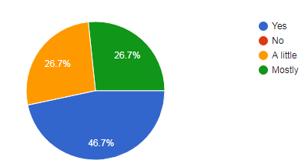
Did you enjoy collaborating through Google Classroom

Slide 55
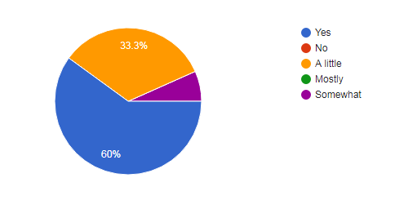
Did you gain confidence in your coding ability?

Slide 56
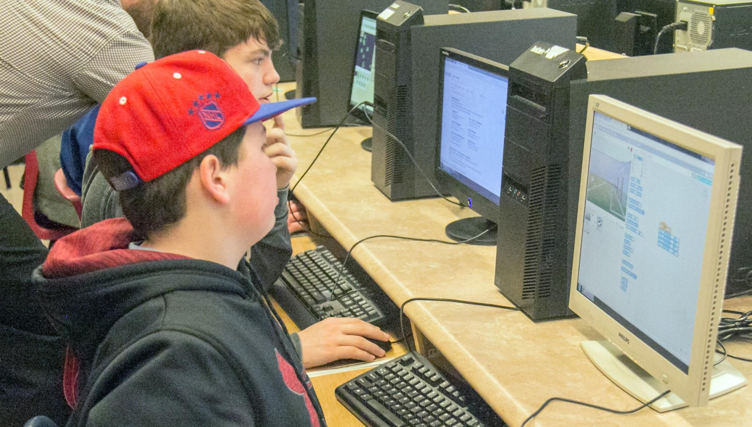
Long term impacts on teaching
More student-centered online collaboration
Coding projects
Notes:
There is no doubt that this project will influence our long term teaching. From having more and encouraging more student-centered online collaboration. Additionally, knowing that we can scaffold lessons easily and effectively for students to grow in their coding abilities from basic to more advanced.

Slide 57
New questions
How can we encourage and promote more open communication in an online learning community?
How can we incorporate more coding projects into our junior high curriculum?
How can we sustain/create a school environment that supports and rewards coding and online collaboration?

Slide 58
“Through collaborative inquiry, teachers integrate new knowledge and understanding of student learning and classroom instruction into their existing knowledge of professional practice. For those engaged in inquiry, the process can serve to expand and refine their personal knowledge base about what it means to be a teacher” ( Earl, in press.)

Slide 59
Teacher Inquiry

Slide 60
How our understanding of teacher inquiry has changed
We were uncertain
Difficulty: Letting go of control
Strength:
Student freedom allowed their curiosity to be peaked,
Gain confidence in online communication
Student freedom left them with a more meaningful learning experience
Challenge: promoting online collaboration
Notes:
All three teachers had some experience with coding and online collaboration, however we were uncertain (and even maybe a little nervous) to see if true learning would occur and if students would take control over their learning and gain confidence in asking peers questions online.
One of the difficulties we as teachers found during inquiry, was letting go of control to allow students to discover what would happen instead of telling them, simply giving them a lesson to complete and expecting them to be able to research how to create such a project and expecting them to look to their peers for guidance in the online chat as opposed to face to face discussions.
The strength was that student freedom allowed their curiosity to be peaked, they were able to discover how to create projects on their own through their own research and exploration instead of be told, which left them with a more meaningful learning experience.
Challenge: for the first half of the project student online communication was lacking. We held 2 extra meetings to encourage students and to try to show them the benefits of online communication.

Slide 61
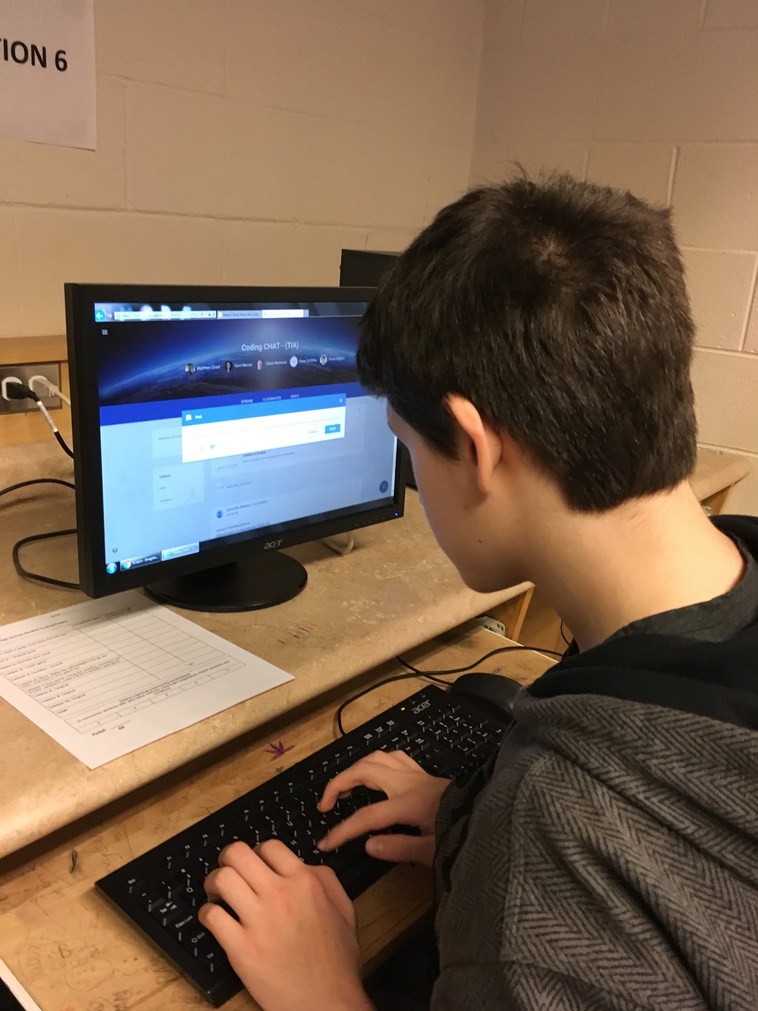
The future of our teacher inquiry
Inquiry and online learning communities and coding are important aspects of teaching.
Continue to create these learning environments.
Notes:
We believe that teacher inquiry is an important aspect to our classrooms and that online learning communities are an effective form of teaching. There is no doubt that there was a tremendous amount of learning by both teachers and students through this project.
We hope to create online learning communities in the future to help ensure students become better online collaborators. We believe that creating these learning environments to enrich our classrooms and student learning.

Slide 62
Our Projects Successes
Teachers: Achieved our goals increasing student engagement in coding and in the online community
Students :
Took part in the learning and sharing environment
more relaxed and confident
Notes:
Yes the project was a success. We were able to achieve our goals increasing student engagement in coding and the online community. Though students were slow in feeling confident in sharing and collaborating online or asking questions their confidence did grow. Students who are often shy in sharing or taking part in the learning and sharing in classroom environment appeared more relaxed and confident when working with peers through the online learning comm
There is no doubt that this project will influence our long term teaching. From having more and encouraging more student-centered online collaboration. Additionally, knowing that we can scaffold lessons easily and effectively for students to grow in their coding abilities from basic to more advanced.

Slide 63
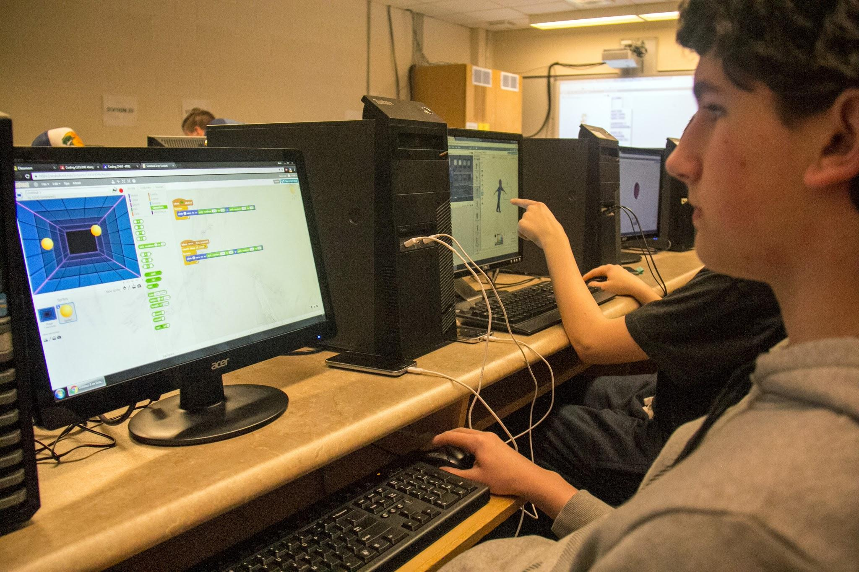
Project and professional learning
Creating student-centered learning environments
Allow students to engage, explore and elaborate through online communities and coding.
Questioning : Online learning communities vs. Traditional class.
Allowed us to explore Online Learning Communities & scaffolding Coding lessons.
Notes:
We have always been interested in creating student-centered learning environments that allow students to engage, explore and elaborate through online learning communities and coding. As educators we may also find ourselves questioning whether we should be spending so much time on online learning communities or if we should stick to traditional classroom discussions. Are students avoiding asking questions online due to lack of confidence and therefore not reaching their full potential.
This project allowed us to explore student collaboration in online learning communities and allwoed us to see some ways to scaffold student coding lessons to allow student success.

Slide 64
Student centered learning environments
Time is always a constraint
This project allowed time for planning to make these environments
New ways of integrating online collaboration
As teachers we took the role of observer with background probing.
Enabled students to develop higher order questioning skills.
Notes:
Time is a constraint for many teachers when it comes to planning lessons. Given that this project allowed us time for planning and organizing lessons we were able to create more lessons that enabled our classroom to be student-centered online learning environments. We found new ways of encouraging and integrating online collaboration Student centered learning took place while the teacher was able to take on a role as an observer in the background probing, encouraging and elaborating. This student-centered learning environment enabled students to develop higher confidence in asking for help from peers . With the group work that took place in most online lessons student-centered learning became easier with the support of their peers.

Slide 65
Project and professional learning
Allowed us to explore:
How we can incorporate even more online collaboration into our classroom and
If it is beneficial to student engagement
Witnessed our students become more confident
Enhanced our professional development in Science and Coding.
Notes:
This project us allowed us to explore how we can incorporate even more activities into our classroom and if it is beneficial to student motivation in the classroom. We witnessed our students become more motivated/interested in our classroom activities as their engagement and understanding increased. Enhanced our professional development in Science.

Slide 66
References/Credits

