Slide 1
Increasing Motivation in Science
Grade 3 - St. Edward’s School

Slide 3
Team Members

Slide 4
Susan Gregg
19 years teaching experience
10th year in grade 3
22 students
Huge fan of coffee, my husband, family, teaching Language Arts and shopping
Why did I join STEM?
Notes:
Introduction
I have always hated brussel sprouts...and teaching science.
I was interested in STEM to change my outlook on teaching science.
I thought we were doing a grand job with student-centered, hands-on science BUT it was not student-led.
I am amazed at how many outcomes you can achieve with a package of paper and a roll of tape!
It wasn’t science- it was my approach to teaching it that was the problem.
Now let’s meet the rest of our team and take a look at our project.

Slide 5
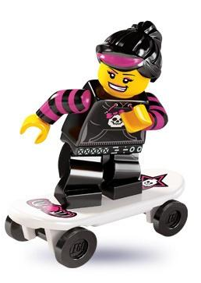
Yolanda Anderson
20+ years teaching experience
10th year in grade 3
19 students
Enjoys new challenges, loves fitness, knitting, spending quality time with my family and my puppy
Why did I join STEM?
Notes:
I joined STEM because I was looking for a way to motivate my teaching in science.

Slide 6
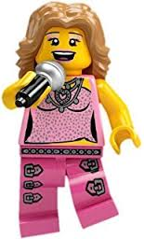
Jill Peach
14 years teaching experience
5th year in grade 3
23 students
Avid knitter, huge baseball fan, enjoys long walks and spending time with my family
Why did I join STEM?
Notes:
I joined the project because I wanted to become more motivated to teach science.

Slide 7
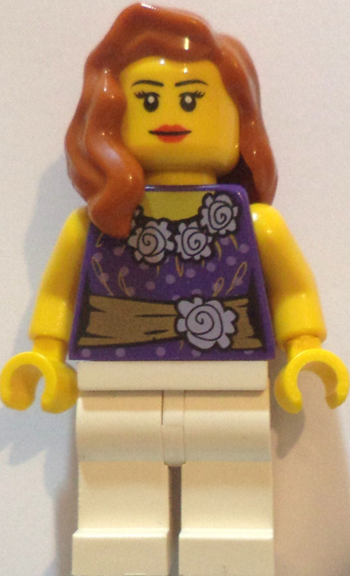
Jennifer Banfield
9 years teaching experience
5th year in grade 3
24 students
Loves spending time with her beautiful 2 year old, Maisy, reading, coffee, shopping, and travelling
Why did I join STEM?
Notes:
I admit that I wasn't always a lover of science which is the main reason I joined the STEM project. I believe that children enjoy learning when they are interested in a topic and have a chance to explore and challenge themselves.

Slide 8
Jenny Berniquez
3 years teaching experience
1st year in grade 3
21 students
Compulsive book buyer, bowling coach, Francophile, and student for life
Why did I join STEM?
Notes:
I joined this project because I got a job in grade 3 and they had already signed up. I thought it would just be cool science activities, and didn’t realize it was a research project until I was working on the research course for my Masters. When I heard about how the other girls felt about teaching science, I realized it echoed my feelings, even though I felt guilty for feeling this way despite being a new teacher.

Slide 9
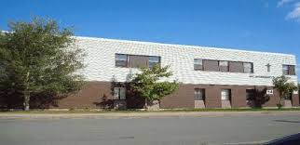
St. Edward’s School
Located in Kelligrews, CBS
In grade 3, there are 132 students
We knew this group of learners was very active and curious (great characteristics for IBL!)
Students felt science was teacher-led
We needed to change that!
Notes:
Our students are very active and curious.

Slide 10
Focus Area & Research Questions

Slide 11
Focus Area
The 5E approach (Engage, Explore, Explain, Extend, Evaluate) in scientific inquiry
We provided opportunities for hands on, student led learning to increase overall student and teacher motivation
Through the use of student literature and manipulatives, students were challenged to design various structures to meet specific criteria.
Notes:
We began our project with the intention of teaching structures and geometry through MineCraft. We were inspired by another school who talked about their use of Minecraft. Our focus did change over the course of the project, especially when we ran into several pitfalls with Minecraft for education. We later changed our focus to inquiry based activities using a combination of simple materials, legos, and children's literature. We also found several articles and activities provided by Tom to be an excellent resource in changing and refining our area of focus.
The grade 3 structures unit focuses on problem solving, so it naturally aligned with inquiry-based learning.

Slide 12
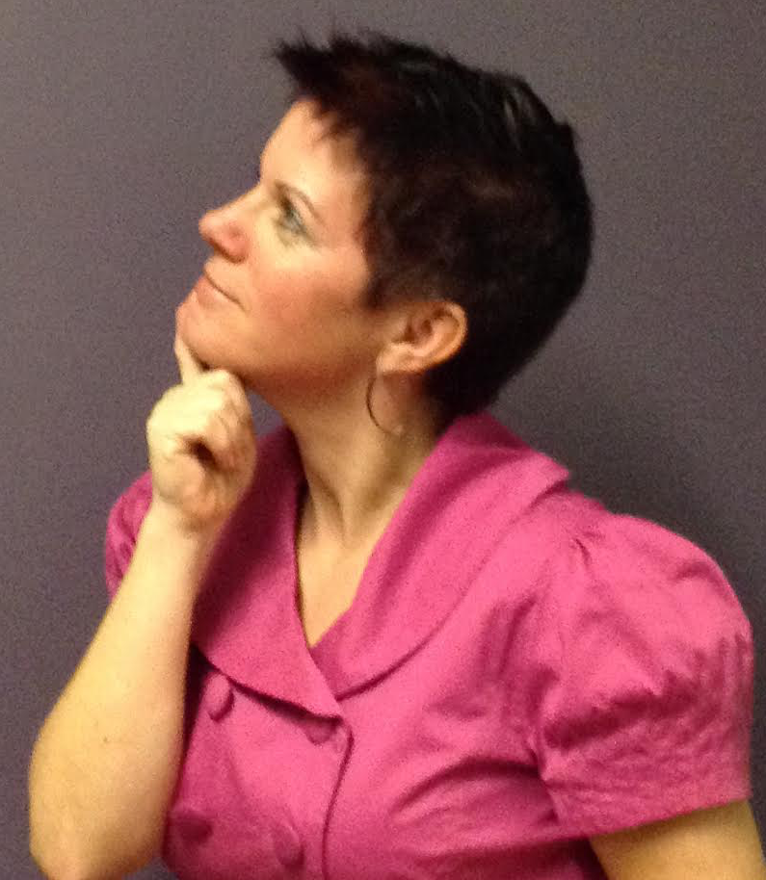
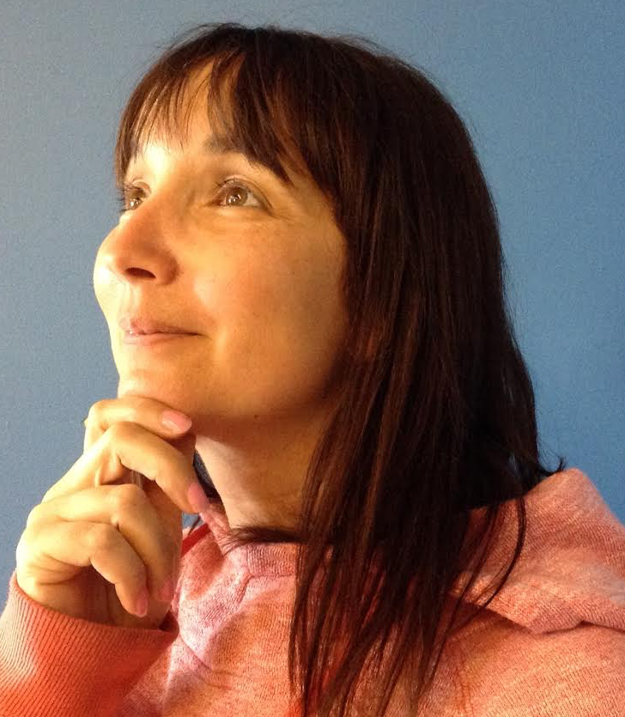
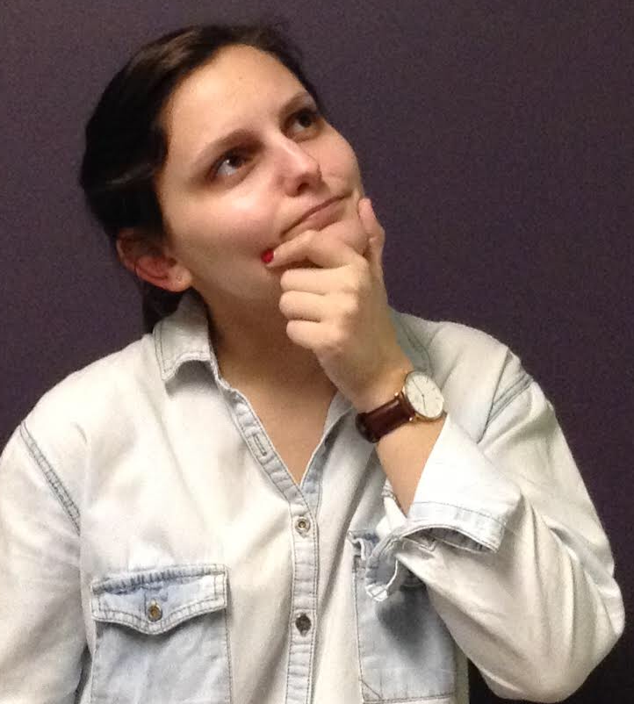
Research Questions
Teacher Question: How will my role as a Science teacher change in using inquiry based learning? Student Question: How will inquiry based learning through the use of technology and student literature enhance student motivation in Science?
Notes:
Teacher Subquestions: What is inquiry based learning?
We needed to better understand the idea of IBL. We had a vague idea but were unsure. IBL is active learning where you start by presenting a question/problem/challenge and allowing students to explore for the answers rather than just telling them the facts or information.
Student Subquestions: What is technology?
During the project our understanding of what technology is changed. Initially we viewed technology as electronic tools such as iPads, computers, apps, etc. Now we view technology as being any tool, whether simple or complex, such as legos.
Our initial questions were student focused and less about us changing as teachers throughout this process. As we discussed and worked on the project, we began to notice changes taking place among us, and felt that our research questions should reflect that change.

Slide 13
Ethical Considerations

Slide 14
Open communication with parents and students
Consent letters and forms
Notes:
We spoke to parents about our project as early as curriculum night, telling them about STEM and how we were looking at using Minecraft to teach structures and reinforce geometry. After our third release day in the fall, we created and sent home consent forms to parents and guardians to ensure they understood and agreed to have their child participate in the project. We were also open with our students, telling them we were participating in a STEM project with the university and that we were looking at changing how we taught science. Although we did mention minecraft early in the fall, most of our students seemed to have forgotten this and did not express disappointment.

Slide 15
Planning

Slide 16
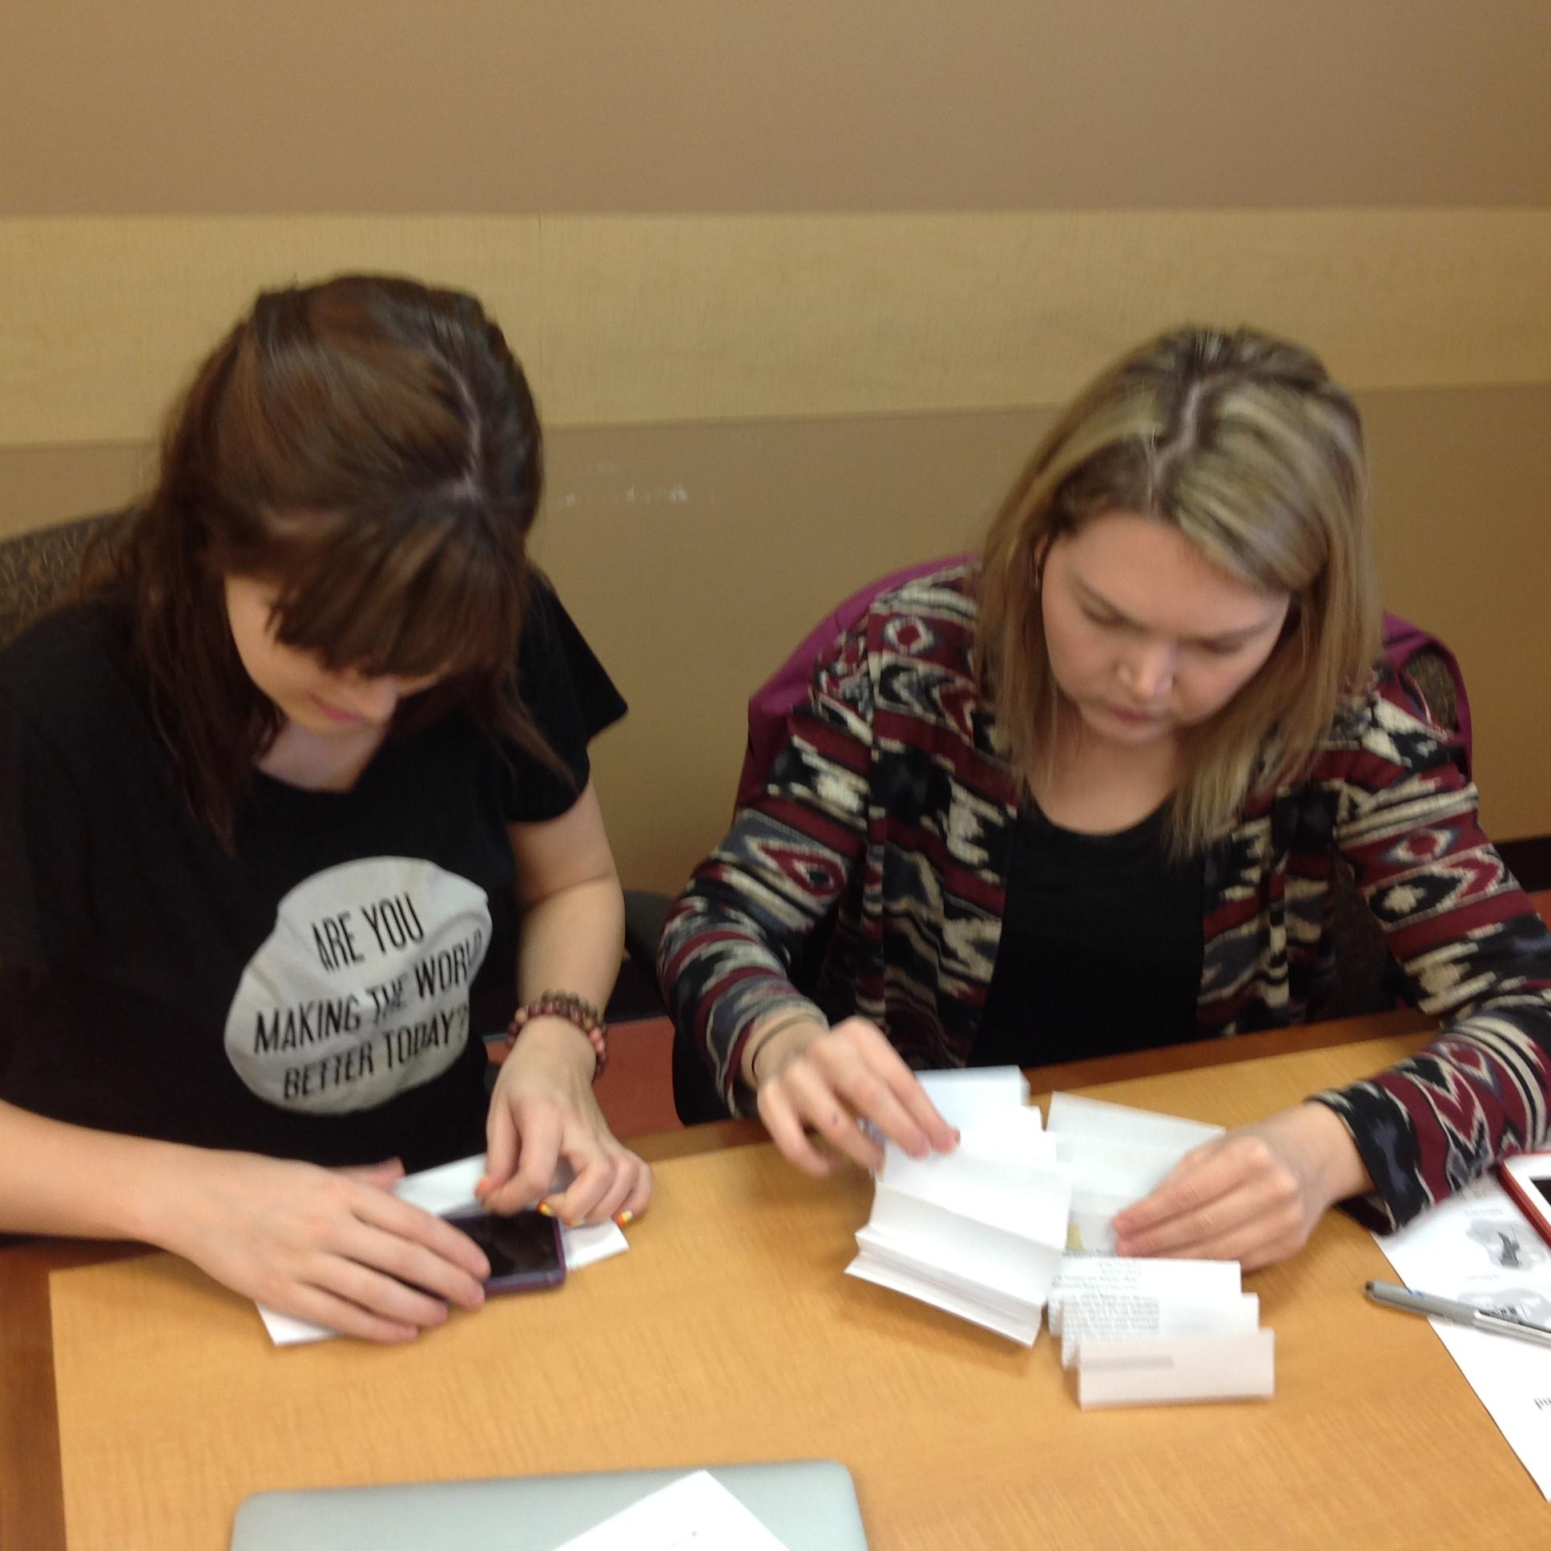
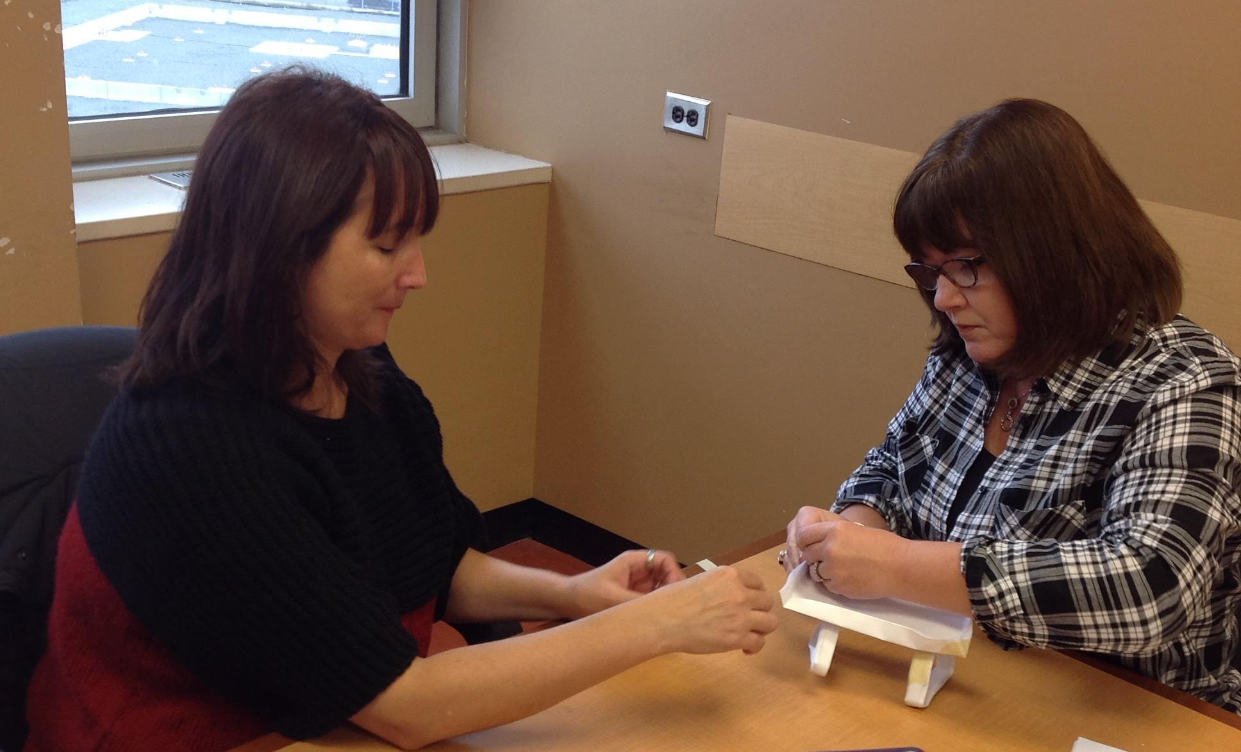
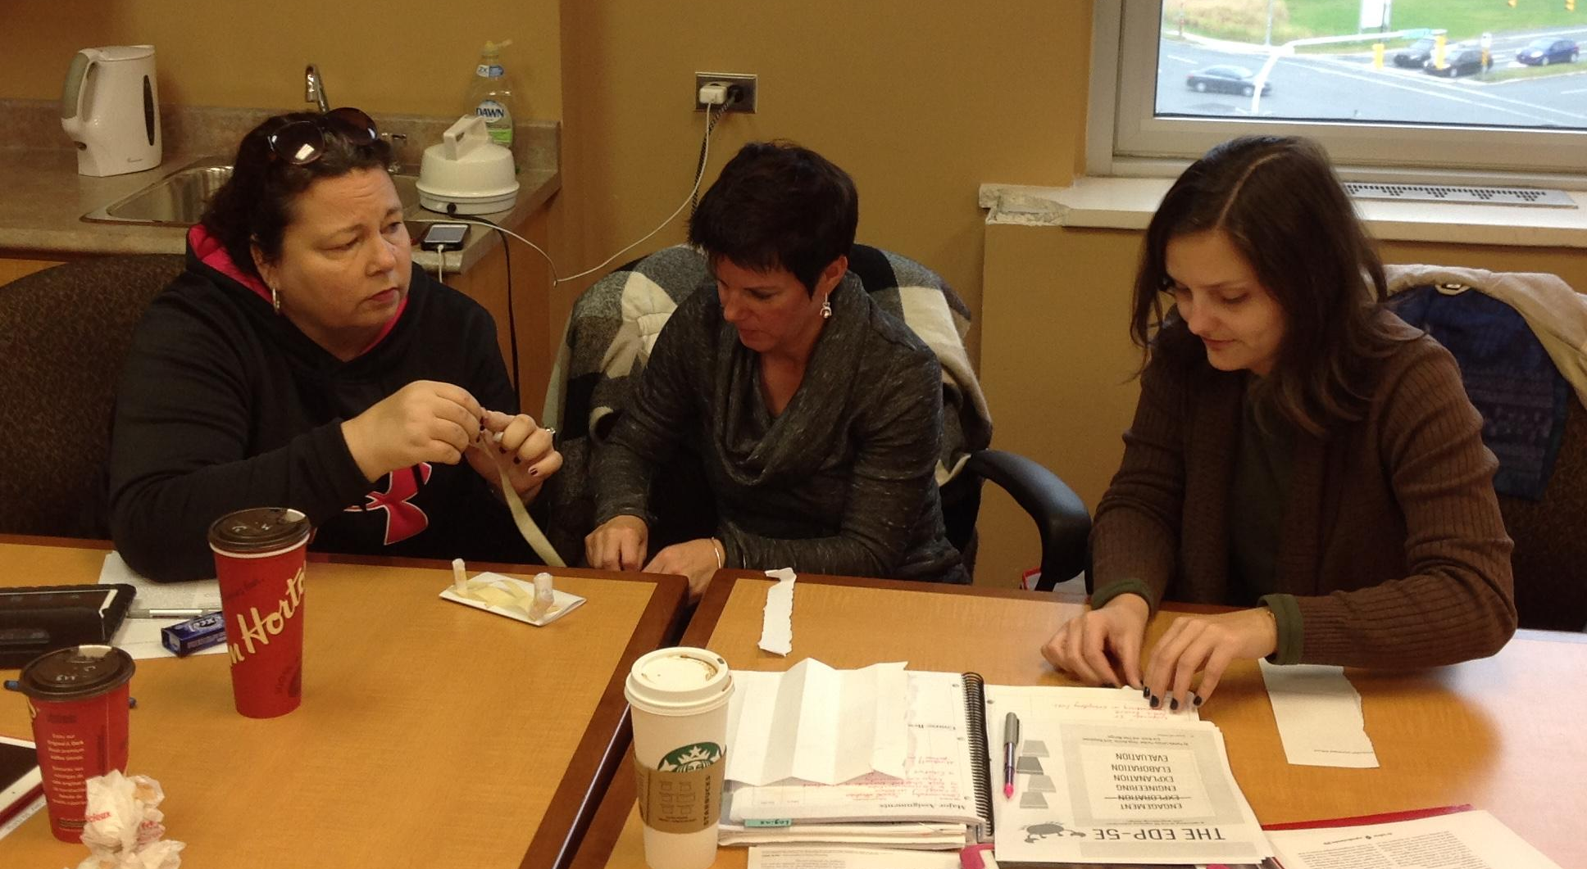
Planning
August TIA STEM professional development
Release days for project planning
Matching curriculum outcomes
Familiarizing ourselves with 5E cycle and classroom action research (CAR)
Articles from Science and Children
Resources from Tom (our saviour!)
“Here we go. Championship engineering for sure.”

Slide 17
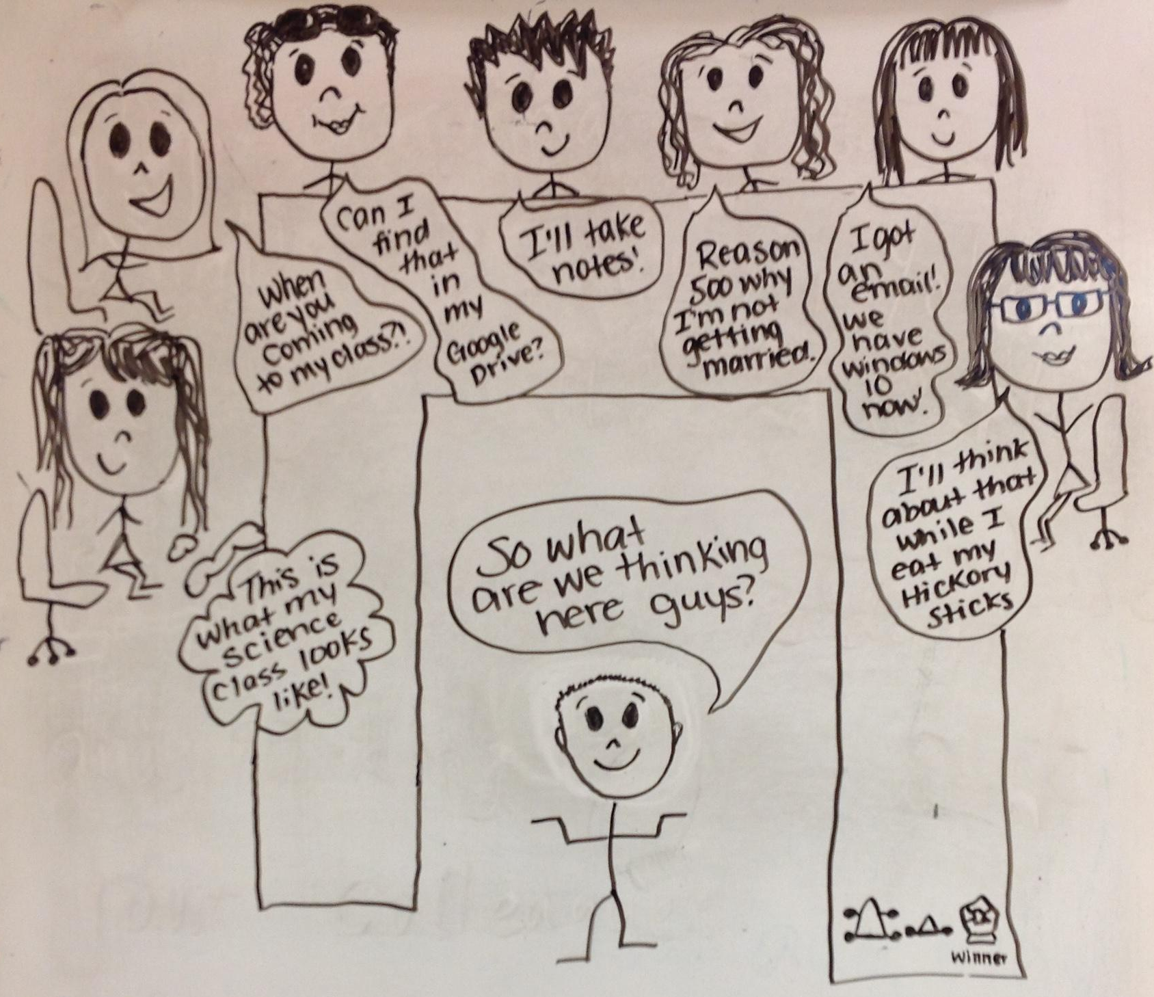
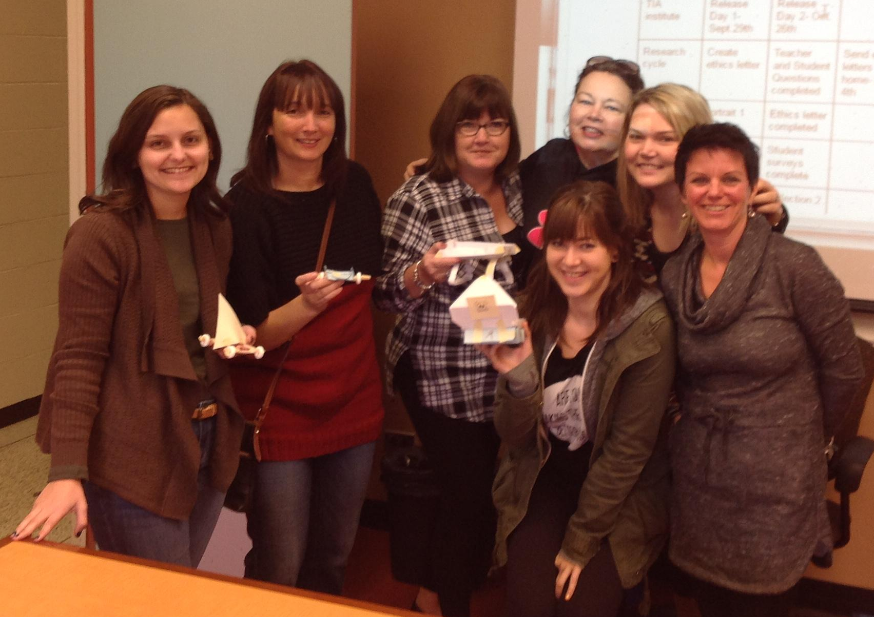
Team Awesome!!!

Slide 18
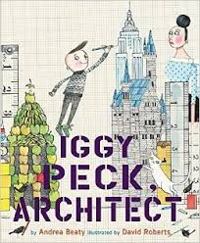
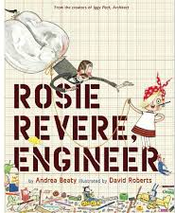
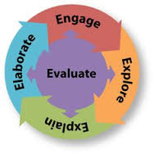

Slide 19
Implementation

Slide 20
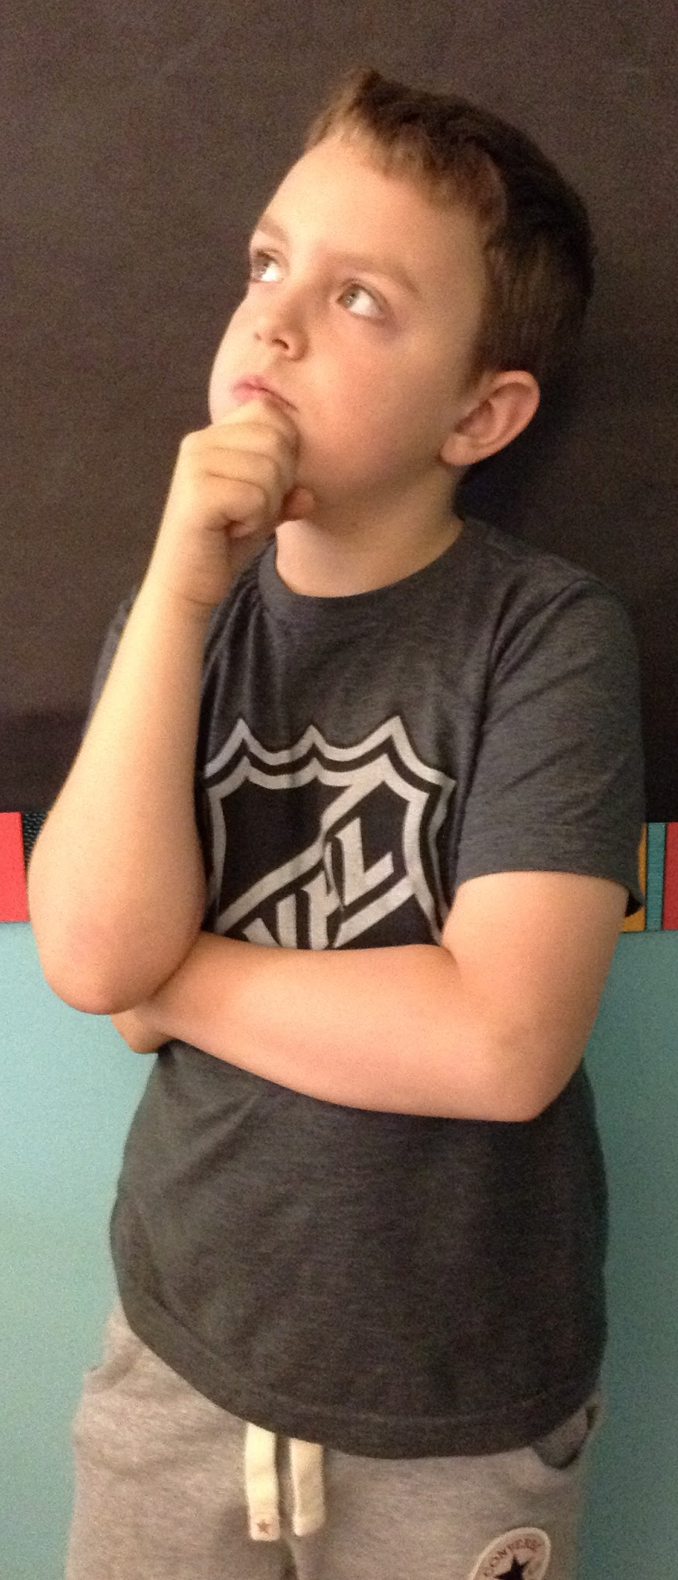
Pre-survey
What is Science? / Qu’est-ce que tu penses “sciences” veut dire?
Science is when you do experiments and spend time with your teacher.
Confuser.
Le travail tout seul?
Pas de fun et tu mélange les couleurs.
I do not no.

Slide 21
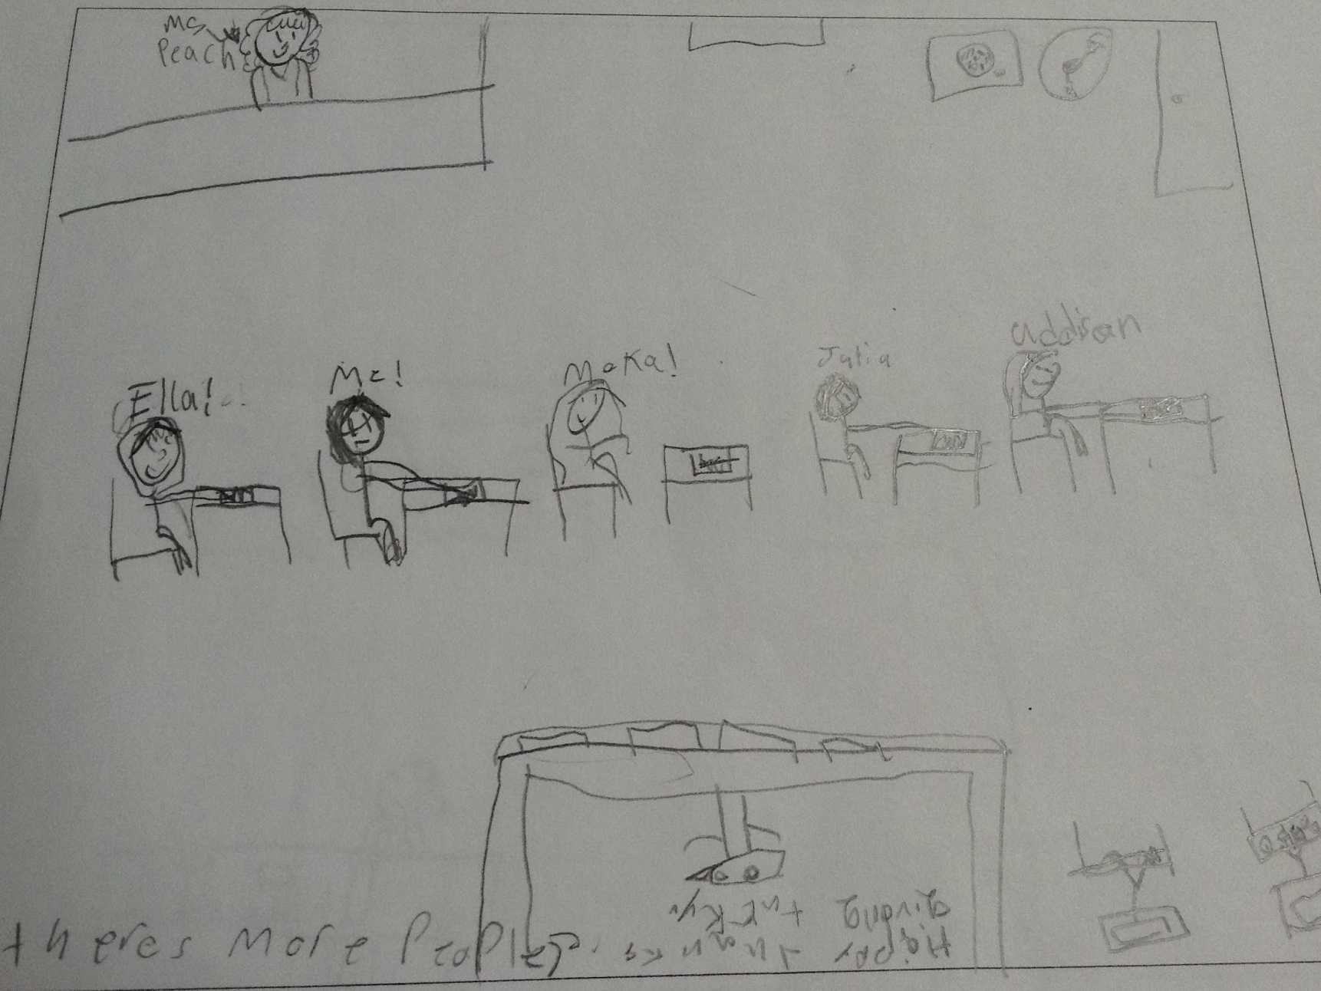
Pre-survey
Science is fun when…
We do funny things and the teacher gets messy.
You make an awesome potion.
You do like experiments and math sheets.
You get work to do all the time.

Slide 22
Pre-survey
Est-ce que tu aimes les sciences?
Non, parce que c’est trop longs.
Non, parce que c’est très difficile.
Je ne sais pas, parce que quelquefois le science c’est l’air et d’autre fois c’est les animaux.
Oui, parce que c’est amusant.

Slide 23
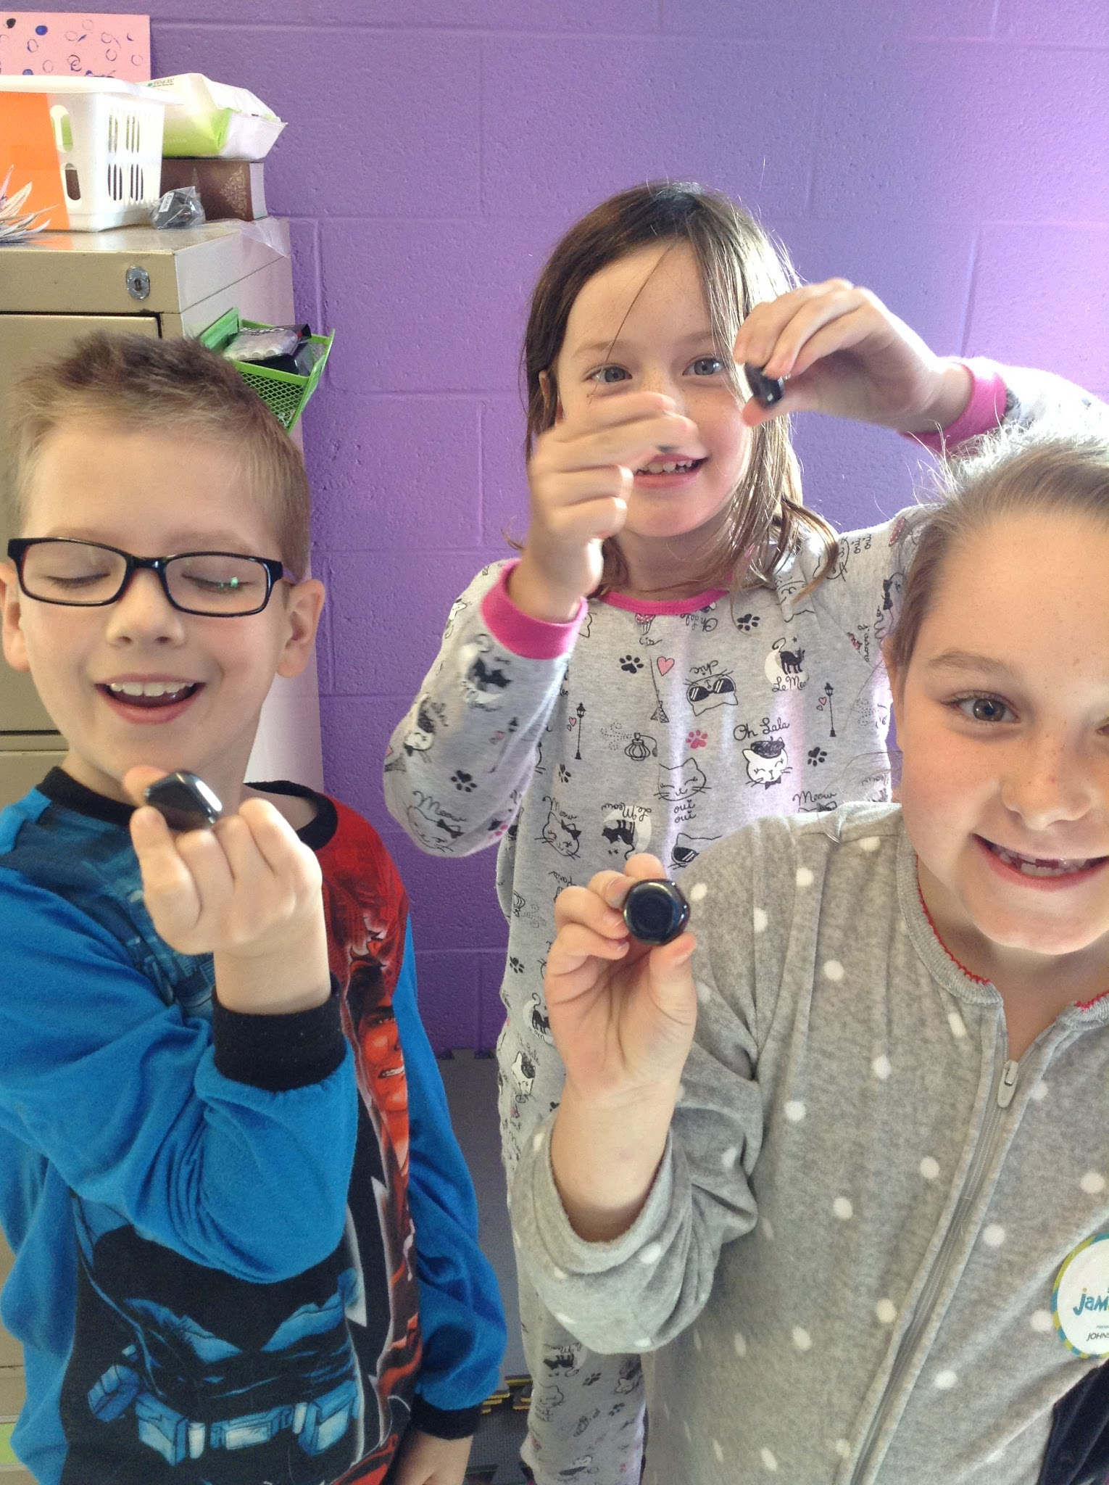
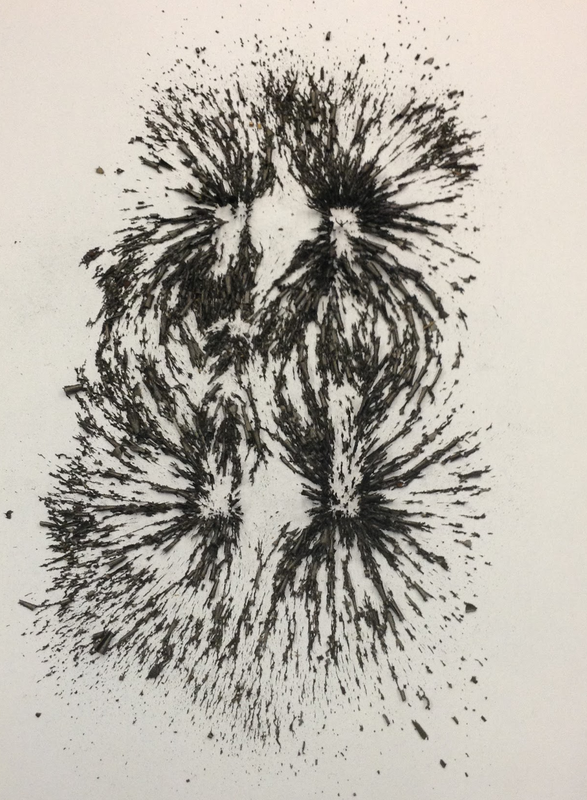
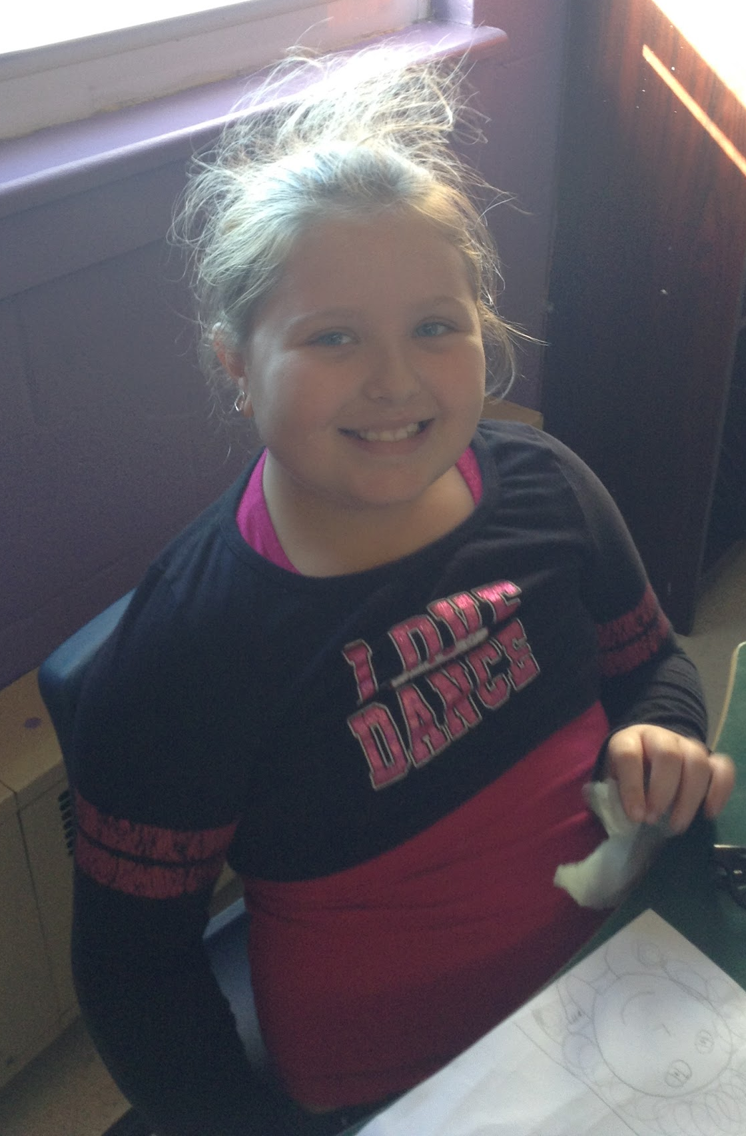
Trial Run at Inquiry-Based Learning with Invisible Forces

Slide 24
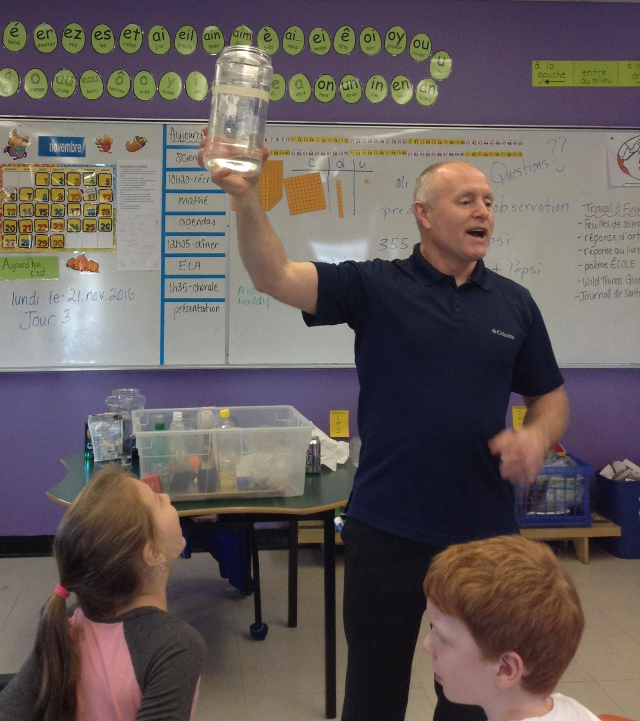
Getting our kids excited about Science - Feat. Mr. Walsh!

Slide 25
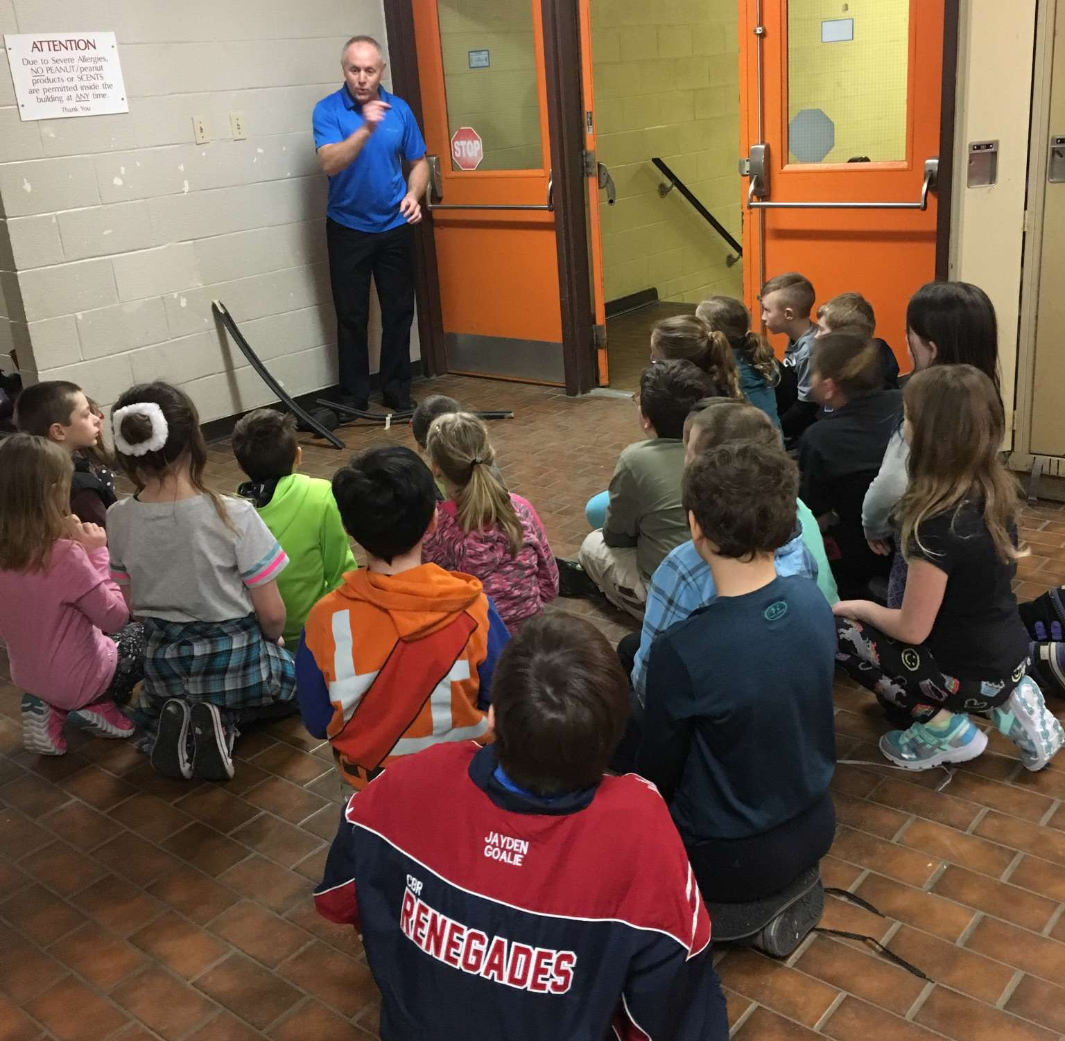
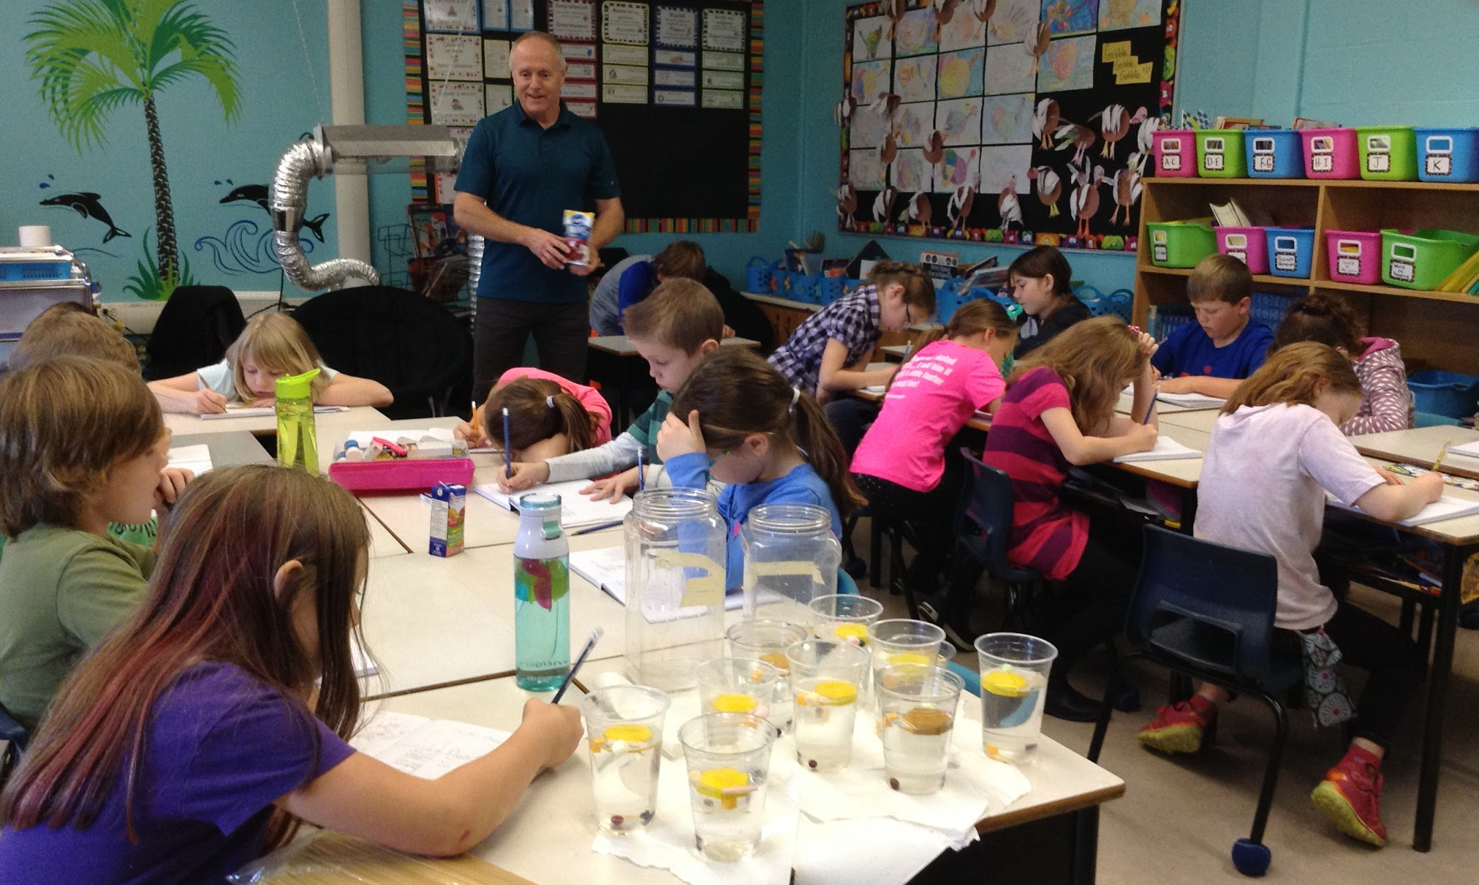
I Wonder…?
Je me demande…?
Testing Predictions!
Making Predictions!

Slide 26
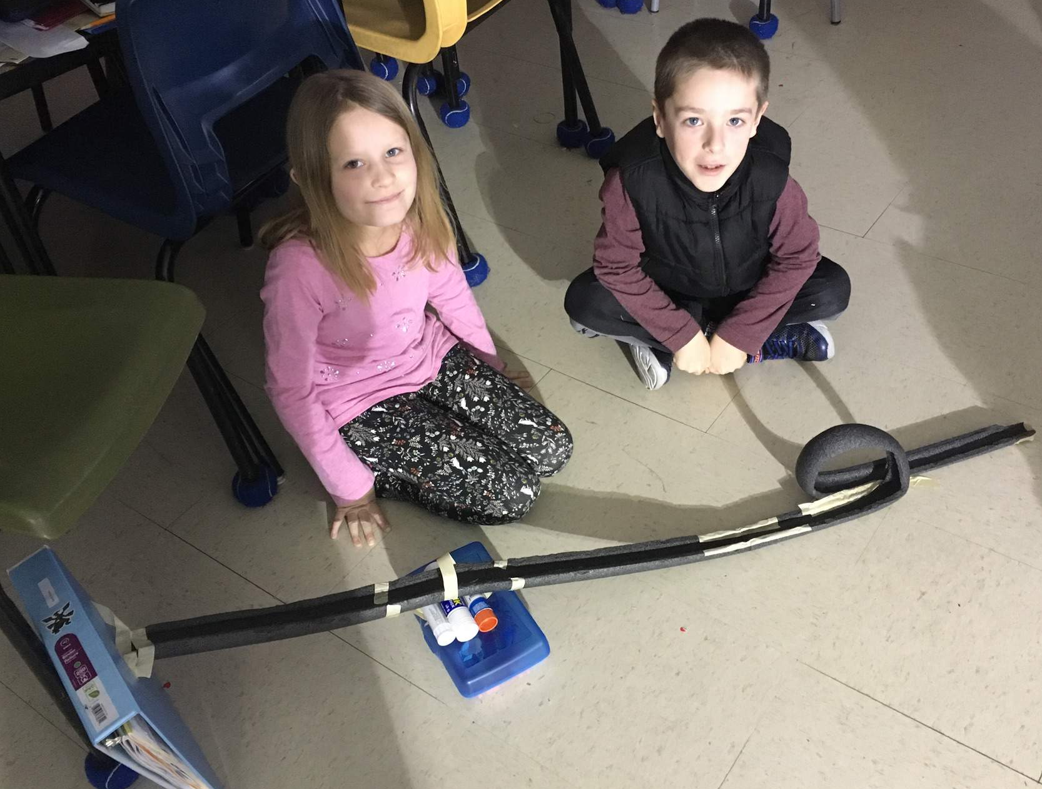
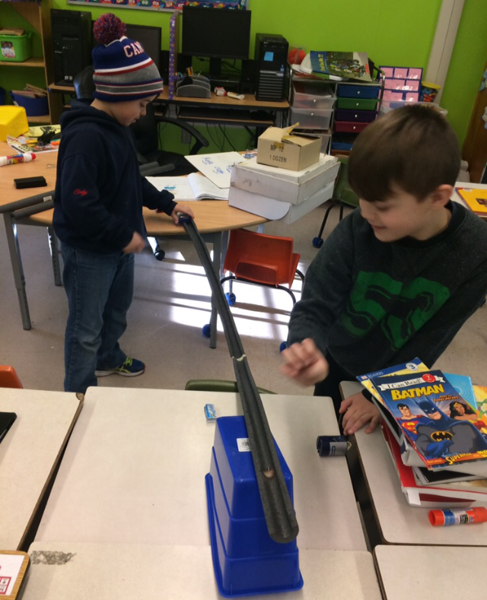

Slide 28
Using the 5E cycle with Structures - Your Turn!
Notes:
Activity with people attending the session (possibly paper and tape structure to hold something off the table?)

Slide 29
Using the 5E Cycle with Structures - Our Students
Sometimes it works
…and sometimes it doesn’t!
Notes:
Initial off the table challenge (inspired by our activity with Tom)

Slide 30
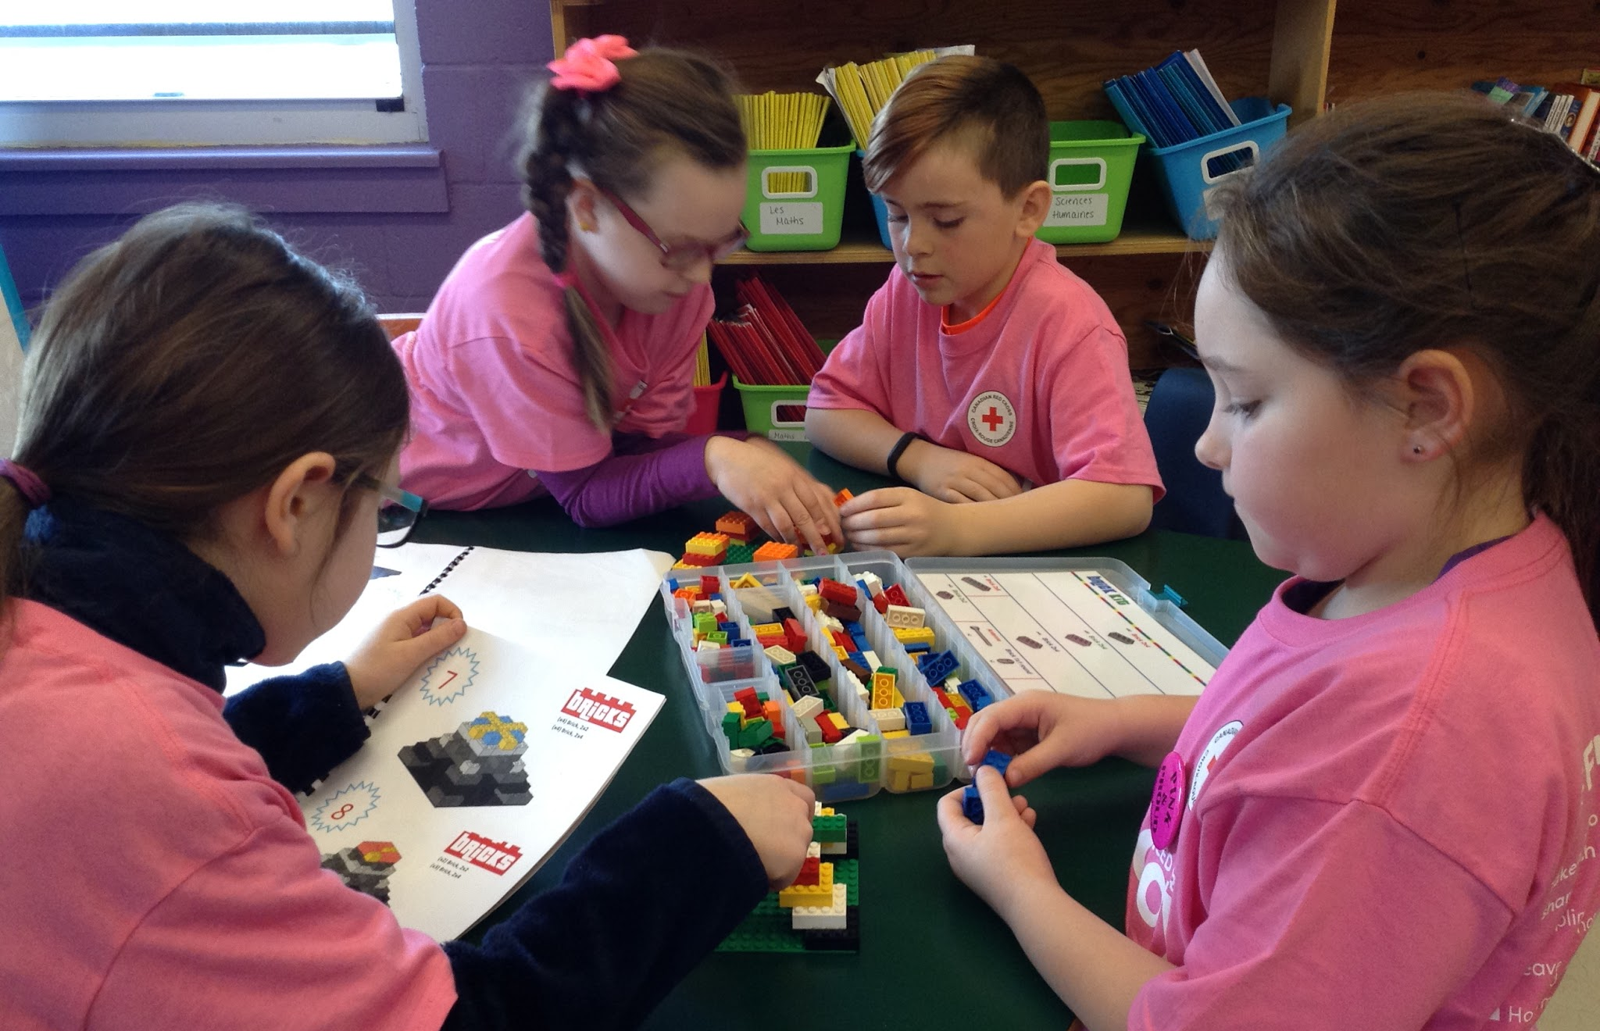
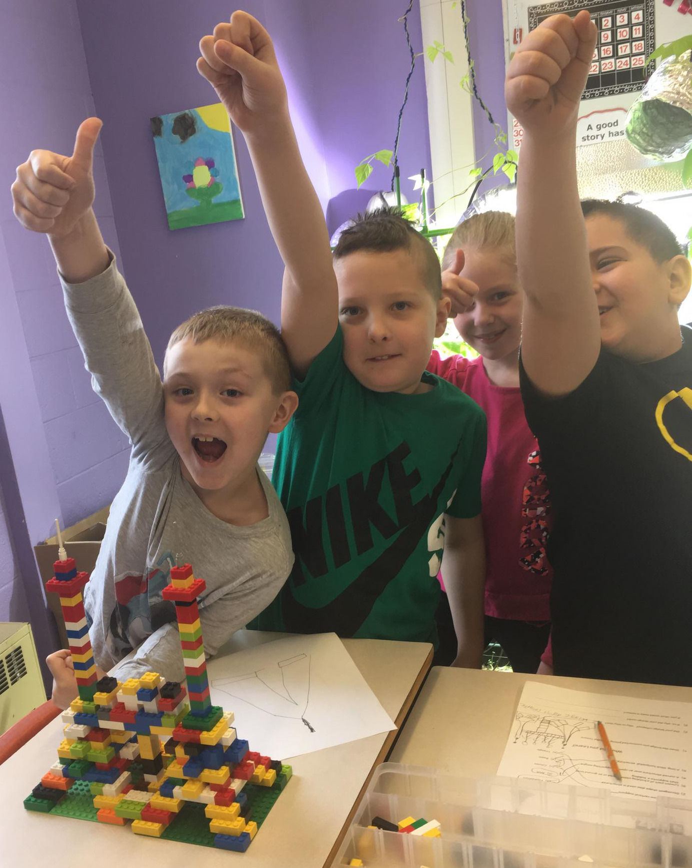
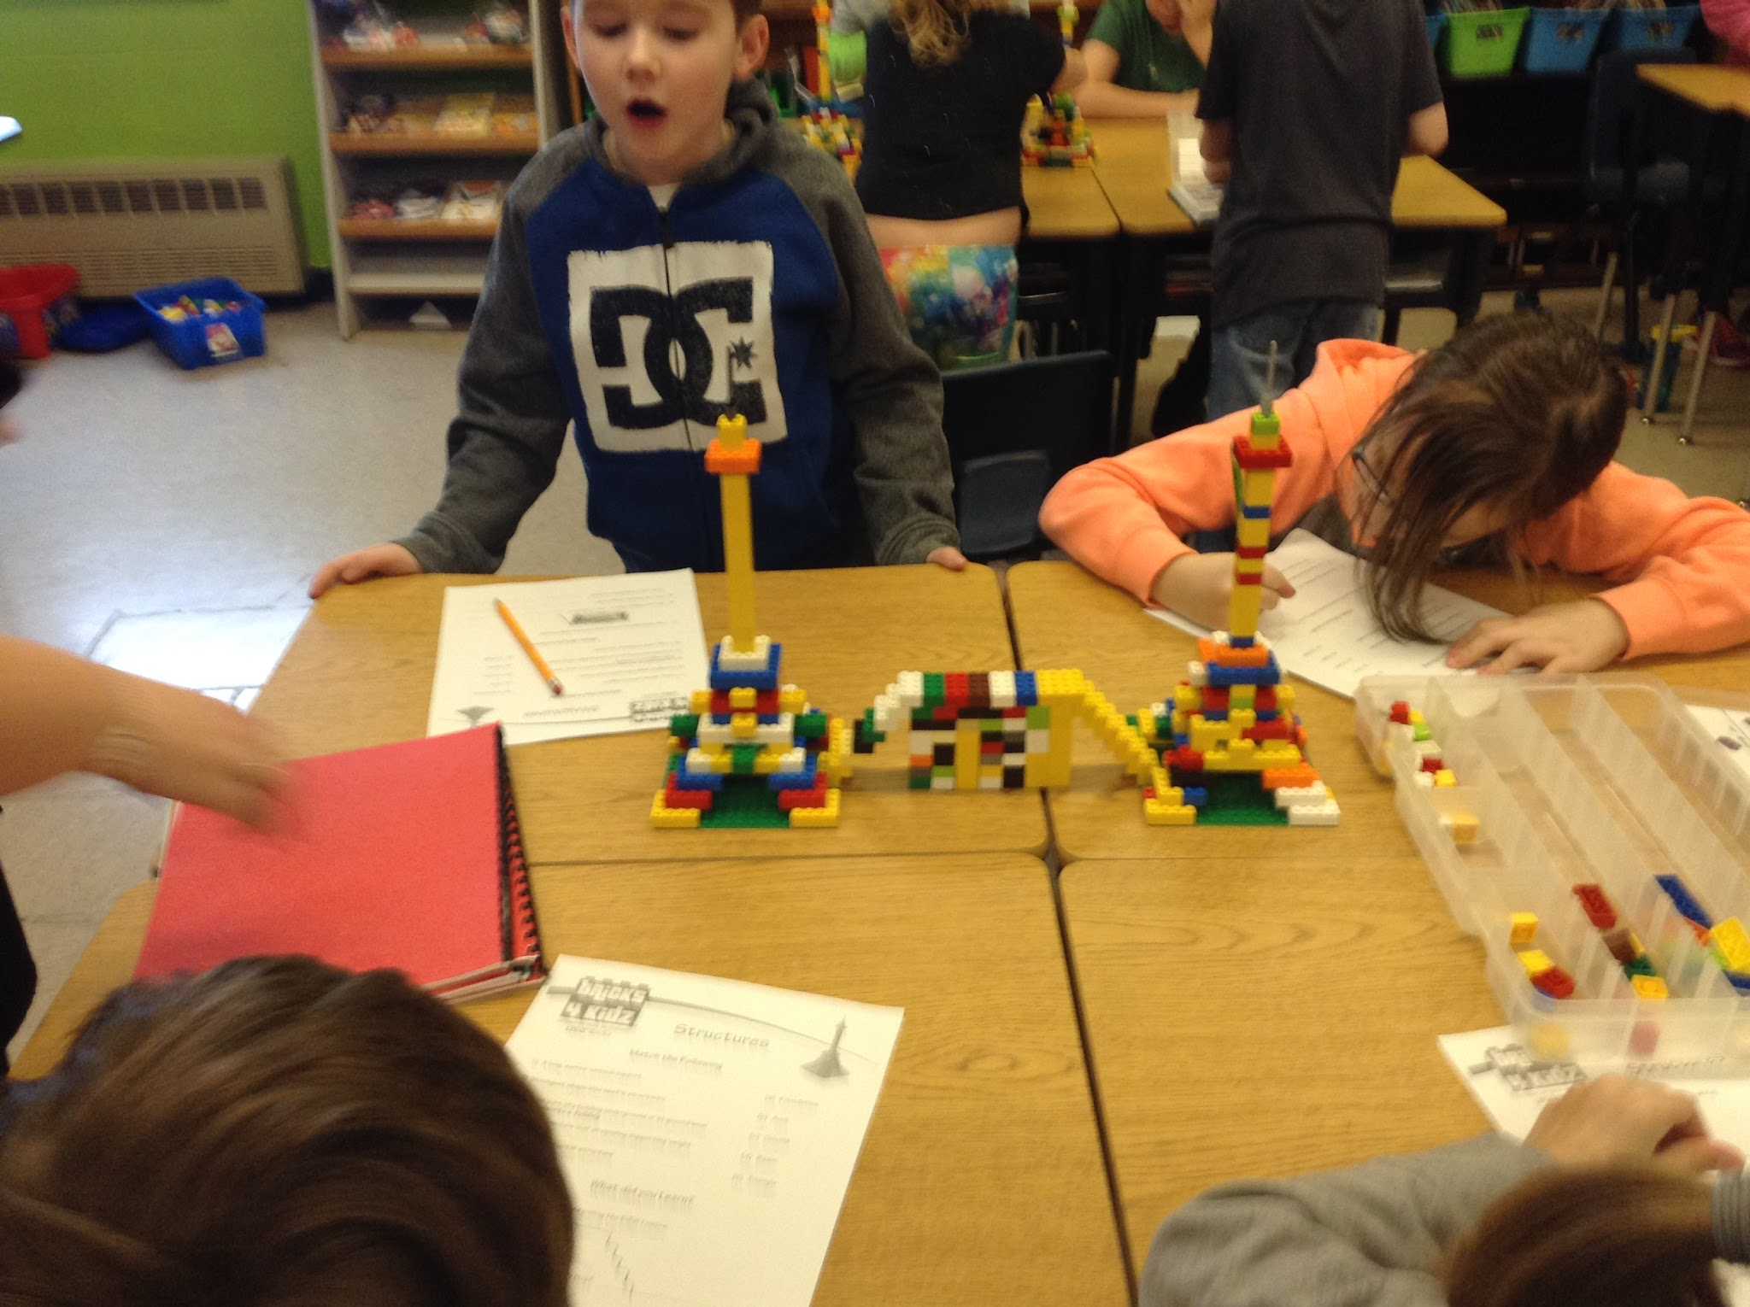
Bricks 4 Kidz®
Notes:
Bricks for Kids - building the Eiffel Tower and making a bridge to connect them.

Slide 31
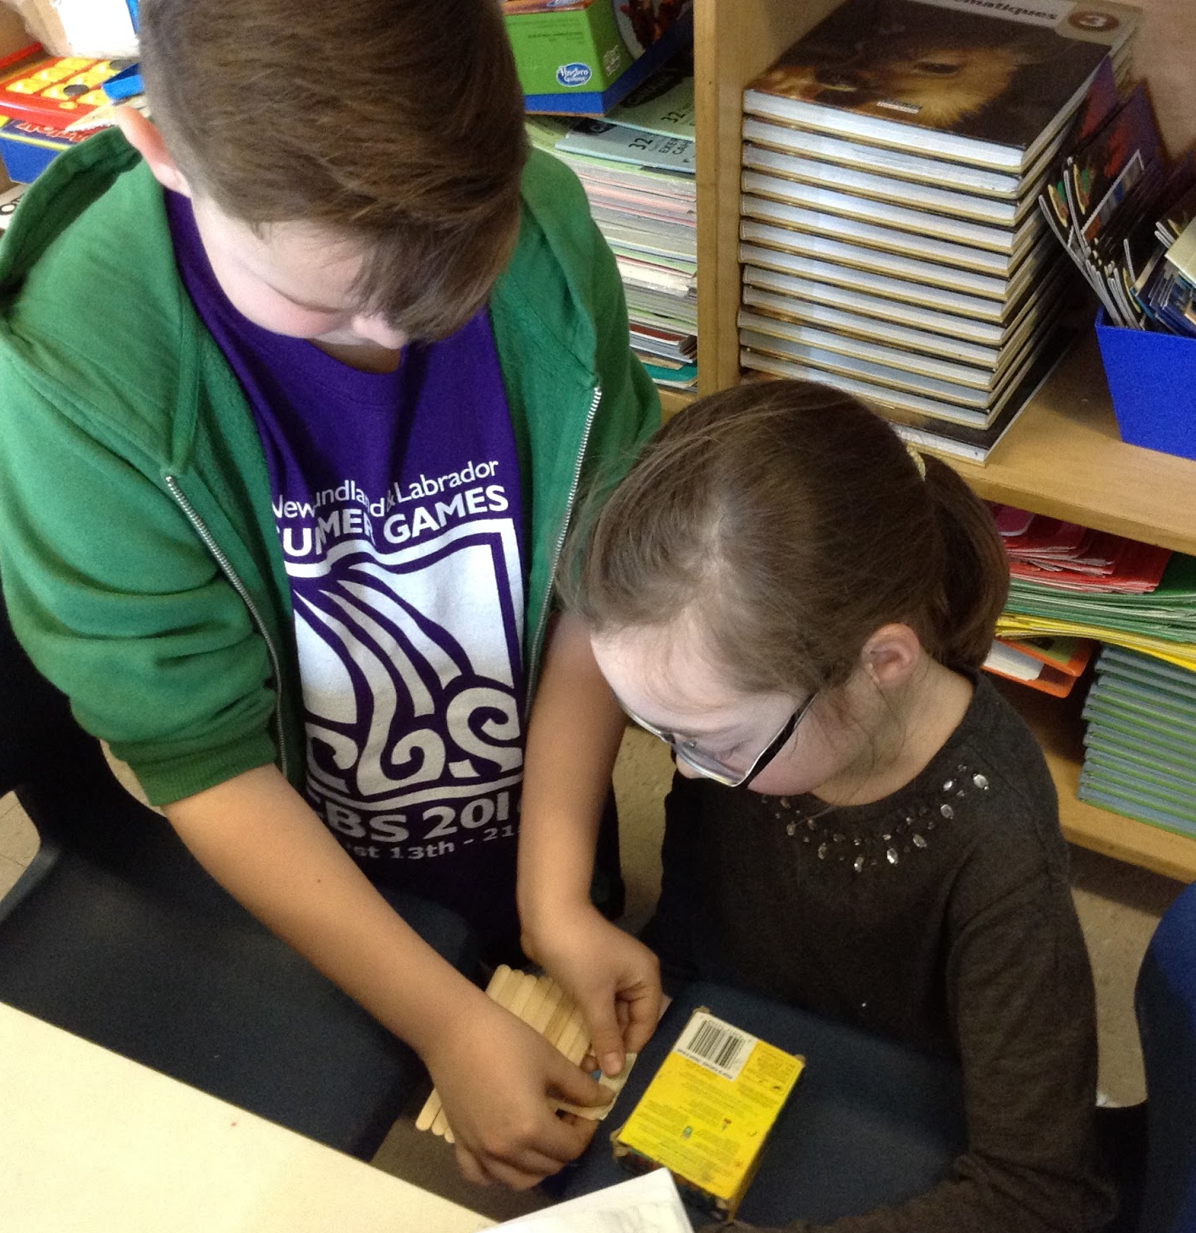
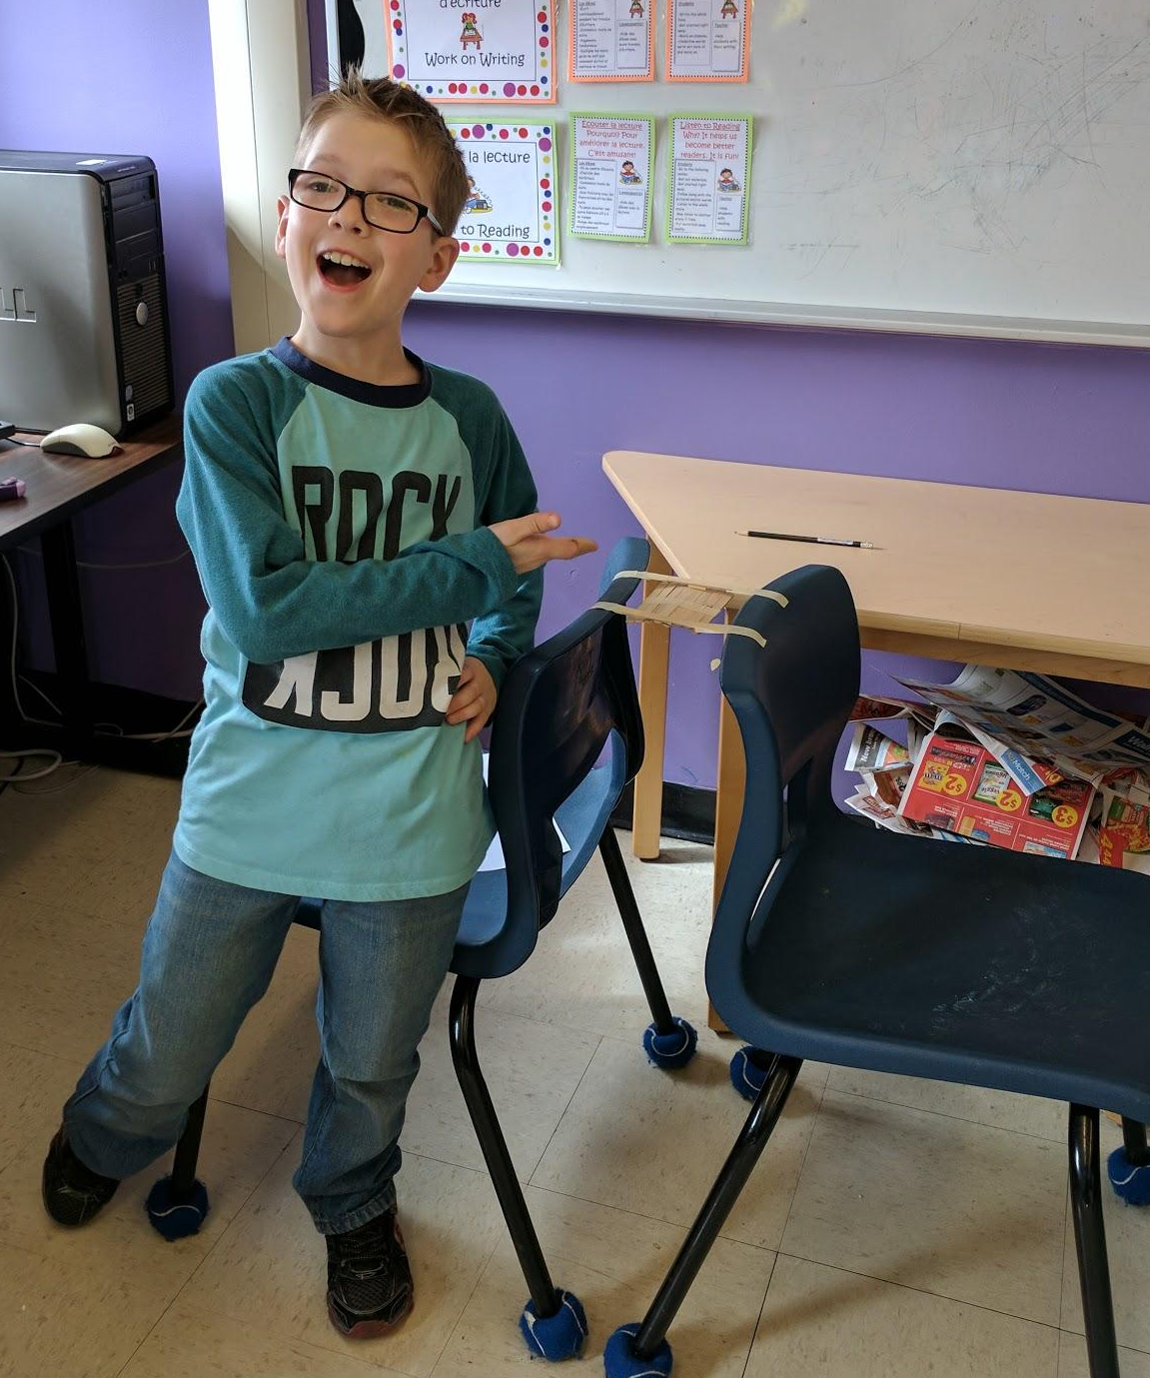
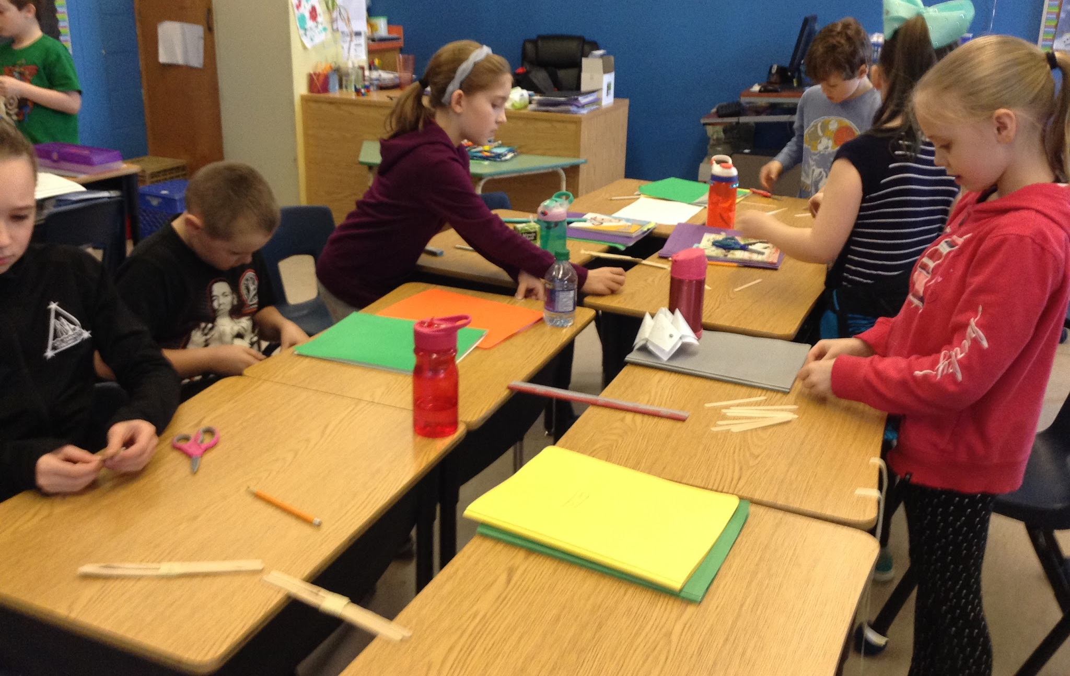
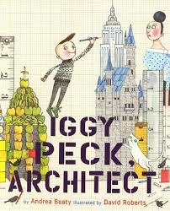
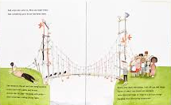
Iggy Peck inspires our students to build bridges!
Notes:
Bridge building challenge - Inspired by Iggy Peck, Architect

Slide 32
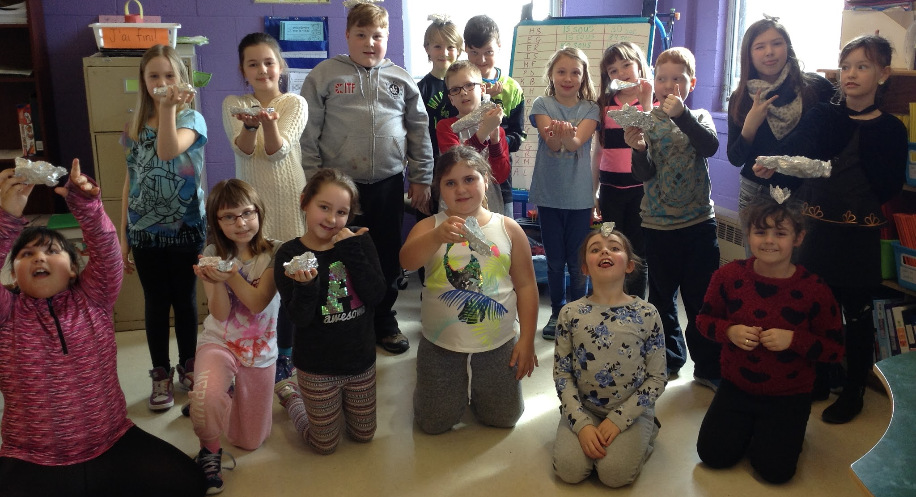
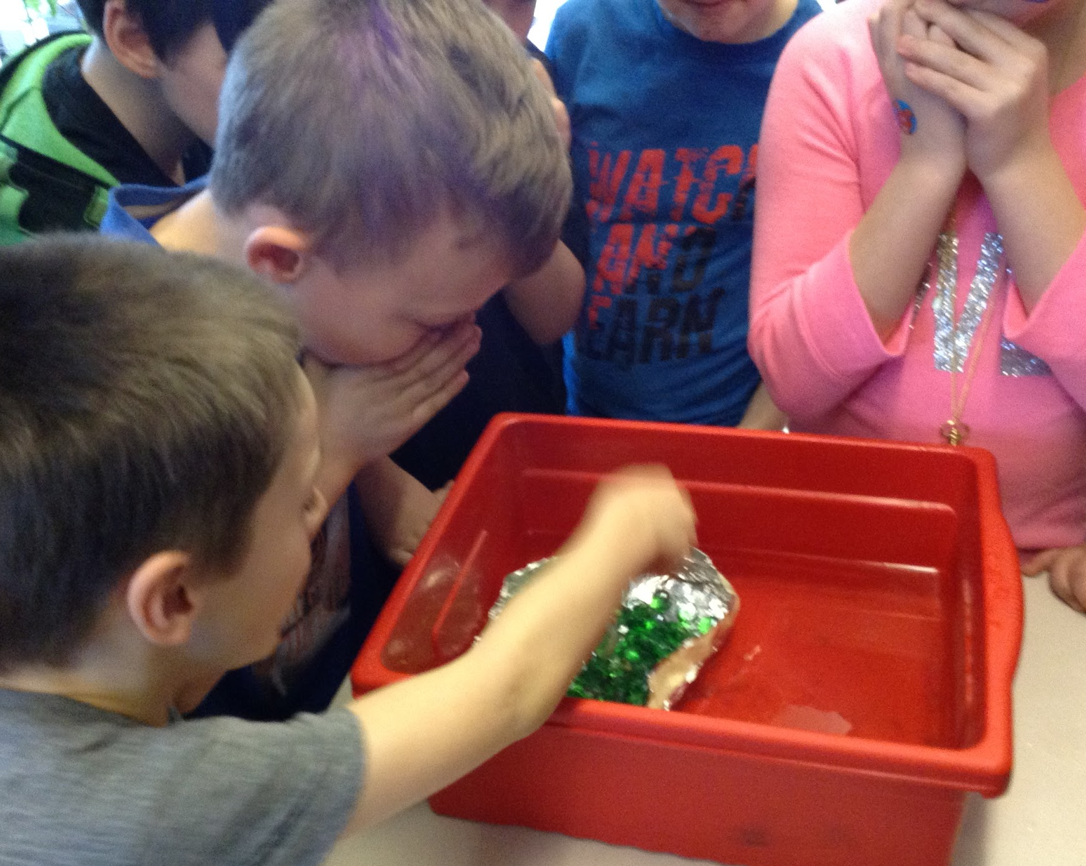
Tinfoil Boat Challenge!
Notes:
Tinfoil boat challenge

Slide 33
Marshmallow Shooters!
Notes:
Marshmallow shooters

Slide 34
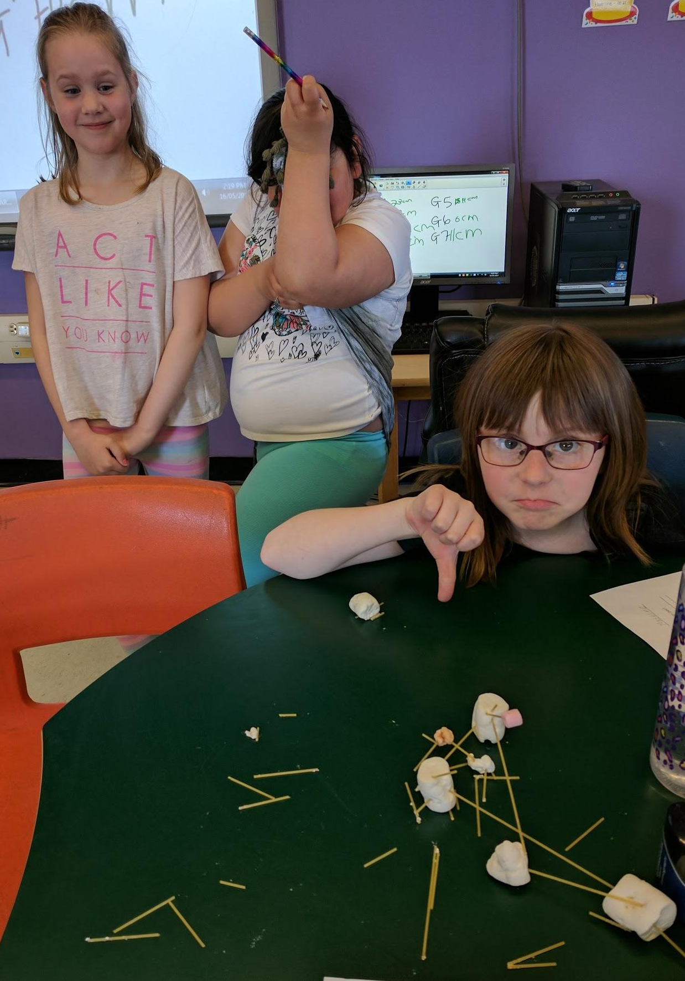
Spaghetti Tower
The materials did not work well for the challenge, but at this point in the project, failure no longer made our students cry!
Success!!
Notes:
Marshmallow and spaghetti structure - even though it didn’t work well, failure no longer made our students cry

Slide 35
Student Final Project - Structures
Notes:
Urban and rural communities
After exploring Newfoundland landforms, vegetation, and bodies of water, and exploring the difference between urban and rural communities, we decided to integrate our Social Studies unit on place with our final project for structures.
In two teams, classes created a rural and an urban community taking into consideration both the structures and the landforms/vegetation/bodies of water.
Teams planned their communities using a blueprint and then built as a team.

Slide 36
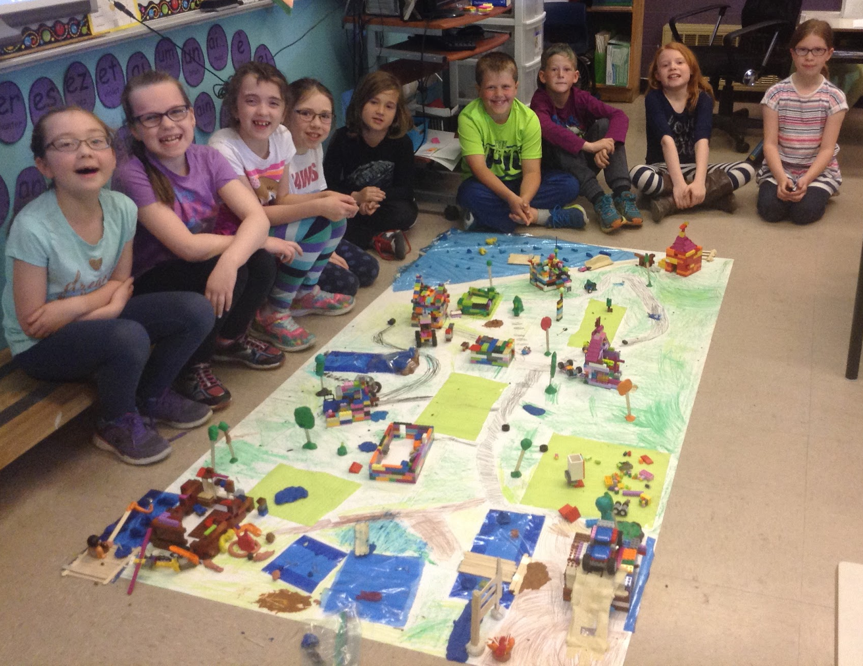
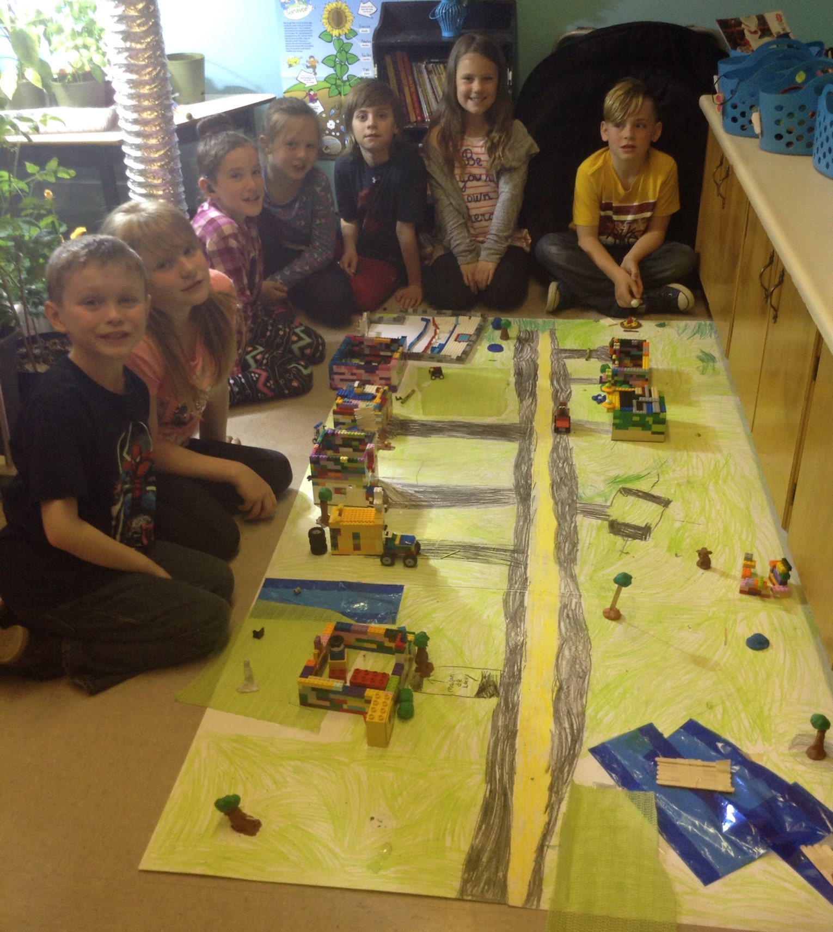
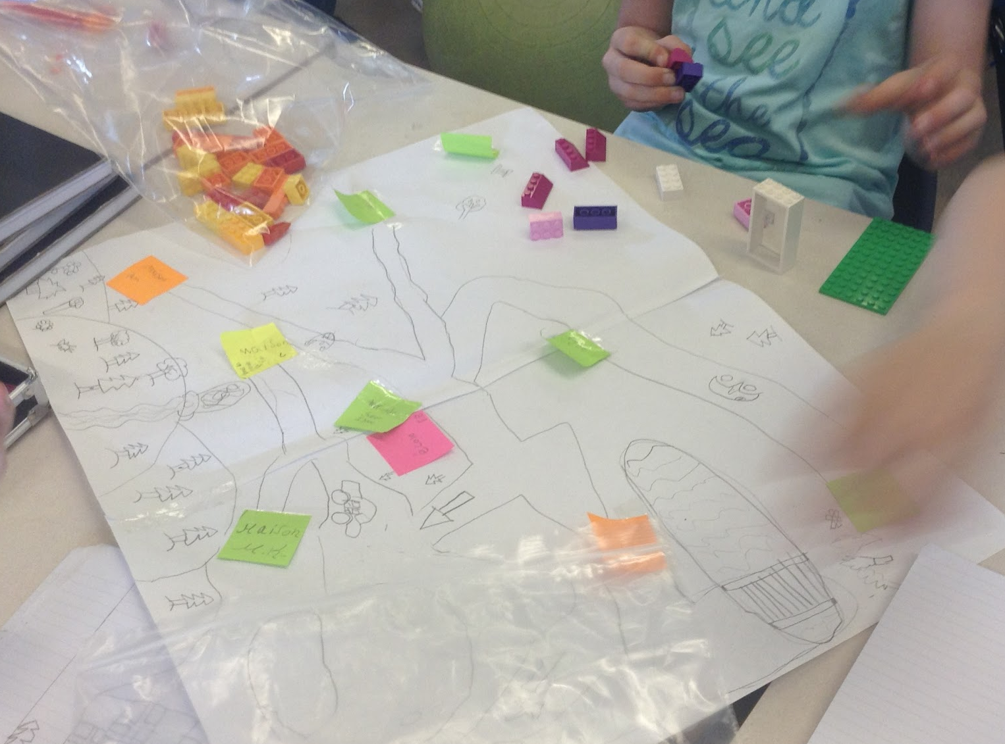
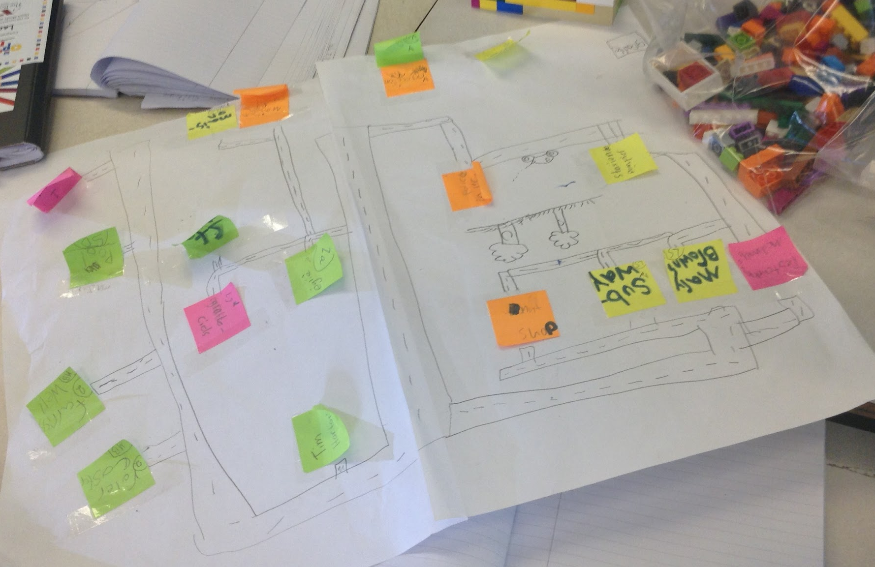
Notes:
Yolanda’s class

Slide 37
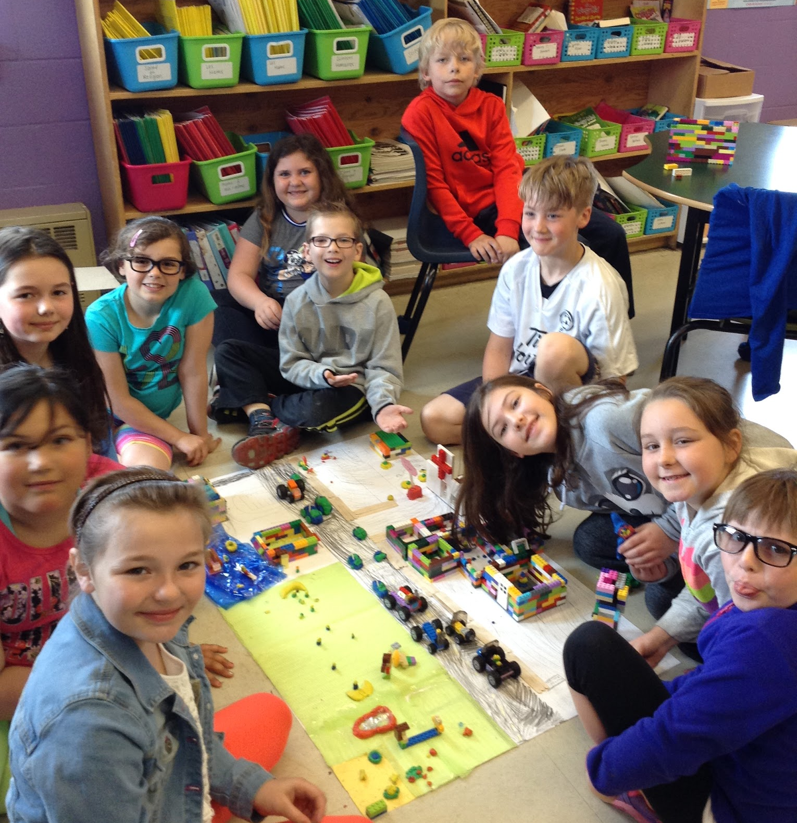
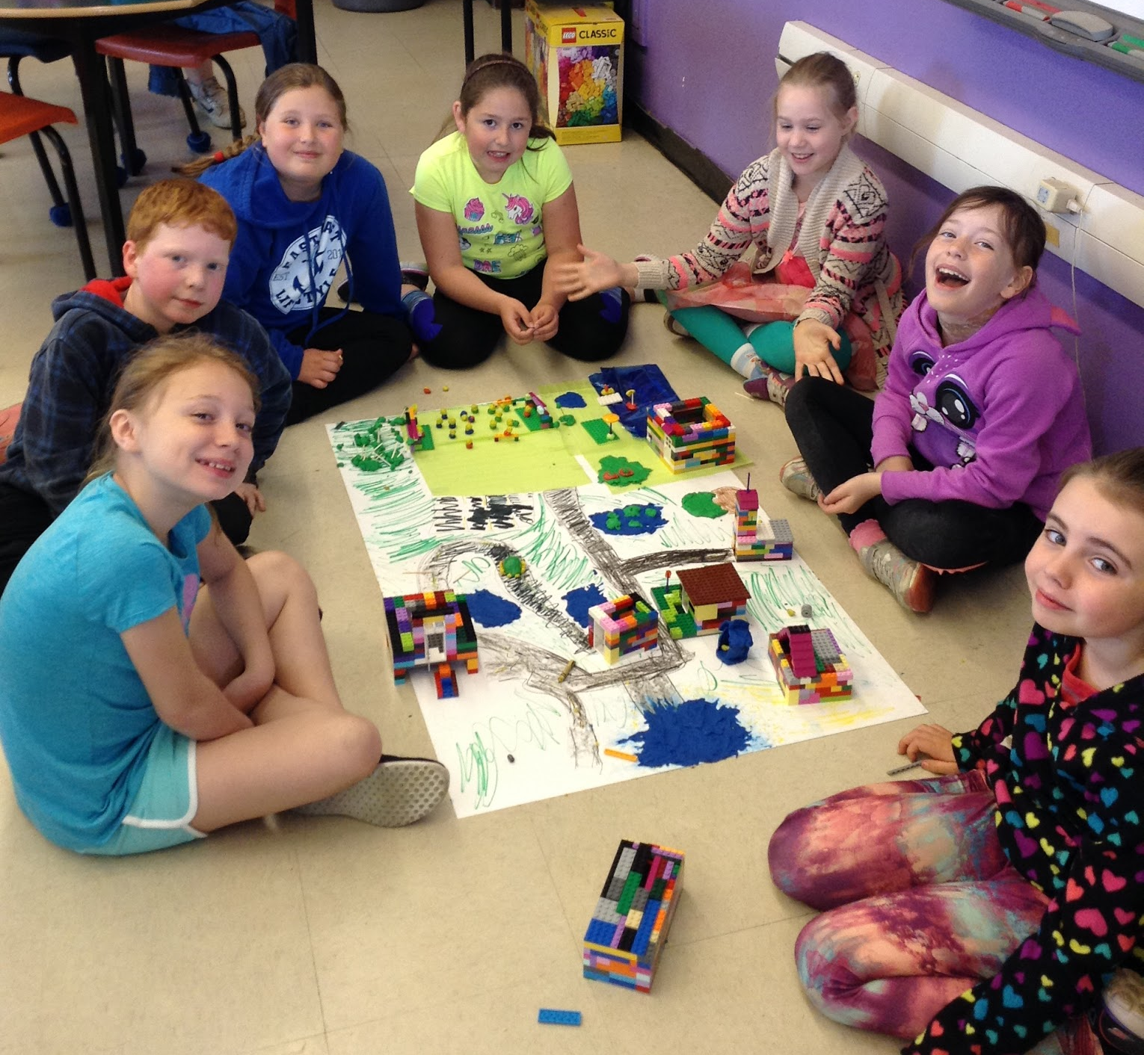
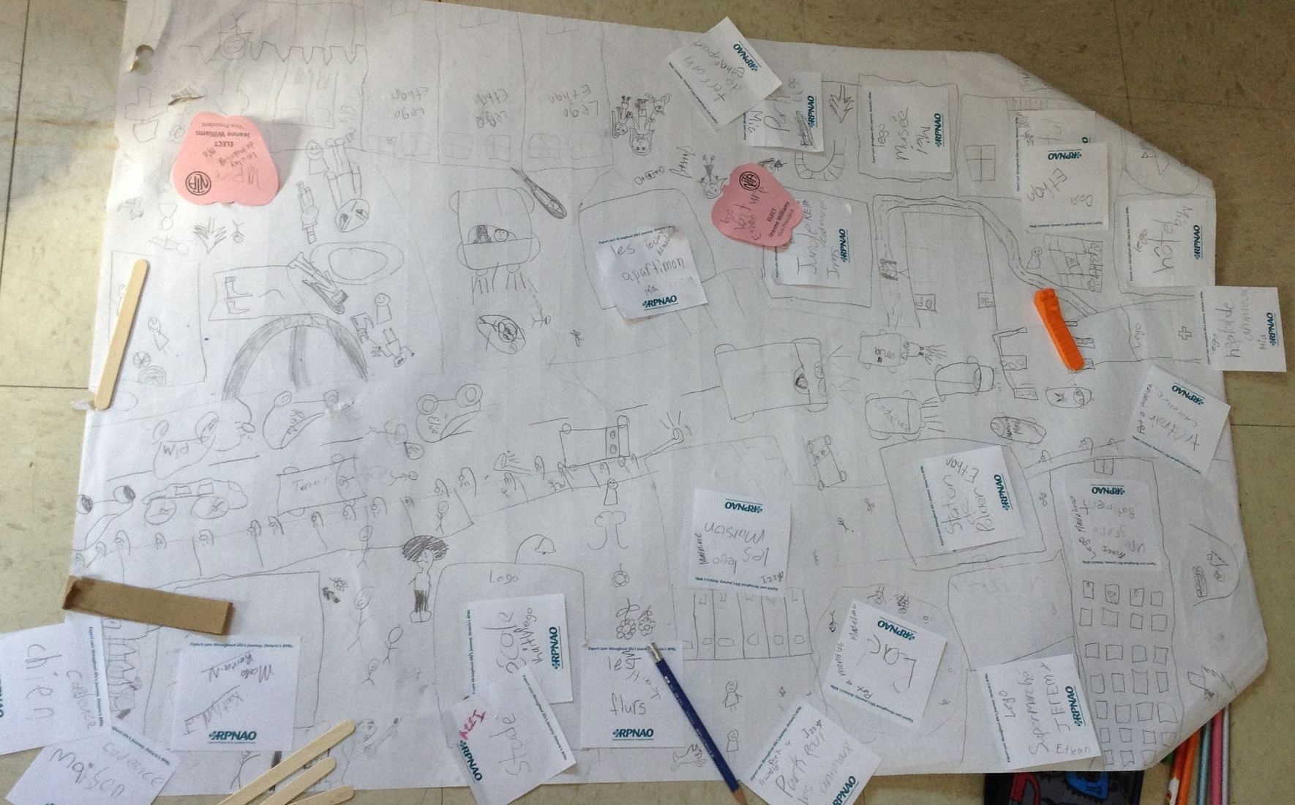
Notes:
Jenny’s class

Slide 38
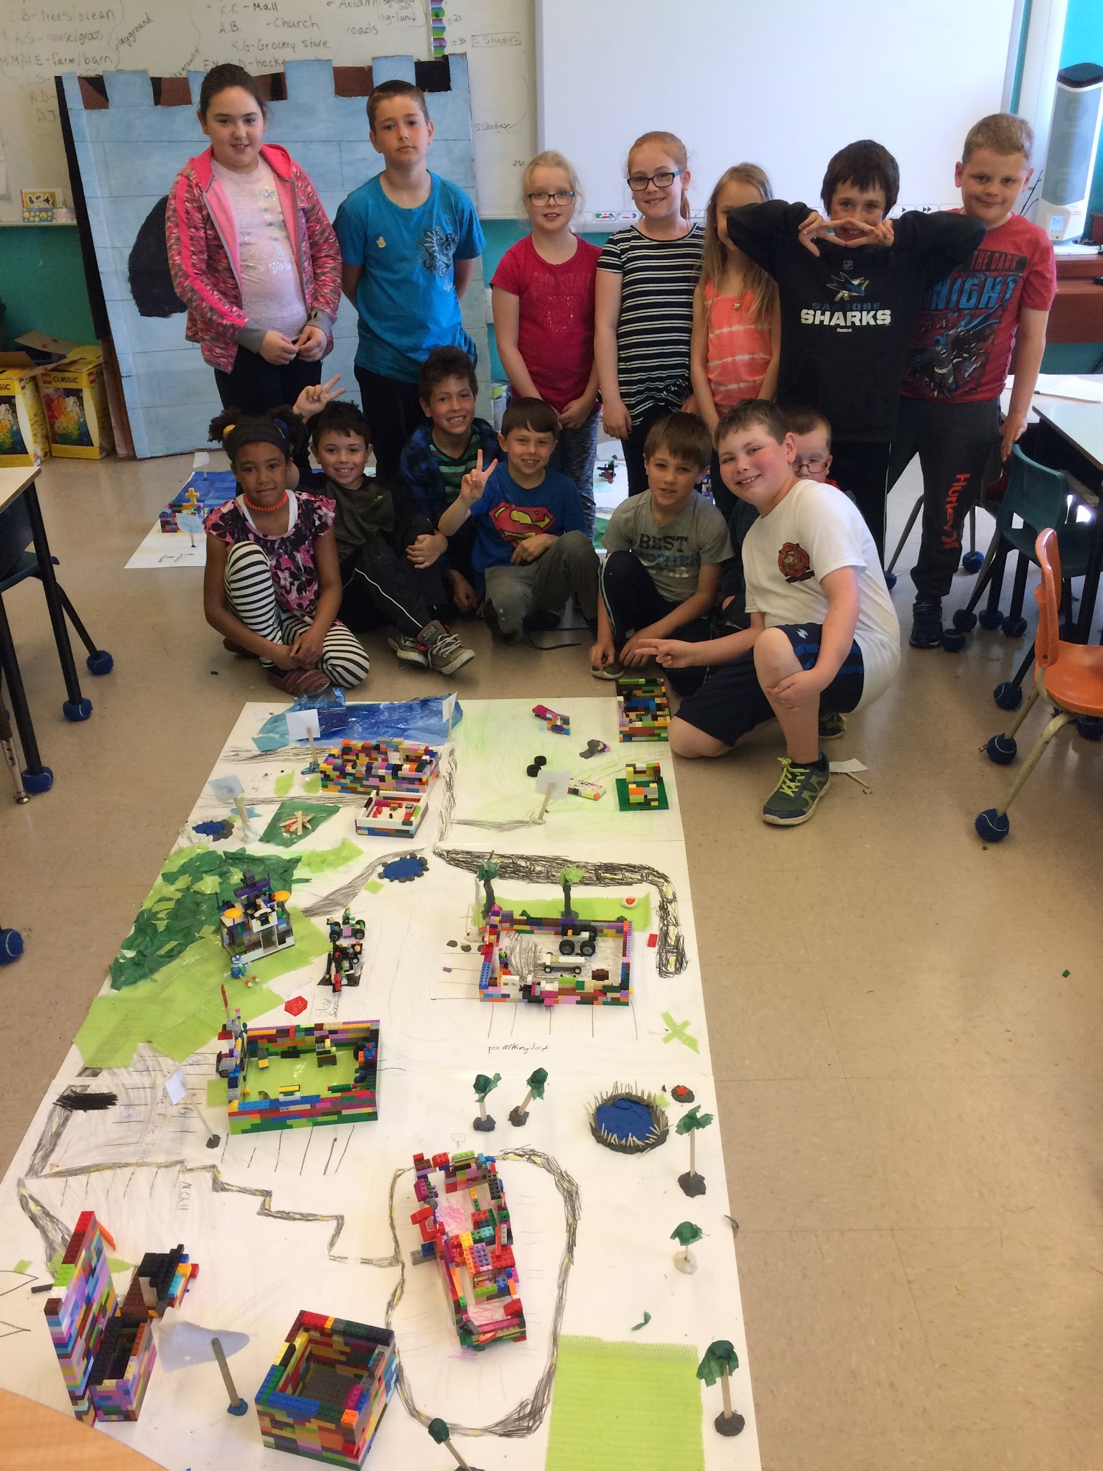
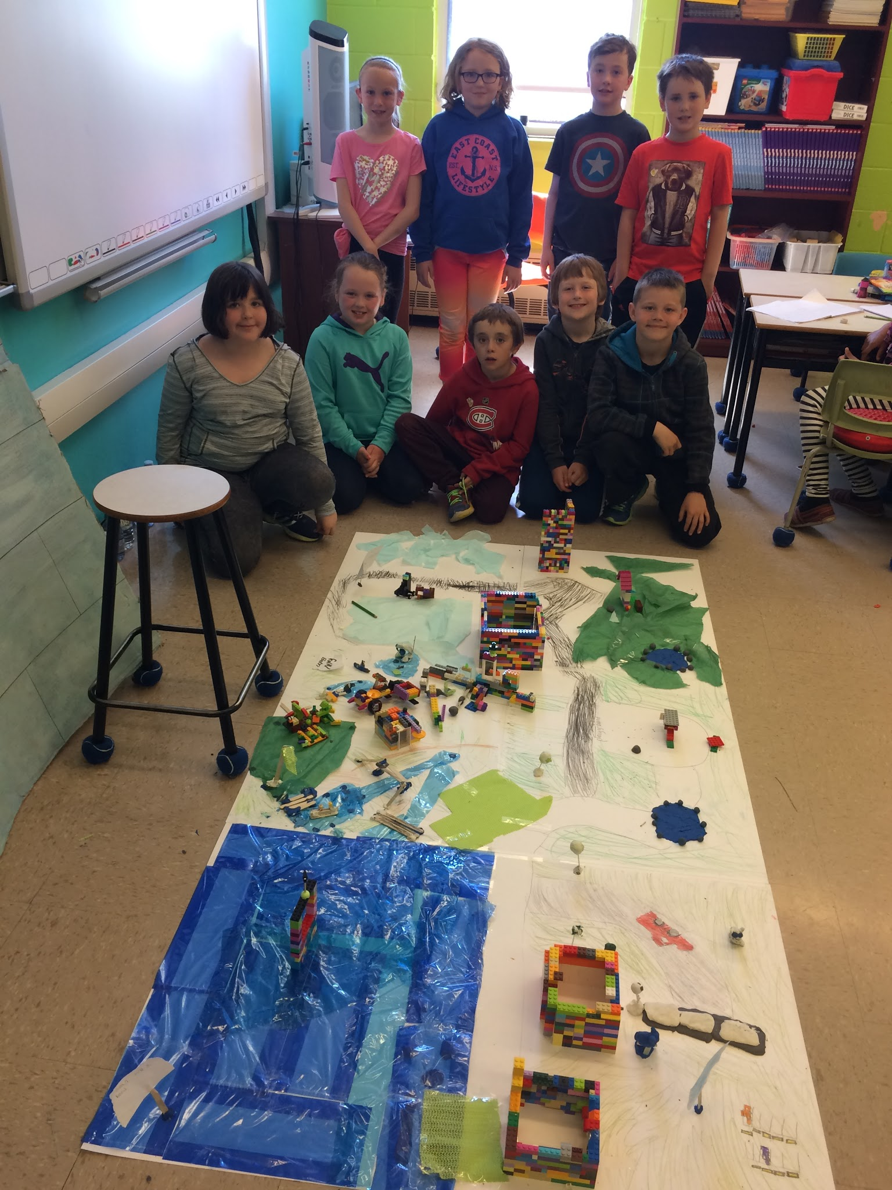
Notes:
Jennifer’s class

Slide 39
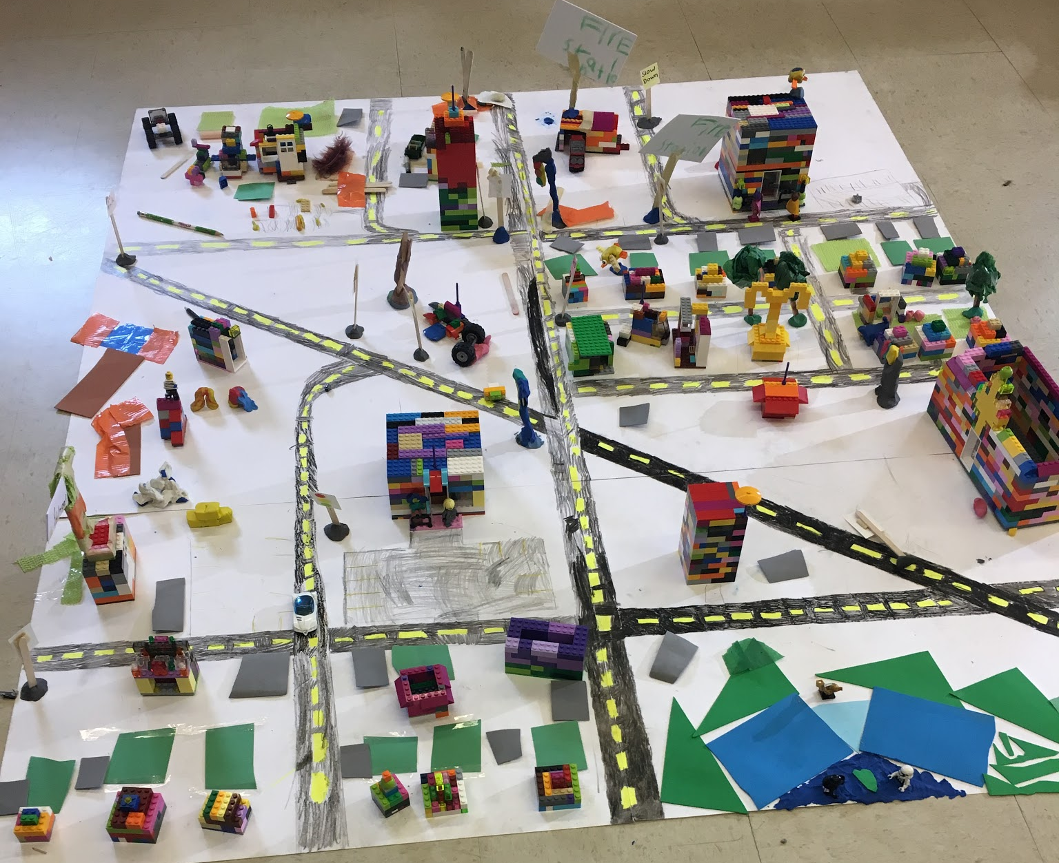
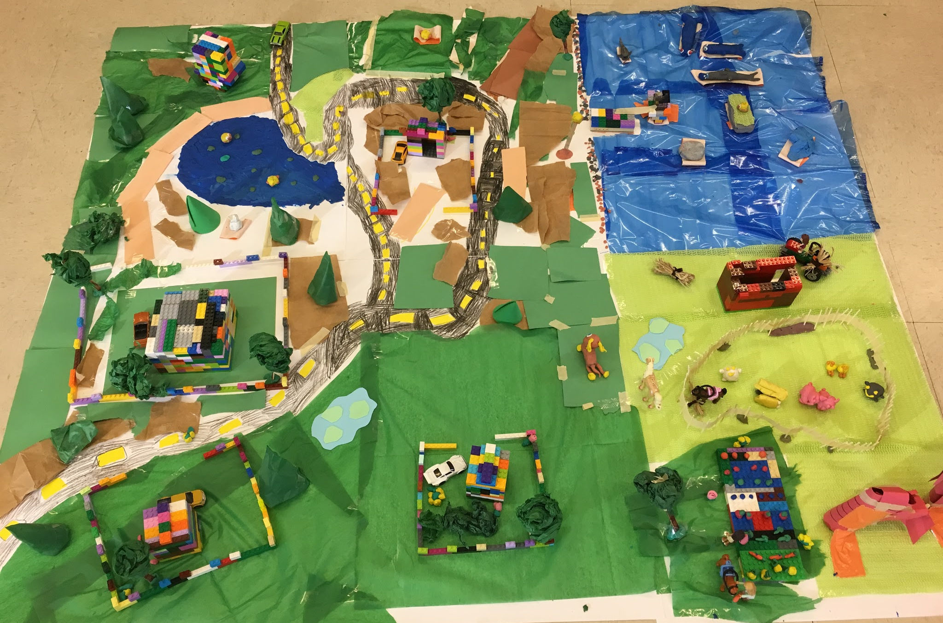
Notes:
Susan’s class

Slide 40
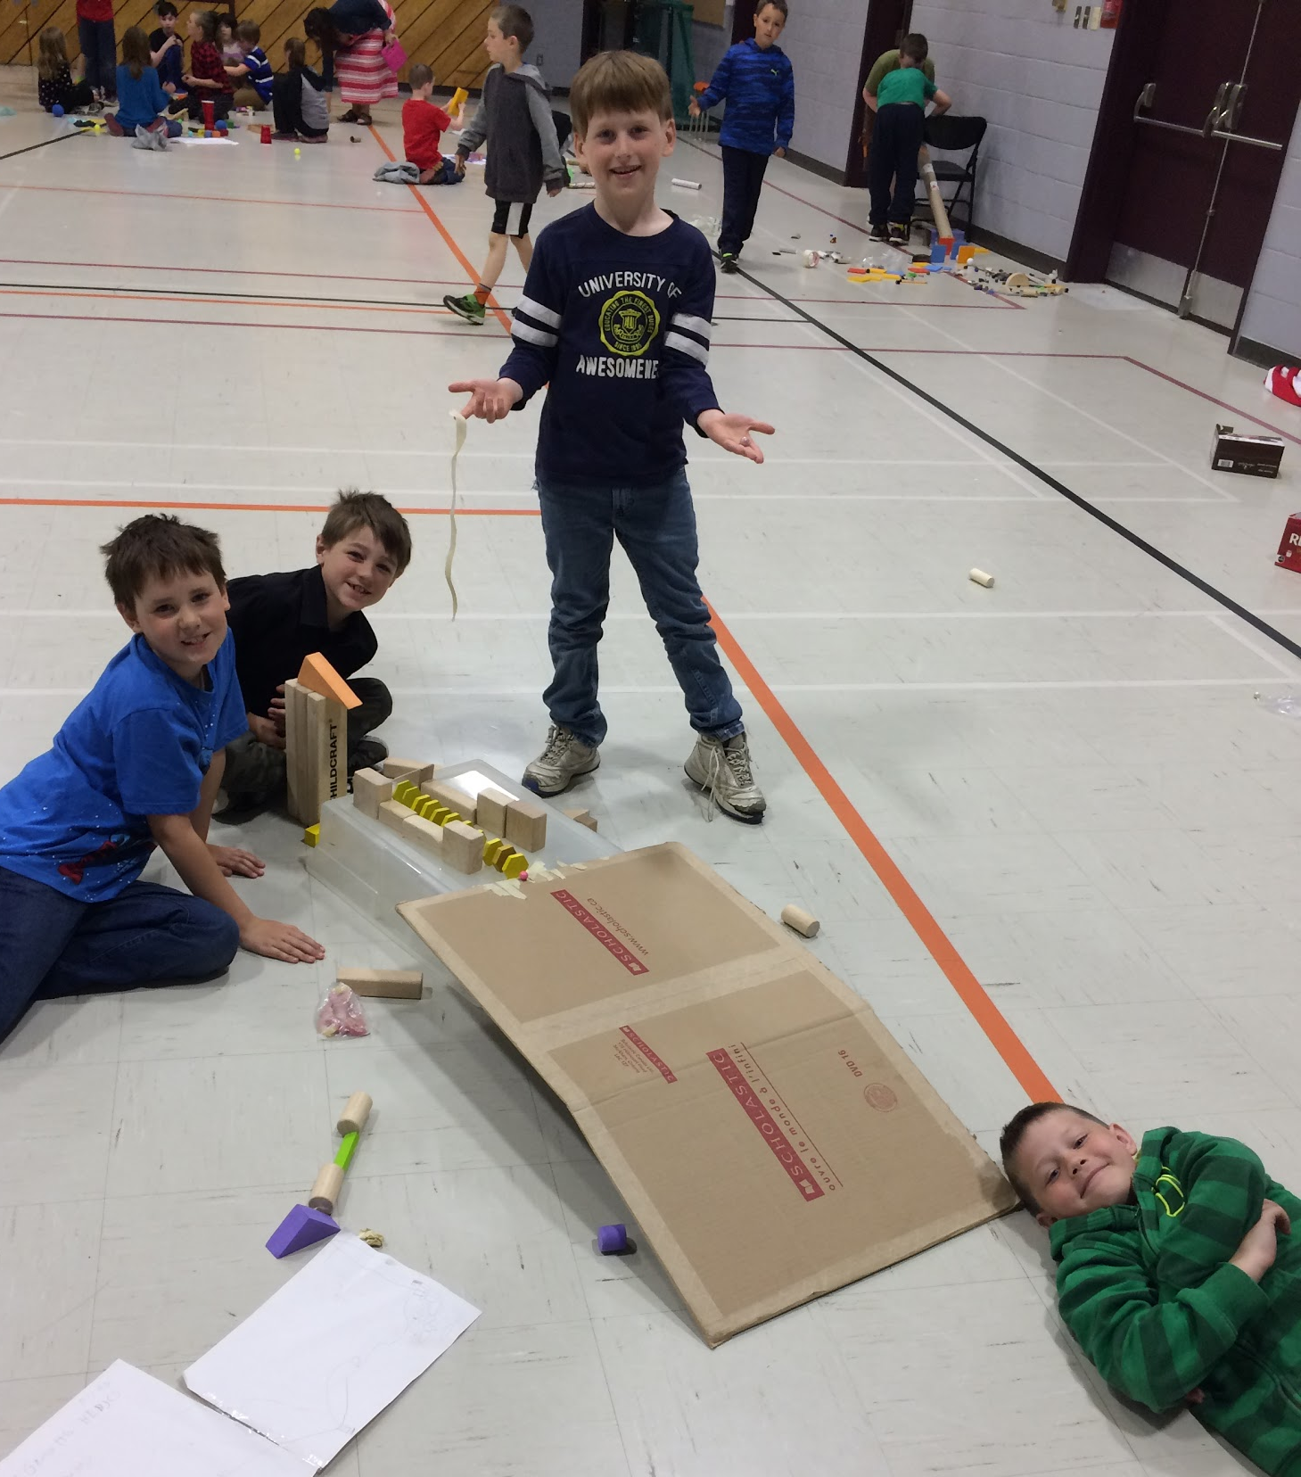
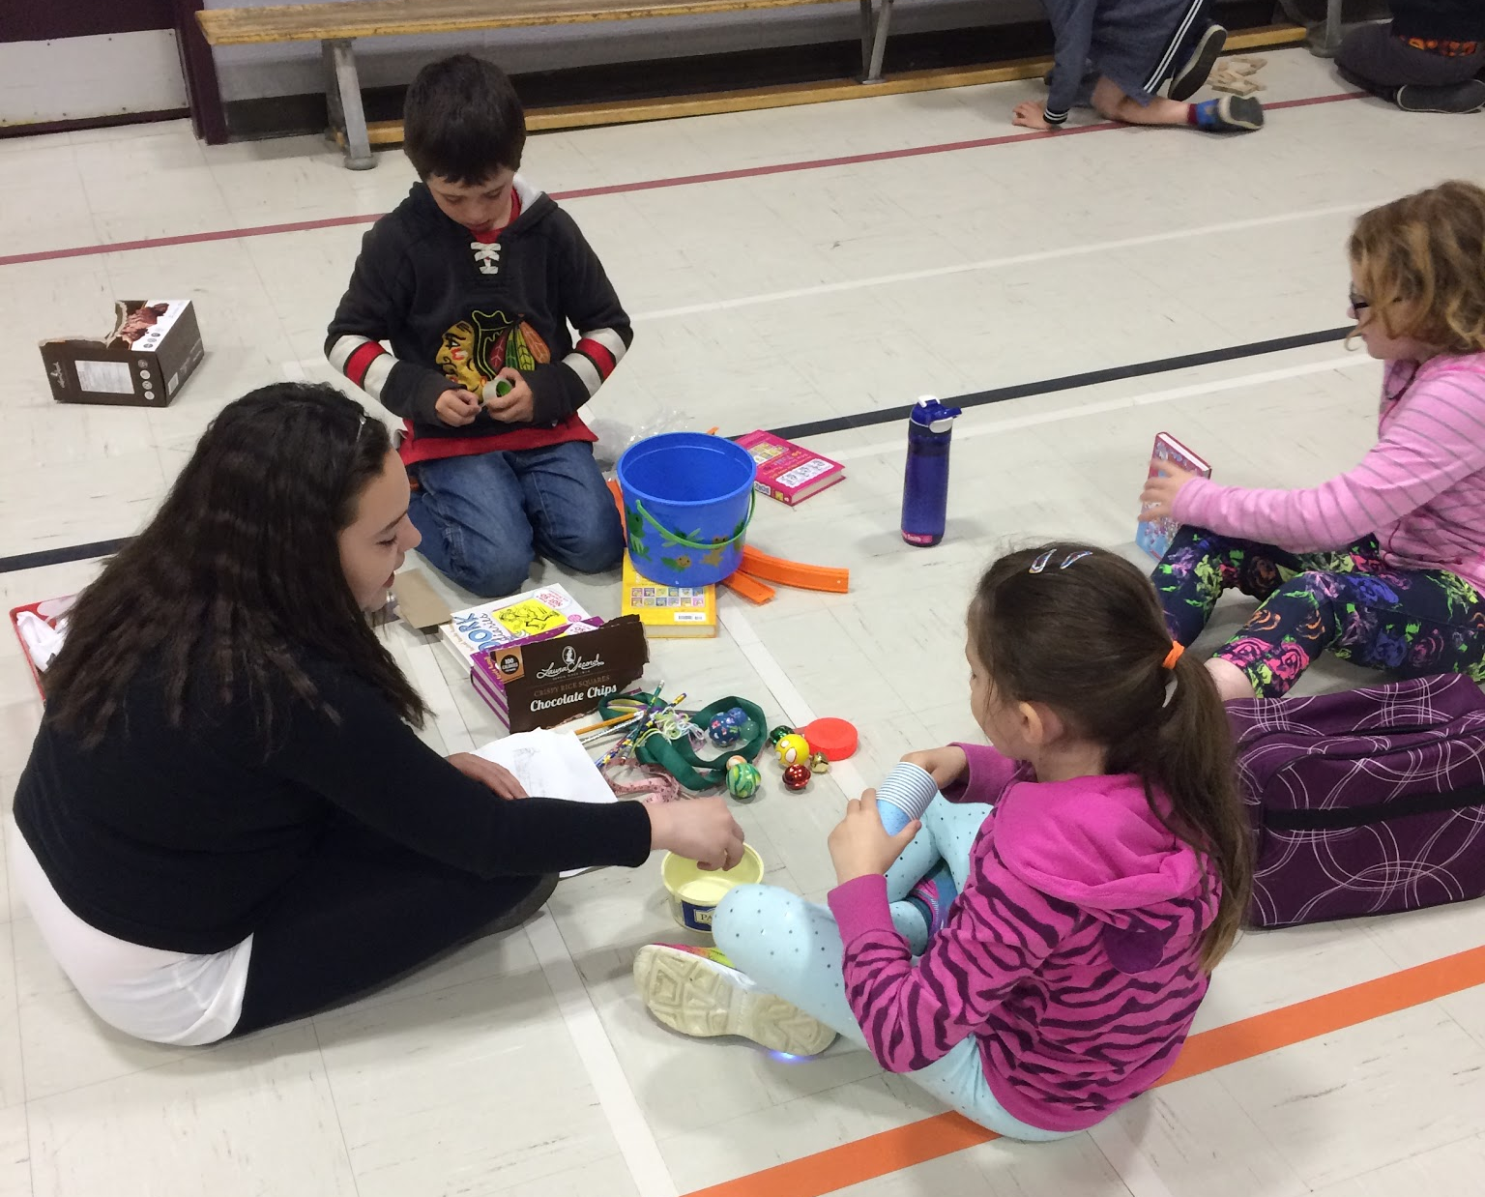
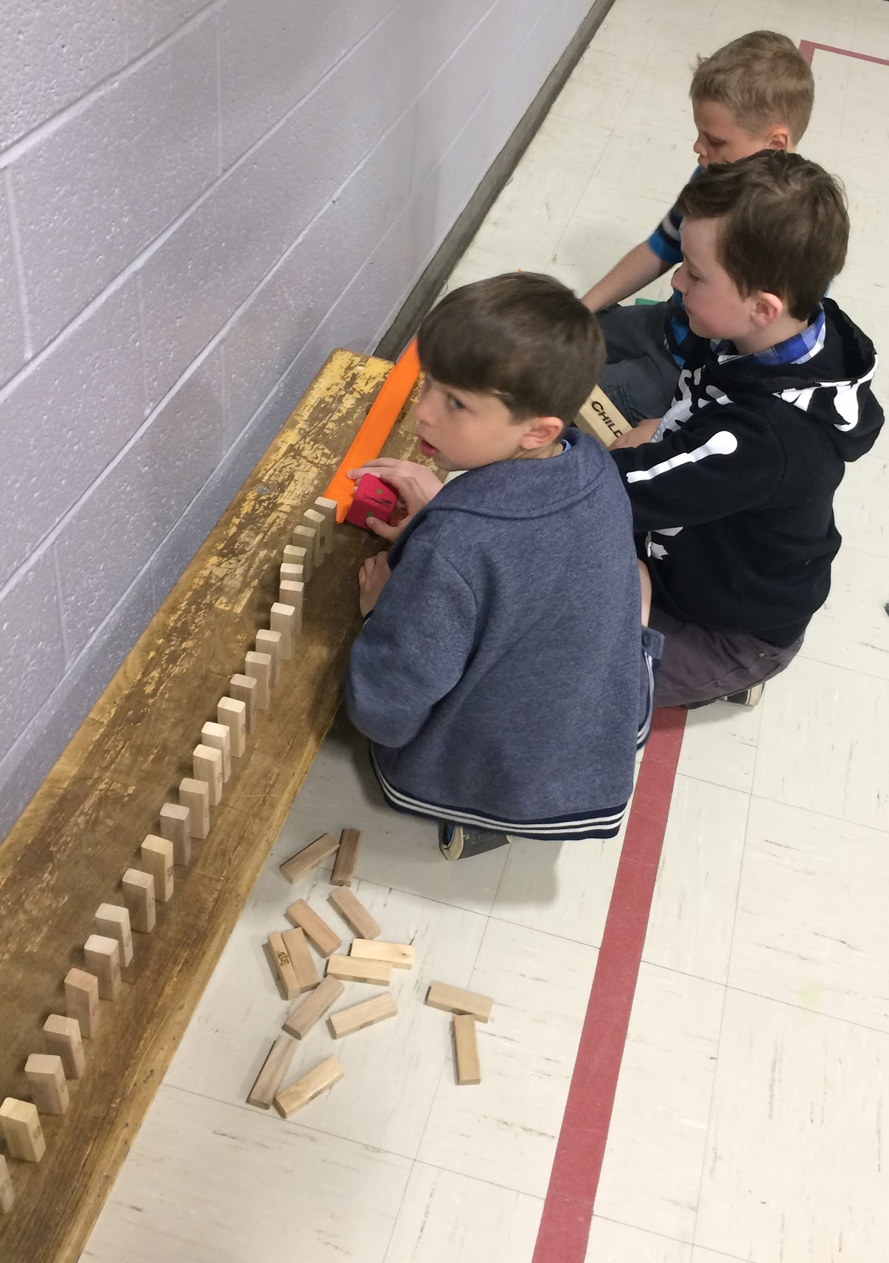
Rube Goldberg
Machines!
Notes:
Rube Goldberg day with Tom

Slide 41
Post-Survey
What is Science? / Qu’est-ce que tu penses “sciences” veut dire?
Science is awesome.
Science is when you make things happen.
Sciences est explorer de nouvelles choses.
Les sciences veut dire beaucoup de prédictions et les expériences. Sois créative!
Notes:
Last child was the same one who thought science was “pas de fun” at the beginning of the year.

Slide 42
Post-Survey
Science is fun when…
We do experiments and we put our hands in it and don’t forget getting messy.
We learn new things. I like to learn new things.
You do stuff with cool stuff to use for whatever it is used for.
Notes:
This is the child who wrote about the teacher getting messy on her pre-survey; obviously things have changed.

Slide 43
Post-Survey
Est-ce que tu aimes les sciences?
Oui, parce que c’est amusant. Aussi c’est quelquefois difficile.
Oui, parce que quand on fait les défis c’est amusant.
Oui, parce que j’aime estimer si ça va marcher ou pas marcher, aussi j’aime construire.

Slide 44
Data Collection & Analysis

Slide 45
How did we collect our data?
Observations
Pre and post surveys
Photographic evidence
Videos
Conversations amongst ourselves
Teacher reflections
Final unit project
Notes:
Pre-surveys were completed before any science was taught to ensure that there was no influence/bias from us on the students’ responses.
We assured students that the surveys were not for a grade and that they should share their honest opinions and ideas with us.
We regularly checked in with each other and had conversations during every release day to look at how we were changing as science teachers.

Slide 46
How did we analyze our data?
Comparing pre and post surveys of the same student
Looking at the progression in student behaviour during science activities
Making note of what students were saying over the course of the project
Looking at how we changed over the course of the project
Notes:
We all analyzed and compared student surveys so that it was not only just us looking at our own students.

Slide 47
Notes:
Yolanda’s student

Slide 48
Notes:
Jennifer’s student

Slide 49
Results

Slide 50
Pre-project
Students felt science was teacher-led with demonstrations while they watched from their desks.
Initially, students had much difficulty with problem solving, working together, and coping with failure.
In our initial teacher reflections, we all expressed a lack of desire and motivation to teach science.

Slide 51
During the project
We noticed an increase in excitement for both students and teachers when it came to science and our various challenges.
Tears began to subside during science activities.

Slide 52
Post-project
We no longer leave science for our substitutes!
Student motivation has increased towards science.
Students have learned that failure is part of the learning process.
Students have also developed problem solving and collaboration skills.

Slide 54
Science makes me feel super energetic!

Slide 58
Teacher Inquiry

Slide 59
“CAR can provide a renewed sense of excitement about teaching” (Mettetal, 2012).

Slide 60
Strengths
Challenges
Student collaboration
Increased motivation for students and teachers
Increased ability to problem solve
Students enjoyed hands-on activities
Opportunities for independent learning and group work
Opportunity for teacher-led professional learning
Increased knowledge of science curriculum outcomes
Lack of working space
Access to resources (technology, French materials)
Limited time in classroom schedule devoted to science
Initial student adjustment period to student-led activities and design challenges

Slide 61
References & Credits

Slide 62
References
Fichtman Dana, N. & Yendol-Hoppey, D. (2014). The reflective educator’s guide to classroom research (3rd ed.). Thousand Oaks, CA: Corwin
Mettetal, G. (2012). The what, why and how of classroom action research. Journal of the Scholarship of Teaching and Learning, 2(1), 6-13. Retrieved from http://josotl.indiana.edu/article/view/1589/1588
Morgan, E. (2012). Bridges and skyscrapers. Science and Children.
Morgan, E. & Ansberry, K. (2015) Every part has a purpose. Science and Children.
STEM Engineering Challenge Projects Ten Pack #2 (Smart Chick Teaching Resources)

Slide 63
Credits
A special thank you to all our students for their cooperation and participation in our Classroom Action Research project!
A very special thank you goes to Mr. Walsh, without whom this project would not have been this much fun!

Slide 64
Science…
I think we have a future!

