Slide 1



Fostering Independence with Mathematical Problem Solving
Brian Sharpe
Kim Joyce
Renee Lynch
Kim Petten

Slide 2
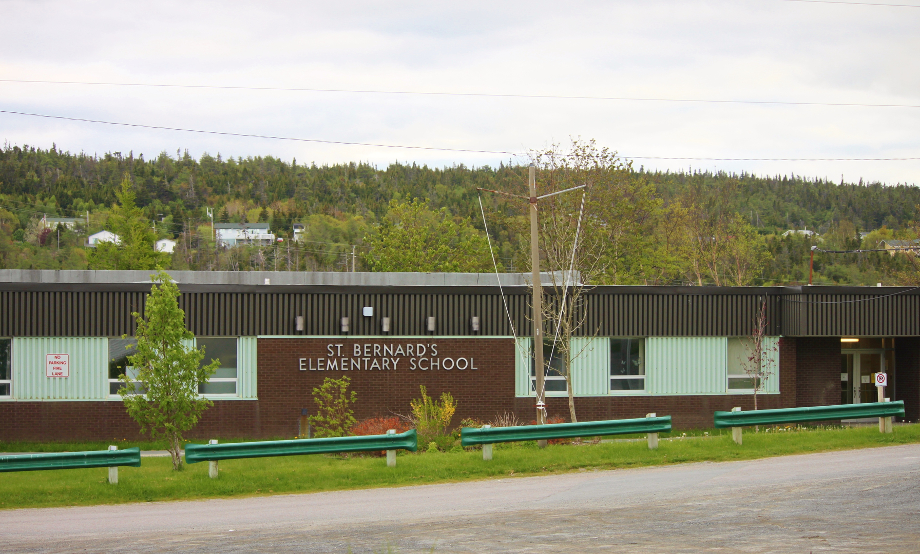
St. Bernard’s Elementary - Witless Bay
Our school has approximately 385 students. It is multi-stream school from Kindergarten to Grade Six. We have a diverse range of students and a growing population.

Slide 3
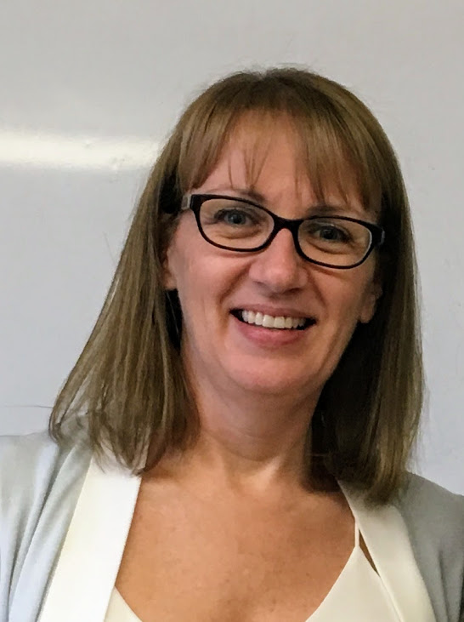
Kimberley Joyce
I have been teaching Grade Three at St. Bernard’s Elementary for six years. This is my third year participating in the STEM project.
My class this year has twenty-two students, with two students receiving IRT support for reading and writing.
I started using a Numeracy Block in my classroom last year. I use the format of Daily 3.
Notes:
I have been teaching for 16 years. Most of my teaching experience has been in grades 4 and 5, with some experience teaching Special Needs and Challenging Needs. This is my second year teaching Grade 3 full time. Currently, there are 21 students in my class. Four students receive supports for reading and writing. Two students are ESL students. I believe motivation is a key factor in student achievement.

Slide 4
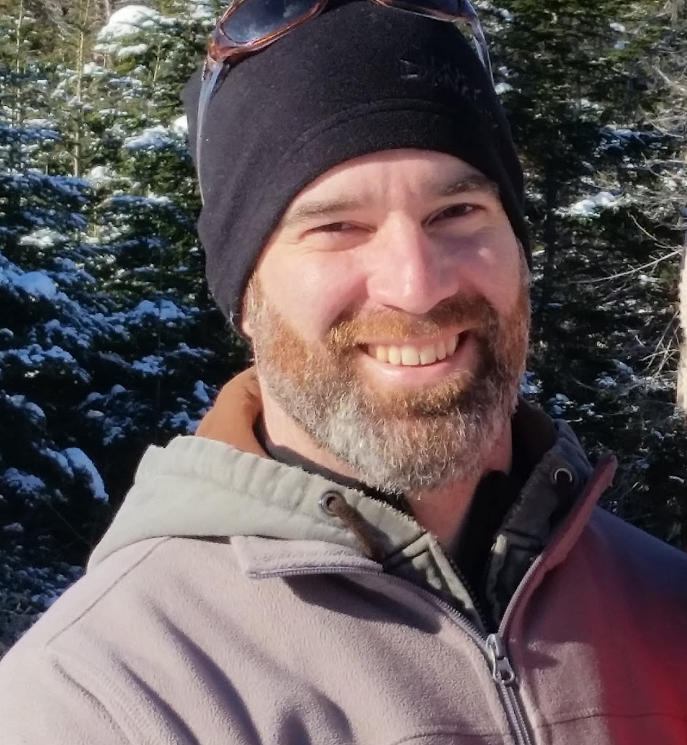
Brian Sharpe
I have been Teaching for approximately 11 years.
This is my 1st year in Grade Four.
This is my third year participating in TIA project.
Class description: 22 students, large variation in student ability, six students in class receiving IRT support for reading, writing and math.

Slide 5
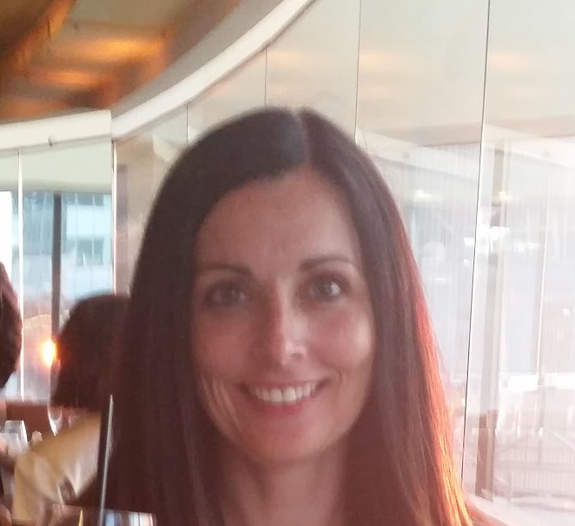
Renee Lynch
I have been teaching for 16 years. Most of my teaching has been in Grades Four and Five. I have taught Grade Three for two years.
This year I have 21 students in my class. Four of my students receive reading and writing supports. Two of my students are ESL students.
This is my second year completing a STEM project.

Slide 6
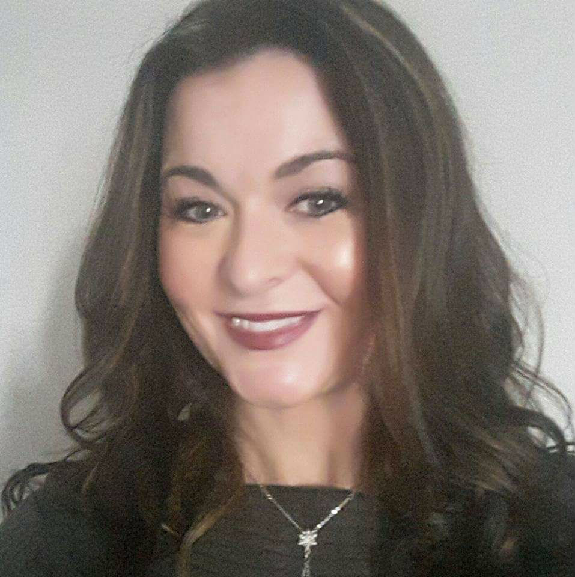
Kimberly Petten
I have been teaching for approximately 14 years.
My focus has been in special services over the past 10-12 years but have recently gone back to the classroom. It is currently my second year teaching full time Grade Four, 4th year teaching math Grade Four.
I first became involved with the STEM project in September, 2016 to foster independence with problem solving in the classroom setting.
My classroom this year consists of 20 students with a wide range of abilities which makes it a perfect year to reflect on current teaching strategies.

Slide 7

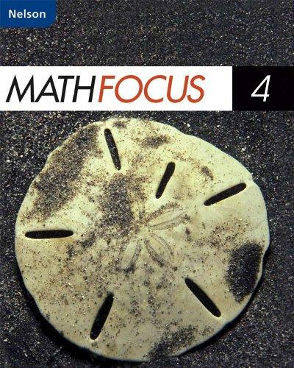
Focus Area
The area of focus for our project was mathematical independent problem solving. We identified that students, at the grade levels we work with, struggle when working on their own to problem solve.

Slide 8
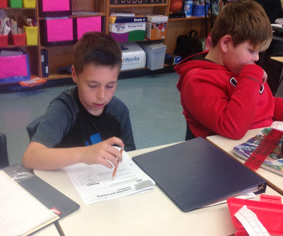
Research Questions
Teacher Questions:
How do we improve students’ ability to problem solve?
How can we find out why students have so much difficulty with problem solving?
  Are they not ready for what is expected?
  Is the language too difficult?
  Why do they have so much trouble with problem solving in life skills as well?
How can we foster problem solving and student independence, using Math Daily 3?
How can we engage students and make problem solving easier for them?

Slide 9
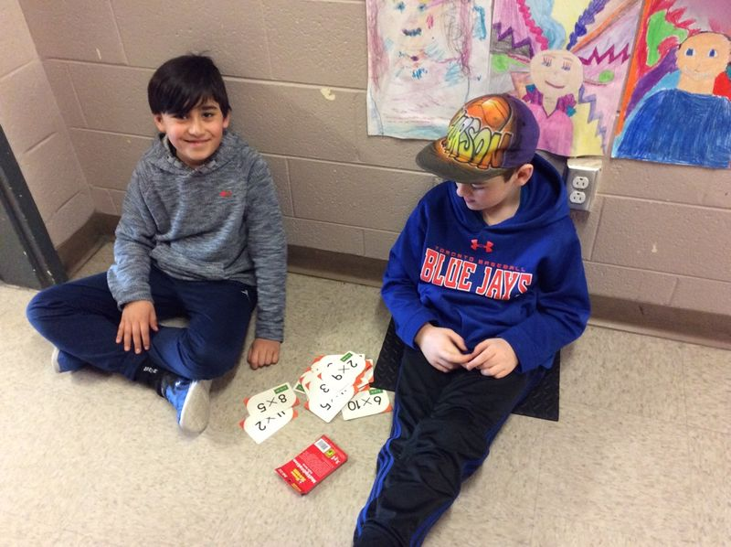
Research Questions
Student Questions:
How will the use of games* and Math Daily 3 increase students’ ability to problem solve?
Will this approach aid in engaging and motivating students?
Will the use of Math Daily 3 aid in developing problem solving skills and mathematical language?
* Our tools changed from using Minecraftedu to using the Math Daily 3 model and the Seesaw App.

Slide 10
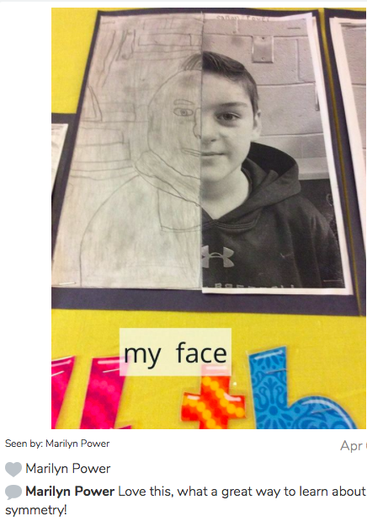
Ethical Considerations
Parental consent
  letter/permission form to participate in the STEM project
  letter/permission form for sharing of work
  multimedia permission form to share pictures, videos, student work
  online acceptance to participate using the Seesaw app/website. Registration for the free app was also required.

Slide 11
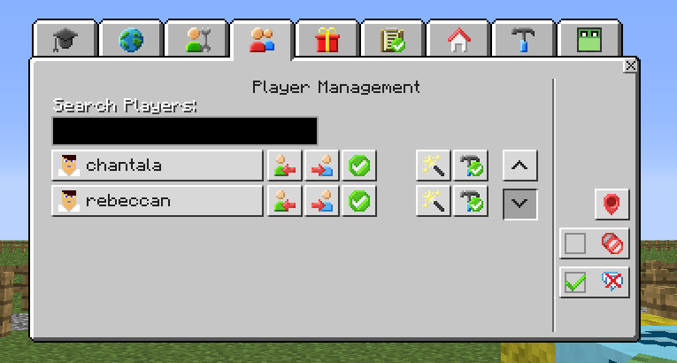
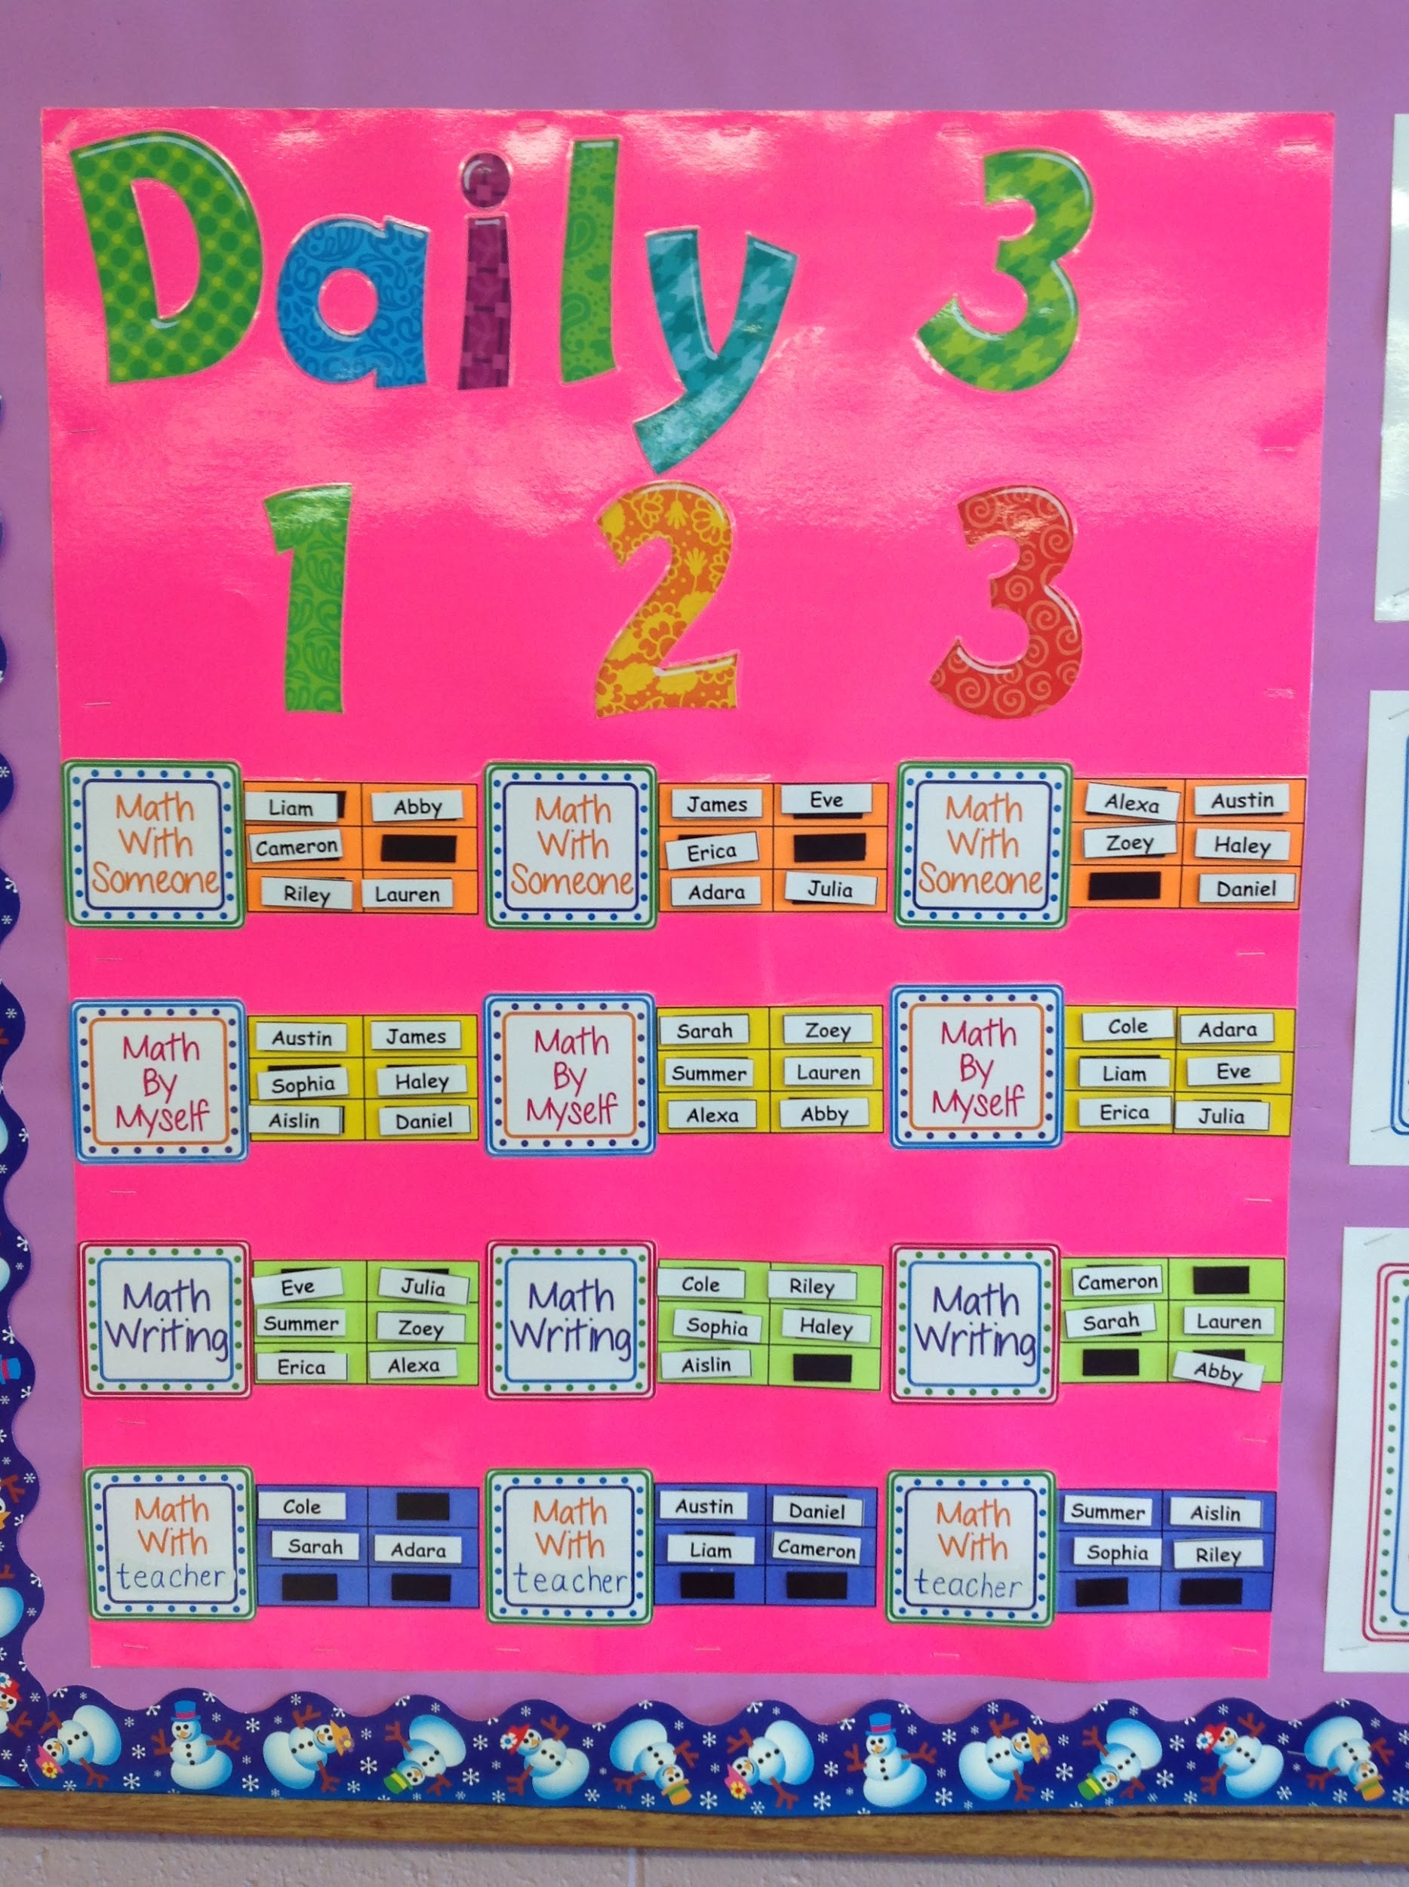
Planning
We had seven release days at Memorial University to plan our project.
We often met after school to discuss our project.
We attended professional development on Seesaw, MinecraftEdu and Math Daily 3
When Minecraft was disabled, we met as a group to discuss other options for our project.
We also had a conference call to discuss the direction our project was going to take without MinecraftEdu.
Throughout our planning process, the Math Curriculum Guide and the 5 E Instructional Model were used to guide our project.

Slide 12
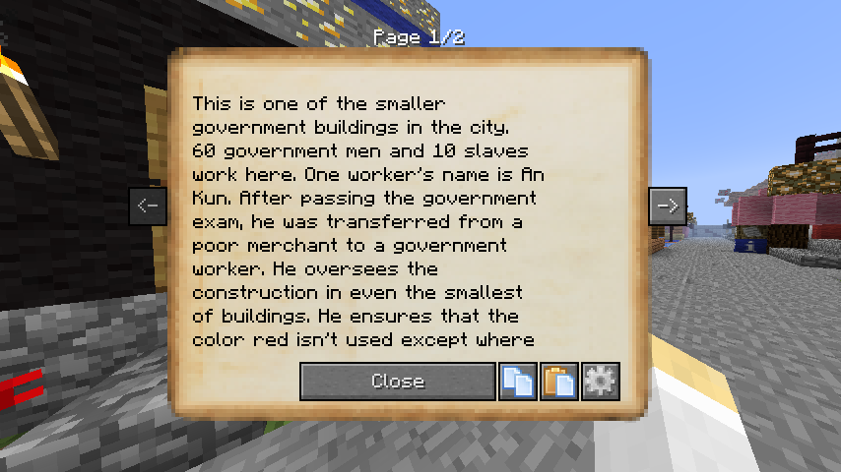
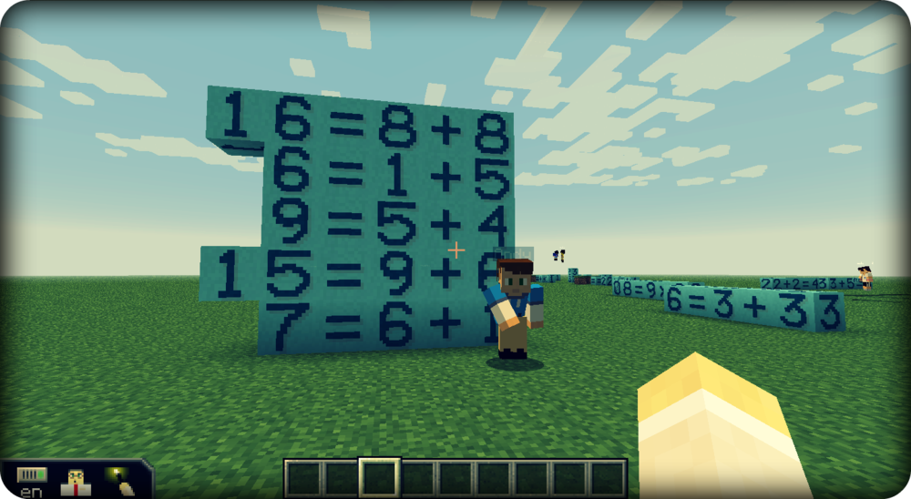
Implementation of Project
Question House
  Assignment Board
  Tiered questions
  Color coded
Individual gardens
  Community setting
  Number blocks
  Sign to explain thinking
Losing MinecraftEdu

Slide 13
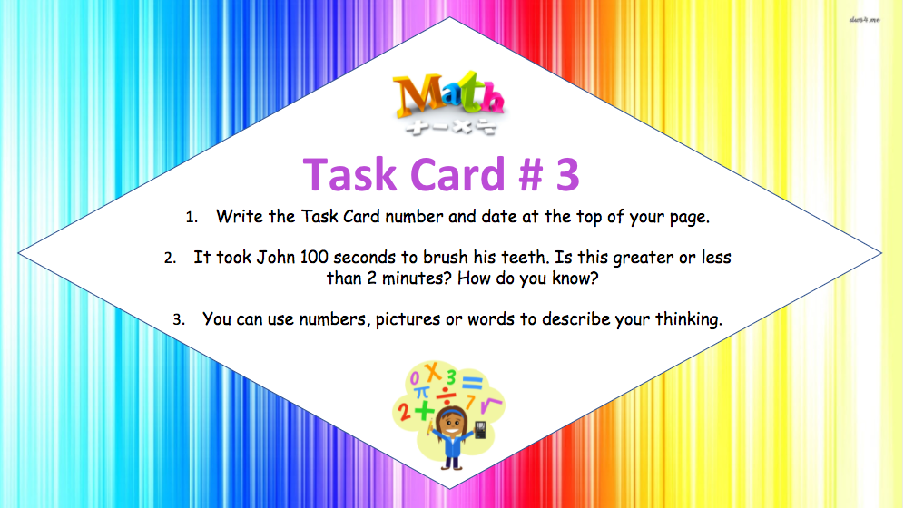
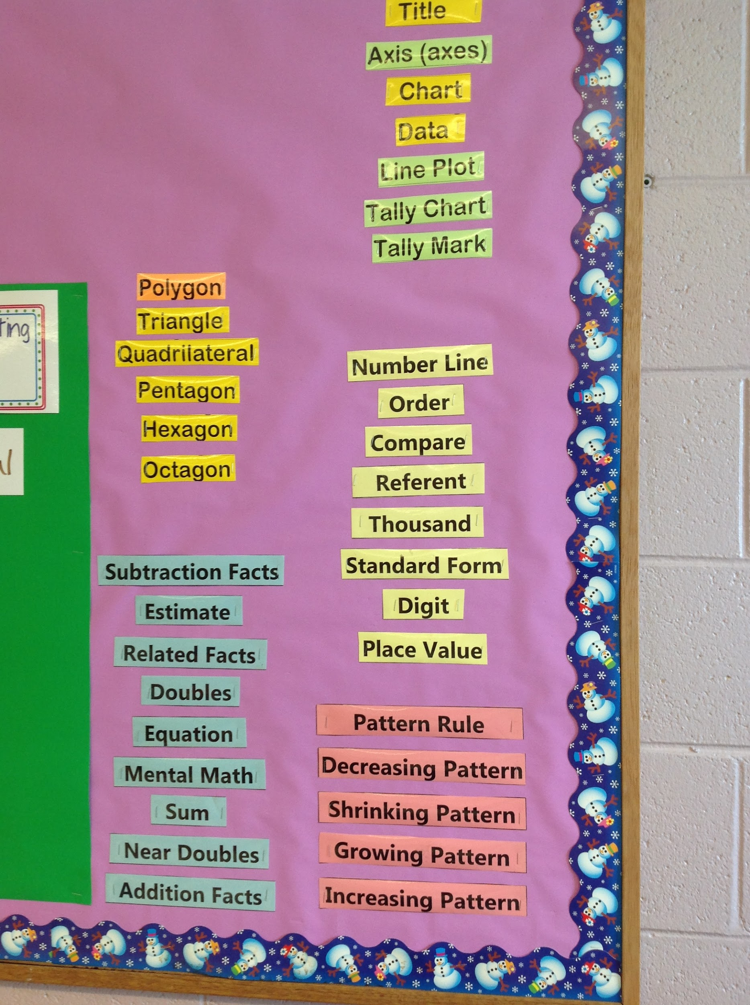
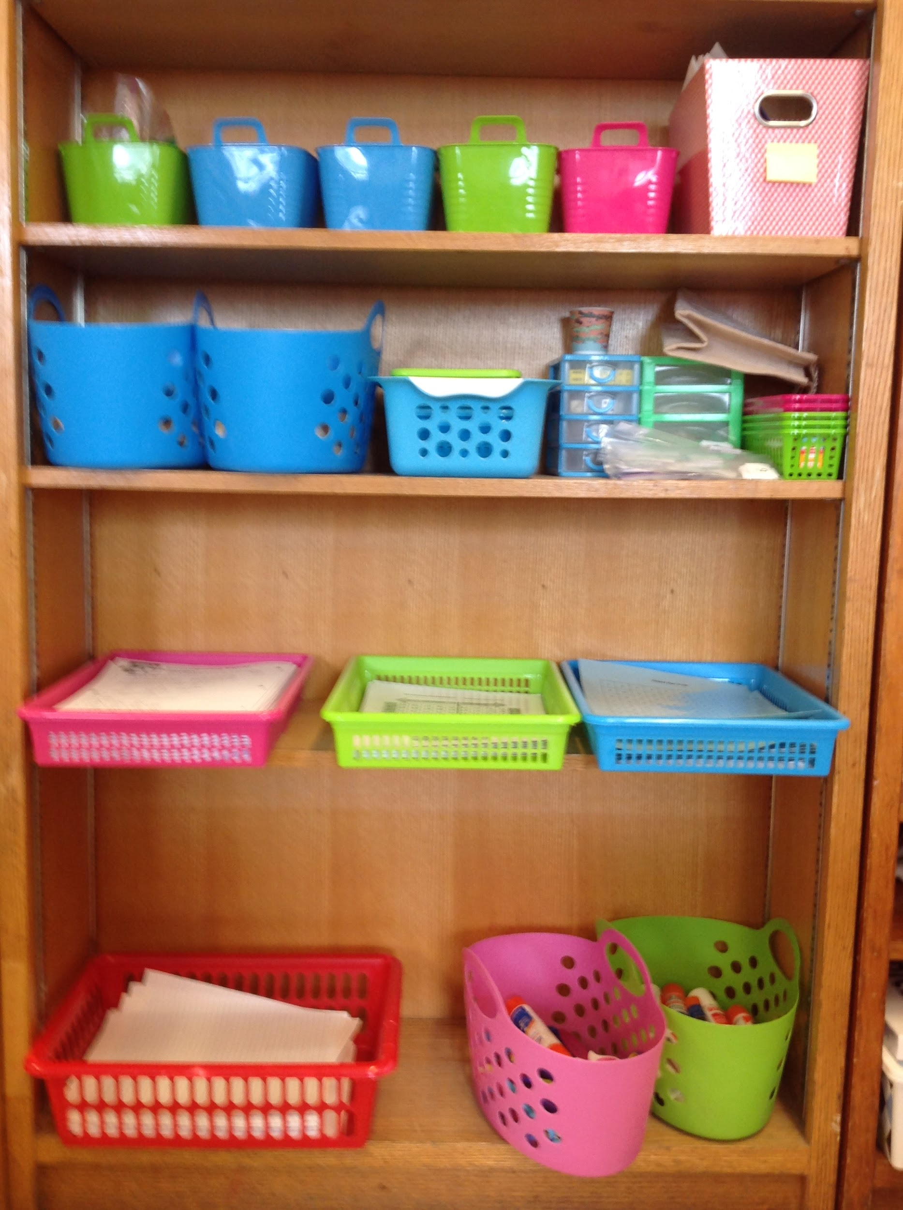
Implementation
Since we had already created our questions, we then had a change in venue, from our virtual world to the classroom. Students would work on the activities during our Math Daily 3 sessions, specifically during their Math by Myself time. We took the problem solving tasks and created laminated cards that students could take, follow the instructions and answer them in their Math binder.

Slide 14
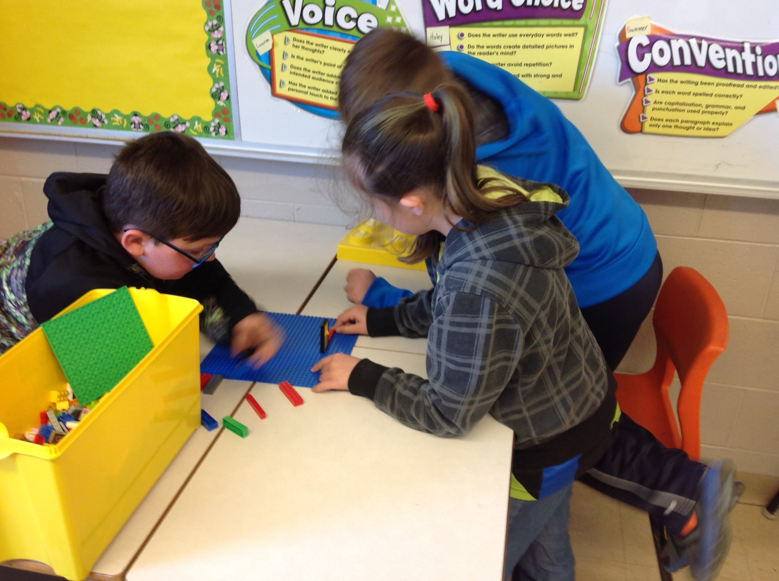
Implementation of Project
Our project was initially started with students addressing the problem solving activities in a virtual Minecraft world. Most students in our project have previous experience with MC and we have found it was a great form of motivation for them in the past.

Slide 15

Implementation
To help students further communicate their reasoning we decided to use an app called Seesaw. This program is a student-driven digital portfolio that empowers students to independently document what they are learning at school. They can take photos of their work, record, audio or video and share what they have done with parents or guardians in minutes. Since work was saved and accessible at any time by the teacher, it also served as a valuable tool for assessment and instruction. Teachers were able to share model answers with the class, review students work whenever time allowed, and keep parents aware of the topics we were covering class.

Slide 16


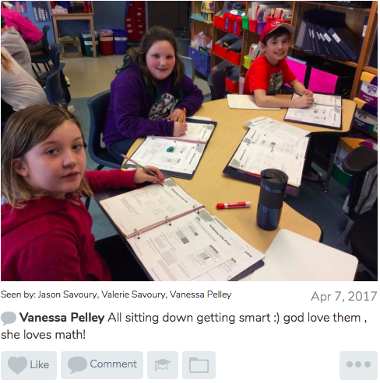
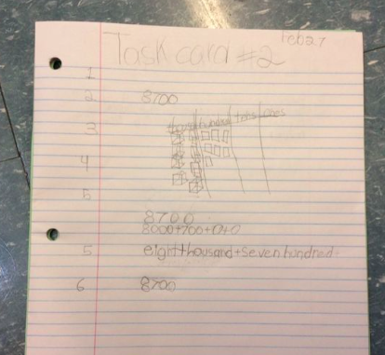
Seesaw App

Slide 17
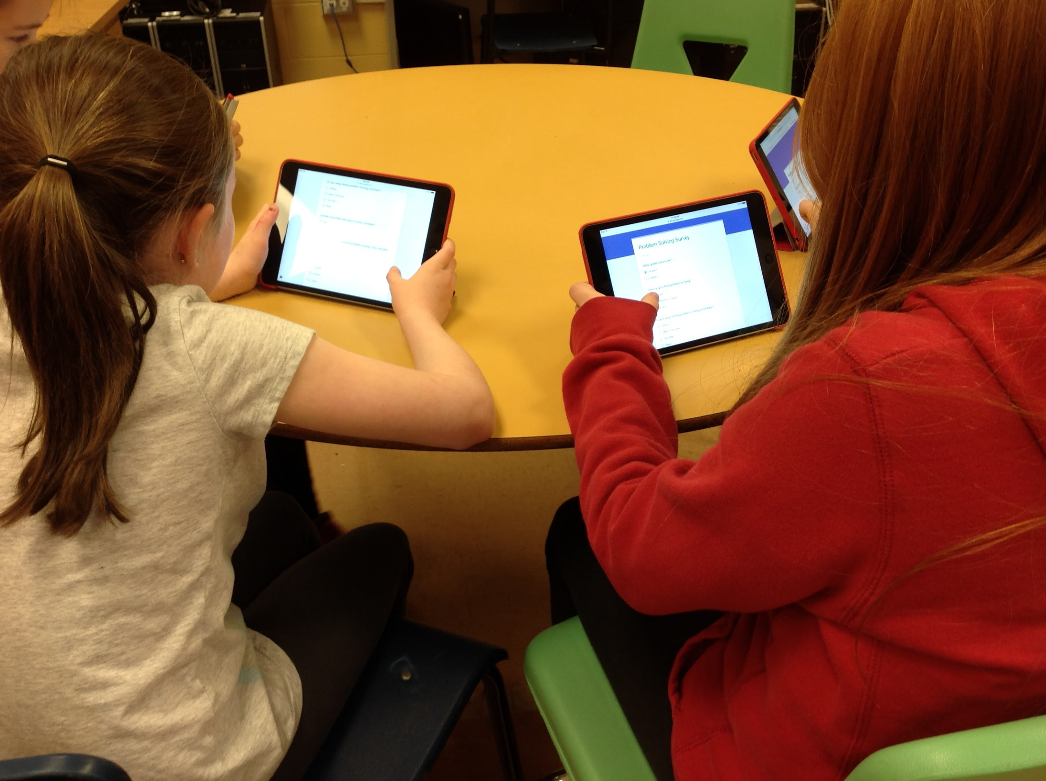
Research methods
Observation
Survey- Google Docs survey
Sample work
Video recordings
Validity of data collection
Make teaching decisions based on student ability
Performance assessment
Primary source material- actual student work as opposed to secondary material such as opposed to secondary material such as referenced testing, interview/conferencing with the student both individually and small group setting.
Analyze your data
Complete an end of project survey
Review survey information
Seesaw Video 3J
Data Collection/Analysis

Slide 18
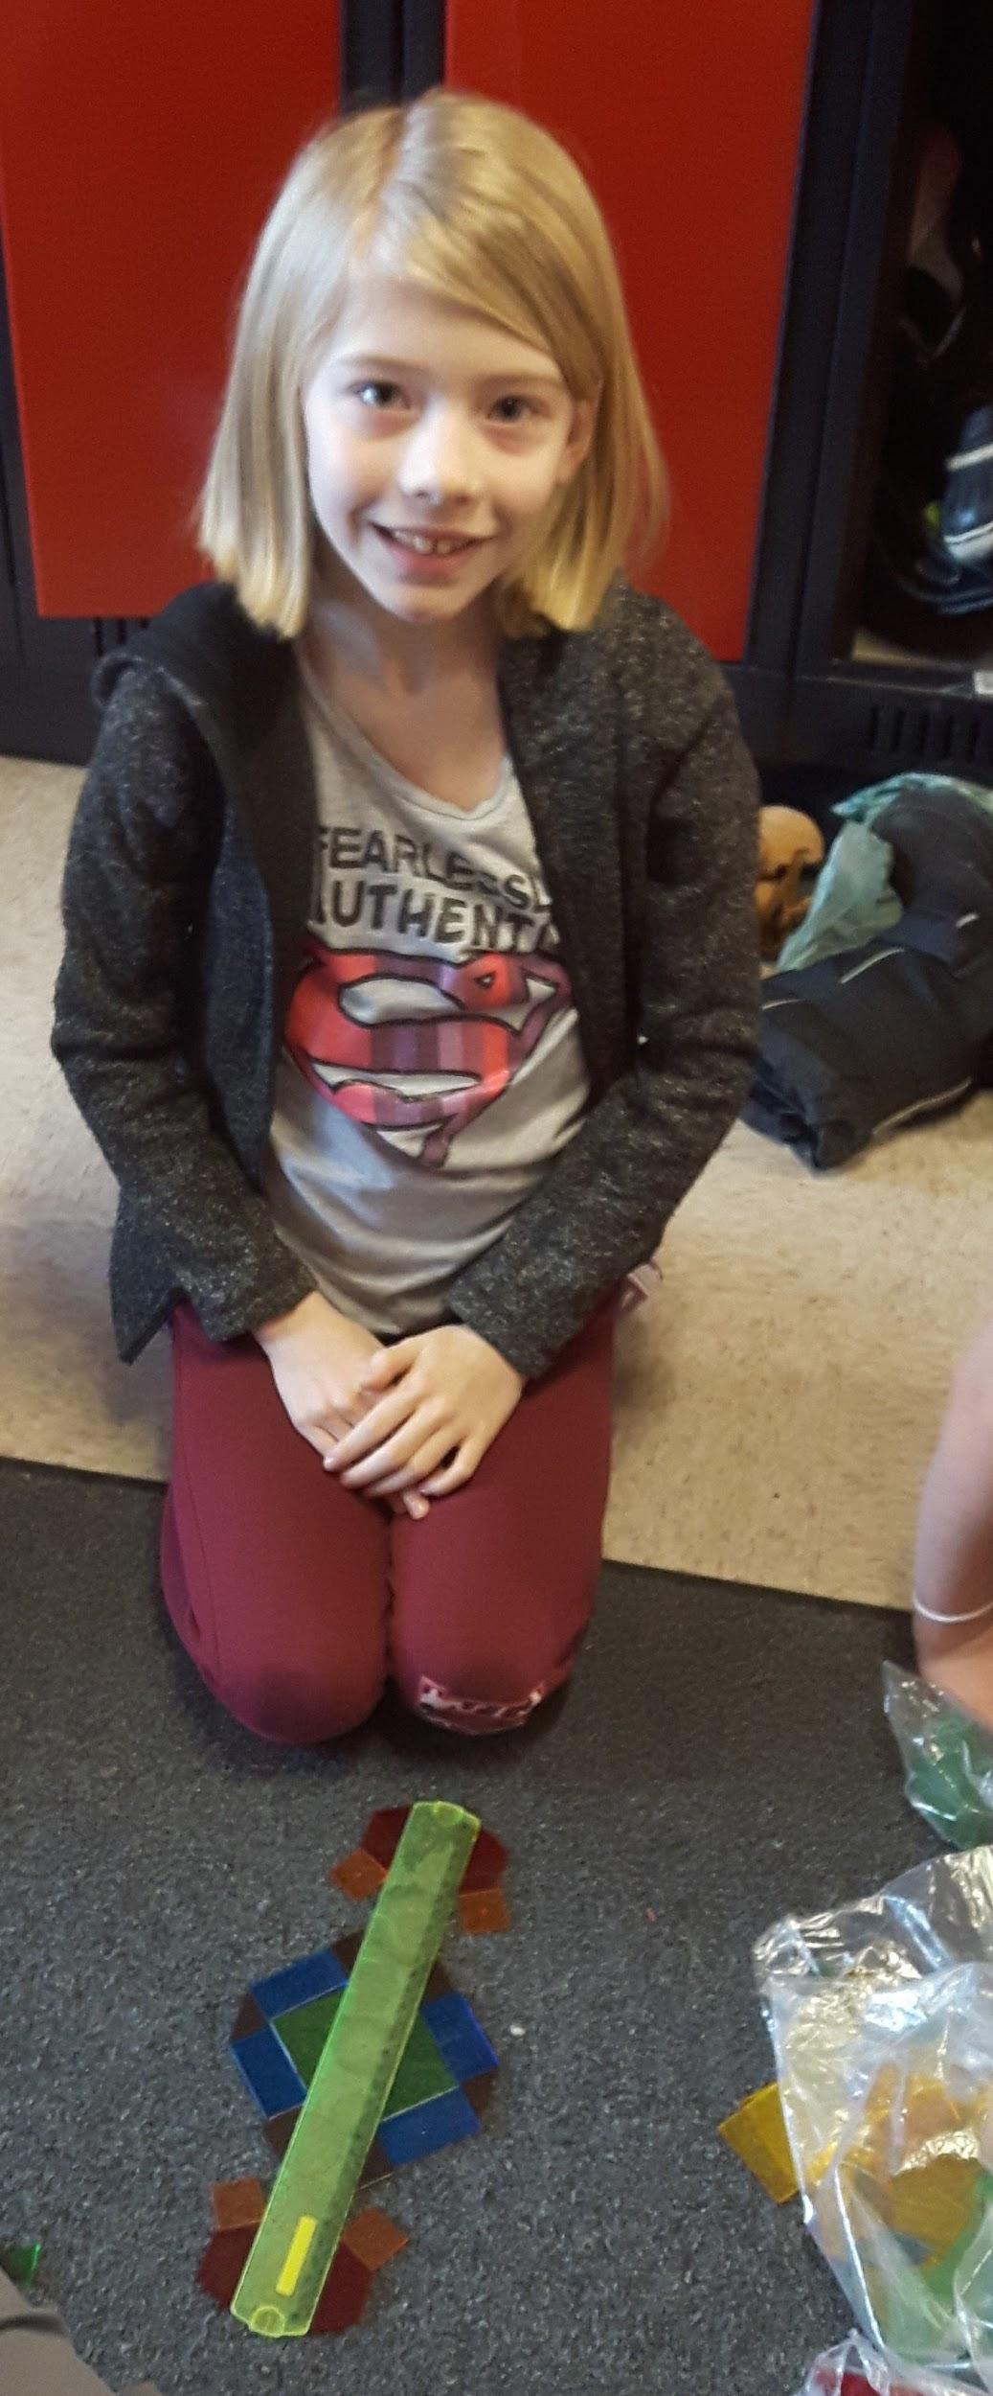
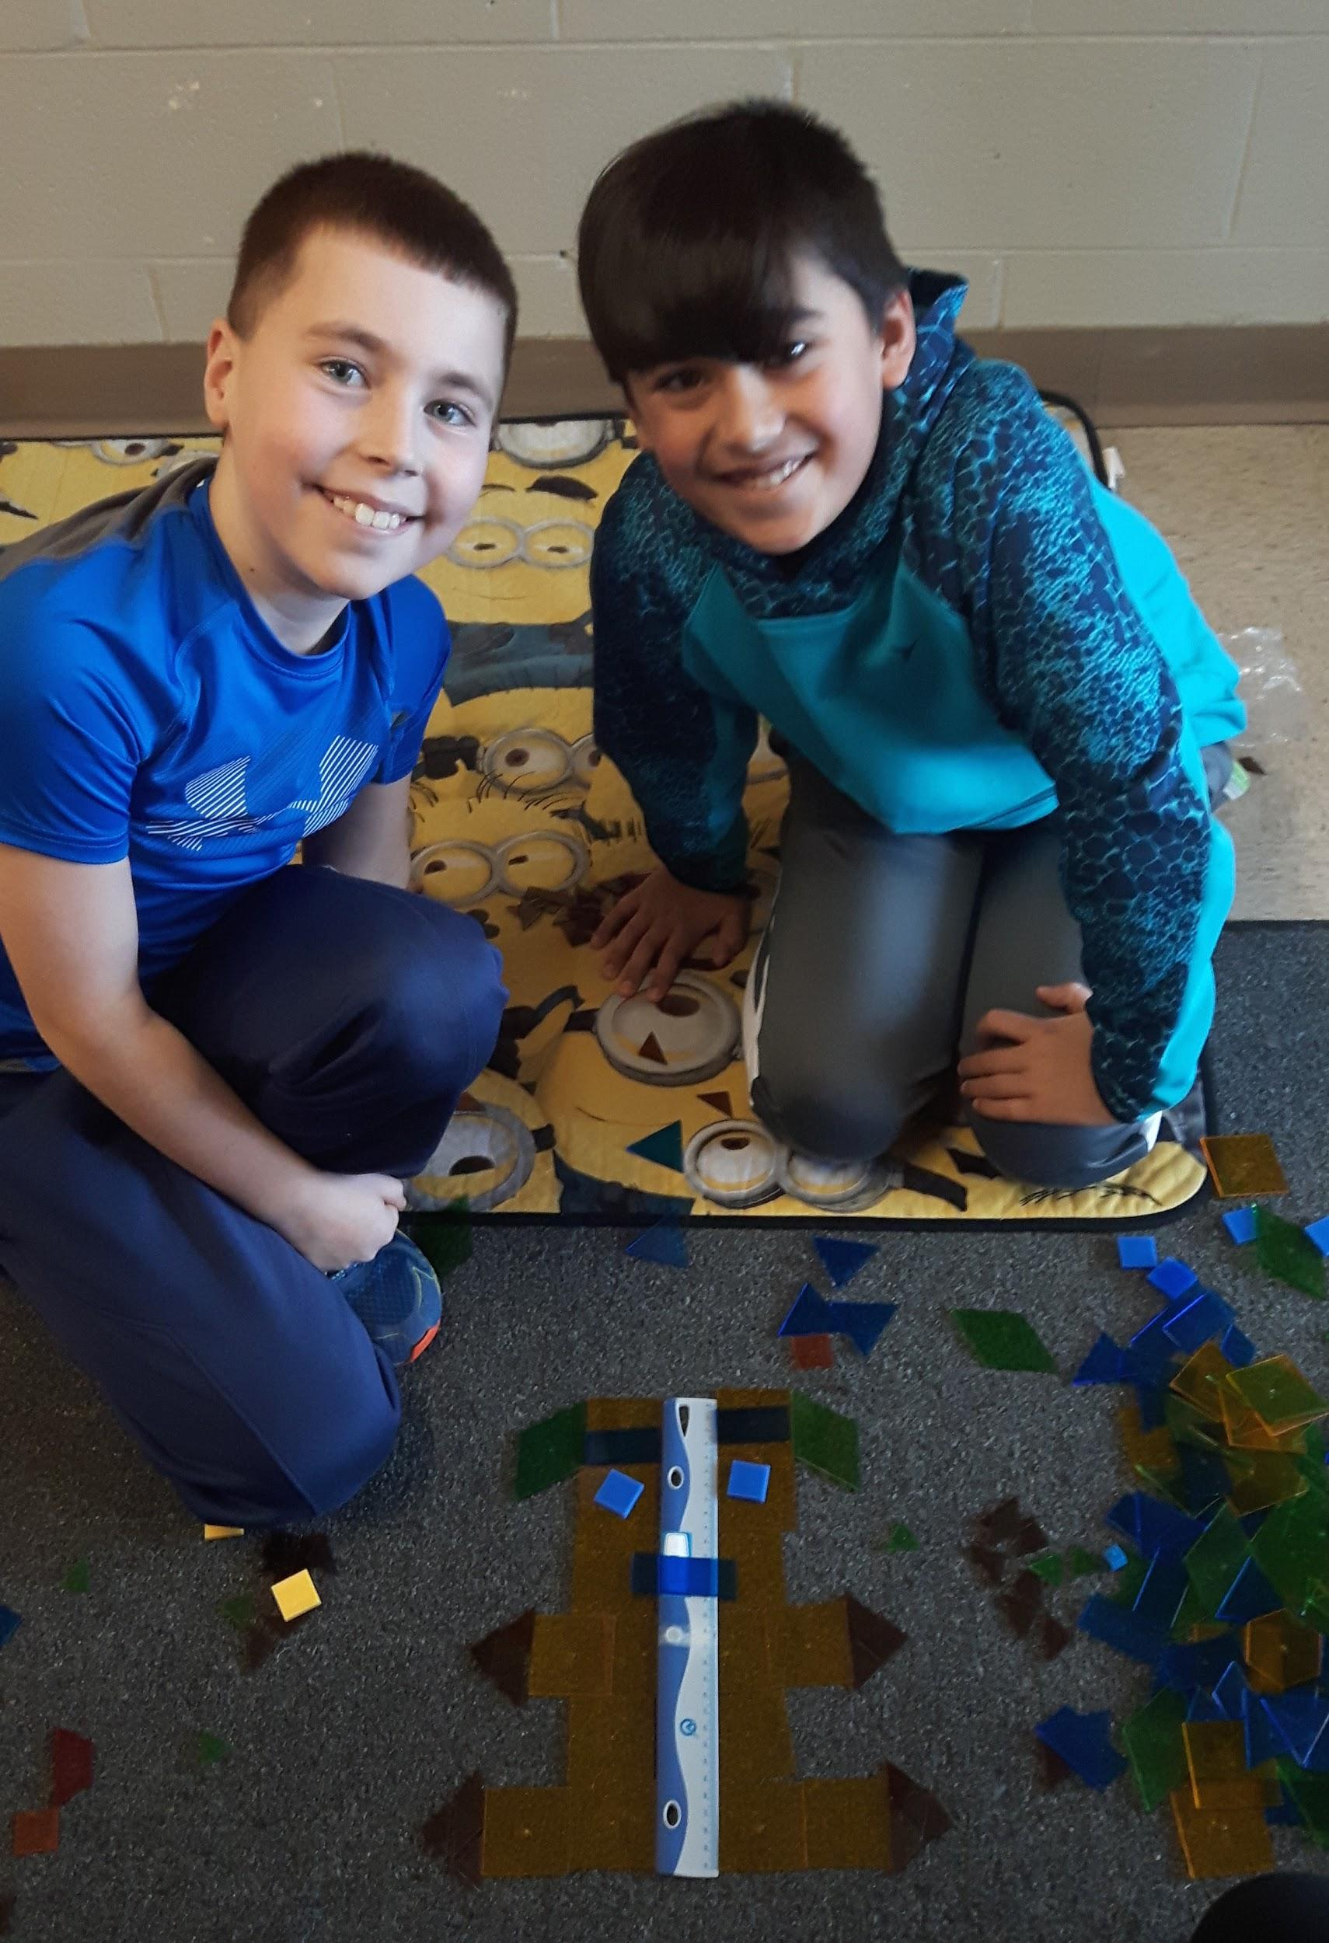
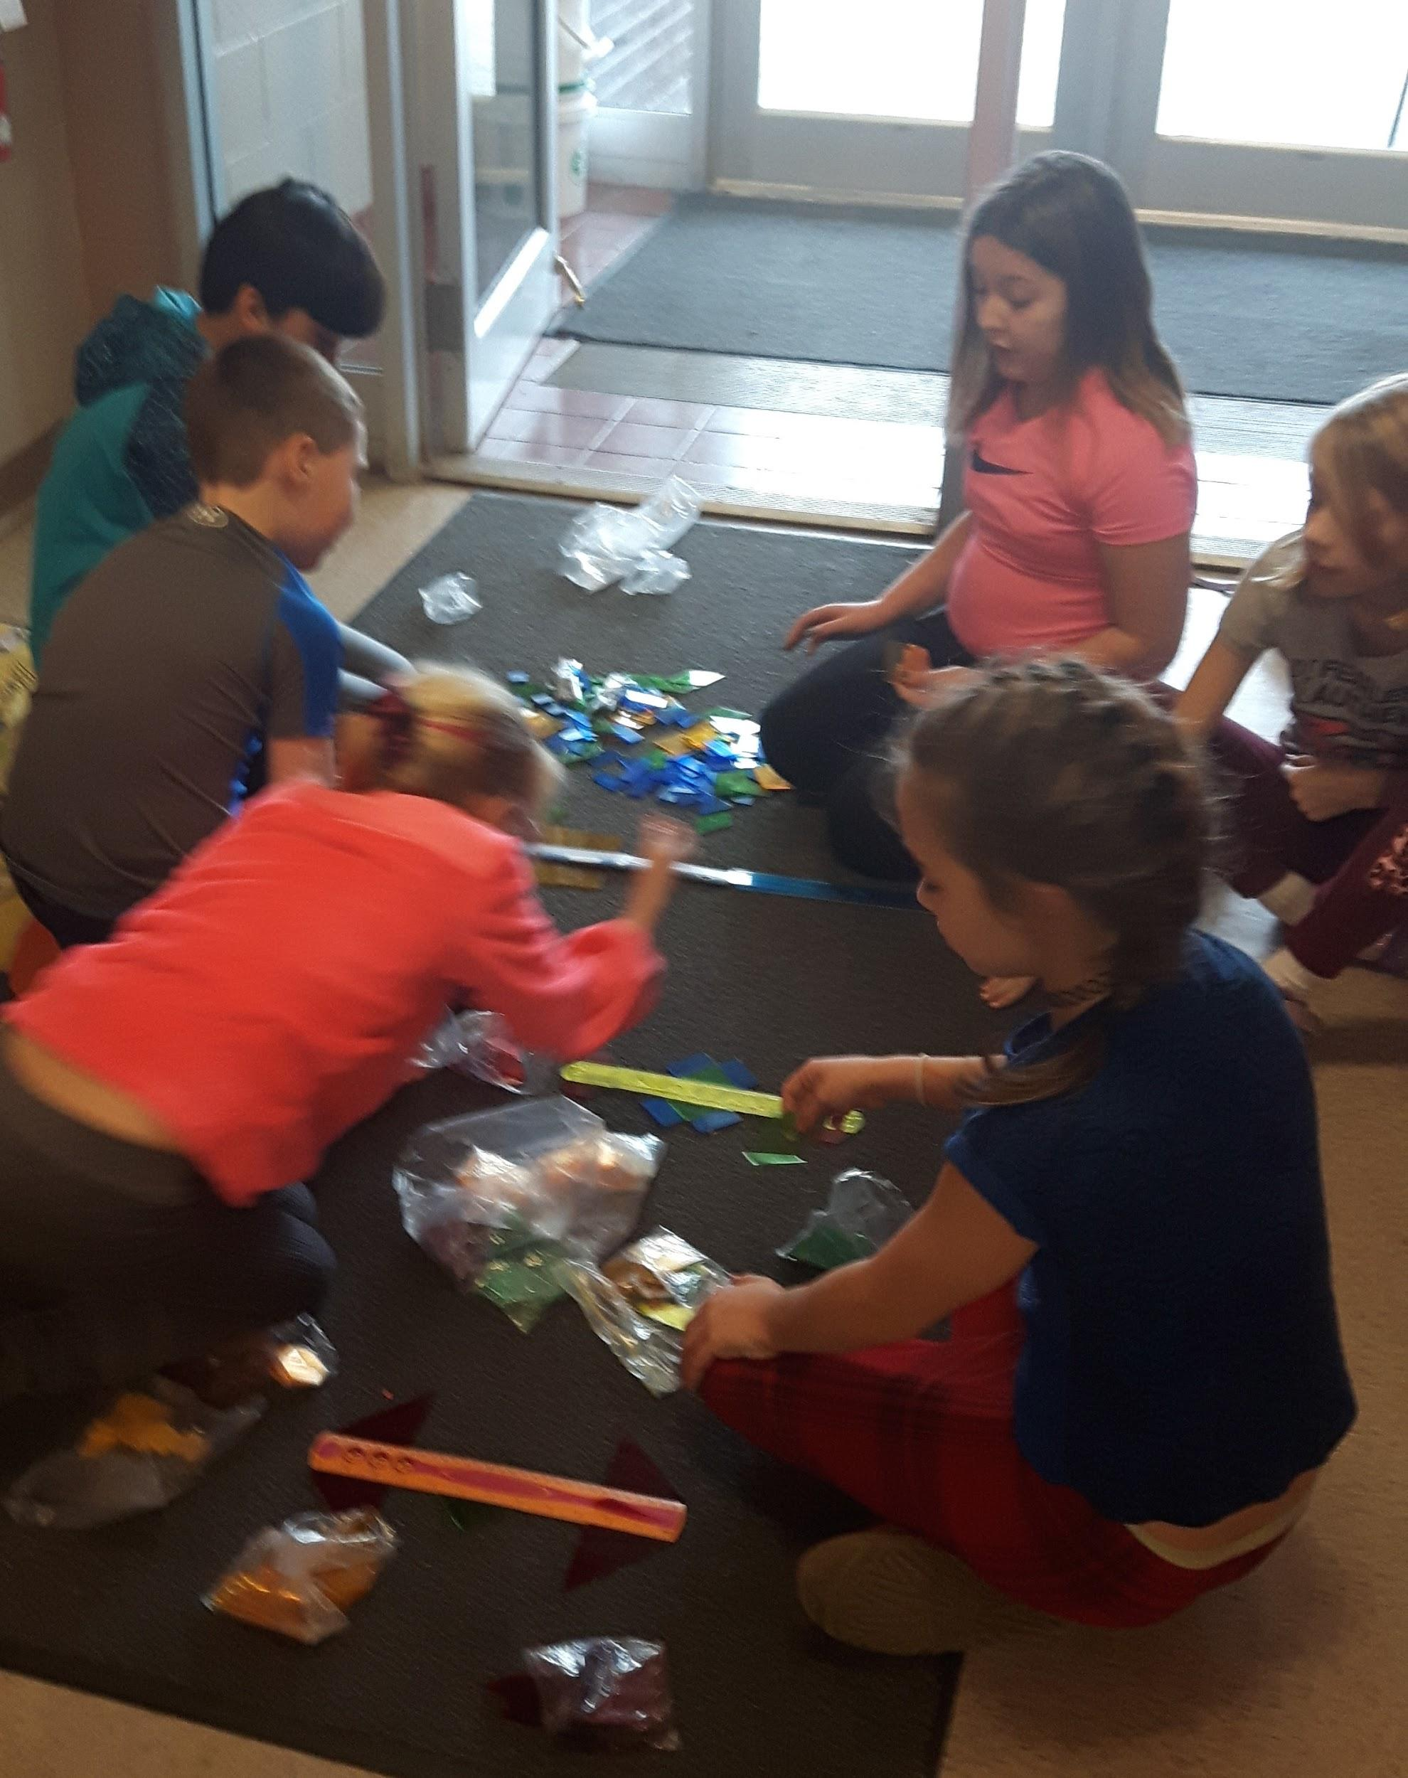
Teacher Inquiry
Through your involvement in this project, how did your understanding of teacher inquiry/action research change?
Teacher inquiry and action research enabled us to reflect on our teaching style. The overall role of the teacher switches from whole class instruction to student centered. The students take a more active role in their learning, investigating and problem solving. They are given the opportunity to solve problems on their own, as a teacher then questioning students about the process becomes extremely important. Guided questioning allows the student to develop a solution without being given a direct answer.

Slide 19
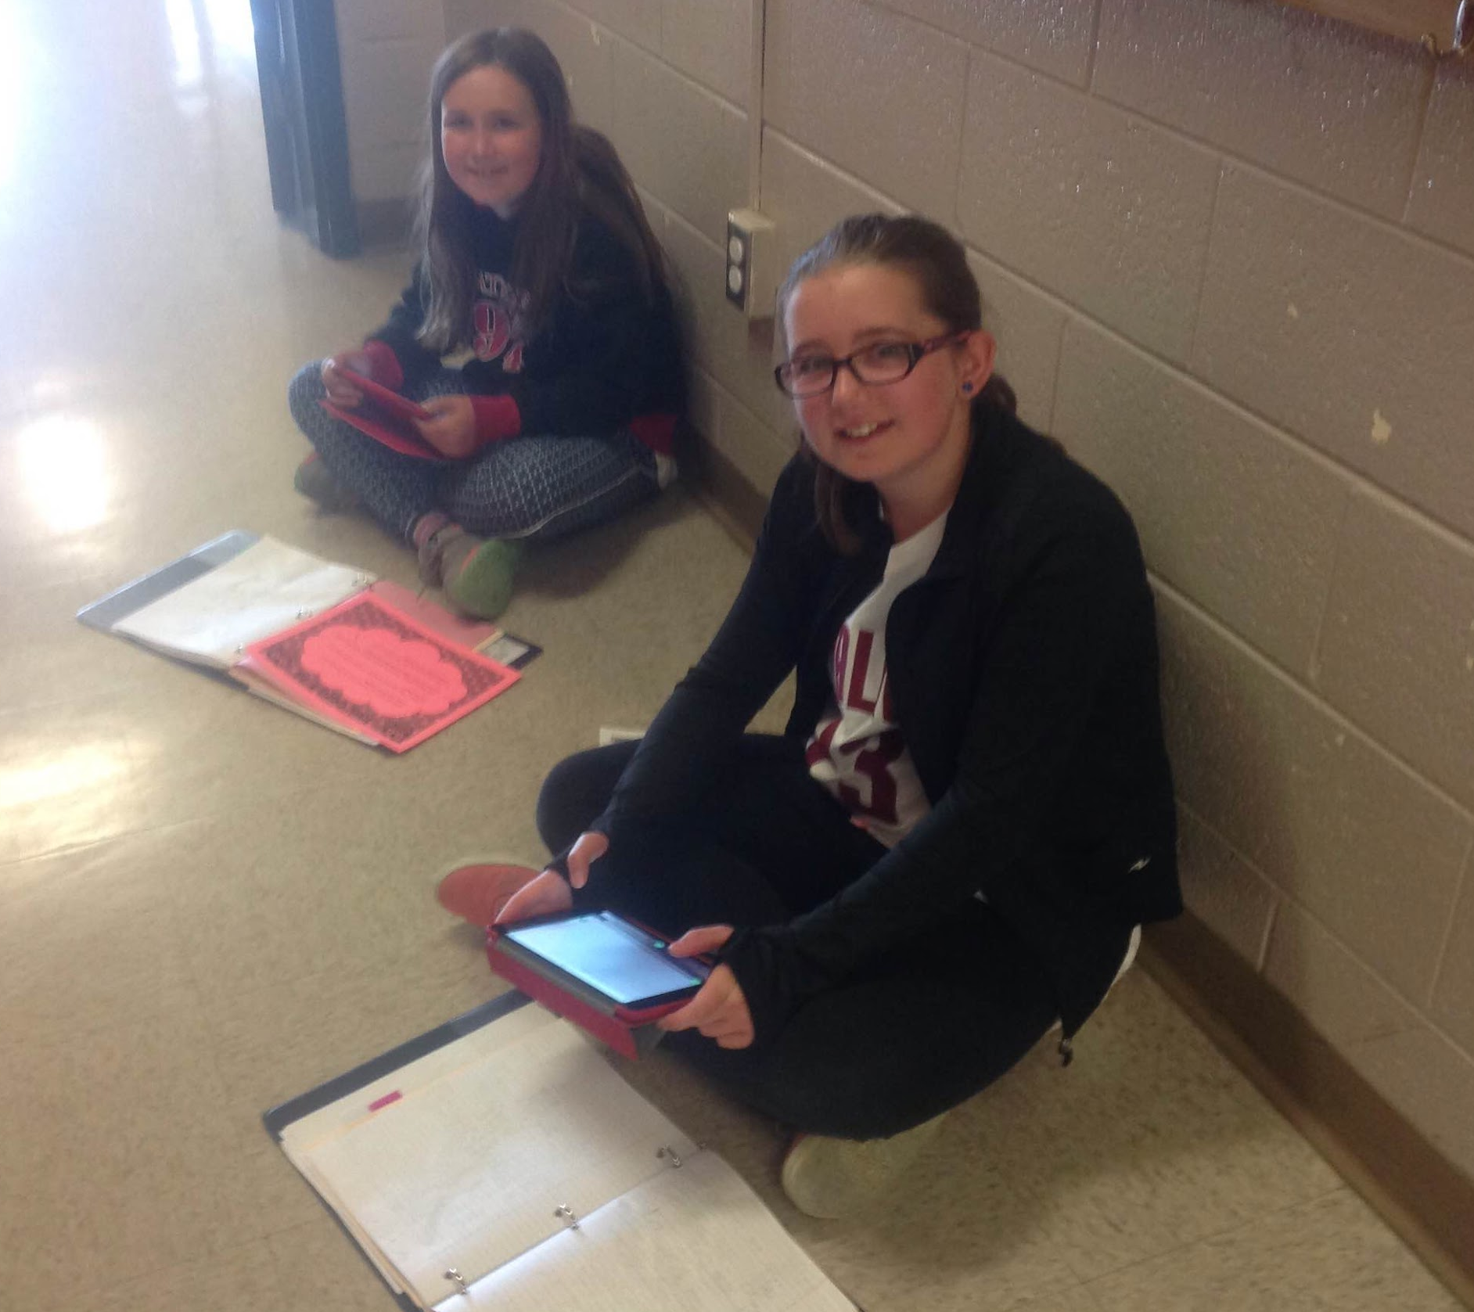
Teacher Inquiry
Strengths of teacher inquiry:
As a teacher, it is difficult to step back and reflect on our own teaching style. After years of providing curriculum in one way, change requires much reflection on both the students, the curriculum, classroom setup and needs within your classroom. Changing your mindset and releasing the level of control requires us to step out of our safety zone as a teacher.

Slide 20
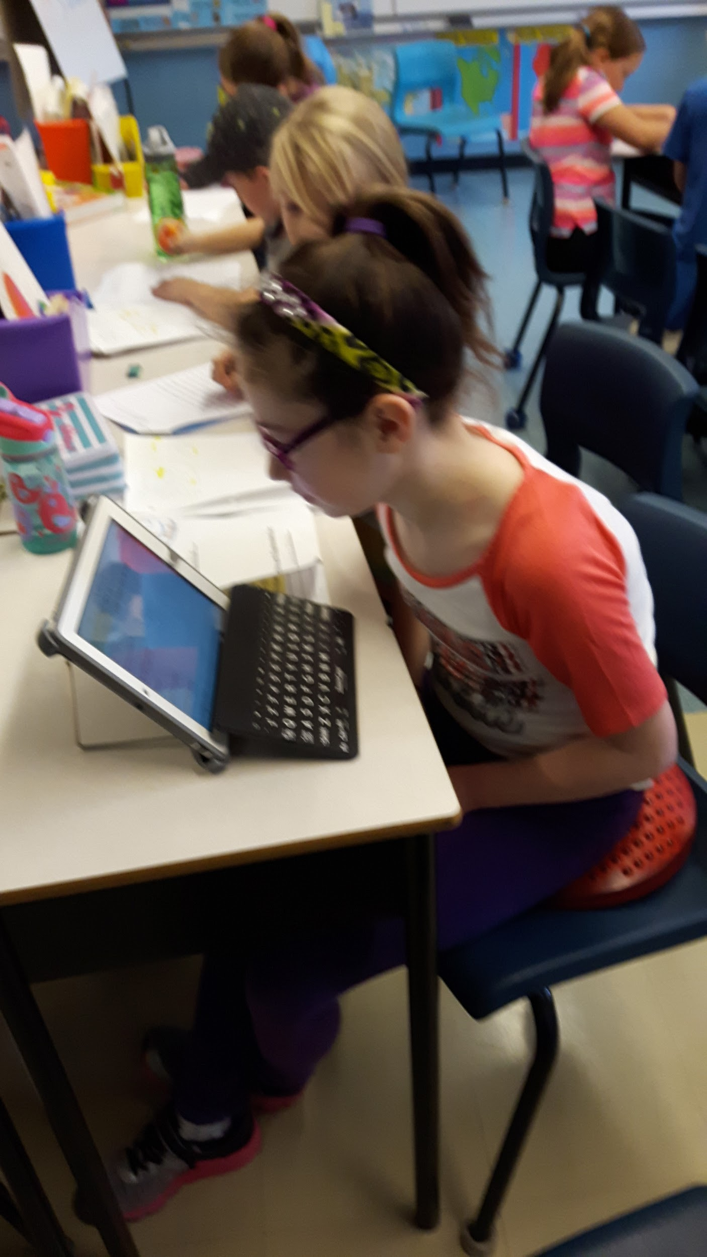
Teacher Inquiry
Are there aspects of teacher inquiry you will continue to use in your teaching?
The student centered process of teacher inquiry will most definitely extend to future years, as well as trickle over into other subject areas. Students find success when they are engaged in their own learning; having the opportunity to express their thinking, interact with objects, equipment, etc. to develop a range of experiences on which to base their thinking, reflect their thinking by writing and expressing themselves and comparing what they think with what others think and make connections between their learning experiences and the real world.

Slide 21

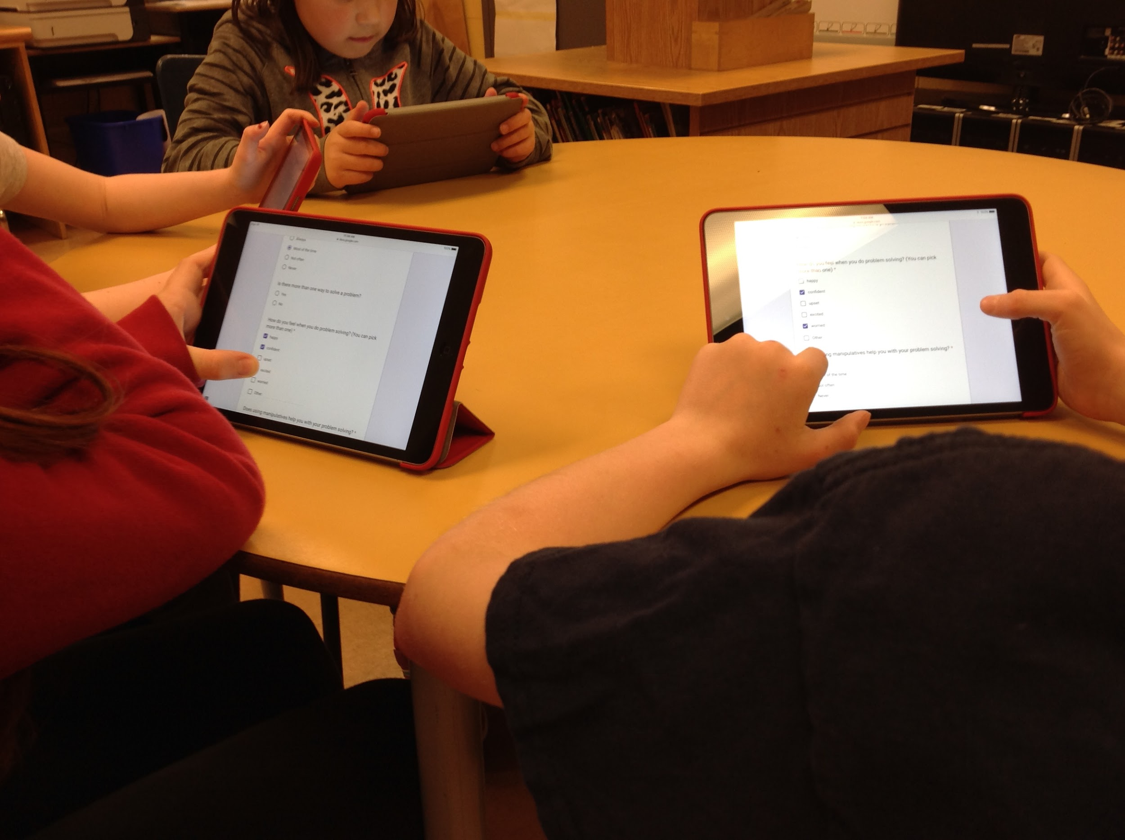
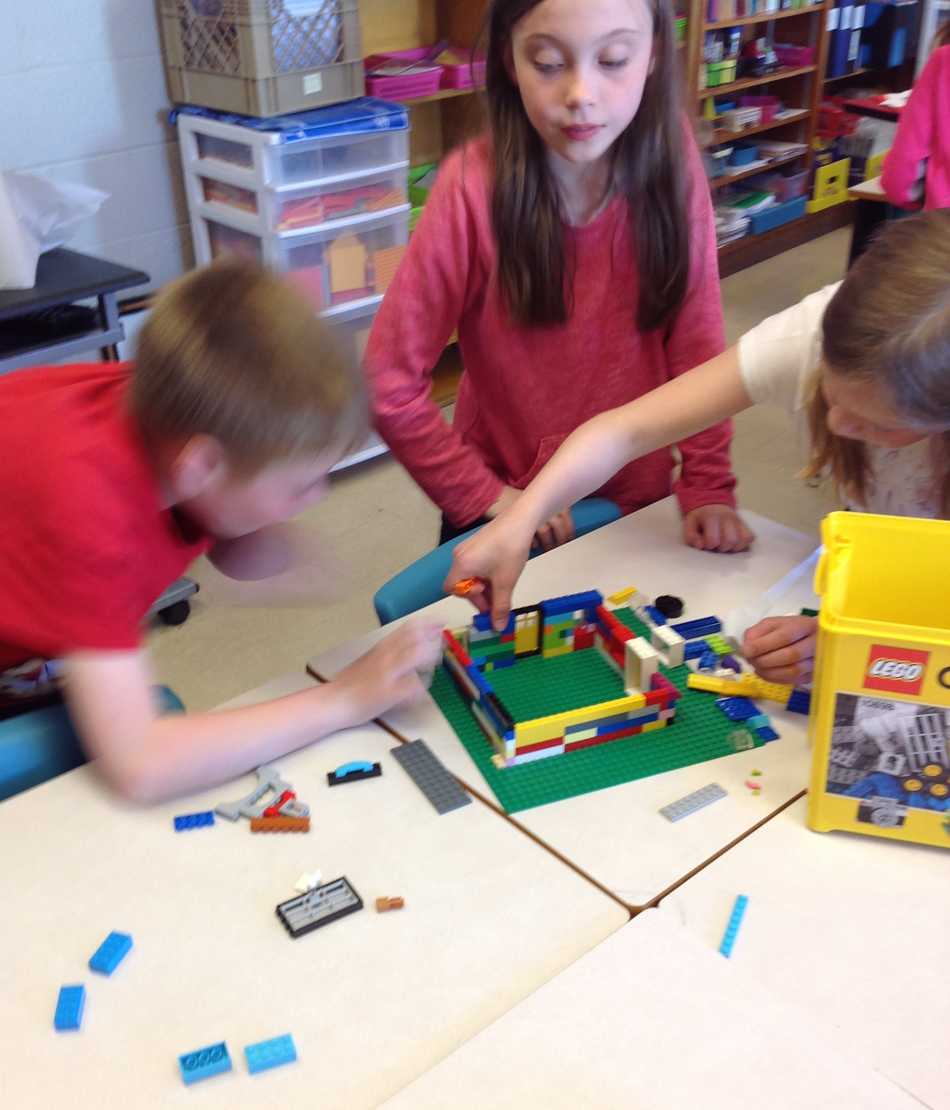
Teacher Inquiry
Was the project successful? Did you achieve your intended goals? Please explain.
At the beginning, we used Minecraft as a tool to further develop problem solving skills but shortly after the onset of the project we were unable to continue due to NLESD restrictions. Phase 2 of the project required us to use alternate tools to develop these skills. This, we found, was extremely successful. We set out to foster a sense of independance, as a result, we have achieved this along with creating a positive, inviting atmosphere for mathematical problem solving.

Slide 22
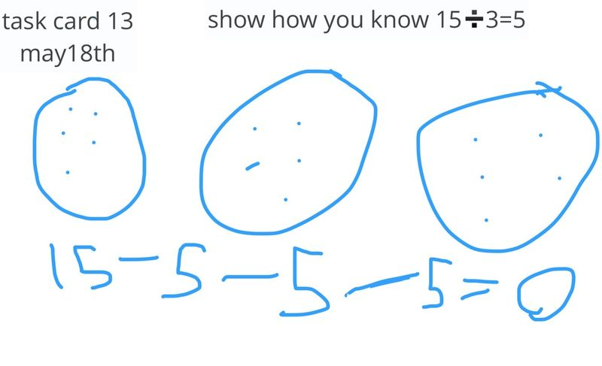
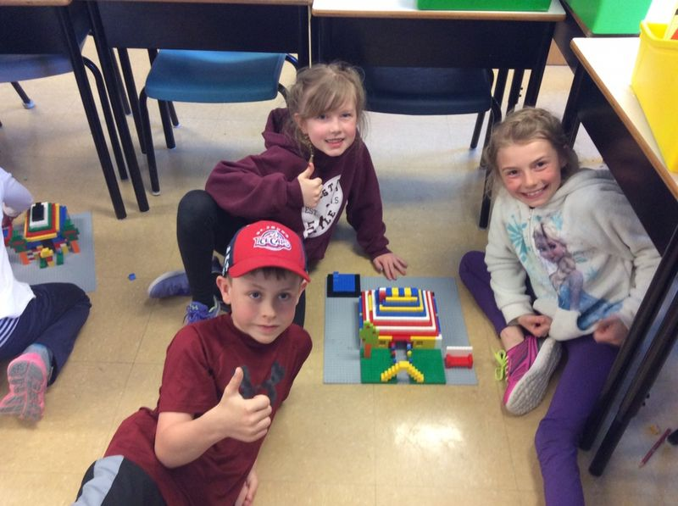
Teacher Inquiry
How did the project meet your professional learning needs?
Professionally, it is always important to reflect on our teaching style to ensure that we are providing curriculum in a way that meets the diverse needs within our classroom. This project allowed us to do just that.

Slide 23
Teacher Inquiry
How did the project help you create student-centered learning environments?
By using the Math Daily 3 model, we were able to create a learning environment where students work at their own pace, participate in varied activities and receive more focused instruction from their teacher.

Slide 24
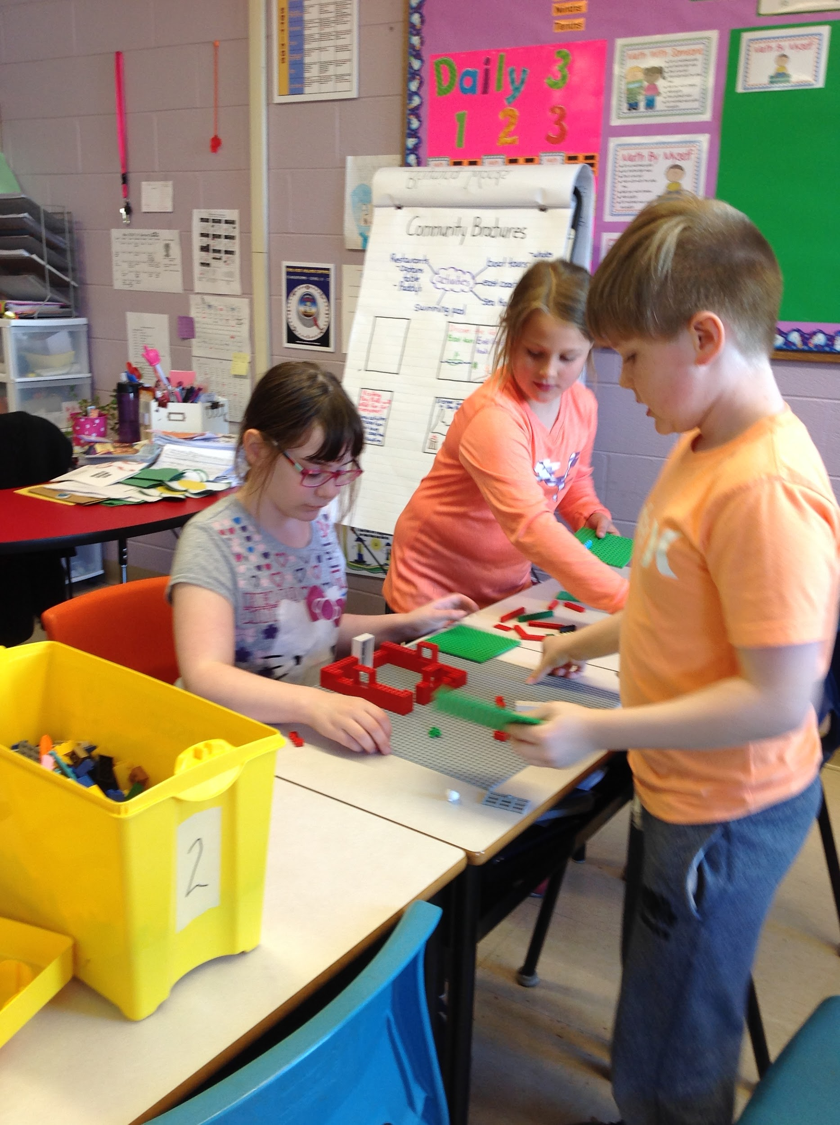
Teacher Inquiry
Do you have any new questions about your teaching that you would like to explore?
Would taking this approach when teaching in other subject areas continue to create a more student centered environment? If so, how would you tackle this challenge?

Slide 25
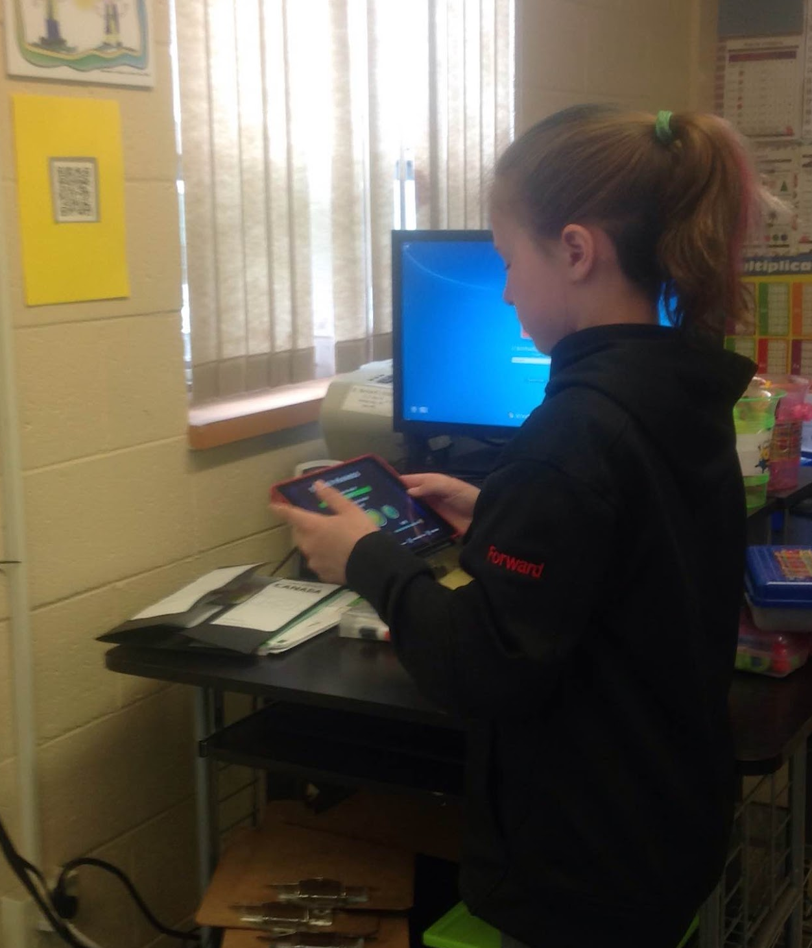
Seesaw
Using Seesaw with Student 1
Using Seesaw with Student 2
Seesaw 4S
Seesaw 4S too

Slide 26
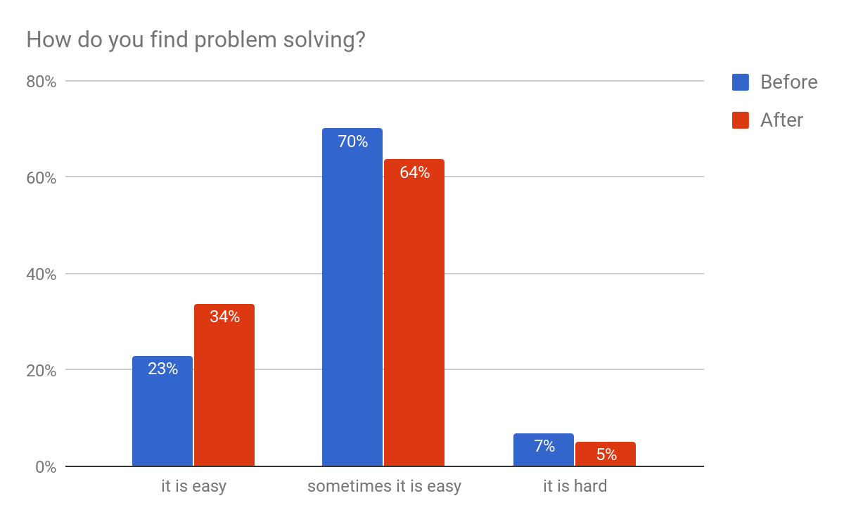
Results of pre/post survey
One of the reasons we felt so many children decided it was easy at the beginning of the survey was because they were doing one-step problem solving in grade two. In grade three, they begin two-step problem solving, and when the survey was completed they had not started this.
There was a slight decrease in the number of students who found it hard after the project. We felt there was an increase in modelling and communication from the teacher. Also, there was an increase in communication between students. There was also an increase in sharing answers with the class.

Slide 27
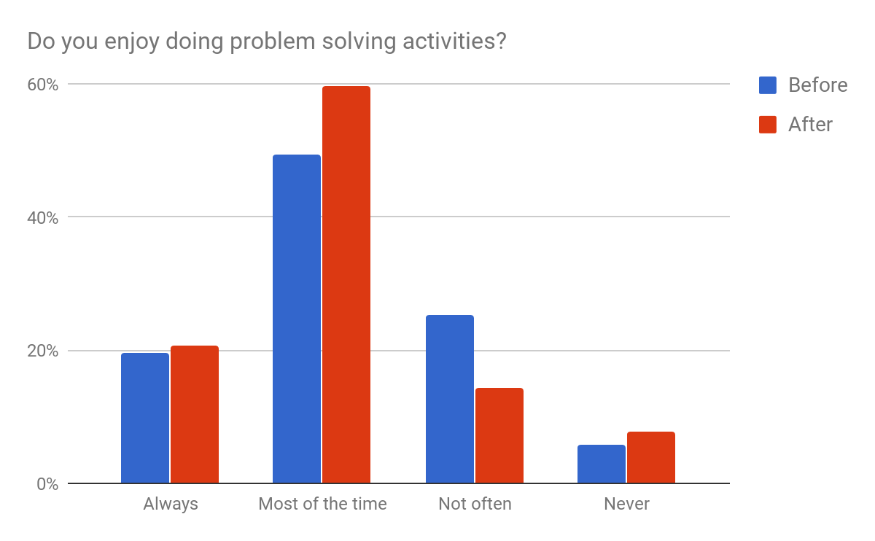
Results continued
There was an increase in students’ enjoyment of problem solving “Most of the time.” Hence, there was also a decrease in the number of students who choose “Not Often.” Positive results for us.

Slide 28
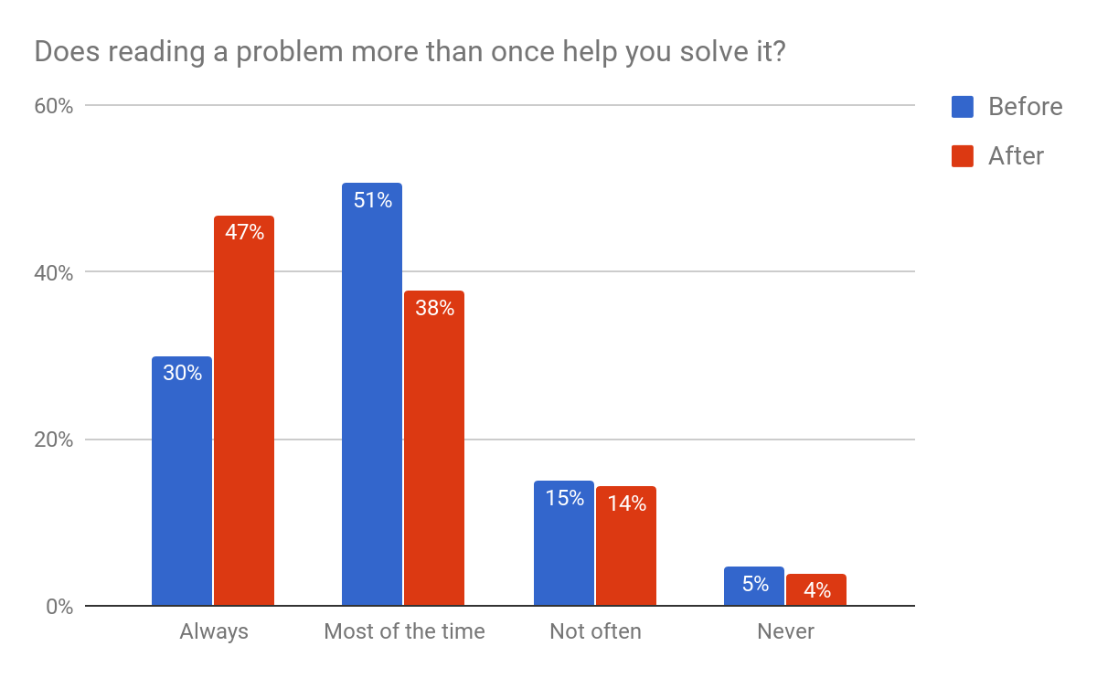
Results continued
Through modelling, we consistently stressed the need to be clear on information needed to answer a question. Reading a problem multiple times is a key strategy to ensuring this. We had an increase by 17% in the number of students who thought “Always” reading a problem more than once was beneficial!

Slide 29
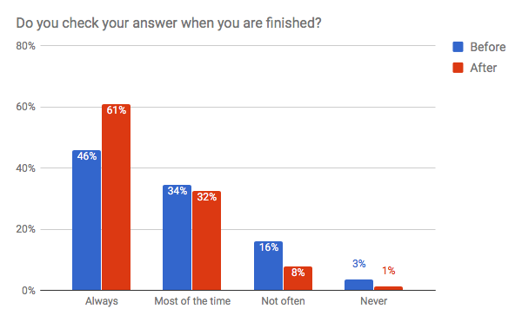
Results continued
There was an increase of 15% in the number of students who always check their work! Also, there was a decrease of 10% of those who never or don’t often check.

Slide 30
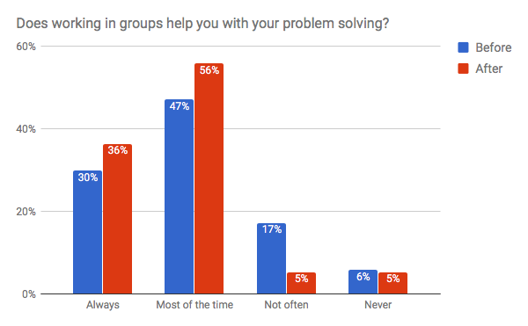
Results continued
Our results showed an increase of 15% in the number students who valued working with others. With only 10% not valuing group work in our post survey.

Slide 31
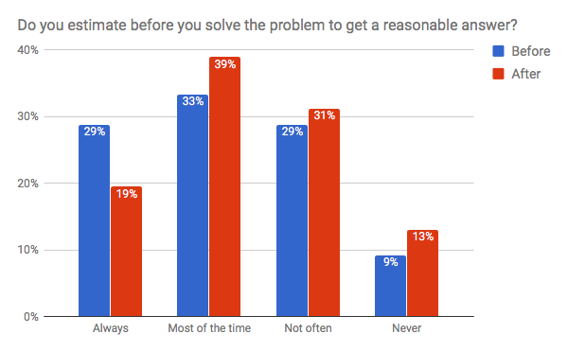
Results continued
It was positive that we showed an increase of 6% of students estimating an answer prior to completion. However, it is also disappointing that there was a decrease of 10% in students who always estimate. We find estimating is a very difficult concept for grade 3-4 students, but it is certainly an area of need!

Slide 32
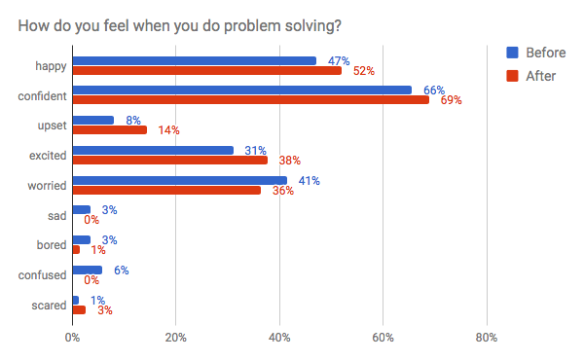
Results continued
Students selected various ways they felt when problem solving. They showed an 18% increase in positive remarks, such as happy, excited and confident. There was also a decrease in students who chose worried, sad or confused.

Slide 33

References
In-Game Minecraft Quests for Elementary Education by Tory Morelli Mail
Learning Mathematics through Minecraft by Beth Bos, Lucy Wilder, Marcelina Cook, and Ryan O’Donnell
Inquiry, the Learning Cycle, & the 5E Instructional Model from the Guidelines for Lesson Planning from the Electronic Journal of Science Education.
Daily 3 Math by the 2 Sisters
Professional development on SeeSaw, MinecraftEdu and Math Daily 3
Math Curriculum Guide for Grades 3 and 4
MinecraftEdu
Seesaw
Thanks Dana Griffiths for all your help, guidance, assistance, and encouragement throughout the year.

