Slide 1
Discovery Centers
Suzanne Curran and Nicole Curlew

Slide 2
Our School
Our school is located in the beautiful community of Colliers, in scenic Conception Bay, Newfoundland. We are approximately 45 minutes from the capital, St. John’s. Our school has a student population of approximately 135 students and 15 staff members. Students, teachers, parents and the community collaborate to develop a positive, child-centered, learning environment which recognizes the value and uniqueness of each individual in the 21st Century.

Slide 3
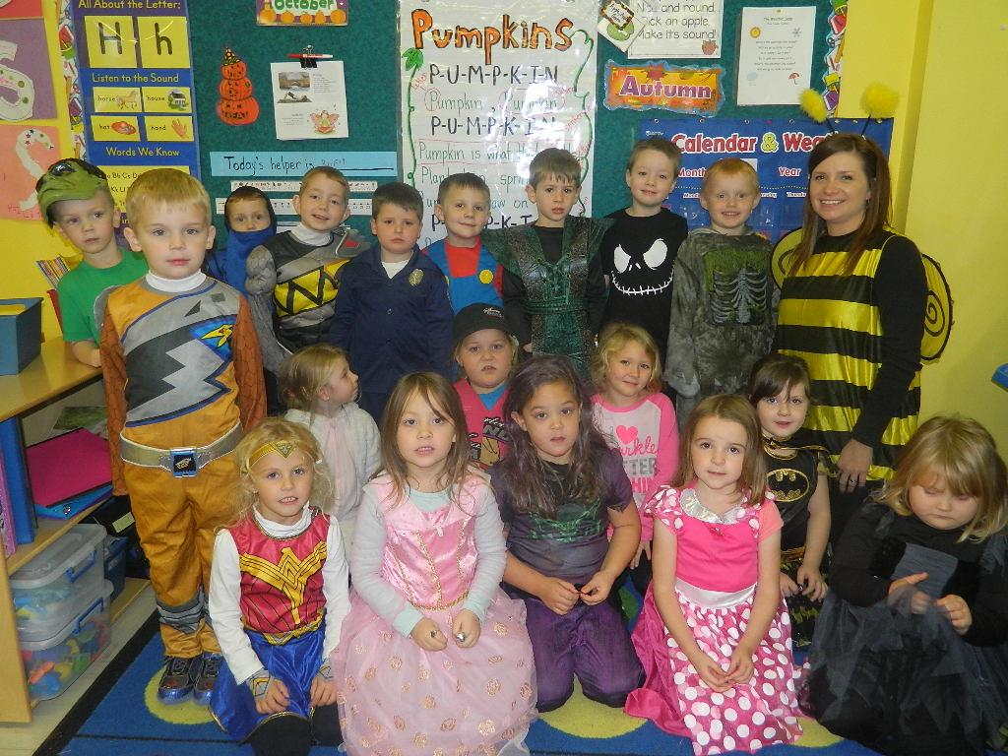
Meet the Team
Suzanne Curran - Kindergarten
Suzanne has been teaching Kindergarten at Immaculate Conception for 10 years. She has also taught Science at other grade levels.
Suzanne took part in a TIA project in 2013-2014.
She has a class of 19 happy and energetic students. Her class consists of 10 girls and 9 boys. This is the first year for the Full Day Kindergarten Program in Newfoundland.

Slide 4
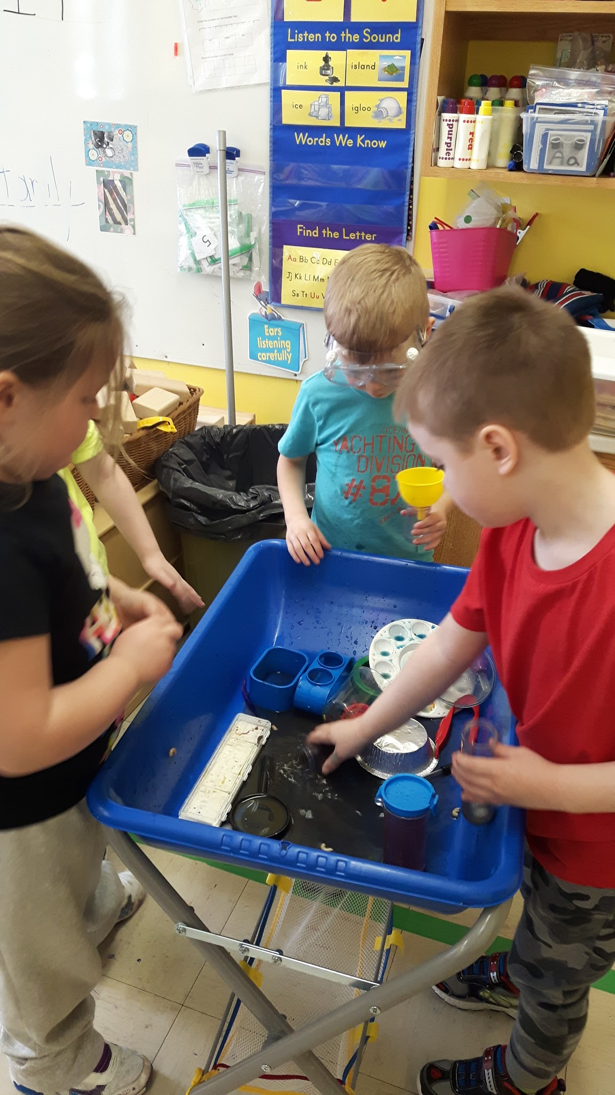
“It is my belief that students learn best when they are given the opportunity to work hands on. The implementation of Full Day Kindergarten has given me the luxury of time to allow for more free exploration.”
Suzanne

Slide 5
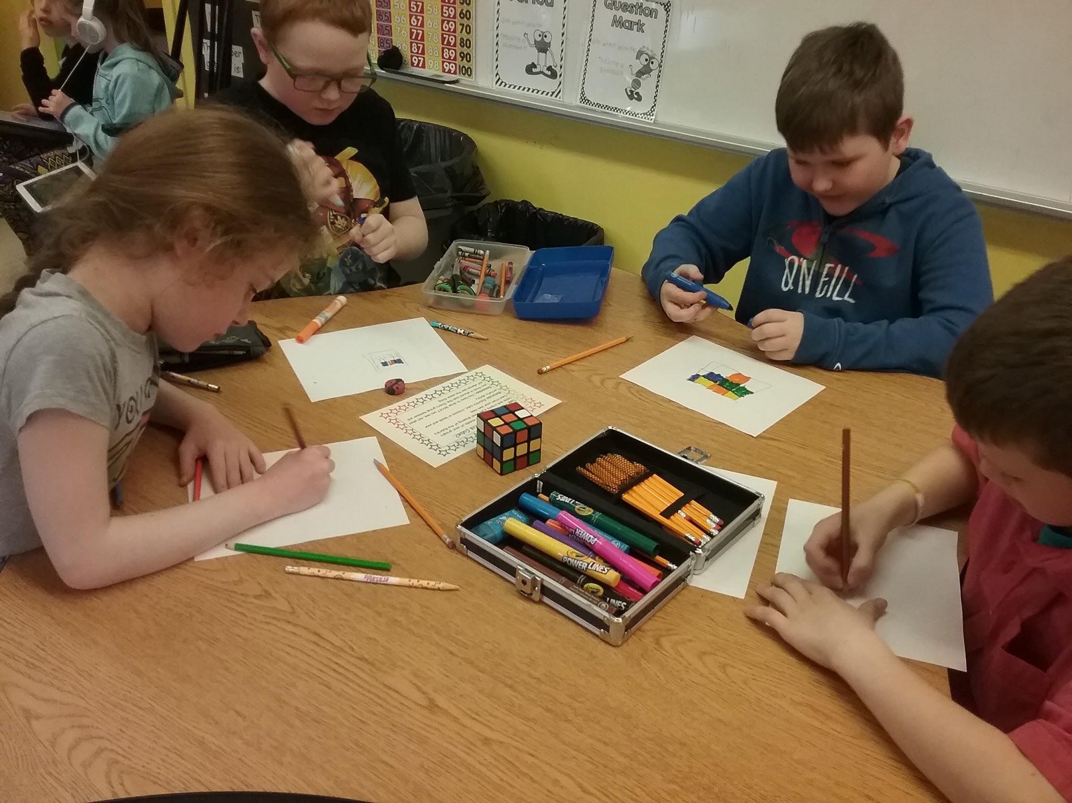
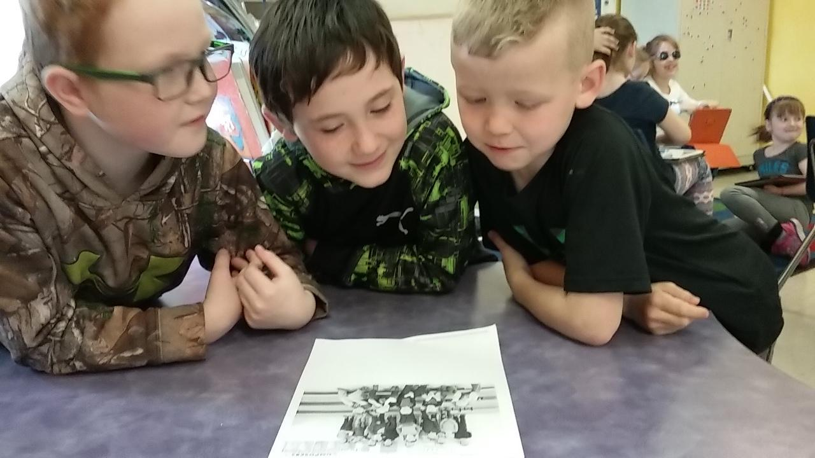
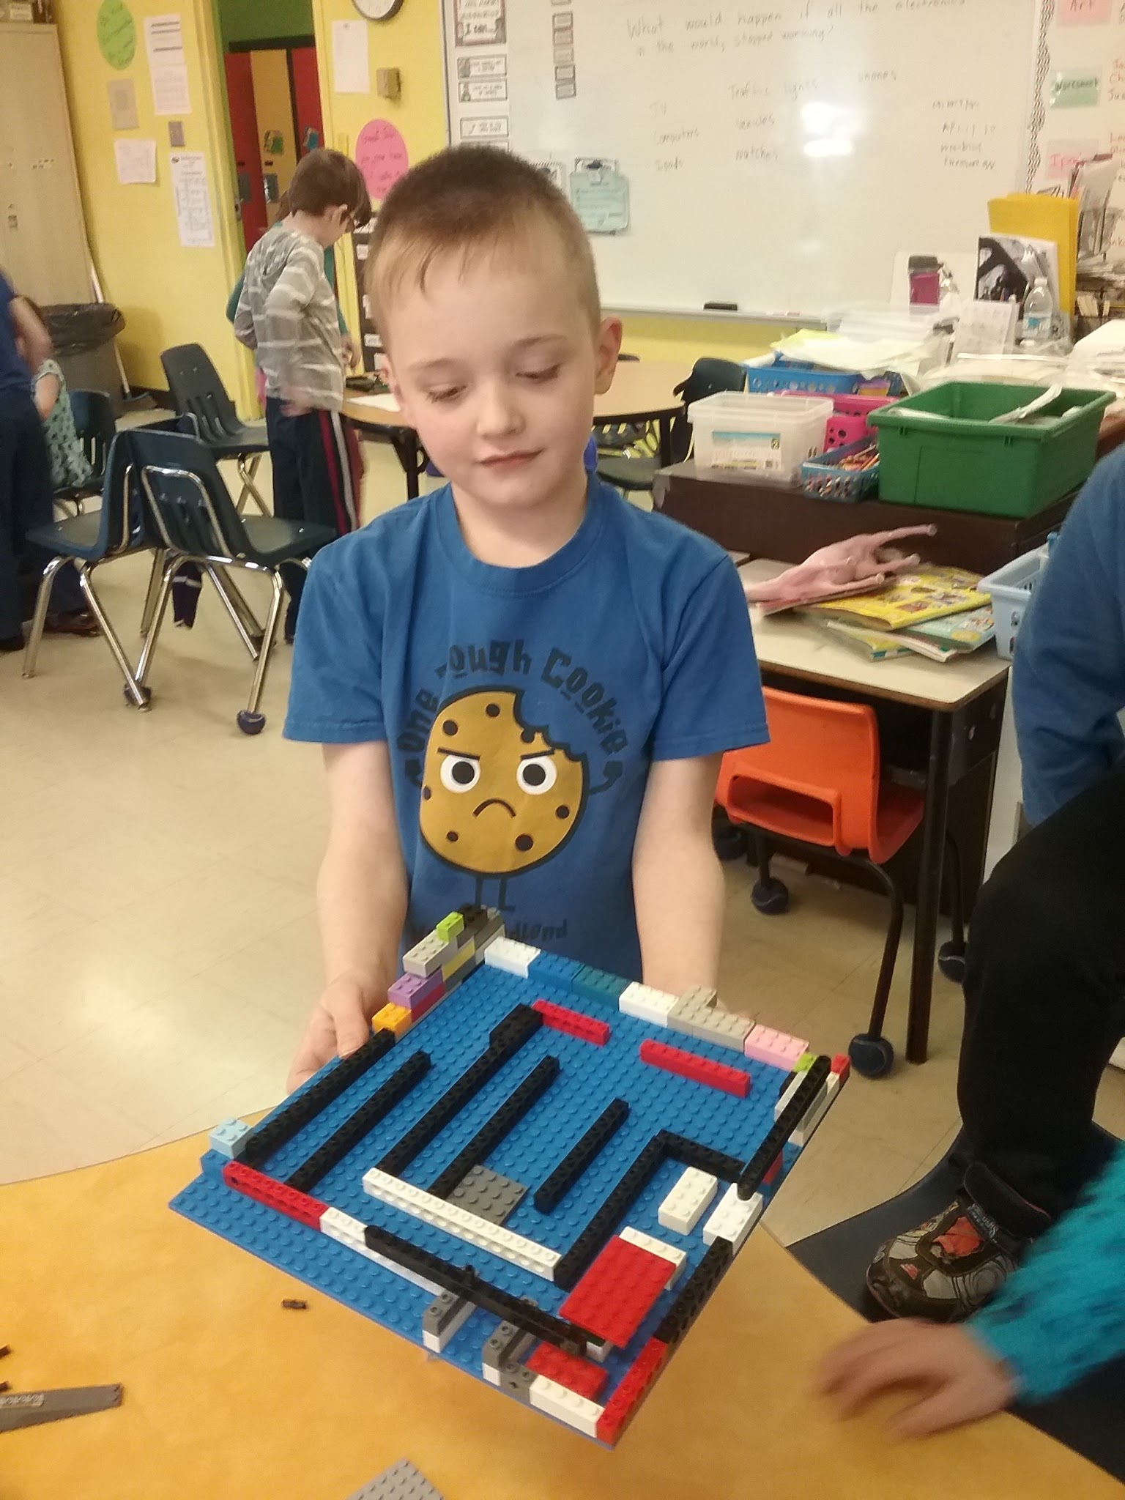
Meet the Team
Nicole Curlew - Grade 2
Nicole Curlew has been teaching at Immaculate Conception for 3 years. Before that she has taught at several different school in grades ranging from kindergarten to grade nine.
This is her first year teaching Grade 2 Science.
She has 18 inquisitive boys and girls in her grade 2 Science class.

Slide 6
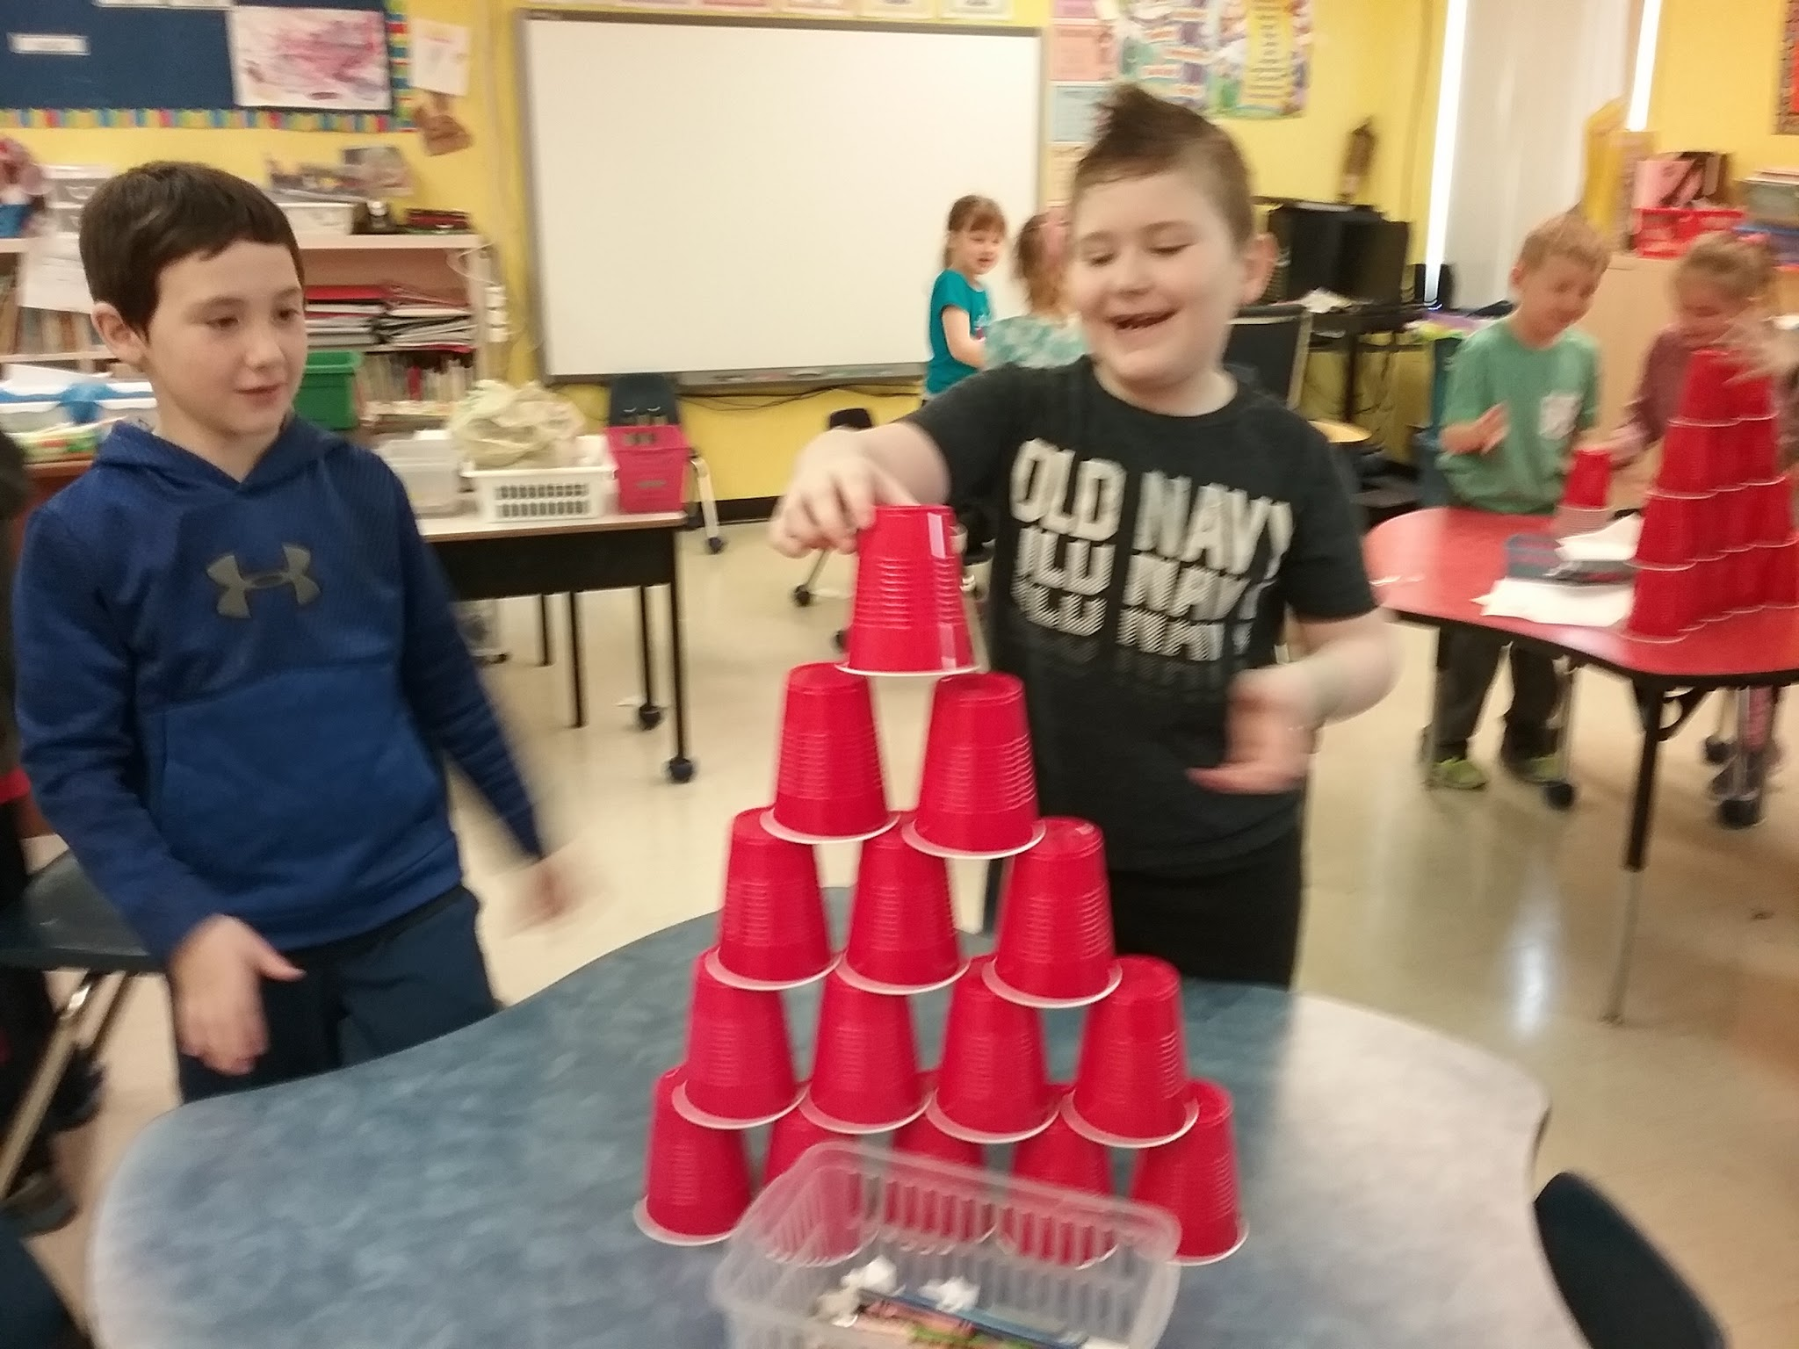
“I believe that students will not always remember what they studied to pass the test, but they will remember the experiences they had. Through these centers and the new Science curriculum, I had the opportunity to provide many hands on experiences that I hope students will remember and use to learn in the years to come.”
Nicole

Slide 7
STEM Background
Our school’s first TIA STEM Project was in 2013-2014. The team created Math Resource Centers. Since then our school has participated in three other projects including our own.
Focus for this project came from a desire to improve and enhance classroom practices by increasing student motivation to learn and use Science. Both teachers were looking at ways that they could engage students more in their classes and wanted to try this new strategy in one specific areas before expanding to other areas of the curriculum.
Discovery Centers seem to fit naturally into the new Science Curriculum. Both teachers decided to use the Discovery Centers in Science. The curriculum in both Kindergarten and Grade 2 lended itself to the development of motivating centers.

Slide 8
Project Research Questions
Question 1: Teacher Question
How will I facilitate inquiry based learning in my Primary Science classroom?
Subquestions:
What is inquiry based learning?
What does inquiry based learning look like in the Primary Science classroom?
Question 2: Student Question
How will inquiry based learning increase student motivation in the Primary Science classroom?

Slide 9
Project Rationale-
Why we chose to develop Science Discovery Centers
Scientific literacy is the aim of Science education in the Atlantic provinces.
“Learning occurs not by passive absorption, but as students actively construct their own meaning and assimilate new information to develop new understandings.”
“Learning experiences in science education should vary and include opportunities for group and individual work, discussion among students, as well as between teacher and students, and hands-on/minds-on activities that allow students to construct and evaluate explanations for the phenomena under investigation.”
Kindergarten Science Curriculum Guide

Slide 10
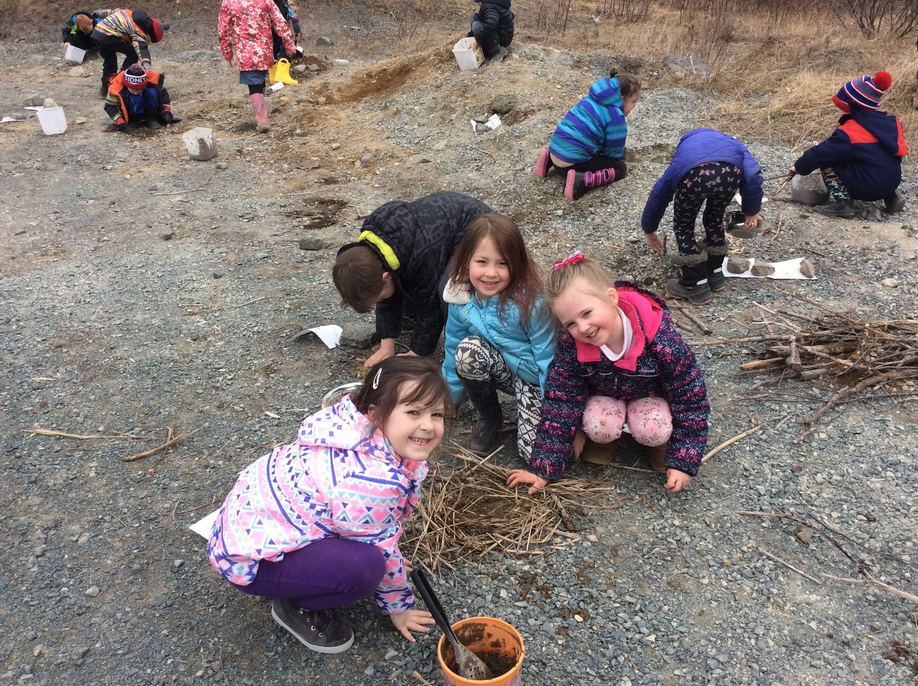
What is a
Discovery Center?
A Discovery Center is a teacher created Science center which will allow a student to explore a particular Science outcome. We each chose outcomes from our Science curriculum and developed activities which would spark our students inquiry skills. Through the development of these skills students become more aware of the world around them and allow their curiosity to lead their learning process.

Slide 11
Planning and Release Days
Curriculum Guides
Choosing Activities
Planning Notes for DC’s
Creating our task cards and center materials
Collaboration
Springboard
Student Survey on Motivation
Tom’s Visit
Evaluation and progress

Slide 12
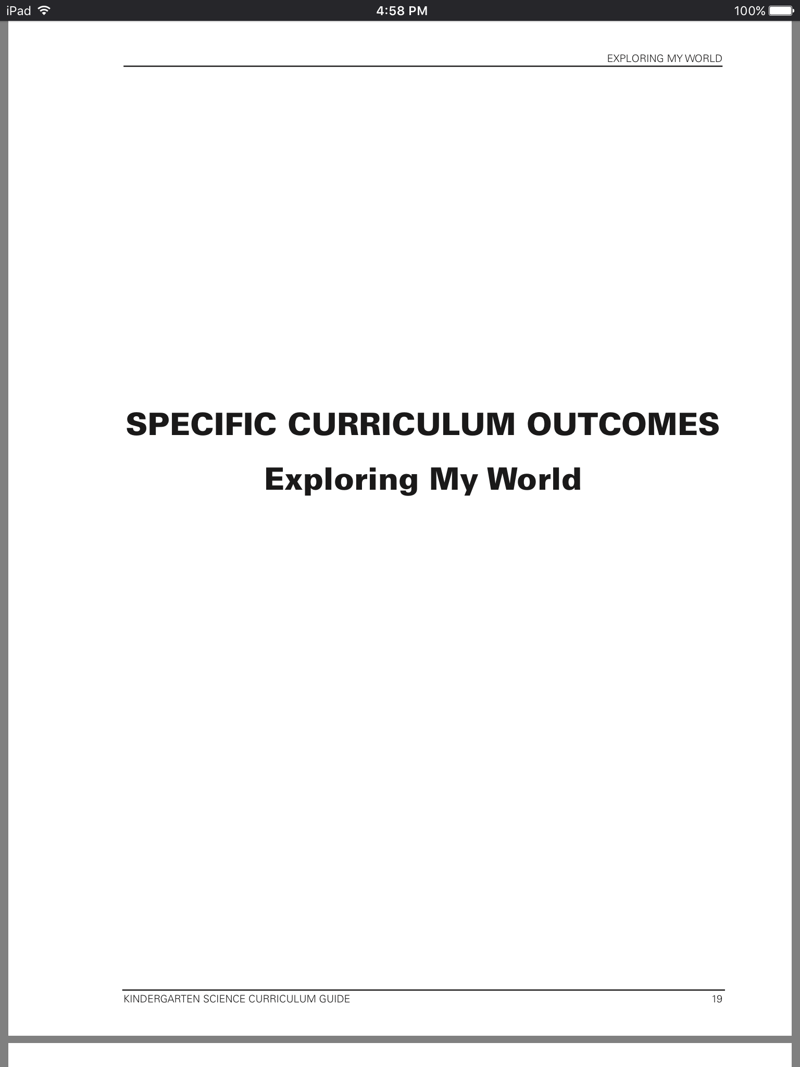
Kindergarten Discovery centers were designed to provide students with hands on activities that could be completed individually or in small groups. The outcomes targeted came from the “Exploring My World” section of the Science Curriculum Guide.

Slide 13
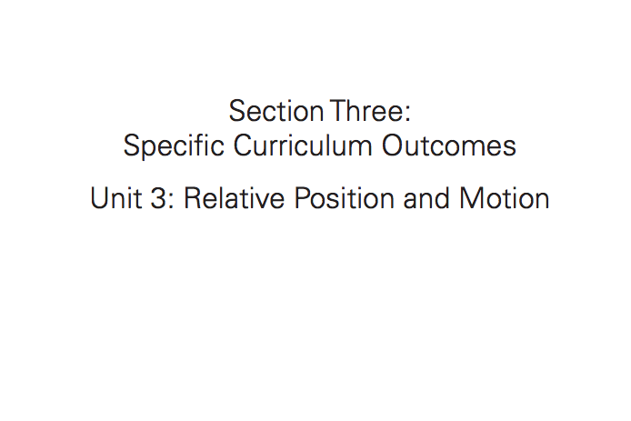
The grade 2 Discovery Centers were taken from both the Grade 2 Science Curriculum and the new Let’s Do Science resource. Most centers were designed to be completed in small groups, so students could discuss and plan as a team.

Slide 14
Data Collection
Student Surveys
Work Samples
Anecdotal Records
Teacher - Student Interviews
Checklists
Pictures and Videos

Slide 15
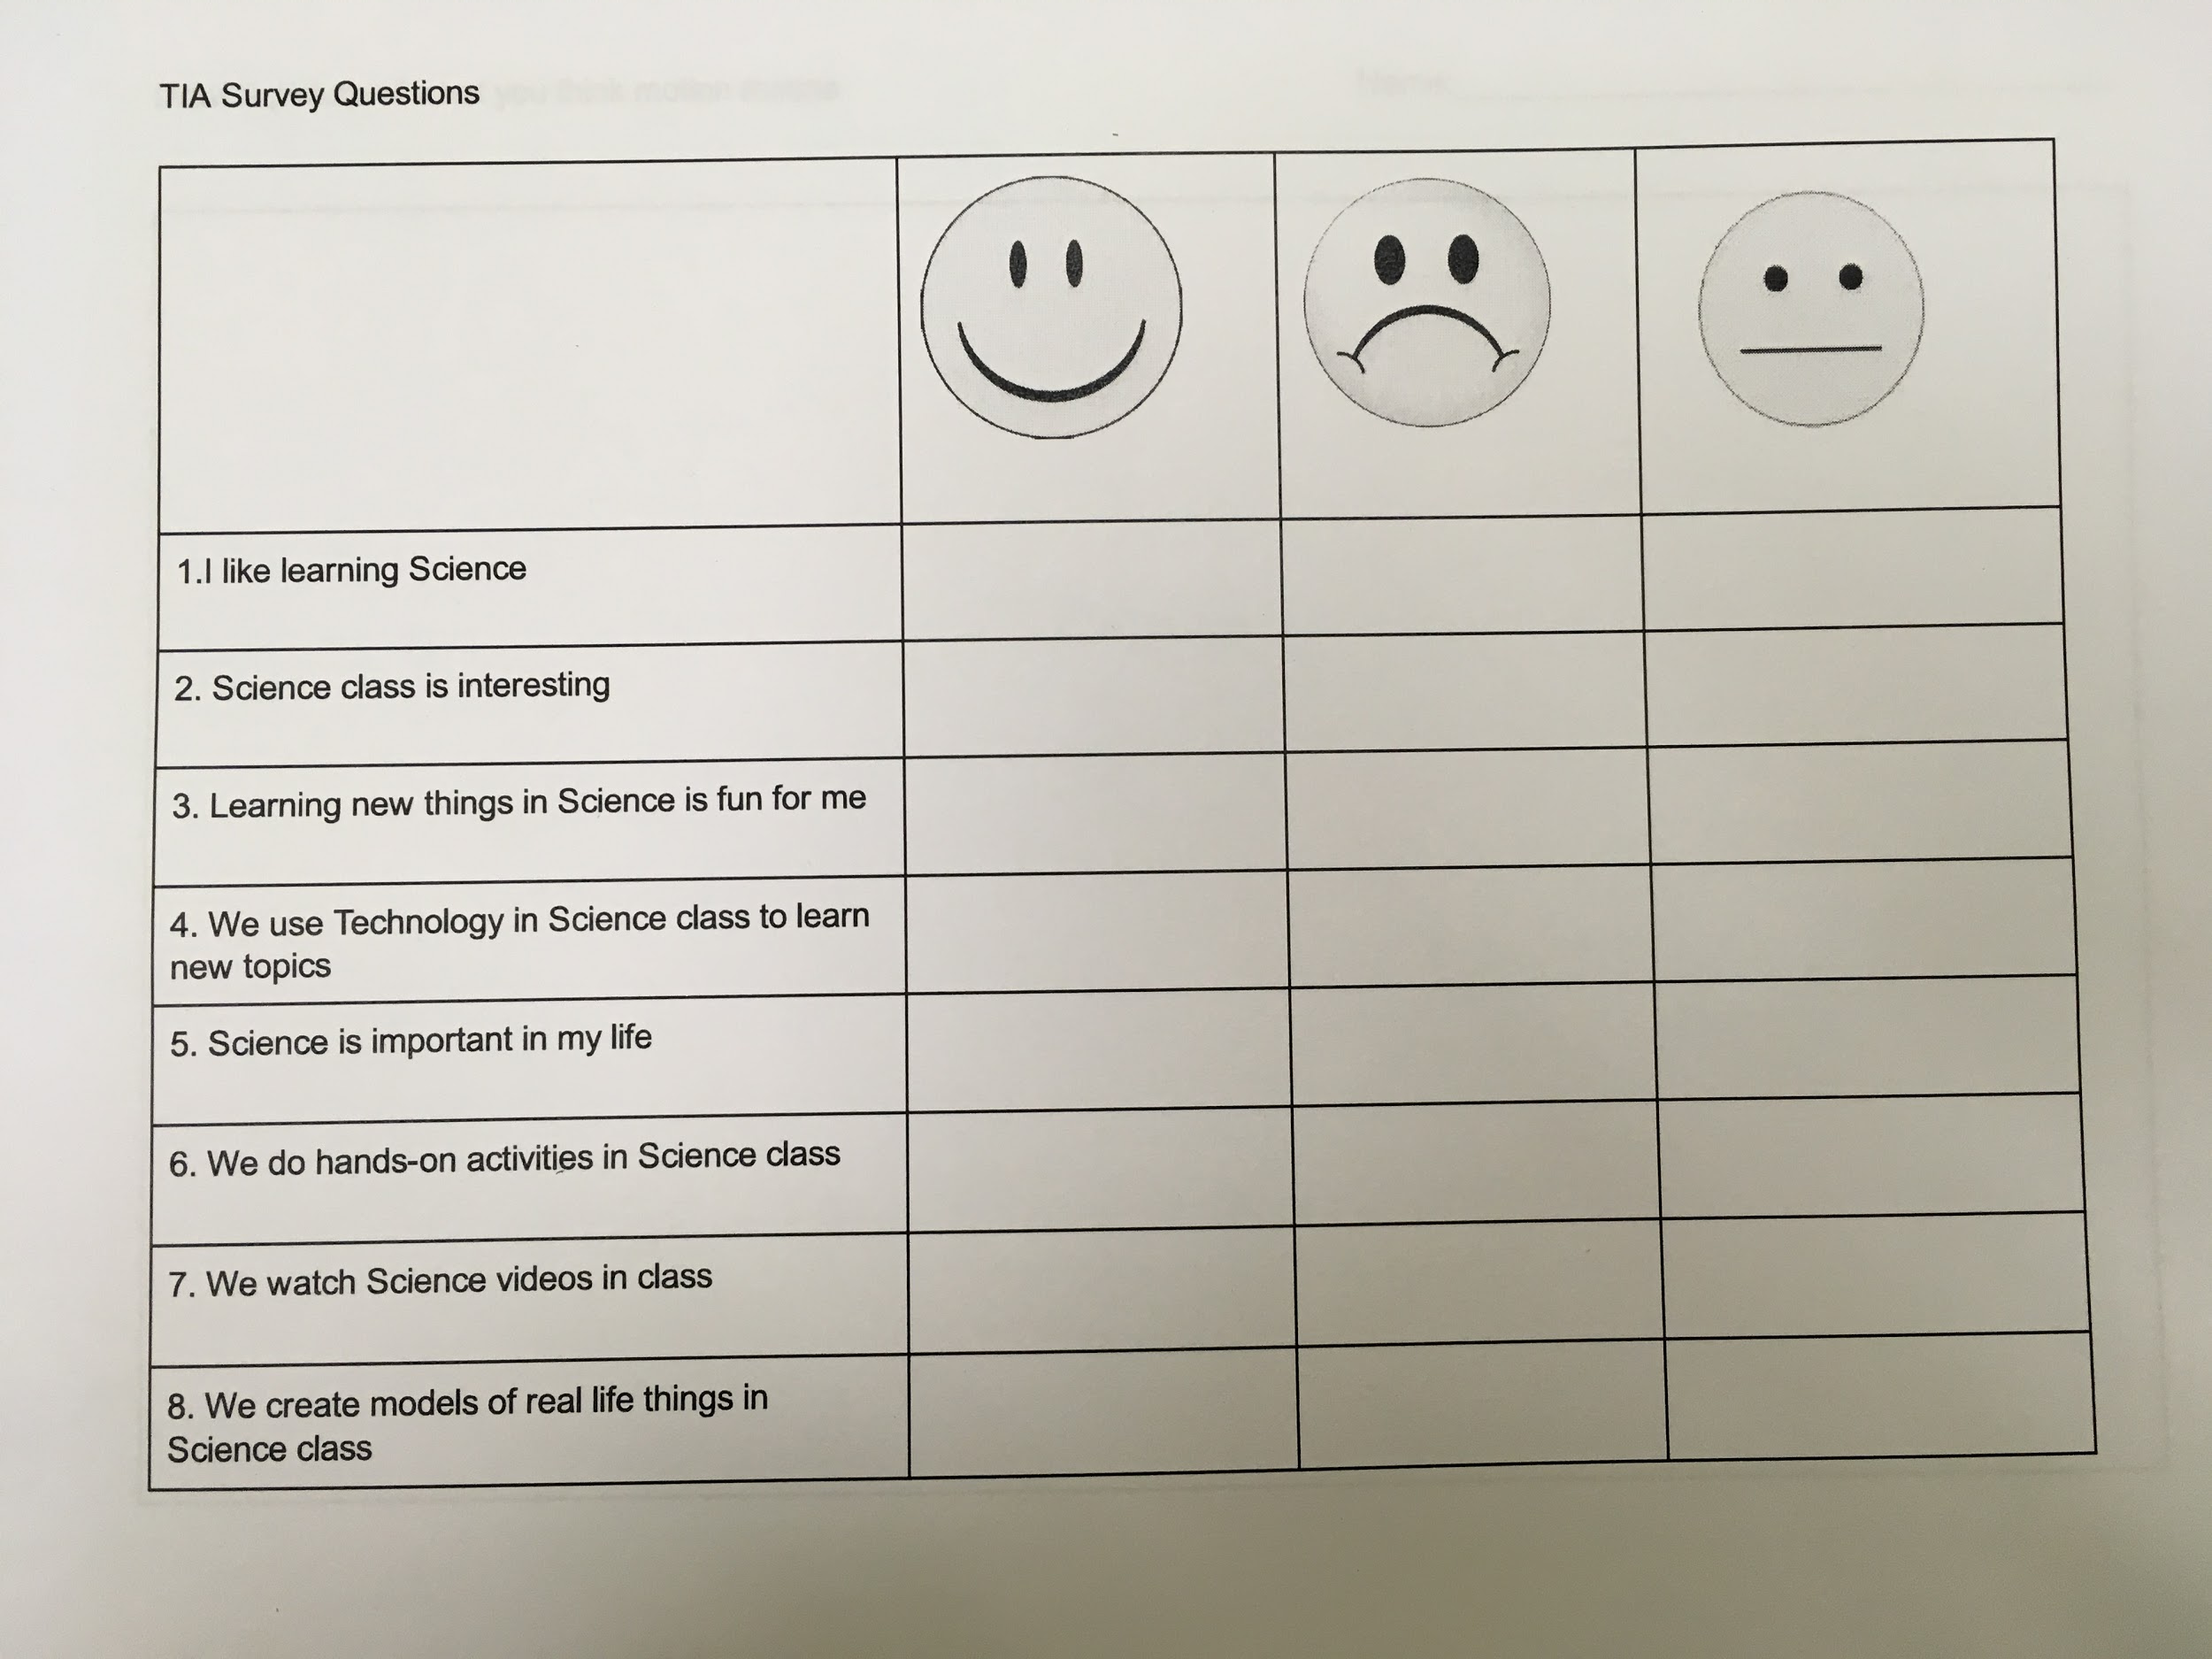
Student Motivation Survey
We gave this exact survey to students before the implementation of the project and then again at the end. This allowed us to compare student motivation towards learning Science after using the Centers.

Slide 16
Task Cards

Slide 17
Task Cards

Slide 18
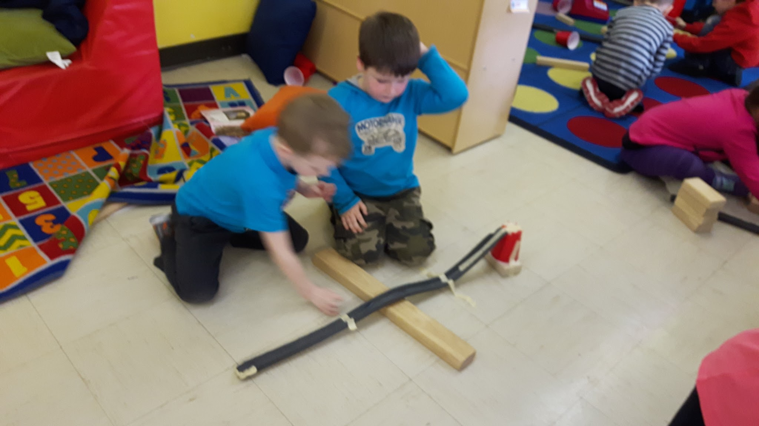
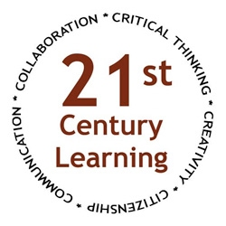
We tried to ensure that our centers followed the 21st century learning model by allowing our students to think critically, collaborate with others and use various technologies.

Slide 19
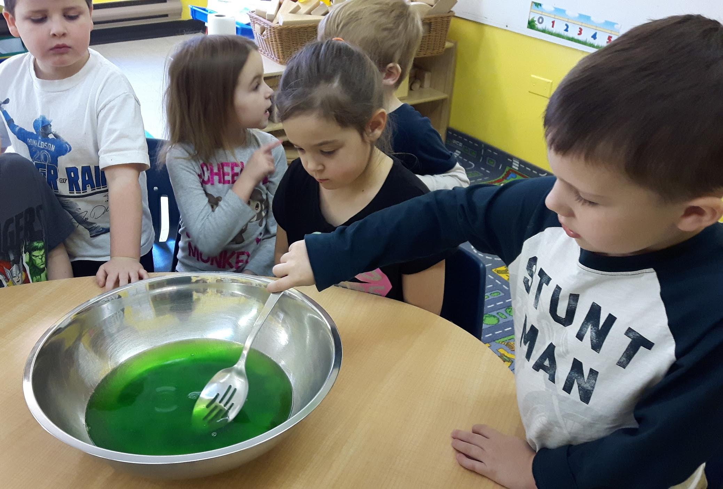
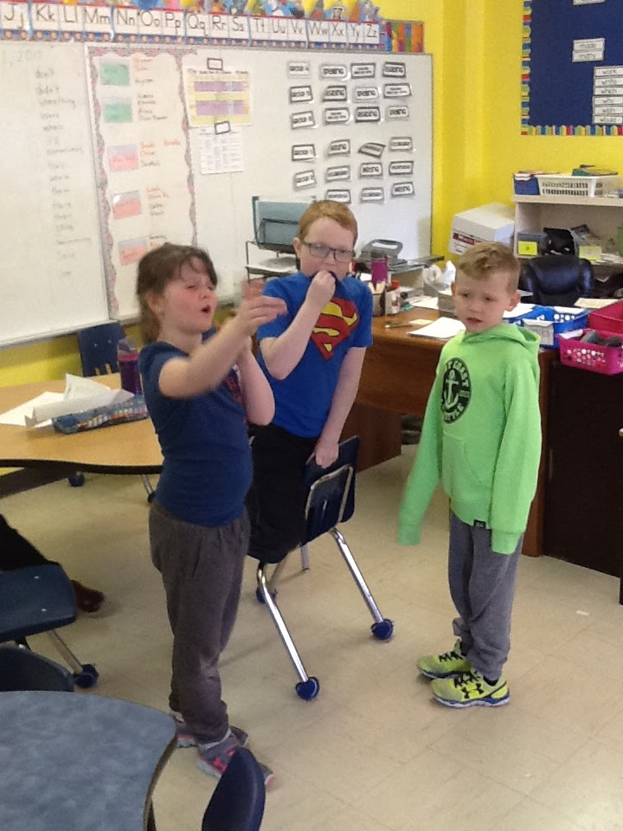

Slide 20
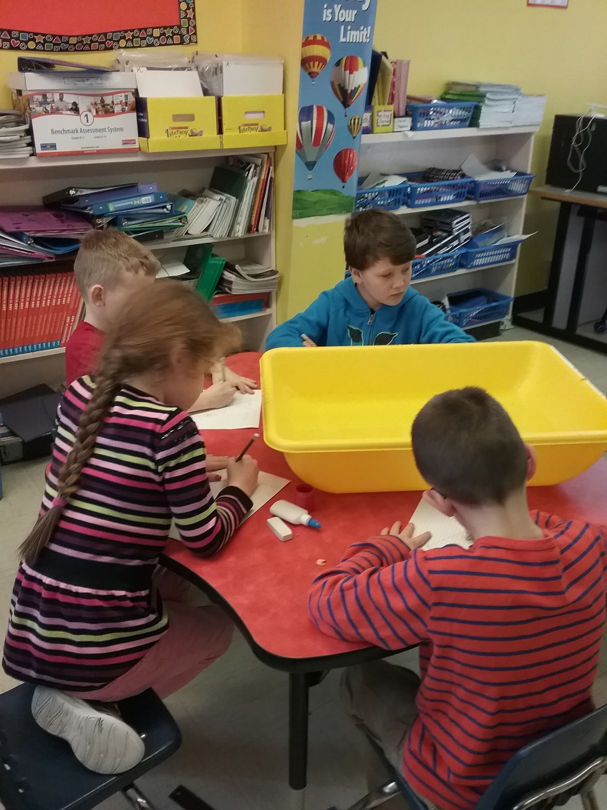
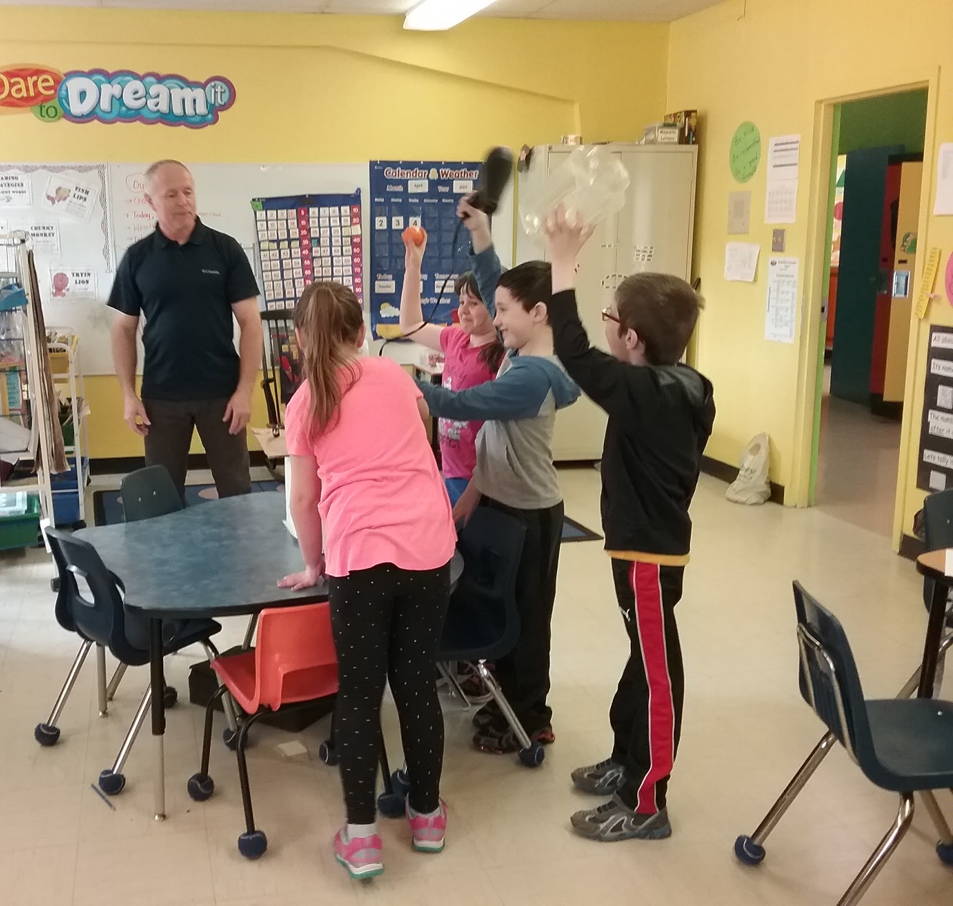
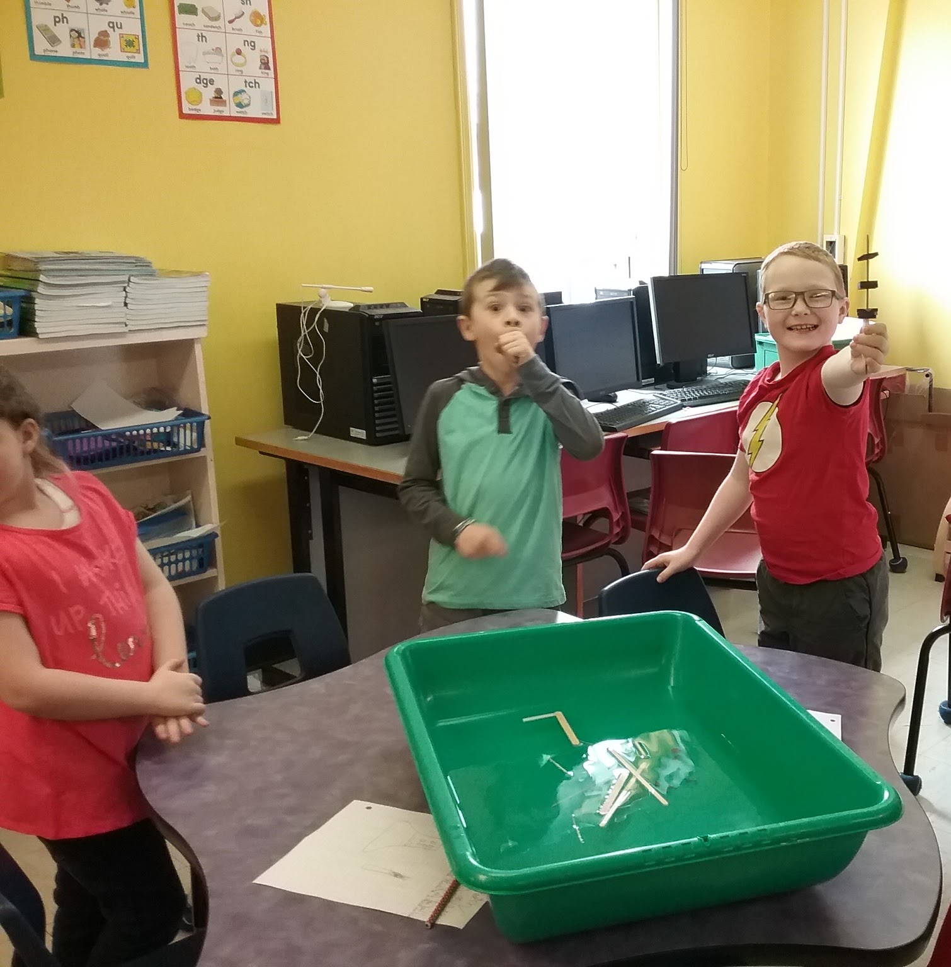
The Best Way to Start
A visit from Tom!

Slide 21
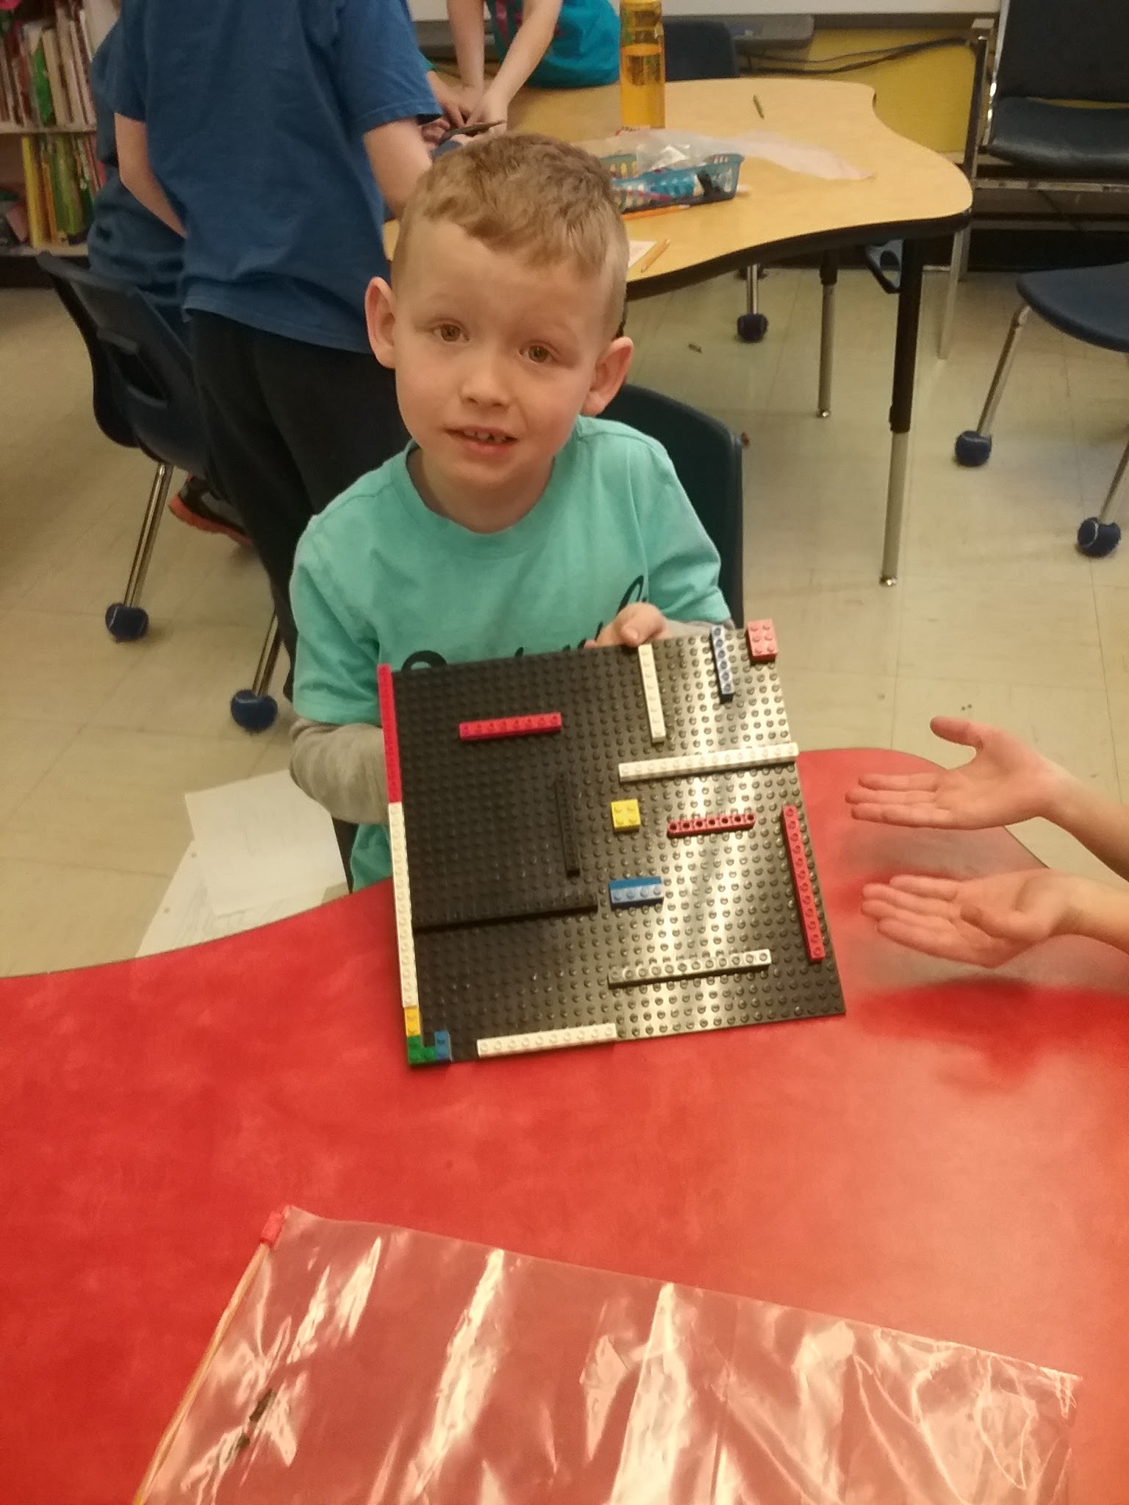
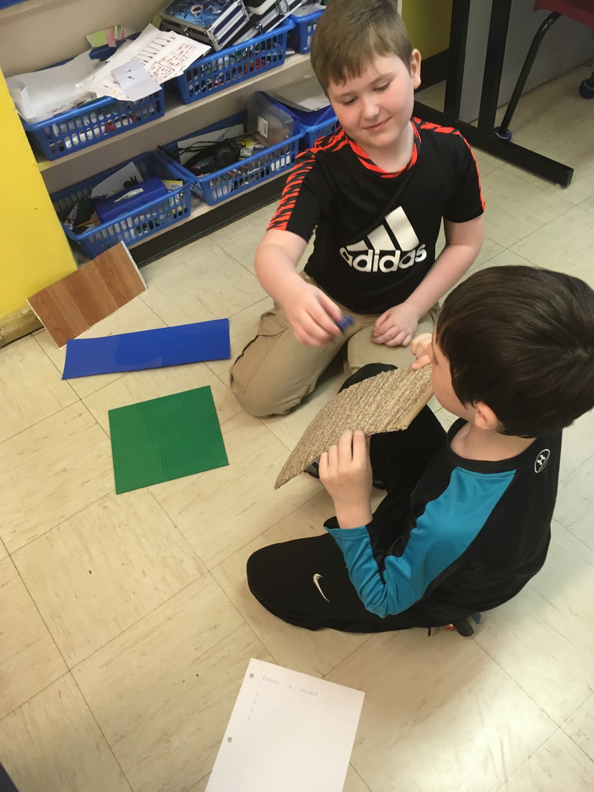
Student Experiences (Grade 2)

Slide 22
Lego Mazes
John testing out his group’s lego maze creation.
“Not as easy as it seems.”

Slide 23
Friction
Justus discussing his choices for best material to use when creating a ramp.
He quickly recognized that lego material would not be a great choice and for good reason.

Slide 24
Ways to Move
Olivia and Jeremy creating their “Ways to Move” video.
They wanted to demonstrate their knowledge with as many movements as possible.

Slide 25
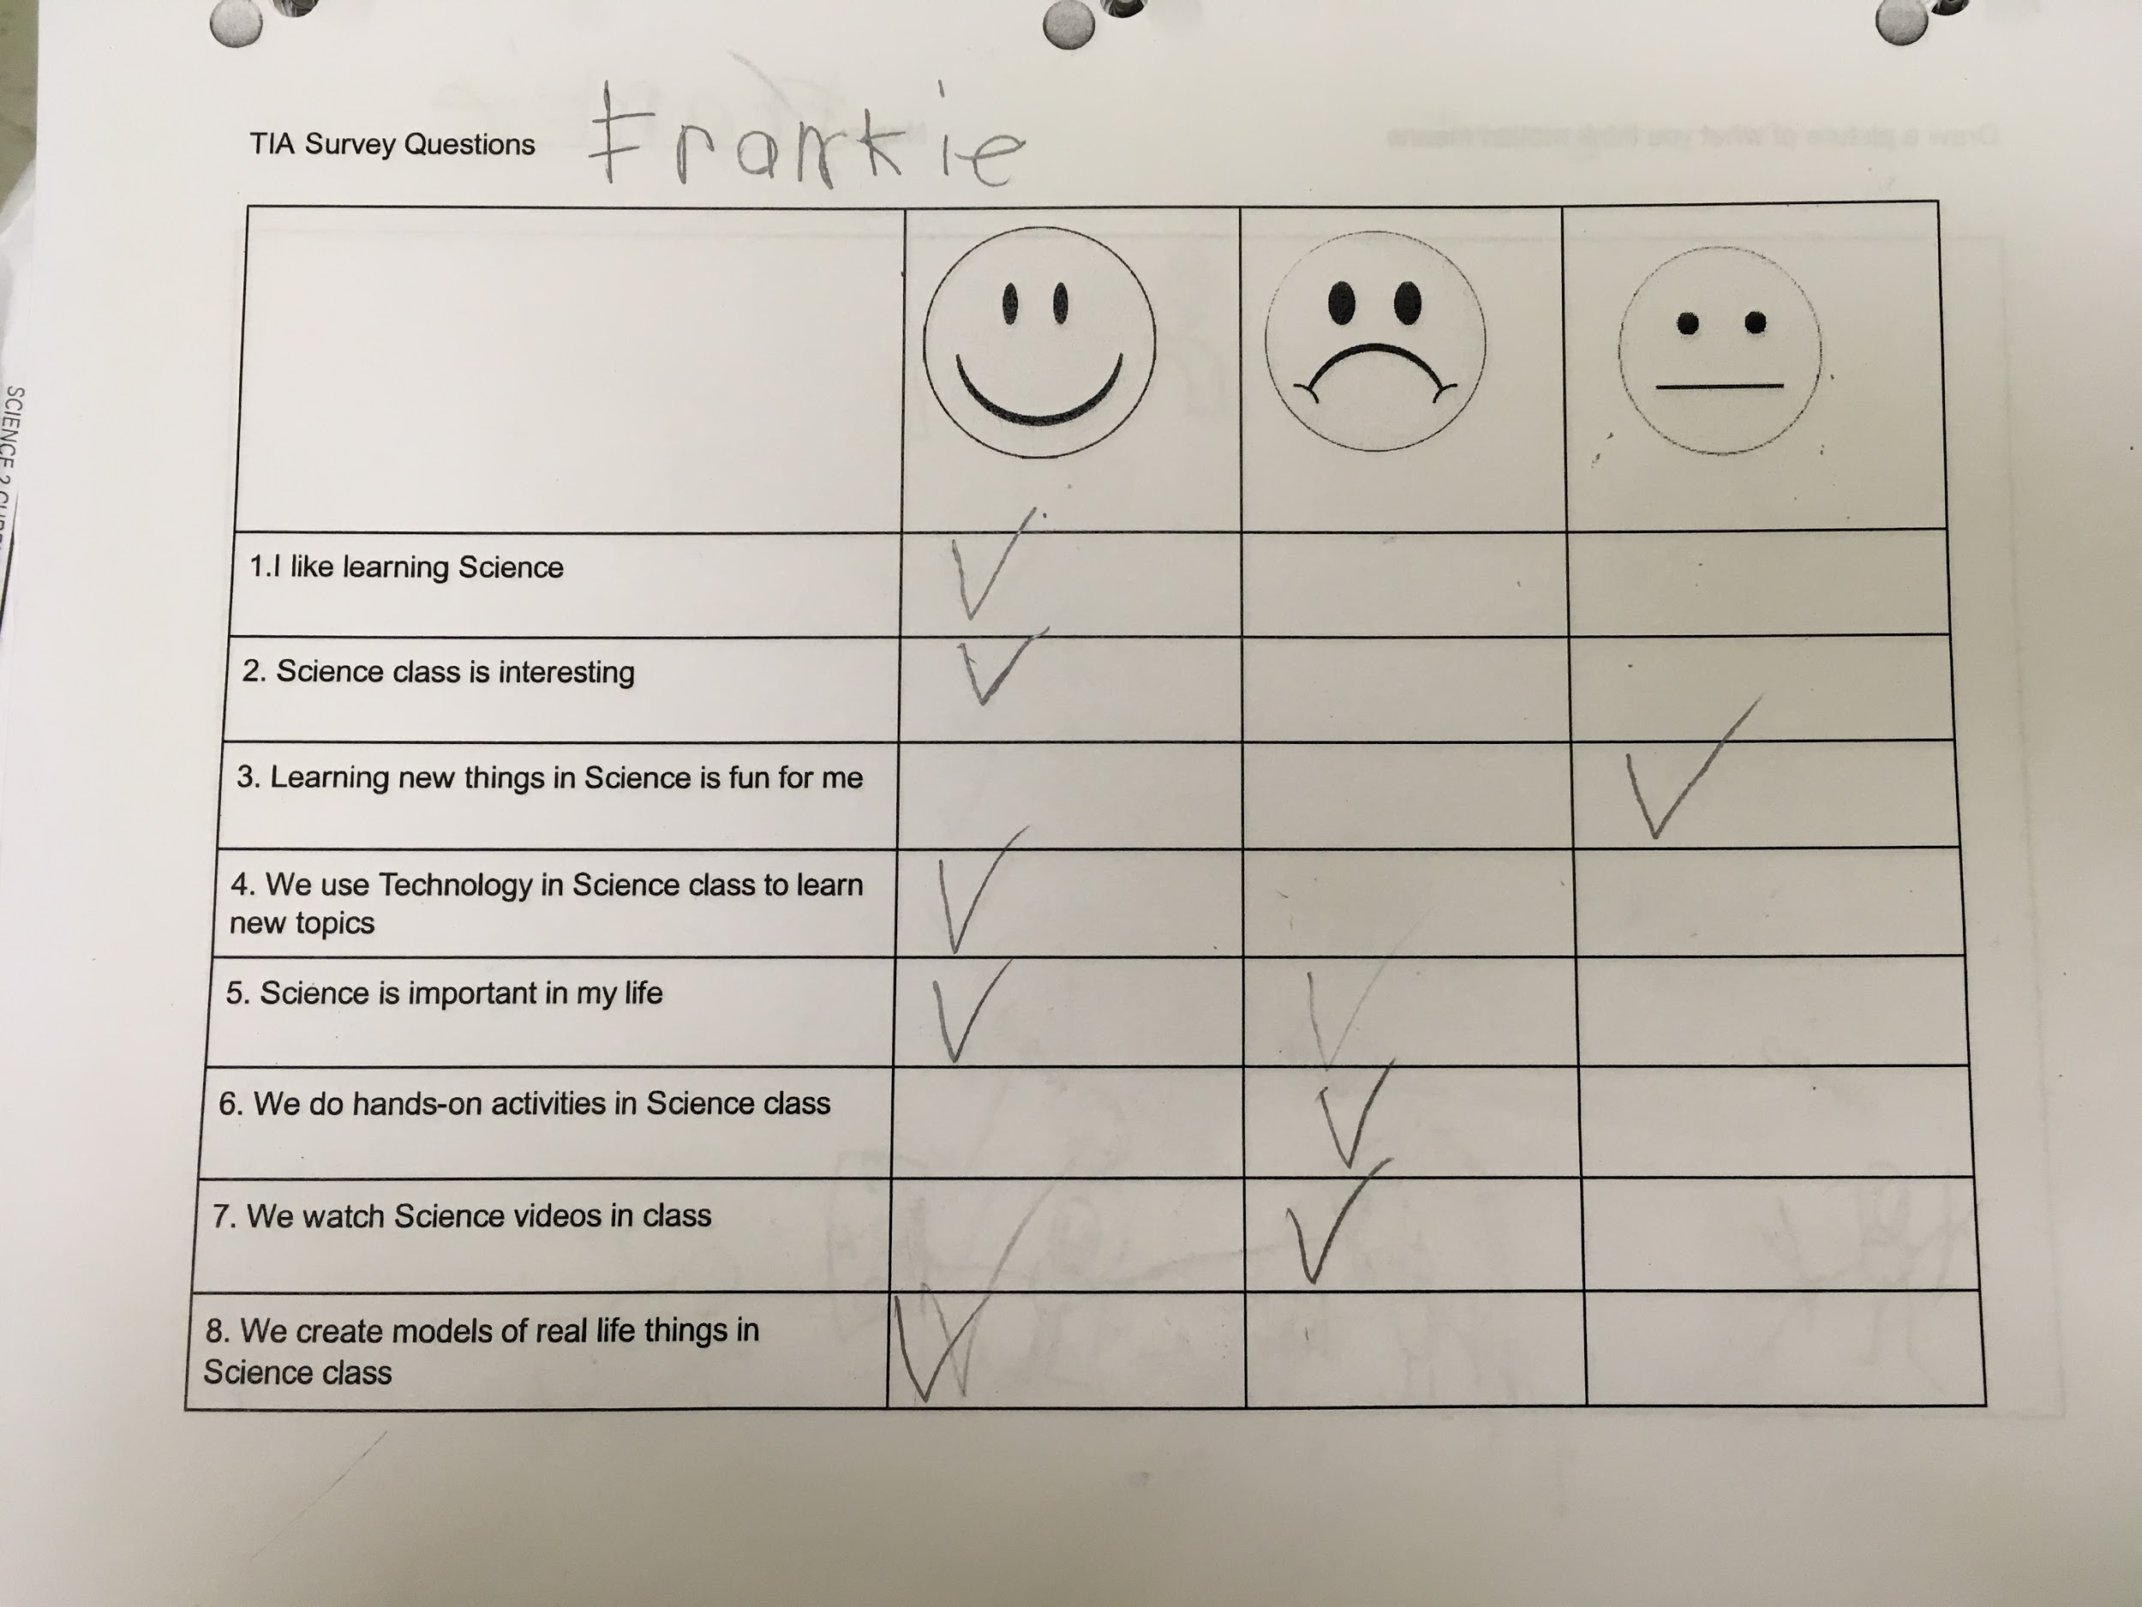
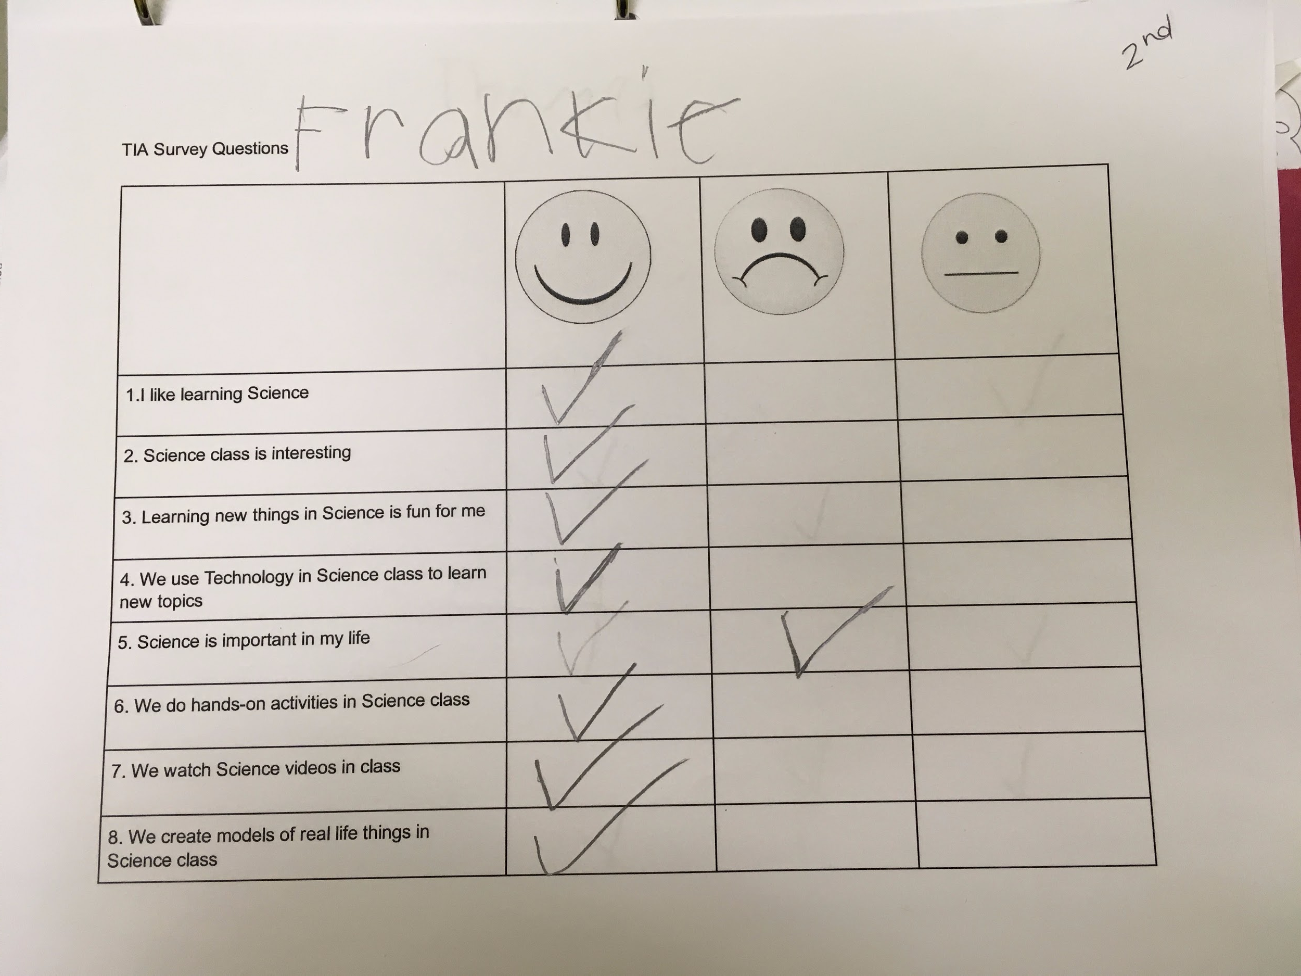
Survey Results (Grade 2)
First Response -Student Survey
Second Response -Student Survey
Frankie had mixed reviews about Science before the start of this unit. He did have a fairly positive attitude, however you can see that it increased even more through these centers.

Slide 26
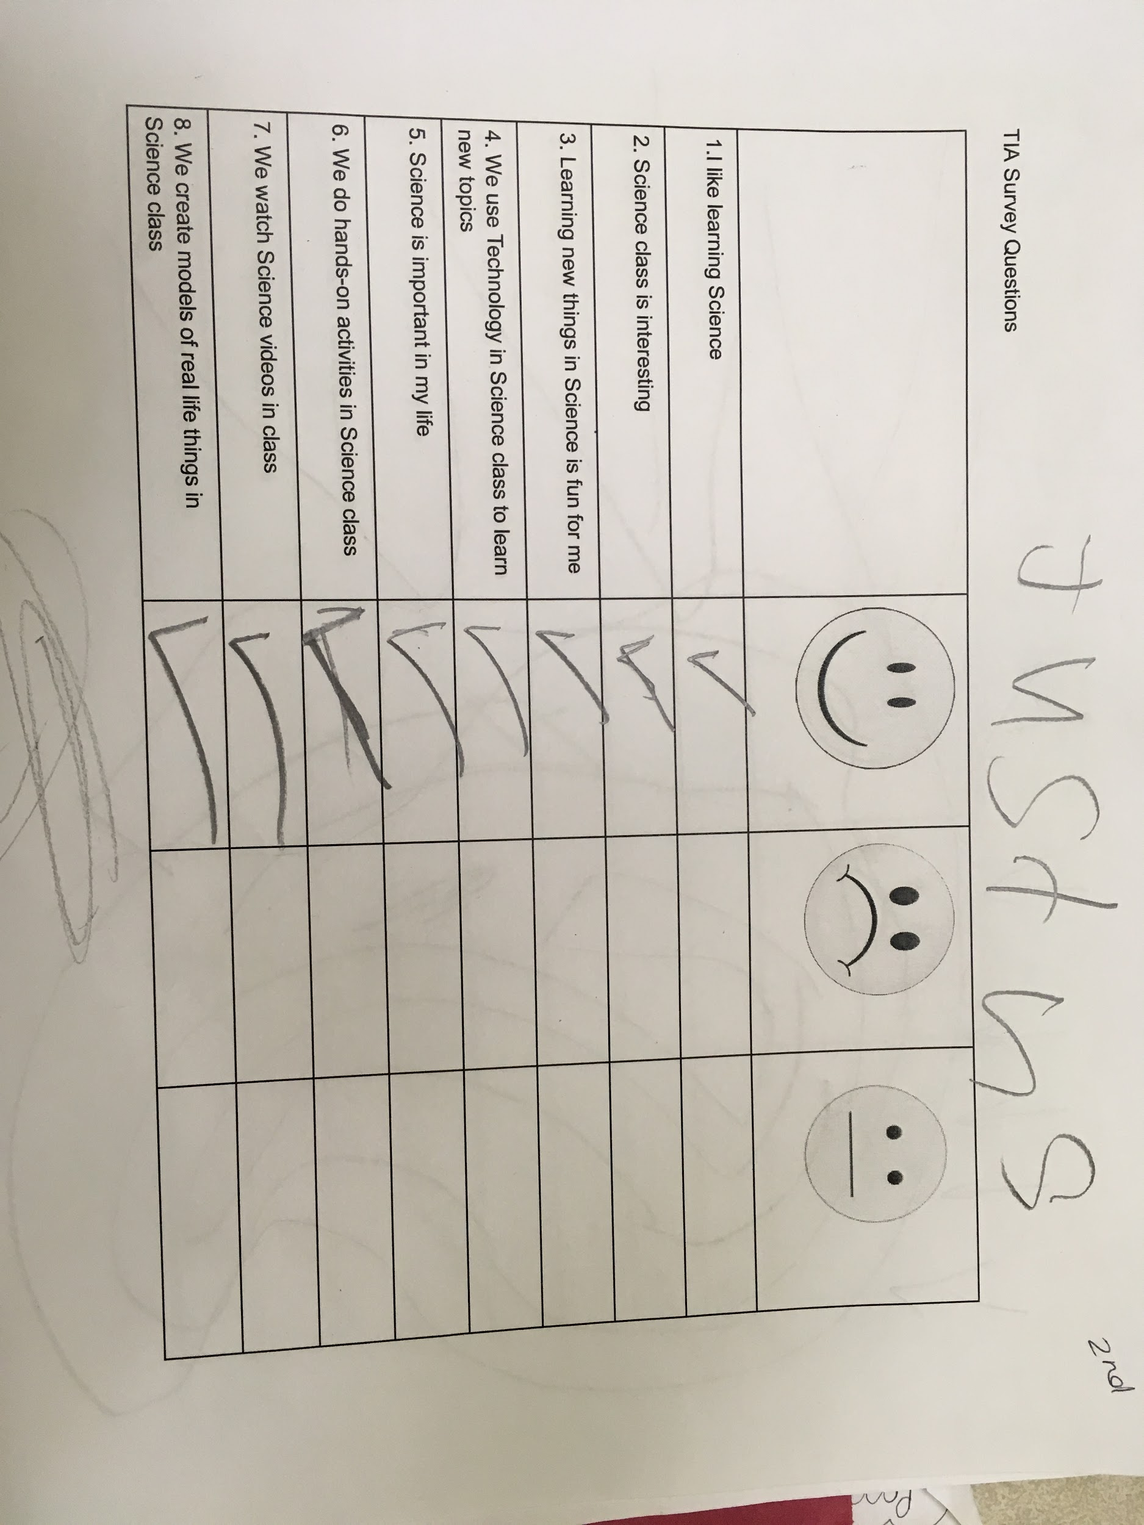
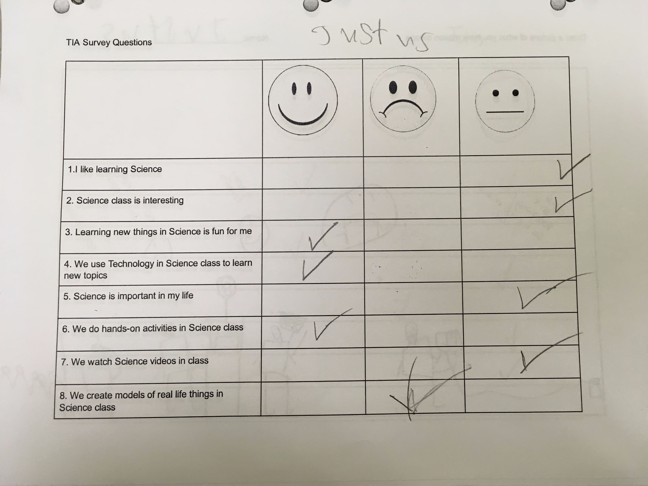
Survey Results (Grade 2)
First Response -Student Survey
Second Response -Student Survey
Justus was very uncertain about Science before the Implementation of the Centers. Through the first survey, I’m left to believe he does not really know what Science really is. You can see after the centers, he knows what Science emcompasses and really enjoyed the process of learning.

Slide 27
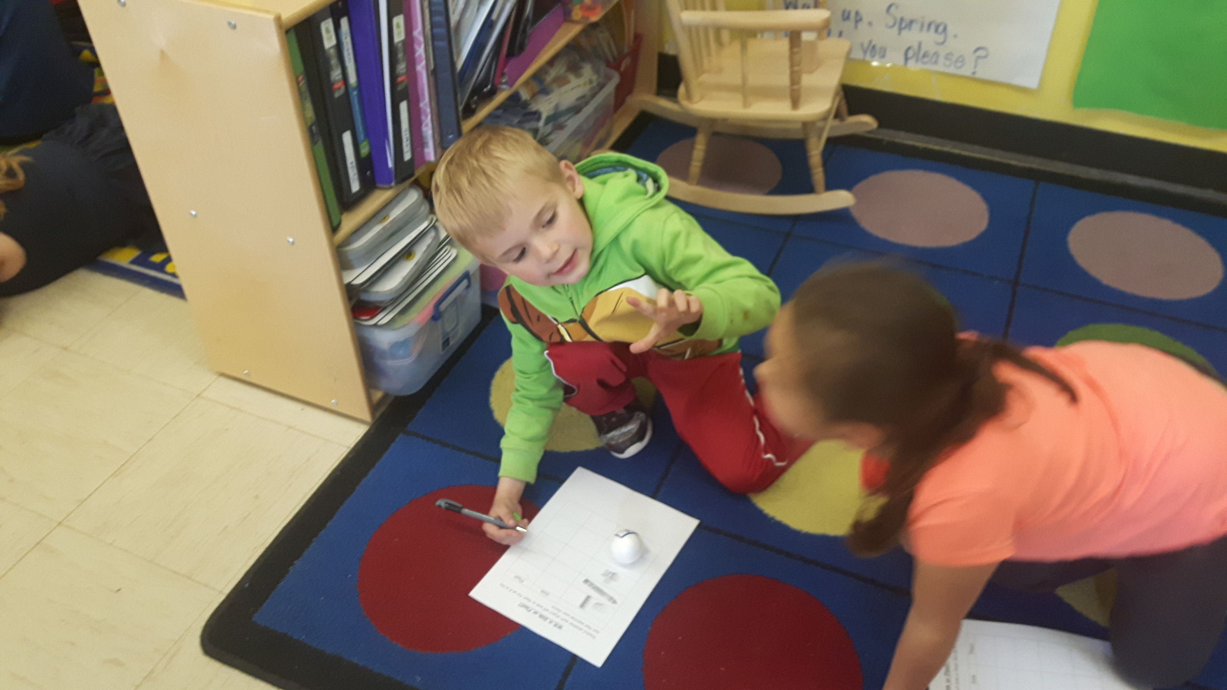
Student Experiences (Kindergarten)

Slide 28
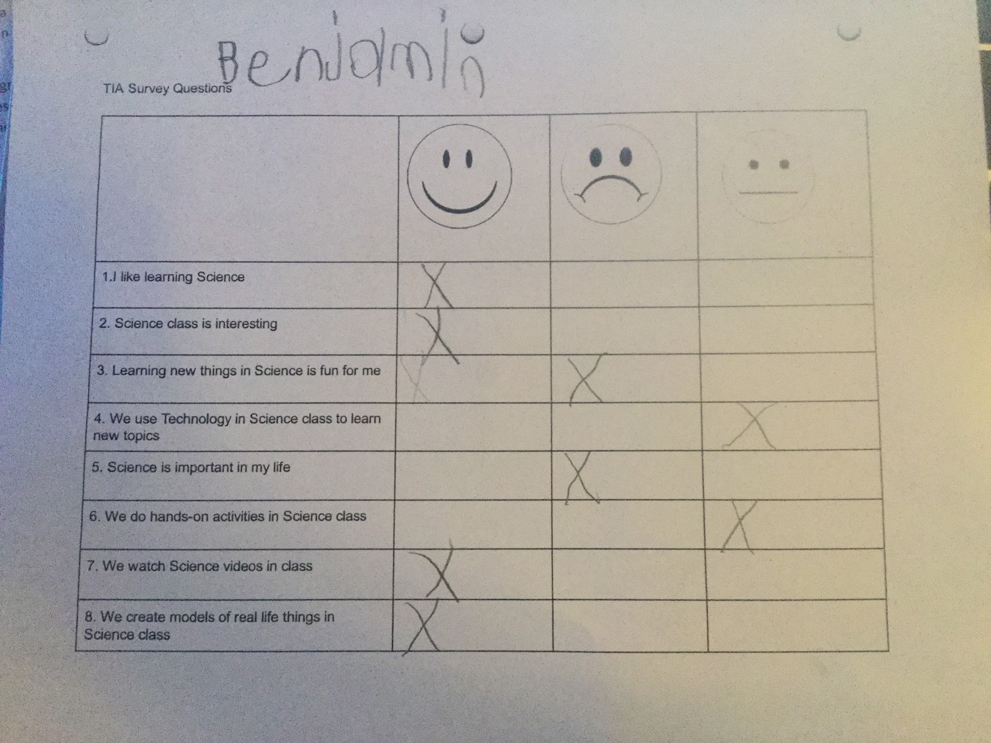
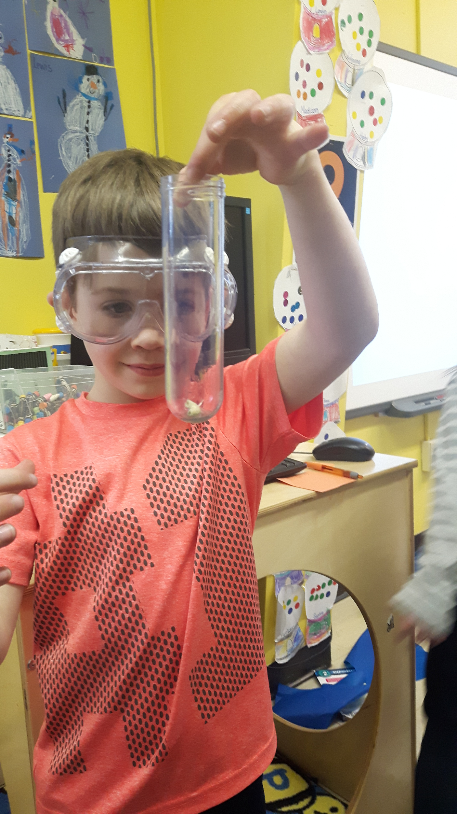
Survey Results (Kindergarten)
On the initial survey Benjamin stated that Science was not fun because they have to sit in their chairs.
During the second survey when Benjamin was asked for his thoughts on Science his answer was, “Science is Cool.”
First Response -Student Survey

Slide 29
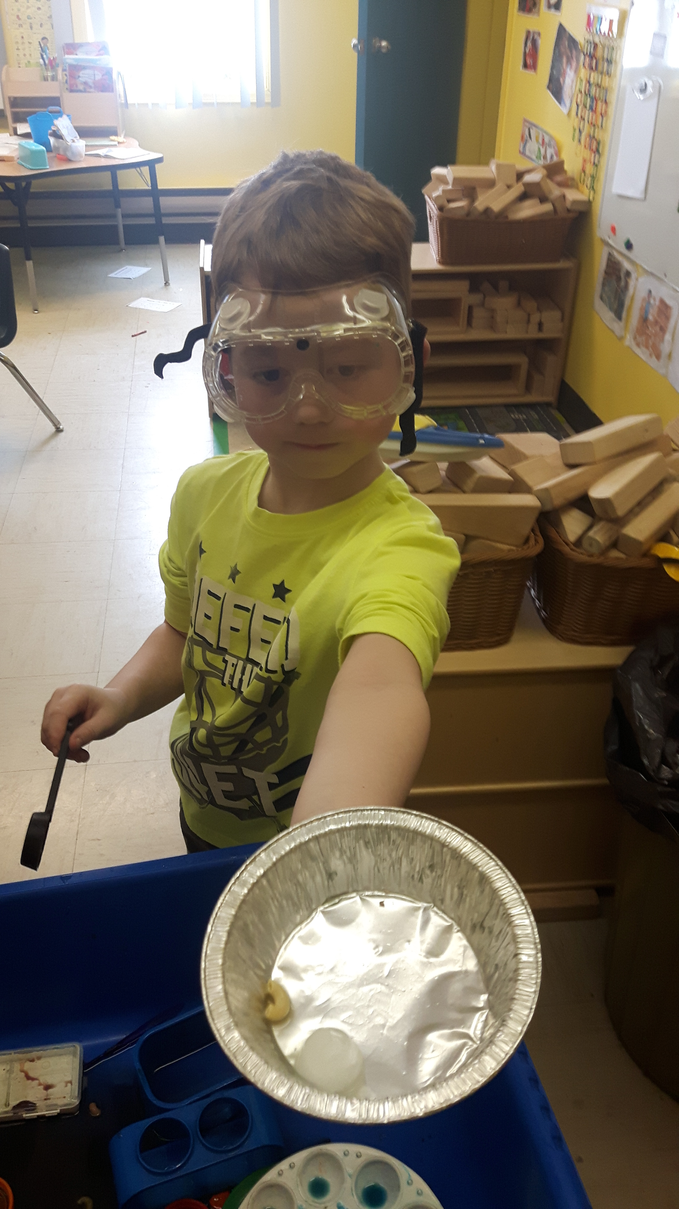
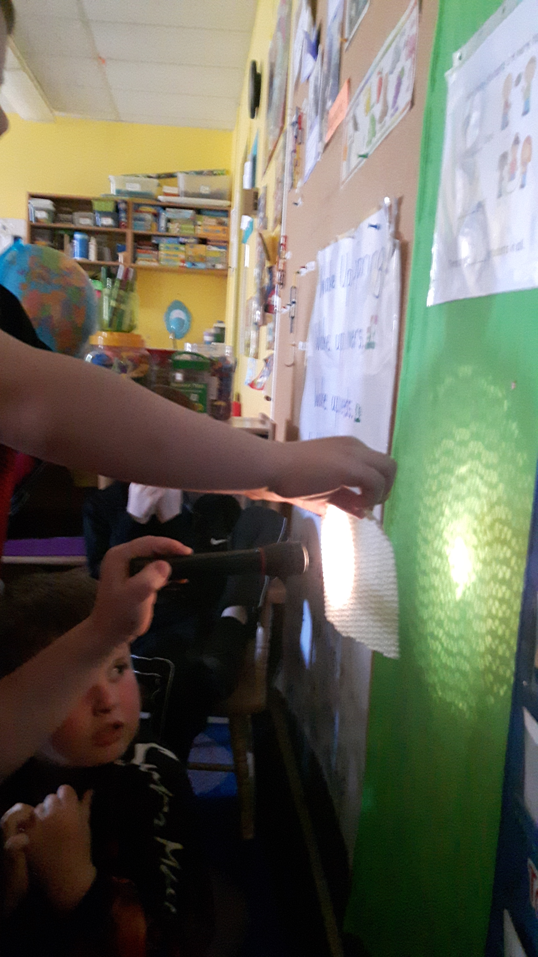
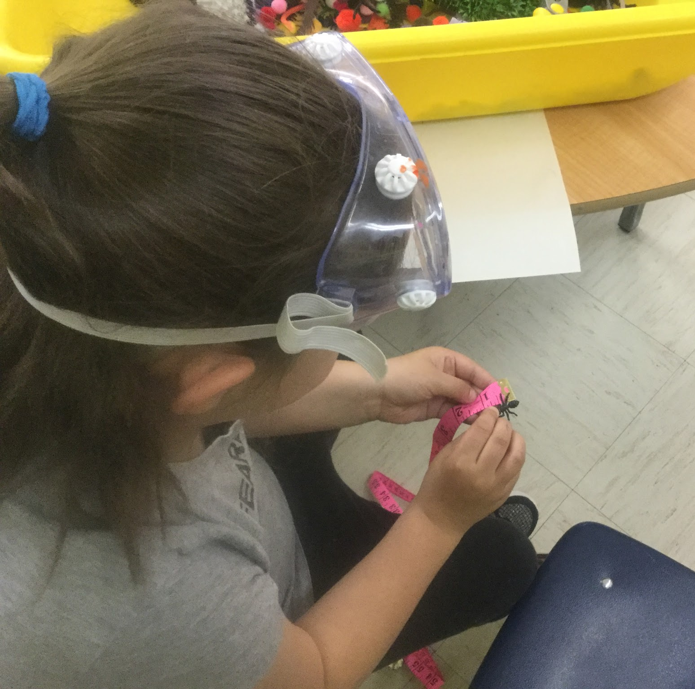
Implementation
Impleme

Slide 30
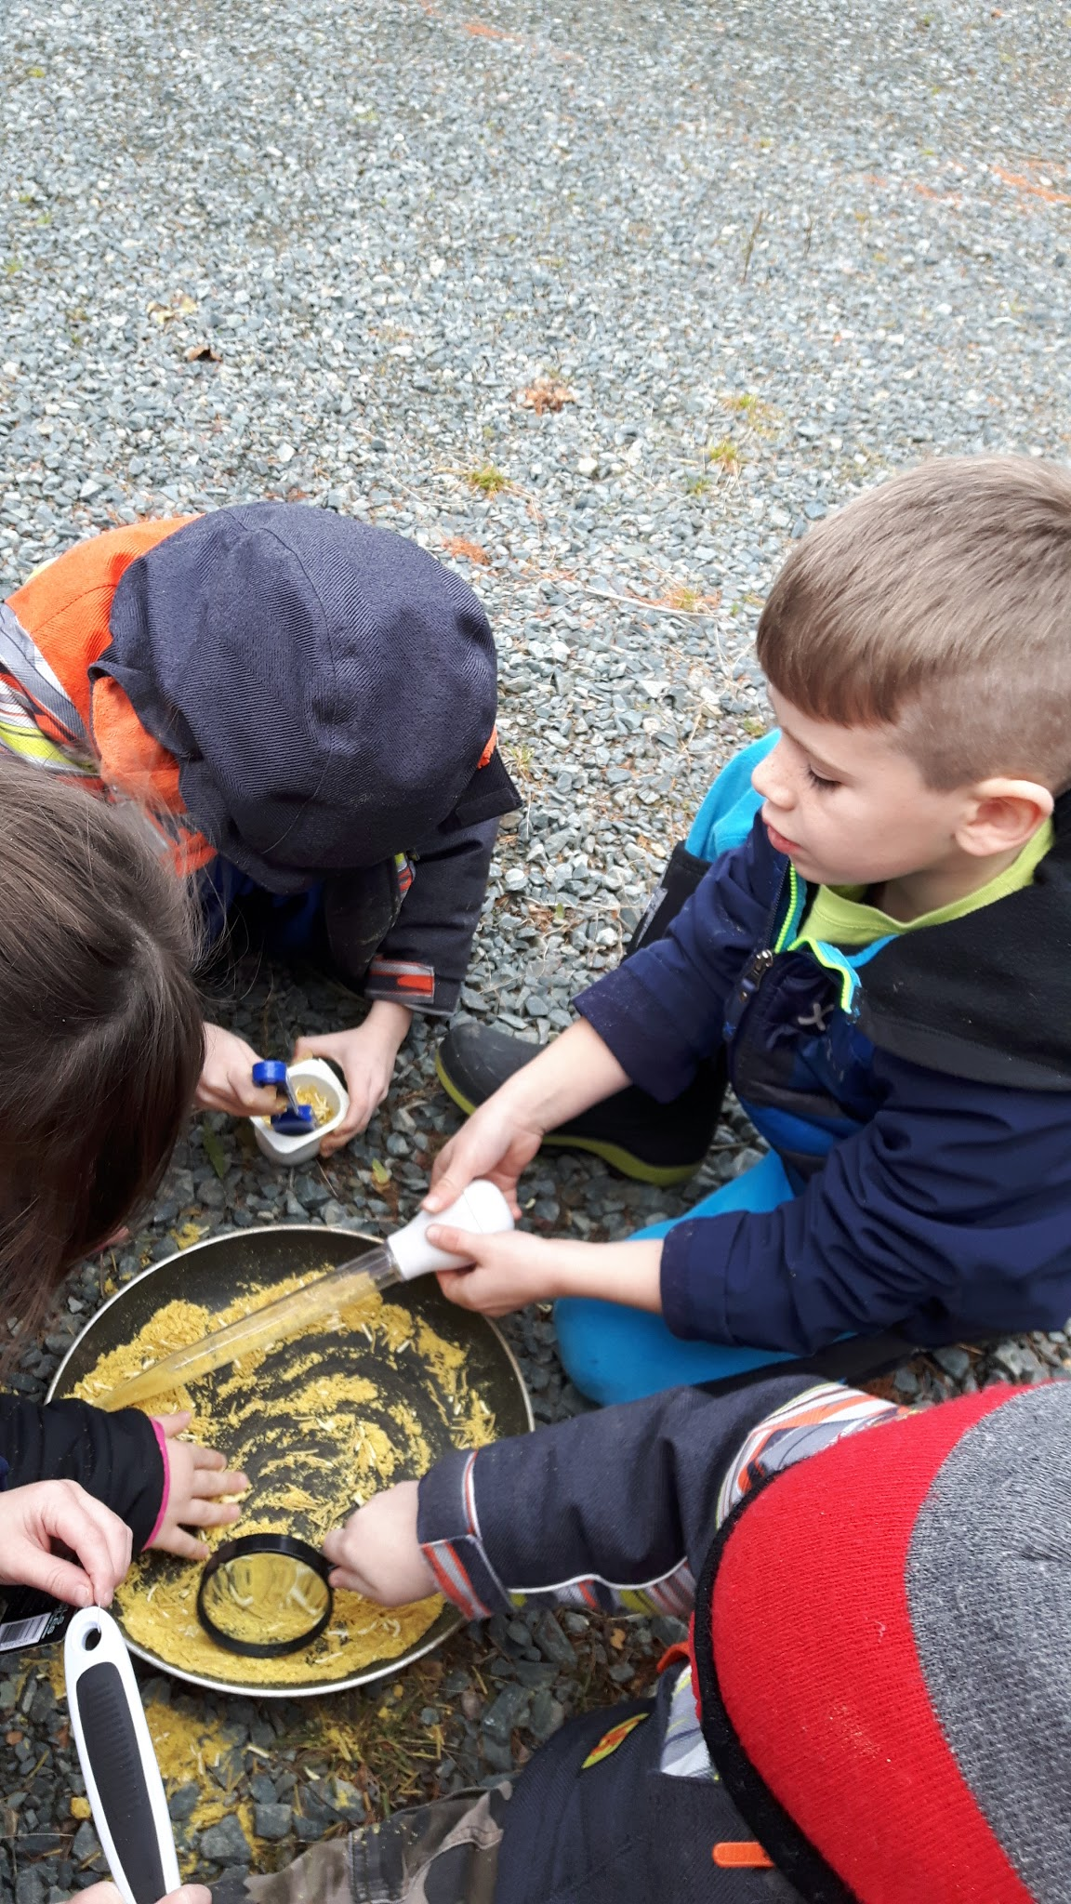
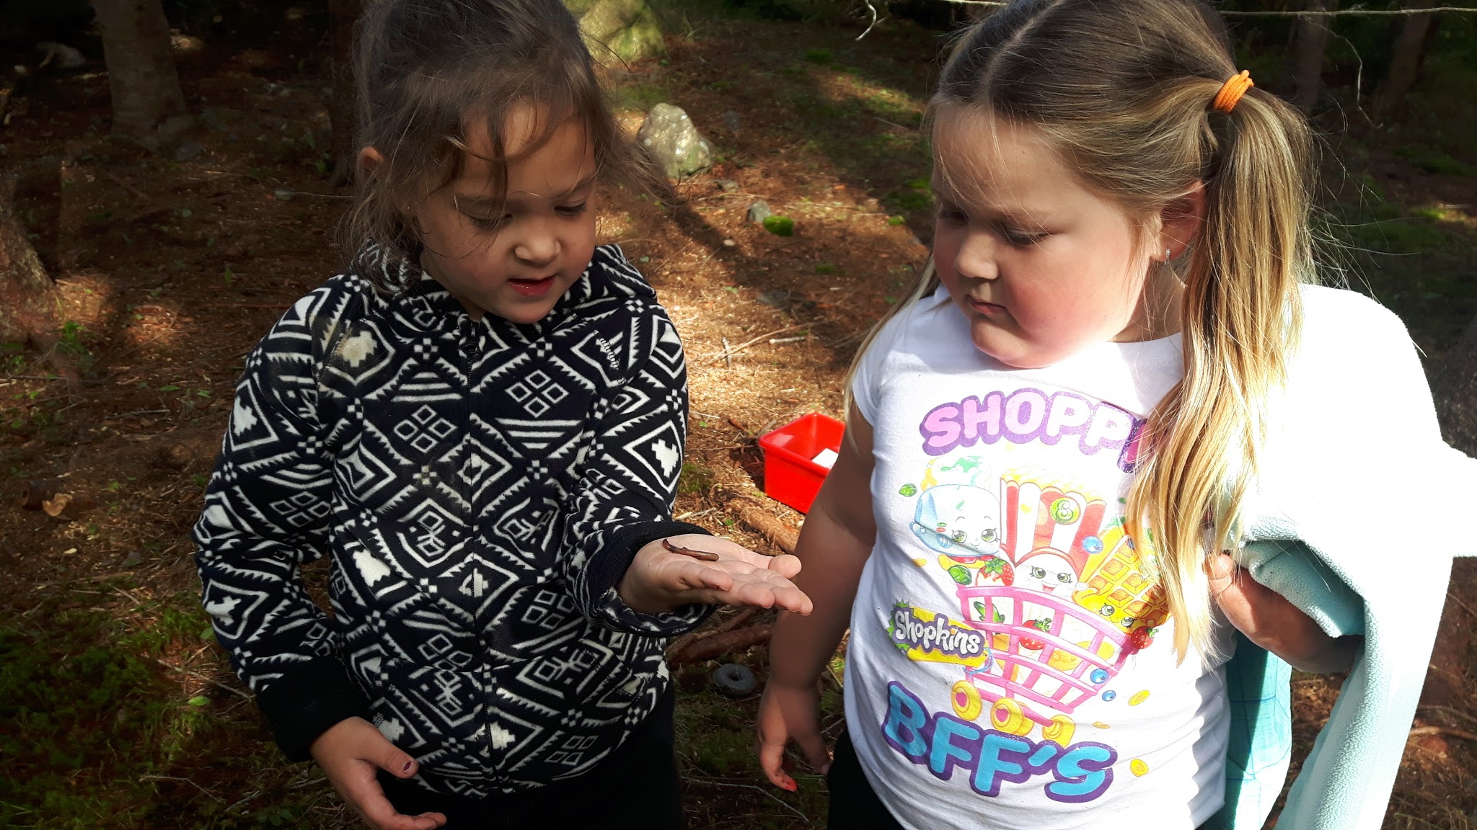

Slide 31
Our Discovery Centers supported student learning and helped students develop scientific knowledge and skills which could be transferred into other learning environments.

Slide 32
Developing a Science vocabulary and process.

Slide 34
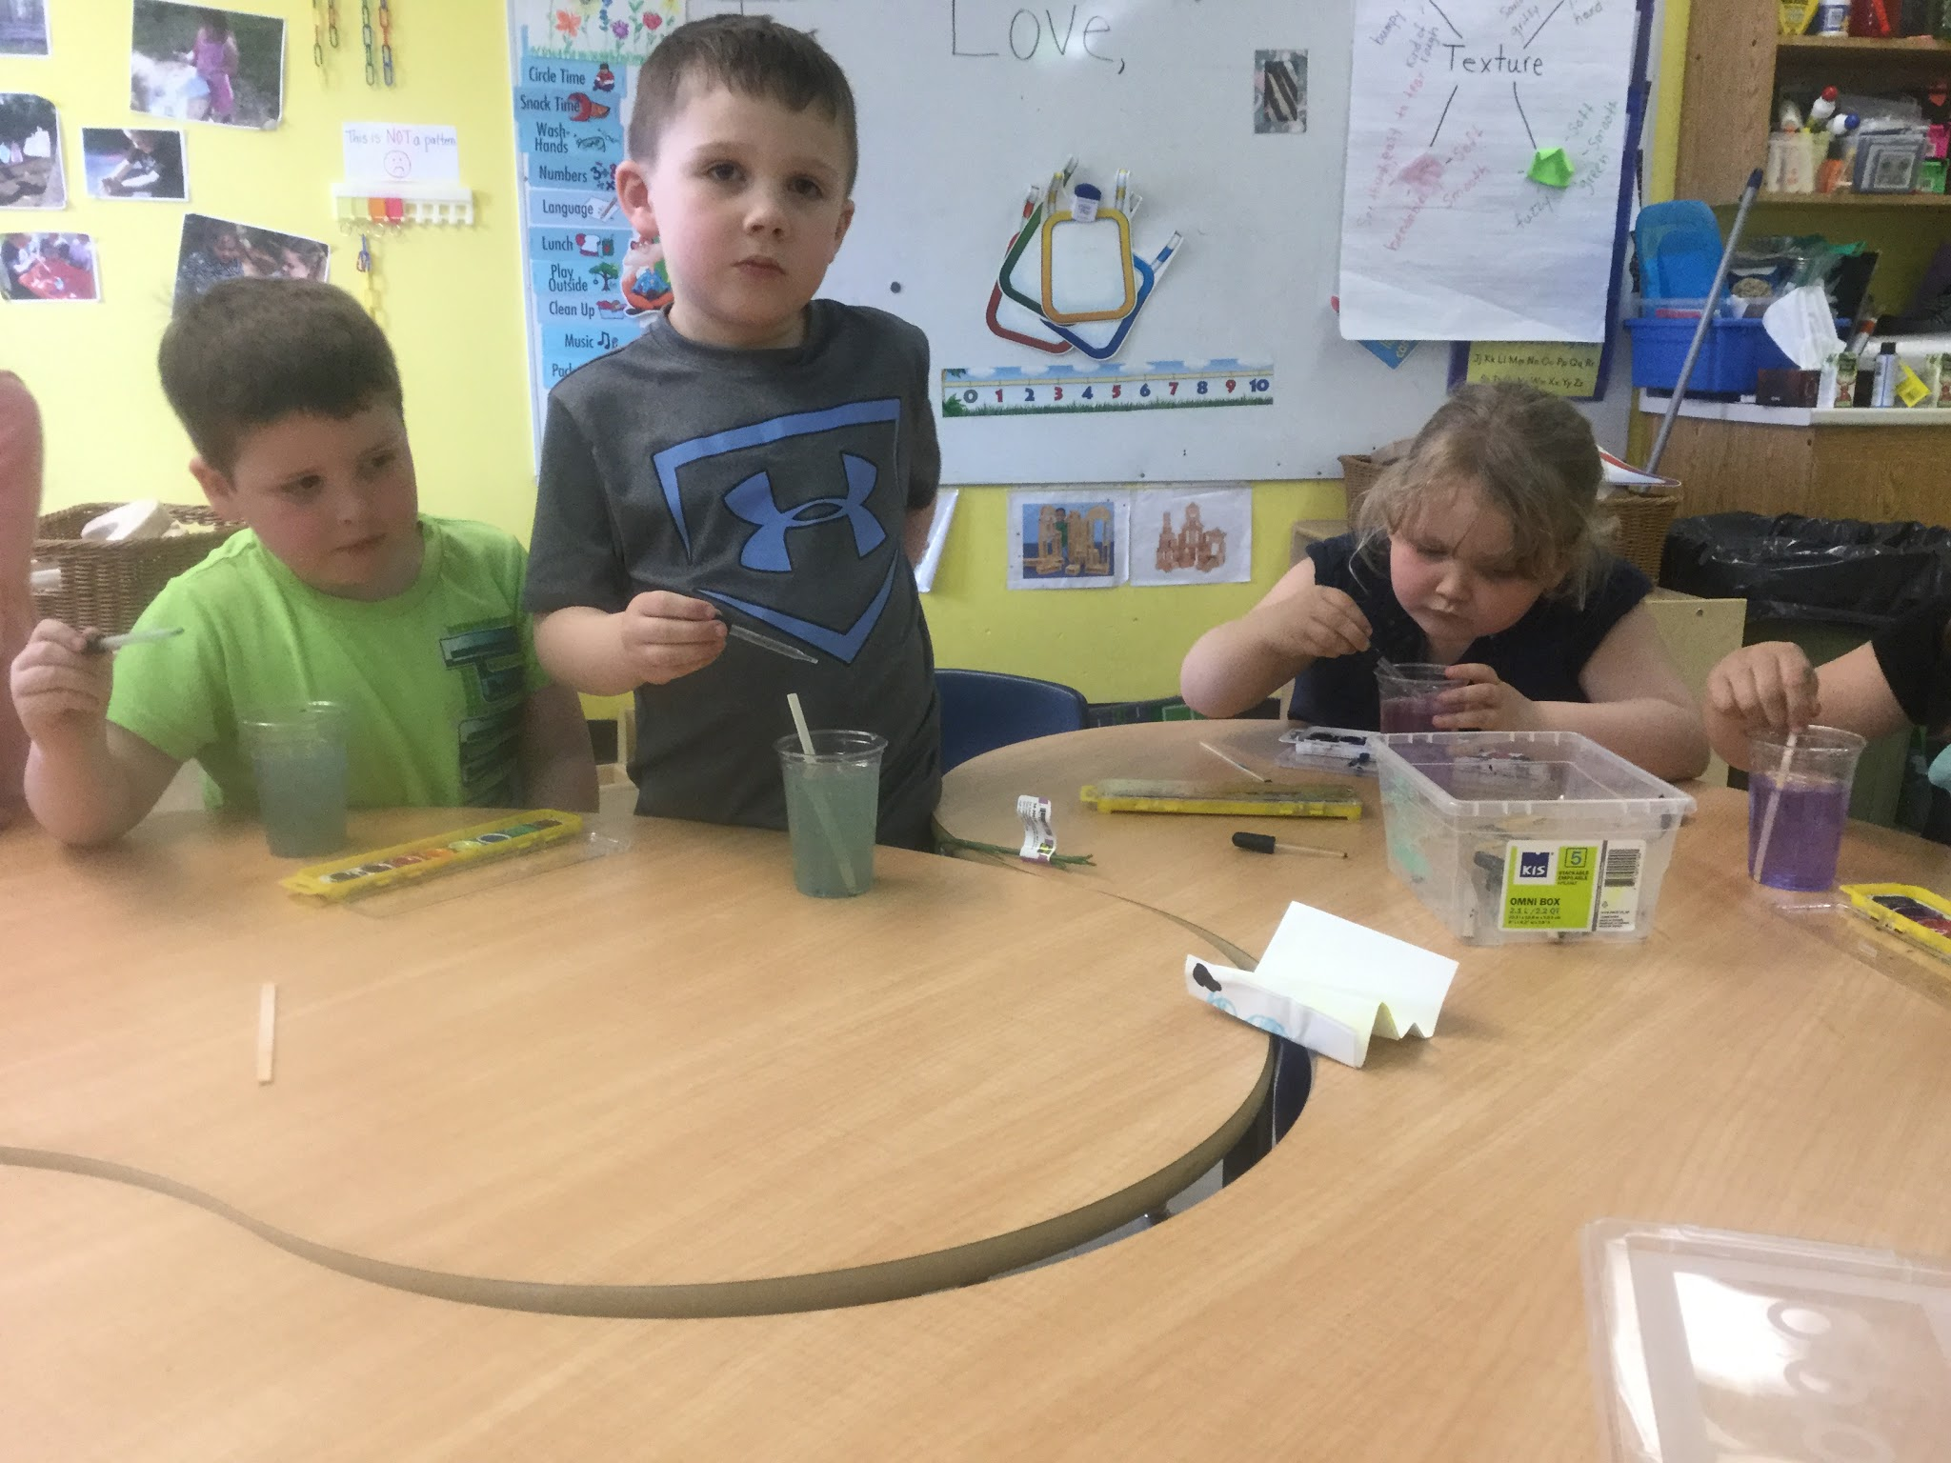
Where did the color go?
“The paint is dissolving.”
“The water is making the paint weaker.”
“If I add more it gets darker.”

Slide 35
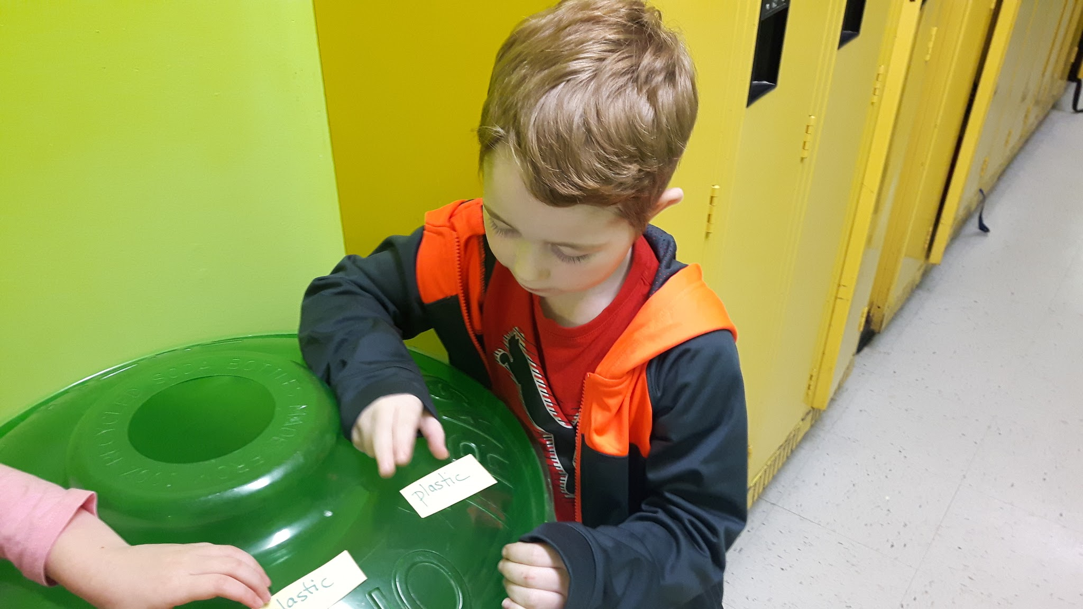
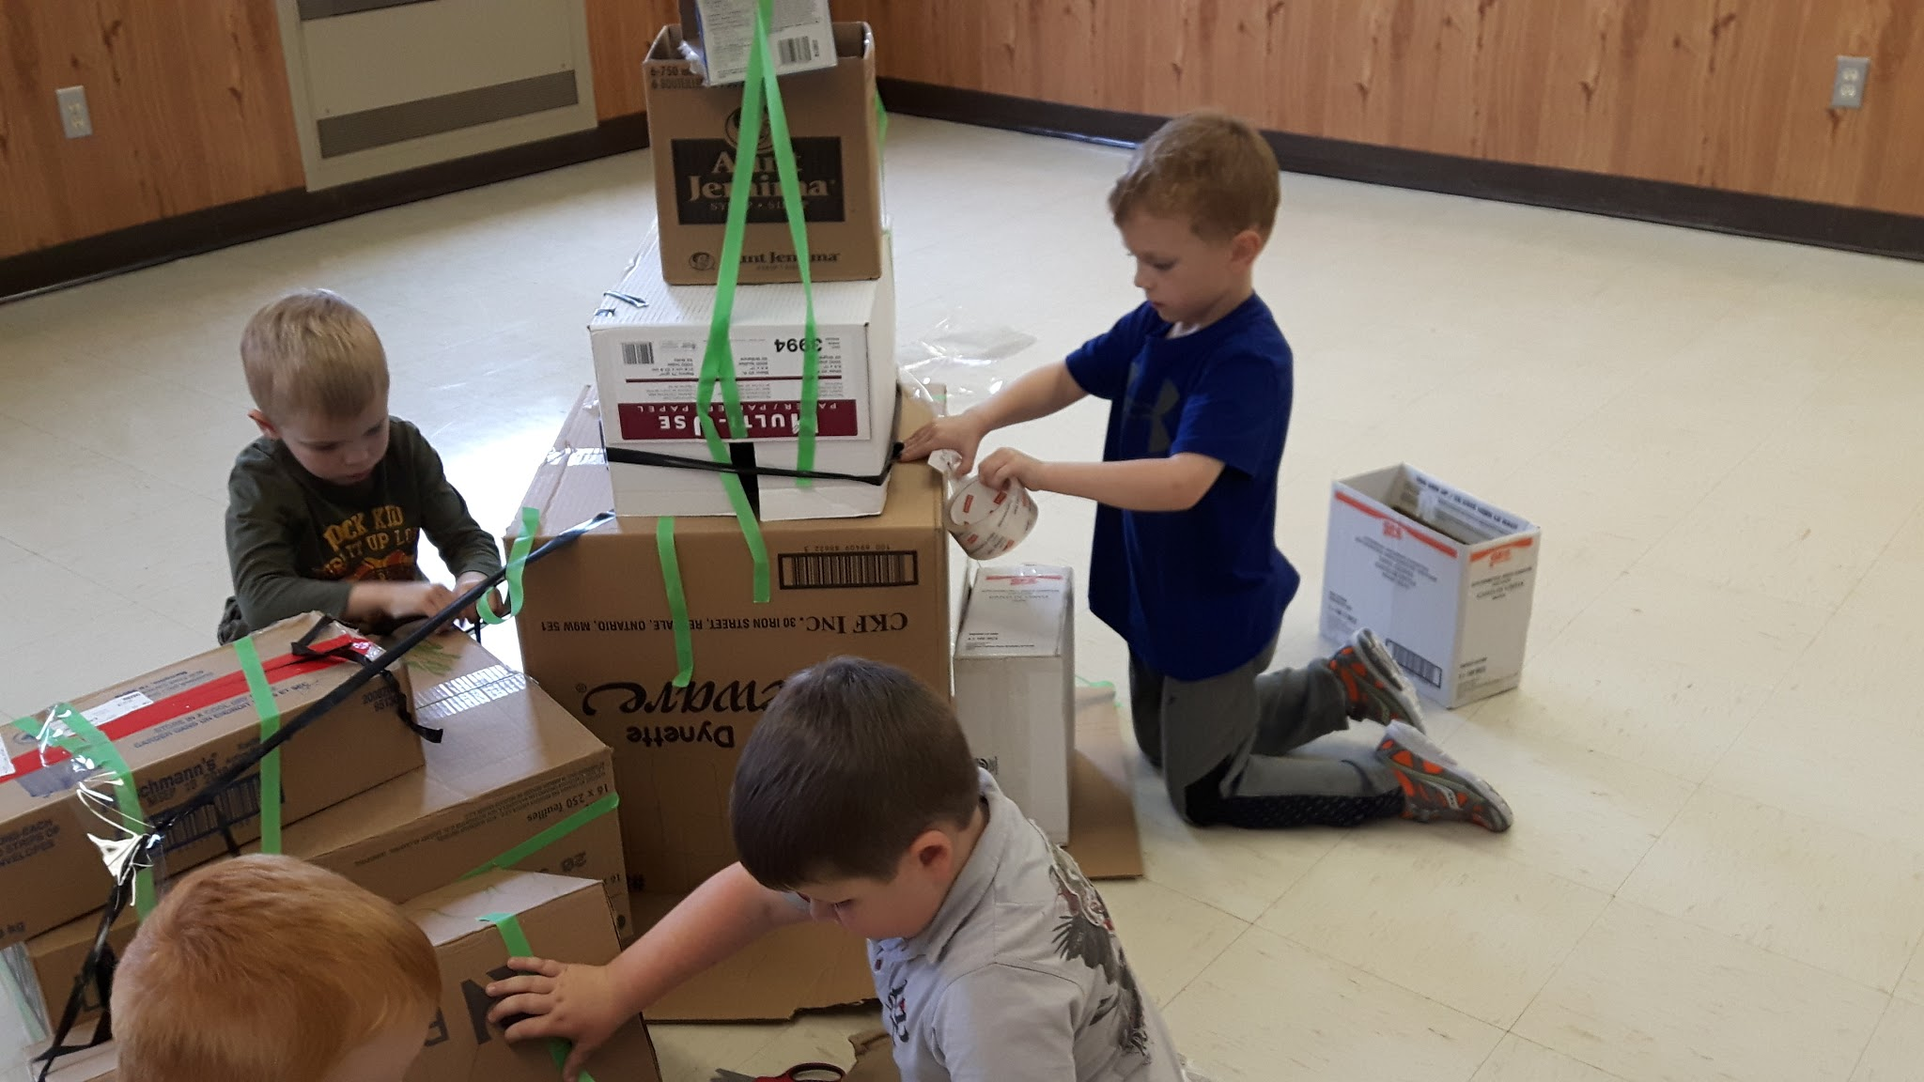
Science
Show and Tell
What is it made of?
What is it made of

Slide 36
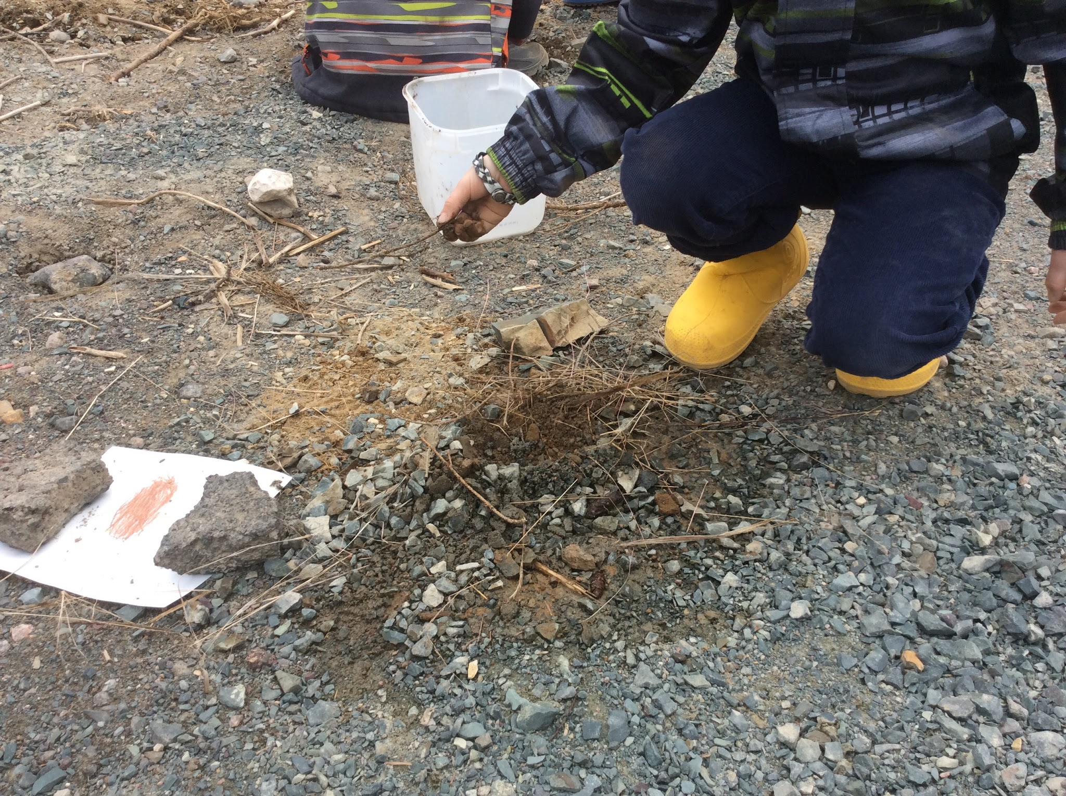
Building A Bird’s Nest
“I need mud to make it stick together.” (getting the right mud consistency)

Slide 37
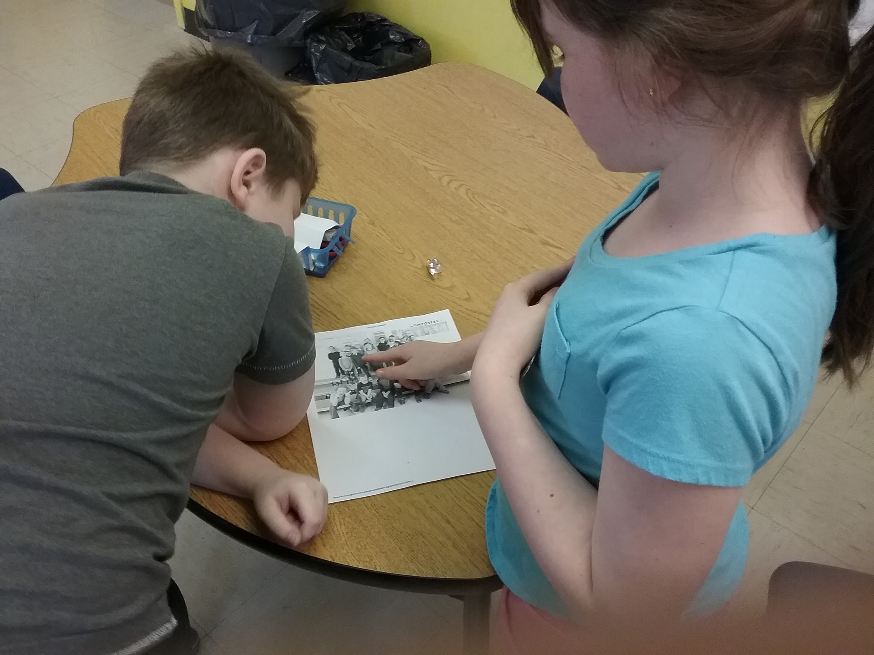
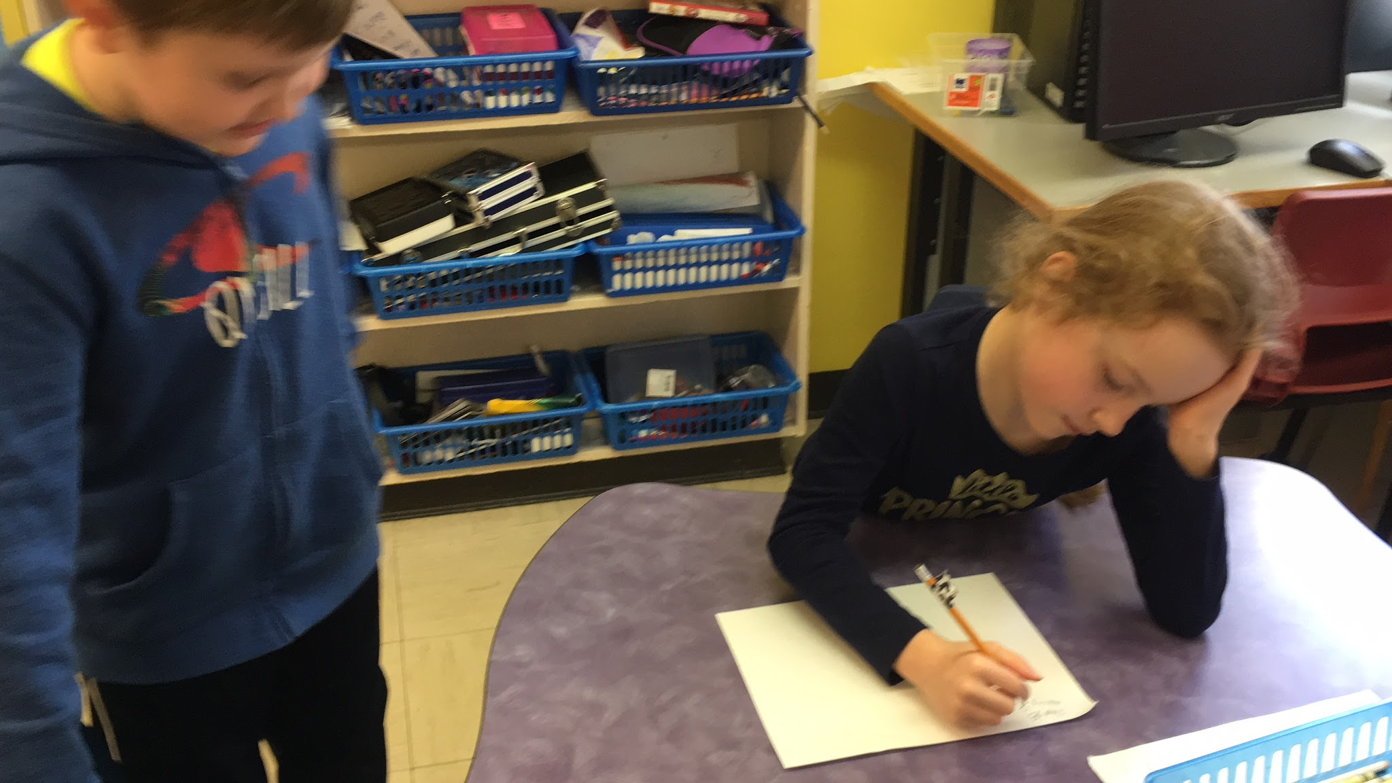
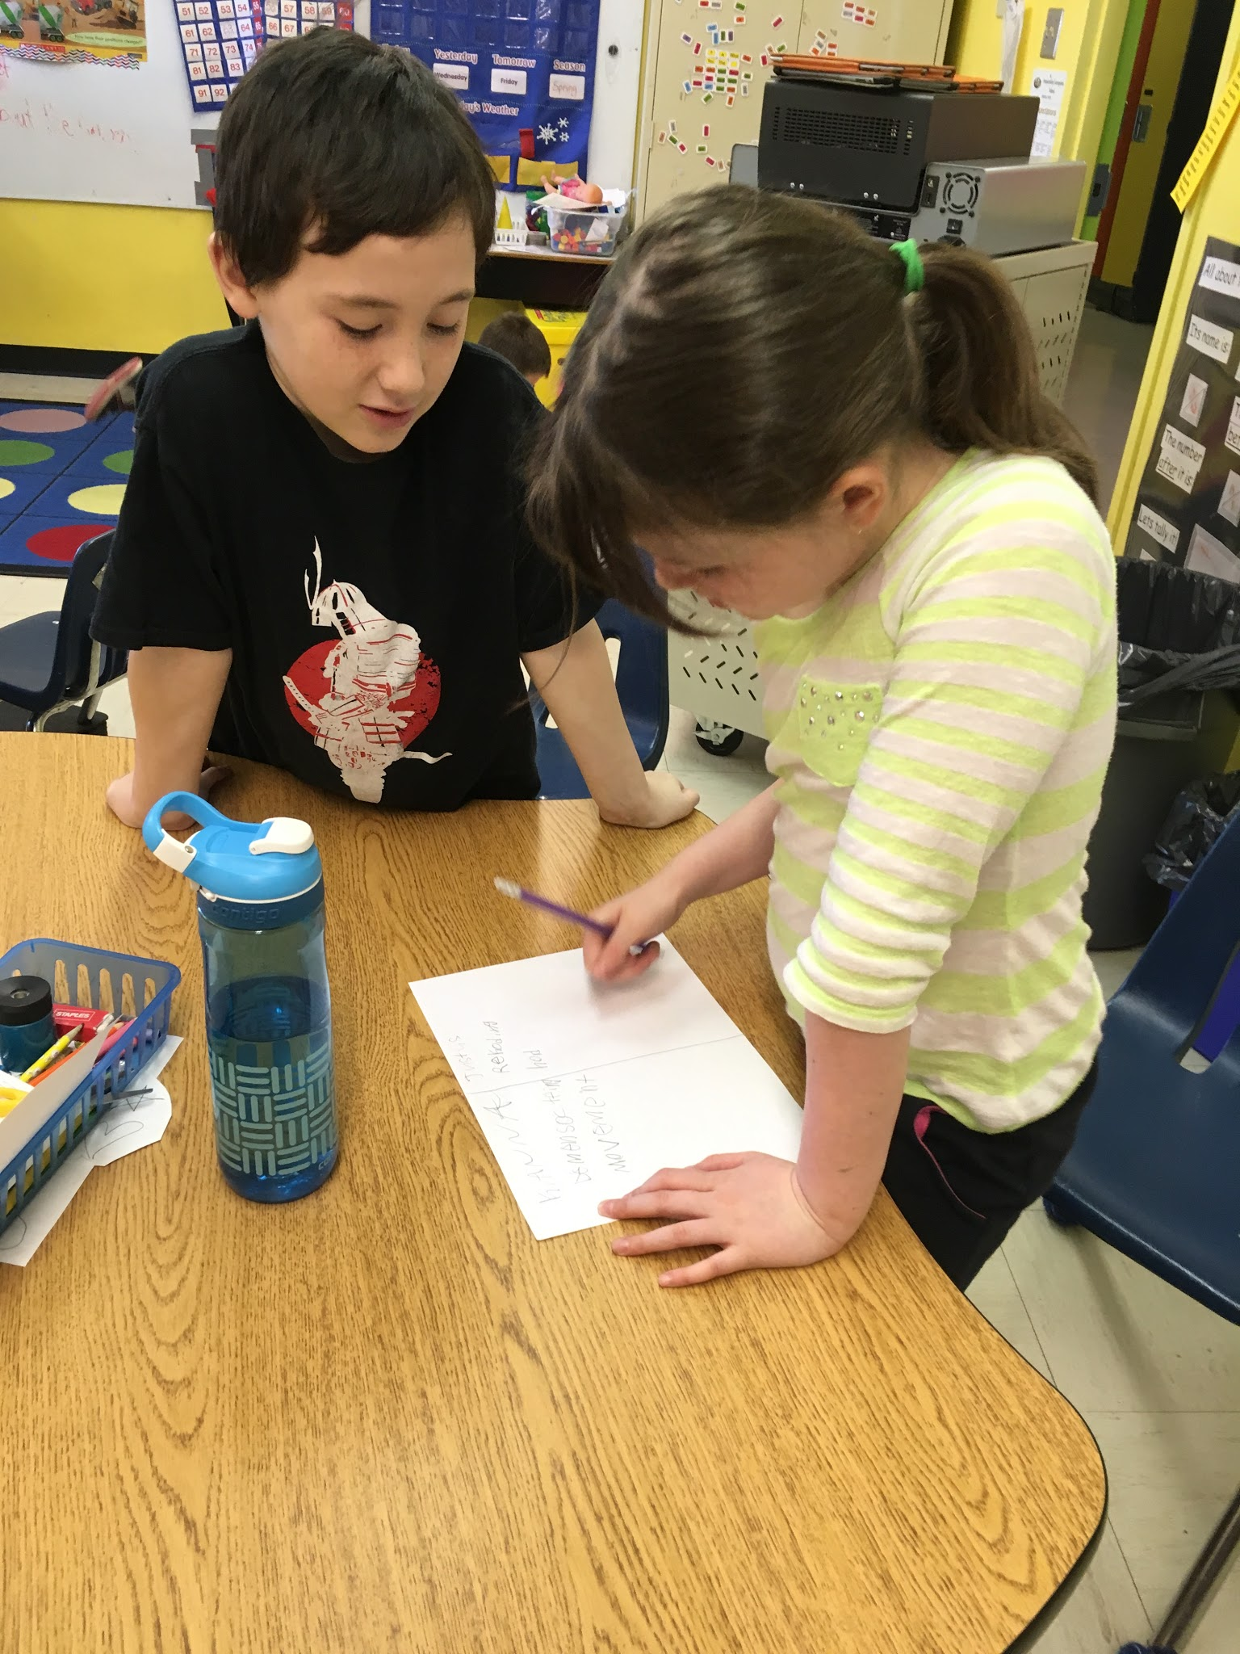
Findings - Teachers
Teacher Notes:
Teachers want to continue with these type of centers in other units as well as other subject areas
Believed they are a great way to encourage students to explore concepts and ideas independently through hands on learning experiences.
Through centers, students are participating in learning opportunities that are linked to outcomes and knowledge
In our opinion, these experiences and activities hold more meaning than stand alone worksheets

Slide 38
“Collaboration”

Slide 39
Future Considerations
Upon completion of our Discovery Centers this year, both teachers have decided to use them again next year. We want to use them in other units of our Science program and expand their development into other areas of the curriculum.
When we use Discovery Centers next year, we want to focus on letting the students explore their thought processes with minimal teacher direction and explanation. We found that given the materials and minimal direction, students flourished in the Discovery Centers and really enjoyed the inquiry process.

Slide 40
TIA Participation
The experience with the TIA project has been amazingly positive. This is Suzanne’s second project and Nicole’s first and together they were given the opportunity to really explore student motivation to learn and explore their own ability to apply STEM principles.
The resources provided to us allowed us to put together centers that can be used for years to come and can be further developed as needed. Important as the resources are, it was the time provided to us to plan and implement our ideas that really made these centers possible.

Slide 41
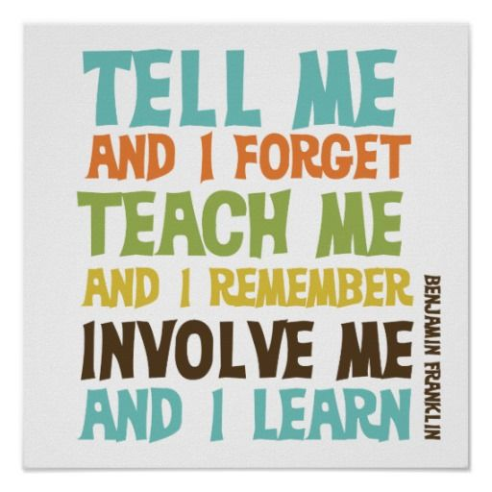

Slide 42
Thank you to all who made this project possible.
Thank you to Karen, Craig and Tom for their support and guidance.
Thank you to Mr. Crane, our administrator, for always encouraging and supporting us as we take on new initiatives and challenges.

