Slide 1
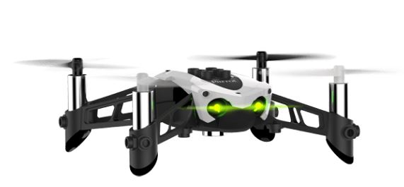
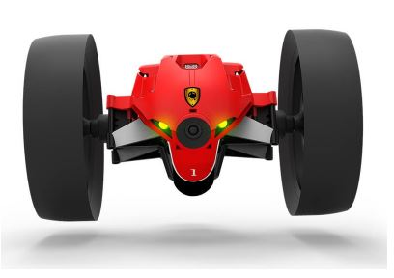
Coding and Droning
Woodland elementary
Teachers in action

Slide 2
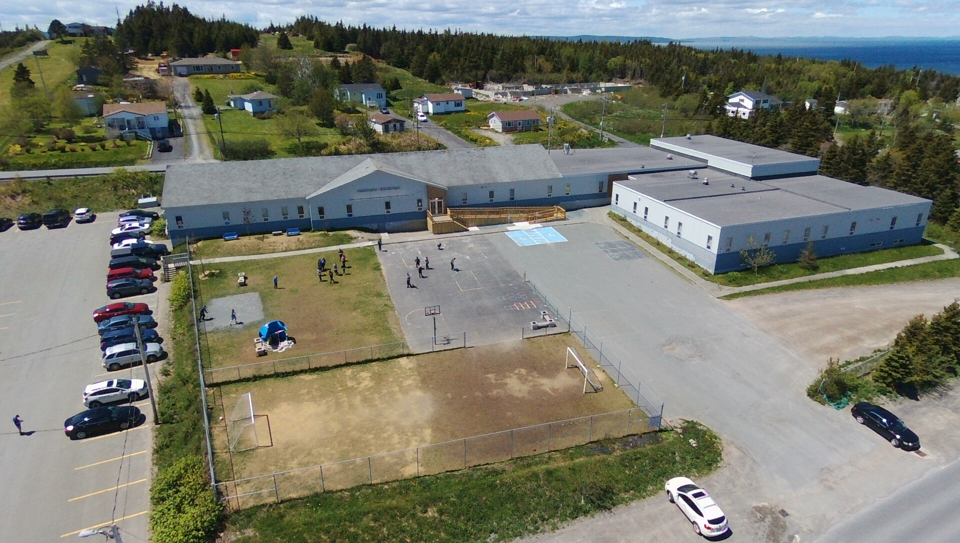
Woodland Elementary
Located in Dildo, NL
School Population 182
K-6 School

Slide 3
Team Members
Rod Rideout has been teaching for 28.5 years.
He is currently teaching grade 6 and LRT at Woodland Elementary in Dildo, NL.
Rod’s current class consists of 19 students - 10 boys and 9 girls.

Slide 4
Team Members
Jennifer Colbourne has been teaching for 10 years.
She is currently teaching grade 3 at Woodland Elementary in Dildo, NL.
Jennifer’s current class consists of 18 students - 8 boys and 10 girls.
Jennifer is currently doing the Little Green Thumbs program and Vermicomposting with her class.

Slide 5
Team Members
Gerald McCarthy has been teaching for 22 years.
He is currently in an administrative position with part time grade 4/5 classroom duties.
Gerald’s current grade 4 class consists of 18 students - 12 boys and 6 girls and his grade 5 class consists of 18 students - 10 girls and 8 boys.

Slide 6
Team Members
Jessica Legge has been teaching for 10 years.
She is currently teaching grade 3 at Woodland Elementary in Dildo, NL.
Jessica’s current class consists of 20 students – 10 girls and 10 boys.
Jessica is also doing the Little Green Thumbs program and Vermicomposting with her class.

Slide 7
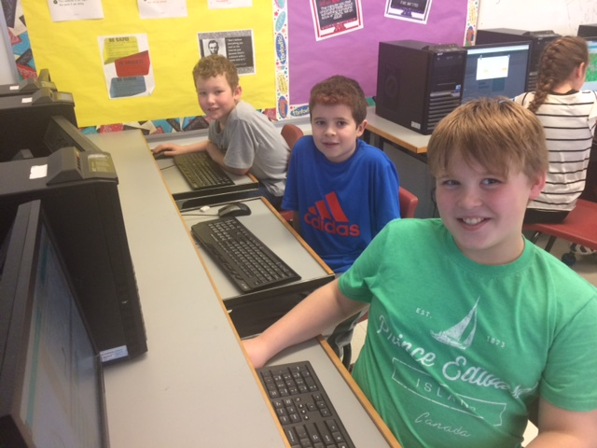
We believe in a student led environment. Our project focuses on students becoming engaged in their own learning, as well as the learning of their fellow classmates. We believe in the teacher providing guidance when needed, allowing students to problem solve and use critical thinking. We believe that this type of environment will help with student motivation and greatly enhance the classroom experience and student performance. All of these skills will help develop the 21st Century learner.
Our beliefs about teaching and student learning

Slide 8
Why Teachers In Action?
STEM has been a part of our school since the beginning of Teachers in Action.
It has slowly grown to include the majority of our staff in various team projects related to their curriculum and grade level.
Almost 70% of our current staff is involved in STEM research.
Being a part of this project allows our school to acquire expensive resources that allow our students to engage in learning.
TIA provides team with the opportunity to collaborate with other teachers in the school and province.

Slide 9
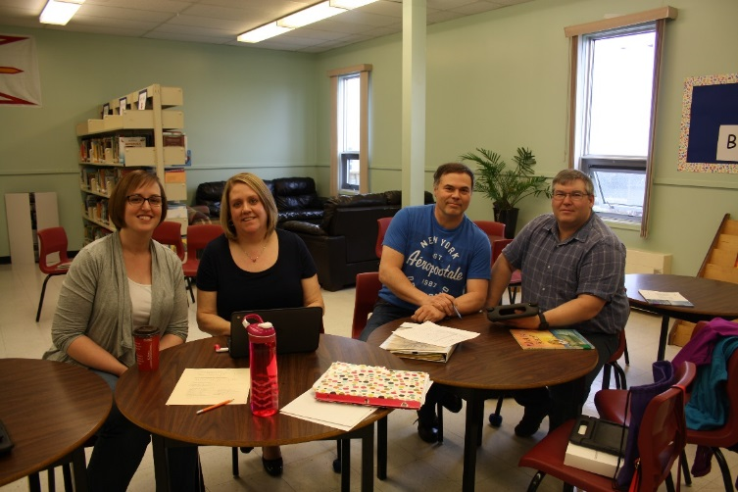
Our Teacher Questions
How will using technology (drones and coding) increase student motivation?
How can we encourage students to make more connections and think ‘analytical’ through the use of hands on experiments?

Slide 10
Teacher Goals
Our Focus
In doing this project, our goal as teachers is to explore coding and its uses in our classroom connecting with curriculum outcomes in science and math.
We are developing more student centered activities to allow students to become more involved in their own learning.
Our lessons will promote the 5 E Model - Engage, Explore, Explain, Elaborate, Evaluate.

Slide 11
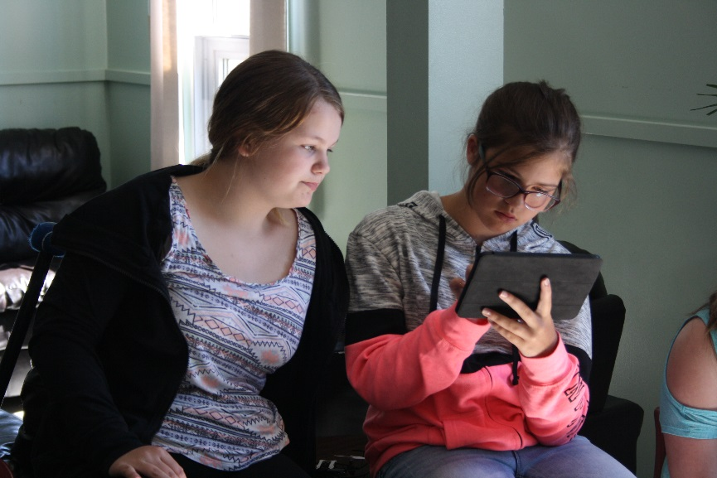
Our Student Questions
Will the use of technology (drones and coding) help to increase student confidence in themselves to explore?
Will the increased use of technology change how students view science and math?

Slide 12
Student Goals
In doing this project, our students will learn about coding and how it connects to science and math.
Students will learn how scientists and engineers are similar and different.
Students will also learn strategies to become better problem solvers and critical thinkers.

Slide 13
School Growth and Development Connection
The outcomes that this unit covers corresponds with our school growth and development plan. Our initiative to support student success in literacy and numeracy is encompassed throughout the projects lessons.

Slide 14
Our Resources
Tynker
Code.org

Slide 15
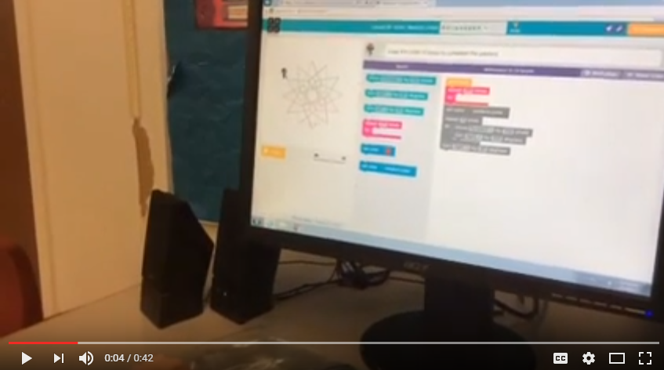
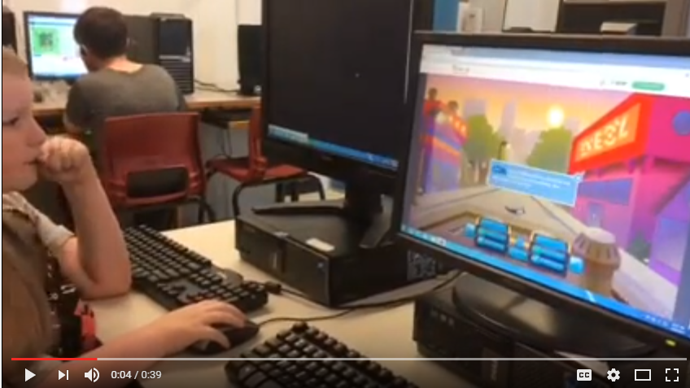
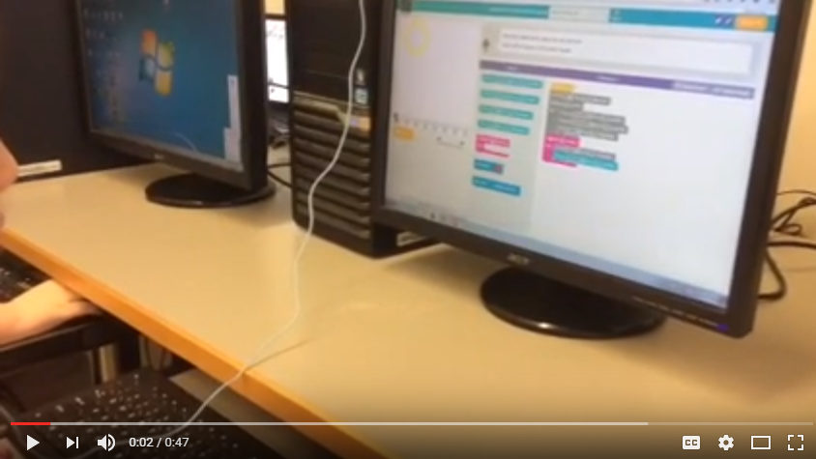
Students Coding

Slide 16
Benefits of Our Online Resources
Both websites allowed students to learn and progress at their own pace.
We developed more student centered activities to allow students to become more involved in their own learning.
Our lessons helped promote the 5 E model - Engage, Explore, Explain, Elaborate, Evaluate.

Slide 17
Ethical Considerations
Communication
Ethical Considerations
MUN and Woodland Elementary consent forms
Teacher email
Staff sharing
School Website
Ensured all students had access to technology
Made accommodations for students receiving supports
Student centered activities that progress at the students own pace

Slide 18
Planning
Meeting with Tom Walsh
Survey to students
Teacher professional development sessions
Presentations involving coding
Communication with Parrot Inc. regarding drones
District Computer Technician Bill Crann

Slide 19
Racing Max Drones
Grade 3 and 4
The grade threes worked on an obstacle course challenge
Used Tynker to code their drones to successfully move through the course
Students made their own course and challenged their classmates to navigate the course

Slide 20
Mambo Flying Drones
Grade 5 and 6
The grade sixes worked on simple coding to control the drone’s movement.
Use coding to complete challenges involving the drone (eg. Picking up an object and placing it elsewhere)
Students create their own scenario and challenged their classmates to solve it

Slide 21
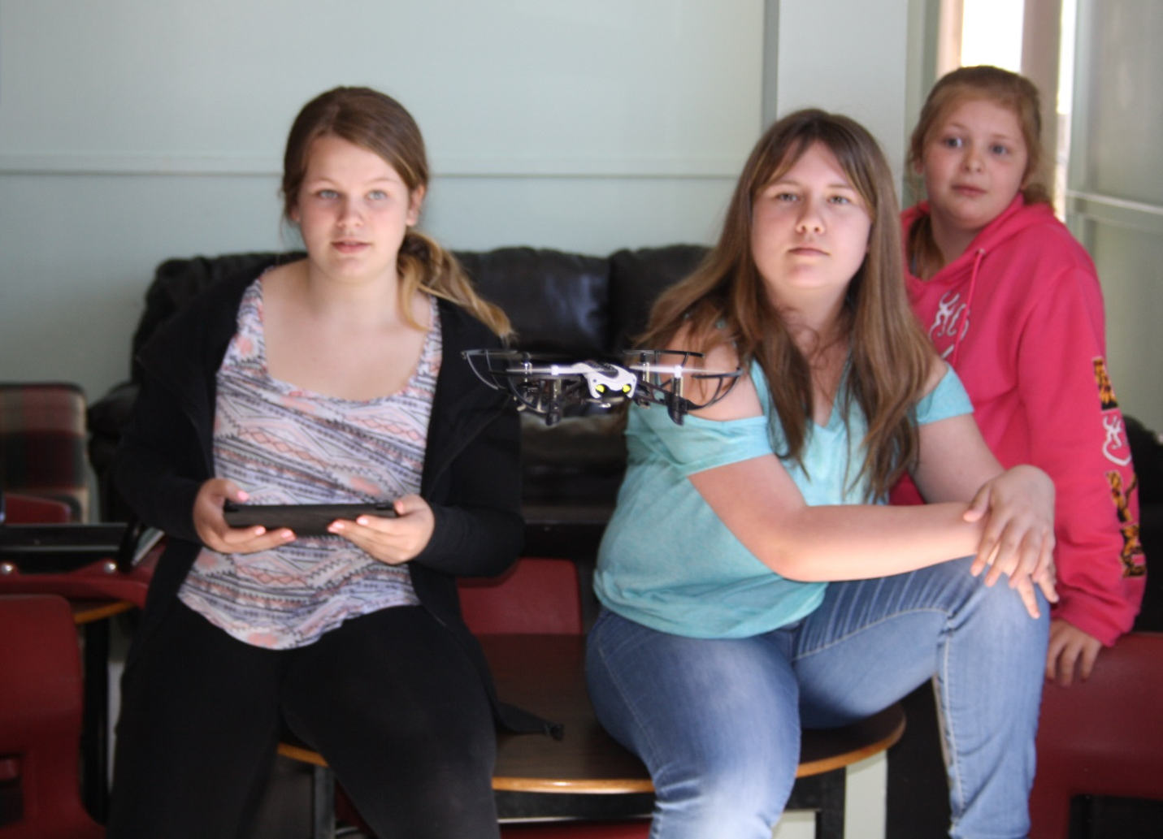
Working With Mambo Drones

Slide 22
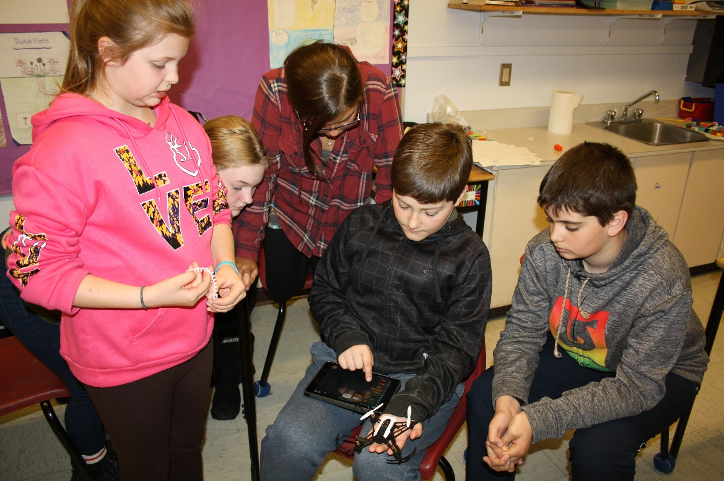
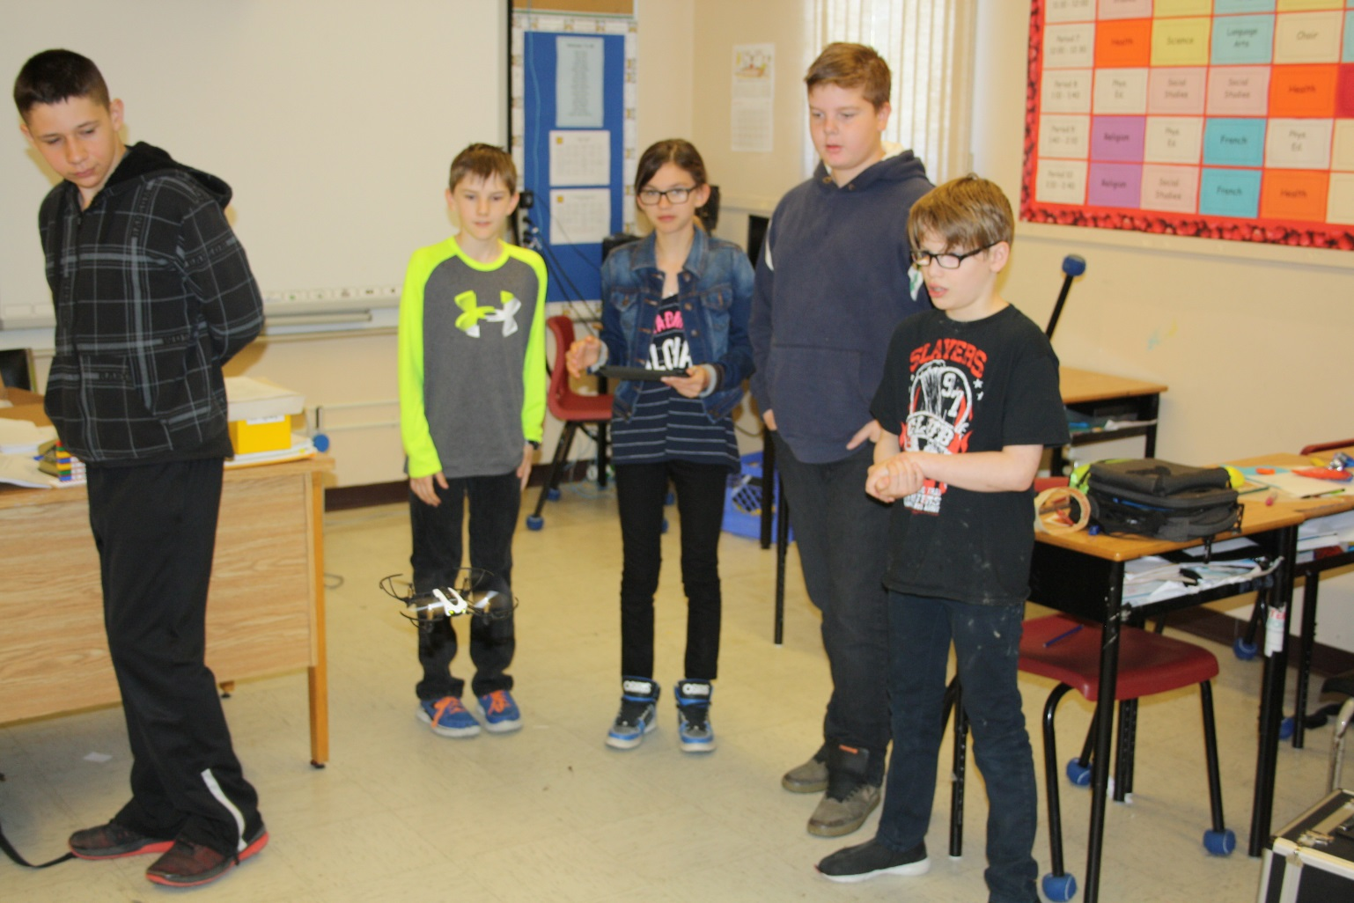

Slide 23
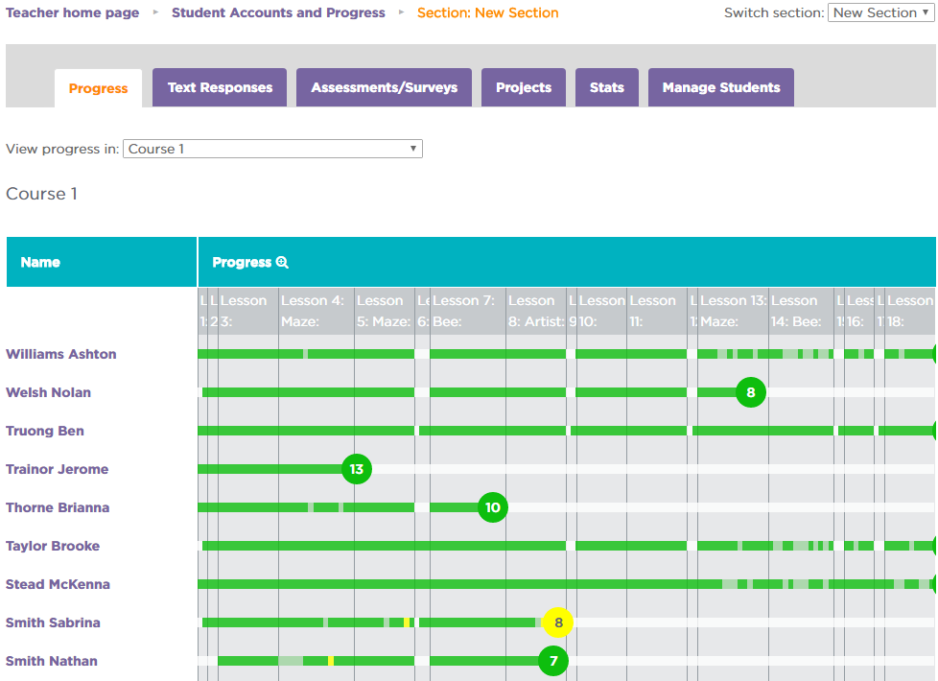
Data Collection, Analysis and Assessment
Pre and Post Survey
Entrance and Exit Card
Student Observations
Anecdotal Notes
Assessment from online courses
Student videos and pictures

Slide 24
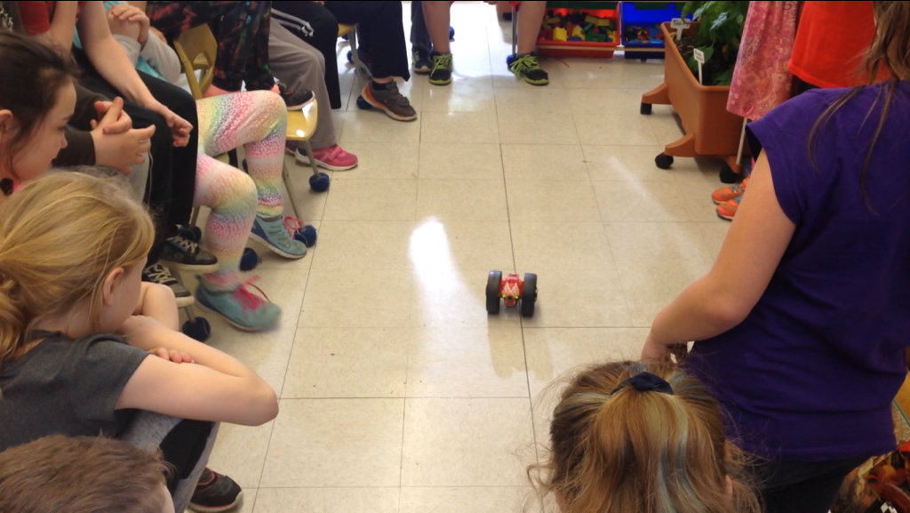
Results … What Changes Occurred in our Classrooms?
Classroom shifted from Teacher centered to Student centered
We saw an increase in student motivation
Our classroom became a Community of learners
We saw the importance of Teacher reflection
More Student collaboration
More Risk taking in the classroom

Slide 25
Results …What Changes Occurred in our Teaching?
Teacher centered to student centered
More self reflection
Teacher motivation
Better understanding and interpretation of
the general and specific outcomes
Better understanding of the 5 E Model
Learned coding ☺

Slide 26
Teacher Inquiry
We recognize the importance of teacher inquiry and how self reflection impacts our teaching
Teacher inquiry promotes life-long learning
Using the 5 E Model we met our goal – our students were engaged, investigating and motivated
It narrowed our focus on a student centered learning environment
It inspired us to implement a student centered learning environment in other subject areas

Slide 27
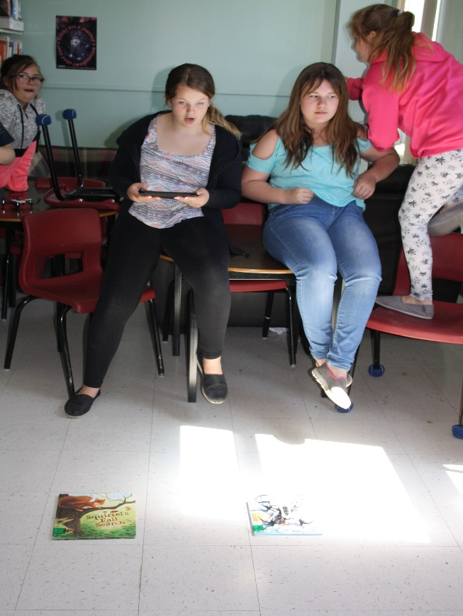
What our students think …

Slide 28
References
“What drone technology can teach students” Leah Levy, October 27, 2015. Edudemic - connecting education and technology.
Tynker - app and online resource - www.tynker.com
Code.org - online resource - www.code.org
Freeflight - app

Slide 29
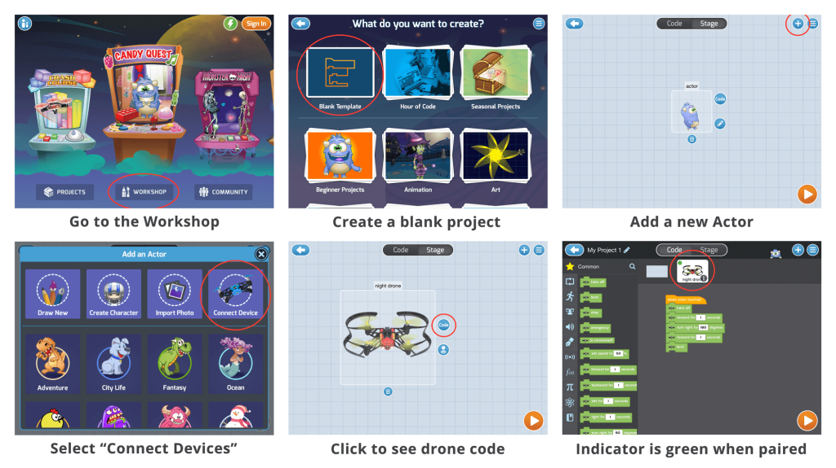
Now it’s your turn!

