Slide 1
STEM Project
3-D Design & Printing
St.Paul’s Junior High School
340 Newfoundland Drive
St. John’s, NL
Website: https://stpaulsjh.net/
Twitter: @stpaulsjh

Slide 2
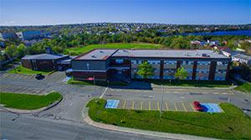
St. Paul’s Junior High
St. Paul’s Junior High is a grade 7–9 public school in the English School District of Newfoundland and Labrador and located in the community of St. John’s Newfoundland.
As part of our role as a learning organization, SPJH offer opportunities for students to learn, utilize, and demonstrate technological skills. However, majority of these opportunities are curriculum based and allows very little opportunity for creativity and innovation. Teachers have identified the need to
provide students opportunities to engage from an inclusionary perspective.

Slide 3
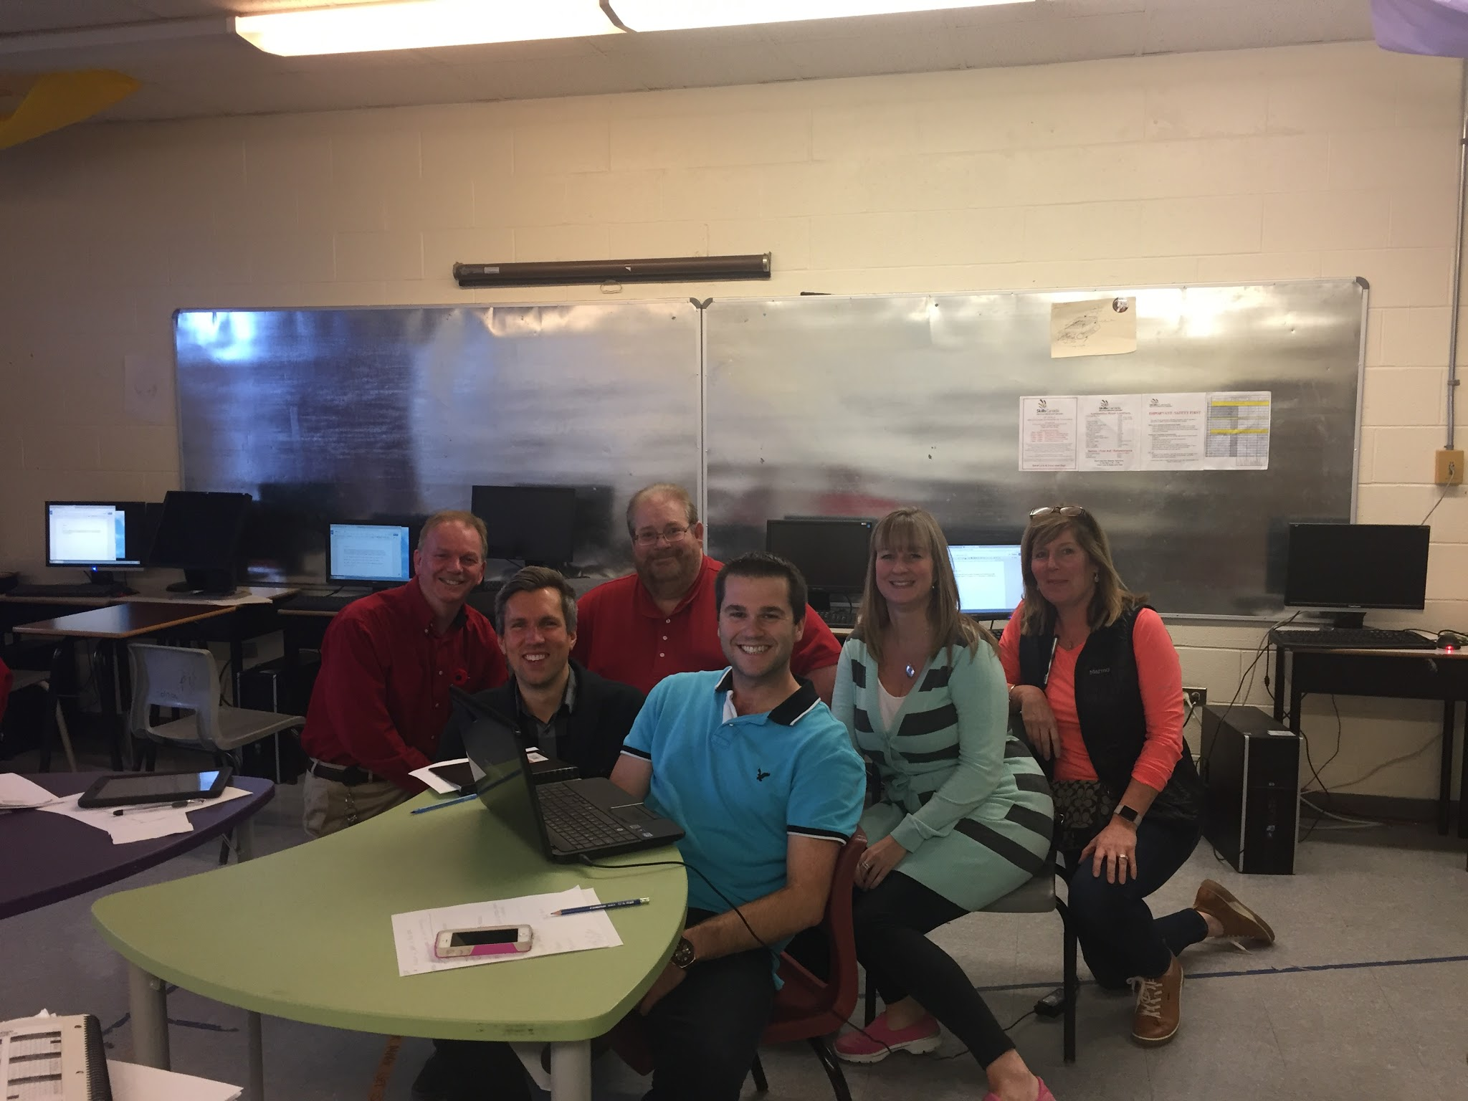
Teacher Profiles

Slide 4
Damian Lethbridge
13 years teaching Jr.High Math
7 years teaching Art and Science
SPJH Math League
Served on Grade 6 Math Curriculum Development Committee
Served on Regional Science Fair Committee (2007-2011)

Slide 5
Damian Lethbridge
Math Class
801 Math (21 students) - A diverse cross section of cultural, socioeconomic and cognitive backgrounds.
~ 40% intrinsically motivated, high performers
~ 40% extrinsically motivated, average performers
~ 20% extrinsically motivated, low performers

Slide 6
Dave Abbott
STEM project, Technology aspect:
My involvement in the project was related to technological training to familiarize the students with the design program “SketchUp Pro.”
My academic background is in the area of Science and Technology with over twenty five years teaching experience.
I was responsible for giving our six grade eight classes ( approximately 150 students) exposure to the software required to complete the project.
The students were very interested and motivated to take part in the project as they were given the opportunity to use our 3-D printers to produce their design.
I was very interested in joining the project as it gave me exposure to new and innovative technology, such as the 3-D printers.

Slide 7
Tyler Norman
4 years experience teaching Math and Science at 4 different schools.
I have a B.Sc with a major in Chemistry and minor in Mathematics
I’m involved with coaching sports and helping with the Math League team

Slide 8
Tyler Norman
Math Classes
Math 805 (Class Profile) Math 804 (Class Profile)
22 students - 24 students
Early French Immersion Class - Early French Immersion class
High achieving students - High achieving students
70% are highly motivated - 85% are highly motivated

Slide 9
Susan Foote
BSc majoring in Pure Mathematics with a minor in Chemistry
Teaching Junior High Math for 20 years minus a few years for maternity leave!
Mathematics Department Head at St. Paul’s Junior High for 18 years.

Slide 10
Susan Foote
Math Classes
Math 802 Classroom Profile
26 students English stream
~ 50% are provided accommodations
~ 10% are high achievers, highly motivated
~ 80% are average achievers, minimally motivated
~ 10% are low achievers, little motivation
Math 803 Classroom Profile
25 students English stream
0% are provided accommodations
~ 80% are high achievers, highly motivated
~ 20% are average achievers, minimally motivated

Slide 11

Anne Hatcher
Teacher-Librarian, English Language Arts and Network Administrator for 25 years
Bachelor of Arts, Bachelor of Education, Diploma in Learning Resources, Masters of Education.
My role is this project was to support the students and teachers in the use of G Suite of Apps to access Google classroom resources and Google forms.
I also used the Cura software with students to splice and print their designed cylinders on the Ultimaker2GO 3D printers.

Slide 12
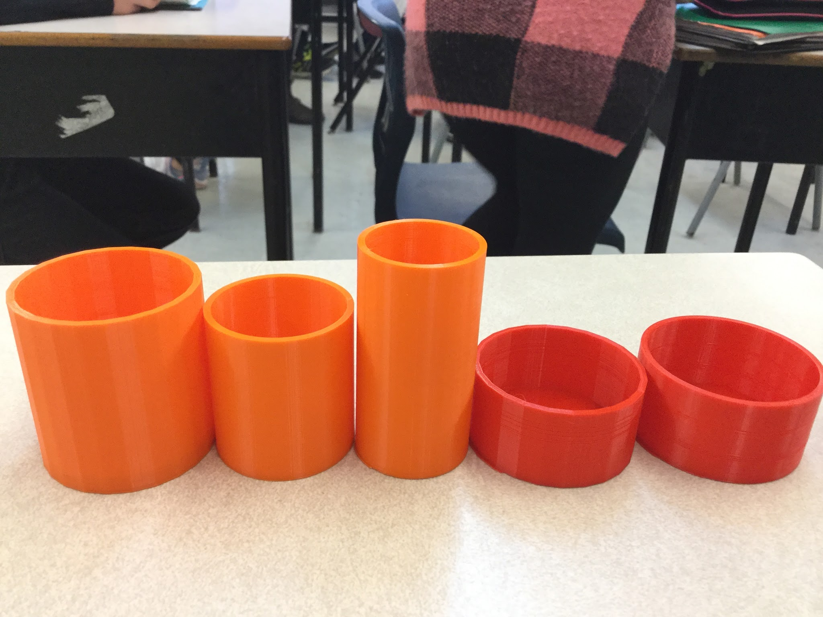
Focus Area
Application of Mathematical concepts encompassing volume and capacity of geometric solids to 3-D printing technology.
After examining the 8 Math curriculum we determined that the strands associated with measuring volume and area were most readily applicable to 3-D printing technologies and therefore chose this as our project focus area.

Slide 13
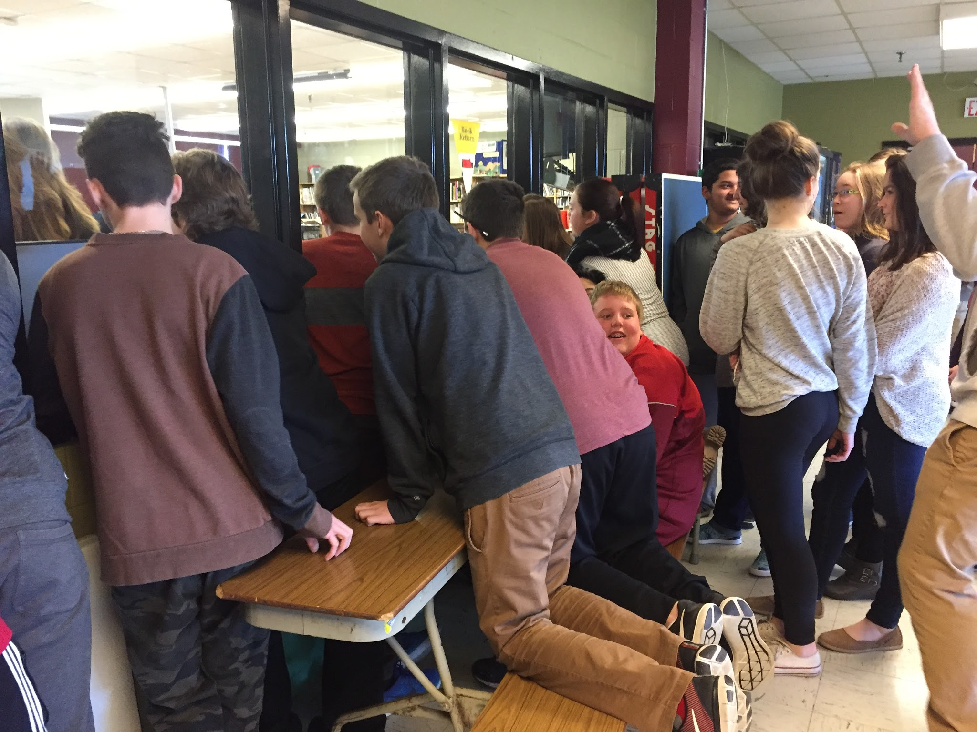
Focus Area
Our objective was to determine if incorporating said technologies would increase student interest and engagement.
Students excitedly watching their projects being printed.

Slide 14
Focus Area
Resources Used to Develop Understanding of Focus Area
NL Grade 8 Math Curriculum Guide
The Reflective Educator’s Guide to Classroom Research 3rd Edition (Dana Yendol-Hoppey
eLearning and eMaking: 3D Printing Blurring the Digital and the Physical. (Jennifer Loy) Educ. Sci. 2014, 4, 108-121
3D Printing log 3D Printing with SketchUp: 10 Tips and Tricks. (Fabian). iMaterialize.com
Turning Students into Engineers with 3D Printing. (Murray). steve@stevemurrayink.com

Slide 15
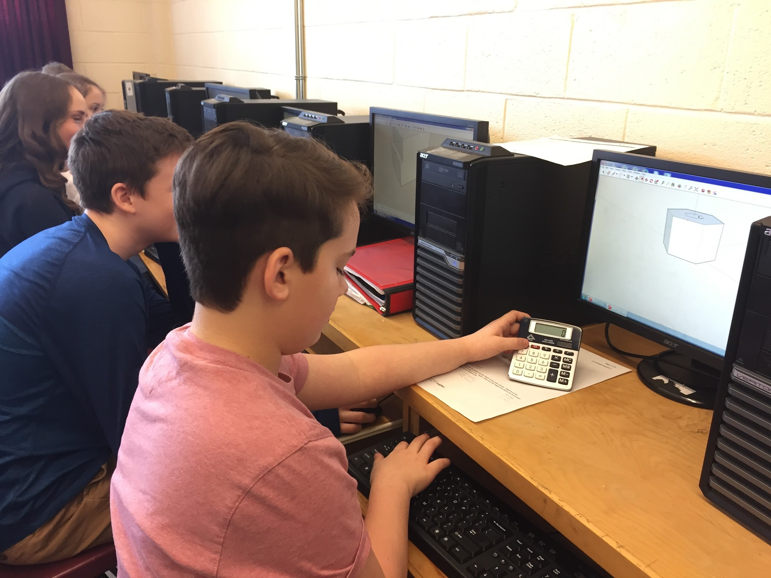
Focus Area
Our project focus area aligned directly with our School Development Plan objective to improve student numeracy skills.
This project provided the opportunity for students to observe and engage in real-world application of Mathematical concepts covered in Math class and school instituted Numeracy support classes.

Slide 16
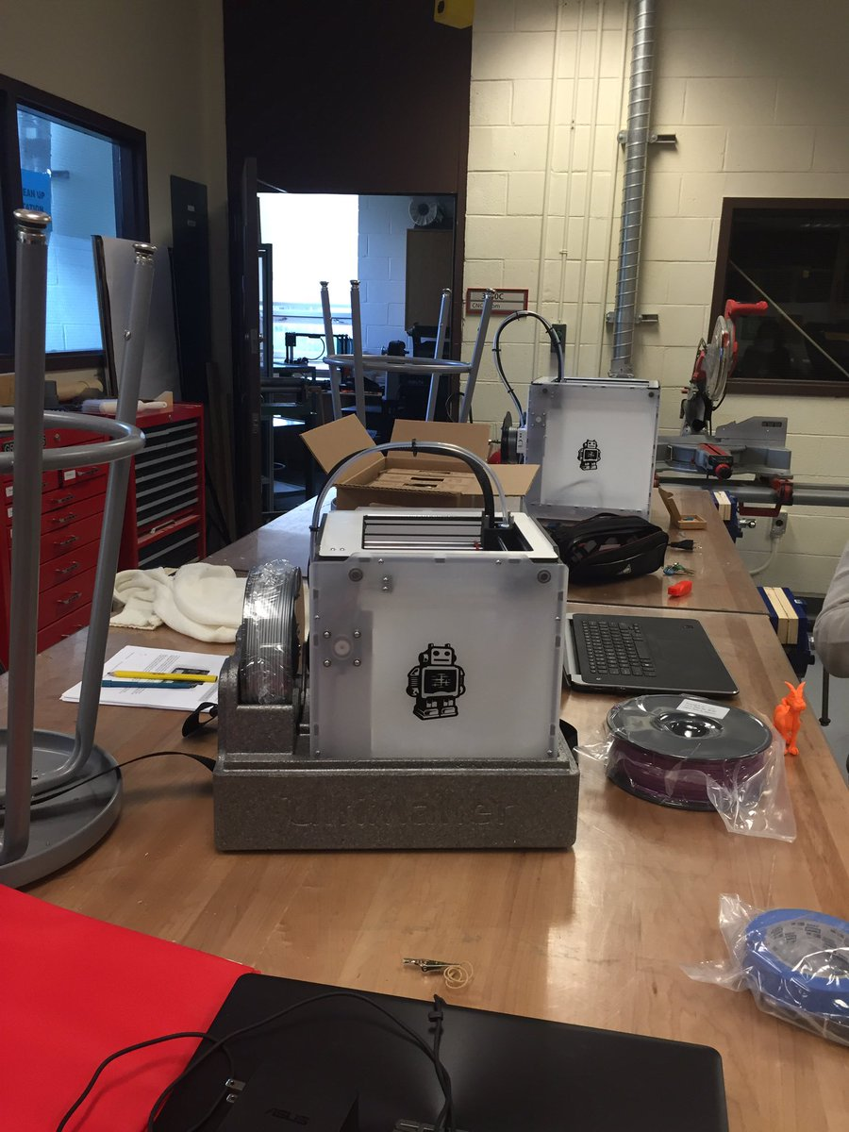
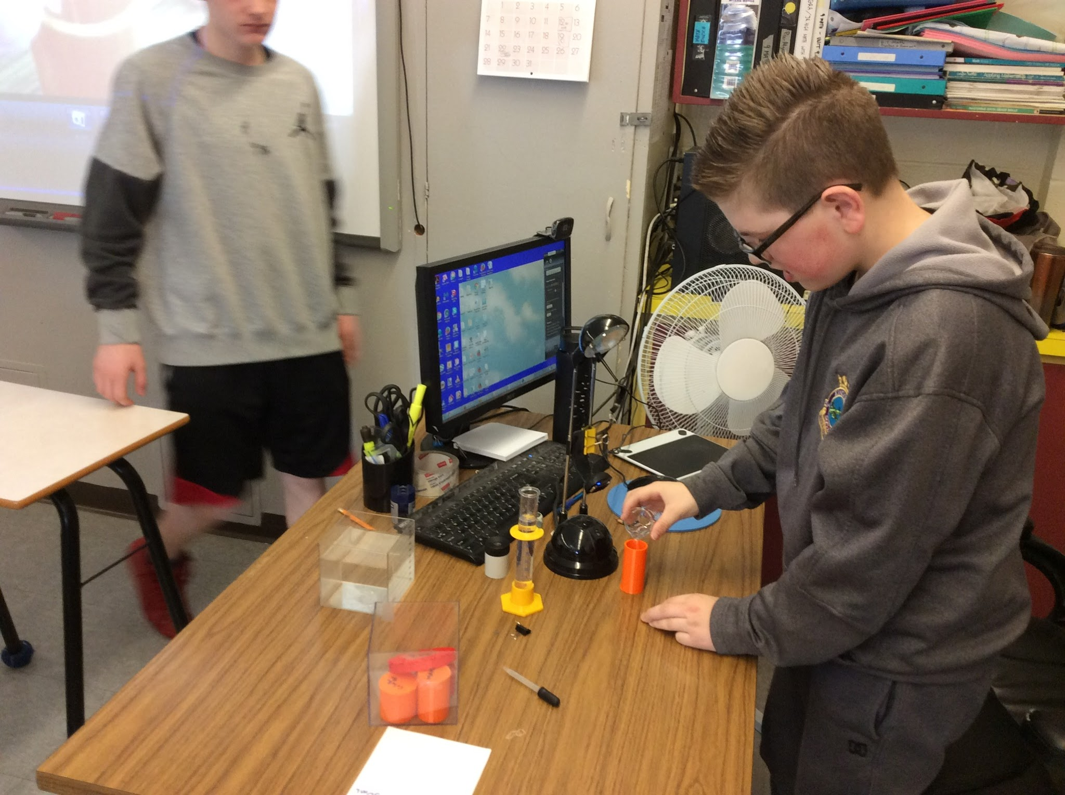
Research Questions
Teacher Question: How can I use a 3D printer to teach math?
Student Question: How can using the 3D printer
in the classroom increase students’ engagement
in the Math classroom?

Slide 17
Ethical Considerations
We developed a letter that was sent home to inform parents of the nature of this STEM project.
This letter also contained a part where parents had to sign to either give or not give us permission to use photos of their child and work samples that were taken through the entire project.
All students had to have a user agreement form completed in order to use St.Paul’s L.A.N (Local Area Network) and G-Suite of apps provided by NLESD.
All instructions provided to teachers and students through Google classroom
During parent teacher interviews some of the student projects were printed in the gym to allow parents the opportunity to see the final stage of the process in action.

Slide 18
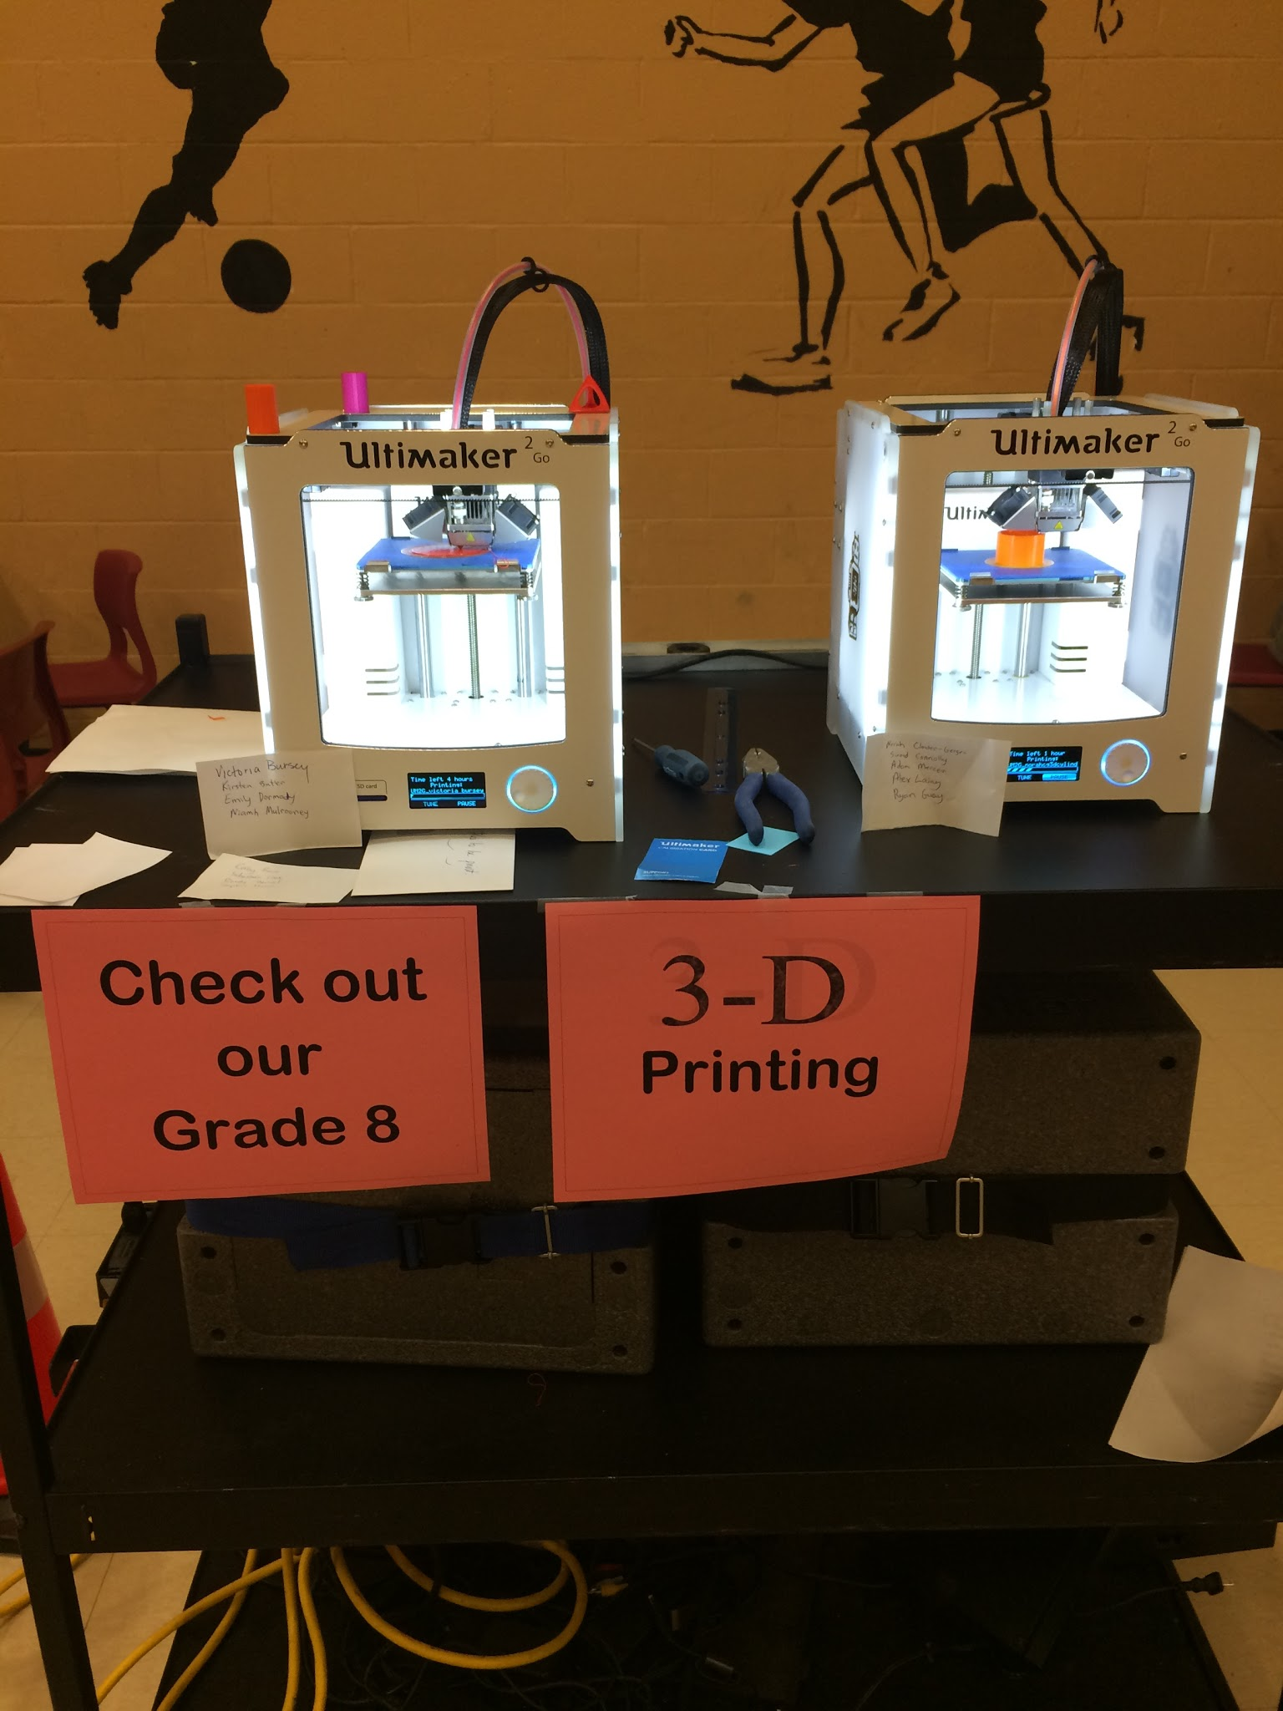
Ethical Considerations
During parent teacher interviews some of the student projects were printed in the gym to allow parents the opportunity to see the final stage of the process in action.

Slide 19
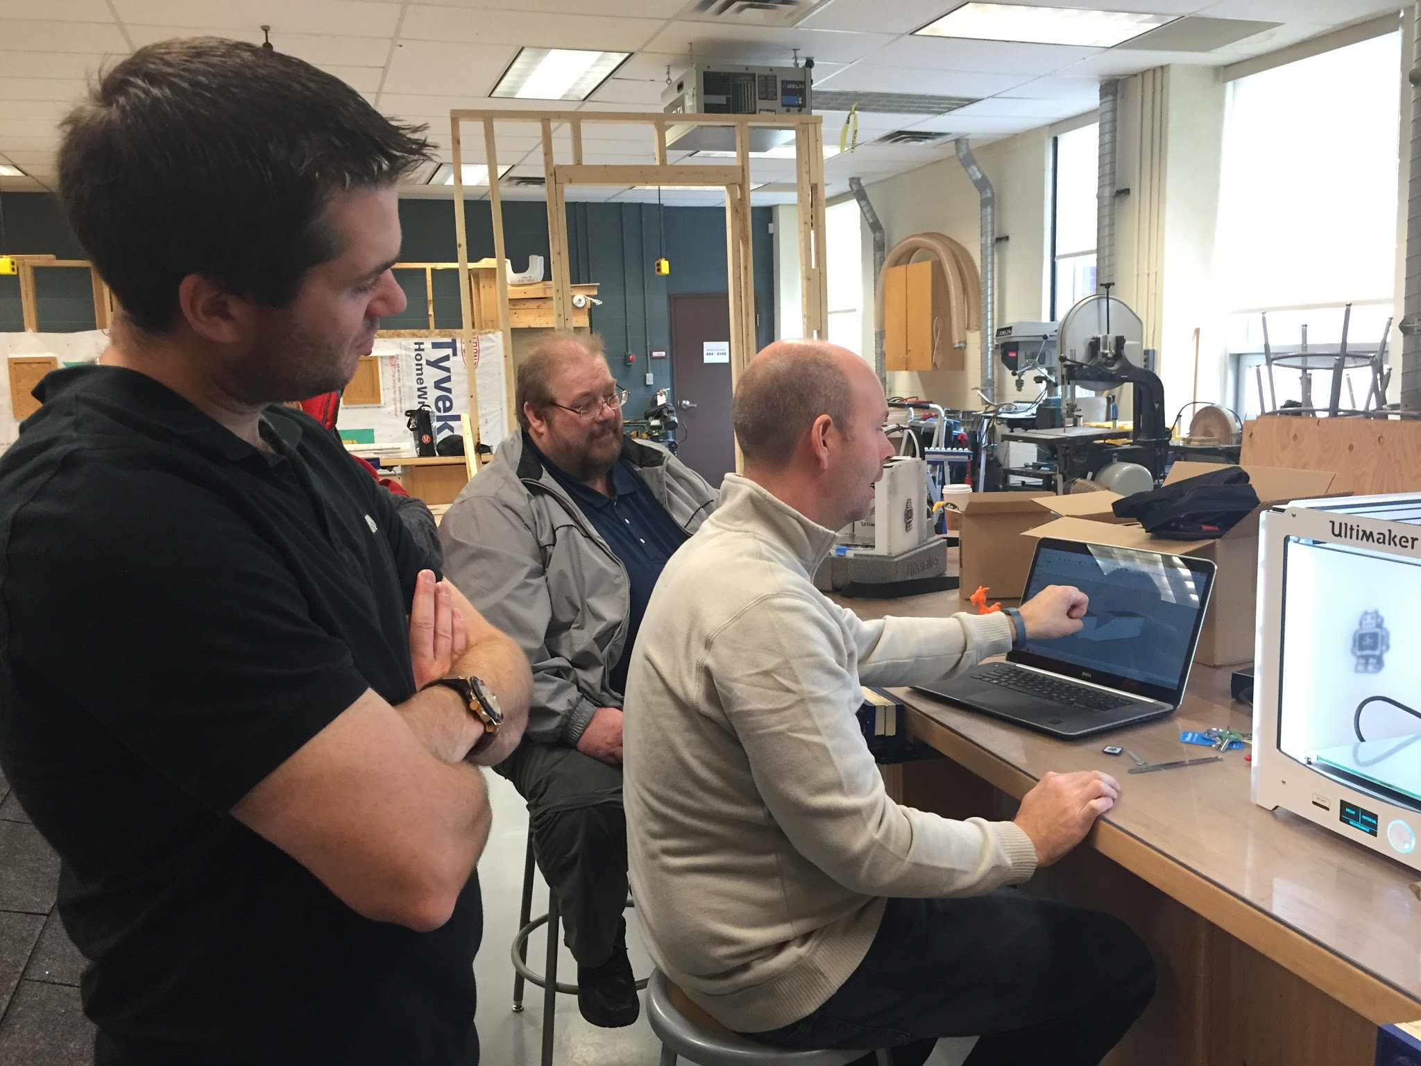
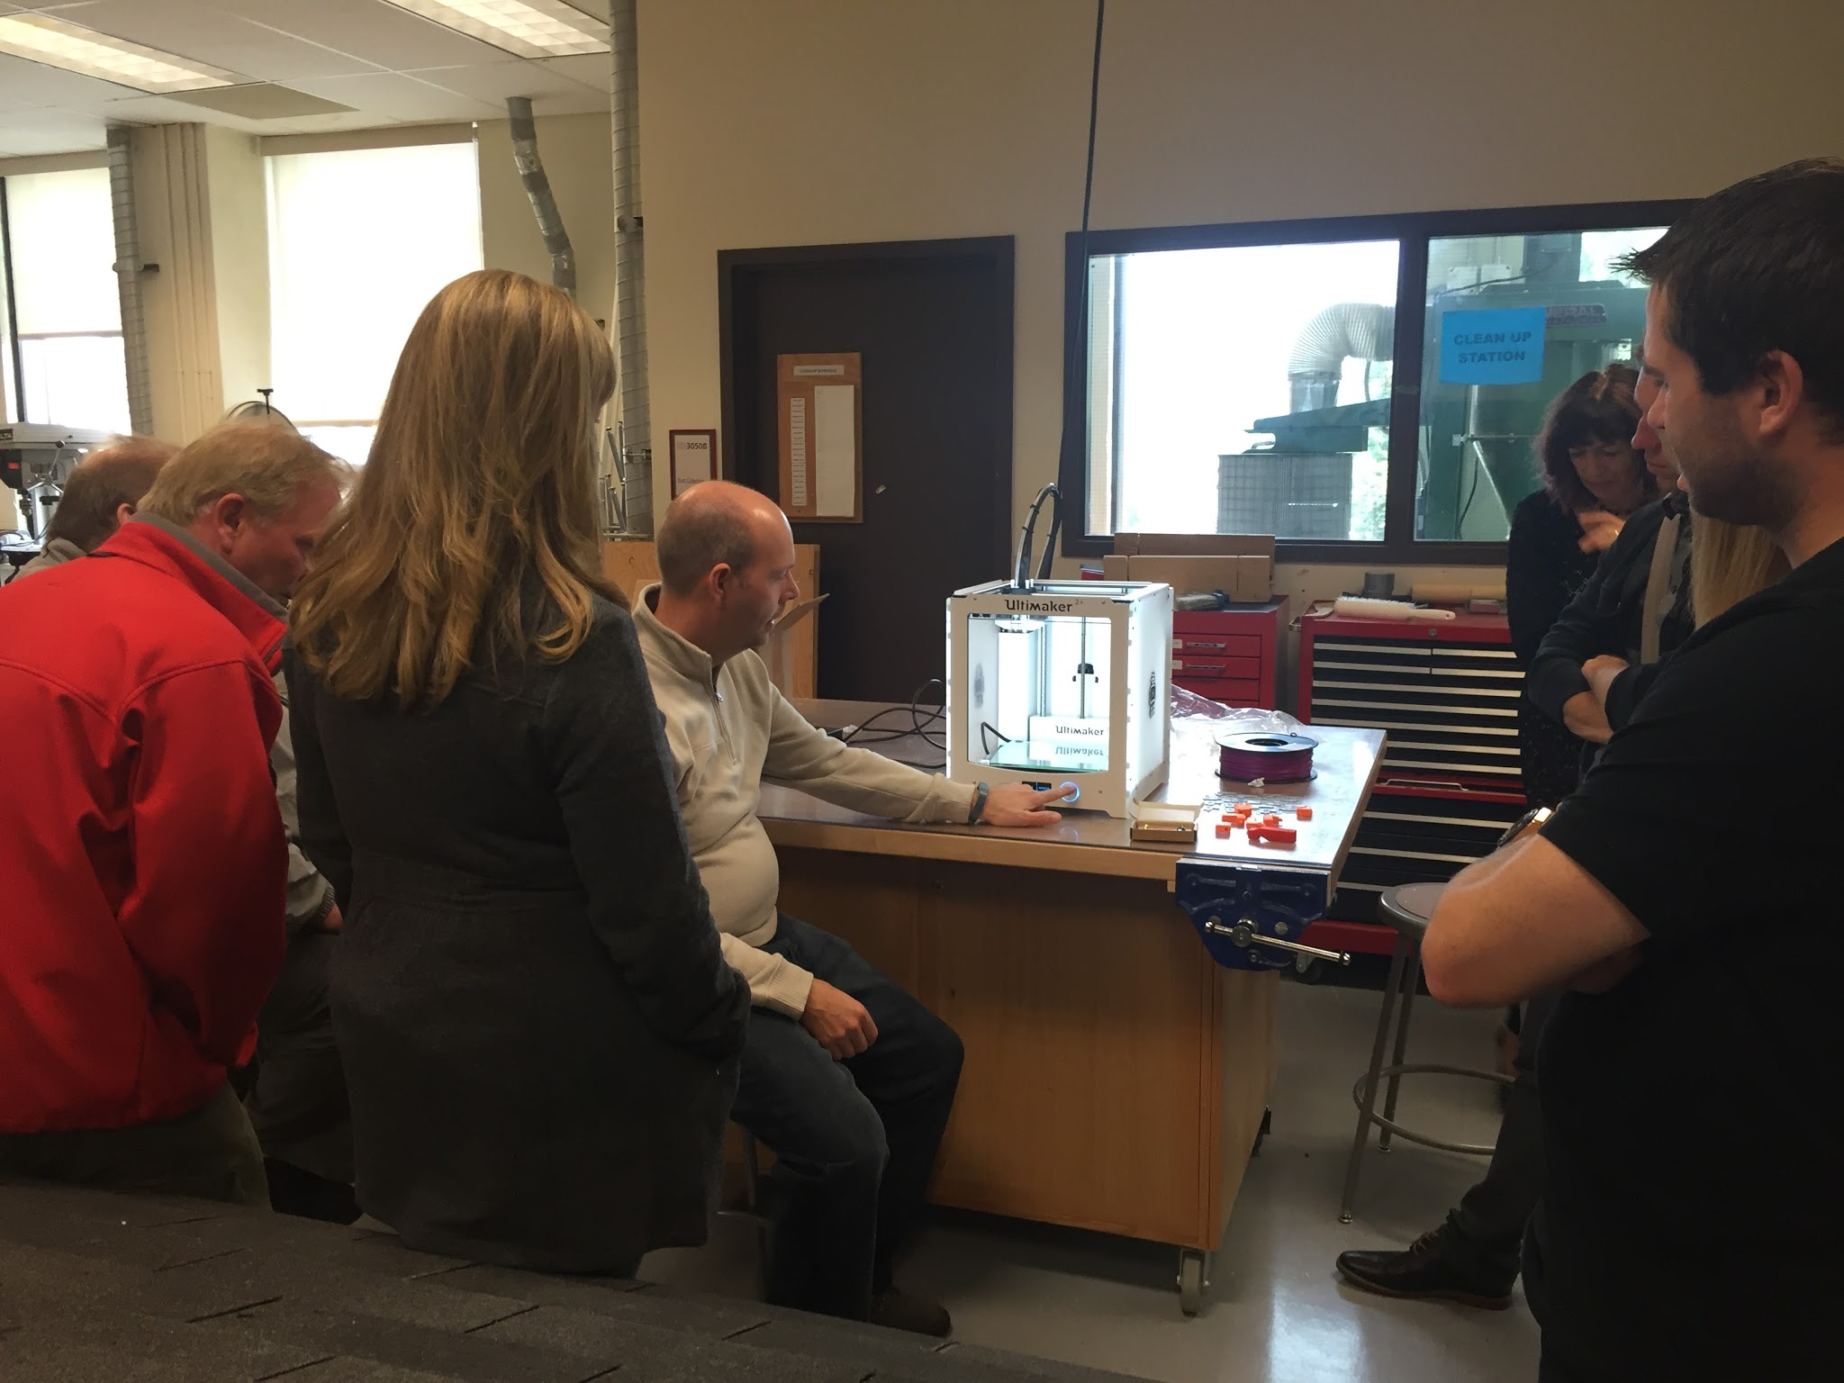
Planning
We utilized our 7 Professional Development days that was allotted to us by STEM to complete our project.
We also attended a Professional Development session in August which gave us an introduction to STEM.
We took advantage of technical training sessions in 3D printing provided through MUN (Dave Gill).
Researched how to use Sketch Up Pro, Cura
Downloaded Ultimaker2Go App to help us use and maintain our 3D printer

Slide 20
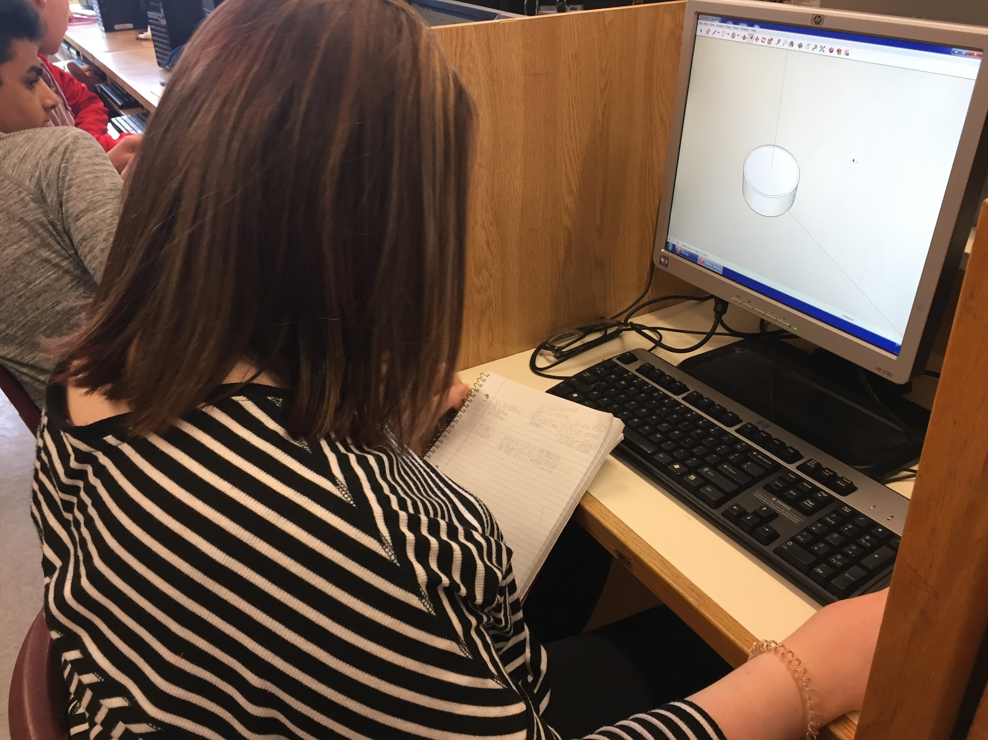

Researched how to use Sketch Up Pro, Cura
Downloaded Ultimaker2Go App to help us use and maintain our 3D printer

Slide 21
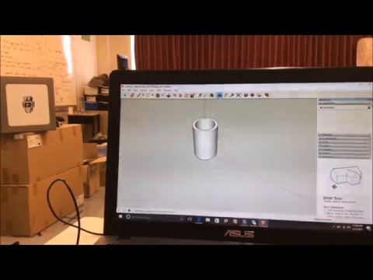
Planning
We created a short instructional video to introduce students to the basic functions of Sketch-Up Pro.
Our Sketch-Up Tutorial Video

Slide 22
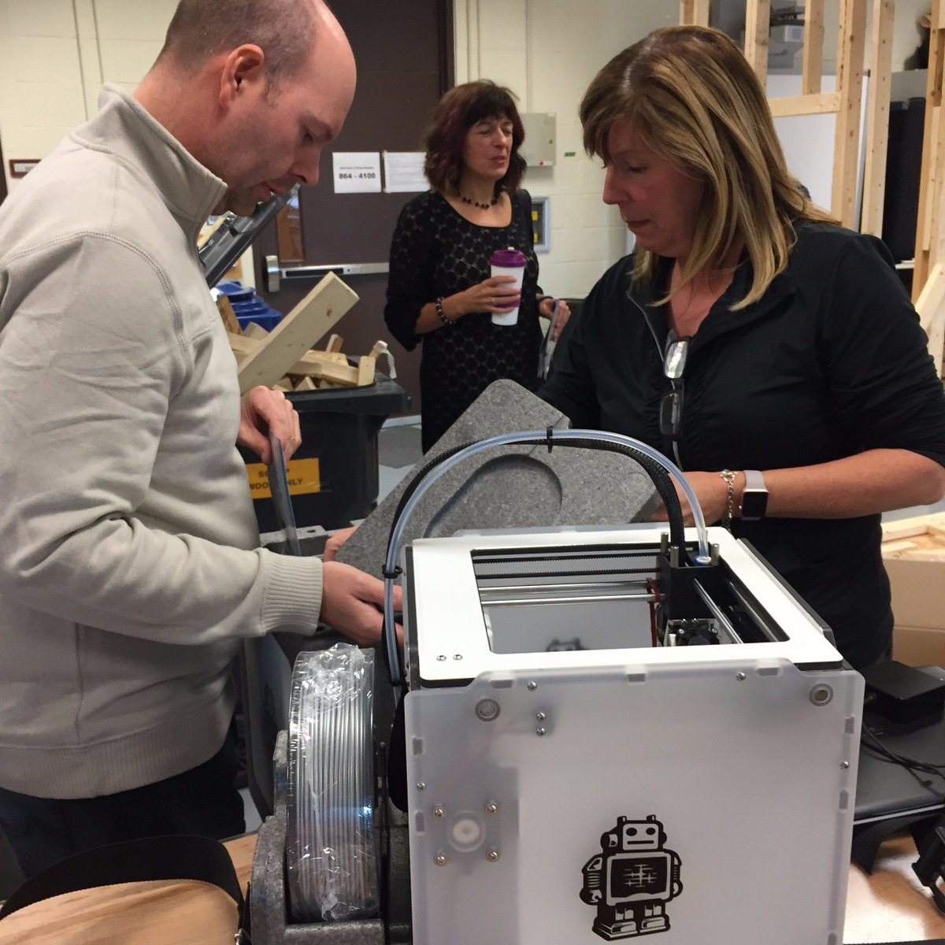
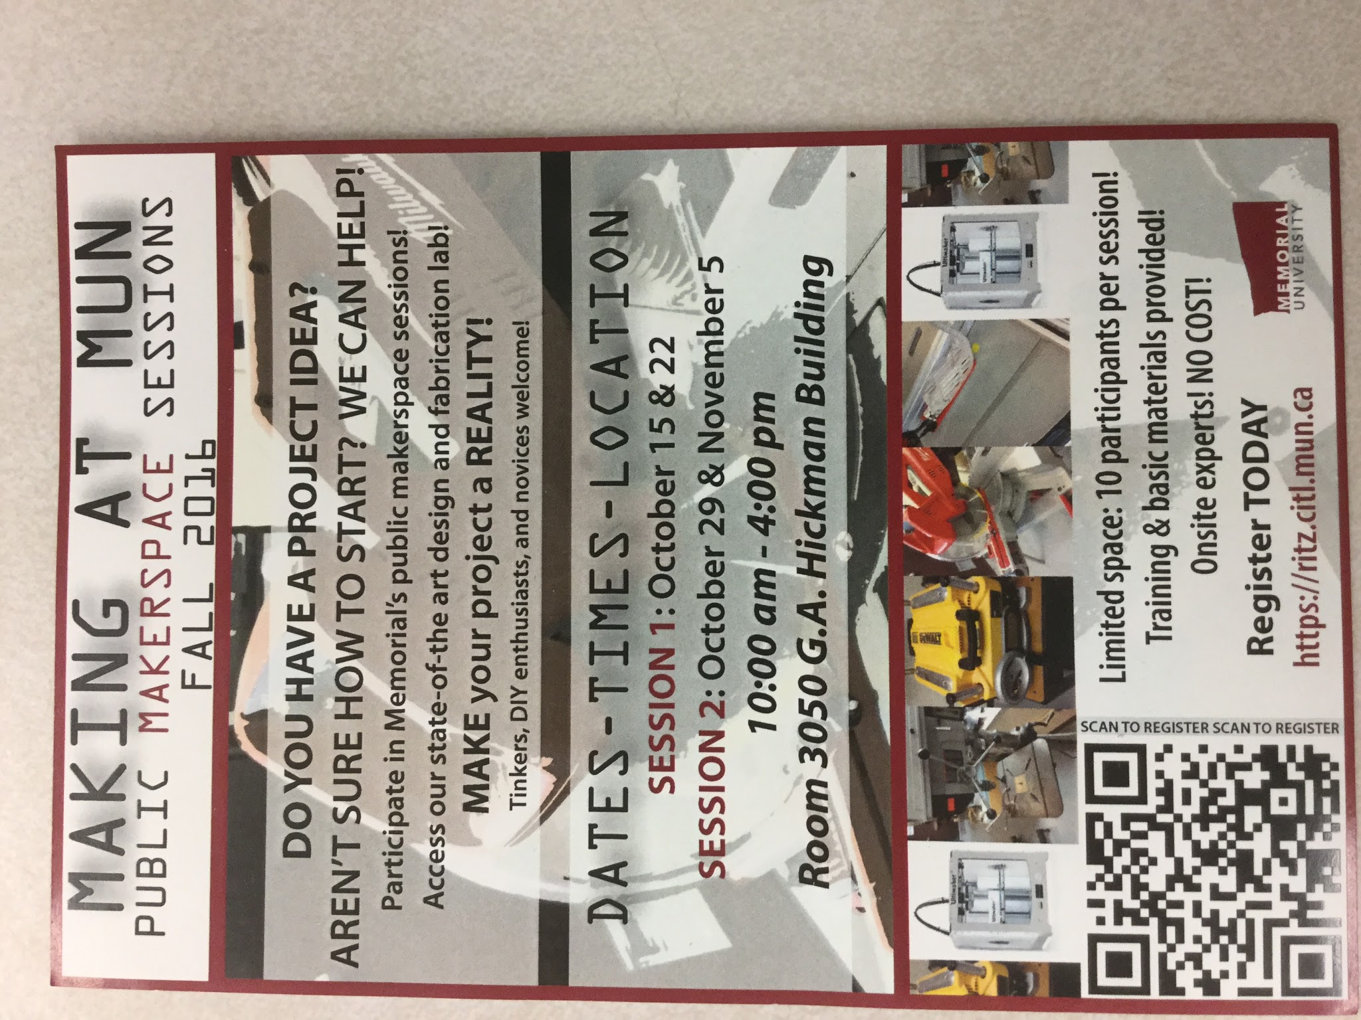
Implementation
To start our project we consulted with the ‘experts’ at MUN. David Gill and select MUN students taught us how to use Sketchpro and our 3D printers. We were also fortunate that he had a grant offering additional saturday sessions in their Makerspace which several of us participated in.

Slide 23
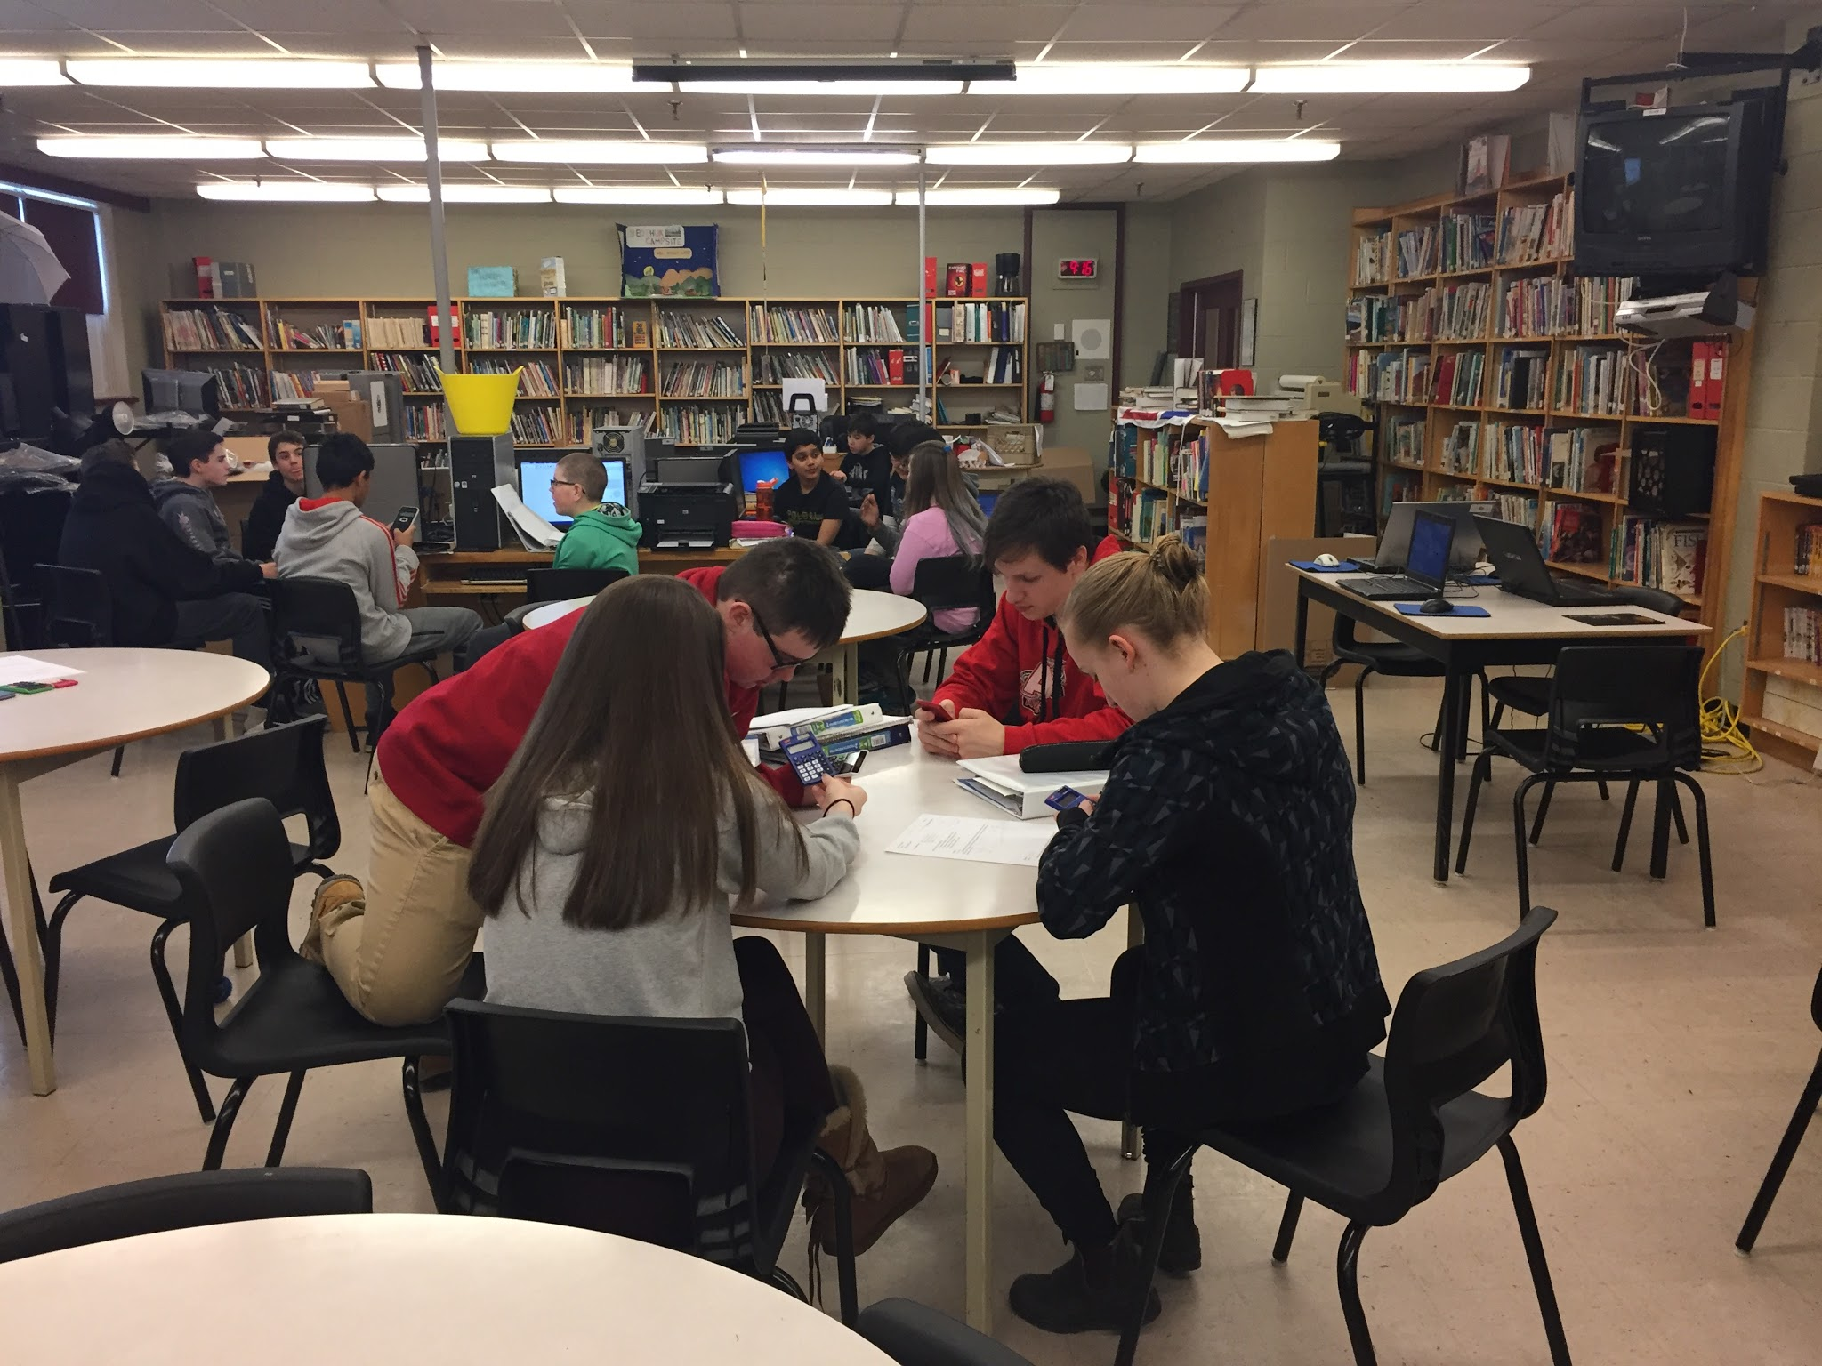
Implementation (Con’t)
Students were organized into groups of 4 and 5.
Within their groups, they were given their assigned tasks. Together through a process of trial and error they determined what dimensions would get them closes to their target volume (50 mL).
Dave Abbott (technology teacher) then introduced the SketchUp Pro software to each individual class.

Slide 24
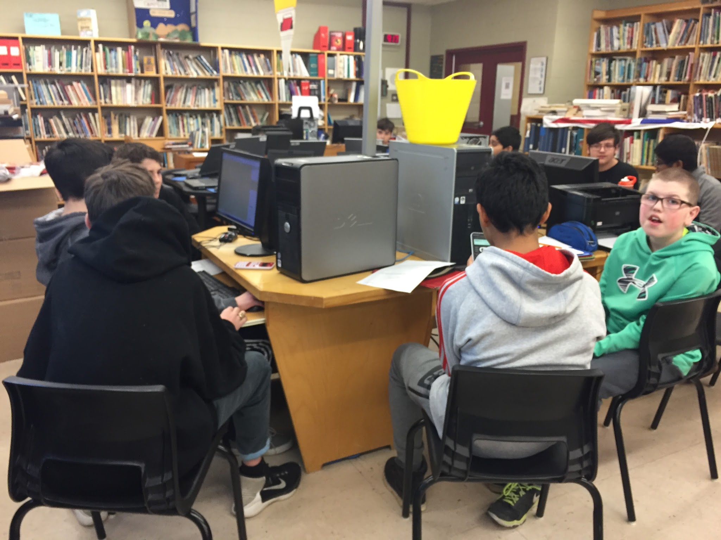
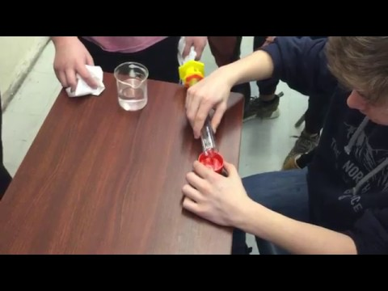
Implementation (Con’t)
Students were then brought to the computer lab/library to design their 3D cylinder on SketchUp.
Then they had the opportunity to view their cylinder being printed on the 3D printer in the library.
Finally, as a class, each group tested their cylinder to see which group came the closest to holding 50 mL of water.
Students working together in groups to design their projects.

Slide 25
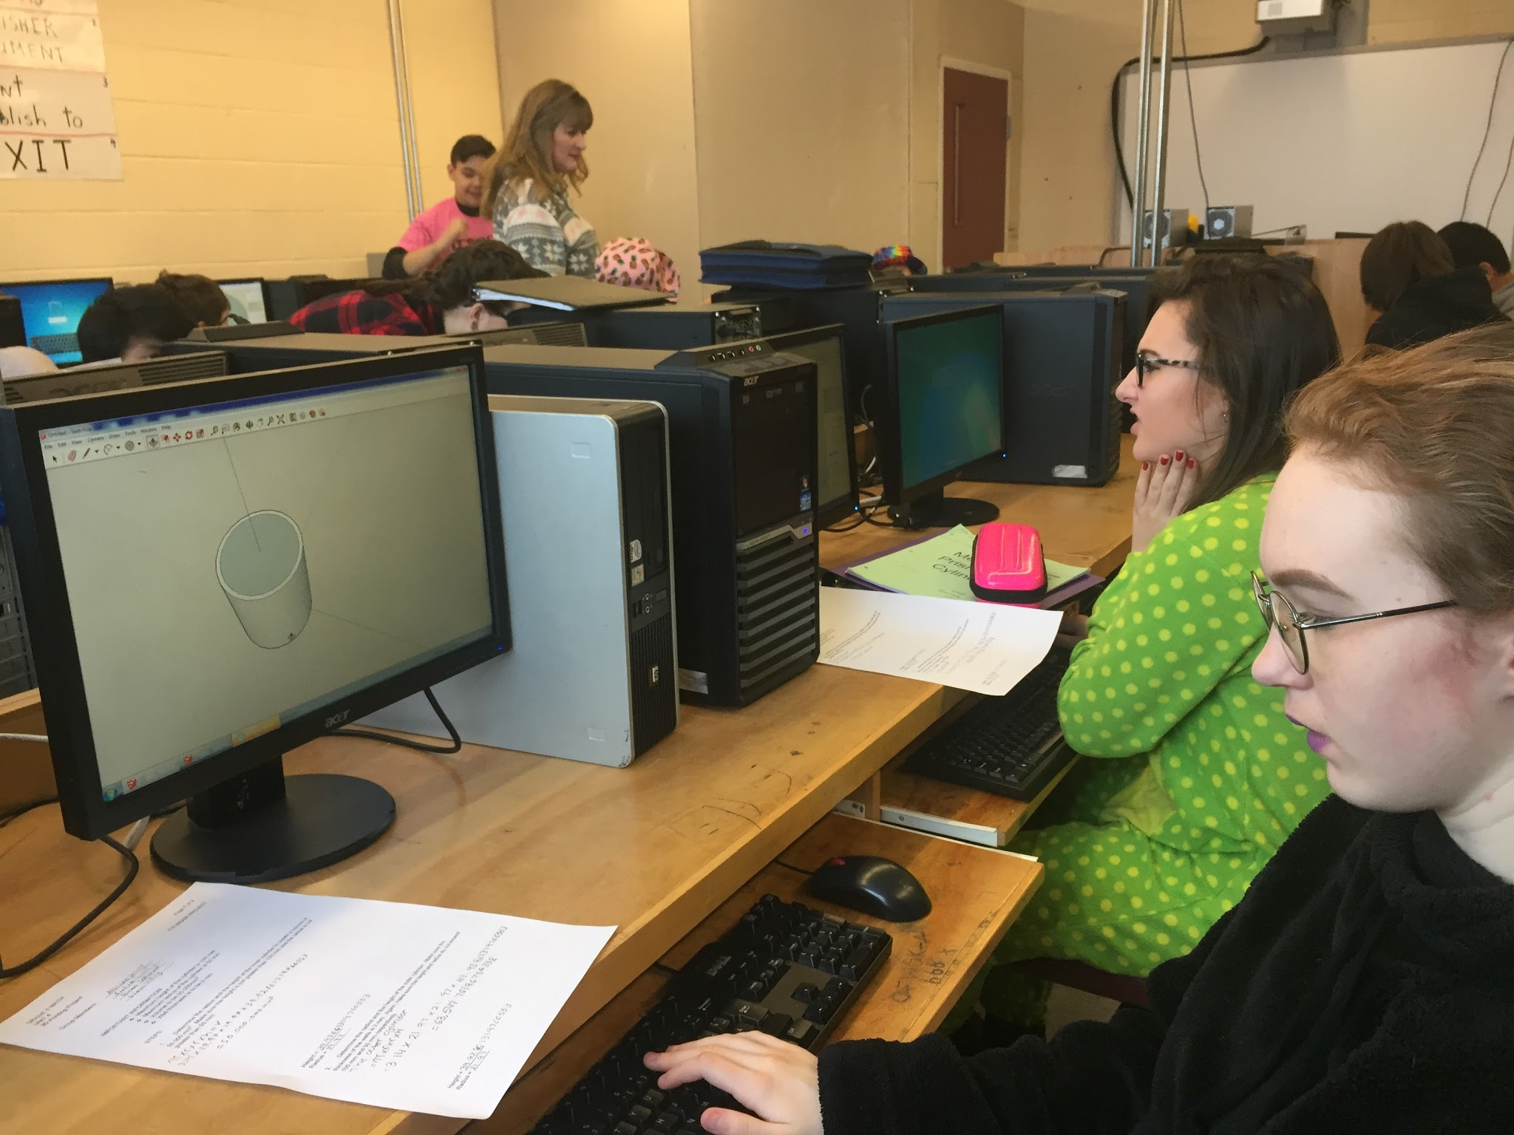
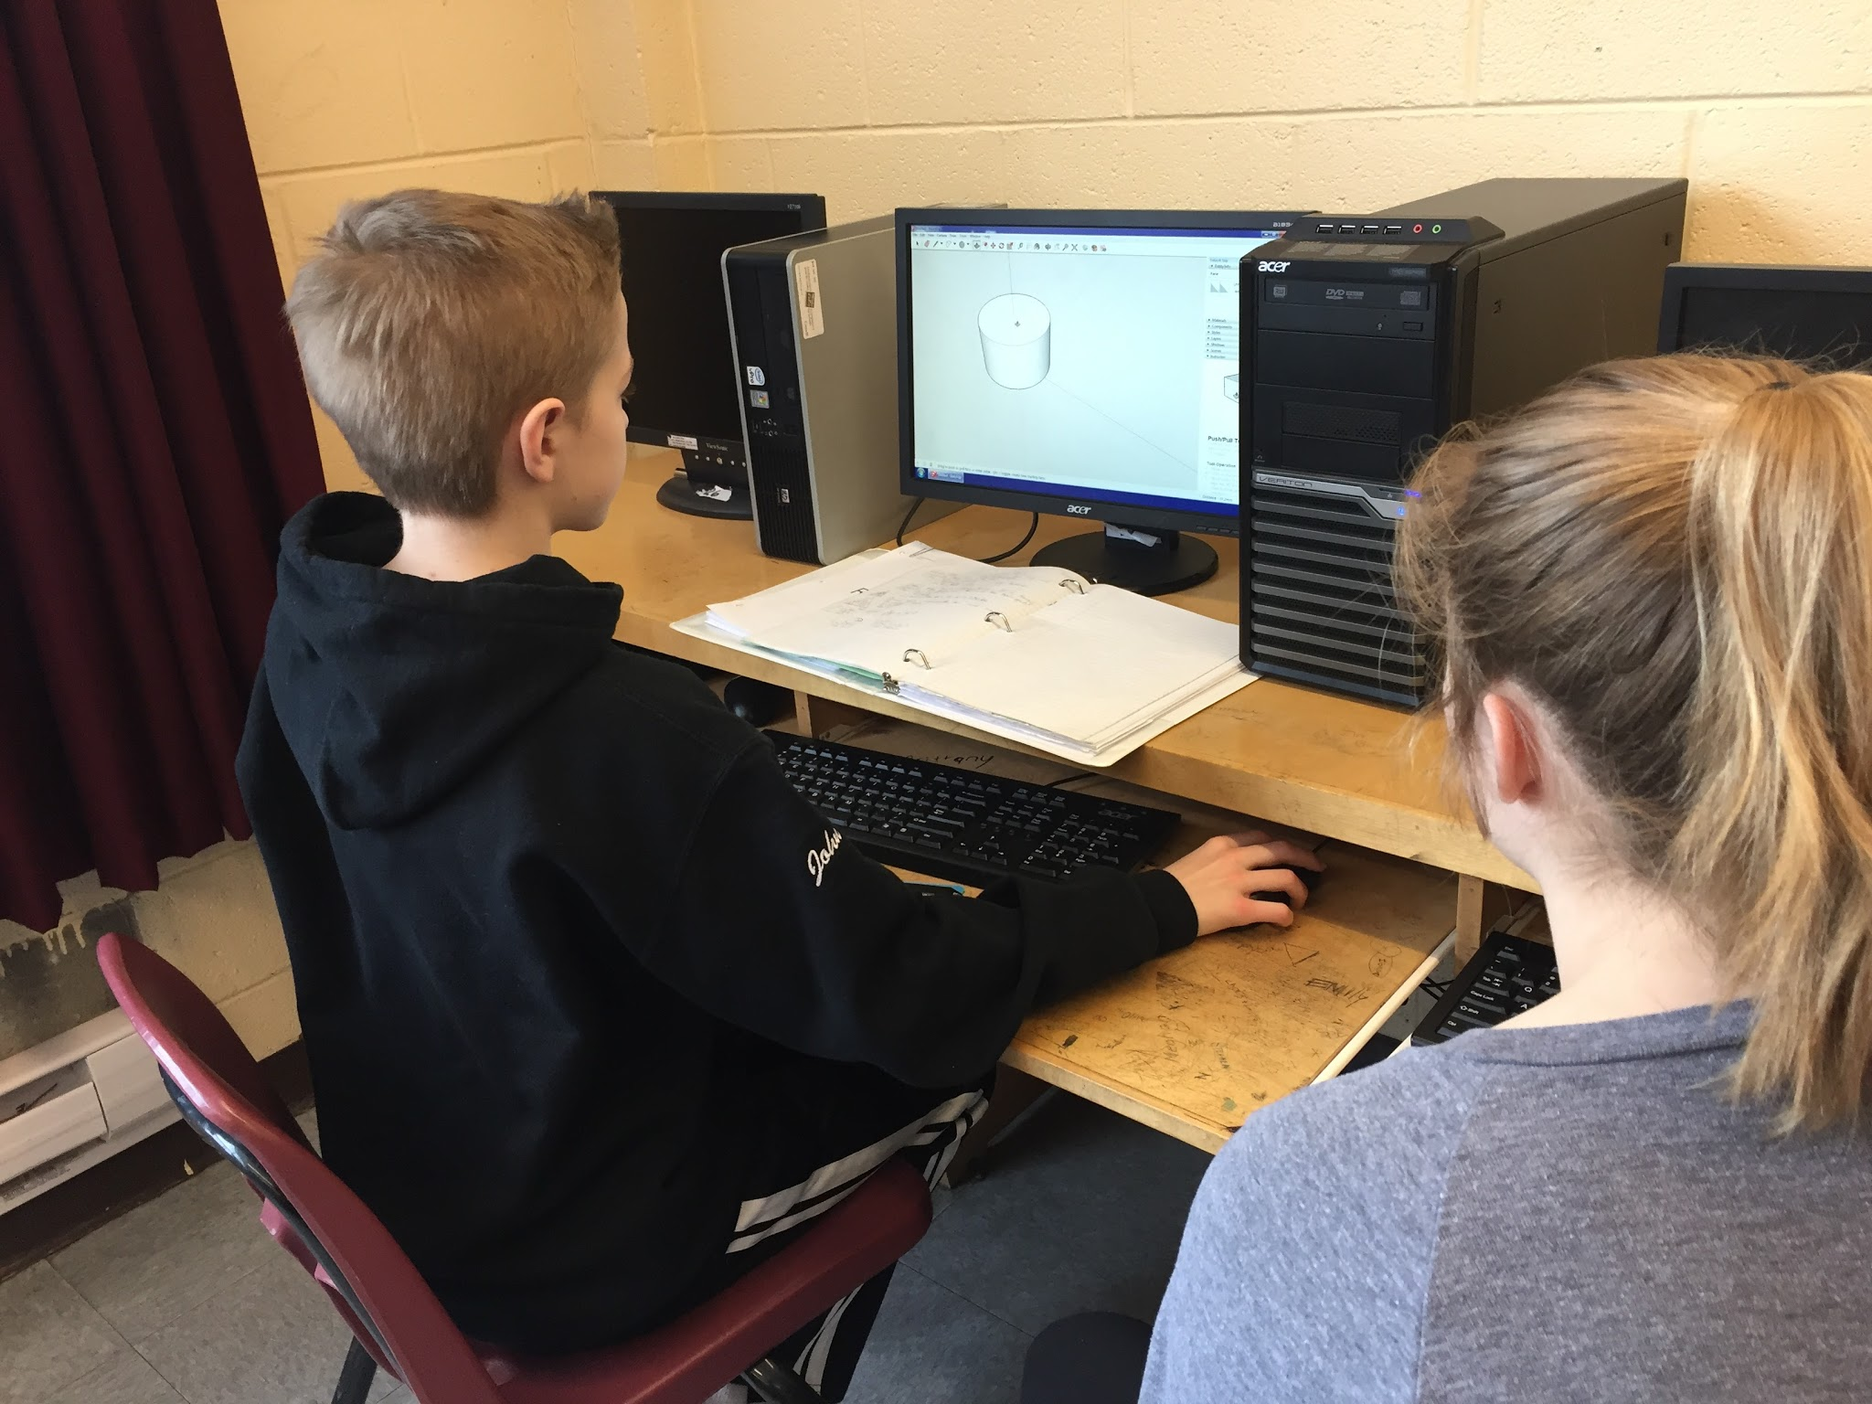
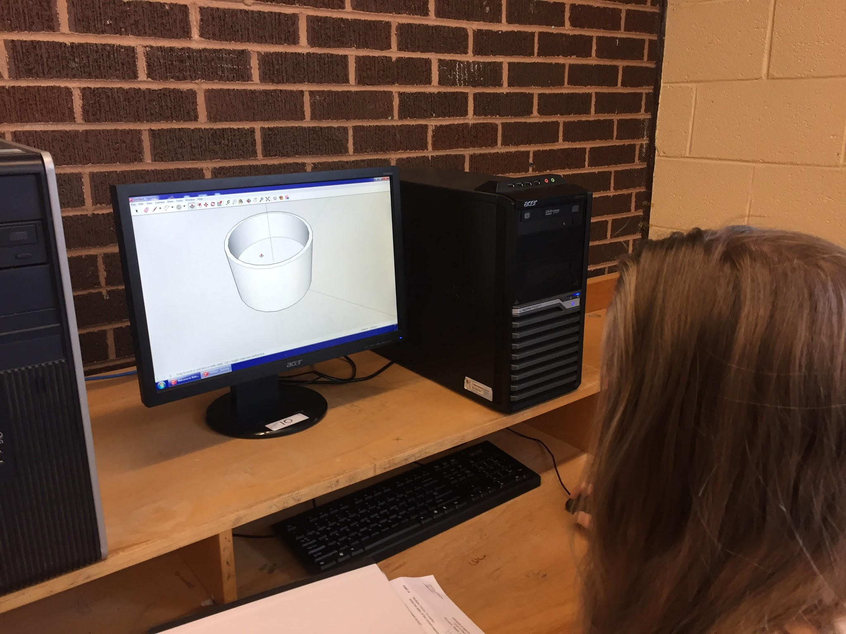
Students designing their cylinders on Sketchup Pro

Slide 26
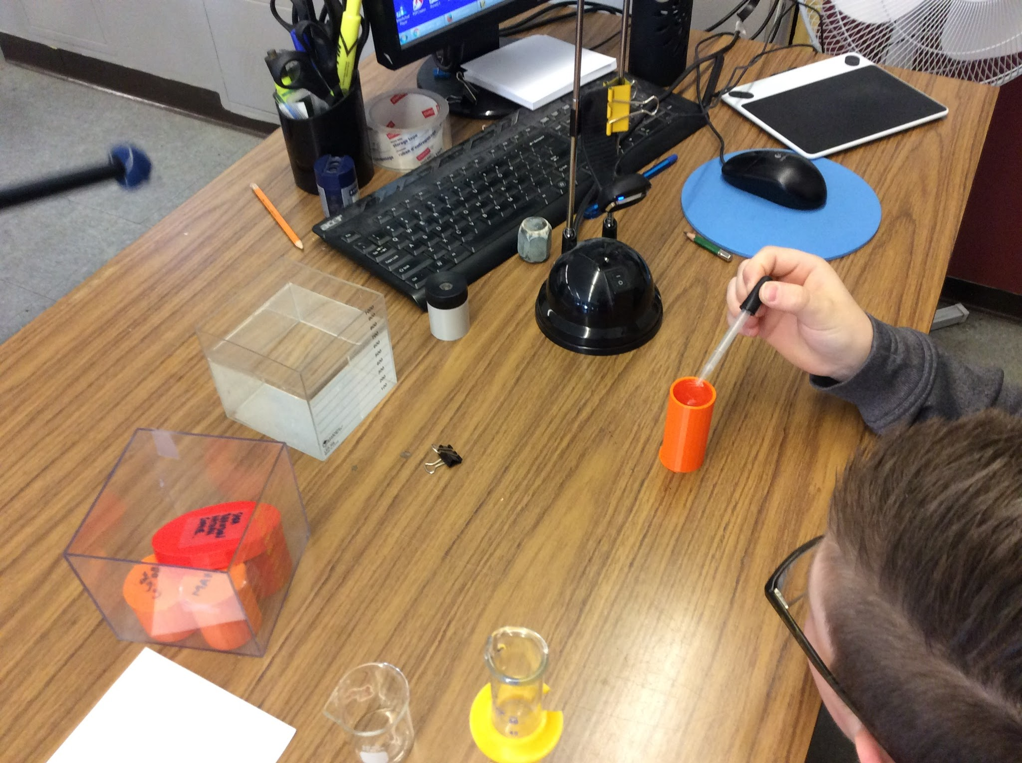
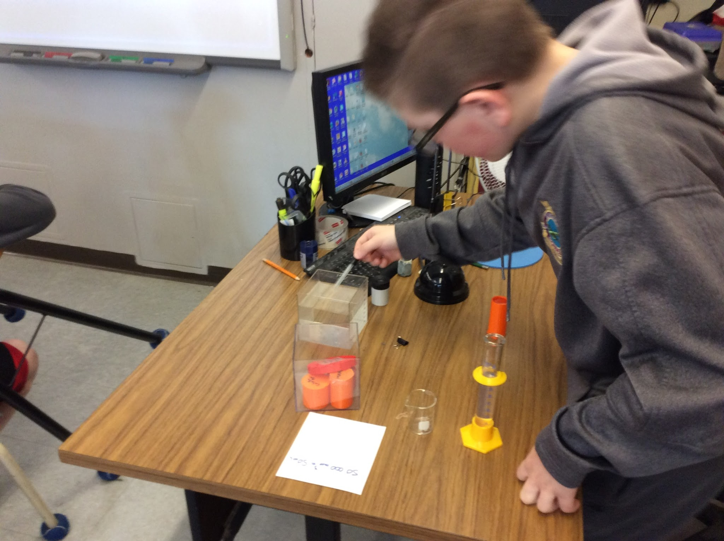
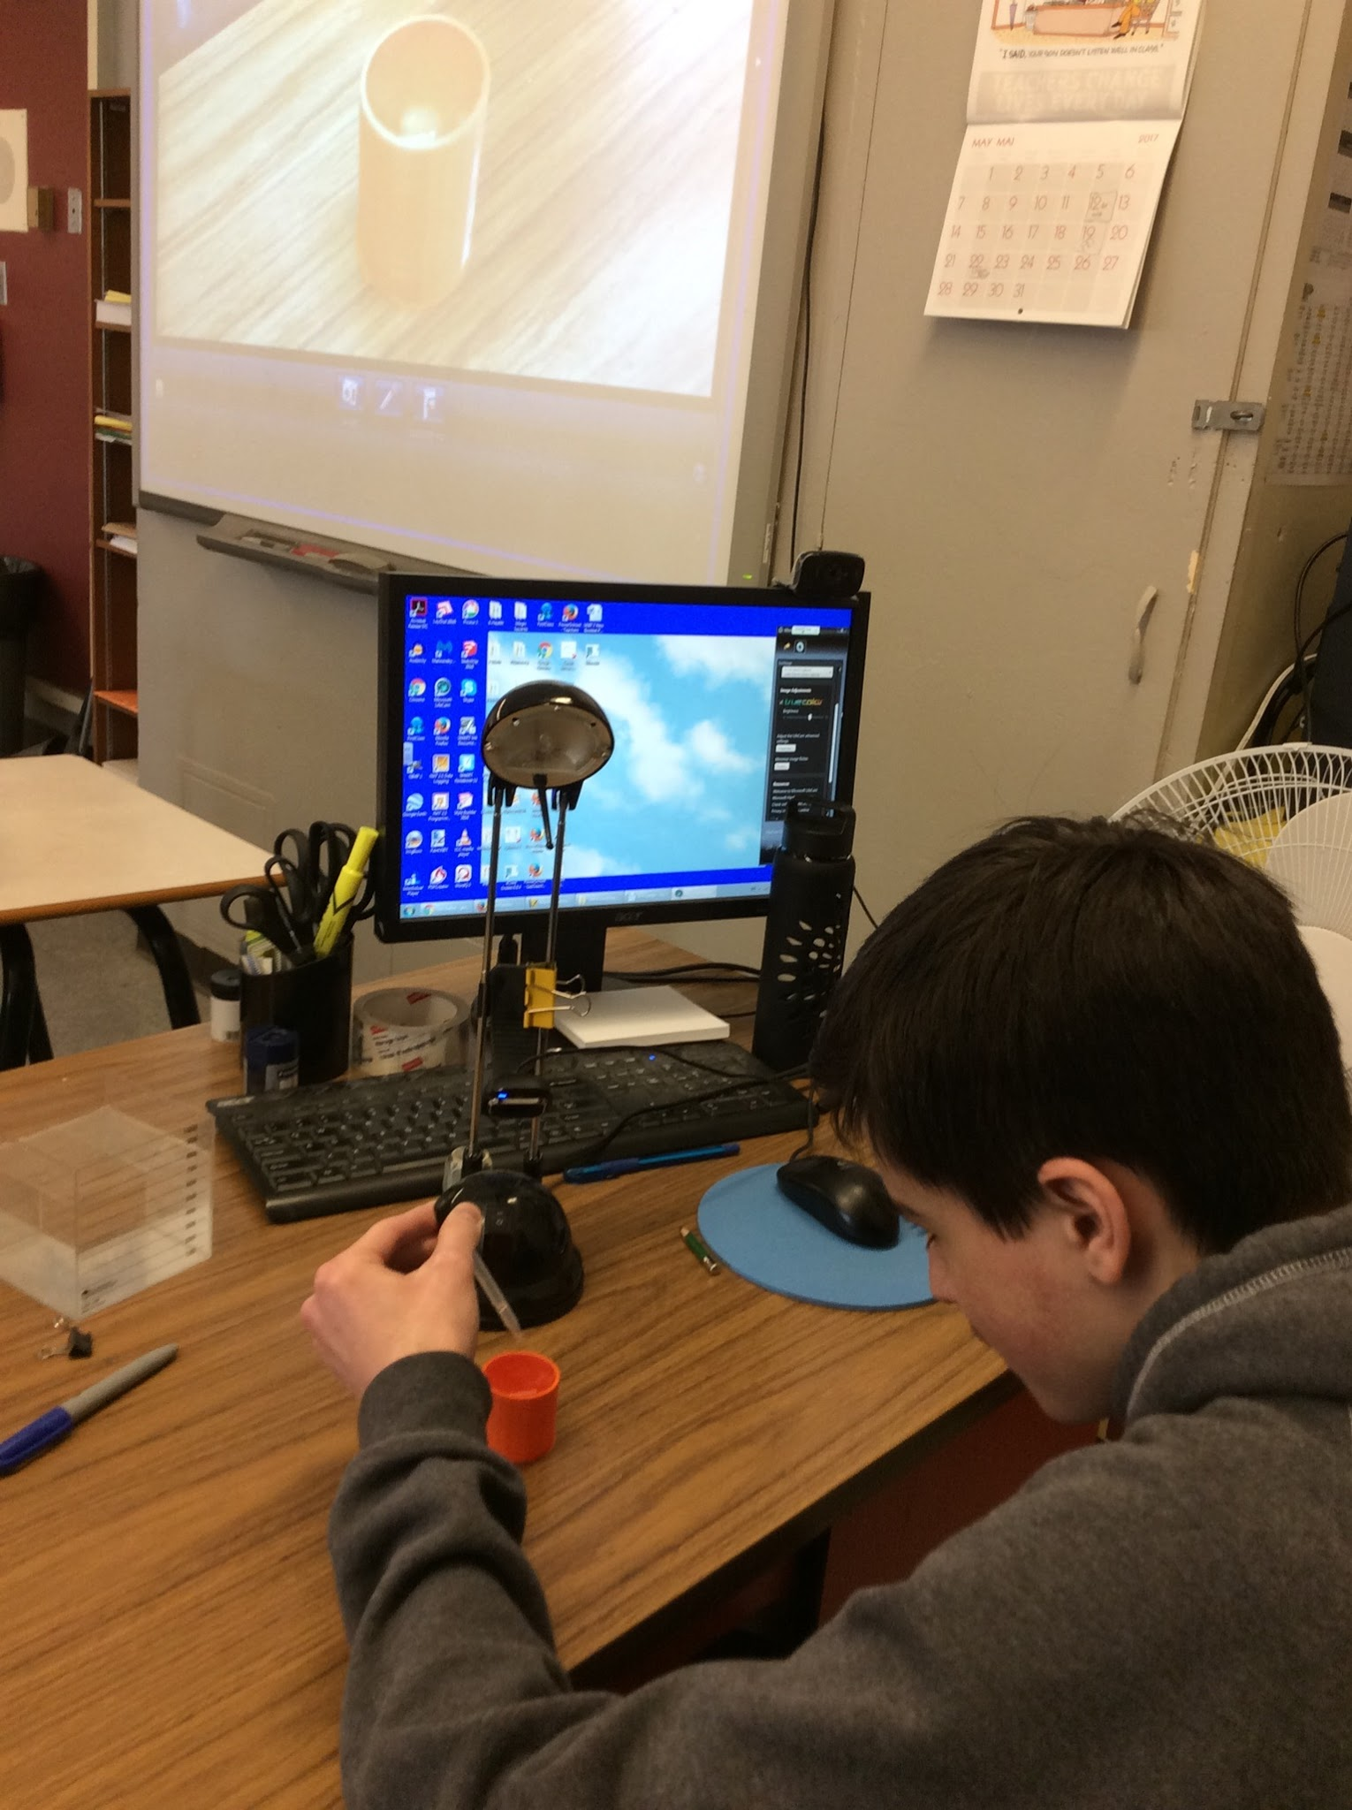
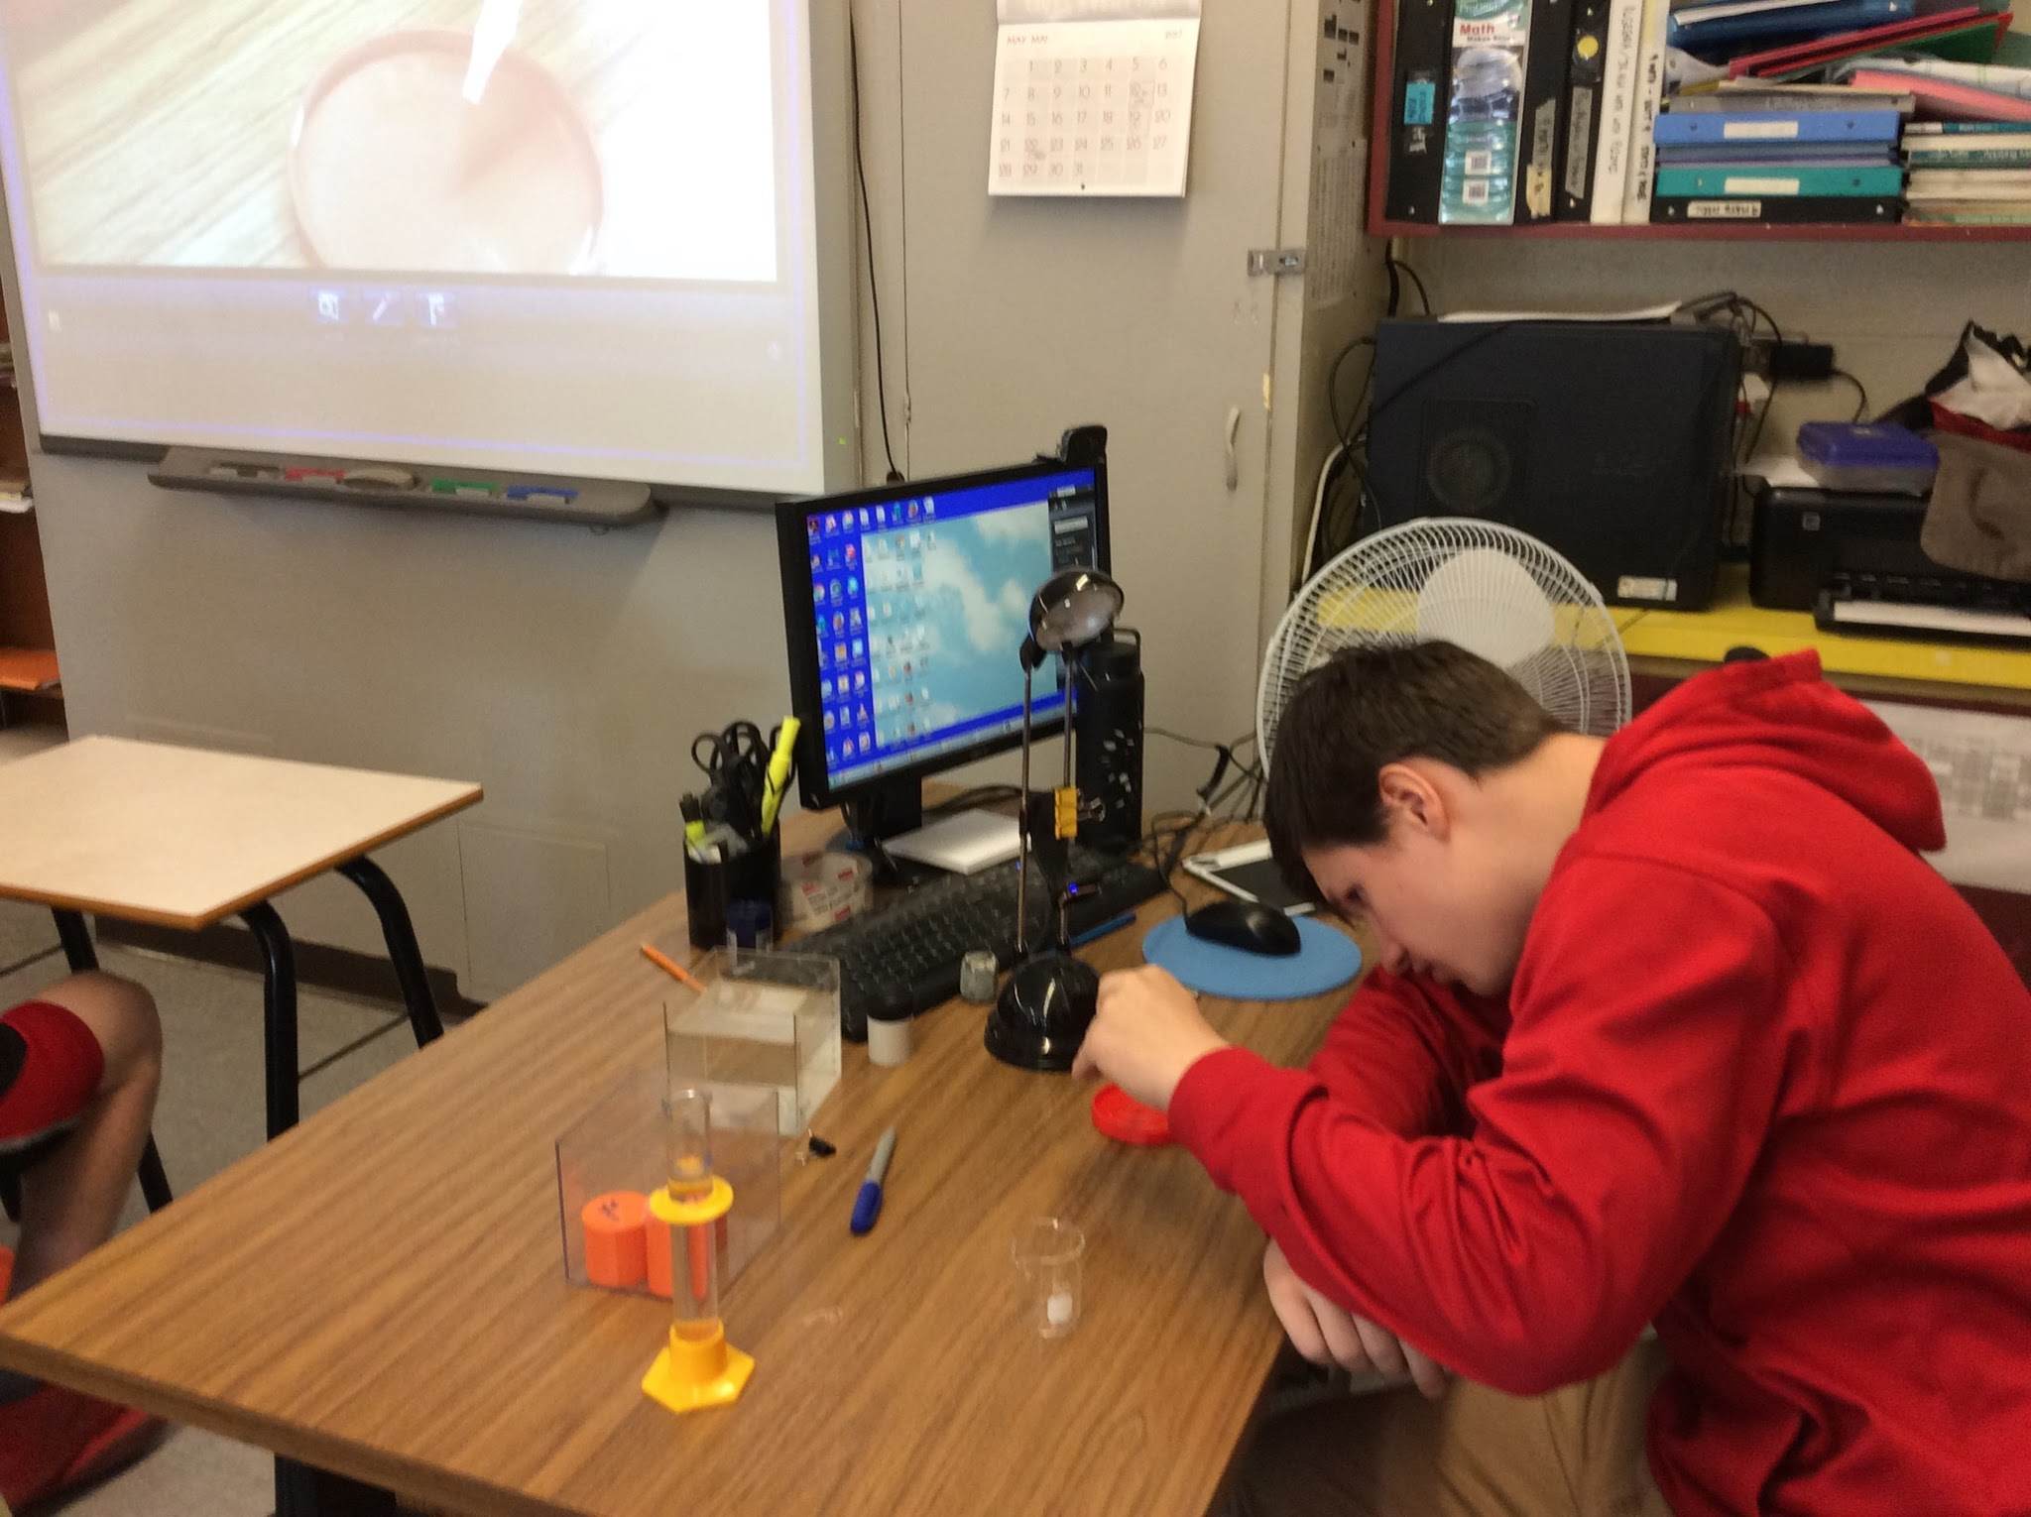
Students testing the volume of their cylinders

Slide 27
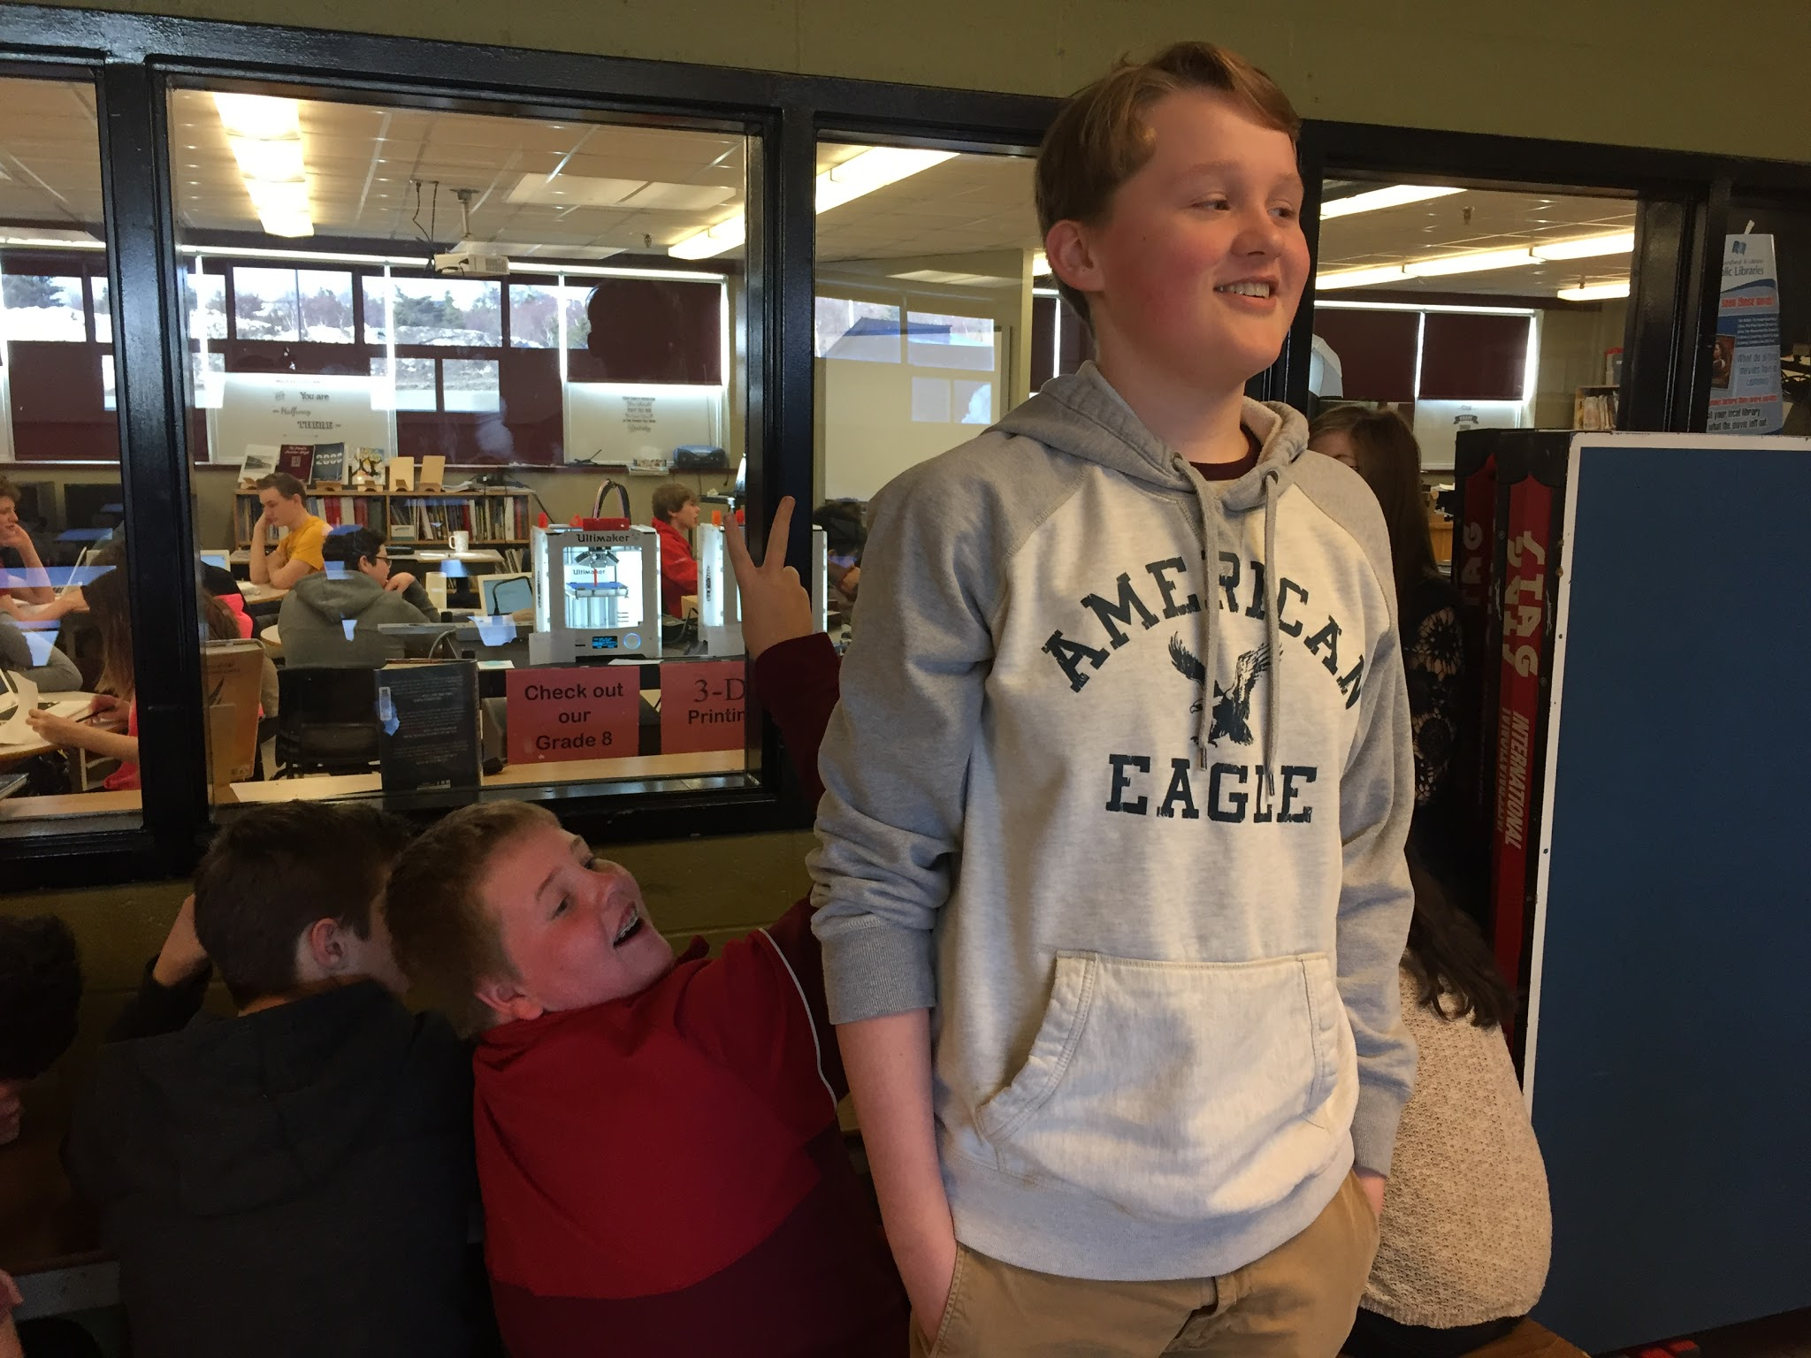
Students watching their cylinders being printed on the 3D printer.

Slide 28
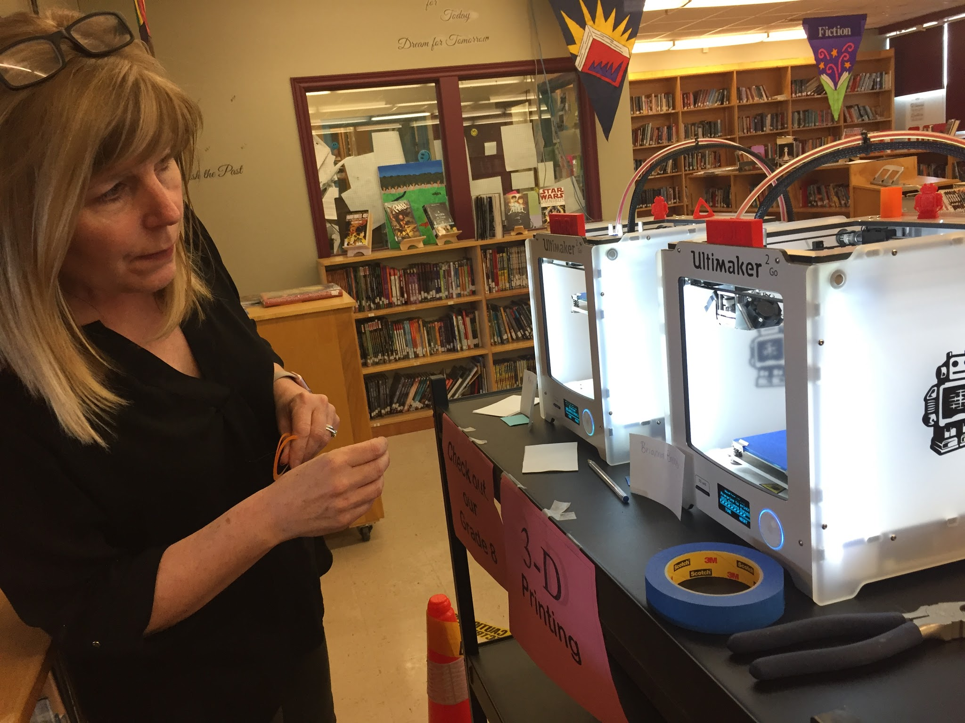
Mrs. Hatcher setting up the 3D printers for the printing stage.

Slide 29
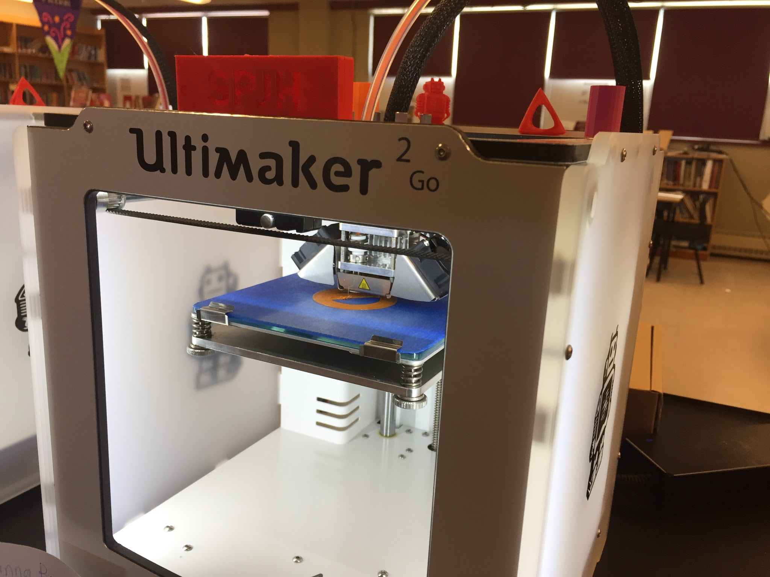
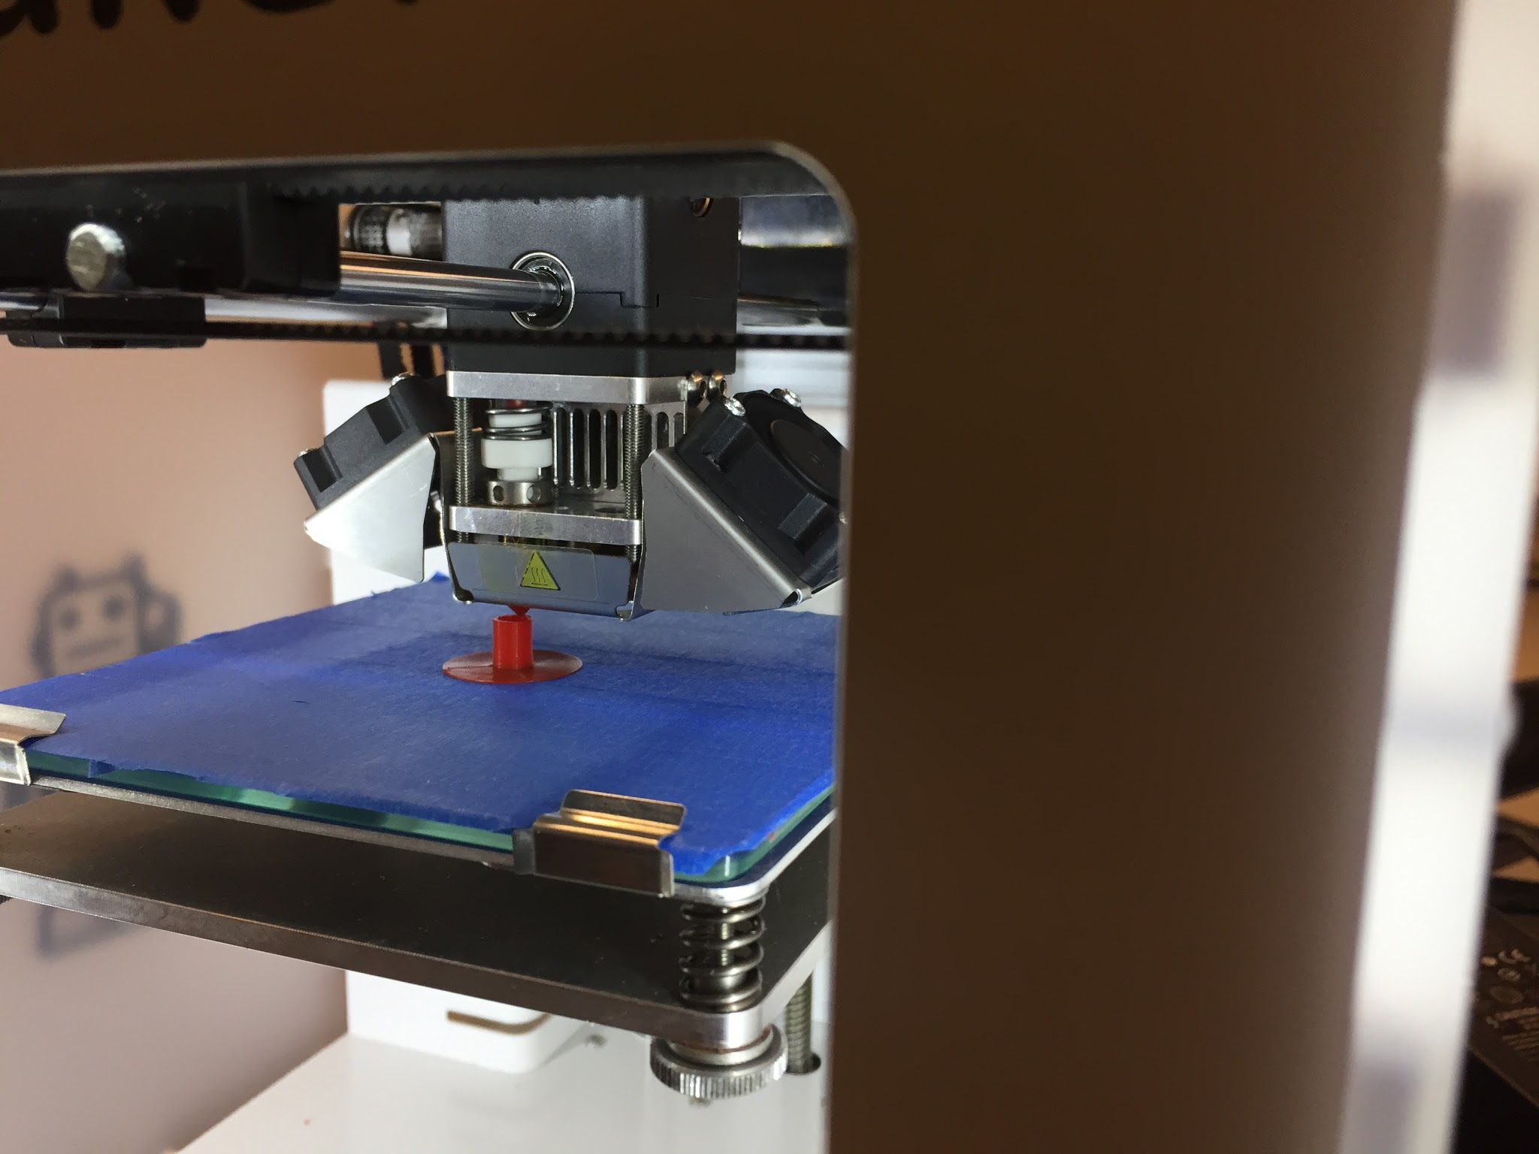
Printing of the 3D cylinders.

Slide 30
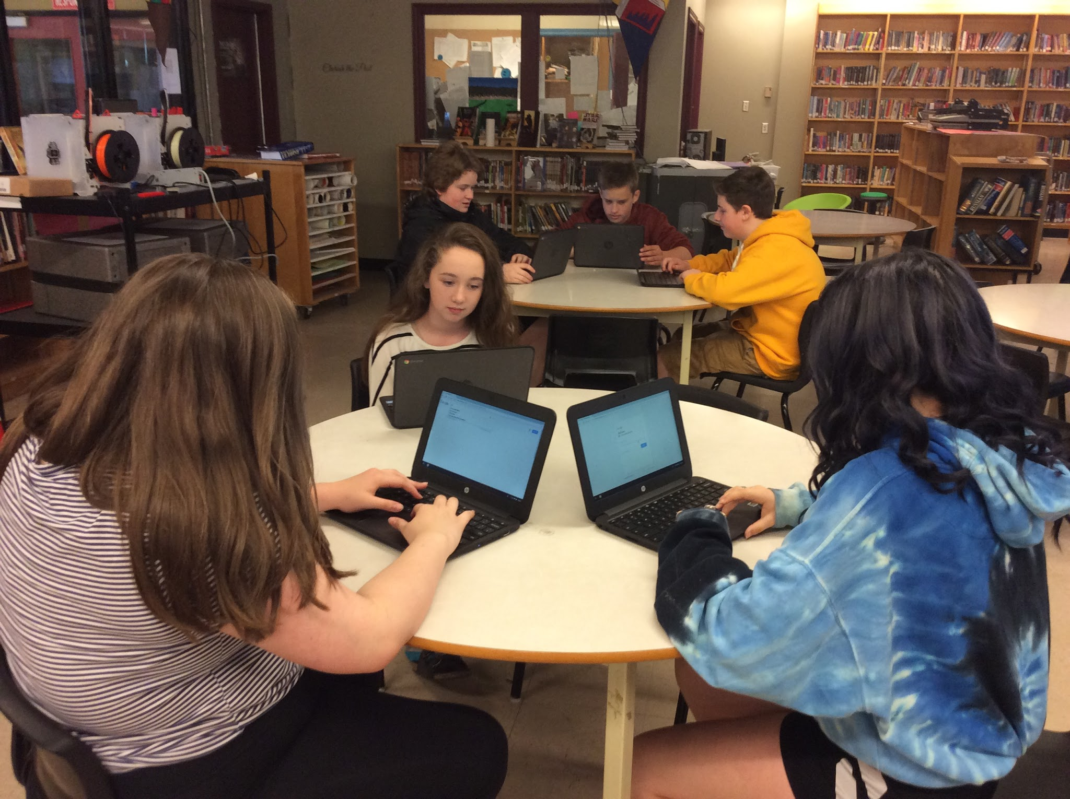
Data Collection/Analysis
Students were given a pre and post survey to determine their overall attitudes toward Math
To establish validity we used repetition of questions to discern consistency of student responses.
We analyzed the data from each class on a percentage basis to account for differences in class size and composition.

Slide 31
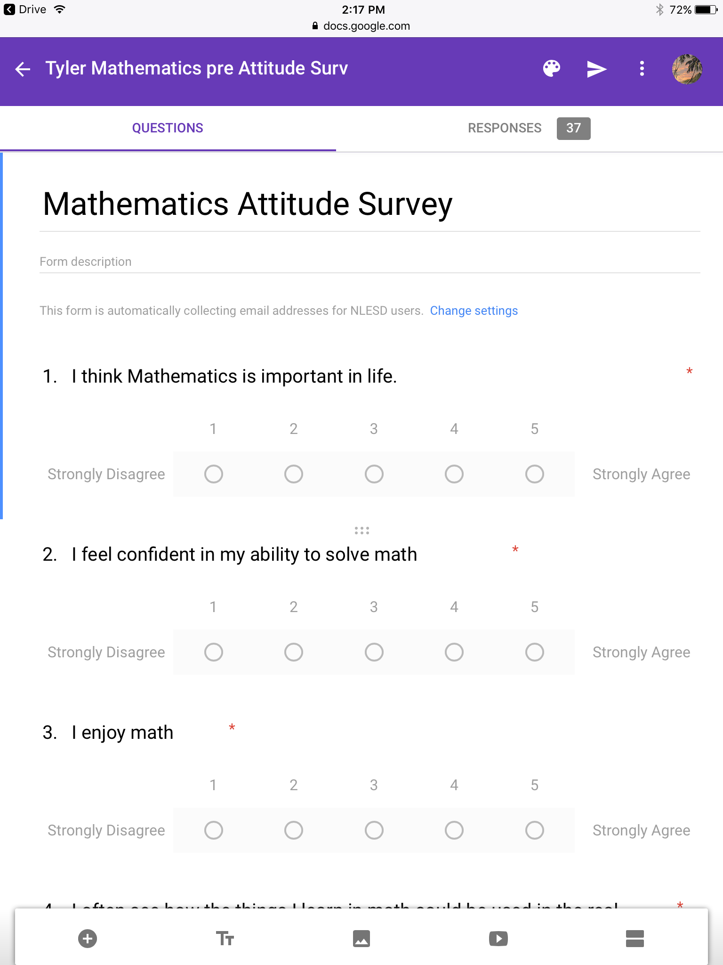
Our survey was composed of general questions which would provide us with insight on each student's’ feelings and attitudes toward Math

Slide 32
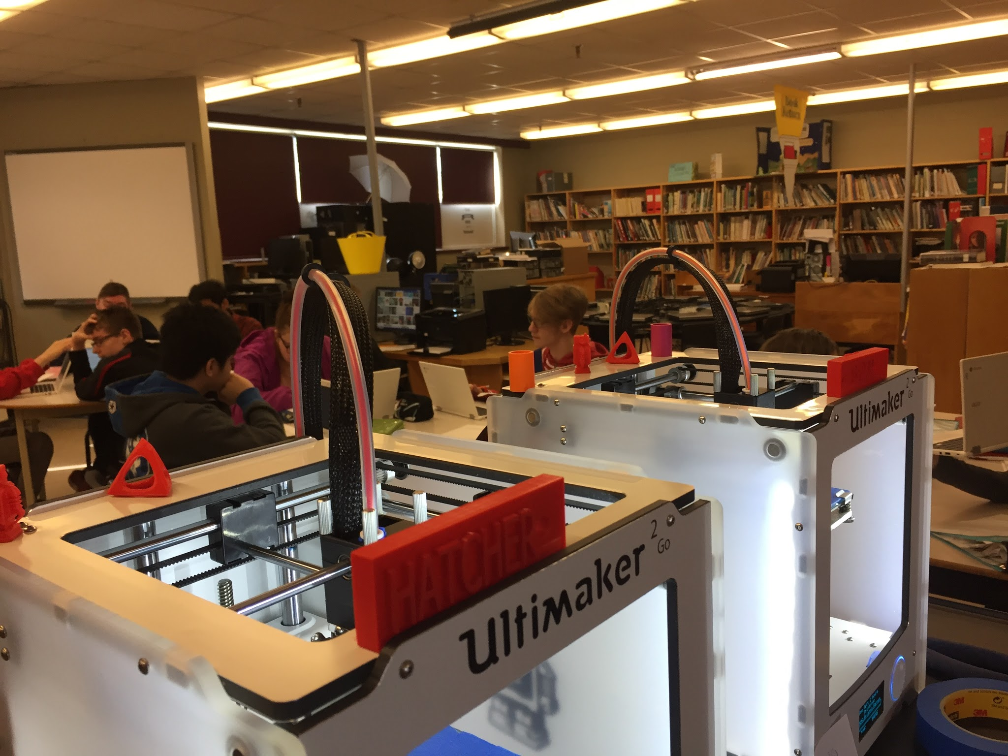
Results - Teacher Understanding of Subject Matter
This project helped us as teachers improve our overall understanding of how the curriculum can be applied to real world situations
We acquired transferable technology skills which we can utilize and continue to develop in years to come.
In short - Math teachers are often posed with the question from students “When will use this in real life”. This project helped us provide a tangible answer to that question.

Slide 33
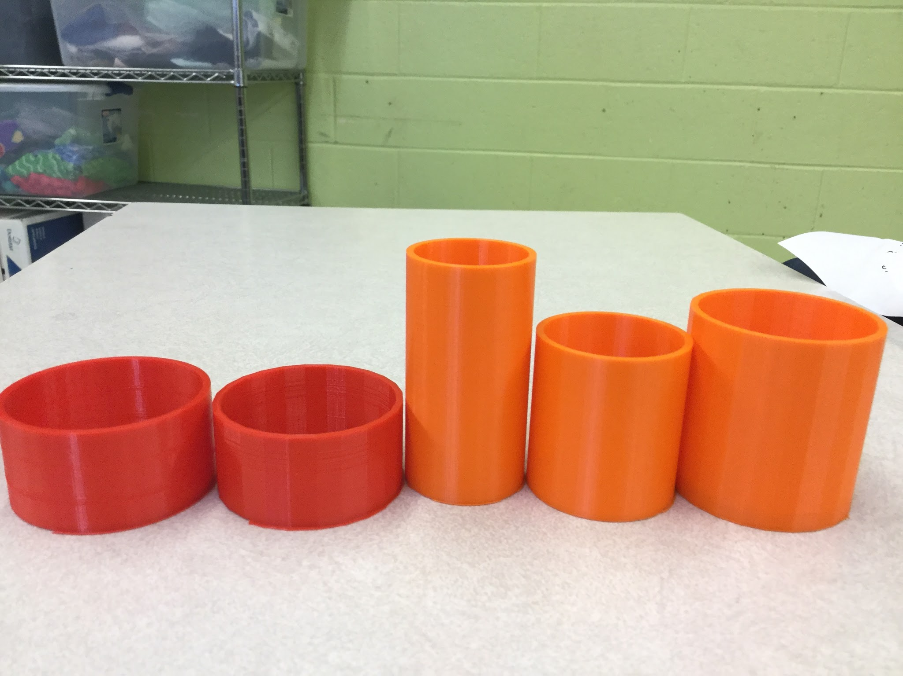
Results - Understanding of Assessment
The project clearly demonstrated that there are other ways of assessing student learning rather than pencil and paper testing.
Students creation of a final project using concepts of volume and capacity helped us gauge depths of student understanding of them.

Slide 34
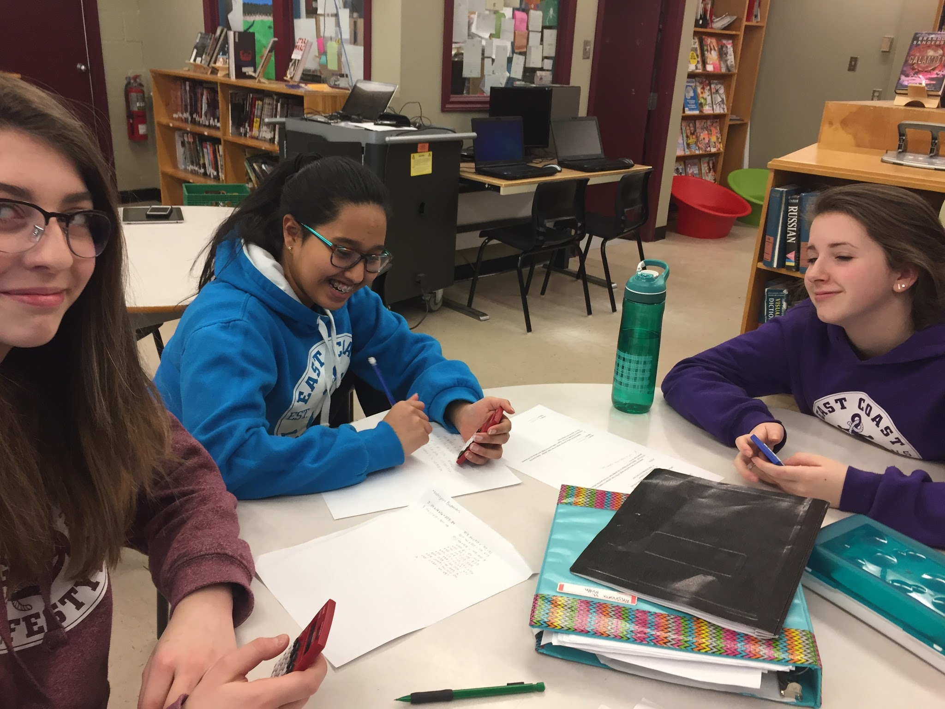
Results - Understanding of Instruction
This was an opportunity for us as teachers to gain experience in student directed learning.
Groups worked together to determine which specific values of height and radius would provide the target capacity of 50 mL
They also had to problem solve as to how difference in volume and capacity would provide sufficient wall thickness

Slide 35
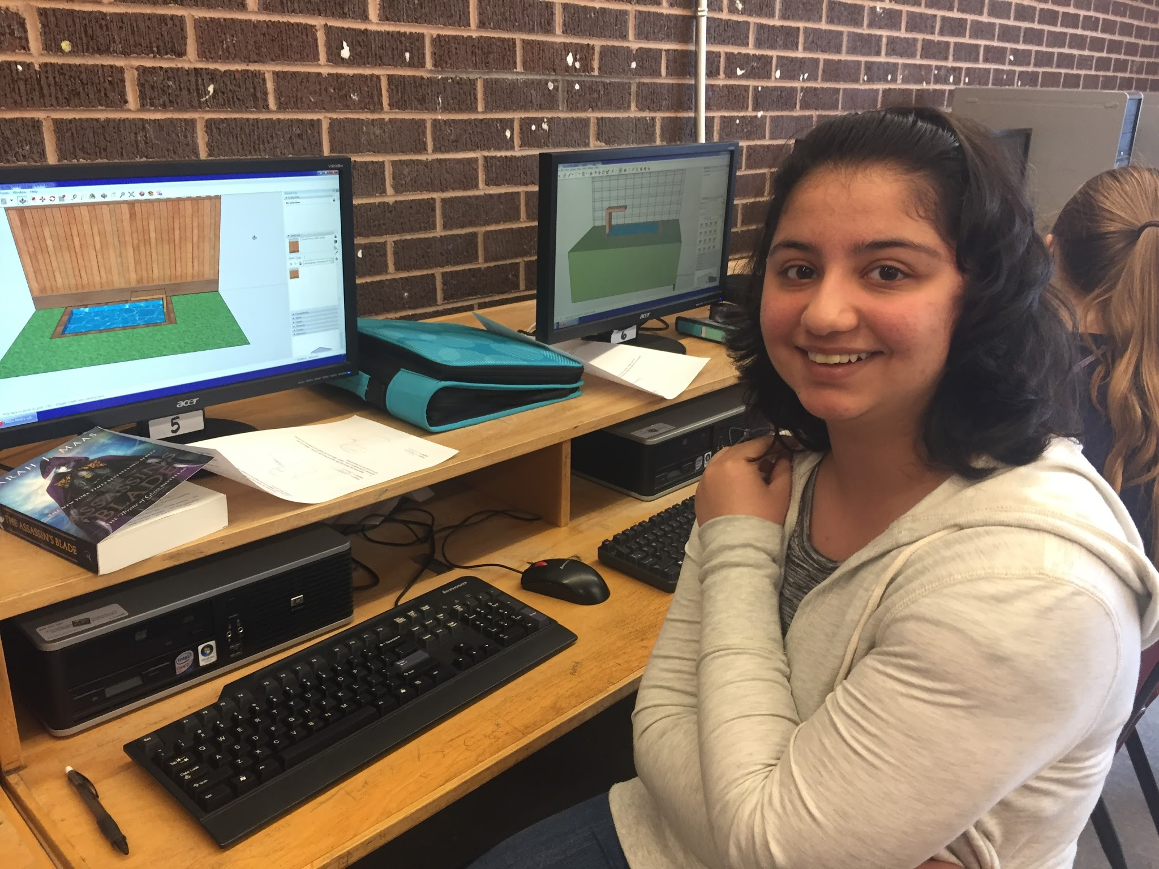
Results - Student Learning
Many students continued to explore applications beyond the scope of this project.
These students initiated self directed projects, applying the skills they had acquired to produce their own final products.
A lunchtime 3D printing club was organized to provide students the opportunity to engage in these self-directed projects.
Students engaged in self-directed printing projects

Slide 36
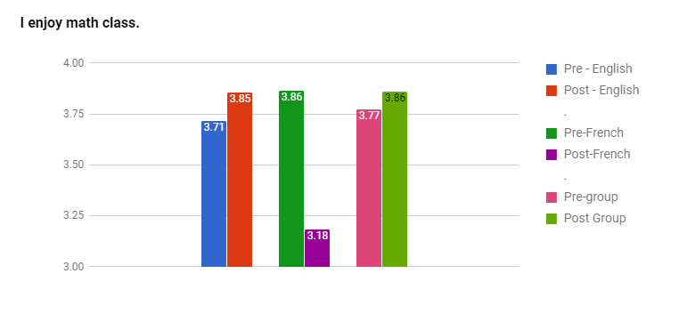
Analysis of Results - Pre/Post Survey
In general overall engagement increased slightly in the English stream classes.
Anomaly: When the post survey was completed in the French class many of the high achieving students were away on a school trip. We believe this skewed the results of the post survey for this particular class.

Slide 37
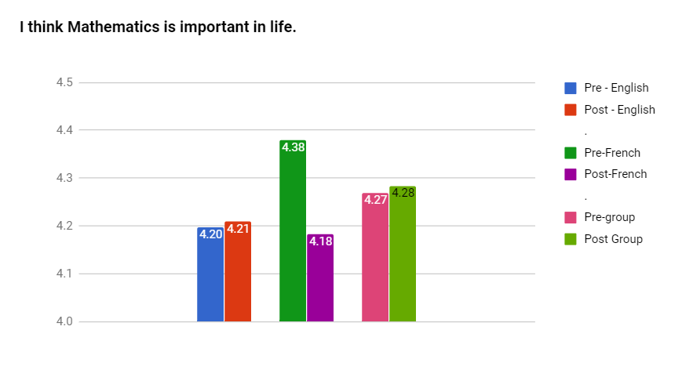
Analysis of Results - Sources of Error
Due to storm days, school holidays and other school based events the length of time between the initial and final stages of the project was delayed excessively.
We believe that this may account for the low levels of increase in student enthusiasm reflected in the survey.

Slide 38
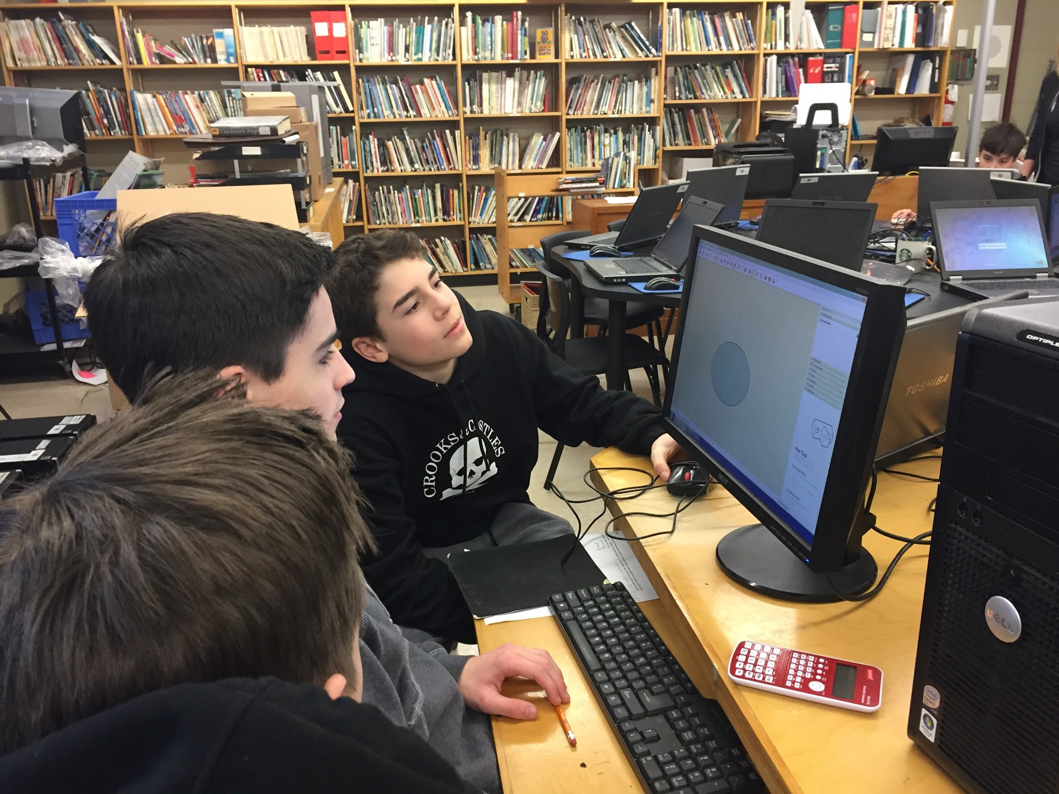
Conclusion
In general we feel that the results of our survey do not accurately reflect the levels of student interest and engagement that we observed throughout the process of the project
Overall we feel that the anecdotal and observational data we have acquired is a better indication of student engagement in this project.

Slide 39
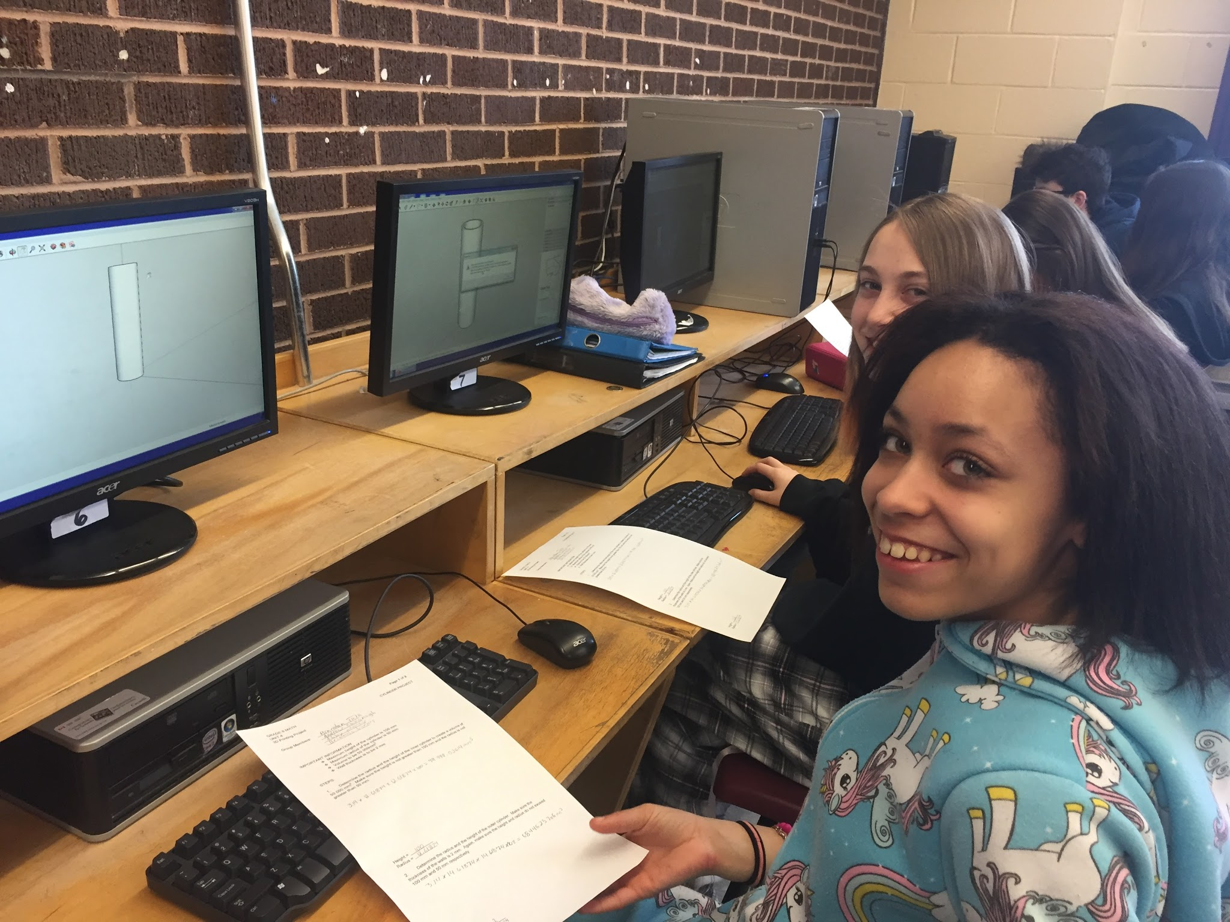
Long Term Impact on Classroom Practice
We believe that this project was successful in achieving our goal of increasing student engagement in the Math classroom.
As a result, we will continue to incorporate 3D printing into aspects of our Math teaching practice for years to come.

Slide 40
Teacher Inquiry
There are so many new technologies out there for teachers to use in their classrooms however finding the time to learn how to use them can be challenging.
Through our participation in this project we have enriched our understanding of 3-D design and printing and how it can be used to help students achieve curriculum outcomes

Slide 41
Teacher Inquiry - Strengths
Provided data/observations to inform future practice.
Opportunity to experience a student directed learning model as opposed to the traditional teacher centered model

Slide 42
Teacher Inquiry - Challenges
Requires considerable time and increased teacher preparation in order for the inquiry model to be successful. This can be problematic in future when PD days are not provided for teacher planning as demands on teachers are continually increasing.
Packed Jr.High Math curriculum also limits time that can be spent in student exploration and inquiry during class.

Slide 43
Teacher Inquiry - Conclusion
Overall a positive experience which we feel benefited students and teachers alike.
We feel the project did achieve our goal of increasing student engagement to a degree.
In future we will continue to explore ways in which we can incorporate 3D design and printing into our Math/Science classrooms.
We will look at ways in which we can increase opportunities for student directed learning within the framework of time & curricular restrictions
We will continue to provide opportunities outside of class time (ie. 3D Design & Printing Club) for students to explore their own 3D design ideas and projects.

Slide 44
Credits
Anne Hatcher
Christina Cox
Damian Lethbridge
Dave Dyer
David Abbott
Susan Foote
Tyler Norman
Teachers and Staff at St. Paul’s Junior High
Teachers in Action Team
Karen Goodnough
Dana Griffiths
Keith Power
Assistant Professor at MUN
David Gill

