Slide 1
Using Daily 3 To Motivate Math Learning
A Teacher In Action Project by:
Pamela Williams, Darlene Pitts, Trudy Power and Paul Monk

Slide 2
Our School

Slide 3
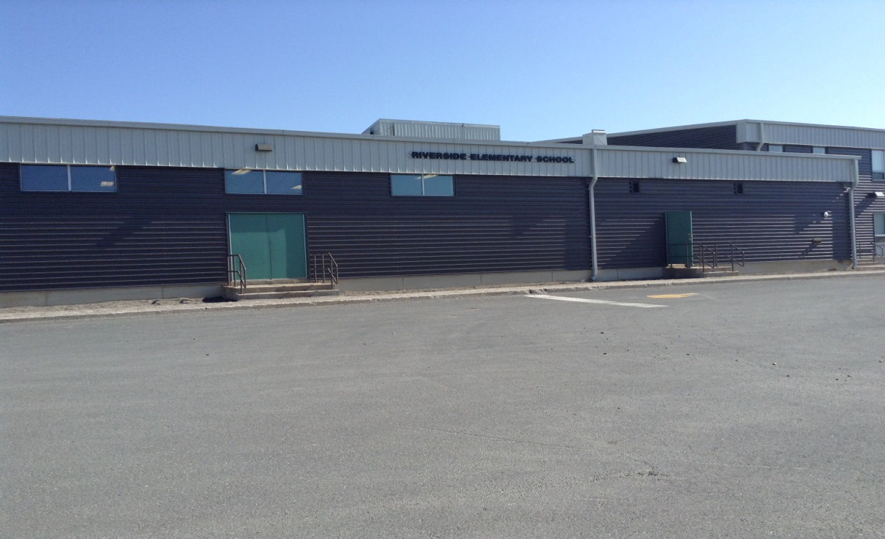
Our School:
Riverside Elementary is a K-6 school comprised of over 700 students from Clarenville and surrounding communities

Slide 4
Focus Area

Slide 5
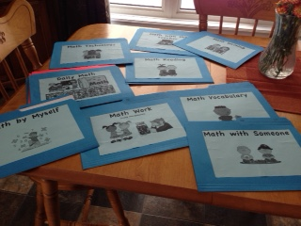
Focus Area:
Using Daily 3 to motivate Math Learning

Slide 6
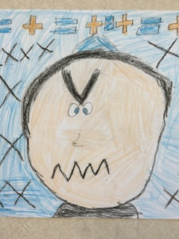
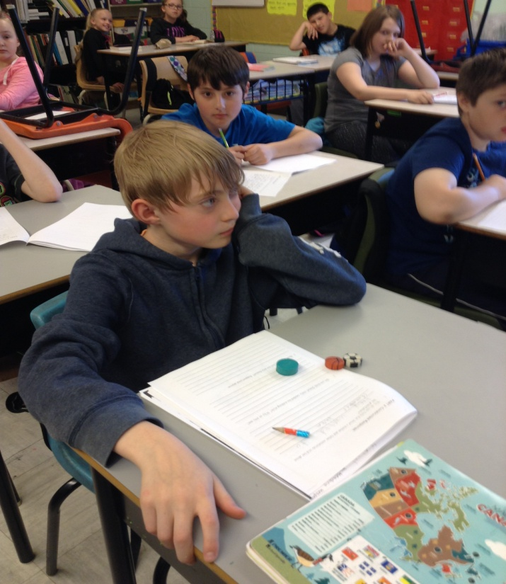
Focus Area:
As a team we expressed a common concern with our math class; our students were not motivated!!

Slide 7
Research Questions

Slide 8
Research Questions:
Teacher Question- How will Math Daily 3 affect the way I teach math?

Slide 9
Research Questions:
Student Questions- What is my role in supporting Math Daily 3? Will Math Daily 3 affect how I teach in general? What will Math Daily 3 look like in my classroom?

Slide 10
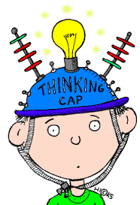
Research Questions:
How will using Math Daily 3 motivate student learning and therefore enhance student learning?

Slide 11
Planning

Slide 12
Planning:
A one day institute was held in the Fall at MUN for TIA participants
Literature that guided our practice:
The Reflective Educator’s Guide to Classroom Research (Third Edition) Nancy Fictman Dana, Diane Yendol-Hoppey
The Daily 5, Fostering Literacy Independence In The Elementary Grades (Second Edition) Gail Boushey & Joan Moser
Teaching Student-Centered Mathematics John A. Van de Walle, LouAnn H. Lovin

Slide 13
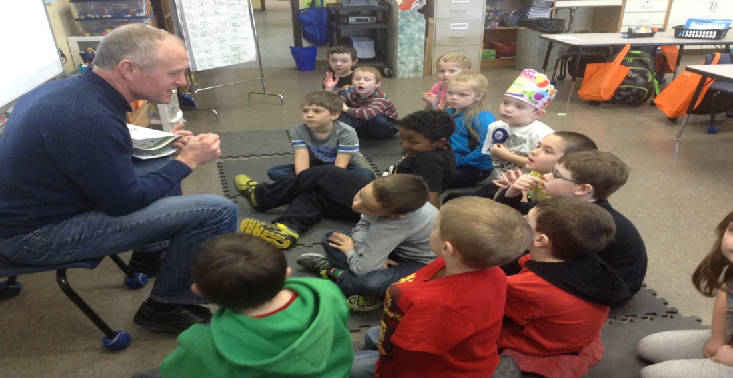
Planning:
Regular meetings were held throughout the duration of our project with Mr. Tom Walsh
The Teachers in Action participants met several times to collaborate on ideas, plan lessons and activities, and gather materials

Slide 14
Implementation

Slide 15
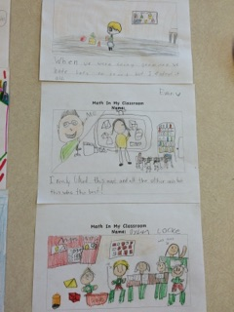
Implementation:
Surveys were created and administered to substantiate our initial impressions of students’ attitudes
Information gathered enabled us to apply the Daily 3 philosophy to our Math classes

Slide 16
Implementation:
Our Math outcomes were analyzed to plan our Daily 3 math activities
Not only were our kids involved and engaged in a variety of activities but students were also assessed in a variety of ways
Validity and Reliability were kept in mind and so we used a variety of methods: surveys, interviews, work samples, videos, and photographs

Slide 17
Daily 3 Activities

Slide 18
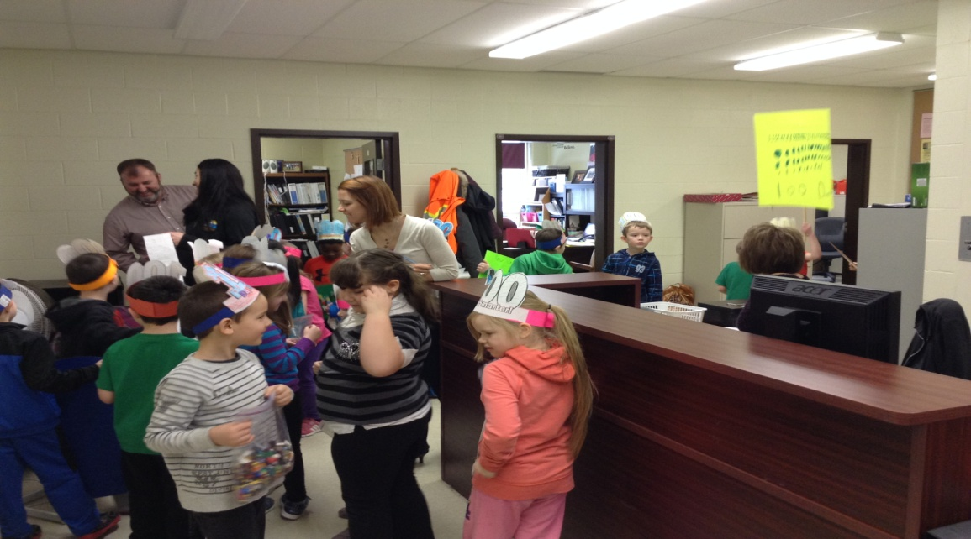
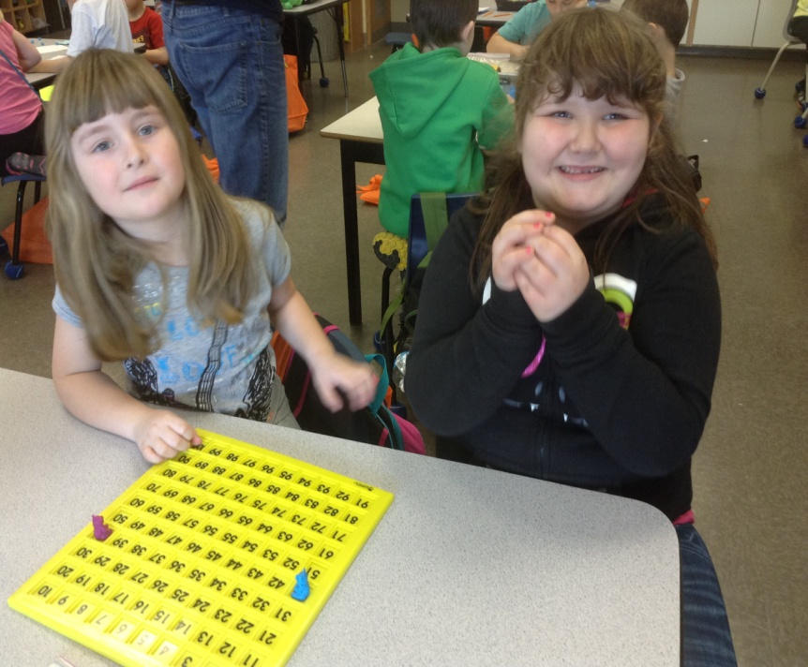
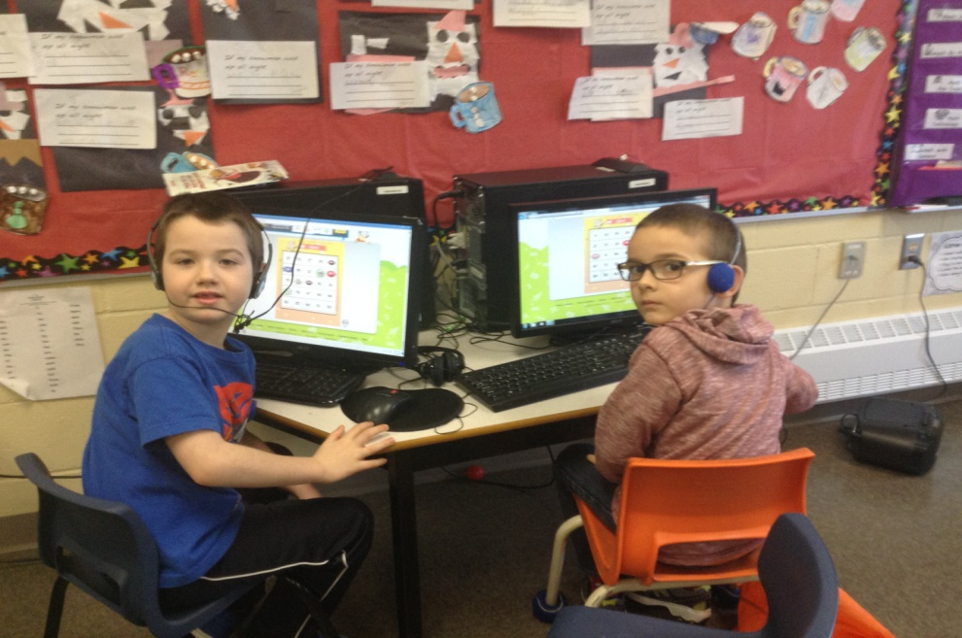
Grade 1
Count to 100

Slide 19
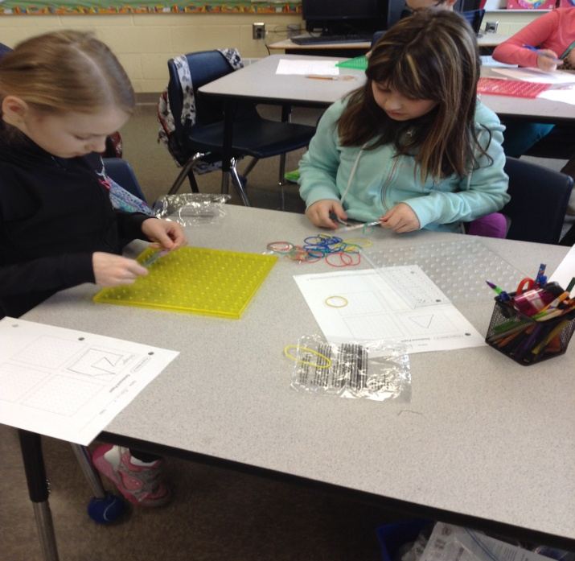
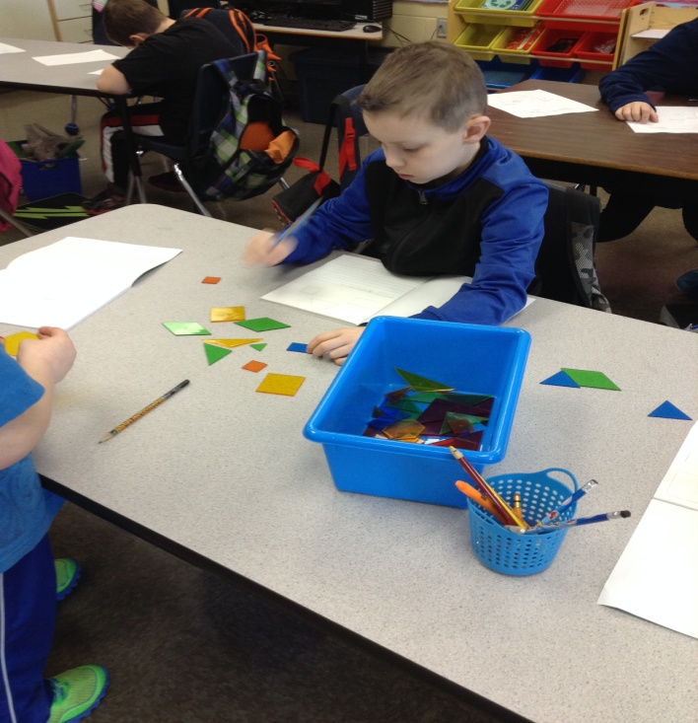
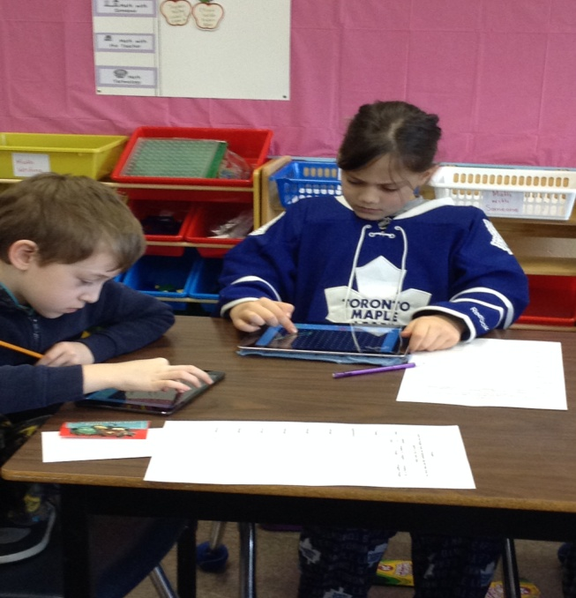
Grade 3
Geometry

Slide 20
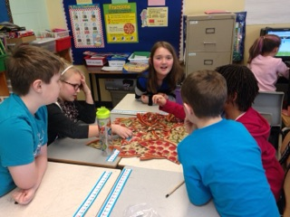
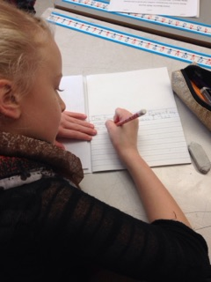
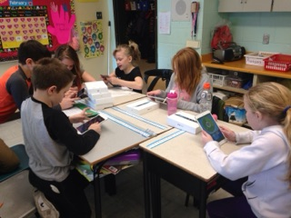
Grades 4 and 5
Fractions

Slide 21
Teacher Findings

Slide 22
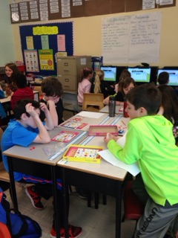
Teacher Findings:
Student enthusiasm increased due to hands on activities
Comments were made on a daily basis such as “ When are we having Math?”
“ Can we do Math instead?”
“ Can we have Math on the IPAD?”
“ Can we play that game again?”

Slide 23
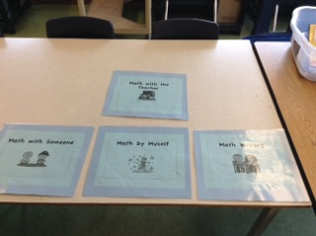
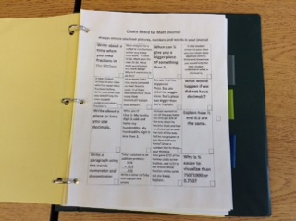
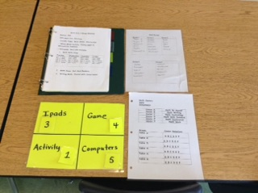
Implementation of Project
Organization of Stations

Slide 24
Implementation of Project

Slide 25
Student Groupings:
Different groupings were used depending on the teacher/task

Slide 26
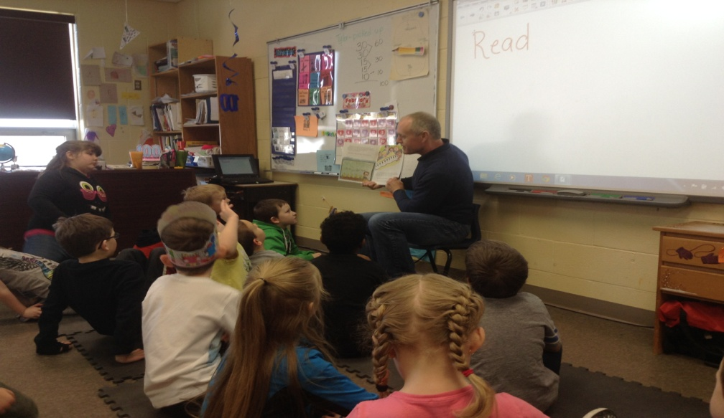
Our Structure:
Mini Lesson
Teacher instruction, read aloud, video, demonstration, computer game

Slide 27
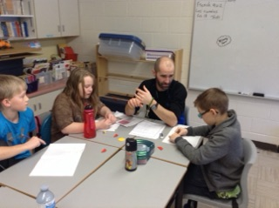
Our Structure:
Math with Teacher: small group being instructed on their level(s) while others were engaged in Daily 3

Slide 28
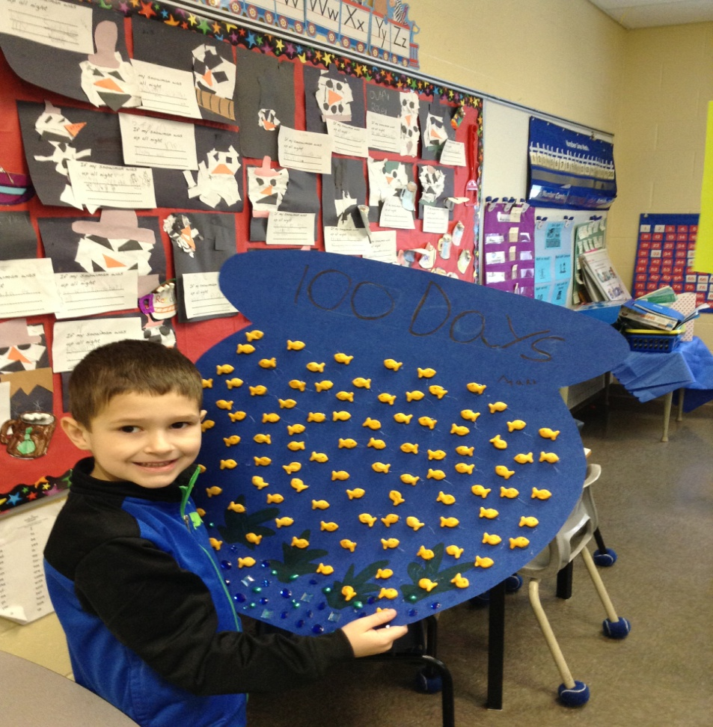
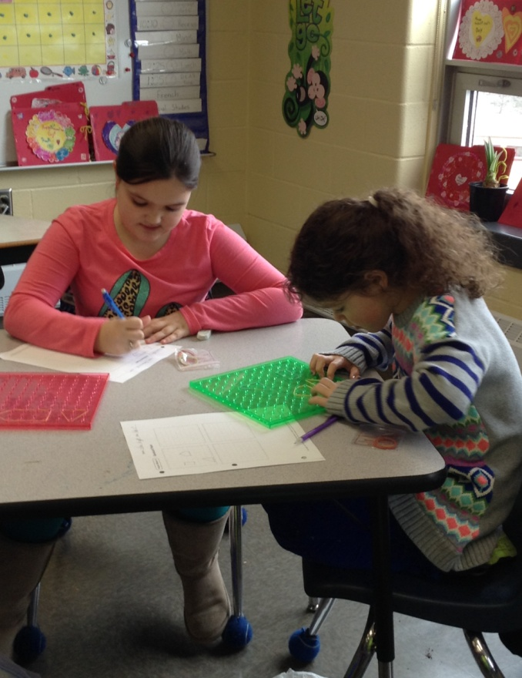
Our Structure:
Pictures of different activities

Slide 29
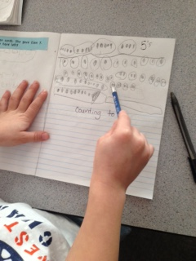
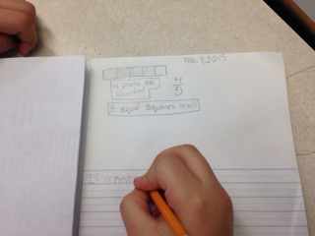
Our Structure:
Check in/ Exit Card at end of Math class

Slide 30
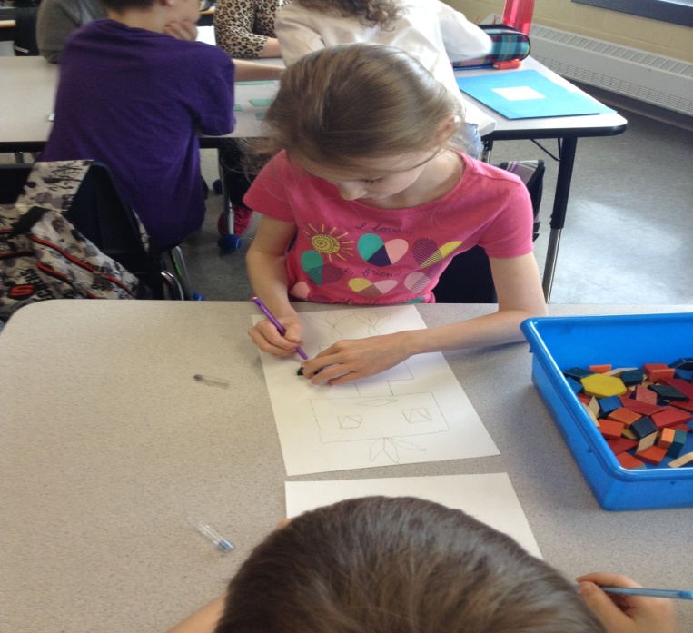
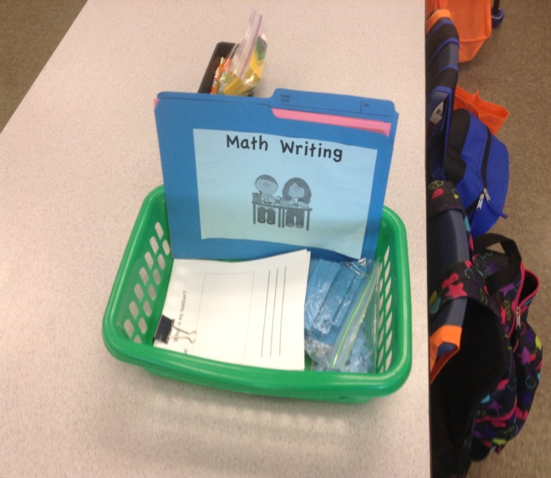
Daily 3:
Math Writing: Math journals whereby a choice board was given with a variety of writing topics at different levels

Slide 31
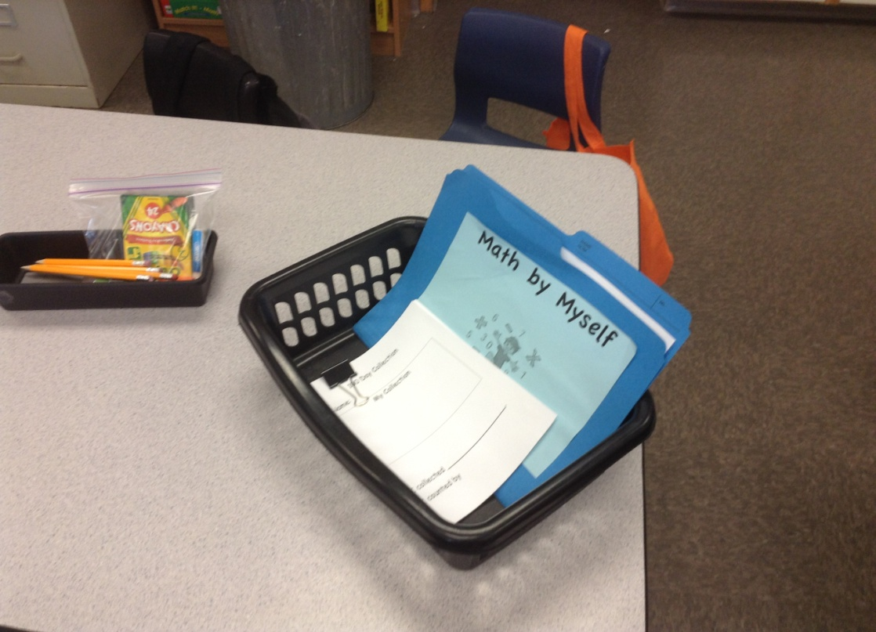
Daily 3:
Math by Myself- independent practice

Slide 32
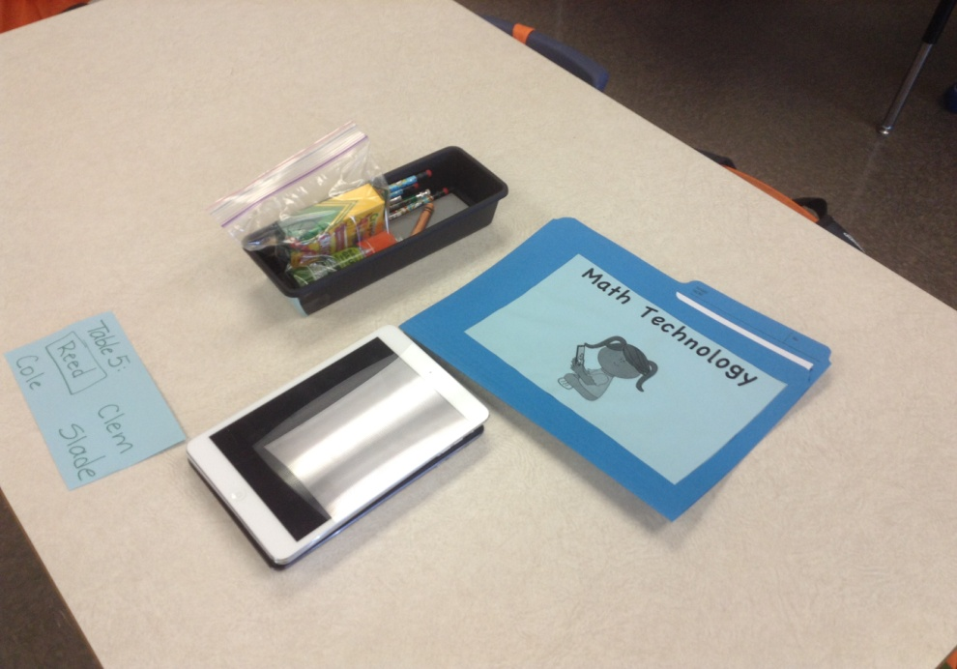
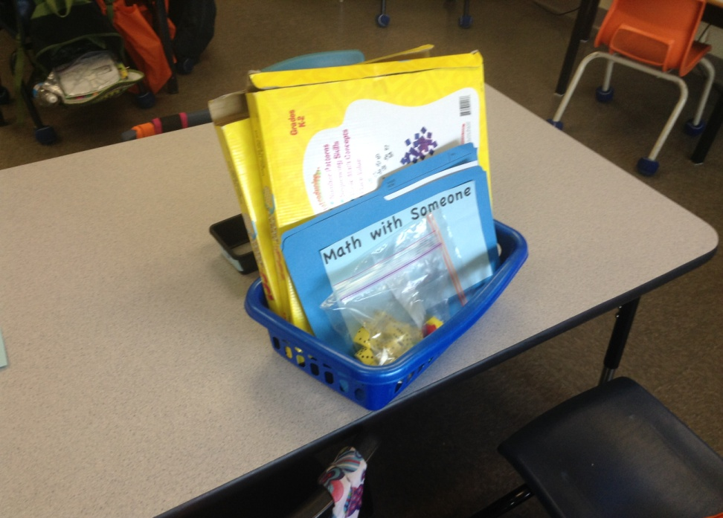
Daily 3:
Math with Someone- games, matching, computers, IPads, problem-solving tasks

Slide 33
Our Findings

Slide 34
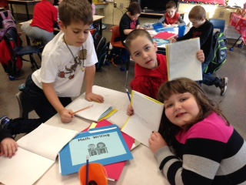
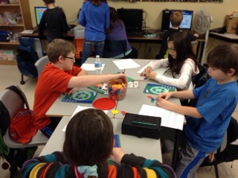
Our Findings:
Students were more engaged

Slide 35
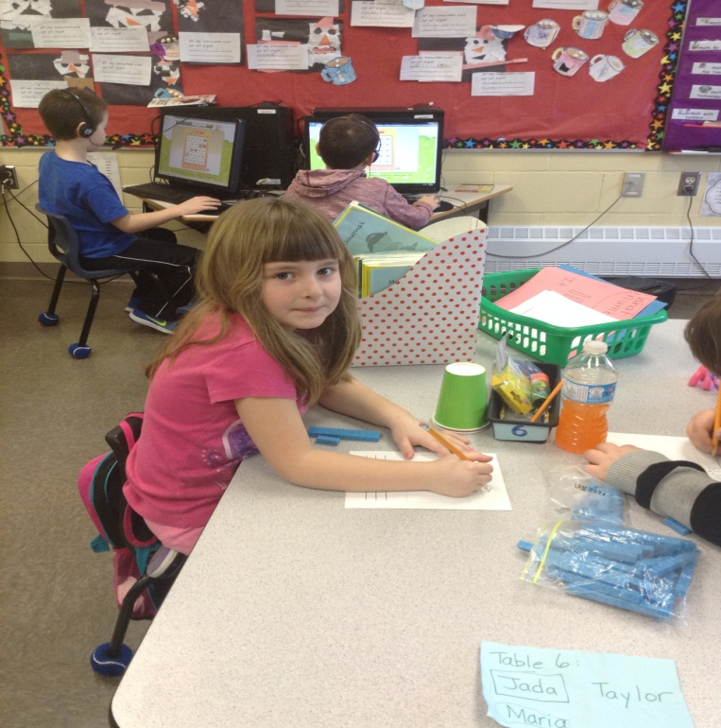
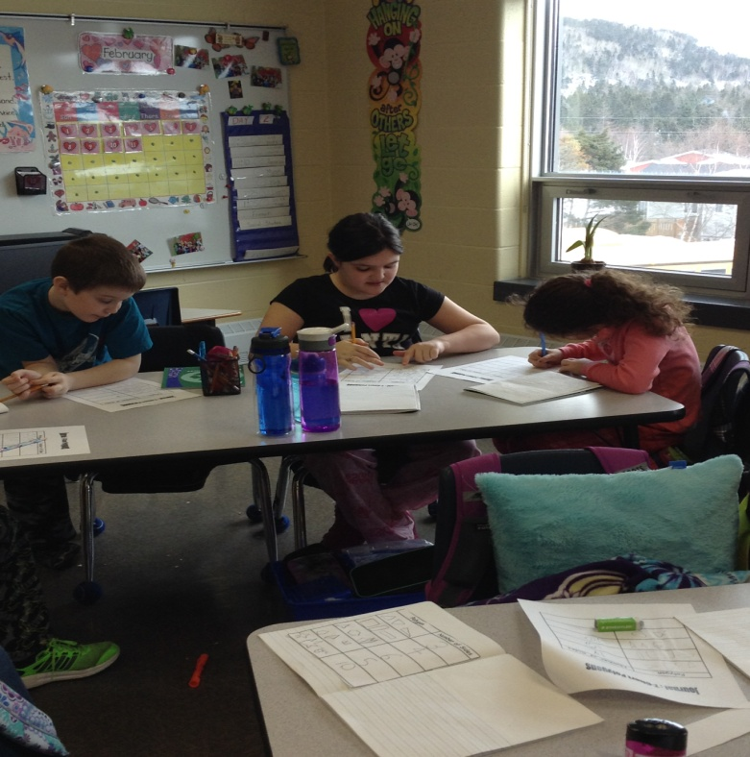
Our Findings:
A lot of positive and focused energy
“What game does our group play?”
“Miss, do we get to work with you today?”

Slide 36
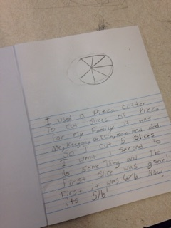
Our Findings:
Journal entries

Slide 37
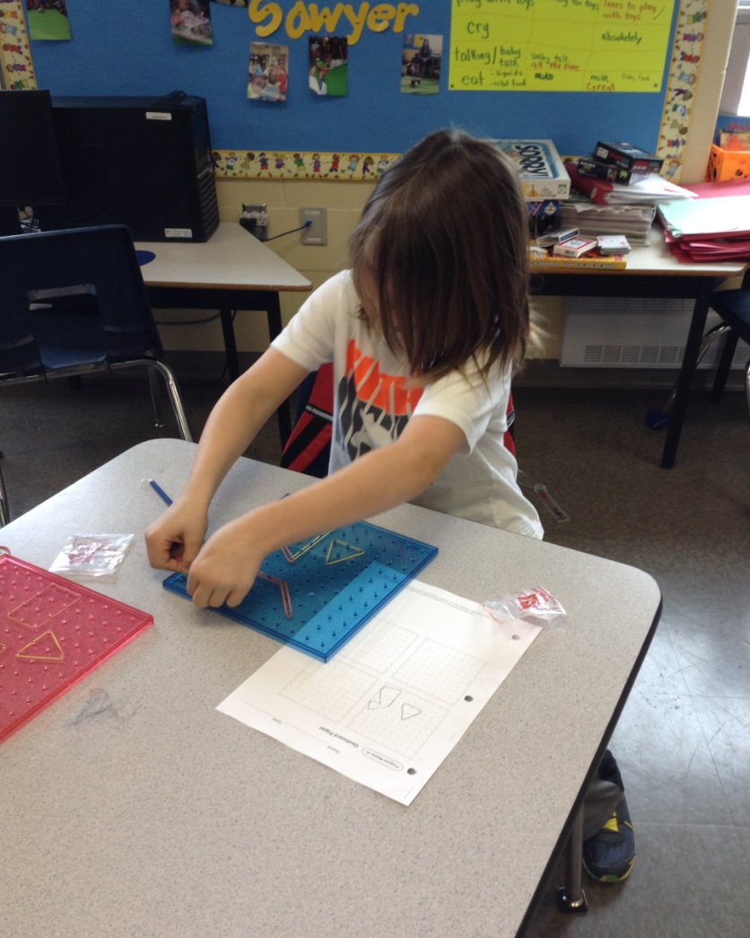
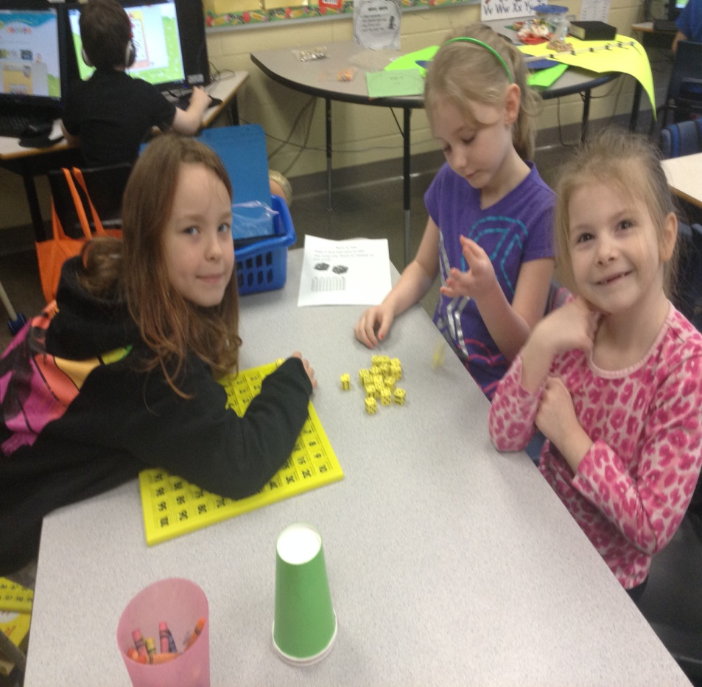
Our Findings:
Math in Our Class

Slide 38
Our Findings:
Small group instruction allowed for students to get more one on one instruction from teacher

Slide 39
Personal Reflections

Slide 40
Personal Reflections:
After our first day, we felt excited about the project
I liked how we could work with our students more one on one

Slide 41
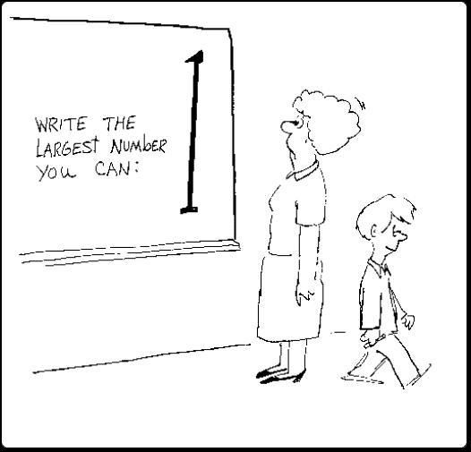
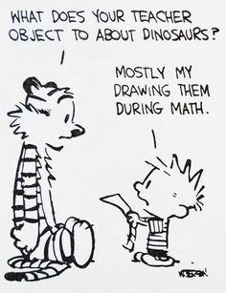
Personal Reflections:
I got to know my students more
My students didn’t mind doing the writing part of Math; before they acted like it was a chore

