Slide 1
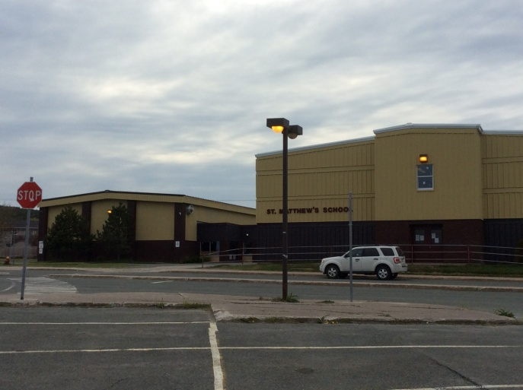
Seed to Plate to Compost: Inquiry in an Outdoor Garden
Grades 1 & 3 STEM Project
St. Matthew’s School
St. John’s, NL
2014-15

Slide 2
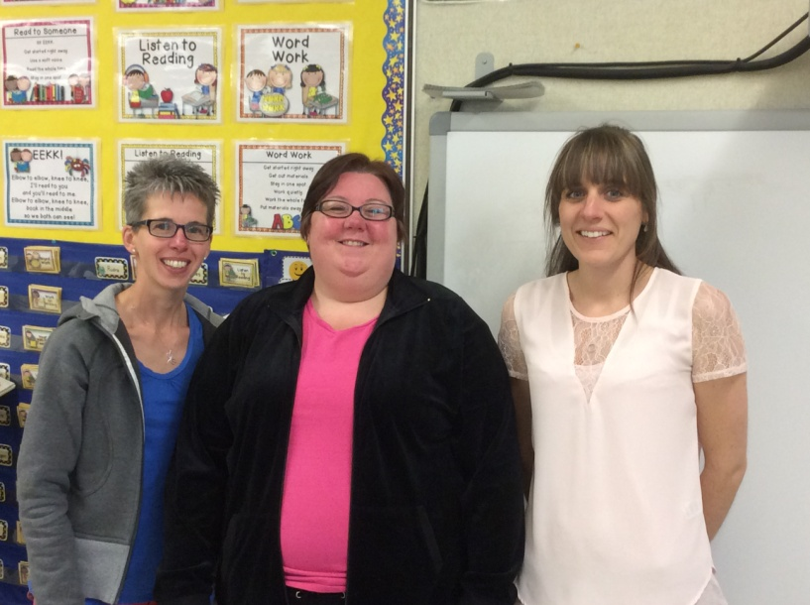
Ms. Nancy Ryan
I am currently teaching grade 3 at St. Matthew’s School. I have 17 students. This is my third year participating with The Little Green Thumbs program through Agriculture in The Classroom. We successfully grew cucumbers, basil, tomatoes, carrots, peas and beans all year long. Our classroom garden was the impetus for this STEM project. This is my first year participating in a teacher inquiry project.

Slide 3
Mrs. Danielle Bishop
I have been teaching for 20 years and have had a wide range of teaching assignments from grades Kindergarten to Grade 5 as well as two Assistant Principal positions. I am currently teaching Grade 3 English at St. Matthew’s School with a class of 17 students – 7 girls and 10 boys of varying interests and abilities.
After returning from a years maternity leave I was both excited and anxious to be part of this STEM Project. I felt this would be a great opportunity to add another dimension to my teaching and improve student learning and achievement.

Slide 4
Mme. Carol Burroughs
I taught primary French Immersion for 2 years in PEI before moving home to Newfoundland last year. I taught French Immersion and Music in Gander last year, and grade 6 French Immersion this fall. In January, I joined the staff at St. Matthew’s Elementary. When the STEM team asked if I was interested in participating in this program I eagerly agreed, not fully understanding what I was signing up for!
I am currently teaching 23 Grade 3 French Immersion students. Prior to teaching, I worked as an interpreter for Parks Canada for 10 years, providing educational programming for school groups, the visiting public and teacher in-services. This experience has enriched my teaching and has instilled in me many good teaching practices which will become a part of my routine for years to come.

Slide 5
Mme. Marlene Audeau - Joyce
Including substitute time, I have been teaching for over 20 years. My substitute experience includes teaching assignments from Grades Kindergarten to Grade 9. Over the past 15 years, I have taught Grade 1 in both the French and English stream and Grade 3 French Immersion. I am currently teaching Grade 1 French Immersion at St. Matthew’s School with a class of 18 - 10 boys and 8 girls.
When Nancy approached me about becoming involved with the STEM project, I said I would love to. At the time, I had no idea what I was getting into. I have thoroughly enjoyed being a part of the whole process. It has certainly added a new dimension to my teaching experiences.

Slide 6
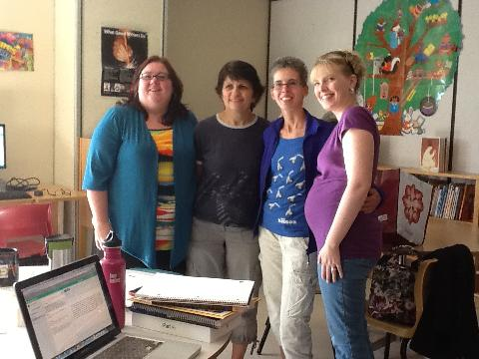
Mme. Lillian Regular
I have been teaching Grade 3 French Immersion at St. Matthew’s for the past 8 years. I was involved with creating the proposal for this project. I began implementation with our team this fall. I am currently on maternity leave since January 2015.

Slide 7
Project Background
May 2014, Nancy Ryan and Lillian Regular completed a STEM proposal in which teachers and students would use inquiry based learning to investigate plant development from seed to plant to compost in an outdoor environment.
They were involved with Little Green Thumbs, an indoor classroom gardening program through Agriculture in the Classroom, for two years. They wanted to carry this experience to an outdoor setting.
Tom Walsh who was involved in a STEM project at our school, visited a classroom garden and “planted a seed” (thought) about inquiry based learning and the possibility of creating an outdoor garden.

Slide 8
Project Focus and Rationale
How can we use science to help us successfully grow healthy plants in our Newfoundland Labrador climate?
In this STEM Project, teachers and students will use problem-based learning to investigate how plants develop from seed to plant to compost in an outdoor environment.

Slide 9
Research Questions
Our Teacher Research Question :
What will my role be in supporting student learning through scientific inquiry using the St. Matthew’s Community School Garden?
Other Considerations:
→ How will this affect my teaching throughout the curriculum? → What is scientific inquiry? → What do I need to understand about outdoor gardening before I can start the project?

Slide 10
Research Questions
Our Student Research Question:
How will the St. Matthew’s Outdoor Community Garden affect student understanding and attitude of learning science?

Slide 11
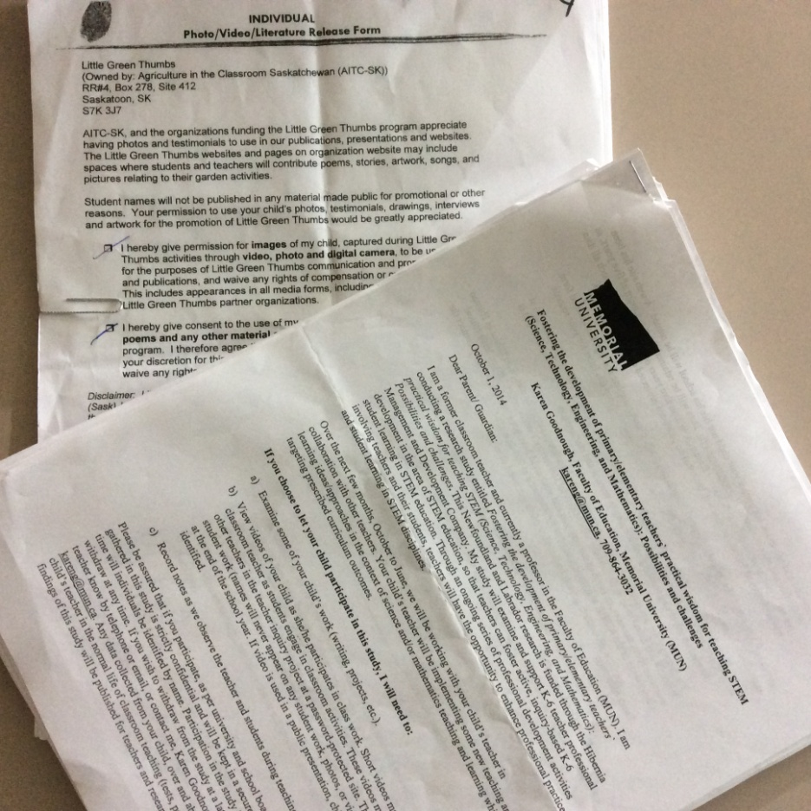
Ethical Considerations
Families were informed of this research project. Two consent forms were sent home to obtain parental consent for this research project – one from Memorial University of Newfoundland and one from St. Matthew’s School.

Slide 12
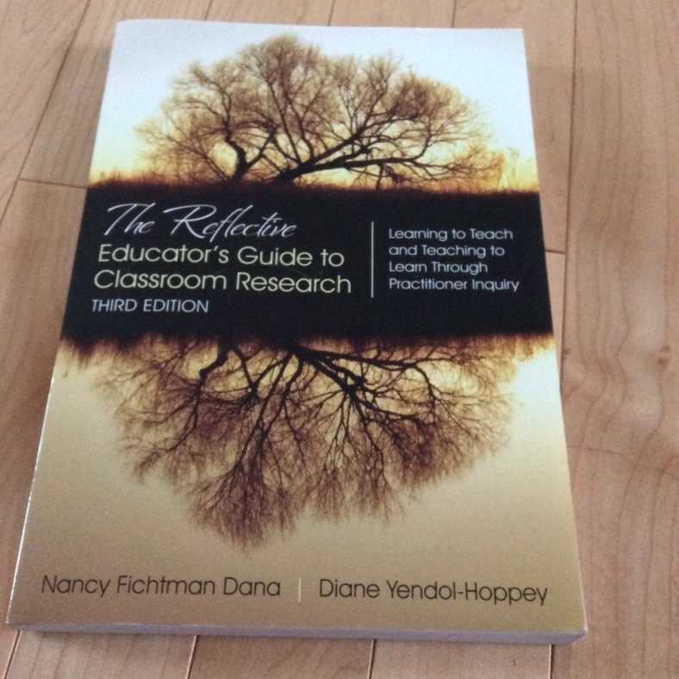
Planning
We read and discussed a wide variety of professional literature.
Release days were held throughout the project with support and guidance from Mr. Tom Walsh.
Teachers met numerous times to share, plan, design, create, and prepare lessons, activities and design challenges. They gathered and created resources, materials and supplies needed. They always reviewed, discussed and reflected upon their individual classroom experiences.

Slide 13
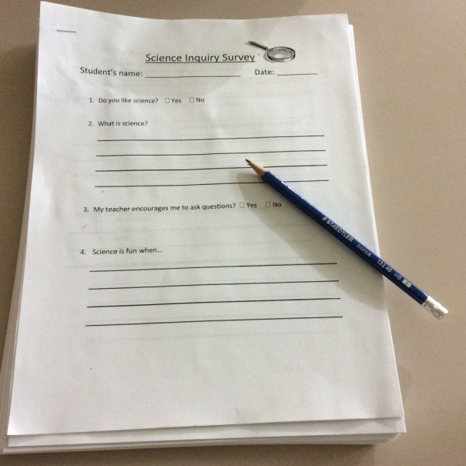
Implementation
Student surveys and interviews were administered (pre and post) to determine student beliefs, feelings, and ideas about science as well as their prior knowledge about gardening and healthy foods.
Teachers reviewed and selected various
curriculum outcomes from grades 1 and 3
to be the focus of our activities and
lessons.

Slide 14
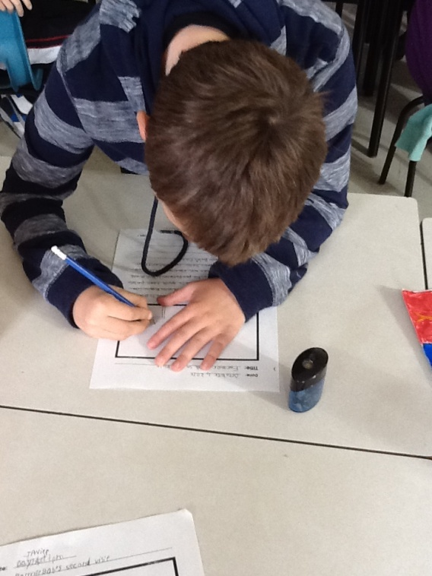
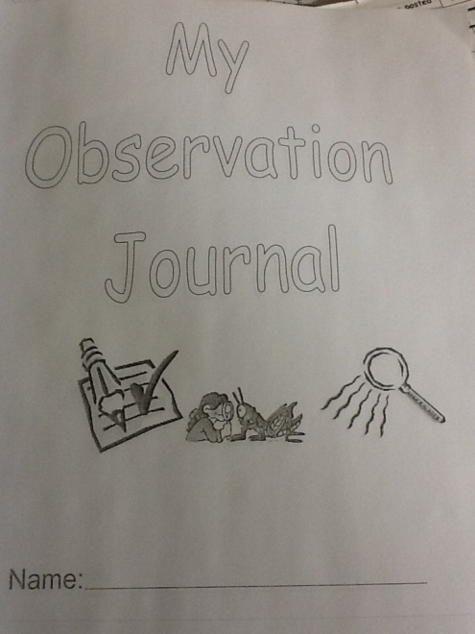
Implementation
Students used “I Wonder” Journals, Observation Journals, Sharing and Discussion Journals to share with their families. Students also kept work samples.
Data was based on surveys, interviews, observations, work samples, videos and photographs.

Slide 15
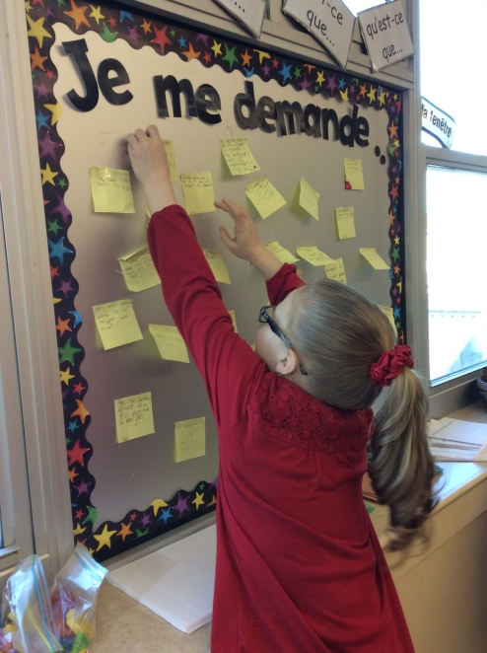
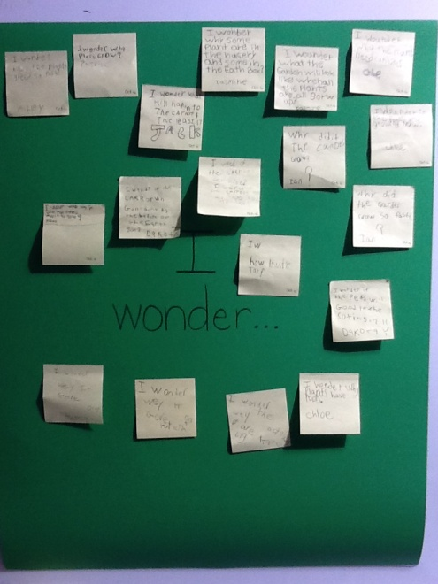
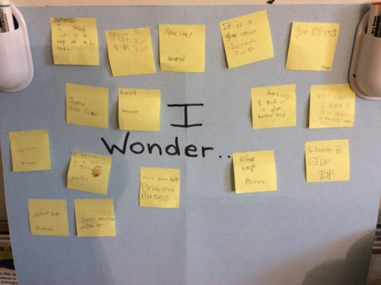
Growing on Many Levels… I Wonder????
Through our release days and collaboration with Tom Walsh our use of inquiry based learning took on a whole new aspect in our classrooms and teaching as “I Wonder” became part of our weekly existence. Our students explored freely, asked questions, predicted, pondered, observed, and sought answers about things we shared with them during “I Wonder Wednesdays”.

Slide 16
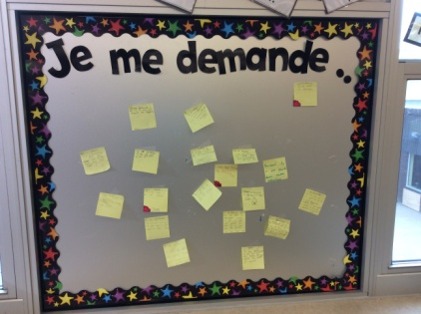
I Wonder????
Gingerbread Man in Water
Apple Slices, Lemon Juice, Salt and Plastic Wrap
Frozen Hockey Pucks
Mystery Objects in Mittens, Gloves, Socks and Boxes
Peat Pellets
Worm Castings
Icelandic Rocks
Balloons ( Static Electricity)
Painted Lady Caterpillars
Baby Chicks
And many more…

Slide 17
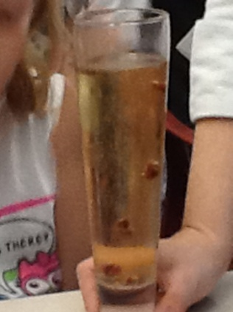
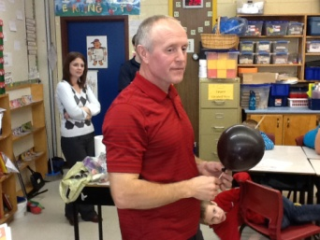
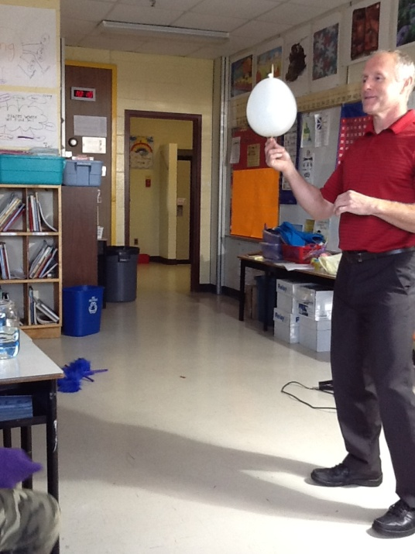
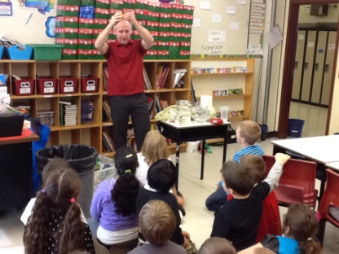
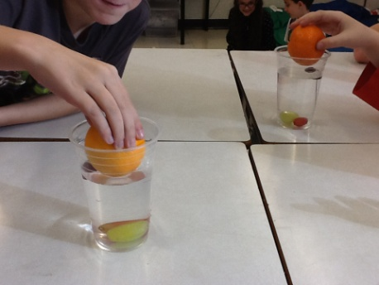
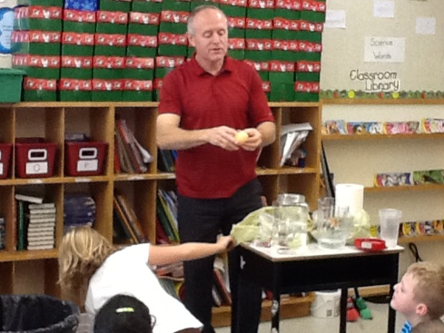
I Wonder???? Mr. Walsh

Slide 18
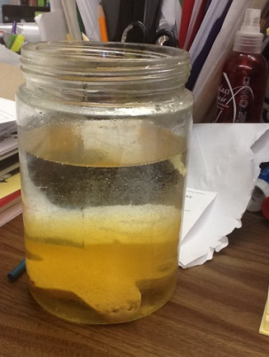
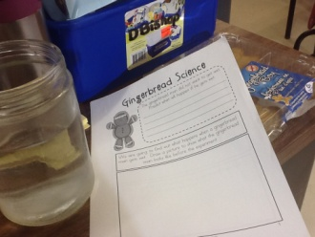
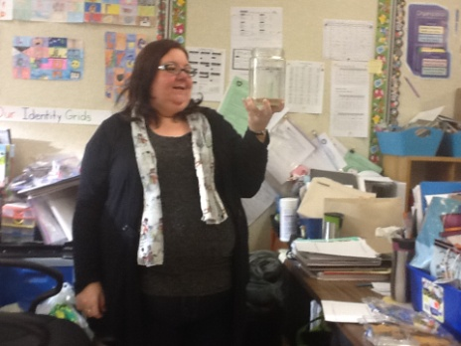
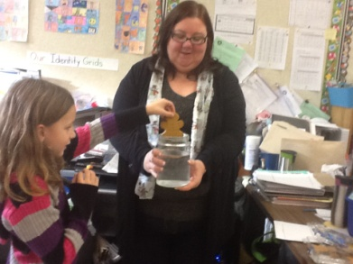
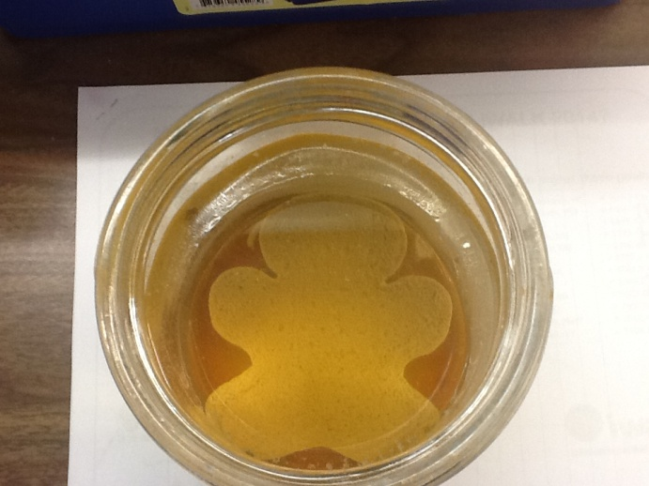
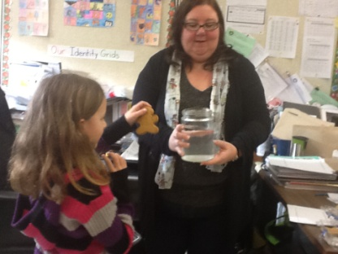
I Wonder???? Gingerbread Man in Water

Slide 19
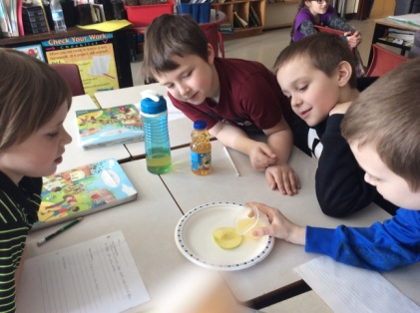
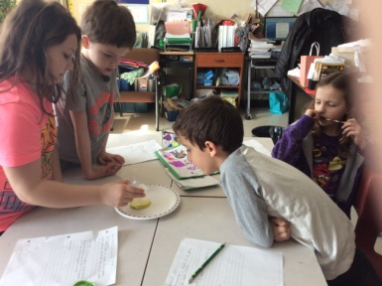
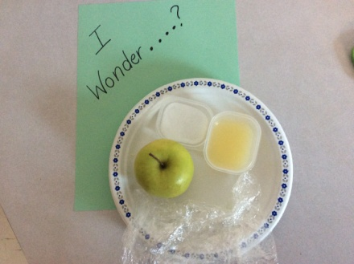
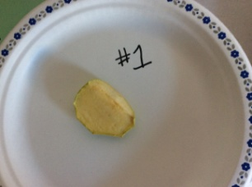
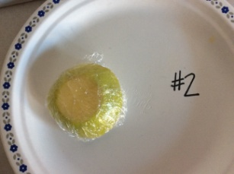
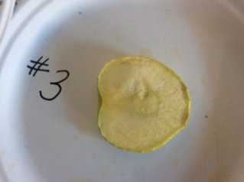
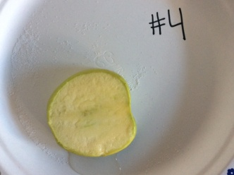
I Wonder???? Apple Slices, Lemon Juice, Salt and Plastic Wrap

Slide 20
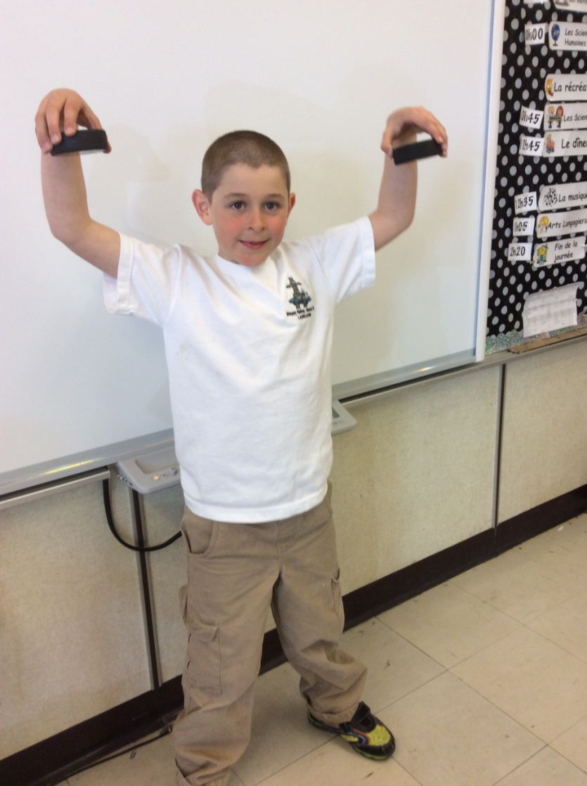
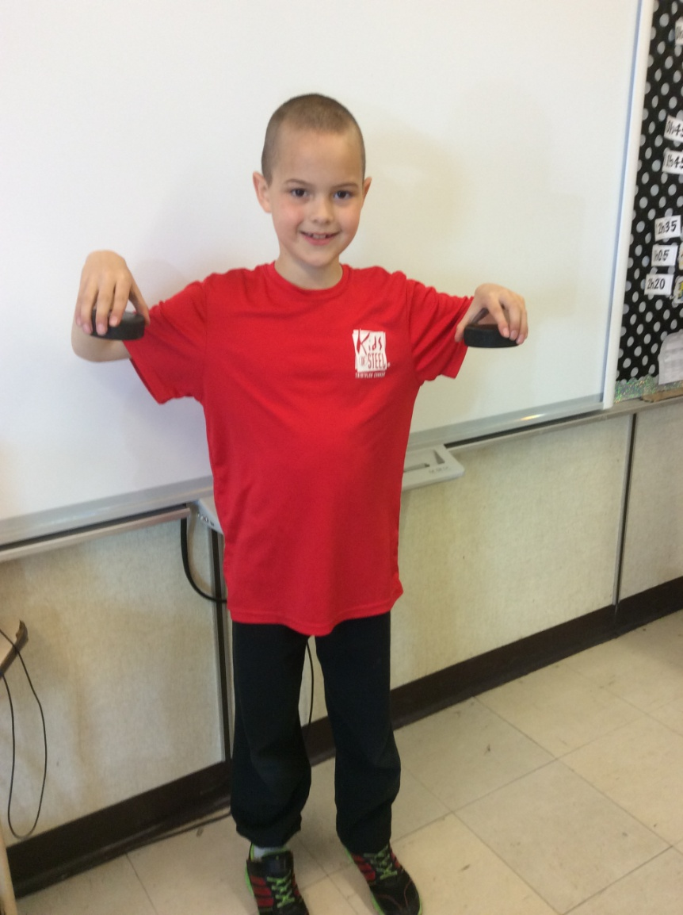
I Wonder???? Frozen Hockey Pucks

Slide 21
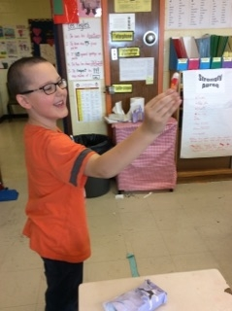
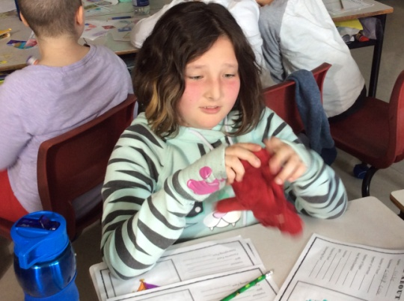
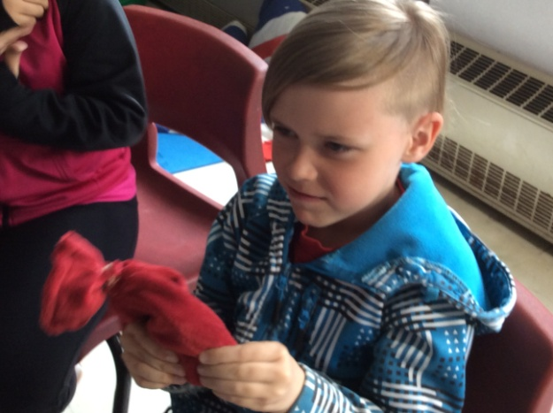
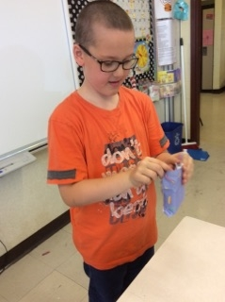
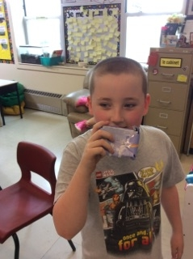
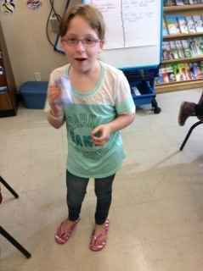
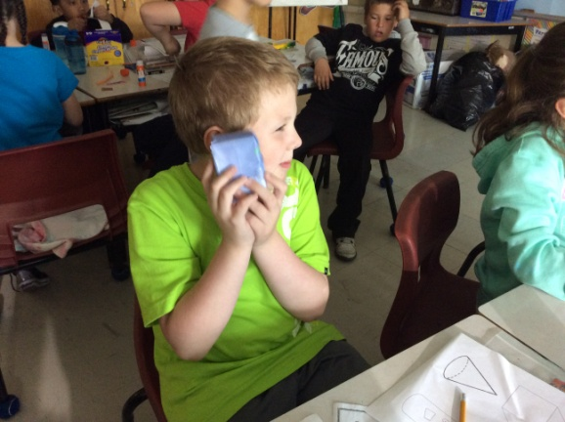
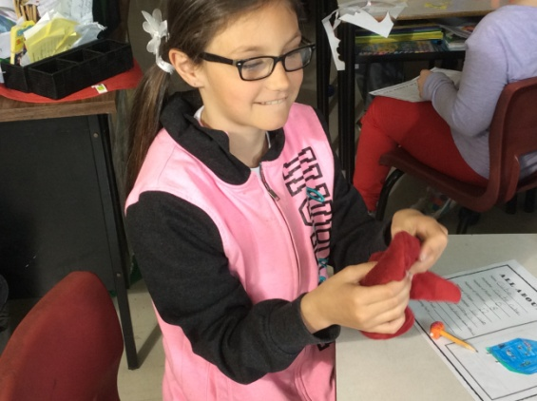
I Wonder???? Mystery Objects in Mittens, Gloves, Socks and Boxes

Slide 22
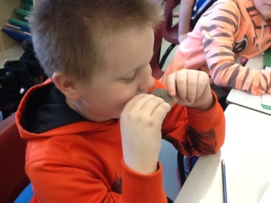
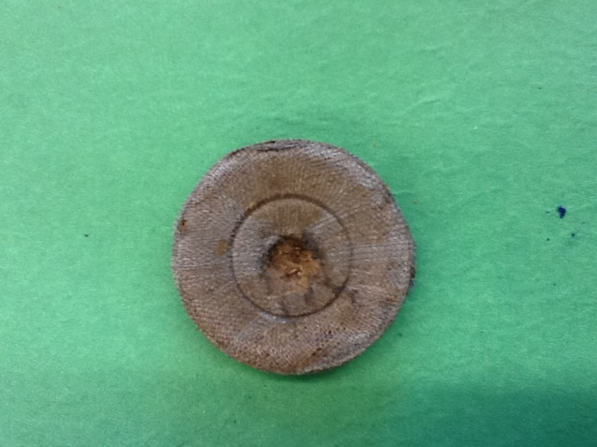
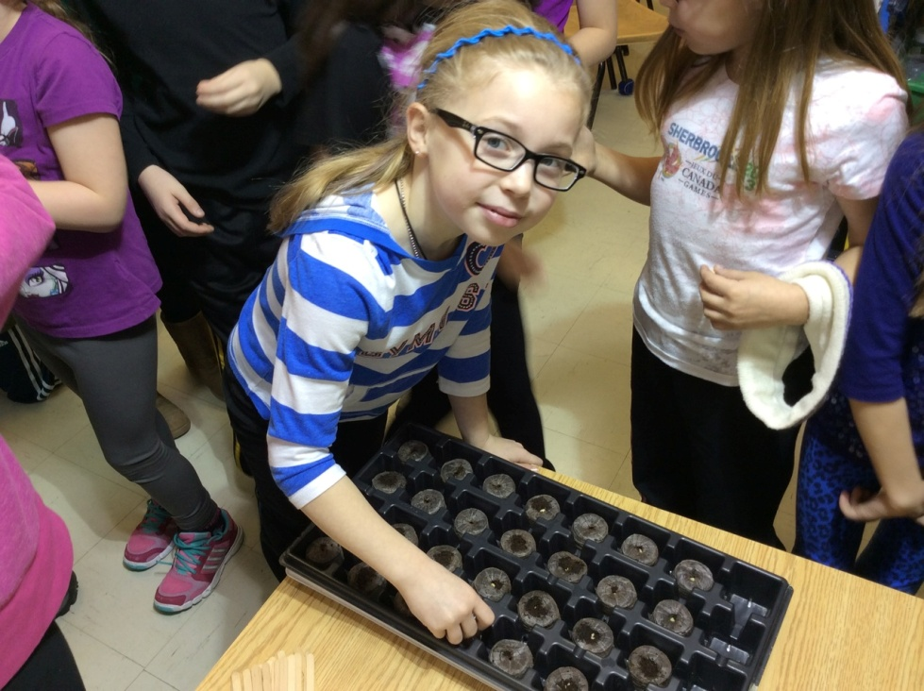
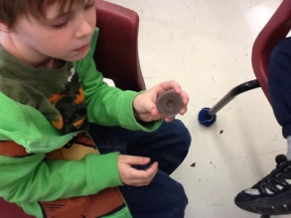
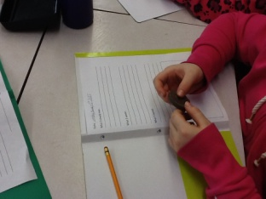
I Wonder???? Peat Pellets

Slide 23
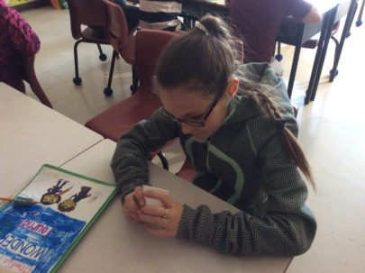
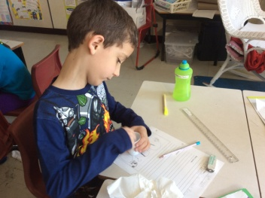
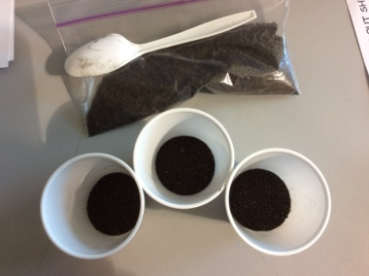
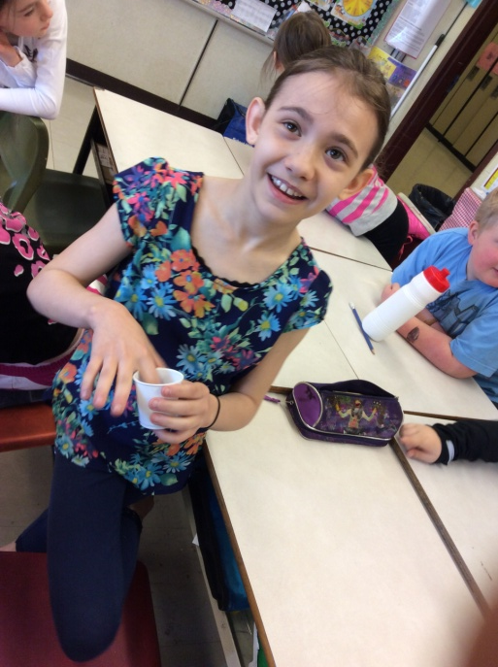
I Wonder???? Worm Castings

Slide 24
I Wonder???? Icelandic Rocks

Slide 25
I Wonder???? Balloons (Static Electricity)

Slide 26
I Wonder???? Painted Lady Caterpillars

Slide 27
I Wonder???? Baby Chicks

Slide 28
Growing on Many Levels… Design Challenges
Through our release days and collaboration with Tom Walsh our use of inquiry based learning took on yet another look in our classrooms as we presented several “design challenges” to our students.

Slide 29
Design Challenges
Little Green Thumbs
Seed Discovery
Project Groundhog
Recycled Art
Compost Terrarium
Vermicomposting

Slide 30
Design Challenges Little Green Thumbs

Slide 31
Design Challenges Seed Discovery

Slide 32
Design Challenges Project Groundhog

Slide 33
Design Challenges Recycled Art

Slide 34
Design Challenges Compost Terrarium

Slide 35
Design Challenges Vermicomposting

Slide 36
Data Collection and Analysis
Students were given various personal journals: I Wonder, Observation and Sharing and Discussion.
Data was based on surveys (pre and post), interviews, observations, work samples, videos and photographs.
Teachers collaborated and shared information through an online blog:
http://kidblog.org/StMatthewsOutdoorCommunityGarden/wp-admin/

Slide 37
Results
33 students were surveyed in October 2014 and May 2015.
Surveys said……..
Pre-Survey
When asked the question “Do you like science?”, 91% of the students said “yes”.
When asked “My teacher encourages me to ask questions.”, 85% of the students said “yes”.
When asked to finish the statement “In science, I like to work alone, in a group or both.”, 10% of the students said “alone”, 27% said “in a group” and 64% said “both”.
When asked “Does anyone in your family have a garden?” 64% said “yes”.

Slide 38
Results
Post Survey
When asked the question “Do you like science?”, 97% of the students said “yes”.
When asked “My teacher encourages me to ask questions.”, 94% of the students said “yes”.
When asked to finish the statement “In science, I like to work alone, in a group or both.”, 12% of the students said “alone”, 21% said “in a group” and 67% said “both”.
When asked “Does anyone in your family have a garden?” 67% said “yes”.
Findings
Students enjoyment of science increased.
More children feel they are being encouraged to ask questions in science class.
There was a slight increase in students who realize they like to work in a group as well as times to work alone.
No significant change in student responses about family gardens.

Slide 39
Results
When asked “What is science?”
Pre-Survey
“something where you explore things, study things, you find out more about things and learn new things”
Post Survey
“Trying new things out. They may not work out the way you might think they will. ”
“fun, it is when we discover things, we ask questions, see new things, make observations”
Findings
Students use of science related words increased.
Students realized that there may not always be an answer.

Slide 40
Results
When asked “ Science is fun when….?”
Pre-Survey
“we do things with Farmer Bob, planting and building things”
“We looked at the dirt and see how it really felt.”
Post Survey
“we get to do experiments, things with the magnets, when we grow our plants and taste them, when we do the I Wonder activities, making our own pots for our seeds”
“We do activities with partners or in groups. ”
Findings
Our students enjoy being hands-on when it comes to science.
They enjoy having an opportunity to explore with their peers.
Our students were positively impacted by the involvement of Farmer Bob and Mr. Walsh.

Slide 41
Results
When asked “To be good in science I need……”
Pre-Survey
Many students listed supplies such as pens, paper and pencils.
“good thinking, work hard, study”
Post Survey
“ to predict, listen carefully, pay attention and focus, ask questions, observe ”
Findings
Students knowledge of science language has increased.
Students are aware of the skills necessary in science inquiry.

Slide 42
Results
When asked “What do plants need to live and grow?”
Pre-Survey
Most responses included soil, water and sun (sunlight).
“ a good farmer or gardener to care for them”
Post Survey
“sometimes shade, special pole for beans to help it grow and wrap around it”
“darkness for the seed to germinate, no wind, planted at a certain time (frost)”
Findings
In the beginning, students had a basic understanding of the needs of plants but now know more specific conditions that promote plant growth.
They did not recognize themselves as “gardeners” at the start of this project.

Slide 43
Results
When asked “What may make gardening difficult to do?”
Pre-Survey
“lots of rocks and bugs”
“having to go outside in bad weather”
“you have to buy a lot of things”
Post Survey
“knowing when and where to plant everything”
“knowing how much to water”
“some people think they have healthy soil and they don’t”
“weeds choke the plants and take all the water”
Findings
We found similar responses in these surveys, however, now their responses were more specific. Statements such as there could be too much or not enough sun or rain, how certain bugs can eat your plants and cause damage, how birds could eat the seeds, how dogs and cats could tear up the garden and the hard work involved were common.

Slide 44
Results
We did enhance our knowledge of plants and soil from the hands on opportunities provided by the design challenges, by reading a variety of professional literature, through our discussions with each other, meeting with Farmer Williams regarding vermicomposting, and ongoing collaboration with Christa Wright of AIC and Farmer Bob.
We did enhance our knowledge of assessment through the use of Evernote for reflections, the importance of documenting student learning through photos, the personal student journals provided, through our teaching styles and classroom organization and structure.

Slide 45
Results
We enhanced our knowledge of instruction and student learning in the following ways:
Questioning
Making predictions based on prior knowledge
Making observations using all 5 senses
Providing thinking time to create questions,
make predictions, share observations
Fostering discussion at home around science
and investigation
More flexible lesson designs and structures
that allow student inquiry to guide instruction
Inquiry based learning
Becoming a more reflective science teacher

Slide 46
Teacher Inquiry
We began this project with a limited understanding of teacher inquiry. Like anything new, it required research, time for planning, implementing and reflecting on our experience. Students were actively engaged, self-motivated, and co-directed the lessons based on the questions they asked and the things that they wondered.
There is no doubt in our minds of the effectiveness of using inquiry based learning in our teaching. Our classrooms have transformed into student-centered learning environments. The learning that has occurred by both students and teachers involved in this project has been immensely rewarding by all.

Slide 47
Project Success
Despite the fact that our Outdoor Community Garden has not been constructed (tomorrow!!), our classrooms have been filled with daily science! From quick Weekly Wednesday I Wonders to more elaborate Design Challenges students are wondering, predicting, observing, and questioning on a daily basis.
We achieved our goals and many more that came up throughout the year.
As classroom teachers we have had an incredible professional learning experience from start to finish. We have developed a new appreciation for the teaching and learning of science.

Slide 48
Future Plans
On June 6th, 2015 we will be having a community build to construct our planter boxes and start our outdoor garden.
The garden will be tended to throughout the summer by students, parents and St. Matthew’s school community members.
A fall harvest celebration will be planned.
All teachers involved will continue to use inquiry based learning within their classrooms.
Teachers involved submitted a STEM proposal for 2015-16.

Slide 49
References and Credits
Special thanks to :
Thomas Walsh
Professor Karen Goodnough, Ph.D
Craig Adams
Keith Power
Memorial University of Newfoundland
Hibernia Management and Development Company Ltd. (HMDC)
Christa Wright
Krista Williams
Farmer Bob Aylward
St. Matthew’s School – Administration and Staff
Our students and their families
Ourselves

