Slide 1
Canada Graduate Scholarship - Doctorate
School of Graduate Studies
Memorial University
September 2021

Slide 2
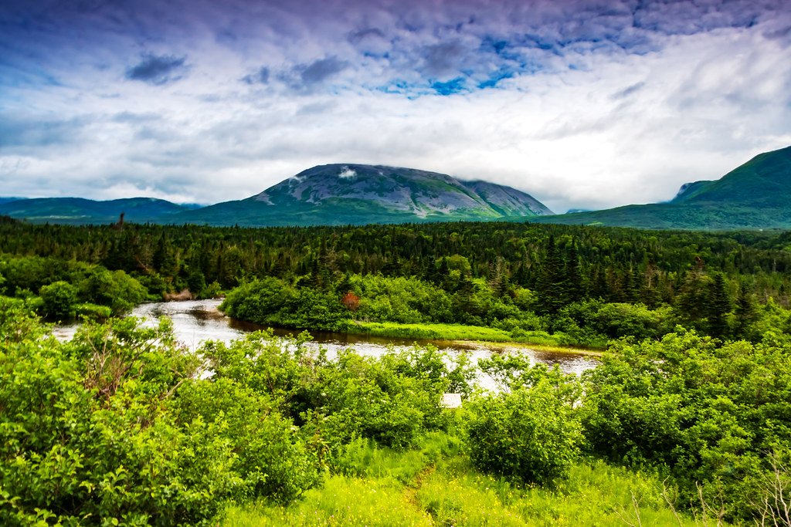
Land Acknowledgement
We respectfully acknowledge the territory in which we gather as the ancestral homelands of the Beothuk, and the island of Newfoundland as the ancestral homelands of the Mi’kmaq and Beothuk. We would also like to recognize the Inuit of Nunatsiavut and NunatuKavut and the Innu of Nitassinan, and their ancestors, as the original people of Labrador. We strive for respectful relationships with all the peoples of this province as we search for collective healing and true reconciliation and honour this beautiful land together.
We also encourage everyone here today to reflect on the lands where you are located, no matter where in the globe, and the Indigenous peoples for whom those lands are traditional territory

Slide 3
Welcome
Dr. Beverly Diamond, Professor Emeritus of Ethnomusicology
Dr. Robert Bertolo, Professor and Deputy Head of Biochemistry
Dr. Eric Vander Wal, Associate Professor of Biology
Gail Lamkin, Scholarship Officer, School of Graduate Studies (SGS)
Moderator: Chelsee Arbour, Special Projects Coordinator, School of Graduate Studies (SGS)

Slide 4
Overview: What will be discussed today
Brief overview of the Canada Graduate Scholarship - Doctoral
Discussion of Eligibility
Application components per council
Application Process
Award Criteria
Times/Submission deadlines
Writing Workshop
Questions with our expert guests
**We will not discuss the mechanics of writing– that is the focus of the writing workshop

Slide 5
Brief overview of Canada graduate scholarships – doctorate (CGS-D)
Three types of CGS-Ds:
CIHR—Frederick Banting and Charles Best Canada Graduate Scholarships Awards;
Must primarily improve or impact health and/or produce more effective health services and products and/or strengthen the Canadian health care system.
NSERC—Alexander Graham Bell Canada Graduate Scholarships;
Must advance knowledge in one or more of natural science or engineering disciplines.
SSHRC—Joseph-Armand Bombardier Canada Graduate Scholarships;
Must add to our understanding and knowledge of individuals, groups, and societies - what we think, how we live, and how we interact with each other and the world around us.

Slide 6
Brief overview CGS-D
Purpose:
“…to promote continued excellence in Canadian research by rewarding and retaining high-calibre doctoral students at Canadian institutions. By providing support for a high-quality research training experience to awardees, the CGS D program strives to foster impacts within and beyond the research environment.”
Value:
$35, 00.00 per year for up to 3 years (non-renewable)
Scope:
Up to 3000 awards per year
Memorial Quota:
NSERC=18
SSHRC=16
CIHR=3

Slide 7
Eligibility:
Canadian citizens/permanent residents or a protected person
Completed no more than 24 months of doctoral studies (as of December 1st, 2021) or no more than 36 months of a joint program (MA/PhD, MD/PhD, BA/PhD, BSc/PhD)
Cannot have already received a doctoral-level scholarship from CIHR, NSERC or SSHRC (does not apply to CIHR Fellowships)
Can only submit a maximum of one scholarship application per academic year to either CIHR, NSERC or SSHRC

Slide 8
Eligibility:
It is important to remember that departmental or SGS base funding will be replaced by CGS-D yearly funding as well as a $5000.00 yearly Dean’s Excellence Award for successful candidates
You cannot hold MUN base funding in addition to the CGS-D award and the Dean’s Excellence Award

Slide 9
Application package: CIHR (Researchnet)
CCV
Application Package
Training Expectations (max 2 pages)
Research Project Summary (max 1 page)
Official Transcripts
Confirmation of Scientific Area form
Completed signature page
Apply for Priority Announcements/Funding Pools (optional)
Doctoral Studies Timeline
Notes:
https://cihr-irsc.gc.ca/e/38887.html

Slide 10
Canadian Common CV (CCV):
Some sections of the CCV has limits to how many entries you can make:
Publications: 20
Artistic Contribution: 10
Presentations: 10
Interviews and Media Relations: 10
Intellectual Property: 5
Activities: 5
Memberships: 5
BUT there are no limits for other sections of the CCV
Notes:
https://cihr-irsc.gc.ca/e/38887.html

Slide 11
Application: CIHR
Identify Participants: Nominated Principal Applicant (i.e. graduate researcher) and a Primary Supervisor
Publications list: supplemental information on entries under Publications in CCV (2 pg. max).
Proof of Canadian Citizenship or Permanent Residency
Identify Sponsors: 2 referee’s to provide an assessment of the applicant.
Proposal Information:
The Title of Research Proposal:
The Lay Title
The Lay Abstract
Notes:
https://cihr-irsc.gc.ca/e/38887.html

Slide 12
Application: CIHR
Proposal Information Cont’:
Certification requirements:
Period of Support requested:
Proposed start date:
Timeline:
Summary of the Research Project
Language in which proposal is written:
Descriptors:
Areas of Research:
Classification:
Themes:
Suggested Institutes:
Notes:
https://cihr-irsc.gc.ca/e/38887.html

Slide 13
Attachments: CIHR
Training expectations (2 pg. max)
Research Summary (1 pg. max)
Confirmation of Scientific Area form
Official transcripts*
Complete Doctoral Studies Timelines form
Copy Official Transcripts
Must be dated to the Fall session if currently registered or the last term completed is not registered
Apply for Priority Announcements/Funding pools (optional)
Print/Upload Signatures page
Should be scanned as 1 PDF
Notes:
https://cihr-irsc.gc.ca/e/38887.html

Slide 14
Application package: NSERC (Online portal)
Form 201
Application/Personal Profile, etc.
Outline of Proposed research (2 pg. max)
Bibliography (5 pg. max)
Contributions to research and development (3 parts, 2 pg. max)
Justification for Eligibility of Proposed Research (Optional - 1 pg. max)
Official Transcripts
Special circumstances (optional)
Two reports/letters of Reference
Notes:
https://www.nserc-crsng.gc.ca/OnlineServices-ServicesEnLigne/instructions/201/pgs-pdf_eng.asp

Slide 15
Application: NSERC
Form 201: Electronic submission
Application:
Application profile
Personal profile
Address(es)
Academic background
Academic, research, and other relevant work experience
Awards
Proposed location (s) of tenure
Scholarship or Fellowship information
Theses completed or in progress
Keywords and research subject code
Diversity considerations in research design
Notes:
https://www.nserc-crsng.gc.ca/OnlineServices-ServicesEnLigne/instructions/201/pgs-pdf_eng.asp

Slide 16
Attachments: NSERC
Outline of proposed research (2 pg. max)
Bibliography (optional for Doctoral applications; 5 pg. max)
Justification for eligibility of proposed research (optional, 1 pg. max if your project could fall within the mandate of more than one tri-council granting agency)
Contributions and Statements (2pg. max., 3 parts)
Special circumstances (optional)*
Official transcripts (both sides of transcript(s)
2 academic letters of reference: one who knows your research very well and one who is sufficiently versed in your research
Signatures
Notes:
https://www.nserc-crsng.gc.ca/OnlineServices-ServicesEnLigne/instructions/201/pgs-pdf_eng.asp

Slide 17
Full Application: NSERC
Diversity considerations in research design
Outline of proposed research (attachment; two pages)
Bibliography (attachment; five pages)
Justification for eligibility of proposed research (attachment; one page)
Contributions and statements (attachment; two pages)
Transcripts or proof of registration (attachment)
References
Application profile
Personal profile
Addresses
Academic background
Academic, research and other relevant work experience
Awards
Proposed location(s) of tenure
Scholarship or fellowship information
Theses completed or in progress
Keywords and research subject code
Notes:
https://www.nserc-crsng.gc.ca/OnlineServices-ServicesEnLigne/instructions/201/pgs-pdf_eng.asp

Slide 18
Application package: SSHRC (Online portal)
Application profile
Program info.
Areas of Study
Biblio. and citations (5 pages max)
Research proposal (2 pages max)
Official Transcripts
Diversity considerations
Two letters of Reference
Research contributions, relevant experience, and activities (2 pages max)
Notes:
https://www.sshrc-crsh.gc.ca/funding-financement/instructions/doctoral/doctoral-eng.aspx

Slide 19
Application: SSHRC
Application profile:
Title of proposal
Preferred selection committee (5 committees, choose the appropriate committee for your discipline
Supplemental award (check if applicable)
Joint or special initiative (check if applicable)
Option for self-identified Indigenous applicants
Program information
Institution
Degree sought
Start date
Months in program
Languages
Areas of study
Ethics
Keywords, & Discipline
Areas of research, temporal period, geographical region, countries
Notes:
https://www.sshrc-crsh.gc.ca/funding-financement/instructions/doctoral/doctoral-eng.aspx

Slide 20
Attachments: SSHRC
Research proposal (max 2 pages)
Bibliography and citations (max 5 pages)
Diversity Considerations in research design:
Transcripts (official transcripts)
Official letter to confirm part-time study and/or eave if absence (1 page max. if applicable)
Allowable inclusions (1 page max. if applicable)
Research contributions, relevant experience and activities (2pg. max, 2 parts):
Supplement justification (1 page max. if applicable)
Joint or special initiatives justification (1 page max. if applicable)
Two letters of reference
Notes:
https://www.sshrc-crsh.gc.ca/funding-financement/instructions/doctoral/doctoral-eng.aspx

Slide 21
CGS-D Award Criteria:
Research Ability and potential (50%)
Relevant experience and achievements obtained within/beyond academia (50%)

Slide 22
Research Ability and potential – 50%
Quality of research proposal: specific, focused and feasible research question(s) and objective(s); clear description of the proposed methodology; significance and expected contributions to research
Relevant training (academic, lived experience and traditional teachings);
Research experience and achievements;
Quality of contributions and extent to which they advance the field of research;
Demonstration of sound judgment and ability to think critically;
Demonstration of responsible and ethical research conduct;
Enthusiasm for research, originality, initiative, autonomy, relevant community involvement and outreach;
Ability or potential to communicate theoretical, technical and/or scientific concepts clearly and logically in written and oral formats

Slide 23
Relevant experience/achievements obtained within/beyond academia – 50%:
Scholarships, awards and distinctions (amount, duration and prestige);
Academic record; transcripts; duration of previous studies; program requirements and courses pursued; course load; relative standing in program (if available)
Professional, academic and extracurricular activities as well as collaborations with supervisors, colleagues, peers, students and members of the community, such as: teaching, mentoring, supervising and/or coaching; managing projects; participating in science and/or research promotion; participating in community outreach, volunteer work and/or civic engagement; chairing committees and/or organizing conferences and meetings; participating in departmental or institutional organizations, associations, societies and/or clubs

Slide 24
Submission process for all Tri-council
All parts of the applications are submitted online;
All required attachments must be uploaded;
All letters of support must be submitted using the online portal system of the appropriate funding division(i.e. CIHR; NSERC; SSHREC);
All official transcripts must be uploaded;
Remember to scan both sides of Official transcript
Official MUN transcripts are $10.00 and can be requested through self-service (Student menu >Academic Information > Request Official Transcript). Requests are processed by order of requesting date/time but the normal processing time is roughly two business days.
Other Universities request process for official transcripts will vary;
be sure to give yourself enough time to request and receive your official transcripts before the internal deadline!

Slide 25
Timeline/deadlines
October 12th, 2021
Completed applications due at SGS (including all official transcripts)
November 21st, 2021
Deadline for institutions to submit applications
April early, 2022
Results released

Slide 26
Important contacts
Program Officer (CIHR): support-soutien@cihr-irsc.gc.ca
Program Officer (NSERC): schol@nserc-crsng.gc.ca
Program Officer (SSHRC): fellowships@sshrc-crsh.gc.ca
Gail Lamkin, Scholarships Officer (SGS): glamkin@mun.ca
Carol Sullivan, Manager of Awards and Scholarships (SGS): carol@mun.ca
Chelsee Arbour, Special Project Coordinator (SGS): csa413@mun.ca

Slide 27
Tips
Start now
Read ALL the instructions
Get transcripts
Contact letter writers
Seek advice on Program of Study
Proofread everything multiple times &
Get someone other than you to proof

Slide 28
Questions for our experts?
Dr. Beverly Diamond, Professor Emeritus of Ethnomusicology
Dr. Robert Bertolo, Professor and Deputy Head of Biochemistry
Dr. Eric Vander Wal, Associate Professor of Biology
Carol Sullivan, BBA, MBA, Manager of Awards and Scholarships, School of Graduate Studies (SGS)
Gail Lampkin, Scholarships Officer, School of Graduate Studies (SGS)

Slide 29
Writing Workshops
Two online writing workshops will be held on September 29th (12:00-3:00pm; 6:00-9:00) through Webex.
These workshops will cover the same material but participants are welcome to attend both.
Writing Centre Tutor Jacinda Sinclair and Chelsee Arbour from SGS will facilitate and provide feedback.
These workshops will focus on:
Writing resources for grant applications
Examples of successful CGS-D applications
How to guides for writing different sections of your grant
Review and editing tips to polish your piece
Writing exercises
Peer review
You can register here or through the awards and scholarship page

Slide 30
Thank you for joining us and all the best with your application preparation!!!

