Slide 1
The Tetra Society: Making Independent Living Possible
Dr. Leonard M. Lye
Professor Emeritus of Engineering
Founder and Coordinator, St. John’s Chapter of the Tetra Society of North America

Slide 2
Outline of Talk
What is the Tetra Society?
Background
What projects will Tetra take on
How Tetra works
Sample of completed projects
Sample of ongoing projects
Acknowledgement

Slide 3
What is the Tetra Society?
It is an award winning charity dedicated to assisting people with disabilities achieve an independent and fulfilling life in the community.
Winner of the Peter F. Drucker Award for Most Innovative Charity in Canada, 1994
Winner of the Provincial Citation Award of the Canadian Association for Occupational Therapists for Contribution to Rehabilitation Endeavors, 2003
Winner of the Glenn Roy Blundon Award, MUN, 2013.
Winner of the “Bridging the Gap” Award from Recreation NL, 2014.

Slide 4
The Tetra Society recruits skilled volunteer engineers, technicians, health professionals, and any “MacGyver types” to design, make, or modify assistive devices or the environment for people with disabilities
The Tetra Society believes that the solutions are often simple but can profoundly change someone’s life
The Tetra Society also believes that people are not handicapped by their disabilities but by obstacles in their living environment.

Slide 5
Background
Founded by Sam Sullivan O.C. of Vancouver (former Mayor of Vancouver, Canada’s first quadriplegic mayor, now Liberal MLA for Vancouver-False Creek)
Sam became a quadriplegic as a result of a skiing accident in 1979, was on welfare and was anxious to get out of his predicament
Sam called APEBC for help and retired engineer Paul Cermak solved many of Sam’s problems
Sam with other volunteers started to help others with disabilities, and the Tetra Society was later formalized in 1987.

Slide 6
Sam Sullivan, O. C.

Slide 7
Tetra now has over 40 chapters, about 500 volunteers, and together has completed more than 5000 projects
St. John’s Chapter was started in 1996. It is the first chapter based in an engineering faculty. It is one of the most active chapter in Canada.
To date the chapter has completed over 100 projects.
The St. John’s chapter volunteers are made up of undergraduate and graduate students, professors, engineers, technicians, medical students, O. Ts., and disability advocates.

Slide 8
What projects will Tetra take on
Tetra fills a large gap in the health care system for people with disabilities in the area that addresses quality of life
Anything that enhances one’s ability to participate in all aspects of life, including work, play, hobbies, family, and community.
The problems that require solutions are as unique, and as varied as the people who has them. Hence, most solutions are “one of a kind”.

Slide 9
Tetra does not compete with commercially available products – although we may design/make a much cheaper or simpler version
Tetra will not handle projects where there is funding available to hire rehabilitation engineers, OT, or other health professionals
Tetra tends to handle cases where others have given up.

Slide 10
How Tetra Works
Person with disability (client) or care giver requests for assistance (RFA form)
Coordinator reviews the request and match volunteer(s) to work with the client
Volunteers and client work together towards a solution
Volunteers and client report back to Tetra on progress, needs, etc.
The St. John’s Chapter does not charge clients for its services. Funding for the projects comes from fund raising, donations, and grants.

Slide 11
Sample of completed projects
Cup-holders for wheelchairs – many versions
Guitar strummer for one handed man
3-ring binder opener
Bumper cane
Cutting guide for cake pan
Customized walker
Wheelchair ball-thrower
Over the bed TV/VCR stand
Stabilizer for wheelchair tray
Glove for fingerless man
Modifications to a wheelchair

Slide 12
Elevating chair
Adaptations/modifications to a tricycle
Door opener for the wheelchair bound
Rail-assisted bathroom transfer device
Easels of various designs
Interrupter switches for bat-op toys
Mice modifications
Sun shade for wheelchair
Custom sitz bath basin
Custom bath seat
Safety gate for hospital bed
Custom shower bath chair

Slide 13
First Tetra Project in 1996/97
Custom walker for man with CP

Slide 14
Sample completed project
Elevating chair for boy with spina bifida

Slide 15
Sample completed projects Forrest-the-ball–thrower-Trask
Ball thrower for boy with CP and visual impairment

Slide 16
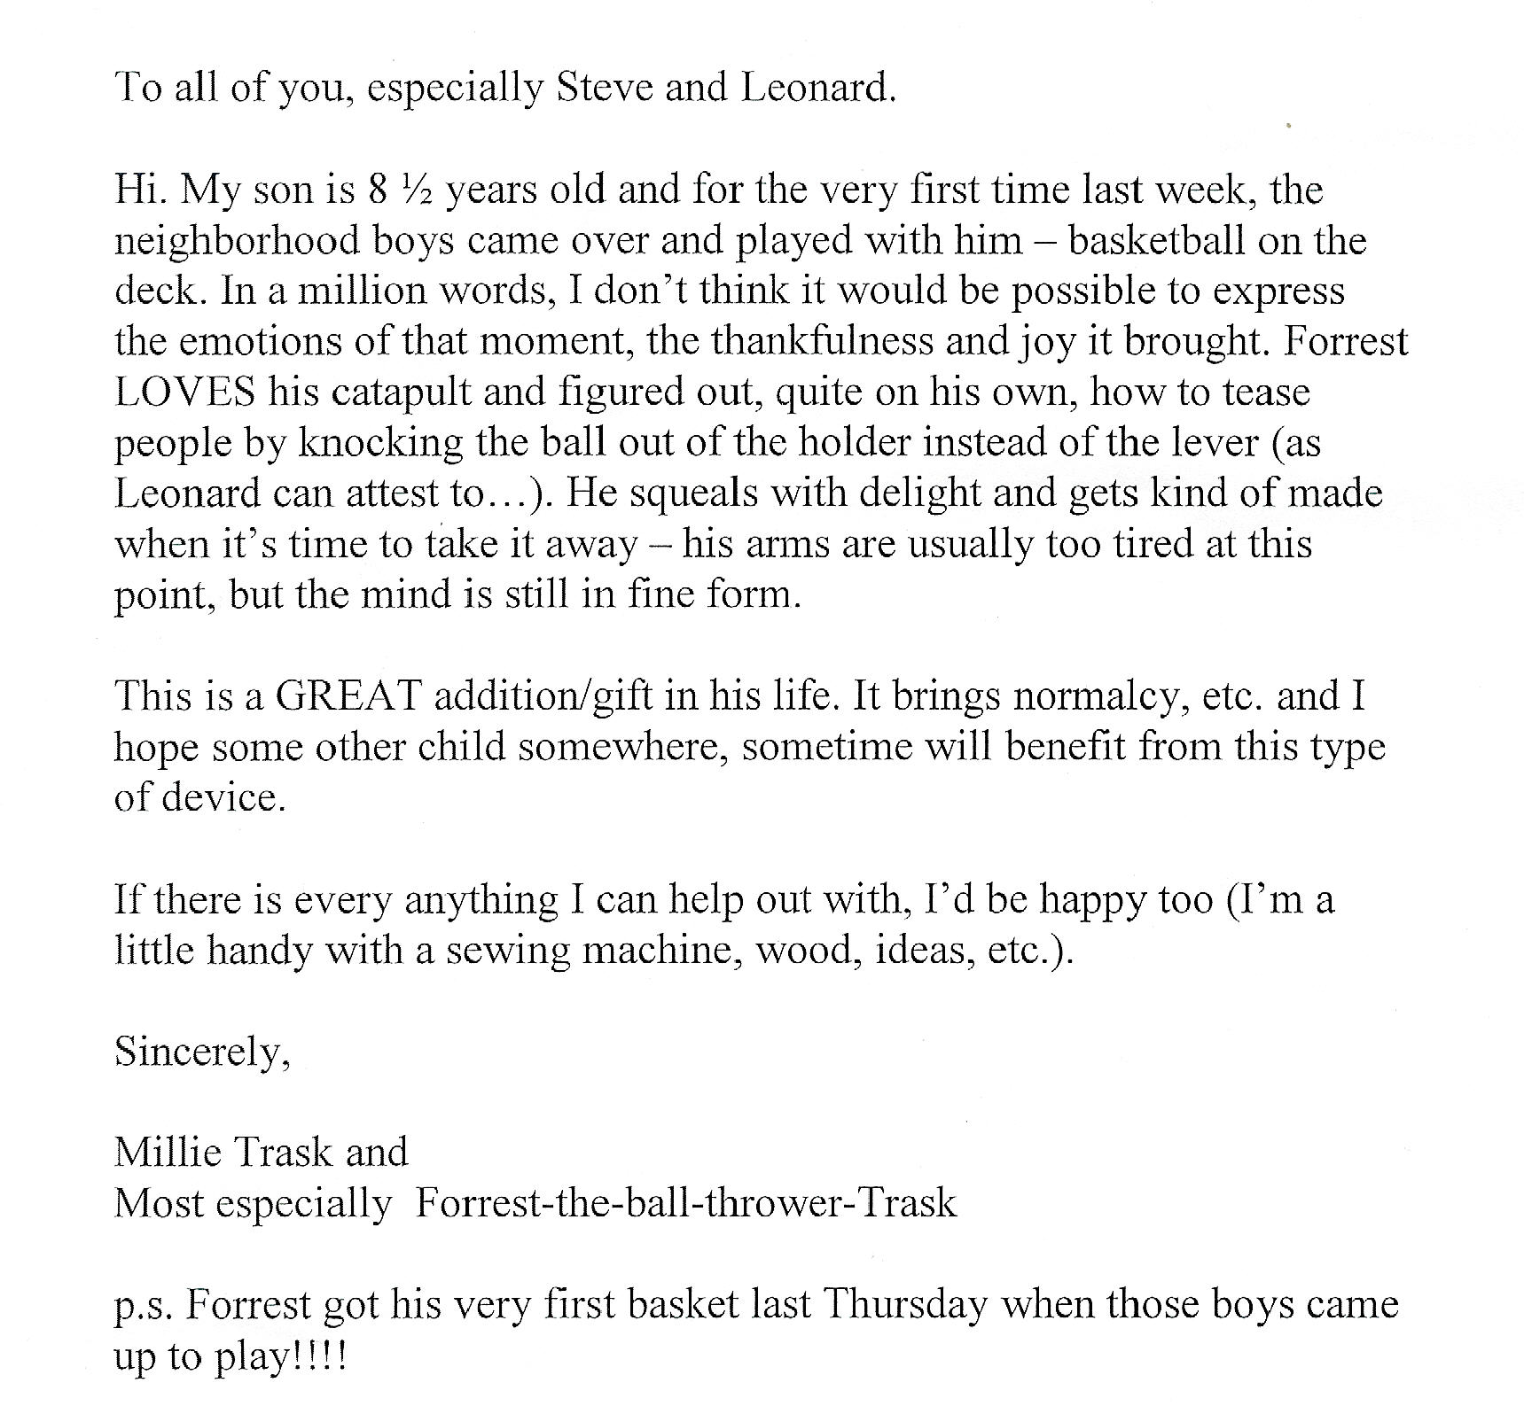

Slide 17
Sample completed project
Mother reassuring daughter that it is safe
The happy camper!

Slide 18
Completed and On-going projects Bat-Op toy surgery
Regular bat-op toys
Bat-op toy with interrupter switch and switch plate

Slide 19
New bed for Brendan
Present bed – lack of head room
New bed – hydraulically operated

Slide 20
Work term students
Work term students Crystal Rideout and Matthew Carter hard at work at Interex Systems workshop

Slide 21
Completed Bed
Installing the bed – Steve Reddin supervising or is he?
Mother playing with the controls

Slide 22
One-handed Guitar
Lever mechanism of strummer
Modified hi-hat stand

Slide 23
One-handed guitar
Volunteers involved in the project – missing Billy Bidgood
Happy client

Slide 24
More projects
Another one-handed guitar
Walker with one-handed control

Slide 25
More sample projects
Braking system for a garden cart
Guitar stand for music therapy program

Slide 26
More sample projects
Custom easel for bedridden student
Foldable safe travel bed

Slide 27
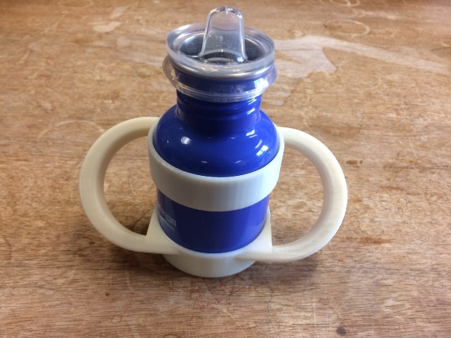
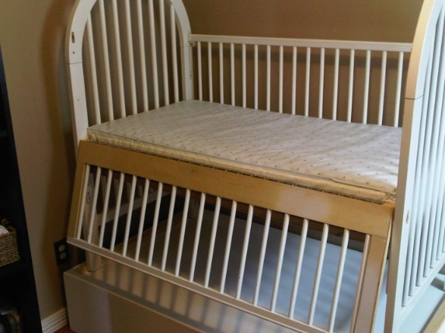
More sample projects
Custom seat for girl with Rhett’s Syndrome
Custom show/bath for woman with CP
3-D printed customized cup-holder
Modified crib for mother with damaged arm

Slide 28
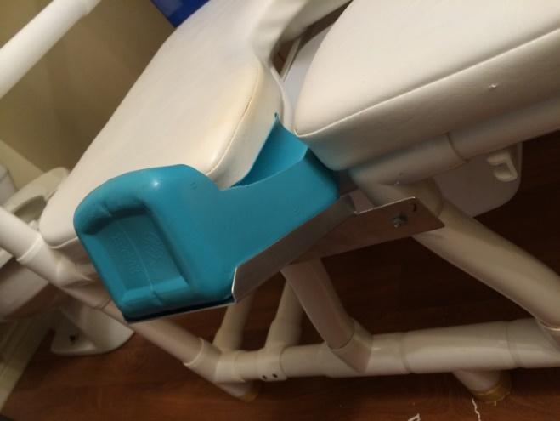
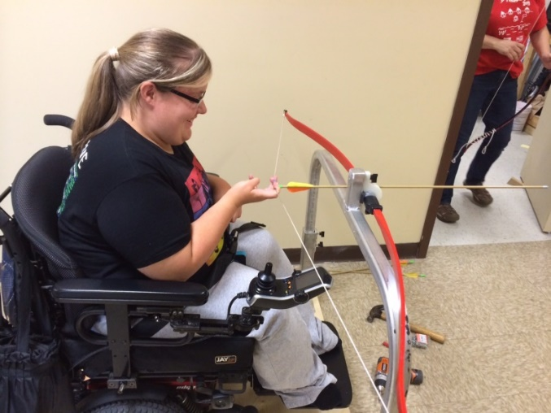
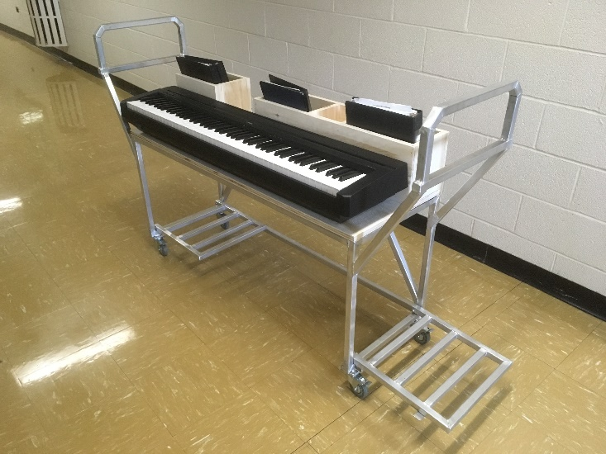
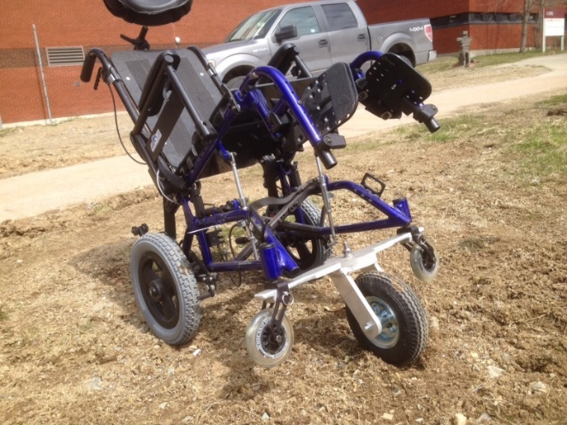
Recent projects
Wheelchair archery
Custom toileting aid
All terrain wheelchair
Piano cart

Slide 29
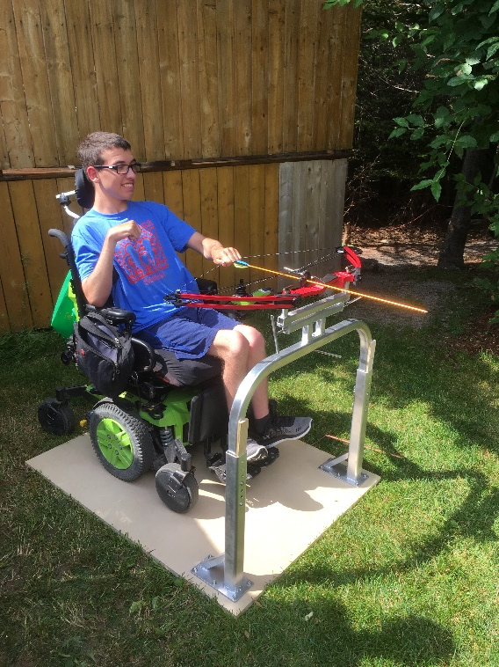
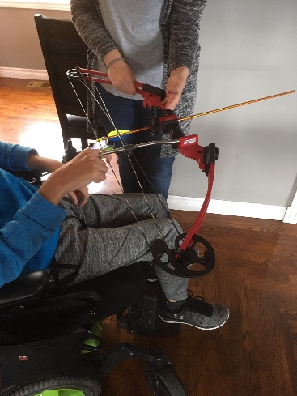
Sample of on-going projects
Archery stand for a compound bow for boy with CP (just completed)
Sensors for wheelchairs
Arm stabilizers for girl with CP
Modifications to toy cars for push button control
Roller chair for girl with CP and severe spine curvature
>>

Slide 30
For more information
http://www.reachdisability.org/tetra
To request for assistance or to volunteer:
Call me at 709-685-0732 or email: llye@mun.ca

