Slide 1
A QUICK INTRODUCTION TO EDITING ON WIKIPEDIA

Slide 2
FIRST A LITTLE BIT ABOUT WIKIPEDIA…
Wikipedia was launched on January 15, 2001 to provide people with free access to knowledge in their own language.
Wikipedia is supported by the non-profit Wikimedia Foundation.
It is written and edited by volunteers from around the world.
Almost all of its articles can be edited by anyone.
It is the fifth most visited website on the planet.
English Wikipedia receives about 200 million page views a day.

Slide 3
Wikipedia outlines its guidelines for editing in its:
FIVE PILLARS
CORE CONTENT POLICIES

Slide 4
WIKIPEDIA SUMMARIZES ITS FUNDAMENTAL PRINCIPLES AS FIVE PILLARS:
Wikipedia is an encyclopedia: it is not a soapbox, advertising platform, vanity press, indiscriminate collection of information, or web directory.
Wikipedia is written from a neutral point of view: keep the tone impartial; all articles must strive for verifiable accuracy by citing reliable sources.
Wikipedia is free content that anyone can use, edit, and distribute: no editor owns an article and any contributions can and will be mercilessly edited and redistributed. Respect copyright laws and never plagiarize.
Wikipedia’s editors should treat each other with respect and civility: avoid edit wars.
Wikipedia has no firm rules: Wikipedia has policies and guidelines, but they are not carved in stone; their content and interpretation can evolve over time.

Slide 5
WIKIPEDIA’S CORE CONTENT POLICIES:
Neutral Point of View – All Wikipedia articles must be written from a neutral point of view without bias
Avoid stating opinions as facts; use non-judgemental language; indicate relative prominence of opposing views.
Verifiability – Material must be attributed to a reliable, published source.
Practice by adding references and citations to existing articles instead of starting new ones.
No Original Research – Wikipedia does not publish original thought or research: all material must be attributable to a reliable, published source. Wikipedia is not journalism, criticism, or scholarship: it’s an encyclopedia.
If you can’t support your statement without published articles or books, you can’t include it in the Wikipedia page.

Slide 6
OTHER GUIDELINES:
Avoid any conflict of interest (COI) – Don’t write about yourself or your family, friends, clients, employers, or your financial and other relationships. COI editing undermines public confidence in Wikipedia.
Instead, you can suggest changes in the talk pages.
Use reliable sources – Sources should be published secondary or tertiary sources. Unpublished materials and interviews are not considered reliable.
Examples of some reliable sources: academic and peer-reviewed publications; textbooks; books published by respected publishing houses; magazines and journals; newspapers.
Notability – Does your topic warrant its own article? If a topic has received significant coverage in reliable sources that are independent of the subject, it is presumed to be suitable for a stand-alone article or list.
HOWEVER, these guidelines can be flexible because they can also reinforce structural racism and sexism. Some groups are represented in published literature much more than others!

Slide 7
WHAT TO EDITORS DO?
An awful lot! Here are a few examples:
Write new articles
Add new content to existing articles
Add new citations
Check that existing citations are correct
Make sure links work
Add new links (including red links)
Edit existing articles for grammar and understanding
Fix mistakes in existing articles
Some editors even specialize in adding the date of a person’s death when they pass away
If you are a new editor, it might be better to add citations, etc. to existing articles before you create a new article. Having multiple edits under your belt will add to your knowledge and credibility.

Slide 8
JOIN THE WIKIPEDIA COMMUNITY

Slide 9
Start by clicking the “Create account” link in the upper right corner on the Wikipedia website

Slide 10
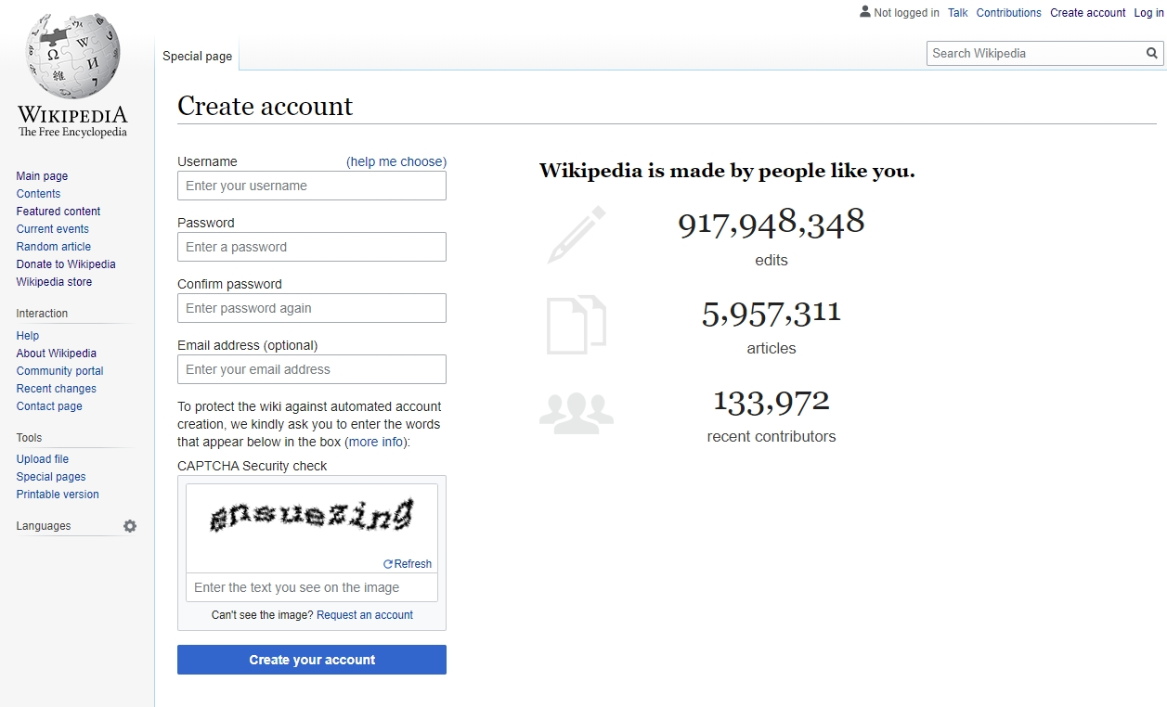

Slide 11
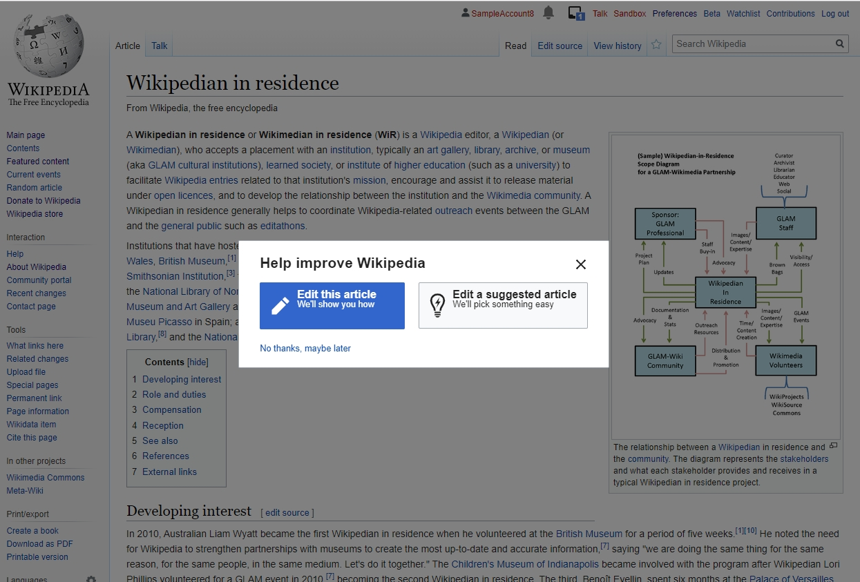

Slide 12
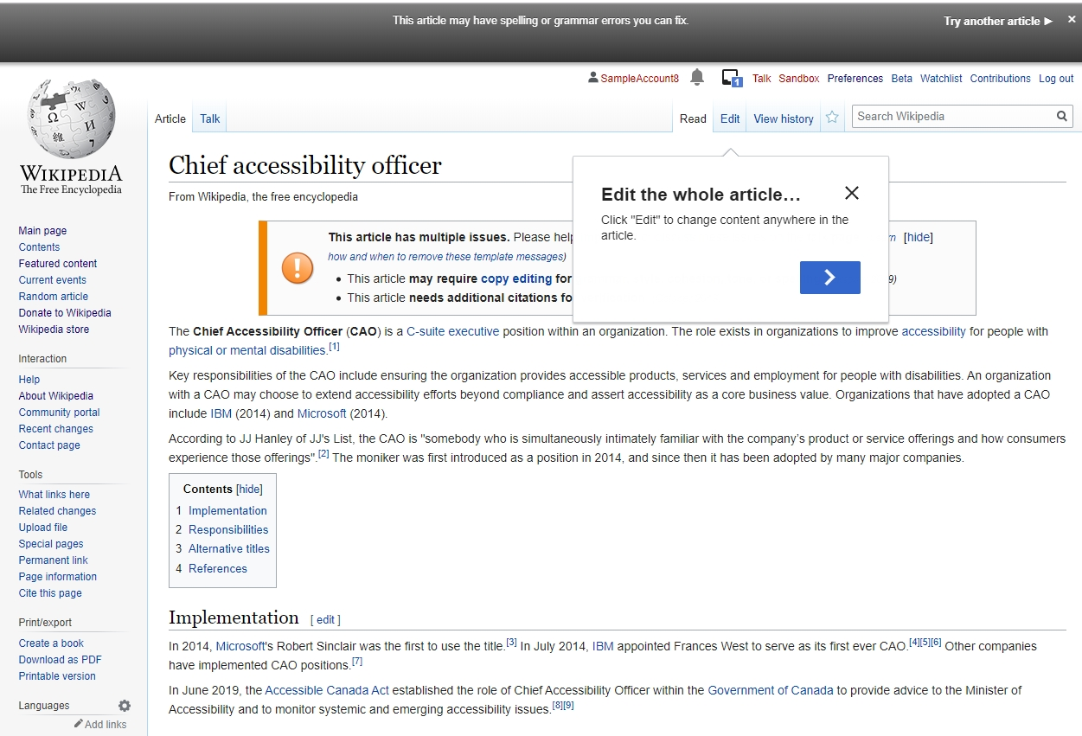

Slide 13
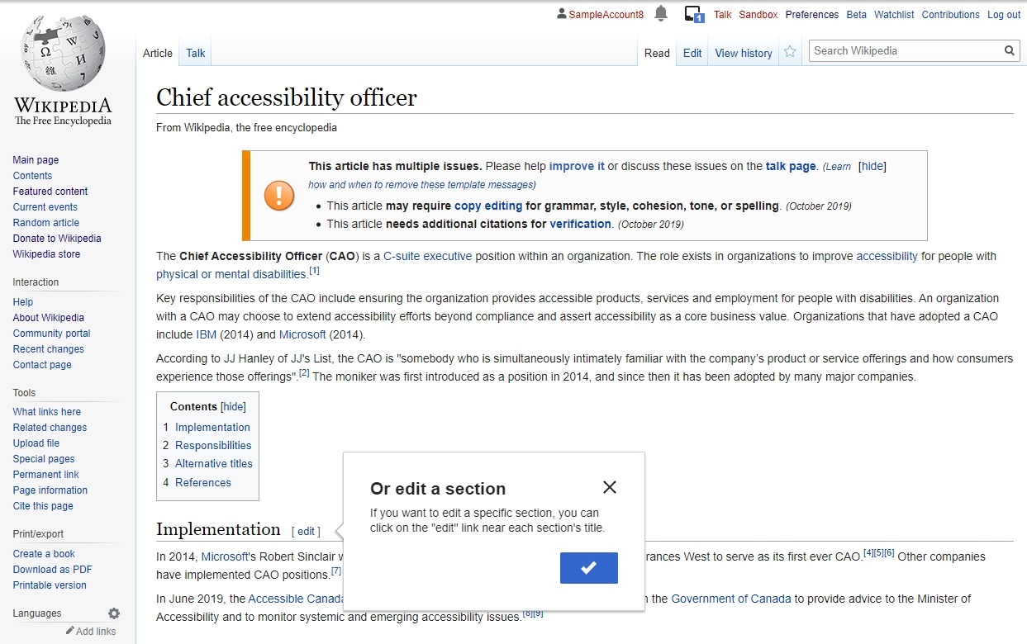

Slide 14
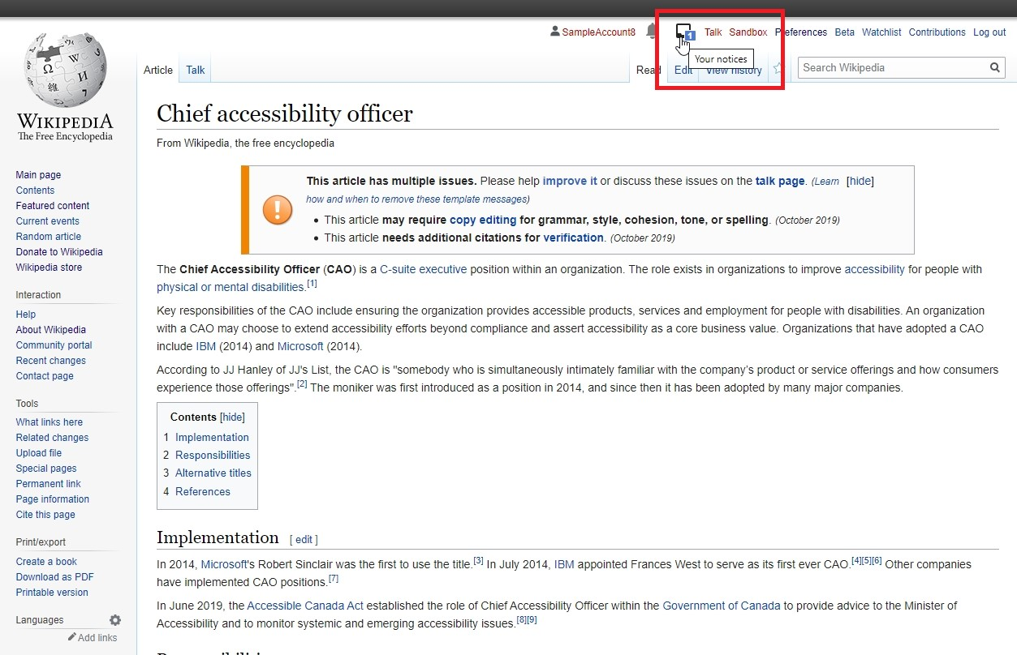

Slide 15
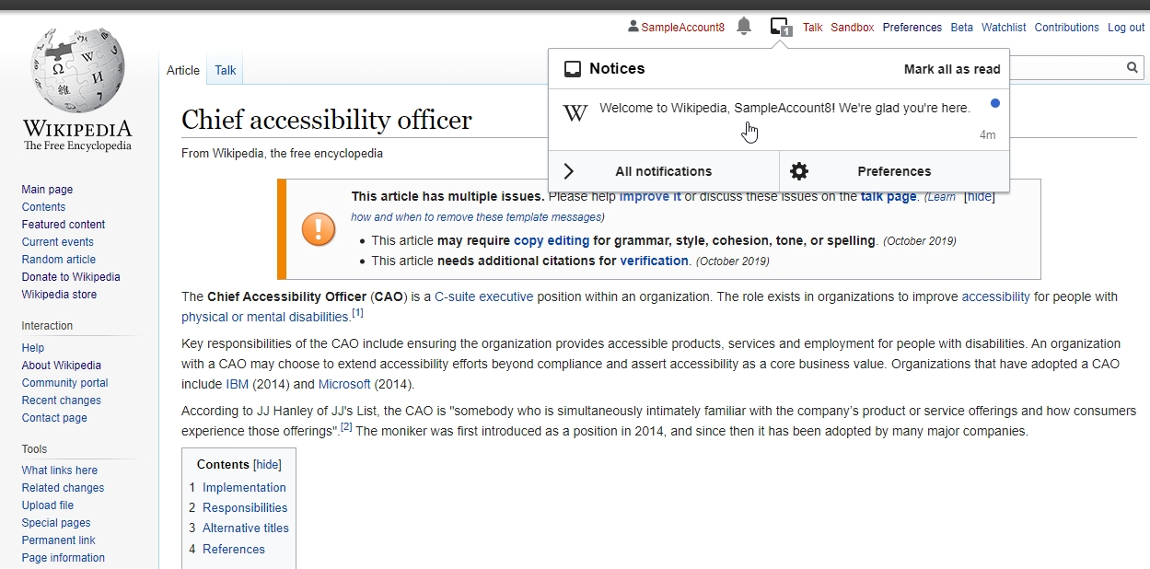

Slide 16
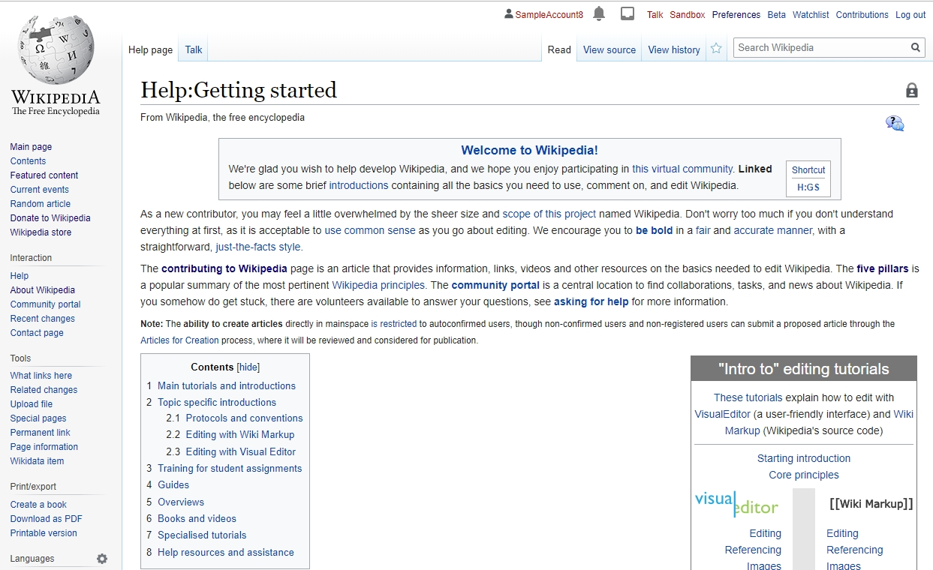

Slide 17
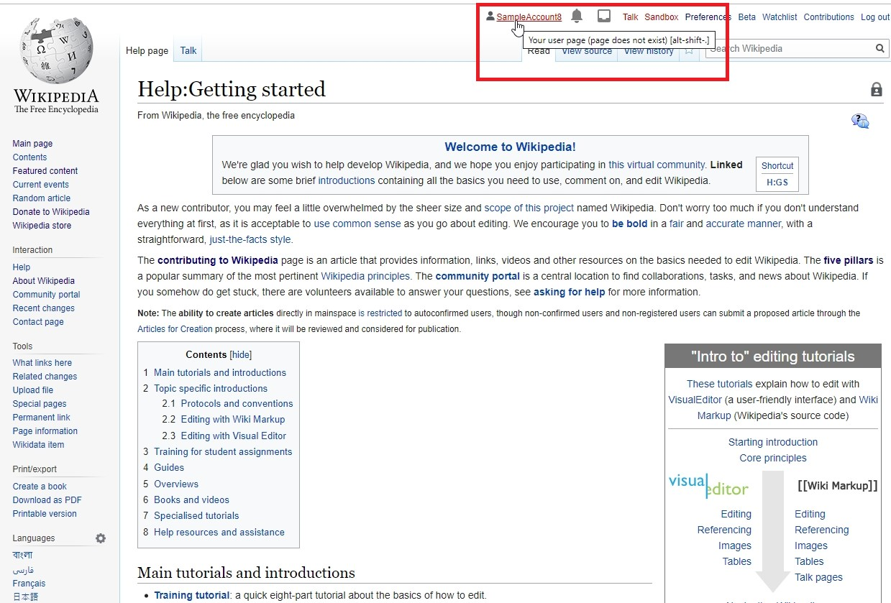

Slide 18
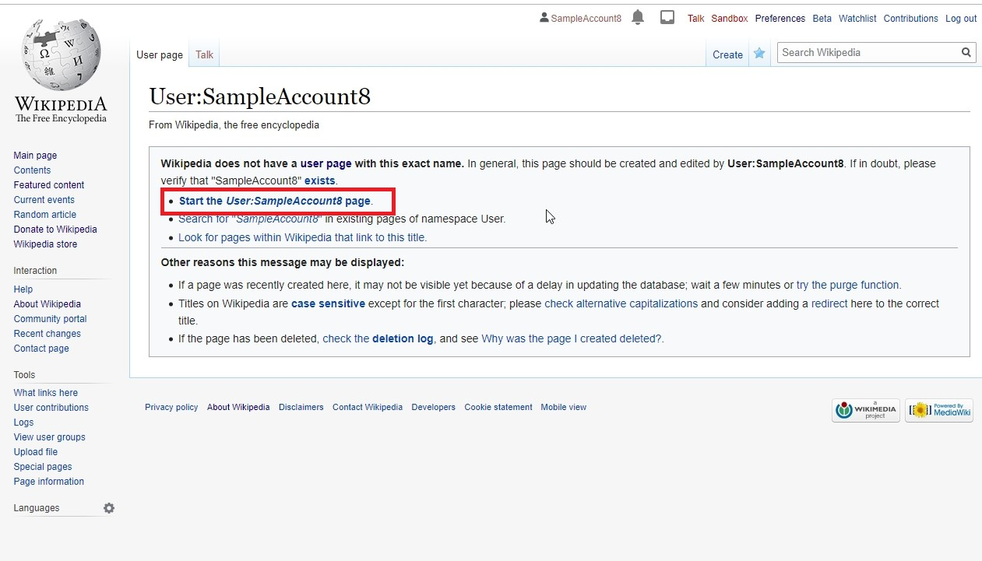

Slide 19
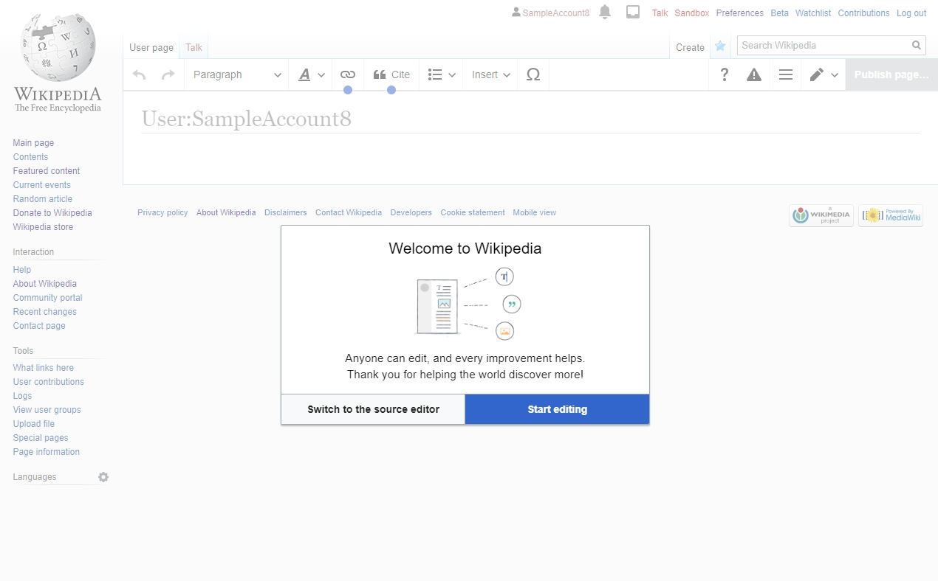

Slide 20
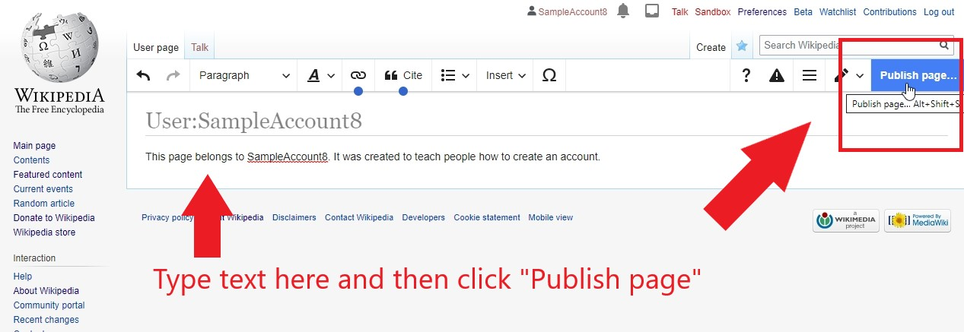

Slide 21
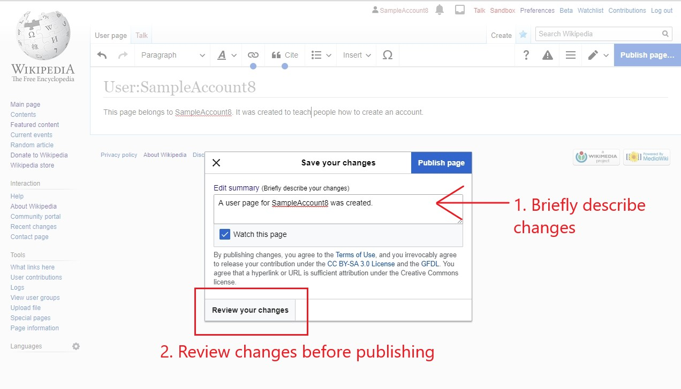

Slide 22
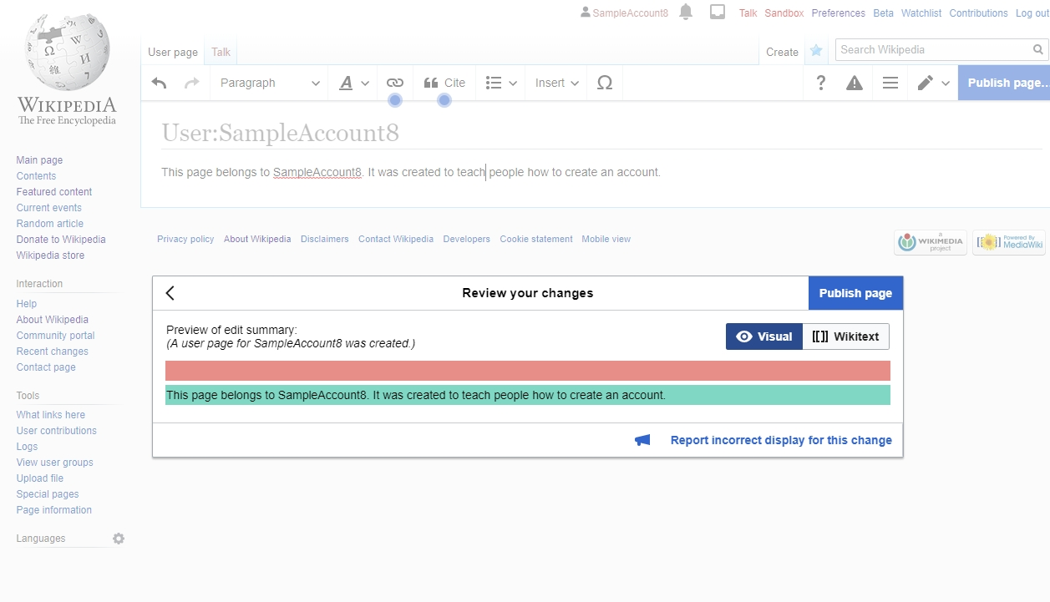

Slide 23
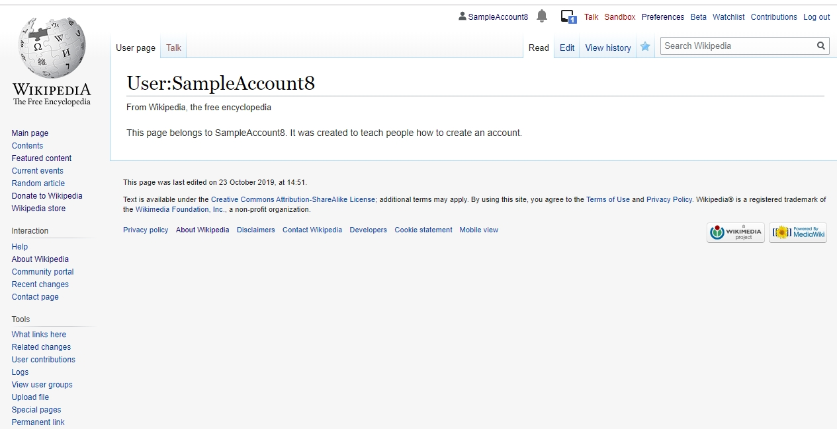

Slide 24
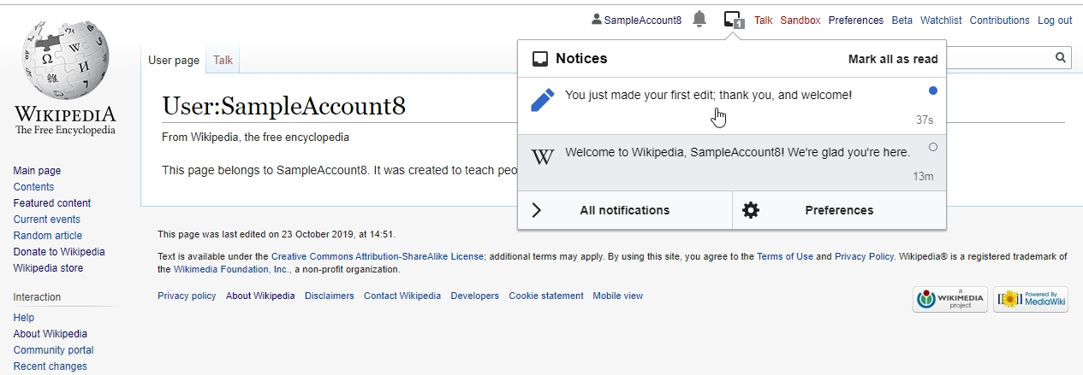

Slide 25
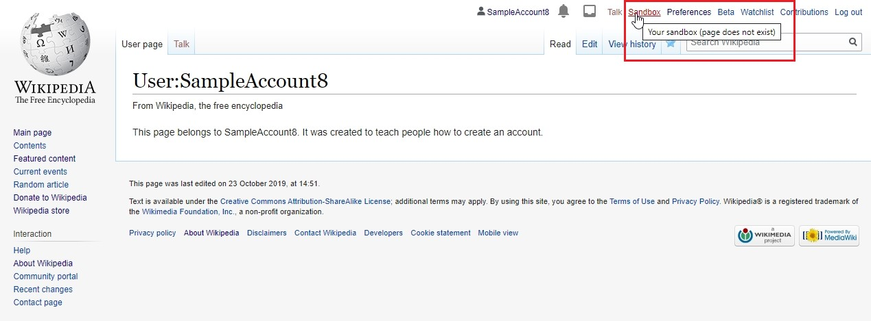

Slide 26
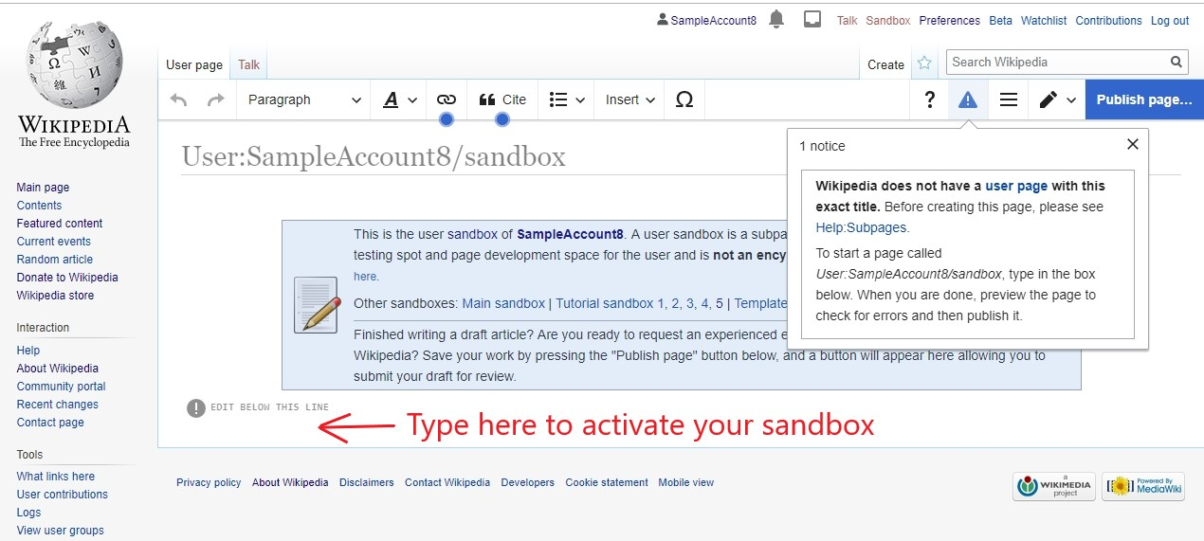

Slide 27
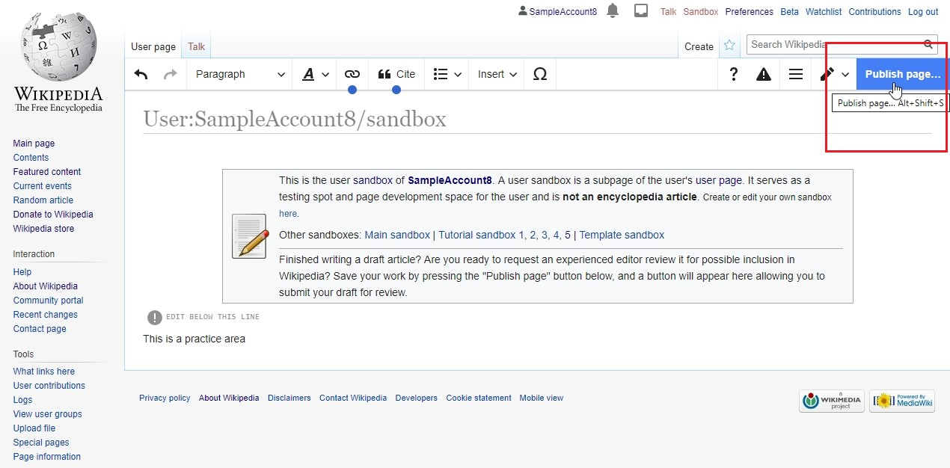

Slide 28
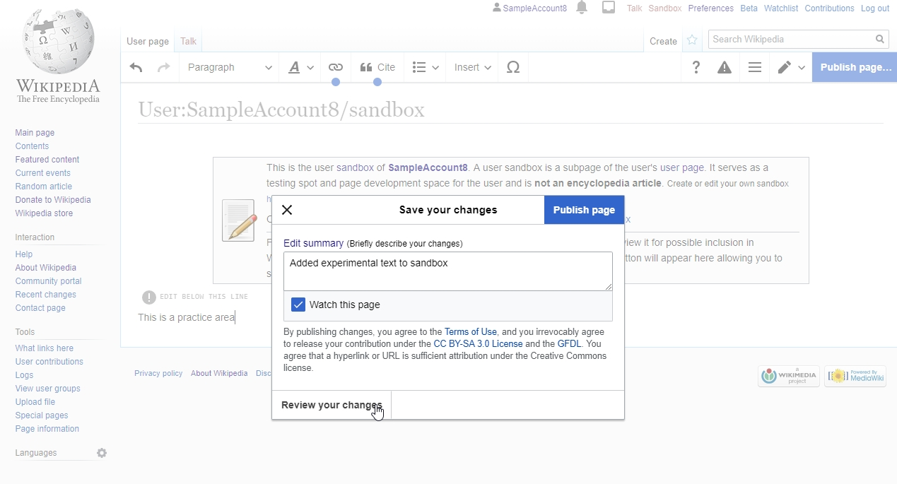

Slide 29
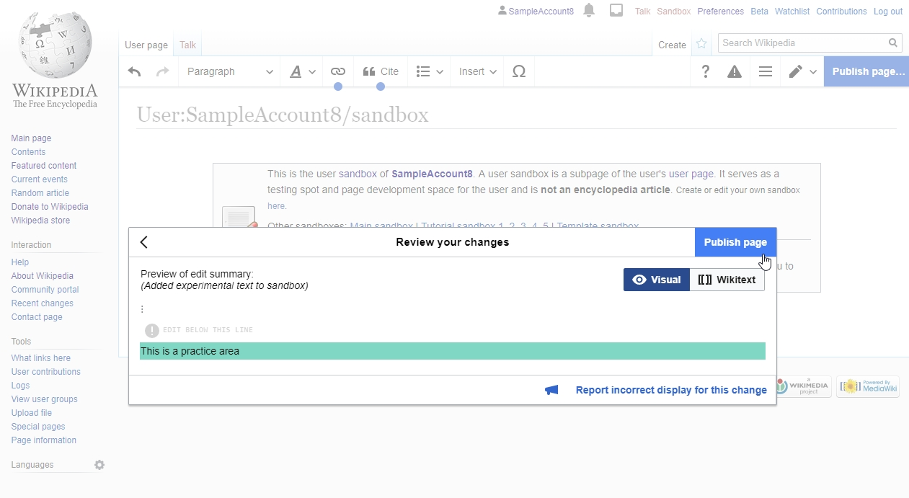

Slide 30
