Slide 1
Webex 101
Connecting Together Across Campus & the Globe
Academic Success Centre
Host: Melissa MacLean

Slide 2
Everyone has a first time using Webex…
Let’s make yours easier.

Slide 3
The Invite
In your email, navigate mail, or course mail you may be sent an email like the one above inviting you to attend a Webex meeting or event. Verify the sender is someone trusted (ex. click on their name, is it a mun.ca email?) and then click on the link.

Slide 4
Registration
If you use Google Chrome for your internet browser. Your Webex registration page will look like this. Click on the blue “register” button.
-if you don’t see the white box = pop-up blocker needs to be disabled for the site registration to function. Alternatively, you can press and hold “ctrl” on your keyboard and refresh the page; this can temporarily override it.

Slide 5
Registration
Now put in your First name, Last name, and your mun.ca email. Click “Register” once done.

Slide 6
Registration
If done correctly, you will have the “your registration has been approved” screen appear and your meeting/event details should appear in your mun.ca email.
if you cannot find the email, check your junk folder.
if it screen says “registration sent”/”registration pending”/etc, your information has been sent and the event organizer will manually approve you.

Slide 7
Event RSVP Email
Your RSVP confirmation email will look similar to the above. Click “Yes”. This will add it to your calendar; it also adds you to the organizer’s RSVP list.
Warning: for some accounts, once approved, the email may become hidden in your “sent” folder BUT the event details have all copied to your calendar.

Slide 8
Event RSVP Calendar
Here it is!
Nice and safe in your email calendar.
If you double click on it, it will open meeting details.

Slide 9
Event RSVP Calendar
The meeting details, URL, and “join” button are all here for you to access any time.

Slide 10
Joining
Go into your email calendar, locate the meeting, and click “join”.
This will either:
Open your webex app
Open WebEx in your browser
Both versions work and are fine, it depends on your computer’s settings what happens.

Slide 11
Joining
Option A- click “launch meeting” to use your WebEx app
Option B - launch the meeting as a browser-based app, click “join from your browser”

Slide 12
Joining
Step 1:
click the red microphone image to unmute yourself
Step 2: click “test speakers and microphone” to verify they work.
Step 3: click “stop video” on and off to confirm it works and set your angle up as preferred
Step 4: Click the “join meeting” button to join the room.
Hint: you may want to turn your mic and camera off before joining, then turn on once in.

Slide 13
In the Meeting
“Participants” list will show the host/panelists and all visible attendees. In some events or meetings, participants may not be able to see all fellow attendees. If you accidentally close the participants list. Click on the “participants” icon in the bottom right of the screen
Click the “Hand” icon to raise your hand during a meeting.
Click the smile “reactions” icon for a menu of emojis you can have appear on screen during the presentation.
“Share” gives you the option to share your entire screen (aka. monitor), select apps (i.e. google, powerpoint), files, or a whiteboard
Start/Stop video:
When it is red “start video” your camera is off. When it is green “stop video” your camera is on.
Unmute/mute:
When it shows red, you are muted. When it shows green you are speaking

Slide 14
In the Meeting [chat]
Click on the drop down box beside “To:” to select if the message you will type should be sent to everyone, all hosts/panelists, or a private message to one of the meeting members that appears in the participants list
Type in this box the message you wish to send. If you do not change the “to:” option, the message will go to all participants
If you need to reopen the chat, click on the “chat” icon
click “CC” if enabled, to activate closed captioning

Slide 15
Ending the Meeting
Click the red circle with the white “X” icon.
On some apps, this may also appear as a red button with “leave” in white text

Slide 16
Ending the Meeting
You will now be given a confirmation window pop up with the option to “leave meeting” (end meeting) or “cancel”.
If you select cancel, the pop up will disappear.
If you select “leave meeting” (end meeting) WebEx will completely close and the meeting will end for you.
hint: if you accidentally leave and need to rejoin, go back to the invite link in your calendar and join the meeting again.

Slide 17
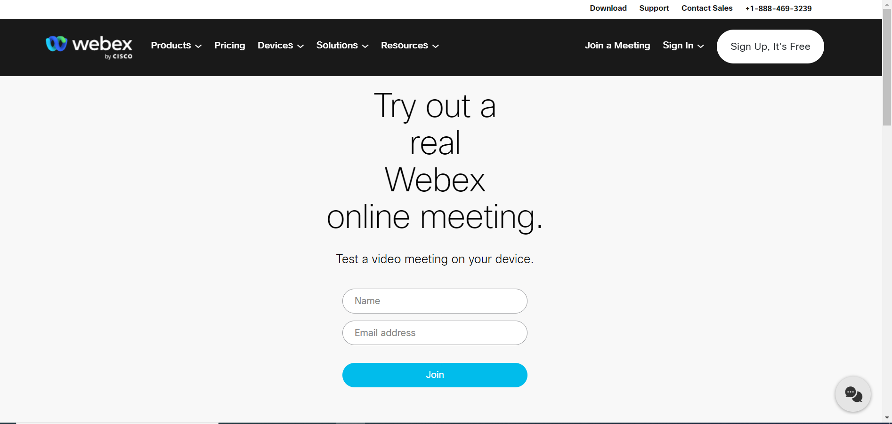
Try a Test Room
https://www.webex.com/test-meeting.html
Try using a test room to become familiar with WebEx or if you are going to be using Webex for the first time on a new device, internet connection, or browser.
The test room is free, not monitored, and will let you click on everything and anything.

Slide 18
Extra Help
WebEx’s Help Page for Troubleshooting
https://help.webex.com/en-us
CITL Support Centre for Students:
“Our Support Centre is available during extended evening and weekend hours for inquiries related to teaching and learning, technical support for learning technologies (e.g. Brightspace, Online Rooms, Webex, etc.) and examinations for online courses.”
https://citl.mun.ca/support/
Using WebEx with low bandwidth:
https://www.mun.ca/cio/media/production/memorial/administrative/cio/itservices/network/webex/Low_bandwidth.pdf
Best practices when working remotely on WebEx:
https://www.mun.ca/cio/media/production/memorial/administrative/cio/itservices/network/webex/Remote_working_Best_Practices.pdf

