Slide 1
Health Services Research
Sarah Williams
MSc Public Health
August 2, 2019

Slide 2
Outline
What is health services research (HSR)?
Definition
Research areas
Examples
How to conduct HSR
Quiz

Slide 3
Types of Health Research
Bio-medical
Clinical
Epidemiology
Public and Global Health
Health Services and Policy Research

Slide 4
Health services and policy research...
“. . . examines how people get access to health care, how much care costs, and what happens to patients as a result of this care. The main goals of health services research are to identify the most effective ways to organize, manage, finance, and deliver high quality care; reduce medical errors; and improve patient safety.” – Agency for Healthcare and Quality
“...requires team members from a wide range of backgrounds, for example, healthcare professionals, university researchers, charities or commercial organisations, social researchers, epidemiologists, economists and statisticians as well as non-professionals such as those who may potentially use the service or treatment.” – South Sudan Medical Journal
“...involves systematically seeking knowledge which will lead to improvements in the delivery of health care”
– Crombie and Davies, 1996

Slide 5
Health services and policy research...
Health services research includes research with the goal of improving the efficiency and effectiveness of health professionals and the health care system, through changes to practice and policy.
Health services research is a multidisciplinary field of scientific investigation that studies how social factors, financing systems, organizational structures and processes, health technologies, and personal behaviours affect access to health care, the quality and cost of health care, and, ultimately, Canadians' health and well-being.
CIHR 2019

Slide 6
Notes:
How the left is related to and influence the outcomes on the right
Can be done at any level from individual up to a population
https://www.youtube.com/watch?v=wxL0-REyleg

Slide 7
Efficacy Effectiveness
...how well a drug, procedure, or device improves clinical outcomes under ideal conditions
...how a given intervention performs in the real world
Notes:
This field seeks to explore the effectiveness of care, a different concept than the more familiar idea of efficacy.

Slide 8
Areas that health services research addresses:
costs, cost-benefit, cost-effectiveness, and other economic aspects of healthcare
patient and population health status/health disparities
outcomes of healthcare technologies and interventions
practice patterns and diffusion of technologies and interventions
quality assurance programs
clinical guidelines, standards, and criteria for healthcare
the need and demand for health services
utilization patterns of health services
patient satisfaction with treatments, providers, and practice settings
organization and delivery of healthcare
the various means of financing healthcare

Slide 9
What is not health services research?
Efficacy studies of experimental clinical interventions with clinical outcomes
Eg: drug studies, medical devices
Animal studies
Bench science
Most epidemiological studies
Eg: those focusing on characterizing disease, incidence, prevalence
Notes:
https://www.youtube.com/watch?v=wxL0-REyleg

Slide 10
Examples of HSR Questions
Notes:
Credit to Roger

Slide 11
Organizational questions:
What is the best way to model care teams for improving outcomes for high risk births?
What role should primary care physicians have in the treatment of autism?
Outcome questions:
Do school nutrition programs have an impact on academic performance?
What types of interventions are most effective at increasing breast feeding by mothers with different cultural backgrounds?

Slide 12
Regulation questions:
What should physicians have to do to maintain their medical licenses?
How should physicians interactions with pharmaceutical companies be regulated and disclosed?
Management questions:
How should a healthcare organization disclose medical errors involving large numbers of patients?
Should publicly-funded hospitals administer drugs which are purchased privately?

Slide 13
Usage and access questions:
Why has the usage of ultrasounds increased during normal pregnancy?
Do women from different cultural or socio-economic backgrounds receive the same access to prenatal services?
Financial questions:
What method for compensating physicians offers the best value-for-money, e.g., fee for service, pay-for-performance?
How do you determine whether a new health innovation is a good use of public resources?

Slide 14
Other Topics:
Health human resources
Physician / Patient Issues
Health information / e-Health
Technology assessments
Ethics

Slide 15
How do you conduct HSR?

Slide 16
Research Idea
Service user comments What do your service users think about the service? Do they think they are receiving what you think you are delivering? Is your service accessible to all?
Personal interest If you have an interesting finding, do other people find the same? Is there a question in the literature left unanswered?
Audit of your own work or the work of others
Topics of local or national interest such as screening programmes. Are you offering a service which is part of a local or national programme? What are your findings? Who attends screening programmes ...who does not attend? Is there anything that you are doing that is different from others offering the same thing?
Service development Are you meeting the needs of your population? Could your research move you or your organisation from providing a basic service to providing an exemplary service?
Role extension Are you happy in your role? Are you capable of more? Could your research provide evidence that you can work at a higher level?
Evidence Based Practice (EBP) Can your research provide the evidence to change practice within your field?
Practice specialty Are you working in a specialty? Can you share that practice with others?

Slide 17
2. Research Question
Formulate a clear and answerable research question
P | Population
I | Intervention
C | Comparison
O | Outcome
Example: Do more girls get vaccinated if the HPV vaccine is part of a free school-based immunization campaign?
P | Young school aged females in Canada
I | Free HPV vaccination programs in schools
C | No free HPV vaccination program in school
O | Rates (%) of young women vaccinated
Notes:
Does the research team have equipoise regarding the question?
Is there really uncertainty about the topic?
Is removing the uncertainty going to change anything?
Are the results of the project something others will be interested?
Is answering the question viable given the available resources?

Slide 18
3. Literature Review
Indicate the scale of the problem you want to research
Summarize what is already known about the topic
Check systematic reviews for recommendations
Check recently published studies
Check trial registries for on-going unpublished research
Highlight questions that would inform practice
Present an account of relevant research on the same or similar topic

Slide 19
4. Methods
Qualitative research
interviews, focus groups, case studies, consensus conferences, ethnography
Quantitative (Observational) research
survey data, administrative database analysis; chart reviews
Policy / Jurisdictional Reviews
Intervention / Experimental research

Slide 20
5. Proposal/Ethics/Grants
If you have developed the project well, (a good research question, literature review, research protocol), ethics proposals are generally not too onerous
Funding is competitive
Be very clear of the impact of the proposed work
Building teams of researchers from multiple centres seems to help
Funding proposals take time to write

Slide 21
6. Collect Data
Tools for HSR
Electronic medical records - track data from patient to population level allows HSR to examine the effects of care
Ex: use EMR to determine if a new heart failure drug reduces admissions in a real-world setting
Health Services Research Projects in Progress (HSRProj)
a database that provides information about ongoing HSR projects
Health Services and Sciences Research Resources (HSRR)
a database that contains information about datasets and instruments that are useful to researchers

Slide 22
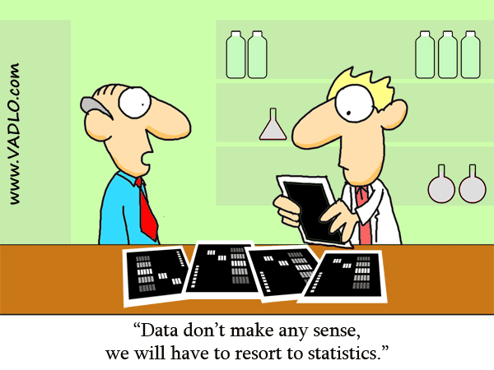
7. Analyze and Interpret Data

Slide 23
8. Disseminate Findings
Dissemination:
the purposive distribution of information and intervention materials to a specific public health or clinical practice audience. The intent is to spread information and the associated evidence-based interventions.
Implementation science:
the study of methods to promote the integration of research findings and evidence into healthcare policy and practice. It seeks to understand the behavior of healthcare professionals and other stakeholders as a key variable in the sustainable uptake, adoption, and implementation of evidence-based interventions.
Notes:
https://www.nlm.nih.gov/hsrinfo/implementation_science.html
the intent of implementation science and related research is to investigate and address major bottlenecks (e.g. social, behavioral, economic, management) that impede effective implementation, test new approaches to improve health programming, as well as determine a causal relationship between the intervention and its impact.

Slide 24
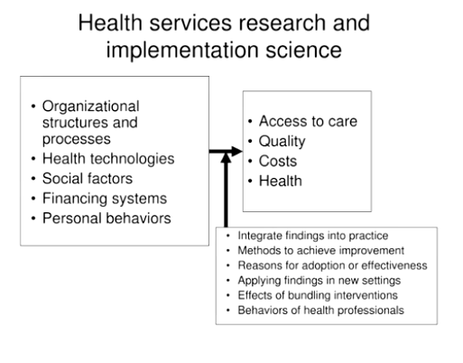
Notes:
https://www.youtube.com/watch?v=wxL0-REyleg
Intertwined with health services factors
Questions can overlap / hybrid designs with HSR and implementation

Slide 25
HSR Journals

Slide 26
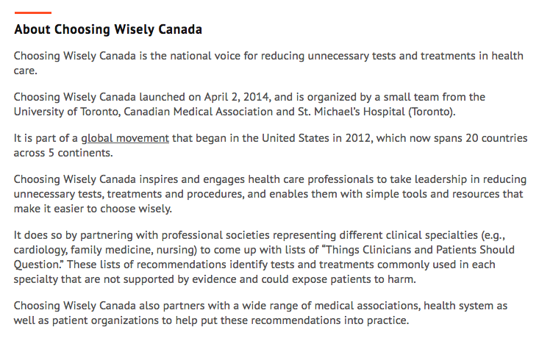

Slide 27
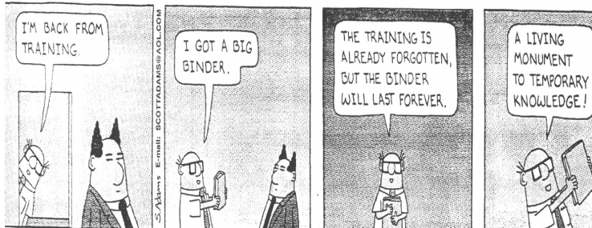
Why is implementation important?

Slide 28
HSR Quiz

Slide 29
Is it health services research?

Slide 30
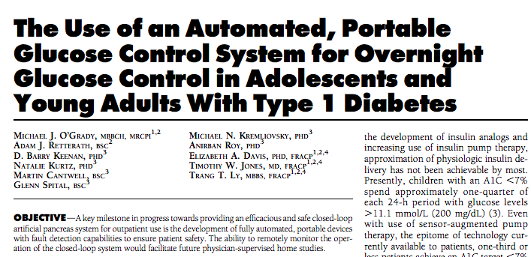
Is it health services research?

Slide 31
Is it health services research?

Slide 32
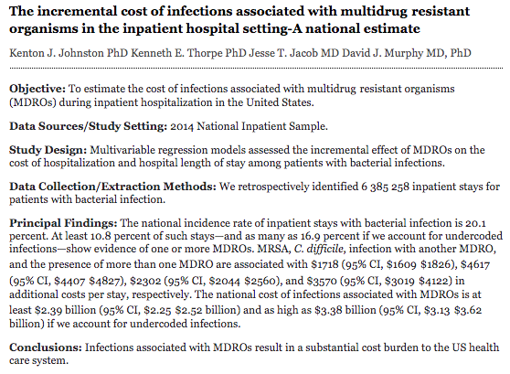
Is it health services research?

Slide 33
Thank you!

Slide 34
References
Academy Health. Retrieved from https://web.archive.org/web/20090901155427/http:/academyhealth.org/About/content.cfm?ItemNumber=831&navItemNumber=514
Canadian Institute of Health Research. (2019). Health Services Research. Retrieved from http://www.cihr-irsc.gc.ca/e/48809.html
Crombie, I. K. and Davies, H. T. O. (1996) Research in Health Care: Design, Conduct and Interpretation of Health Services Research, Wiley.
Ebinger, J. (2017). Health Services Research: Cardiology in the Changing Health Care Landscape. Journal of the American College of Cardiology, 69(72). https://doi.org/10.1016/j.jacc.2017.03.539
Encyclopedia of Health Services Research. Retrieved from http://sk.sagepub.com/reference/download/healthservices/n103.pdf
Lancey, A. (2010) 'Evidence based medicine: searching the medical literature Part 1', Southern Sudan Medical Journal, (1).
Lohr, K. N. and Steinwachs, D. M. (2002) 'Health services research: an evolving definition of the field', Health Serv Res, 37(1), 7-9.
Moja, L. P., Moschetti, I., Nurbhai, M., Compagnoni, A., Liberati, A., Grimshaw, J. M., Chan, A. W., Dickersin, K., Krleza-Jeric, K., Moher, D., Sim, I. and Volmink, J. (2009) 'Compliance of clinical trial registries with the World Health Organization minimum data set: a survey', Trials, 10, 56.
National Information Center on Health Services Research and Health Care Technology (NICHSR). Retrieved from https://www.nlm.nih.gov/hsrinfo/implementation_science.html
Richardson, W. S., Wilson, M. C., Nishikawa, J. and Hayward, R. S. (1995) 'The well-built clinical question: a key to evidence-based decisions', ACP J Club, 123(3), A12-3.
South Sudan Medical Journal. Retrieved from http://www.southsudanmedicaljournal.com/archive/august-2011/conducting-health-services-research.html
Weiner, M. (2014). Michael Weiner: Health Services Research. https://www.youtube.com/watch?v=wxL0-REyleg

