Slide 1
OFFICE OF LEARNER WELL-BEING AND SUCCESS
Investment session
Office of learner well-being and success
www.mun.ca

Slide 2
Items of discussion
Registered savings “accounts”
Investment Options
Risk Appetite
Investment/Management Fees
A Word From The Wise
Q & A with Financial Advisors
Office of learner well-being and success
www.mun.ca

Slide 3
Registered savings “accounts”
Registered Retirement Savings Plan (RRSP) – is not really a plan….
Tax Free Savings Account (TFSA) – Its not really an account…
Both are investment tools that gives different tax incentives to save money
Office of learner well-being and success

Slide 4
Registered Retirement Savings Plan (RRSP)
It is not a plan, it is a savings program/tool and you decide how the money gets invested – savings account, bonds/stocks, Exchange Traded Fund (ETFs), mutual funds, crypto, etc.
Any money you invest now gives you a tax break this tax year (money back in taxes)
Contribution room increases every year (18% of income) and carries forward
The assets in the RRSP are not taxed until you withdraw funds
Good if you need discipline
You pay taxes at the end – when you withdraw from it
Office of learner well-being and success

Slide 5
Tax Free Savings Account (TFSA)
It is not an account, it is a savings program/tool and you decide how the money gets invested – savings account, bonds/stocks, Exchange Traded Fund (ETFs), mutual funds, crypto, etc
No tax break
Increases annually, last increase was $6,000 – tied to inflation
More flexible, no penalty for withdrawing funds, and you get back the contribution space the next calendar year
Investments can grow interest free
You pay taxes at the beginning
Office of learner well-being and success

Slide 6
What are my options?
Stocks: own part of a business – some pay dividends some don’t
Bonds: You lend your money to a business – can be traded, can increase in value
Guaranteed Investment Certificate (GICs): Guaranteed return over a period of time
Mutual funds: actively managed bucket of items like stocks and bonds – typically high fees
An exchange traded fund (ETF): Similar to mutual funds, but only tracks specific assets or indexes – typically lower fees
Crypto currency: prices vary greatly
Other: real estate, private business ideas, other valuables
Office of learner well-being and success

Slide 7
What do I invest in?
Know your risk appetite
Do you need access to your investments in the near term, ie do they need to be liquid?
Are you okay with the value of your investments going up and down?
Do you have enough knowledge (and time) to invest yourself as this is often cheaper?
Office of learner well-being and success

Slide 8
Financial advisors
The terms “financial advisor” and “financial planner” are used broadly. These terms don’t always mean that a person has specific qualifications, expertise, or certifications. Outside of the province of Quebec, anyone can call themselves a “financial advisor” or “financial planner.”
They ALWAYS have sales goals
Some are paid by commission that depends on what they sell you
Some are fee based – ie you pay a flat fee regardless of what they sell you
Robo Advisors: Less personal (not actually a robot) – but typically lower fees/cost
Office of learner well-being and success
www.mun.ca

Slide 9
Invest or pay off debt?
1
2
3
4
5
6
Pay off credit cards
Pay off other debt with interest higher than 3%
Max out employee contribution
Max out TFSA
Max out RRSP
Look into other options – Whole life insurance, etc
Office of learner well-being and success
www.mun.ca

Slide 10
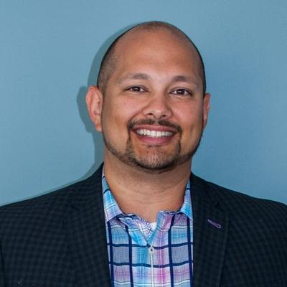
A word from the wise
Dr. Angus Hartery – Associate Professor, Discipline of Radiology
Office of learner well-being and success
www.mun.ca

Slide 11
Q & A Session with financial advisers
Chris Hamilton – Insure Med Financial - chris@insuremed.ca
Ben Mayhew- MD Financial Management - Ben.Mayhew@md.ca
Denise Penton – RBC - denise.penton@rbc.com
Mike Kidney – Live By Wealth - Mike@livebywealth.ca
David Smith - Scotiabank - davidj.smith@scotiabank.com
David Holwell – CIBC – david.Holwell@cibc.ca
Donna McGrath – NL Credit Union - sgoodyear@nlcu.com
Office of learner well-being and success

