Slide 1
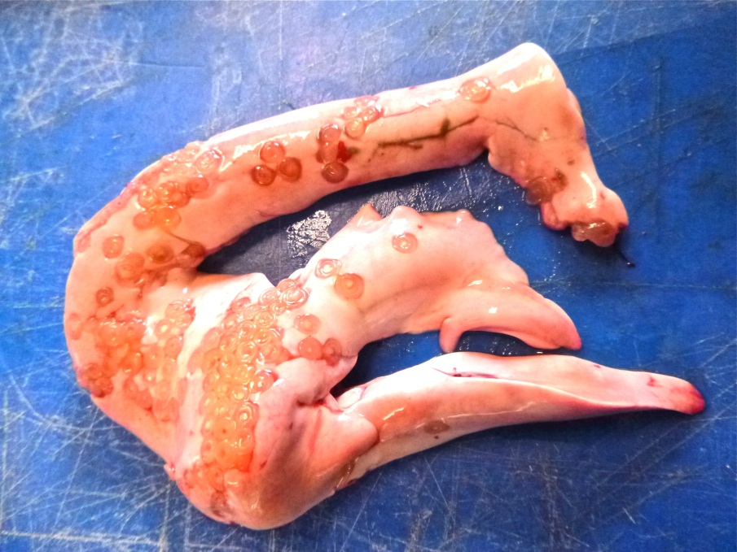
Do infection levels of A. simplex differ between cod stocks of the Northwest Atlantic?
Laura Carmanico
R code: #input data
setwd("C:/Users/lcarmani/Desktop")
lcparasites<-read.table(file="LCparasites26.txt", header=TRUE)

Slide 2

The data - parasites
    Count data (how many parasites) – Abundance
    Binomial data (infected or uninfected) - Prevalence
    Continuous variable (parasites/kg of flesh) – Density

Slide 3
Abundance data

Slide 4
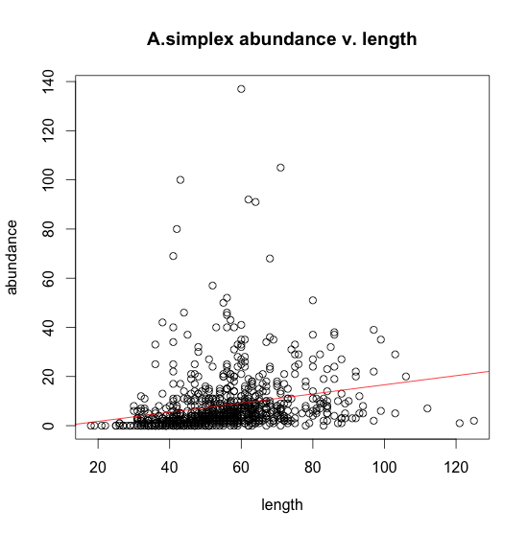
plot(ta~length,ylab="abundance",main="A.simplex abundance v. length")
abline(lm(ta~length), col="red")

Slide 5
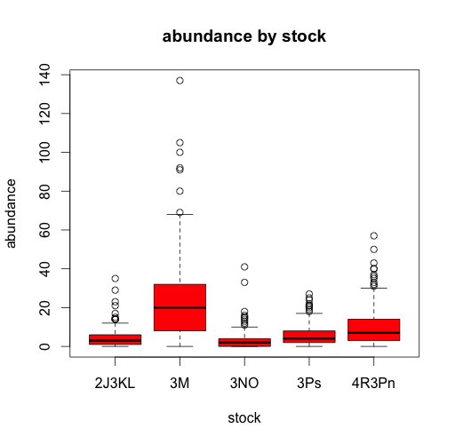
boxplot(ta~stock, data=lcparasites, col="red", xlab="stock", ylab="abundance", main="abundance by stock")

Slide 6
Table of contents
Abundance model
    Poisson
    Quasipoission
    Negative binomial
    Normal error with a residual variable
    Log transformation of data
    Using density as a variable (sealworm)

Slide 7

First Step: Poisson
A = e^{(η)} + poisson error
η = β_{o} + β_{L}·L + β_{S}·S + β_{C}·C +β_{L·S}L·S +β_{L·C}L·C+β_{C·S}C·S+β_{L·S·C}·L·S·C
A = Abundance (response)
Β_{o} = Intercept
L = Length (explanatory - control)
S= Sex (explanatory – control of interest)
C = Cod stock (explanatory)

Slide 8
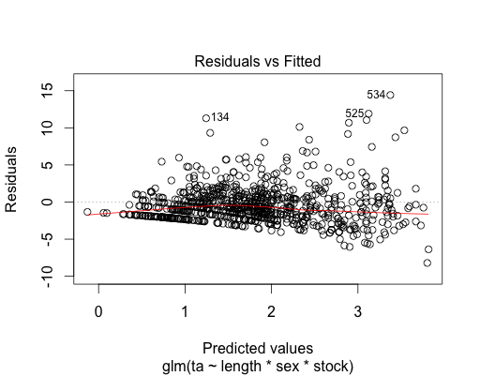
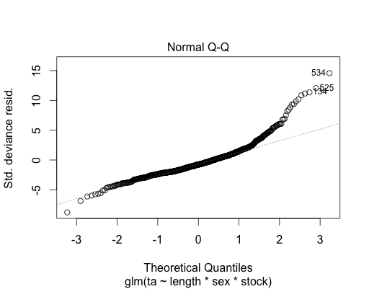
1. Poisson
R code: pois<-glm (ta ~ length * sex * stock, poisson, data= parasites)
Null deviance: 9505.1 on 807 df
Residual deviance: 5062.6 on 788 df
AIC: 7617.7
Residual deviance much greater than res. Df
Res. Dev/res. Df = 6.42
Overdispersion, so we try quasipoisson…

Slide 9

2. Quasipoisson
R code: glm(ta~length*sex*stock, quasipoisson, data=parasites)

Slide 10
Again, values are highly overdispersed – errors not homogeneous and not normal.
NEXT: we try negative binomial

Slide 11
Out of curiosity…
The assumptions were not met, and therefore we cannot trust the estimates of Type I error, but out of curiosity I wanted to look at the output of the model and see if we could take out some interaction terms for a better fit…
The two way interaction terms were far from significant, except for the interactive effect of stock and length.
So..we can expect that stock*sex , and length*sex can be removed.
Minimal adequate model:
glm(ta ~ length*stock + sex, family = quasipoisson, data=parasites)'

Slide 12
R output – quasipoisson
Call: glm(formula = ta ~ length * stock + sex, quasipoisson)
Deviance Residuals:
Min 1Q Median 3Q Max
-7.1665 -2.0050 -0.7790 0.6712 15.2100
Coefficients:
Estimate Std. Error t value Pr(>|t|)
(Intercept) -0.658091 0.443846 -1.483 0.13855
length 0.032572 0.006181 5.270 1.76e-07 ***
stock3M 3.170199 0.476116 6.658 5.15e-11 ***
stock3NO 0.508929 0.555307 0.916 0.35969
stock3Ps 0.875672 0.629919 1.390 0.16488
stock4R3Pn 0.824289 0.657136 1.254 0.21008
sexM 0.092146 0.072210 1.276 0.20229
length:stock3M -0.021524 0.006764 -3.182 0.00152 **
length:stock3NO -0.009747 0.008072 -1.208 0.22758
length:stock3Ps -0.006525 0.009652 -0.676 0.49926
length:stock4R3Pn 0.007060 0.010635 0.664 0.50701
---
Signif. codes: 0 ‘***’ 0.001 ‘**’ 0.01 ‘*’ 0.05 ‘.’ 0.1 ‘ ’ 1
(Dispersion parameter for quasipoisson family taken to be 8.36668)
Null deviance: 9505.1 on 807 degrees of freedom
Residual deviance: 5147.6 on 797 degrees of freedom
Number of Fisher Scoring iterations: 5

Slide 13
Comparison of models: removal of interaction terms (1 of 2) – classical
F test – for overdispersion
R code:
quasi1<-glm(ta~length*stock+sex,family=quasipoisson, data=LCparasites26)
quasi2<-glm(ta~length*stock*sex,family=quasipoisson, data=LCparasites26) anova(quasi1,quasi2,test=“F")
Analysis of Deviance Table
Model 1: ta ~ length * stock + sex
Model 2: ta ~ length * stock * sex
Resid. Df Resid. Dev Df Deviance F Pr(>F)
1 797 5147.6
2 788 5062.6 9 85.025 1.1501 0.3245

Slide 14
Comparison of models: removal of interaction terms (2 of 2) opposite
F test – for overdispersion
Analysis of Deviance Table
Model 1: ta ~ length * stock*sex
Model 2: ta ~ length*stock + sex
Resid. Df Resid. Dev Df Deviance F Pr(>F)
1 788 5062.6
2 797 5147.6 -9 -85.025 1.1501 0.3245
Not significant, so we can accept model 2
1. η = β_{o} + β_{L}·L + β_{S}·S + β_{C}·C +β_{L·C}L·C +β_{L·S}L·S +β_{C·S}C·S +β_{L·S·C}·L·S·C
2. η = β_{o} + β_{L}·L + β_{S}·S + β_{C}·C +β_{L·C}L·C
Notes:
Flip it, and get same numbers. Can add or remove terms to test the models

Slide 15
3. Negative Binomial
R code for negative binomial:
Library(MASS)
glm.nb(ta~length*stock*sex,data=parasites)

Slide 16
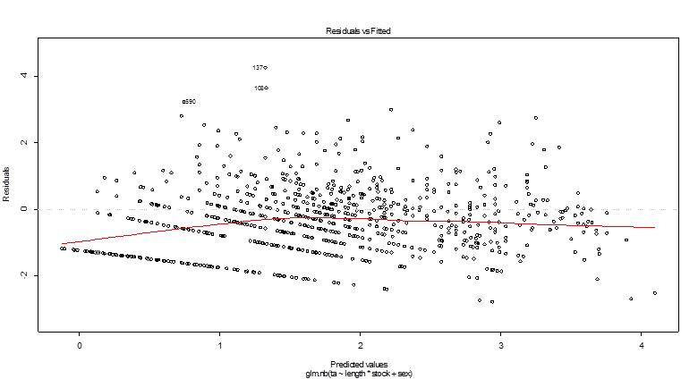
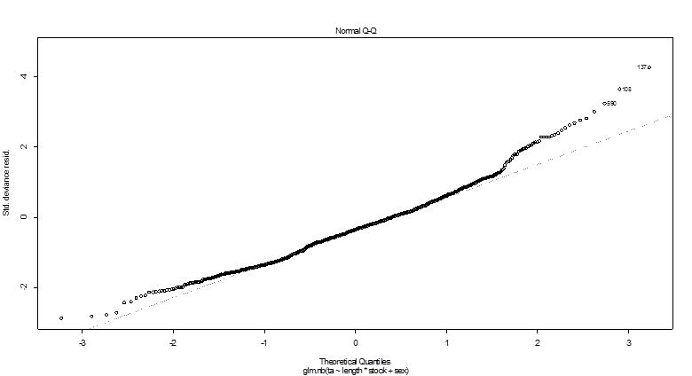
Checking Assumptions
Variance acceptably homogeneous and the residuals deviate much less from normal distribution.

Slide 17
Out of curiosity..
Again, I wanted to take a look at goodness of fit when interactive effects were removed and see what the output looked like…

Slide 18
Negative binomial Error – testing models
R code:
> library(MASS)
>nb1<-glm.nb(ta~length*stock*sex,data=parasites)
>nb2<-glm.nb(ta~length*stock+sex,data=parasites)
> anova(nb1,nb2,test=“Chi")
Likelihood ratio tests of Negative Binomial Models
Response: ta
Model theta Resid. df 2 x log-lik. Test df LR stat. Pr(Chi)
1 length * stock + sex 1.476484 797 -4603.186
2 length * stock * sex 1.497169 788 -4596.620 1 vs 2 9 6.566185 0.6821839
Not significant, so we continue with model2

Slide 19
Negative Binomial – showing AIC method
Akaike information criterion
R code:
> library(MASS)
> nb1<-glm.nb(ta~length*stock*sex,data=parasites)
> step(nb1)
Model | AIC | Notes
nb1<-glm.nb(ta~length*stock*sex, data=parasites) | 4638.6 | All 2-way and 3-way interaction terms
nb2<-glm.nb(ta ~ length*stock + sex, data=parasites) | 4627.2 | 2-way interaction between length and stock, sex for control
nb3<-glm.nb(ta~length*stock + length*sex,data=parasites) | 4628.9 | 2-way interaction between length and sex, and length and stock
Nb4<-glm.nb(ta~length + stock + sex, data=parasites) | 4638.4 | No interaction terms
Notes:
came out with the same model! Goodness of fit
AIC penalizes for the number of parameters – takes into consideration the goodness of fit and the number of parameters.
Leave the world of the P value – no conclusion about statistical significant.

Slide 20
F test vs AIC
F-test
AIC
Log likelihood ratio - ΔG
Used when models are nested
High G = low P → evidence against the reduced model
Models do not need to be nested
No p-value
Gives weight of evidence
No standards
Stick to one or the other!

Slide 21
R output – neg.binom
glm.nb(ta~length*stock+sex,data=LCparasites26)
Deviance Residuals:
Min 1Q Median 3Q Max
-2.7836 -1.0219 -0.3439 0.2465 4.2533
Coefficients:
Estimate Std. Error z value Pr(>|z|)
(Intercept) -0.857278 0.284080 -3.018 0.002547 **
length 0.036062 0.004363 8.266 < 2e-16 ***
stock3M 3.145196 0.376816 8.347 < 2e-16 ***
stock3NO -0.377391 0.373308 -1.011 0.312047
stock3Ps 0.915645 0.443379 2.065 0.038909 *
stock4R3Pn 0.425303 0.548361 0.776 0.437992
sexM 0.051087 0.067165 0.761 0.446881
length:stock3M -0.020936 0.006003 -3.488 0.000487 ***
length:stock3NO 0.006580 0.006068 1.084 0.278208
length:stock3Ps -0.006939 0.007328 -0.947 0.343737
length:stock4R3Pn 0.014940 0.009737 1.534 0.124972
---
Signif. codes: 0 ‘***’ 0.001 ‘**’ 0.01 ‘*’ 0.05 ‘.’ 0.1 ‘ ’ 1
(Dispersion parameter for Negative Binomial(1.4765) family taken to be 1)
Null deviance: 1566.18 on 807 degrees of freedom
Residual deviance: 885.99 on 797 degrees of freedom
AIC: 4627.2
Number of Fisher Scoring iterations: 1
Theta: 1.4765
Std. Err.: 0.0938
2 x log-likelihood: -4603.1860

Slide 22
Comparison of error structures
Negative Binomial
Quasipoisson
2 ways to do this in R
1. R code:
res<-residuals(mod)
fits<-fitted(mod)
plot(res~fits)
2. Rcode:
plot(mod)
mod = name of your model
GOOD!
BAD!

Slide 23
Dealing with a significant interaction
Since we can’t analyze the main effects when they have an interactive effect, we must address this
Regression of parasite abundance on length by stock
Analyze the residuals by stock and length
This makes our new response variable: length adjusted parasite load

Slide 24
4. Length adjusted parasite load
Model each stock by length and parasite count (negative binomial)
Find the residuals for each data point → length adjusted parasite load
Use residuals as response variable in new model

Slide 25
Counts by length for each stock
This is done for each stock!
>mod1<-glm.nb(ta[stock=="2J3KL"]~ 0+length[stock=="2J3KL"])
>plot(mod1)
Output:
Deviance Residuals:
Min 1Q Median 3Q Max
-2.2121 -1.0600 -0.4426 0.2709 2.6190
Coefficients:
Estimate Std. Error z value Pr(>|z|)
length["2J3KL"] 0.023516 0.001247 18.85 <2e-16 ***
>plot(length [stock=="2J3KL"], ta[stock=="2J3KL"], pch=1, ylim=c(0,50), xlim=c(0,150))
Notes:
Since we didn’t want a negative intercept, we put 0+ to bound the variables above 0.

Slide 26
R code for each stock:
mod1<-glm.nb(ta[stock=="2J3KL"]~ 0+length[stock=="2J3KL"])
mod2<-glm.nb(ta[stock=="3M"]~ 0+length[stock=="3M"])
mod3<-glm.nb(ta[stock=="3NO"]~ 0+length[stock=="3NO"])
mod4<-glm.nb(ta[stock=="3Ps"]~ 0+length[stock=="3Ps"])
mod5<-glm.nb(ta[stock=="4R3Pn"]~ 0+length[stock=="4R3Pn"])
0+length → bounds the intercept above 0, can’t have a negative parasite load.

Slide 27
Coefficients for each regression
Stock | Estimate | Std. Error | z value | Pr(>|z|)
2J3KL | 0.023516 | 0.001247 | 18.85 | <2e-16 | ***
3M | 0.55789 | 0.001719 | 32.56 | <2e-16 | ***
3NO | 0.021695 | 0.001622 | 13.37 | <2e-16 | ***
3Ps | 0.0303947 | 0.0009623 | 31.59 | <2e-16 | ***
4R3Pn | 0.043409 | 0.001295 | 33.53 | <2e-16 | ***
Notes:
Errors look somewhat ok

Slide 28
Assumptions
Homogeneity ok, some deviation from normal distribution of errors…

Slide 29
lm<-lm(residuals~stock*sex,data=parasites)
Assumptions not met?…but I wanted to look at the output….
Residuals:
Min 1Q Median 3Q Max
-2.2776 -0.7438 -0.0714 0.5683 3.8591
Coefficients:
Estimate Std. Error t value Pr(>|t|)
(Intercept) -0.35012 0.10504 -3.333 0.000898 ***
stock3M -0.05695 0.17054 -0.334 0.738532
stock3NO -0.06387 0.14938 -0.428 0.669076
stock3Ps 0.07567 0.14134 0.535 0.592553
stock4R3Pn 0.12366 0.14813 0.835 0.404074
sexM -0.07438 0.15695 -0.474 0.635695
stock3M:sexM 0.51196 0.25009 2.047 0.040974 *
stock3NO:sexM 0.04541 0.21586 0.210 0.833442
stock3Ps:sexM 0.17119 0.21010 0.815 0.415433
stock4R3Pn:sexM -0.08528 0.22651 -0.377 0.706644
---
Signif. codes: 0 ‘***’ 0.001 ‘**’ 0.01 ‘*’ 0.05 ‘.’ 0.1 ‘ ’ 1
Residual standard error: 0.9965 on 798 degrees of freedom
(4 observations deleted due to missingness)
Multiple R-squared: 0.01589, Adjusted R-squared: 0.004789
F-statistic: 1.432 on 9 and 798 DF, p-value: 0.1701

Slide 30
5. Log transformation of data
Log transformed parasite counts → log10 (n+1) so we don’t have any zero's
Back to the general linear model, but with results on multiplicative scale because of log transform.
lm<-lm(log10(ta+1) ~ length * stock *sex, data= parasites)

Slide 31
Assumptions met?
>plot(lm)
Yes!

Slide 32
R output: log transformation
Call:
lm(formula = log10(ta + 1) ~ length * stock * sex, data = parasites)
Coefficients:
Estimate Std. Error t value Pr(>|t|)
(Intercept) -0.245413 0.120137 -2.043 0.0414 *
length 0.013763 0.001915 7.187 1.54e-12 ***
stock3M 0.877239 0.175191 5.007 6.81e-07 ***
stock3NO 0.211575 0.162335 1.303 0.1928
stock3Ps 0.316534 0.202146 1.566 0.1178
stock4R3Pn 0.049744 0.250060 0.199 0.8424
sexM 0.159477 0.175949 0.906 0.3650
length:stock3M -0.004139 0.002767 -1.496 0.1350
length:stock3NO -0.004481 0.002714 -1.651 0.0992 .
length:stock3Ps -0.002498 0.003352 -0.745 0.4564
length:stock4R3Pn 0.007327 0.004447 1.647 0.0999 .
length:sexM -0.003003 0.002879 -1.043 0.2972
stock3M:sexM 0.020101 0.268545 0.075 0.9404
stock3NO:sexM -0.351461 0.238055 -1.476 0.1402
stock3Ps:sexM -0.217929 0.300709 -0.725 0.4688
stock4R3Pn:sexM -0.162171 0.404415 -0.401 0.6885
length:stock3M:sexM 0.001943 0.004484 0.433 0.6649
length:stock3NO:sexM 0.006927 0.004131 1.677 0.0940 .
length:stock3Ps:sexM 0.004675 0.005156 0.907 0.3649
length:stock4R3Pn:sexM 0.002122 0.007447 0.285 0.7757
---
Signif. codes: 0 ‘***’ 0.001 ‘**’ 0.01 ‘*’ 0.05 ‘.’ 0.1 ‘ ’ 1
Residual standard error: 0.33 on 788 degrees of freedom
Multiple R-squared: 0.4753, Adjusted R-squared: 0.4626
F-statistic: 37.57 on 19 and 788 DF, p-value: < 2.2e-16
NO significant interaction effects!!!

Slide 33
Anova – Type III
R code:
>library(car)
> Anova(lm, type="III")
Anova Table (Type III tests)
Response: log10(ta + 1)
Sum Sq Df F value Pr(>F)
(Intercept) 0.455 1 4.1729 0.04141 *
length 5.626 1 51.6462 1.543e-12 ***
stock 3.123 4 7.1677 1.138e-05 ***
sex 0.089 1 0.8215 0.36501
length:stock 1.014 4 2.3279 0.05472 .
length:sex 0.119 1 1.0882 0.29718
stock:sex 0.336 4 0.7717 0.54373
length:stock:sex 0.337 4 0.7738 0.54235
Residuals 85.839 788
---
Signif. codes: 0 ‘***’ 0.001 ‘**’ 0.01 ‘*’ 0.05 ‘.’ 0.1 ‘ ’ 1

Slide 34
Conclusions
There are significant differences in infection levels among stocks, on a log scale.
  (F=7.1677, df= 4, p= 1.138 e-5)
There are significant effects of length on infection levels, on a log scale.
  (F=51.6462, df=1, p= 1.543 e-12)
There are no significant differences in infection levels between male and females
on a log scale.
  (F=0.8215, df= 1, p= 0.36501)

Slide 35
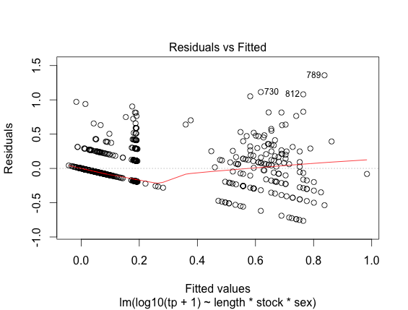
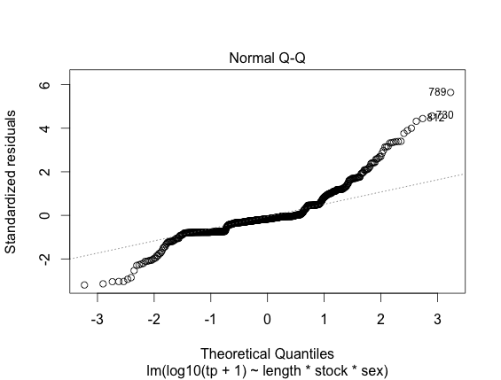
With sealworm… ☹
= TERRIBLE
Anova Table (Type III tests)
Response: log10(tp + 1)
Sum Sq Df F value Pr(>F)
(Intercept) 0.000 1 0.0081 0.928210
length 0.048 1 0.7899 0.374389
stock 0.408 4 1.6897 0.150375
sex 0.000 1 0.0049 0.943944
length:stock 1.056 4 4.3721 0.001676 **
length:sex 0.001 1 0.0212 0.884260
stock:sex 0.864 4 3.5763 0.006698 **
length:stock:sex 0.971 4 4.0180 0.003114 **
Residuals 47.585 788
---
Signif. codes: 0 ‘***’ 0.001 ‘**’ 0.01 ‘*’ 0.05 ‘.’ 0.1 ‘ ’ 1

Slide 36
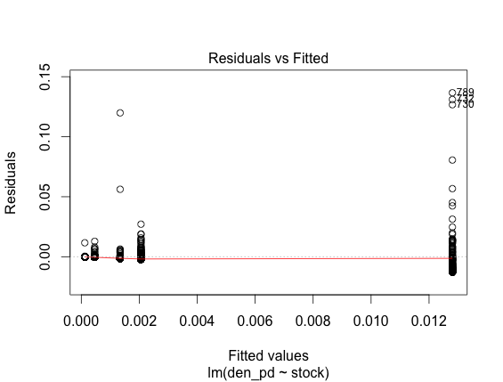
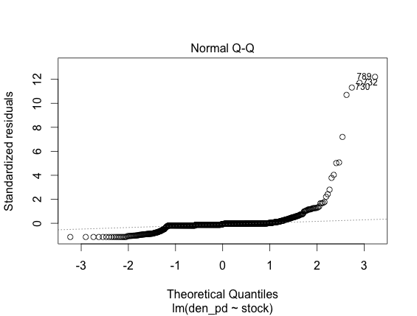
6. Density as a variable
lm<-lm(den_pd~stock*sex,data=lcparasites)
BAD!
Look at output on next slide out of curiosity…

Slide 37
R output - density
Call: lm(formula = den_pd ~ stock * sex, data = lcparasites)
Residuals:
Min 1Q Median 3Q Max
-0.013935 -0.001989 -0.000665 -0.000222 0.135490
Coefficients:
Estimate Std. Error t value Pr(>|t|)
(Intercept) 4.663e-04 1.189e-03 0.392 0.695
stock3M -2.445e-04 1.930e-03 -0.127 0.899
stock3NO 5.407e-04 1.691e-03 0.320 0.749
stock3Ps 1.659e-03 1.600e-03 1.037 0.300
stock4R3Pn 1.347e-02 1.677e-03 8.033 3.4e-15 ***
sexM -8.865e-06 1.776e-03 -0.005 0.996
stock3M:sexM -2.037e-04 2.831e-03 -0.072 0.943
stock3NO:sexM 6.877e-04 2.443e-03 0.281 0.778
stock3Ps:sexM -1.268e-04 2.378e-03 -0.053 0.957
stock4R3Pn:sexM -2.753e-03 2.564e-03 -1.074 0.283
---
Signif. codes: 0 ‘***’ 0.001 ‘**’ 0.01 ‘*’ 0.05 ‘.’ 0.1 ‘ ’ 1
Residual standard error: 0.01128 on 798 degrees of freedom
(4 observations deleted due to missingness)
Multiple R-squared: 0.1477, Adjusted R-squared: 0.1381
F-statistic: 15.36 on 9 and 798 DF, p-value: < 2.2e-16

Slide 38
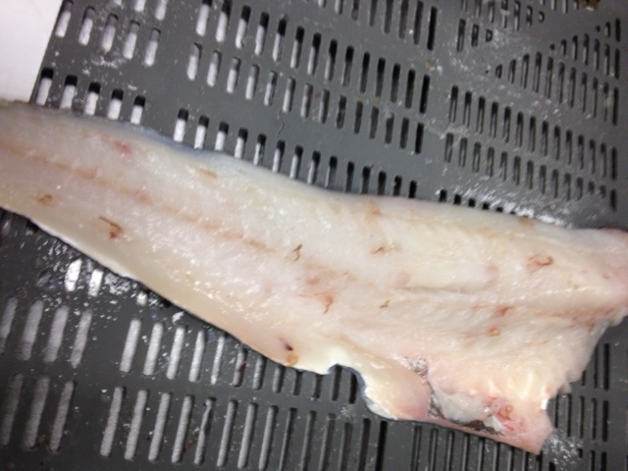
Next: Randomization Test!!
The assumptions for the distributions are not holding for analysis of density data
So, we evaluate our statistic by constructing a frequency distribution of outcomes based on repeating sampling of outcomes when the null is made true by random sampling (to be done).
End result: A p value with no assumptions

Slide 39
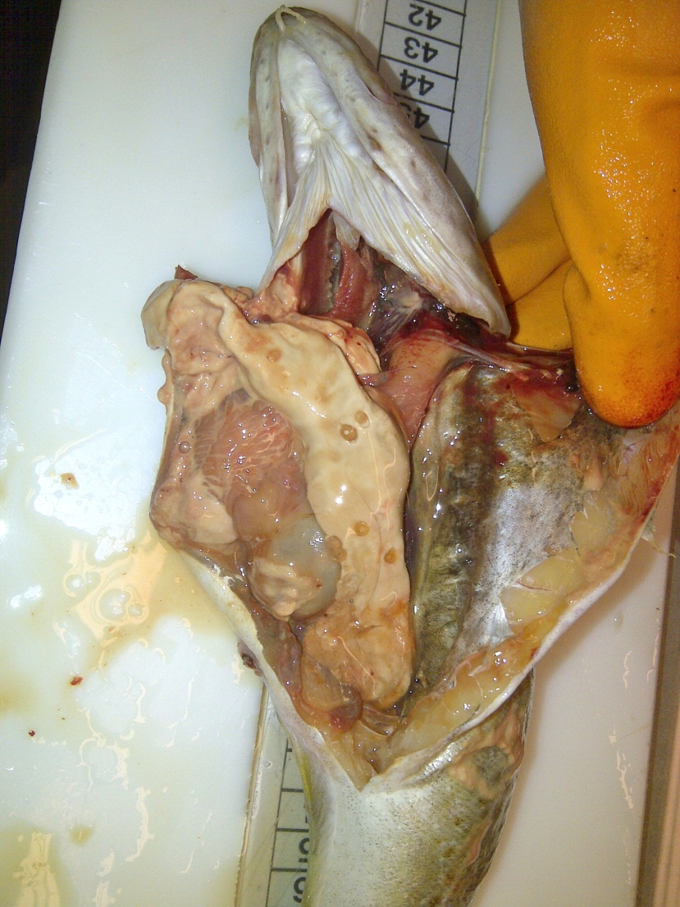
Prevalence data – binary response variable

Slide 40
Data inspection
R code: table(inf_a,stock)
inf 2J3KL 3M 3NO 3Ps 4R3Pn
0 35 2 55 9 4
1 128 103 128 198 150
total 163 105 183 207 154
R code: tapply(inf_a,stock,mean)
2J3KL 3M 3NO 3Ps 4R3Pn
0.7853 0.9810 0.6995 0.9565 0.9740
R code: table(inf_a,sex)
sex
inf F M
0 50 53
1 385 320

Slide 41
Prevalence model
Prevalence(yes/no) → Binomial error (logit)
I = e^{(η)} + binomial error
η = β_{o} + β_{L}·L + β_{S}·S + β_{C}·C +β_{L·S}L·S +β_{L·C}L·C+β_{C·S}C·S+β_{L·S·C}·L·S·C
I = Infection (response)
Β_{o} = Intercept
L = Length (explanatory - control)
C = Cod stock (explanatory)
S= Sex (explanatory - control)

Slide 42
Goodness of Fit
> anova(model1,model2,test="Chi")
Analysis of Deviance Table
Model 1: inf_a ~ stock * length * sex
Model 2: inf_a ~ stock * length + sex
Resid. Df Resid. Dev Df Deviance Pr(>Chi)
1 788 398.40
2 797 413.57 -9 -15.175 0.08623 .
---
Signif. codes: 0 ‘***’ 0.001 ‘**’ 0.01 ‘*’ 0.05 ‘.’ 0.1 ‘ ’ 1
Not significant so we accept model 2! (if assumptions met)

Slide 43
R-output – prevalence
glm(formula = inf_a ~ stock * length + sex, family = binomial, data = LCparasites26)
Deviance Residuals:
Min 1Q Median 3Q Max
-3.00278 0.07431 0.20625 0.40994 1.64307
Coefficients:
Estimate Std. Error z value Pr(>|z|)
(Intercept) -3.472648 0.883234 -3.932 8.43e-05 ***
stock3M 4.123888 2.879948 1.432 0.152
stock3NO -0.213392 1.213776 -0.176 0.860
stock3Ps 1.130513 1.902475 0.594 0.552
stock4R3Pn -4.741315 4.795454 -0.989 0.323
length 0.091729 0.017859 5.136 2.80e-07 ***
sexM 0.037974 0.253119 0.150 0.881
stock3M:length -0.021996 0.068304 -0.322 0.747
stock3NO:length 0.004583 0.025777 0.178 0.859
stock3Ps:length 0.014434 0.040066 0.360 0.719
stock4R3Pn:length 0.161736 0.111830 1.446 0.148
---
(Dispersion parameter for binomial family taken to be 1)
Null deviance: 616.60 on 807 degrees of freedom
Residual deviance: 413.57 on 797 degrees of freedom
AIC: 435.57
Number of Fisher Scoring iterations: 8

Slide 44
Test of the fit of the logistic to data: Using Rugs
Rugs, one-D addition, showing locations of data points along x axis.
Are values clustered at certain values of the regression explanatory variable vs evenly spaced out
Use “jitter” to spread out values
Data was cut into bins, plot empirical probabilities (with SE), for comparison to the logistic curve

Slide 45
R code:
Make sure you attach your data file first: attach(lcparasites)
plot(length,inf_a)
rug(jitter(length[inf_a==0]))
rug(jitter(length[inf_a==1]))
rug(jitter(length[inf_a==1]),side=3)
cutl<-cut(length,5)
tapply(inf_a,cutl,sum)
table(cutl)
probs<-tapply(inf_a,cutl,sum)/table(cutl)
probs
probs<-as.vector(probs)
resmeans<-tapply(length,cutl,mean)
lenmeans<-tapply(length,cutl,mean)
lenmeans<as.vector(lenmeans)
lenmeans<-as.vector(lenmeans)
model<-glm(inf_a~length,binomial)
xv<-0:150
yv<-predict(model,list(length=xv),type="response")
lines(xv,yv)
points(lenmeans,probs,pch=16,cex=2)
se<-sqrt(probs*(1-probs)/table(cutl))
up<-probs+as.vector(se)
down<-probs-as.vector(se)
for(i in 1:5){lines(c(resmeans[i],resmeans[i]),c(up[i],down[i]))}
My variables:
length – regression variable
inf_a – infected/uninfected (0 or 1)
In blue is the code that I changed.
Refer to Page 596-598 in “R Book” by Crawley

Slide 46
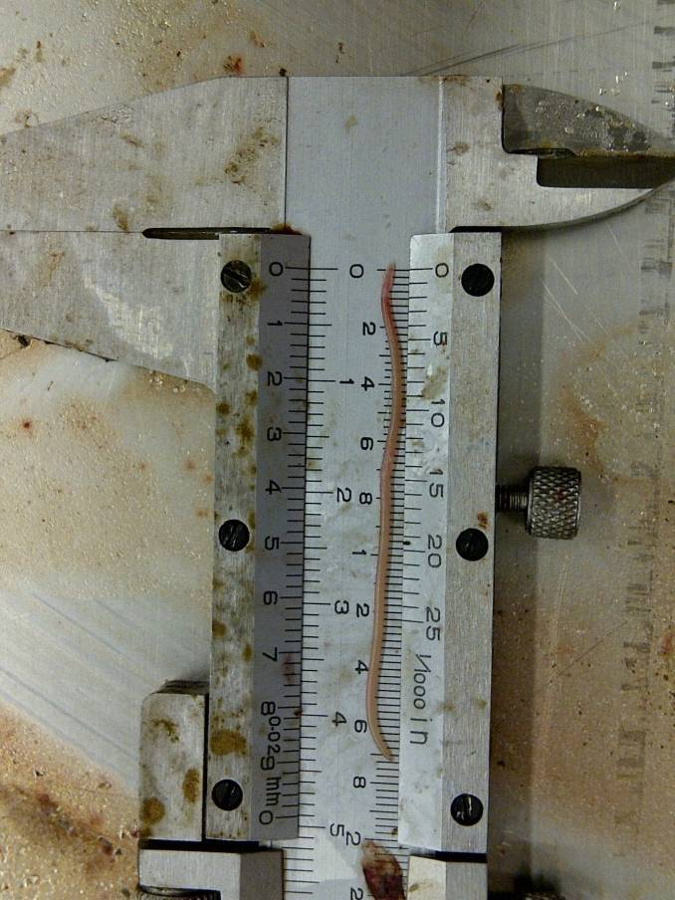
Sealworm
table(inf_p,stock)
inf_p 2J3KL 3M 3NO 3Ps 4R3Pn
0 135 102 160 123 17
1 28 3 23 84 137
tapply(inf_p,stock,mean)
2J3KL 3M 3NO 3Ps 4R3Pn
0.171779 0.028571 0.125683 0.405797 0.889610

Slide 47
R output - sealworm
glm(formula = inf_p ~ stock * length + sex, family = binomial,
data = lcparasites)
Deviance Residuals:
Min 1Q Median 3Q Max
-2.3849 -0.6254 -0.4311 0.4714 3.0123
Coefficients:
Estimate Std. Error z value Pr(>|z|)
(Intercept) -2.9683810 0.7821365 -3.795 0.000148 ***
stock3M -2.4639280 2.2165005 -1.112 0.266297
stock3NO -0.1618711 1.0326490 -0.157 0.875439
stock3Ps 2.9116929 1.0705641 2.720 0.006533 **
stock4R3Pn 2.3761654 1.8461957 1.287 0.198073
length 0.0227430 0.0117422 1.937 0.052763 .
sexM 0.0118247 0.1940257 0.061 0.951404
stock3M:length 0.0074580 0.0312028 0.239 0.811091
stock3NO:length -0.0006478 0.0163626 -0.040 0.968419
stock3Ps:length -0.0286721 0.0174418 -1.644 0.100203
stock4R3Pn:length 0.0290167 0.0349088 0.831 0.405854

Slide 48
R output: sex and length first
No change…
Call:
glm(formula = inf_p ~ sex + length * stock, family = binomial,
data = parasites)
Deviance Residuals:
Min 1Q Median 3Q Max
-2.3849 -0.6254 -0.4311 0.4714 3.0123
Coefficients:
Estimate Std. Error z value Pr(>|z|)
(Intercept) -2.9683810 0.7821365 -3.795 0.000148 ***
sexM 0.0118247 0.1940257 0.061 0.951404
length 0.0227430 0.0117422 1.937 0.052763 .
stock3M -2.4639280 2.2165005 -1.112 0.266297
stock3NO -0.1618711 1.0326490 -0.157 0.875439
stock3Ps 2.9116929 1.0705641 2.720 0.006533 **
stock4R3Pn 2.3761654 1.8461957 1.287 0.198073
length:stock3M 0.0074580 0.0312028 0.239 0.811091
length:stock3NO -0.0006478 0.0163626 -0.040 0.968419
length:stock3Ps -0.0286721 0.0174418 -1.644 0.100203
length:stock4R3Pn 0.0290167 0.0349088 0.831 0.405854
---
Signif. codes: 0 ‘***’ 0.001 ‘**’ 0.01 ‘*’ 0.05 ‘.’ 0.1 ‘ ’ 1
(Dispersion parameter for binomial family taken to be 1)
Null deviance: 1034.96 on 807 degrees of freedom
Residual deviance: 687.04 on 797 degrees of freedom
(4 observations deleted due to missingness)
AIC: 709.04
Number of Fisher Scoring iterations: 6

Slide 49
Table of results for sealworm
Stock | N total | N infected | Proportion | odds | OR | corrected OR** | SE | z value
2J3KL | 163 | 28 | 0.171779 | 0.207407 |  |  | 0.782137 | -3.795
3M | 105 | 3 | 0.028571 | 0.029412 | 0.141807 | 0.0851 | 2.216501 | -1.112
3NO | 183 | 23 | 0.125683 | 0.14375 | 0.69308 | 0.850551 | 1.032649 | -0.157
3Ps | 207 | 84 | 0.405797 | 0.682927 | 3.292683 | 18.3879 | 1.070564 | 2.72
4R3Pn | 154 | 137 | 0.88961 | 8.058824 | 38.85504 | 10.76355 | 1.846196 | 1.287
OR = odds ratio
**Corrected odds (where length and sex were included in model)
= exp(Estimate)
Ex: for 3M
coefficient = -2.4639 (previous slide)
odds ratio corrected for length and sex = exp(-2.4639) = 0.0851

Slide 50
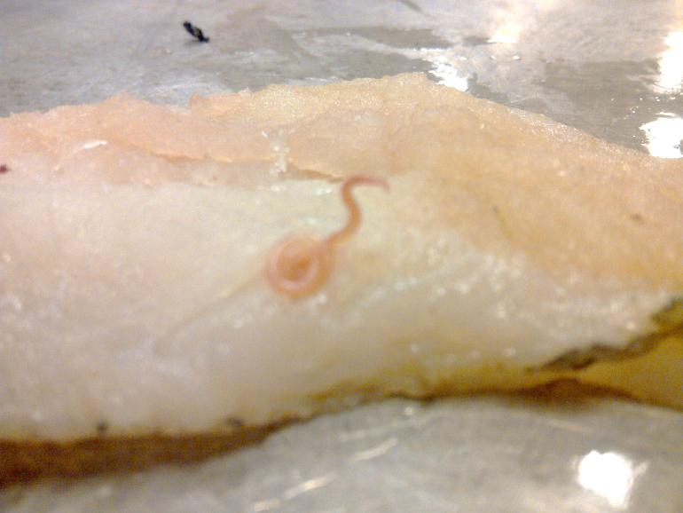
TO BE CONTINUED….
Thank you for listening!!!

