Slide 1
The Rna Code and Protein Synthesis
Ryan Collins, Gerissa Fowler, Sean Gamberg, Josselyn Hudasek, & Victoria Mackey

Slide 2
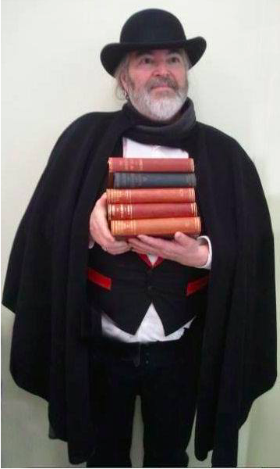
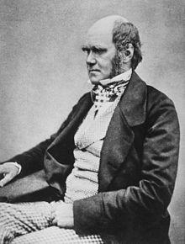
Timeline Leading up to Nirenberg's 1966 paper
1859:
Charles Darwin published his book “The Origin of Species”

Slide 3
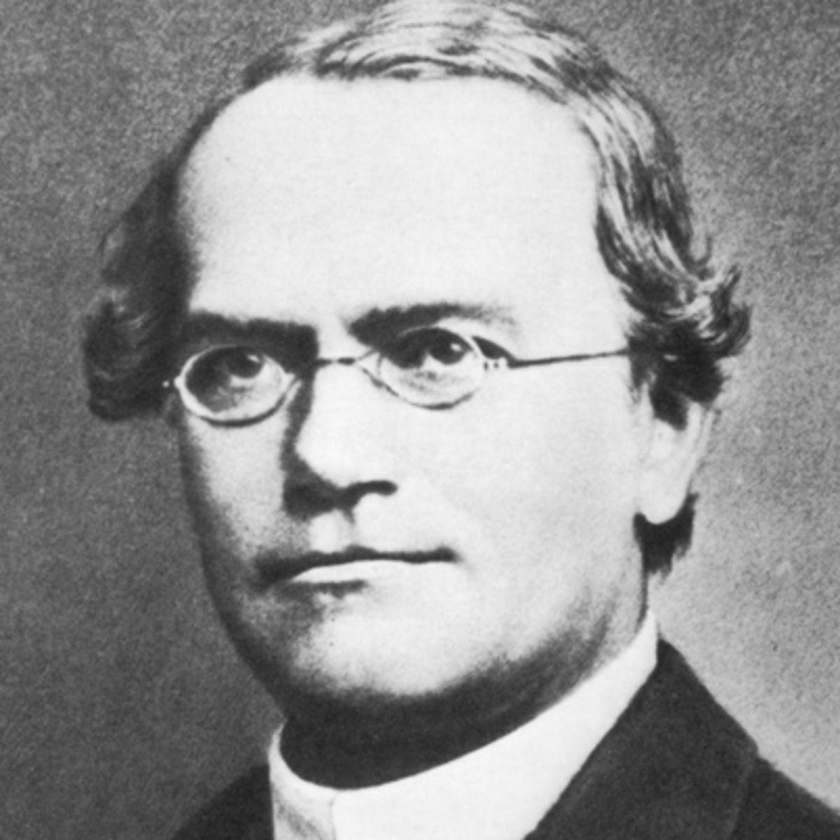
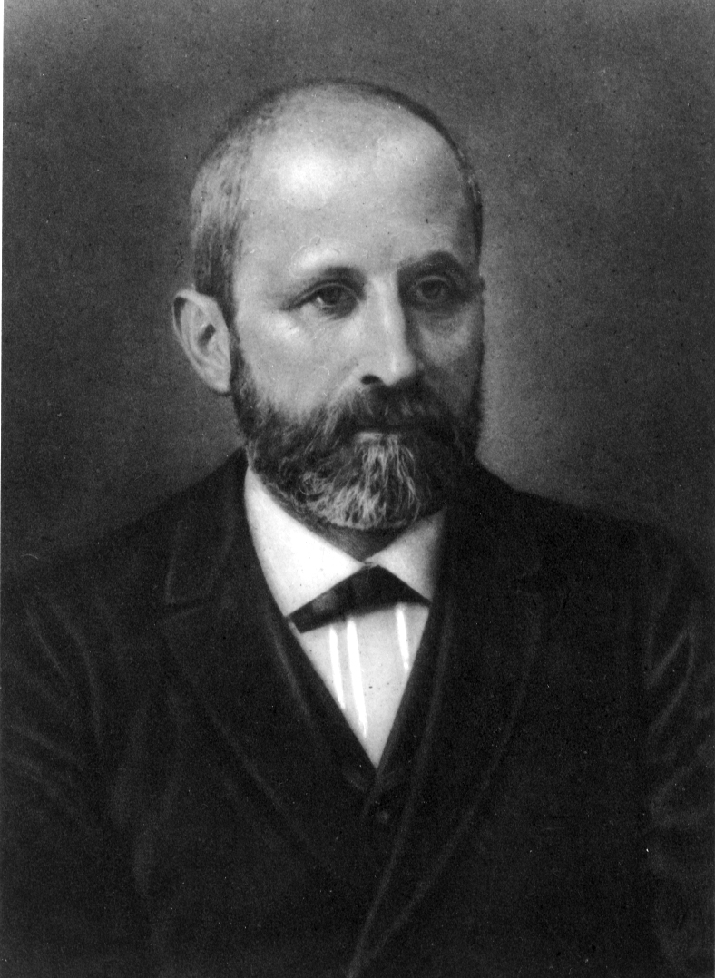
1866:
Gregor Mendel completed his experiments on pea plants, thus marking the beginning of genetics as a science
1868:
Friedrich Miescher isolated nuclein from the cell nuclei

Slide 4
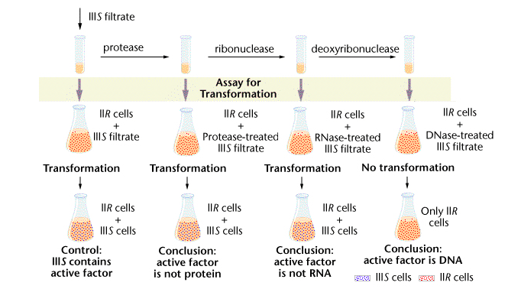
1944: Avery discovered DNA and suggested that it responsible for the transforming principle
1950: Chargaff’s rules

Slide 5
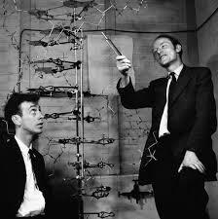
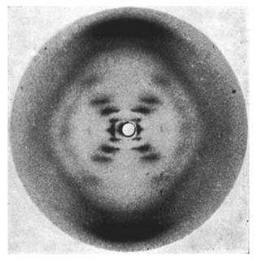
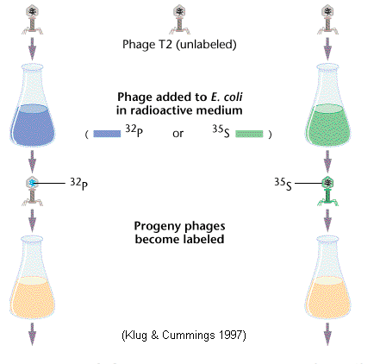
1952: Photo 51 by Franklin and Gosling
1952: Hershey & Chase blender experiment
1953: Watson & Crick’s DNA model

Slide 6
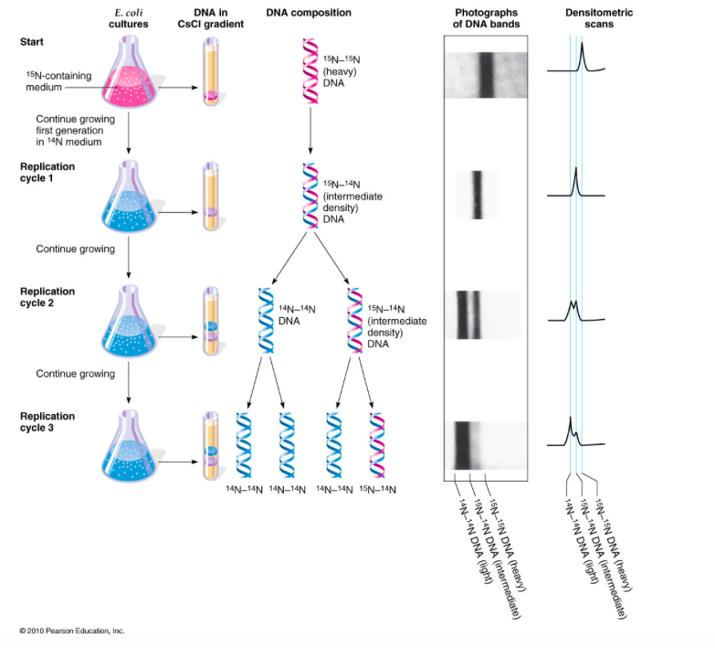
1958: DNA is Semiconservative
1961:
Brenner, Jacod, Crick & Monod discovers mRNA
Gamow suggests triplet code
Nirenberg and Matthaei identify the amino acid for poly-U

Slide 7
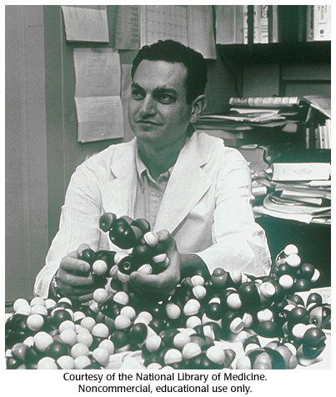
Dr. Marshall Nirenberg (1927-2010)
•Born in NY city and grew up in Florida
•Interest in bird-watching
•University of Florida
•B.Sc. and master’s
•University of Michigan
•Ph.D.
•National Institute of Health
•Interested in fundamentality of life

Slide 8
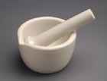
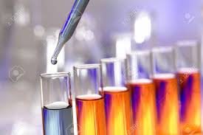
Poly-U Experiment
E. Coli bacteria is ground up to produce a cell-free system
Treated with DNase
20 test tubes were used, one radioactively labeled, containing:
E. Coli extract
Synthetic RNA made of uracil
Amino acids

Slide 9
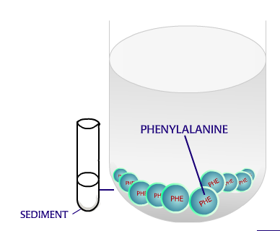
Results
When radiolabeled Phenylalanine was added to the test tube with synthetic RNA composed of only uracil they found polypeptides made of only Phenylalanine
The code can be broken!!

Slide 10
1963 Cold Spring Harbor Meeting
Central Dogma and properties of the RNA code
Questions raised about the fine structure of RNA
DNA
RNA
Protein

Slide 11
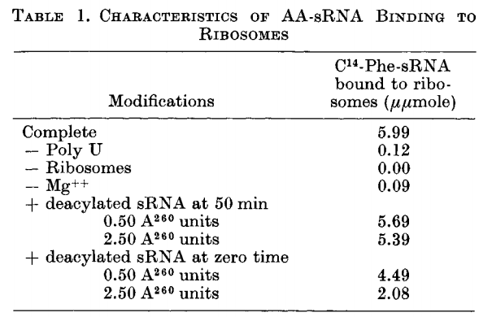
Formation of codon-ribosome-AA-sRNA complexes
Base sequence assay requires the following:
trinucleotides are able to serve as templates for AA-sRNA-ribosome binding
codon-ribosome-AA-sRNA complexes can be retained by cellulose nitrate filters

Slide 12
Formation of codon-ribosome-AA-sRNA complexes
Poly U: codon
Ribosome: translational apparatus. Sourced from E. coli
Mg++: Critical for Aminoacyl tRNA synthetase action
deacylated sRNA: Competitively binds to ribosome

Slide 13
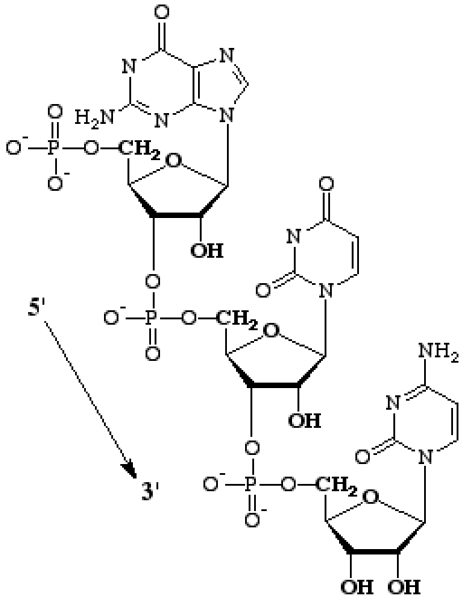
Formation of codon-ribosome-AA-sRNA complexes
Oligionucleotides synthesized using two methods:
Polynucleotide phosphorylase (PNPase)
UpU + pUp = UpUpU + Pi
Pancreatic RNase catalysis
uridine- or cytidine-2’,3’ cyclic phosphate

Slide 14
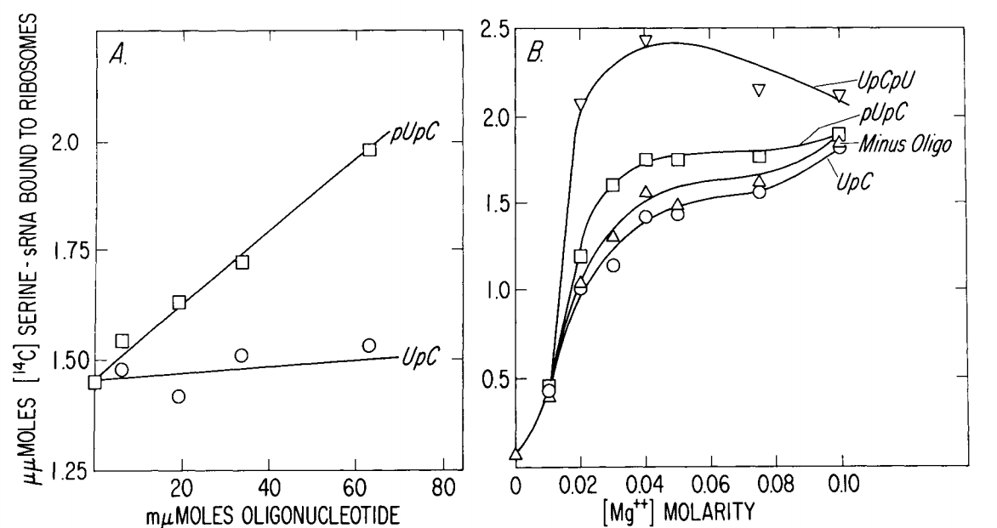
Template Activity of Oligonucleotides with Terminal and Internal Substitutions
Trinucleotides stimulate binding of respective sRNA to a much greater degree than corresponding dinucleotides
Demonstrates triplet code, 3 sequential bases

Slide 15
Template Activity of Oligonucleotides with Terminal and Internal Substitutions
Triplets with 5’ terminal phosphate have greater activity than those with 3’ terminal phosphates
Hexa-A nucleotides more active than penta-A
Two Lys-sRNA bind to hexa-A, only one to penta-A
Multiples of 3

Slide 16
Template Activity of Oligonucleotides with Terminal and Internal Substitutions
Doublet with a 5’ phosphate pUpC templates for Ser-sRNA but not Leu-sRNA or Ile-sRNA
Ser: UCx
Leu: UCG > UCx
Ile: AUC
UpCpU > pUpC >>> UpC

Slide 17
Template Activity of Oligonucleotides with Terminal and Internal Substitutions
A doublet with a 5’ phosphate can serve as a specific (though weak) template
Implications:
Occasional recognition of only 2 of 3 bases during translation
triplet code made have evolved from a primitive doublet code

Slide 18
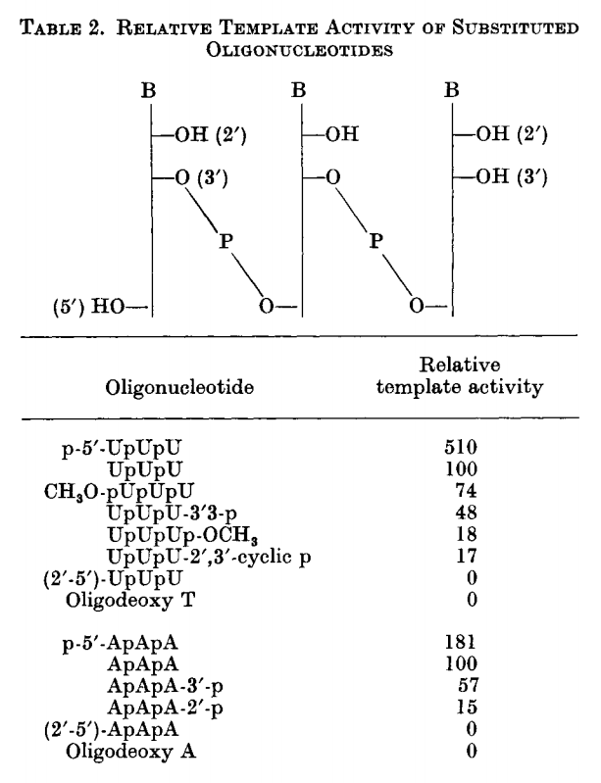
Template Activity of Oligonucleotides with Terminal and Internal Substitutions
Three classes of codons, differing in structure:
5’-terminal
internal
3’-terminal
The first base of 5’-terminal and last of 3’-terminal may be recognized with less fidelity
Greater freedom of movement in the absence of a ‘neighbor’
Terminal bases may serve as operator regions

Slide 19
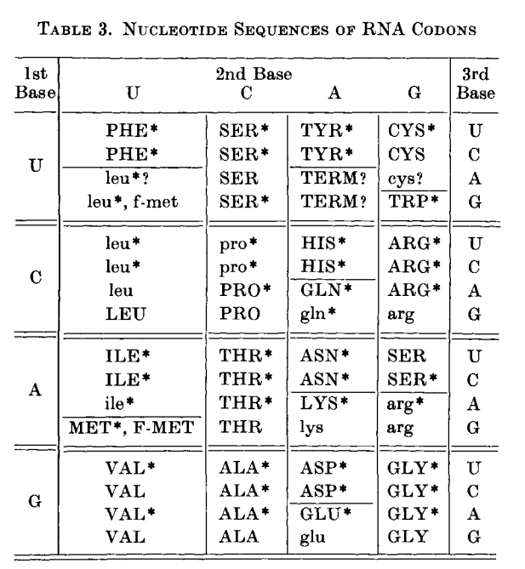
Nucleotide Sequences of RNA Codons
Determined by stimulating E. coli AA-sRNA binding to E. coli ribosomes with trinucleotide templates
Forty-six codon base compositions confirmed using trinucleotide studies
Almost all triplets correspond to amino acids

Slide 20
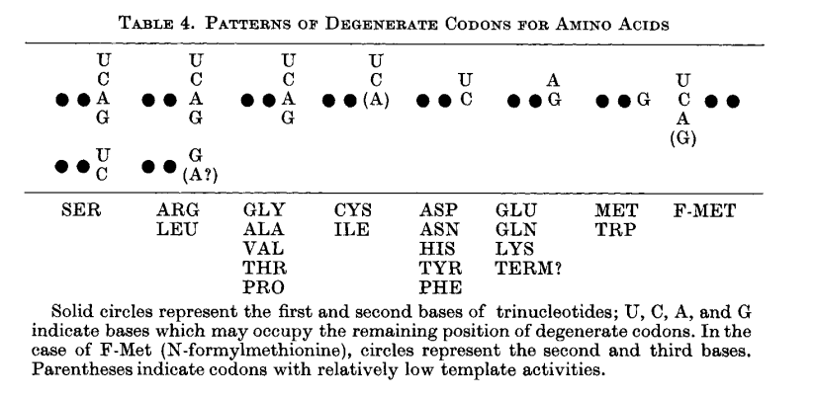
Nucleotide Sequences of RNA Codons
Alternate bases of degenerate codons usually occupy the third position
Triplet pairs with 3’ pyrimidines (XYU and XYC) usually correspond to the same amino acid
Triplet pairs with 3’ purines (XYA and XYG) often correspond with the same amino acid

Slide 21
Nucleotide Sequences of RNA Codons
Implications:
Single base replacements may be silent
Structurally/metabolically related amino acids have similar codons
Asp (GAU and GAC) similar to Glu (GAA GAG)

Slide 22
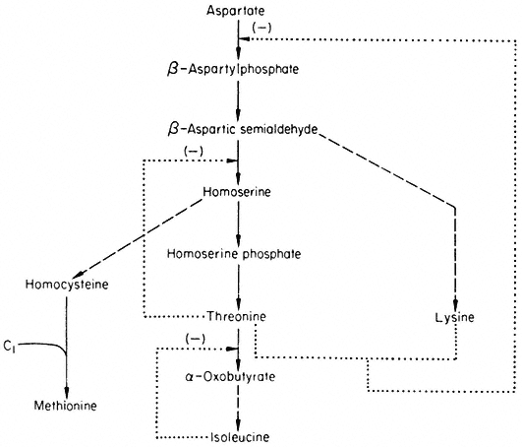
Nucleotide Sequences of RNA Codons
Grouping by biosynthetic precursor suggest codon relationships:
Asp: GAU, GAC
Asn: AAU, AAC
Lys: AAA, AAG
Thr: ACU, ACC, ACA, ACG
Ile: AUU, AUC, AUA
Met: AUG
Aromatic amino acids often begin with U:
Phe: UUU, UUC
Tyr: UAU, UAC
Trp: UUG

Slide 23
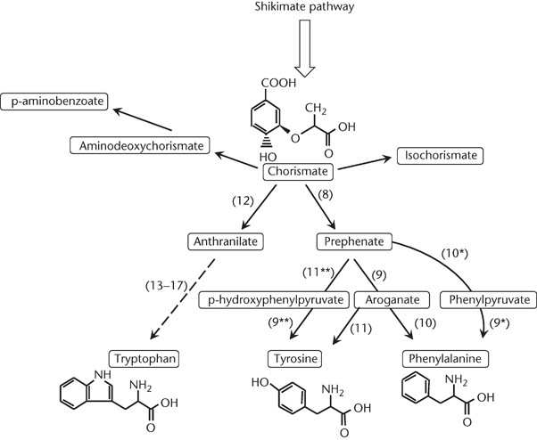
Nucleotide Sequences of RNA Codons
These relationships may be artifacts of evolution or be evidence of direct interaction between amino acids and codon bases

Slide 24
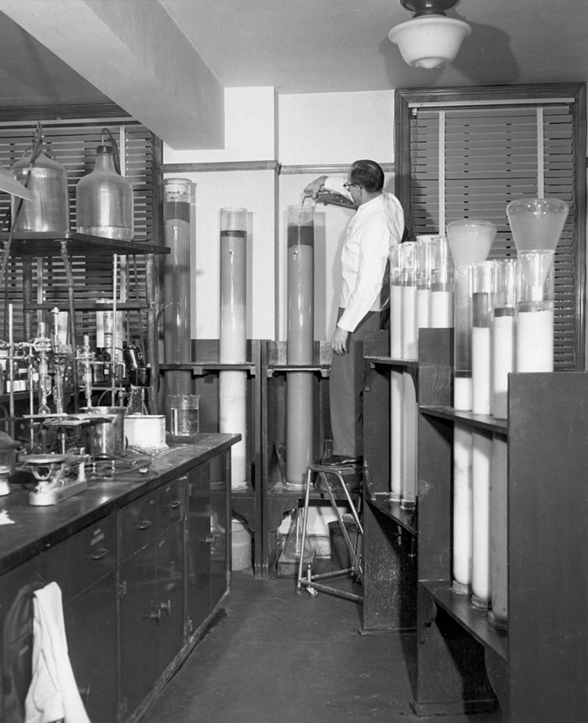
Patterns of Synonym Codons Recognized by Purified sRNA Fractions
Degenerate codons for the same amino acid may be recognized by specific sRNAs (referred to as sRNA fractions)
Fractions were purified using column chromatography and countercurrent distribution

Slide 25
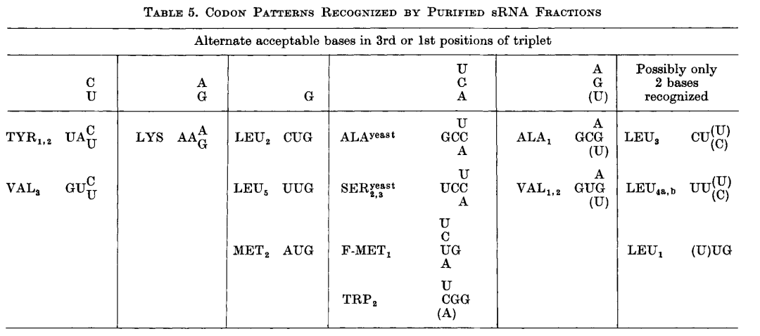
Patterns of Synonym Codons Recognized by Purified sRNA Fractions
Discernable patterns of recognition in third position synonym codons:
C = U
A = G
G
U =C = A
A = G = (U)

Slide 26
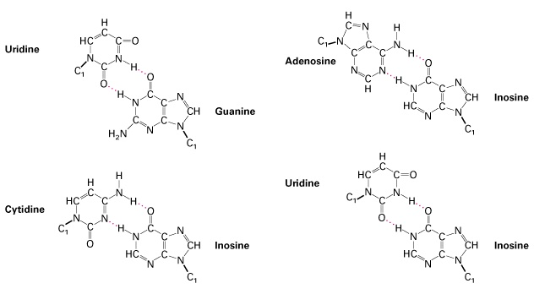
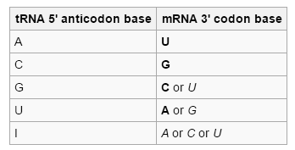
Mechanism of Codon Recognition
Crick (1966) suggests certain anticodon bases form alternate hydrogen bonds with corresponding mRNA bases
“Wobble mechanism”

Slide 27
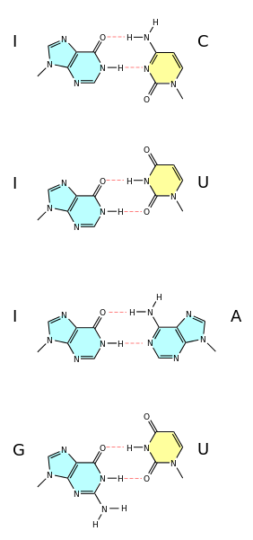
Crick’s Wobble Hypothesis
Pairings in between two nucleotides that do not follow
Watson-Crick base pair rules
Guanine-Uracil, Hypoxanthine-Uracil, Hypoxanthine-Adenine
and Hypoxanthine-Cytoseine

Slide 28
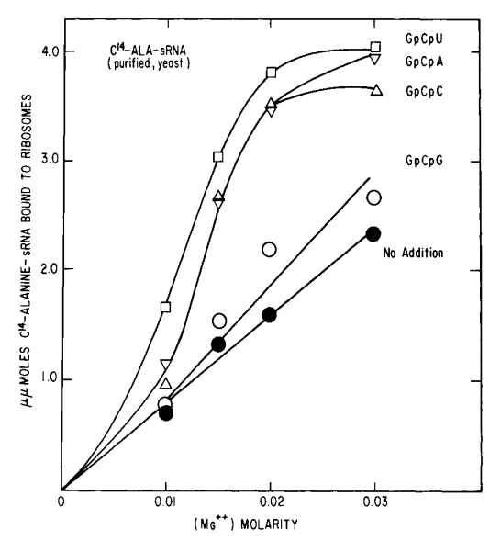
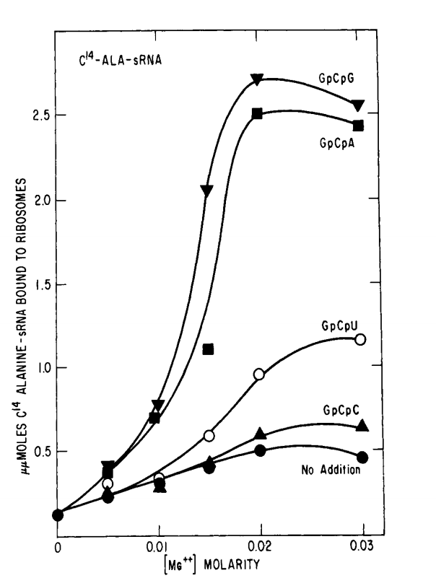
Mechanism of Codon Recognition
Purified yeast (Fig. 2) and unfractionated E. coli (Fig. 3) C¹⁴-Ala-sRNA response to synonym Ala-codons as a function of [Mg++]
Different codons may elicit divergent responses

Slide 29
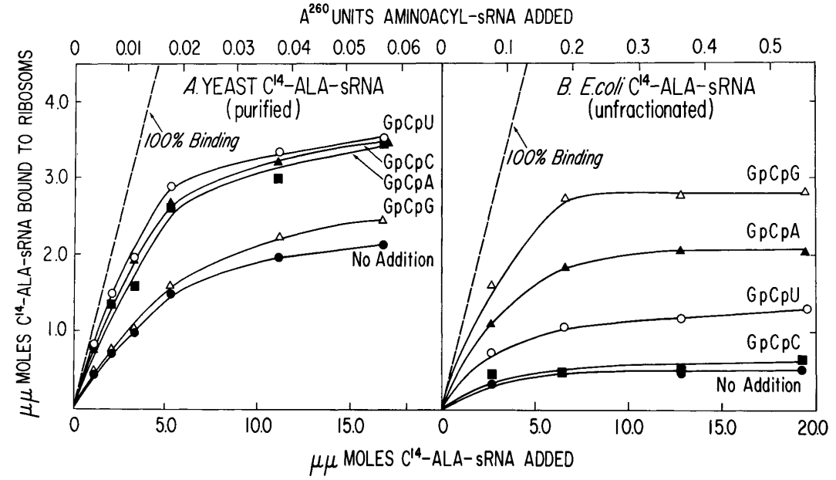
Mechanism of Codon Recognition
At limiting concentrations of C¹⁴-Ala sRNA
Yeast:
GCU - 59%; GCC - 45%; GCA - 45%; GCG - 3%
E. coli:
GCU - 18%; GCC - 2%; GCA - 38%; GCG - 64%

Slide 30
Mechanism of Codon Recognition
The purity of the yeast Ala-sRNA used in these experiments was > 95%
This implies that one specific molecule of Ala-sRNA recognizes at least 3 synonym codons
Additionally, there are disparate responses to synonym codons between yeast (Eukaryota) and E. coli (Bacteria)

Slide 31
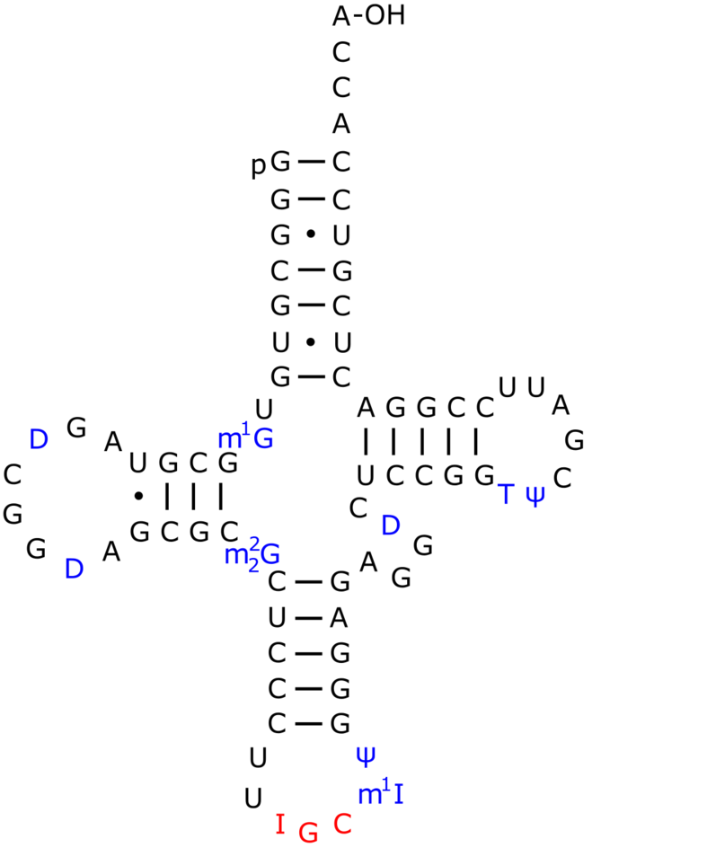
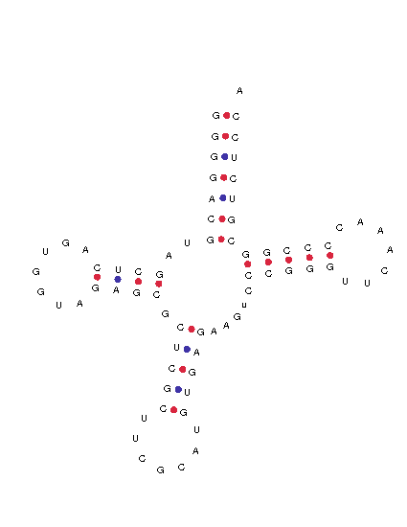
Mechanism of Codon Recognition
To further derive information about the structure of Ala-sRNA and the mechanism of codon recognition, we may relate it to its conjugate mRNA
Possible anticodon sequences:
-IGC MeI-
or
DiHU-CGG-DiHU
* I = hypoxanthine/inosine; DiHU = dihydrouracil

Slide 32
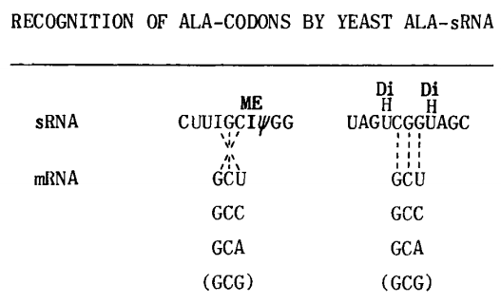
Mechanism of Codon Recognition
If CGG is the anticodon we will observe:
parallel hydrogen bonding with GCU, GCC, and GCA
If IGC is the anticodon we will observe:
antiparallel hydrogen bonds between GC in the anticodon and GC in the first and second position anticodons
alternate pairing of I in the anticodon with U, C, and A (but not G) in the third position of the Ala-codon

Slide 33
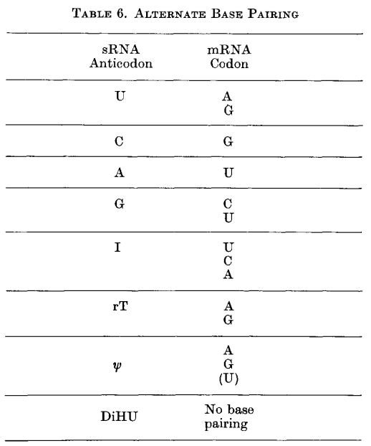
Mechanism of Codon Recognition
Evidence is consistent with an IGC Ala-anticodon
Patterns of codon recognition support wobble hypothesis
Suggest only 2 of 3 bases may be recognized

Slide 34
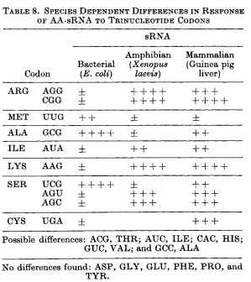
Universality
RNA code is largely universal
Cell may may differ in specificity of codon translation
Near identical translations in bacteria, mammalia and amphibia
Similarity suggests functional genetic code may be > 3 billion years old

Slide 35
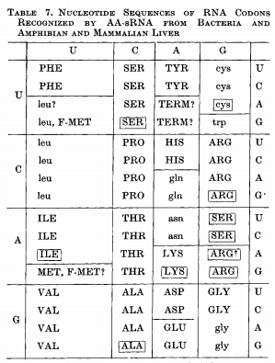
Universality

Slide 36
Unusual Aspects of Codon Recognition as potential
indicators of special codon functions
Introduction
Codon Frequency and Distribution
Codon Position
Template Activity
Codon Specificity
Conclusion

Slide 37
Introduction
Codons can serve multiple functions other than corresponding to amino acids; such as initiation & termination codons or the regulation of protein synthesis.
Some codons can exhibit special properties related to codon position, template activity/specificity, stability of codon-ribosome-tRNA complexes, etc.
These topics will be discussed to explain how they are possible indicators of special codon function.

Slide 38
Codon Frequency and Distribution
Multiple species of tRNA can correspond to the same amino acid, differing only in the 3rd base of the anticodon
Since a different tRNA is required for each codon it can be concluded that protein synthesis may be regulated by the frequency and distribution of codons (as there's a limited abundance of each tRNA) as well as recognition of degeneracies.

Slide 39
Codon Position
They discussed how reading of the mRNA is probably initiated at the 5’ terminal end to the 3’ end.
N-formyl-Met-tRNA may act as an initiator of protein synthesis (done in E. coli), binding primarily to AUG.
In E. coli protein synthesis can be initiated by start codons specifying the N-formyl-Met-tRNA or by other means that do not involve the N-formyl-Met-tRNA (possibly codons with a high Mg++ concentration).
UAA and UAG trinucleotides seem to function as terminator codons because they do not stimulate binding of the tRNA to the ribosomes.

Slide 40
Codon Position Continued
Extragenic suppressors can affect the specificity of these terminator codons (UAA and UAG).
Amber mutation - UAG codon
Ochre mutation - UAA codon
The amber suppressor mutates the tRNA to override the stop codon (UAG) and continue reading the strand (ochre suppressors working in much the same way). The amber suppressor has a higher efficiency than the ochre suppressor, therefore ochre mutations (UAA codons) are more frequent in vivo.
Protein synthesis can be regulated by the position of the codon in respect to the amber suppressors.

Slide 41
Template Activity
UAA, UAG, & UUA show little template activity for AA-tRNA, while other codons are active templates for tRNA in some organisms but not others.
Possible explanations for low template activity can be: codon position, abundance of appropriate tRNA, high ratio of deacylated to AA-tRNA, low Mg++ concentrations, special codon function, etc.

Slide 42
Codon Specificity
Synonym trinucleotides differ in template specificity and can change depending on the concentration of Mg++ present (Shown in Table 9).
At 0.010-0.015M Mg ++ trinucleotide specificity is high but at 0.03M Mg ++ there's so much Mg++ present that the specificity is reduced resulting in recognition of trinucleotides becoming ambiguous.

Slide 43
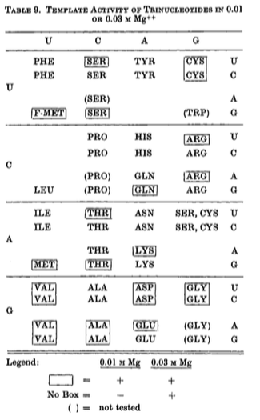
In some cases one or two codons in a synonym set are active at 0.01 m Mg++ and all degeneracies are active at 0.03 m Mg++. Other times all synonym trinucleotides are active at both concentrations (ex: Valine) or only active at the 0.03 m Mg++ concentration (ex: Tyrosine).
Codon-ribosome-AA-tRNA complexes (formed with degeneracies) therefore have varying stability.

Slide 44
Conclusion
Codons can have alternate meanings, in that the location of the codon in the strand will affect what amino acid is produced.
A codon can have multiple functions
These functions are subject to change
Degenerate codons usually exhibit differences in their template properties

Slide 45
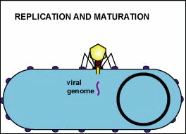
MODIFICATION OF CODON RECOGNITION DUE TO PHAGE INFECTION
Discovering the changes that a bacteriophage can make in a host cell’s protein synthesis.

Slide 46
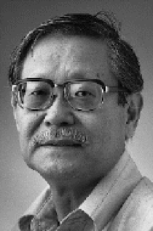
Noboru Sueoka - Molecular Biologist
born April 12 1929 in Kyoto Japan
Undergraduate (1953) and Master’s degrees from Kyoto University, PhD (1955) from California Institute of Technology
Research fellow at Harvard, Cambridge and Massachusetts
Professor at The University of Illinois, Princeton and Colorado
Member of the American Academy of Arts and Science
Contributor to over 140 articles on genetics and molecular biology
Daughter and Wife
Enjoys Fly Fishing and Skiing in his spare time

Slide 47
The Original Experiment That led to Helping Nirenberg
Completed at Princeton University
Knew that phage infection causes differentiation in gene expression within the host cell, but How?
Maybe sRNAs are involved! Using E.coli as the host cell Sueoka compared the aminoacyl-sRNAs for 17 amino acids before and after infection
Used the MAK (methylated albumin-kieselguhr) column fractionation technique
Only leucyl-sRNA showed a significant change after infection, and with even closer analysis only certain components of the sRNAs were being altered
With further experimentation, it was also found that the phage DNA must be injected into the host and protein synthesis from the host cell must continue for a short time after the infection
In the end, the host cell’s protein synthesis was inhibited and the virus’ continued

Slide 48
Sueoka & Nirenberg working together
What does this mean for the modified Leu-sRNAs codon recognition?
sRNAs were isolated from the E. coli host cell before the phage infection and at 1 minute and 8 minutes after the infection
sRNA was then acylated with H³ leucine by E. coli or Yeast synthetase (yeast allows both anticodon recognition and enzyme recognition sites to be monitored)
MAK chromatography was then used to purify the Leu-sRNA preparations
this allowed the observation of the differential binding to ribosome templates between each of the fractions of Leu-sRNA

Slide 49
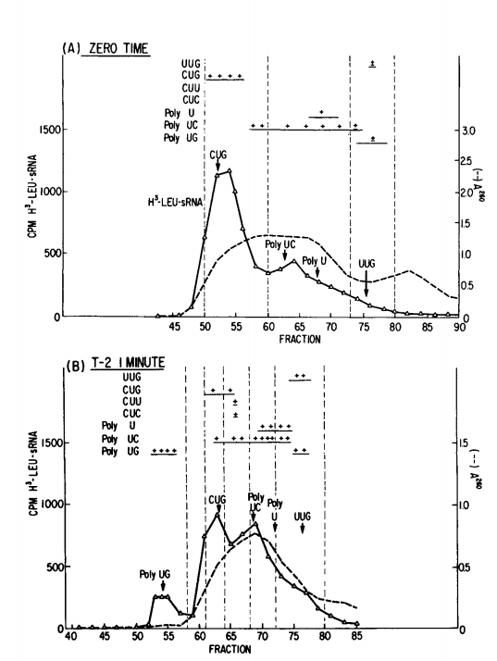
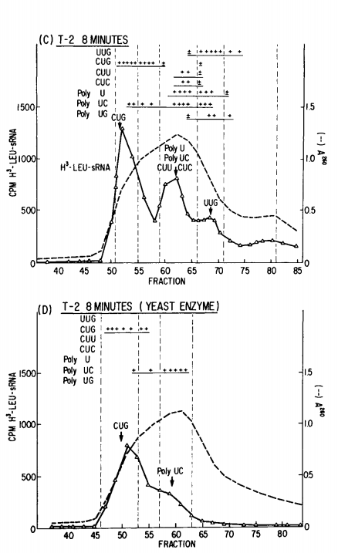
- after 1 minute of infection, Leu-sRNA₂ decreased in its response to CUG
- correspondingly, Leu-sRNA₁ had an increase in response to poly UG but not to the trinucleotides and was completely undetected after 8 minutes
where’d you go?

Slide 50
- an increase in Leu-sRNA₅ response to UUG was observed at 1 minute after infection and was even greater at 8 minutes
- both Leu-sRNA₃ and Leu-sRNA_{4a,b} had greater response to poly UC 8 minutes after infection but they also had varying responses in yeast and E. coli

Slide 51
this suggests that a fraction of Leu-sRNA₃ must differ from the Leu-sRNA_{4a,b} even though they both respond to poly UC
and the multiple responses of Leu-sRNA_{4a,b} to poly U, poly UC and the trinucleotides CUU and CUC suggests that the fractions may be from two different species of Leu-sRNA

Slide 52
Why are these fractions responding so differently?
Leu-sRNA fractions 1,2 and 3 respond to both E. coli and Yeast Leu-sRNA synthetase
Leu-sRNA₅ and Leu-sRNA_{4a,b} are only recognized by E. coli synthetase
This suggests that there are two separate cistrons for Leu-sRNA
fractions 1, 2 and 3 in one cistron and fractions 4 a, b and 5 in another
the corresponding decrease in Leu-sRNA₂ and increase in Leu-sRNA₁ suggests that Leu-sRNA₂ is the precursor of Leu-sRNA₁ and the data also suggests it is the precursor of Leu-sRNA₃

Slide 53
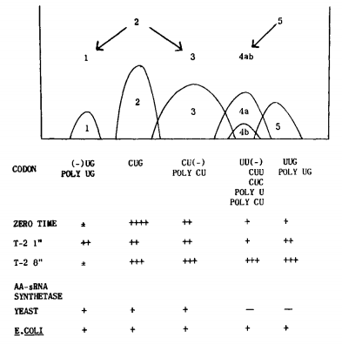
Cistron “A” includes the Leu-sRNA fractions 1, 2 and 3
Leu-sRNA₂ shows a relationship with the CUG codon
Leu-sRNA₃ to the CU(-) codons, (can be substituted with multiple end bases)
Leu-sRNA₁ to the (-)UG codons

Slide 54
Cistron “B” includes the Leu-sRNA fractions 4 a, b and 5
Leu-sRNA₅ differs from Leu-sRNA₂ in both anticodon and synthetase recognition sites
Data suggests that Leu-sRNA₅ is the precursor to Leu-sRNA_{4a, b}
Leu-sRNA₅ demonstrates a relationship with the codon UUG
Leu-sRNA₄ with the codons UU(-), UC(-), UA(-), CU(-), and AU(-)

Slide 55
So what does this mean?
we know that modification of Leu-sRNA after infection requires protein synthesis to occur (from Sueoka’s prior experiment), which suggests that specific enzymes may be needed to modify the Leu-sRNA fractions
the inhibition of the E.coli’s protein synthesis but not the virus’ suggests that the modifications to Leu-sRNA may be to blame
the initiator of protein synthesis in E. coli responds to the same trinucleotides as the Leu-sRNA fractions (UUG and CUG)
the modification of Leu-sRNA must result in the prevention of E. coli protein synthesis initiation but must leave the viral protein synthesis unaffected

Slide 56
Further studies were required…

Slide 57
References
Carr, S. (2016, Feb). Suppressor mutations: "Two wrongs make a right". Retrieved from: https://www.mun.ca/biology/scarr/4241_Suppressor_mutation.html
Carr, S. (2015). Cracking the code. Retrieved from https://www.mun.ca/biology/scarr/4241_Cracking_the_Code.html
Cold Spring Harbor Laboratory. (2016). Retrieved from http://www.cshl.edu
Leder, P., M.F. Singer and R.L.C. Brimacombe. 1965. Synthesis of trinucleotide diphosphates with poly-nucleotide phosphorylase. Biochem. 4: 1561-1567.
Nirenberg, M., Caskey, T., Marshall, R., Brimacombe, R., Kellogg, D., Doctor, B., Hatfield, D., Levin, J., Rottman, F., Pestka, S., Wilcox, M., & Anderson, F. (1966). The RNA code and Protein Synthesis. Cold Spring Harb Symp Quant Biol, 31: 11-24.
Nobelprize.org. (2016). Retrieved from http://www.nobelprize.org
Office of NIH history. (2016, February 1). Retrieved from https://history.nih.gov/index.html
Sueoka, N., and T. Kano-Sueoka. 1964. A specific modification of Leueyl-sRNA of Escherichia cell after phage T2 infection. Prec. Natl. Acad. Sci. 52: 1535- 1540.
Wacker, W. E. C. (1969), The Biochemisty of Magnesium. Annals of the New York Academy of Sciences, 162: 717–726. doi: 10.1111/j.1749-6632.1969.tb13003.x

