Slide 1
“Things Fall Apart”: a mitogenomic challenge to the “Out of Africa” theory of Honey Bee evolution (Apis mellifera)
Dr Steven M Carr
Genetics, Evolution, & Molecular Systematics Lab
Department of Biology, Memorial University of Newfoundland
Nature Science Reports (2023) 13:9386-9398
Notes:
00

Slide 2
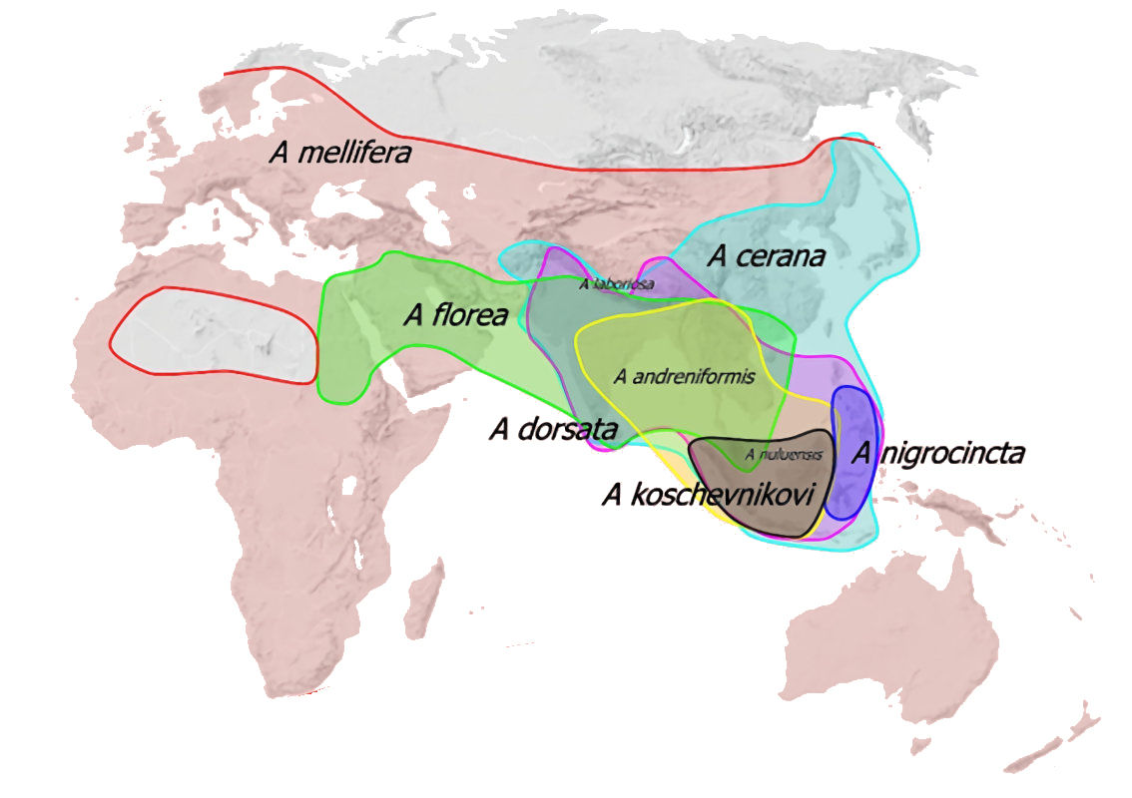
Distribution of Apis honey bees

Slide 3
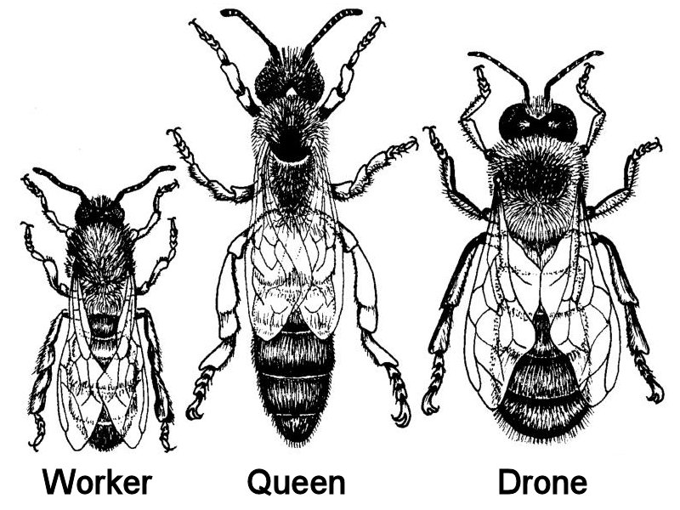
Notes:
Eusocial, colonial Hymenoptera; Haplo-Diploid mating system

Slide 4
European Dark Honey Bee, Apis mellifera mellifera L.

Slide 5
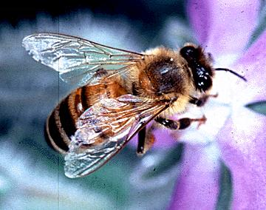
Italian honey bee, A. m. ligustica Spinola 1806

Slide 6
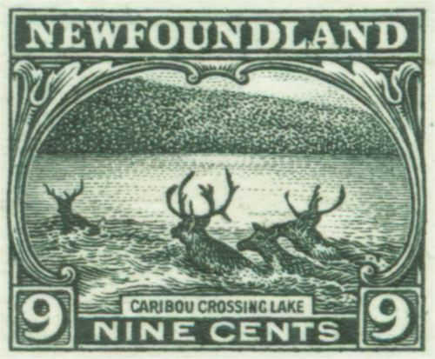
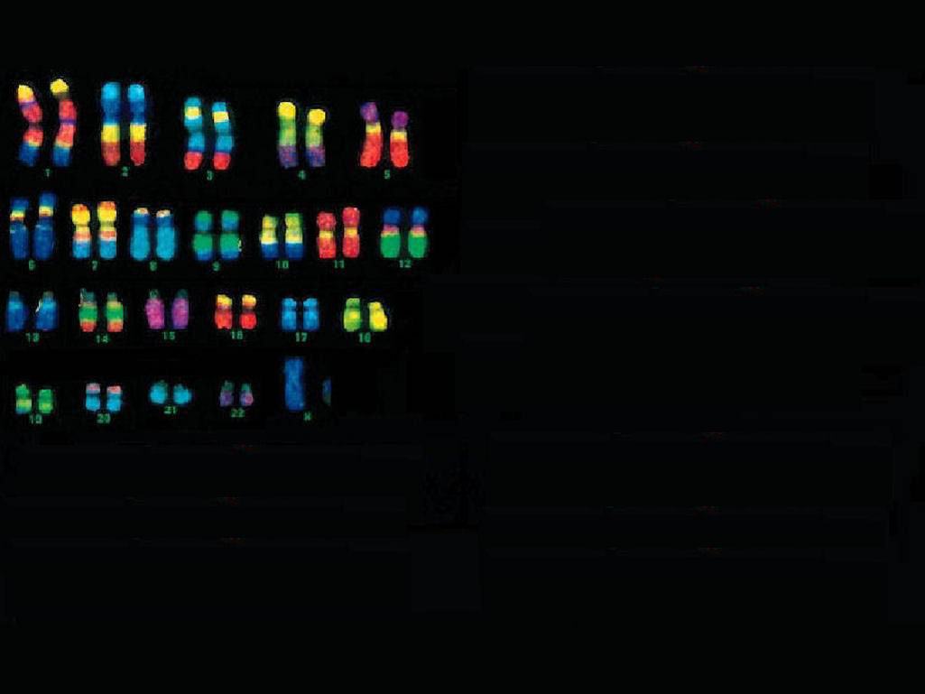
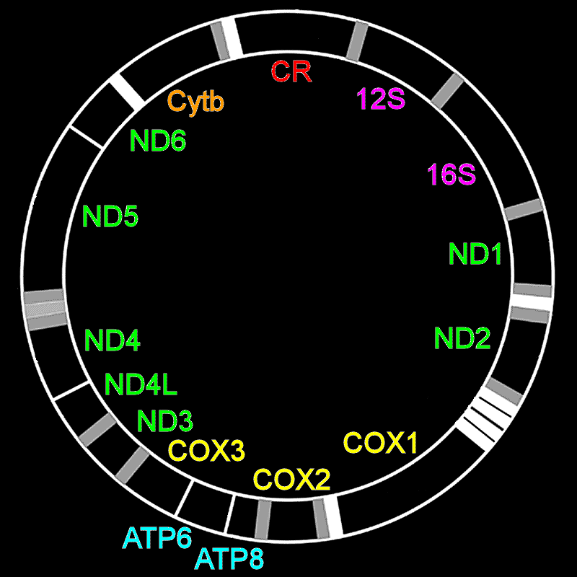
Two Genomes
2N = 16
nucDNA genome
227,093 Mbp
10,546 genes
mtDNA genome
~16,343 bp
38 genes
Notes:
Two genomes. mtDNA genome extranuclear, maternally inherited, rapidly evolving. Apis nucDNA is 0.227 vs 3.088 Gb in Homo; 2N=16 chromosomes

Slide 7
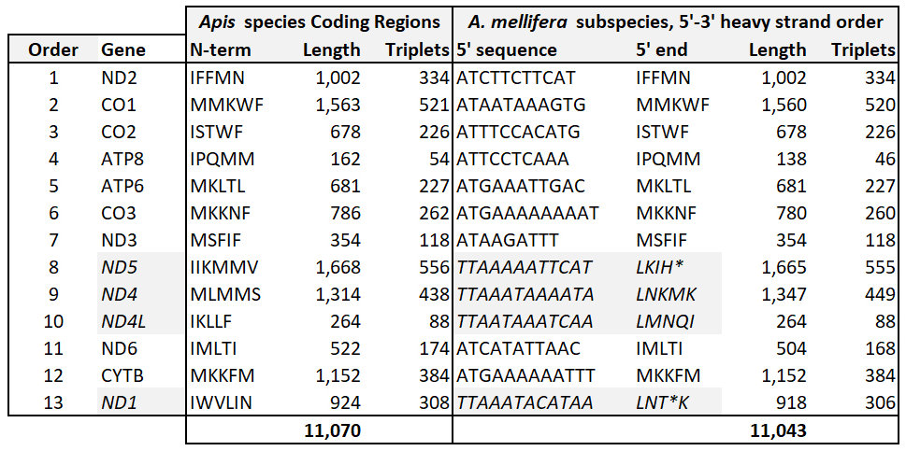
Organization of Apis mitogenome

Slide 8
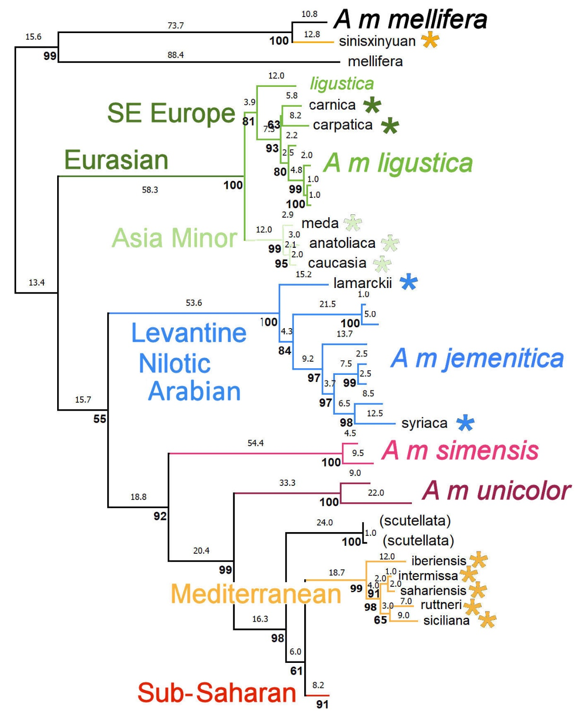
Maximum Parsimony: n = 86 bees Pairwise differences, SPR search, 3,000 bootstrap reps

Slide 9
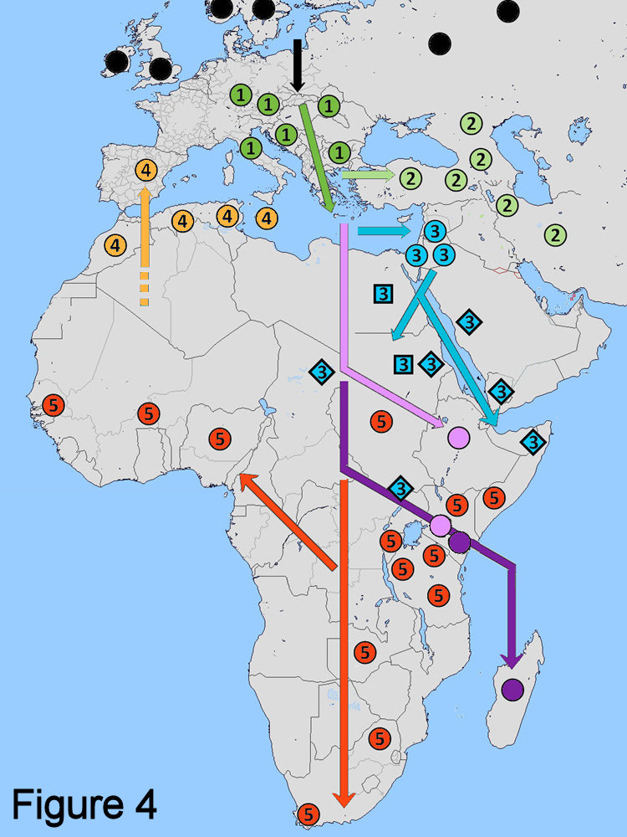
Phylogeographic evolution of Honey Bees (Apis mellifera): a new North – South hypothesis
A m mellifera
SE Europe
Asia Minor
Mediterranean
Levant >
E Africa >
Arabia
A m simensis
A m scutellata /
A m capensis
A m unicolor

Slide 10
Bumble Bee (Bombus) root for Honey Bees (Apis) confirms
Dwarf bees as outgroup to Giant & Cavity-Nesting forms,
including Western Honey Bees (A mellifera).
2. Whole Coding Region mitogenome analysis of multiple individuals / ssp says
Things Fall Apart with Out of Africa (or Asia) hypotheses.
3. Phylogeographic Model: basal Apis m. mellifera in Northern Europe, recognizable clades
Occupy Southeast Europe (inc A m ligustica),
Extend eastward into Asia Minor
Spread via the Levant, Nilotic East Africa & Arabia,
Diversification in sub-Saharan Africa (six ssubspecies, inc A m scutellata)
Mediterranean clade re-established in Iberia, Malta, & Sicily’ , thence N Africa;
Sicily’’ & Crete occupied from SE Europe
Multiple exemplars / subspecies indicates paraphyly artefacts from
Mis-assignment to type subspecies
Single atypical and/or faulty sequences
Faulty / suspect phylogenetic inference
MtDNA does not support morphology- & (or) nucDNA-based biogeographic models
ACMO too rigidly Continental?
P-distances bx SE European, Asia Minor, & Mediterranean ssp << w/in ssp distances
Re-consideration of the gamma taxonomy indicated.

