Slide 1

Guidelines for Communication with PowerPoint
Dr Steven M Carr
Dept of Biology
Memorial University of Newfound
Biol 4241 – Advanced Genetics
Winter 2026

Slide 2
KISS Points
(“Keep it simple, stupid”)
Limit # slides to ~ 1 minute: practice presentation
Use bullet points
  Titles in largest font.
    Major points in smaller font.
      Nested points in smaller point (don’t overdo it)
Fit each idea on single line: break phrases
Telegraphic style
  Audience should not read while you talk
  Use Sentence fragments
  No “a”, “an”, “the”; “&” for “and”; no “.”
  Cut extra words: adjectives & adverbs
Be visual
  Bold for main terms
  Italics for foreign words, action words
  Colour for emphasis, recurring terms ( A C G T )

Slide 3
Be Telegraphic
Charles Robert Darwin was born on February 12th, 1809. He was an English naturalist, geologist and biologist, best known for his contributions to the science of evolution. His proposition that all species of life have descended over time from common ancestors is now widely accepted, and considered a foundational concept in science. He introduced his scientific theory that this branching pattern of evolution resulted from a process that he called natural selection, in which the struggle for existence has a similar effect to the artificial selection involved in selective breeding. Darwin has been described as one of the most influential figures in human history. He died on April 19th, 1882. [Plagiarized from Wikipedia]
Charles Robert Darwin (1809 – 1882)
English geologist & biologist
  Naturalist onboard HMS Beagle (1831 – 1836)
Contributions to Theory of Evolution
  All species descended over time from Common Ancestor
  Branching Pattern of evolution results from Natural Selection
  Struggle for Existence leads to Differential Survival & Reproduction
  Analogous to Artificial Selection in selective breeding
“One of the most influential figures in human history”
Notes:
Do not use blocks of text in slides, even if they are your own and not plagiarized as here.
You do not want your audience reading when they would be listening to what you have to say

Slide 4
Telegraphic Summary with bullets
Modern persons have mtDNA sequences identical / similar to ancient Beothuk & (or) Maritime Archaic (MA):
  Ojibwa - Beothuk connection: Ojibwa - Mi’kmaq connection?
  Distinguish common ancestry versus shared relationship
  See SM Carr (2020) Genome, 63:349–355
Ancient Beothuk & MA temporally & genetically disjunct
  Contrasting model for continuity of Beothuk within Mi’kmaq ?
Newfoundland Mi’kmaq genetically diverse
  Multiple Native American haplogroups
  Euro-American haplogroups in Miawpukek FN from intermarriage
  Detailed maternal, paternal, & bi-parental (mt-, Y-, nucDNA) genes needed:
Biological, historical, social, ethical issues for First Nations
Notes:
Use of bullet points in a summary slide. Title in largest font. Major points in smaller font. Each idea fits on single line: exception is first line, where phrase is split in two at natural point. Note telegraphic style: no “a”, “an”, “the”; substitute “&” for “and.” Eliminate all unnecessary extra words. Note use of Bold for main terms. Note use of italics for Latin, journal name, key verbs. Note use of colour to distinguish four recurring terms: in this case ethnic groups & First Nations.

Slide 5
Miscellaneous Peeves
Scientific names: Two rules, no exceptions
  Genus capitalized, species lower case: Homo sapiens
    Even if proper name: Rhea darwini
  Both in Italics
    If handwritten, underline separately: Pan troglodytes
Don’t read slides: everyone can already read
Limit slides to 1 ~ 2 per minute
Check pronunciation & Spelling of names & technical terms
    Mispronunciation suggests you don’t understand your material
    Misspelling suggests you haven’t proofed your presentation
    Makes your lab & supervisor look bad
“Data” takes plural verb: Data are, Datum [singular] is
“Using” a dangling participle: replace by “with”
“Which” non-restrictive: “Which Hunt” replaces with restrictive “that”

Slide 6
Use picture for background
This text box has 100% transparency
This text box has 30% transparency
This text box has 0% transparency
Notes:
Consider the use of some picture as a background, rather than plain color. Fade out the background picture so it doesn’t interfere with text & foreground pictures. Text boxes are by default 100% transparent, which lets the background show through & may interfere with readability. I find 30% transparency provides a light background, allows easy text readability, and lets background show through.

Slide 7
Use simple san serif fonts
[serifs: fancy tails on letters]
This line uses Times New Roman
This line uses Tahoma, Calibri, & Arial
This line uses Comic sans MS
Notes:
Consider the use of some picture as a background, rather than plain color. Fade out the background picture so it doesn’t interfere with text & foreground pictures. Text boxes are by default 100% transparent, which lets the background show through & may interfere with readability. I find 30% transparency provides a light background, allows easy text readability, and lets background show through.

Slide 8
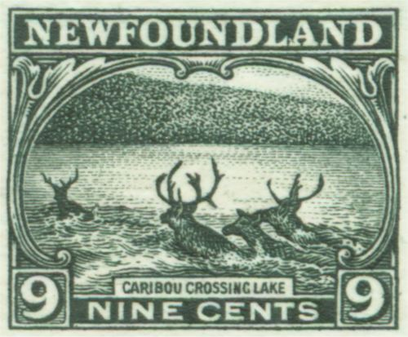
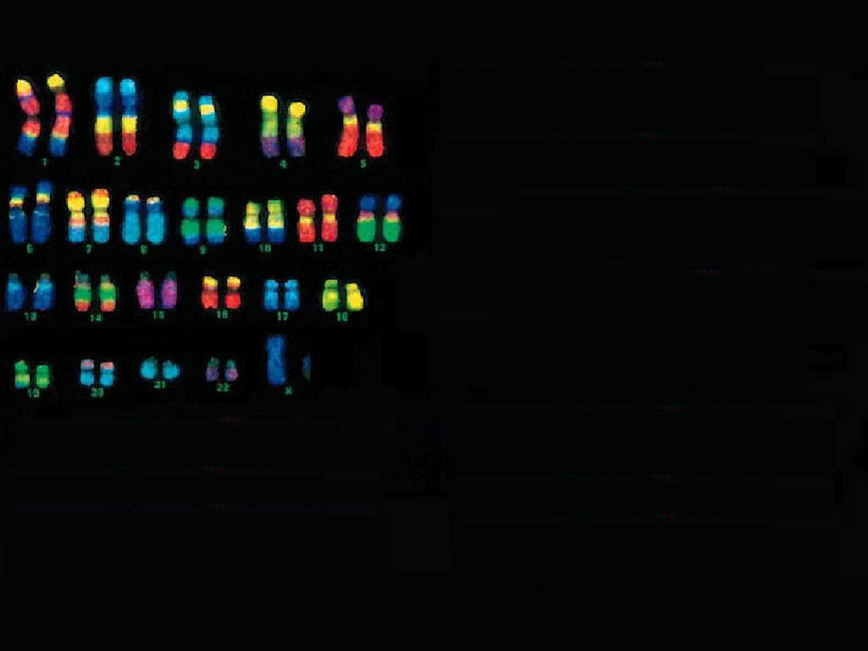
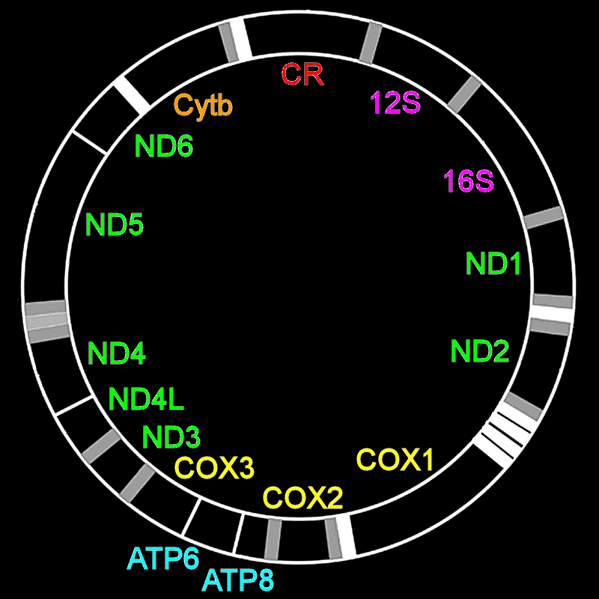
Two Genomes
nucDNA genome
3,096,649,726 bp
20,449 genes
mtDNA genome
~16,590 bp
38 genes
Notes:
Complicated idea presented simultaneously: the human nuclear genome vs the mitochondrial genome. Use of color makes complicated ideas simpler. Note that “red” “floats”

Slide 9
Two Genomes
nucDNA genome
3,096,649,726 bp
20,449 genes
mtDNA genome
~16,590 bp
38 genes
Notes:
Animation introduces second concept as parallel to first

Slide 10
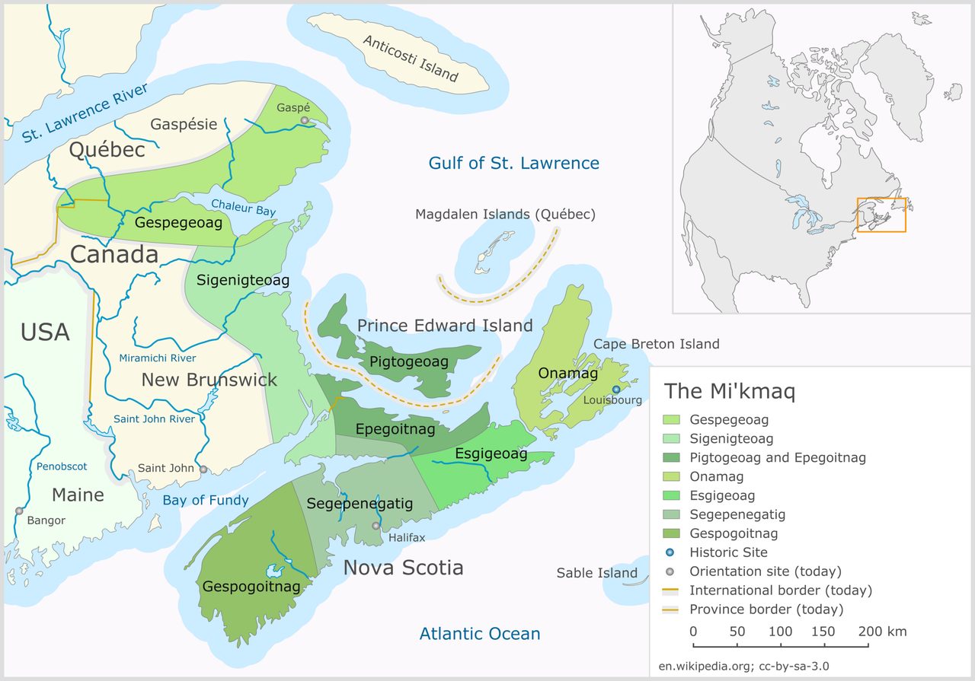
Improve pictures for your purpose
Distribution of Mi’kmaq Districts, including Newfoundland
Taqamgug
Miawpukek First Nation, Samiajij reserve (1987), Bay d’Espoir (NL)
Qalipu First Nation (2011), all of insular Newfoundland (landless)
Taqamgug (NL) historically associated w/ Onamag (NS) & Pigtogeoag (PEI)
Notes:
Best available map of Mi’kmaq districts does not show Taqamgug (NL):
Add arrows (many people don’t know where island of Newfoundland is)

Slide 11
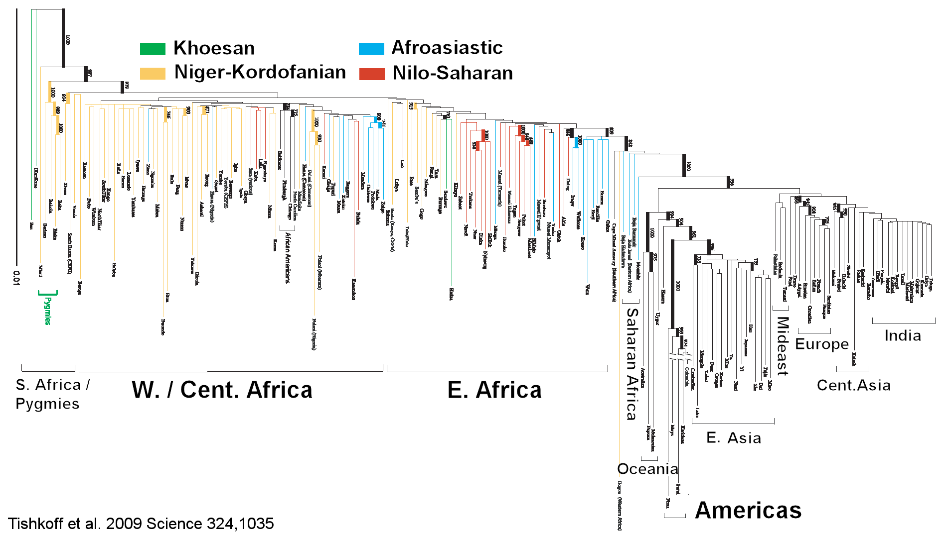
Draw simplicity from complexity:
Global Genetic Structure of Humans
Notes:
Used of Animation emphasizes successive events:
Origin of humans from upper left corner, differentiation in Africa
Subsequent movement “Out of Africa”, from left
Europeans “appear” within non-African box.

Slide 12
Never combine Red text on Blue background
Eye cannot focus on both, simultaneously
Text will “shimmer” & be unreadable
Audiences known to become nauseated
Same thing happens with blue on red
Notes:
Never use red text on blue background, or vice versa. The human eye cannot focus on both simultaneously

Slide 13
Historical Note
White text on blue background
hangover from olden days
Black typing on white paper photographed w/ color film
Negative film is white on blue
Cut film, mount your own slides
It’s called a slide because physical 2”x3” film holder would “slide” into place in “slide projector.”
Notes:
Historical note on “slides”

