Slide 1
Tips and Techniques for effective scientific presentations*
Sherri Christian, PhD
sherri.christian@mun.ca
Associate Professor
Dept Biochemistry, MUN
*The opinions presented here are my own, you are encouraged to formulate your own opinions
This presentation can be downloaded from my website:
www.mun.ca/faculty/sherri

Slide 2
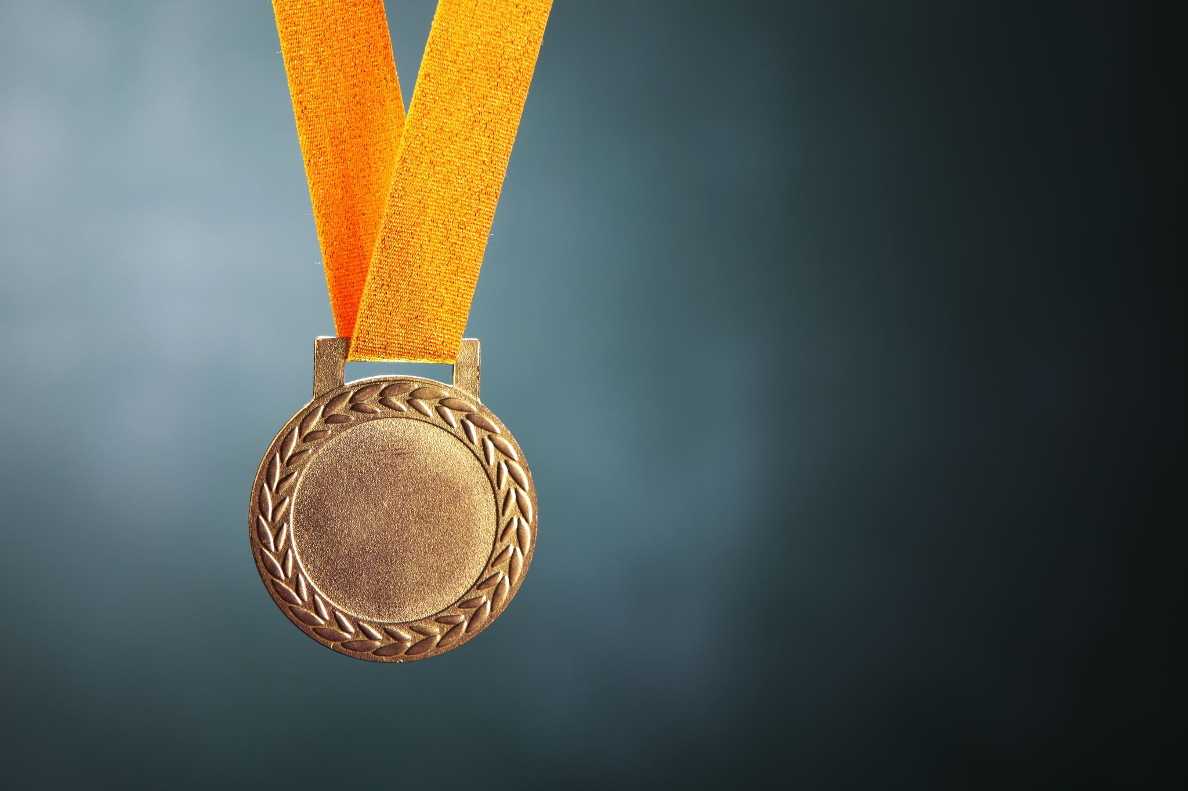
Does it matter?
What’s the point of a talk/lecture/presentation?
Communication
Ideas
Data
expertise
Award
Grade
Degree
Job
Contacts

Slide 3
Presenting well is a learned skill
Present early and often
Lab meetings
Journal clubs
Departmental seminar series
Annual departmental symposium
Conferences
3-Minute Thesis
Practice different formats
Poster vs. slide show (oral presentation)

Slide 4
Before you start…
What is your message?
Who is your audience?
Timing

Slide 5
The message
1-2 big messages for the entire talk
1-2 points/slide
DO NOT expect your audience to remember something if it’s not on the slide in front of them- if it is important enough to say then put it on the slide
Tell them what you are going to say
Tell them
Tell them what you said

Slide 6
Know your audience
You are a scientist→ Do your research
General public vs. science department vs. medical department vs. specialized research group vs. lab mates
Don’t assume any prior specialized knowledge
When in doubt: Assume very smart people who don’t know the details but have an understanding of basic biology
Suggestion: have a person in mind that represents the least knowledgeable/ most difficult person in your audience

Slide 7
How does the Ras pathway decrease STAT2 protein levels?
degradation
protein
translation
degradation
mRNA
AAAAAA
AAAAAA
transcription
X

Slide 8
Timing
Rough Guideline: 1-2 minutes per slide
Pace: keep consistent but not monotone; show excitement/emphasis when appropriate
Don’t be afraid of pauses/ silences
Approximately 50% of your audience are NOT native English speakers so speak clearly
Know thyself- what do you do when you’re nervous?
PRACTICE, OUT LOUD

Slide 9
Before you start…
What is your message?
Main message: 1, maybe 2, take-home points
Who is your audience?
General audience vs. specialized audience
assume “complete ignorance and complete intelligence”
Don’t assume any prior specialized knowledge
Timing
stick to your time limit
Prioritize
Practice, practice and maybe practice again

Slide 10
Organization
INTRODUCTION
Significance: “Why you should care”
Background: “What you need to know to understand the rest of the talk”
THE SUBSTANCE
Hypothesis: “The Question”
Rationale: “Why we care about the question”
Approach: “How the question was addressed”
Results: “What we found”
CONCLUSION
Significance: “What does this mean in the context of the original hypothesis and the field”
Future Directions
Broad
Details
Broad

Slide 11
Introduction
What we know and what we don’t know
Significance/ Rationale (why we care)
Objectives
Overall Hypothesis:
“The Ras pathway negatively regulates the interferon system”
Overview of approach- big picture
No surprises/punchline
Main conclusions/Model 1st
Build up to the model/ BIG conclusion

Slide 12
Outline?
Rough guideline: only include for talks longer than 30 min
use to aid in transitions
meaningful - like a map
The pathways
Interferon & Ras
Regulation of STAT2 by Ras
Transcription vs. Stability
Identification of TF
Future Directions
Introduction
Methods
Results
Conclusion

Slide 13
Summary of results
Active Ras pathway decreases STAT2 expression
Inhibition of Ras/MEK/ERK restores STAT2 expression
Reduced STAT2 levels cause impaired IFN signaling- but not only factor in reducing the overall anti-viral response
What else does Ras/MEK/ERK do to reduce the anti-viral response?

Slide 14
Results slides
Title: Conclusion or Question
Rationale for experiment
Objective
Approach (flow chart & model)
Result
Conclusion
Interpretation! (return to model)
Add complexity in layers; animation
Include Summary slide

Slide 15
Ras pathway
IFN pathway
IFNAR
Ras
-GTP
Tyk2
JAK1
?
STAT2
P
Raf
P
STAT1
P
IRF9
MEK1/2
P
Anti-viral genes
ERK1/2
STAT2
P
P
STAT1
IRF9
“MODEL SLIDE”
ISRE
IFN-regulated
Anti-viral genes

Slide 16
Inhibition of Ras pathway restores IFN-α signaling
RasV12
RasV12
-GTP
-GTP
IFN-α
Raf
U0126
P
STAT2
P
MEK1/2
P
STAT1
P
P
IRF9
ERK1/2
ERK1/2
Anti-viral genes
(OAS)
siRNA
STAT2
P
P
STAT1
IRF9
ISRE
IFN-regulated
Anti-viral genes
Christian et al. J Virol 2009

Slide 17
Conclusions
Big Picture
“What does this mean to me?”
“Did you answer the question?”
Future Directions or New Questions

Slide 18
The IFN system
Phase 1
Detection of virus
Phase 2
Activation of host defense
RasV12
-GTP
IFNAR
Ptx3
Tyk2
JAK1
TLR3, 7, 9
STAT2
P
Mda-5
RIG-I
STAT1
P
TRIF/MyD88
IPS-1
IRF9
GBP2
STAT2
P
P
STAT1
IRF7
IRF9
IRF3
c-Jun
NF-κB
ISRE
IFN-regulated
Anti-viral genes
IFN-α/β promoter

Slide 19
Acknowledgements
Scientific contributors
PI
lab members
collaborators
FUNDING AGENCIES
say “Thank you”

Slide 20
Slide Content
Critical evaluation of your slides
Keep it simple
Phrases not full sentences
Everything important is on the slide
Re-create diagrams to illustrate your point
Use slides as a memory aid only
Diagrams/ flowchart/ pathways NOT text
Aesthetically pleasing (alignment, color)

Slide 21
Color Scheme
Clarity above all
contrast
red/green colour blind

Slide 22
Color Scheme
Clarity above all
contrast
red/green colour blind
Consistency!

Slide 23
Color Scheme
Clarity above all
contrast
red/green colour blind
Consistency!
Backgrounds
keep simple
should NOT distract from slide content

Slide 24
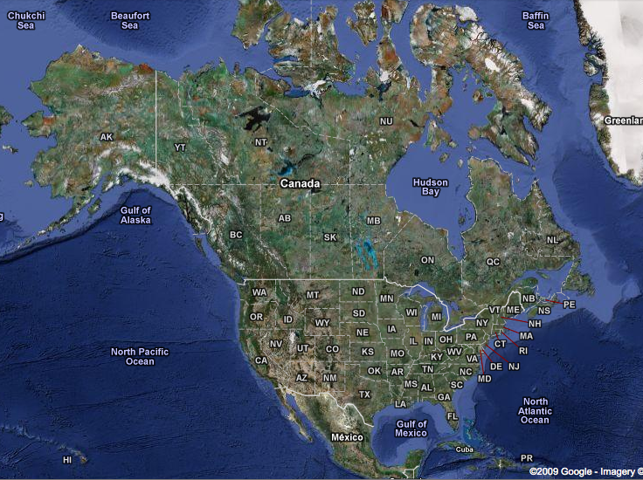
Regulation of Gene Expression and Cell Fate by the Ras pathway
“Watermark background”
Sherri Christian, PhD
Division of Basic Medical Sciences
Faculty of Medicine
Memorial University of Newfoundland

Slide 25
Flow of talk
Transition between ideas/slides
Having shown that...
Next, we considered whether…
To investigate this, we ...
This means that … (return to the model)
Transition slides can be helpful

Slide 26
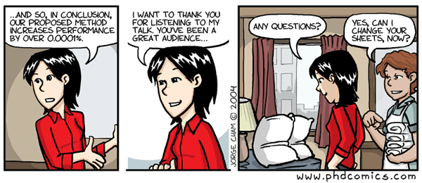
Humour
Using humour can wake up your audience
Must be in good taste! (know your audience)
As a rule- don’t start with a joke

Slide 27
Fonts
size: 24 pt or more
be consistent
bold? shadow?
sans serif / serif (following are all 24 pt)
Times New Roman
Arial
Helvetica
Comic Sans MS

Slide 28
Animations
Use sparingly; can be a great tool or an irritant
Need a good reason
3-4 bullets: don’t animate
complicated pathway: animate
experimental design: maybe animate

Slide 29
Animated Slide Transitions
DON’T
Example of one exception: by Christian Alberto

Slide 30
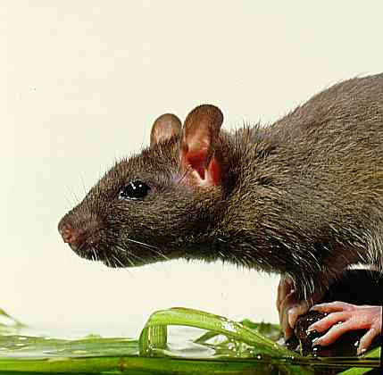
www.dkimages.com/.../ previews/887/95001173.JPG

Slide 31
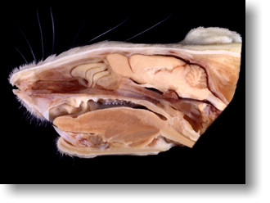
http://www.apuche.org/OIA/Anatomical-Page-03.htm

Slide 32
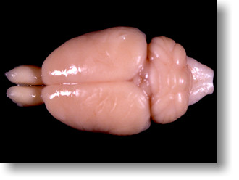
http://www.apuche.org/OIA/Anatomical-Page-03.htm

Slide 33
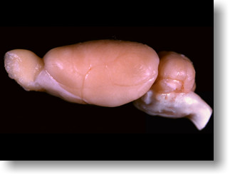
http://www.apuche.org/OIA/Anatomical-Page-03.htm

Slide 34
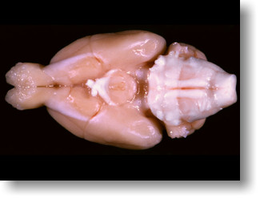
http://www.apuche.org/OIA/Anatomical-Page-03.htm

Slide 35
http://www.apuche.org/OIA/Anatomical-Page-03.htm

Slide 36
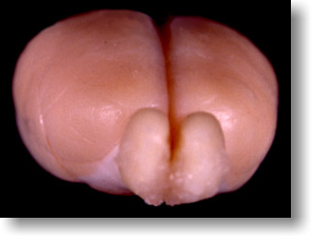
http://www.apuche.org/OIA/Anatomical-Page-03.htm

Slide 37
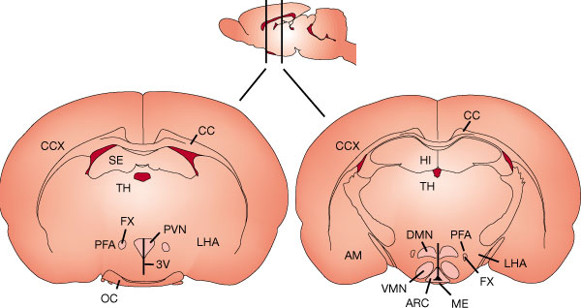
http://www.nature.com/nature/journal/v404/n6778/fig_tab/404661a0_F3.html

Slide 38
Presentation technique 1
Own the room
Do not apologize or ask permission,
unless it’s obviously needed
Avoid meta-commentary
Oh, that text isn’t
formatted correctly, oops

Slide 39
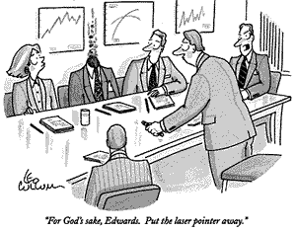
Presentation technique 2
Laser pointer/ Mouse
Eye contact with your audience/ with your camera
Your ‘ticks’
Be confident but not arrogant

Slide 40
Presentation technique 3
OMG
You are right- Dr. Christian is such a jerk.
Know your tools
Getting to previous slides quickly
Using the advancer easily
Prevent “auto-updates” or notifications
Sharing your screen

Slide 41
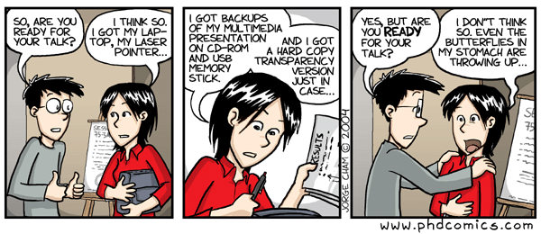
Nervousness
Relaxation techniques
breathing
use the nervous energy
Practice
Experience
Public speaking courses

Slide 42
Final thoughts
What is your message?
Clear communication
Keep it simple
Analyze other presentations (good & bad)
Prepare early
Tell them what you are going to say
Tell them
Tell them what you said

Slide 43
Other Resources
www.cs.berkeley.edu/~jrs/speaking.html
www.ascb.org/files/0602wicb.pdf
http://www.ncbi.nlm.nih.gov/pmc/articles/PMC1857815/
Ten Simple Rules for Making Good Oral Presentations
www.ncbi.nlm.nih.gov/pmc/articles/PMC1876493/
Ten Simple Rules for a Good Poster Presentation

Slide 44
Acknowledgements
Michael Gold, UBC- PhD supervisor
Kelly Drew, UAF- PDF supervisor
Ken Hirasawa, MUN- PDF supervisor
Past students and labmates
Online colleagues with similar interests who write on these topics.

