Slide 1
Pluto or Bust...
Inquiry Learning with Staff and Students of Brother Rice Junior High

Slide 2
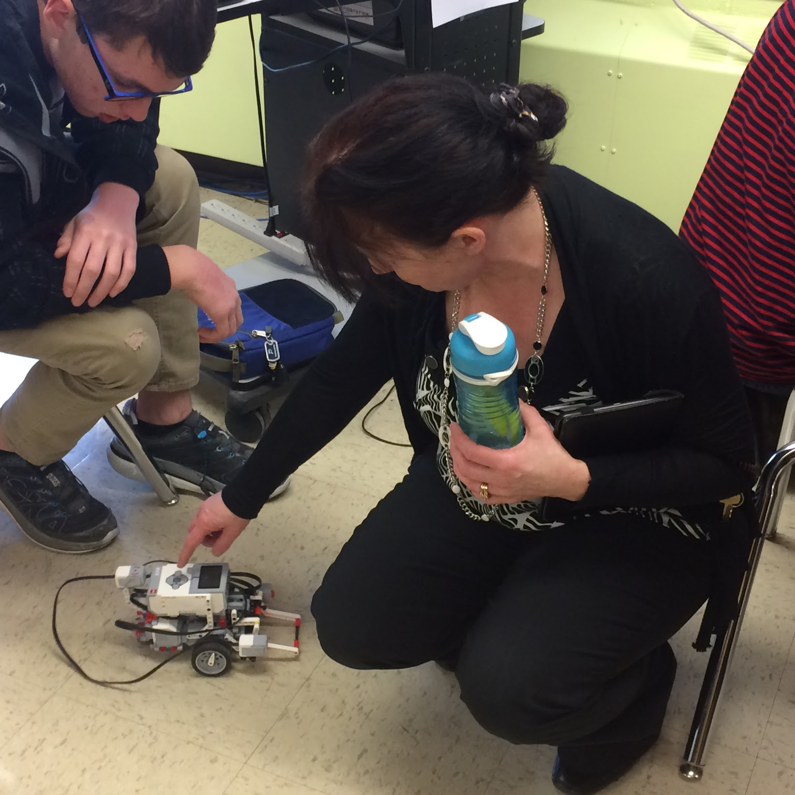
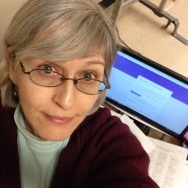
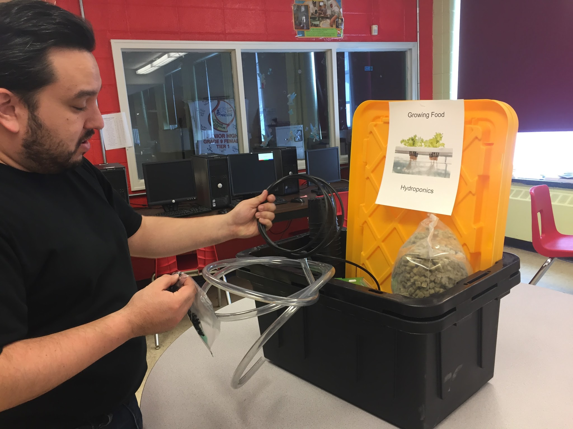
The team
Jason Aue
Angela Dawe
Mary Hayden
Suzanne Fitzpatrick
Math and Technology
Music and Art
Special Services
Literacy Enrichment and Academic Readiness for Newcomers (LEARN)

Slide 3
Background Info:
With over 70 years of combined classroom teaching experience, this team brings a collection of varied and diverse perspectives, experiences, ideas, questions and answers.
Having worked together in the same school for the past 6 years, they have built a strong, respectful, collegial rapport. They decided to undertake this project together to help move a portion of the BRJH School Development Plan forward.
BRJH is an intermediate school housed in the centre of St. John’s. With a population of approximately 420, there is a wide spectrum of strengths, needs, learning profiles and personalities.

Slide 4
We did not use one particular class for our project, except for the LEARN class experience with hydroponics. Rather, we opened up MakerSpace at lunchtime to all interested students on a voluntary basis. We ended up with 25 diverse students from grades 7 through 9.
Our goal was to provide an alternate learning space for students during unstructured time. We wanted to encourage students to be hands on and largely self-directed. Our focus was to entice our “academically at risk students” (in conjunction with our school development plan) to learn to love learning via inquiry/experiential learning, along with the idea of increasing student achievement and engagement. Additionally, we aimed to engage in inquiry based learning in Math and Science in the LEARN class, and involve newcomer students in the lunchtime MakerSpace.

Slide 5
None of the members of our team are science teachers, although the learning outcomes came directly from the intermediate science curriculum.
However, our team shares a love of learning, the love of sharing learning opportunities with students, and creating new and different ways of reaching curriculum objectives -- regardless of subject area.

Slide 6
Focus Area
The focus was to create a MakerSpace for students, and to increase science content in the LEARN classroom. We decided to root our MakerSpace in the science curriculum objectives. While this was not a familiar area to our team, we thought we could grab the students’ interest in an untraditional method. There is a strong focus on Math and English in our school, so we hoped to promote the Science curriculum. In doing so, we were able to incorporate Science, Tech, Engineering and Math into our project -- now to get the arts, as well! Go STEAM!

Slide 7
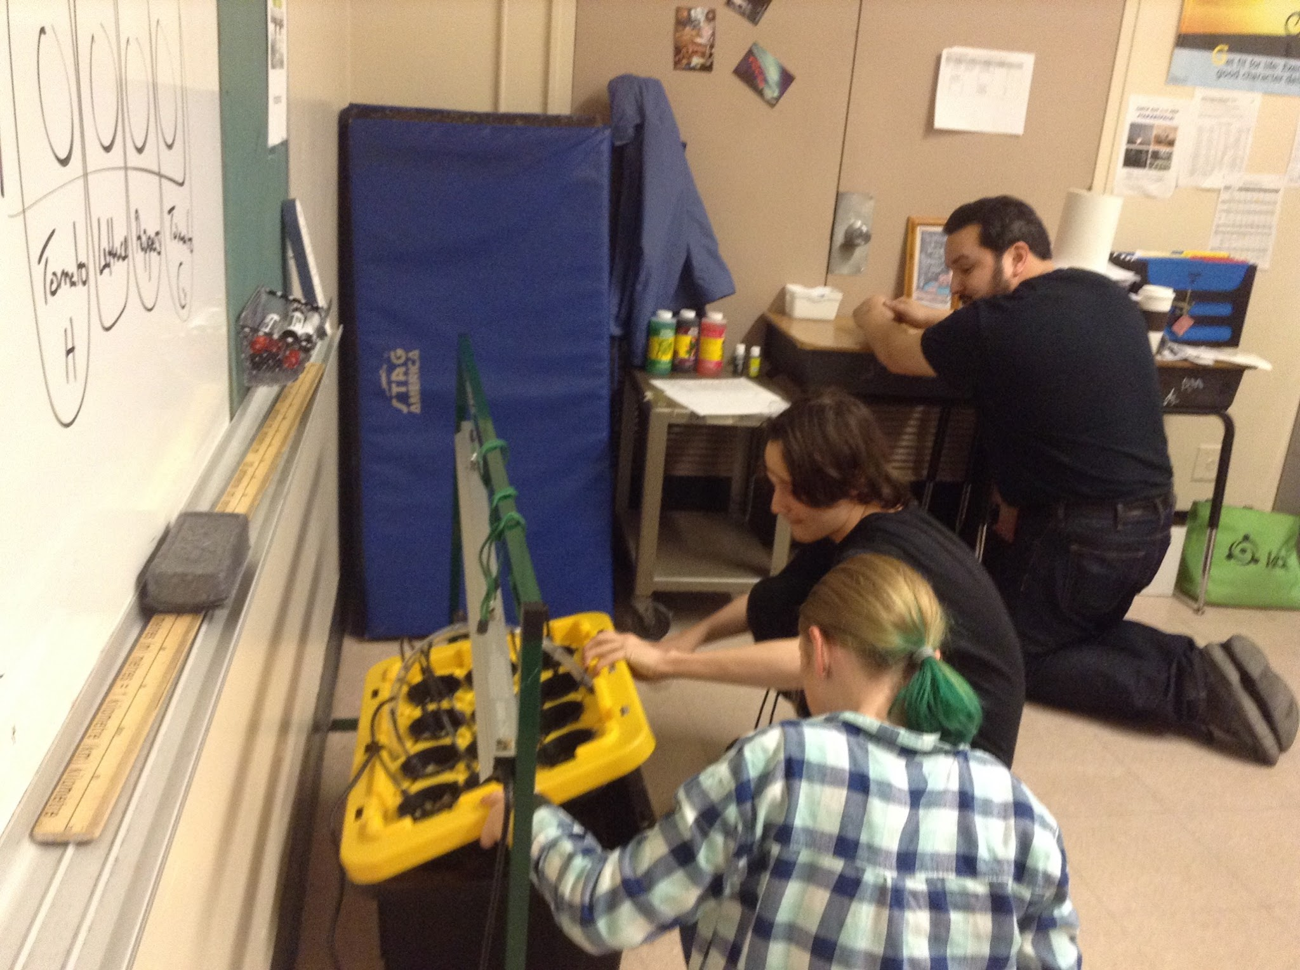
Research Questions
T

Slide 8
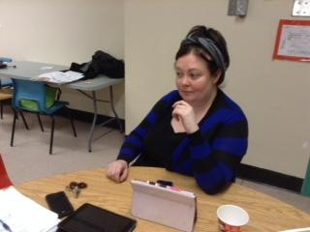
Teacher Question:
How does involvement in a makerspace transform teachers’ attitudes and emotional responses to the stressors of daily work?
Subquestion:
How is our “fire” for teaching affected?

Slide 9
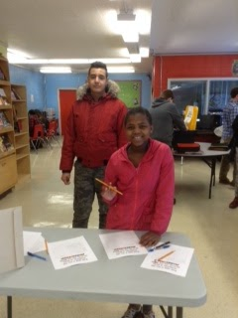
Student Question:
How is the affective domain of students altered by use of the makerspace? Intrinsic motivation? Engagement? Attendance? Through teaching others? Through leadership in learning?
Subquestion:
How do students perceive these teachers at the beginning and the end of the MakerSpace project/school year?

Slide 10
Ethical Considerations:
We learned A LOT through this process! Initially, we wanted to gear our project towards “academically at risk” students - as this is a major focus at our school. However, we quickly learned that to do this, we would have to have this spelled out in our ethics letter to parents. There is no politically or sensitively correct way to target such a group, so we had to change our mandate.
We instead opened up the opportunity to the entire school population on a voluntary basis. We promoted the project with posters, word of mouth, an open house, and through the school announcement forums.
We subsequently followed protocol and obtained consent from parents using a modified version of the TIA consent form which explained the project and what we would be doing. We communicated with students weekly.

Slide 11
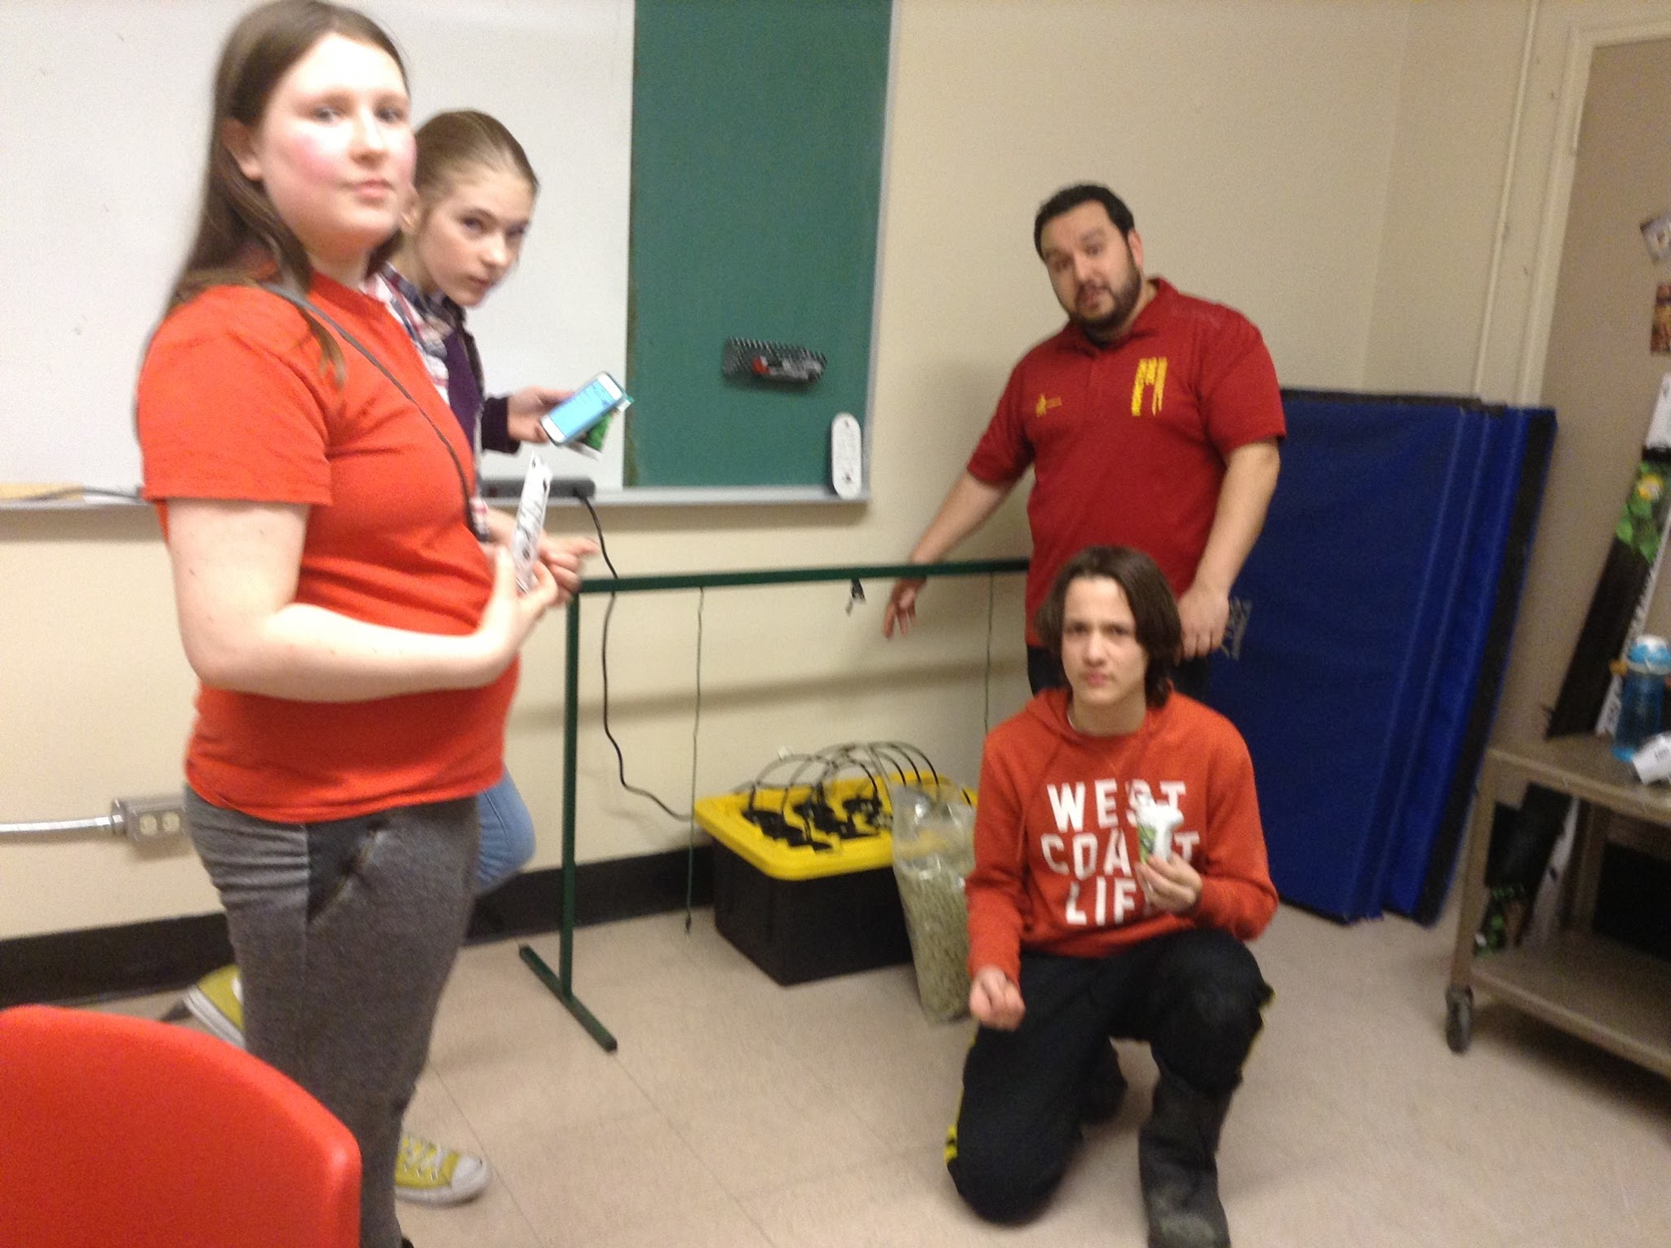
Planning:
We engaged in regular meetings among team members. We reached out to community experts/members for information regarding hydroponics and coding.
Gaze Seed provided us with information regarding the hydroponics unit. One particularly useful website that we referred to was www.simplyhydro.com.

Slide 12
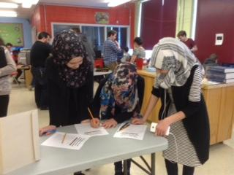
Open
House
&
Sign
Up

Slide 13
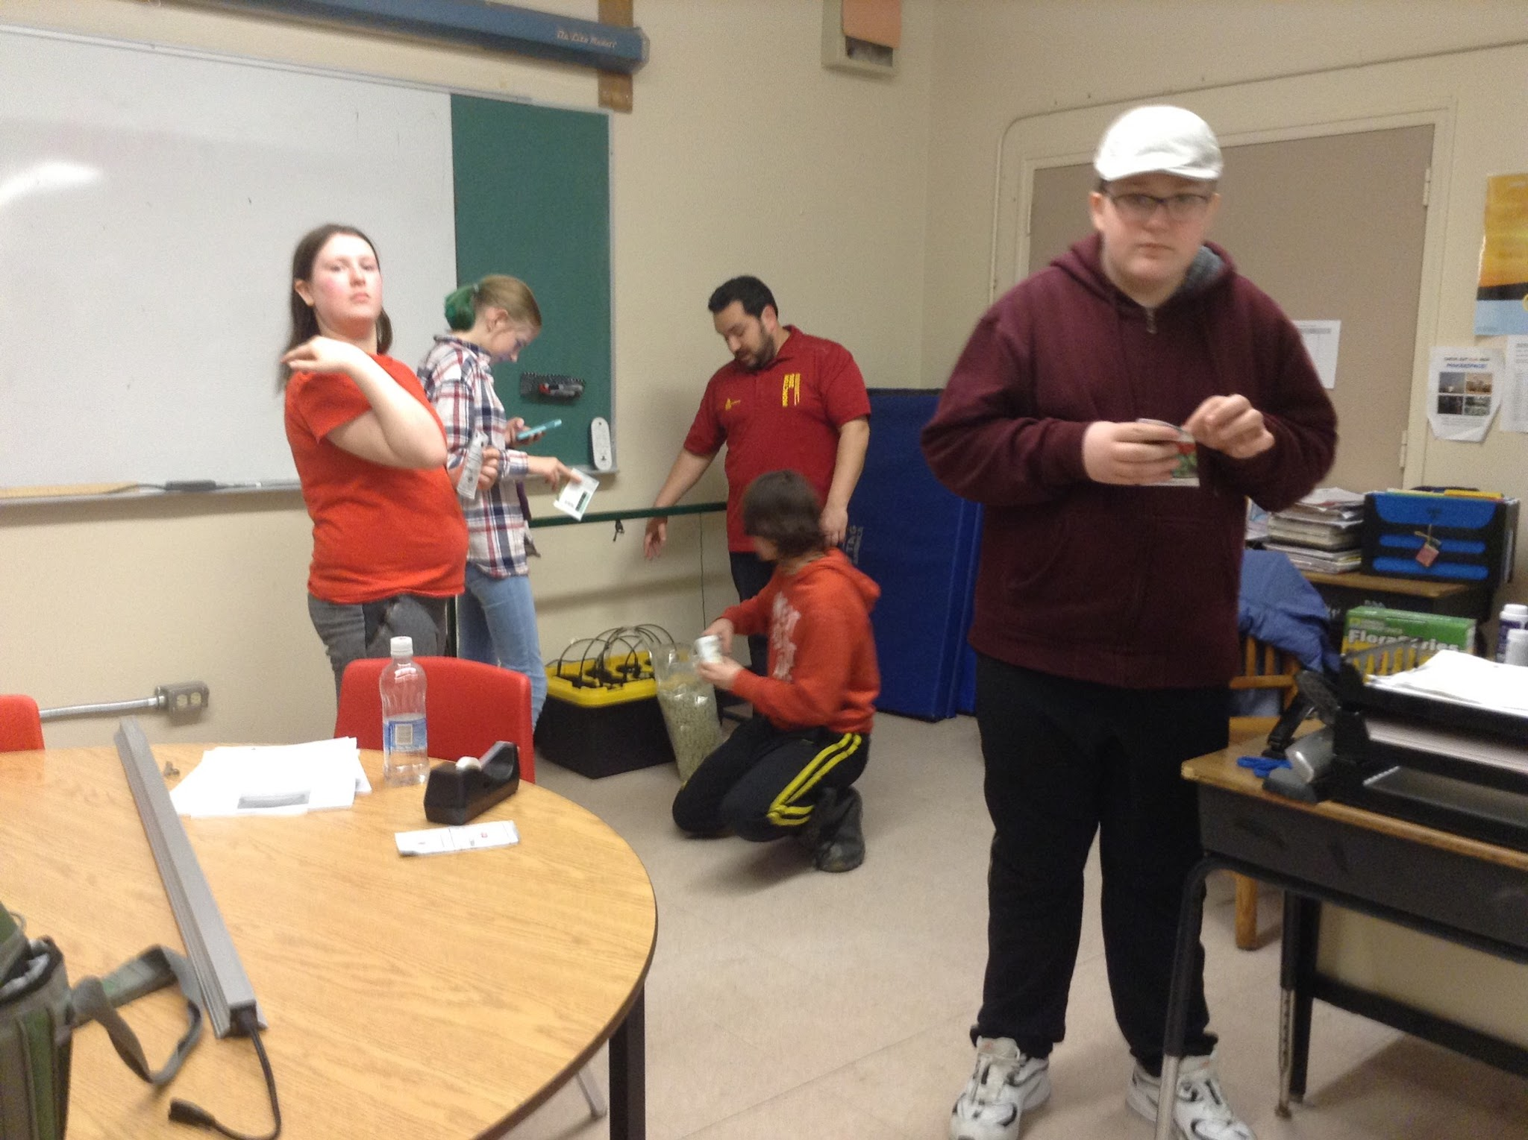
Implementation:
We held a two-day open house in the Learning Resource Centre (LRC) which was well attended. Initially, we began MakerSpace in the LRC which worked well as students were engaged and enjoyed exploring the Kerbal Software program, the Arduino wearable tech, coding and Lego Robotics.
We later moved the project to Room 203 because
of time constraints and convenience.
Students enjoyed setting up and monitoring the
hydroponics unit, and exploring the Lego Robotics
and Coding modules.

Slide 14
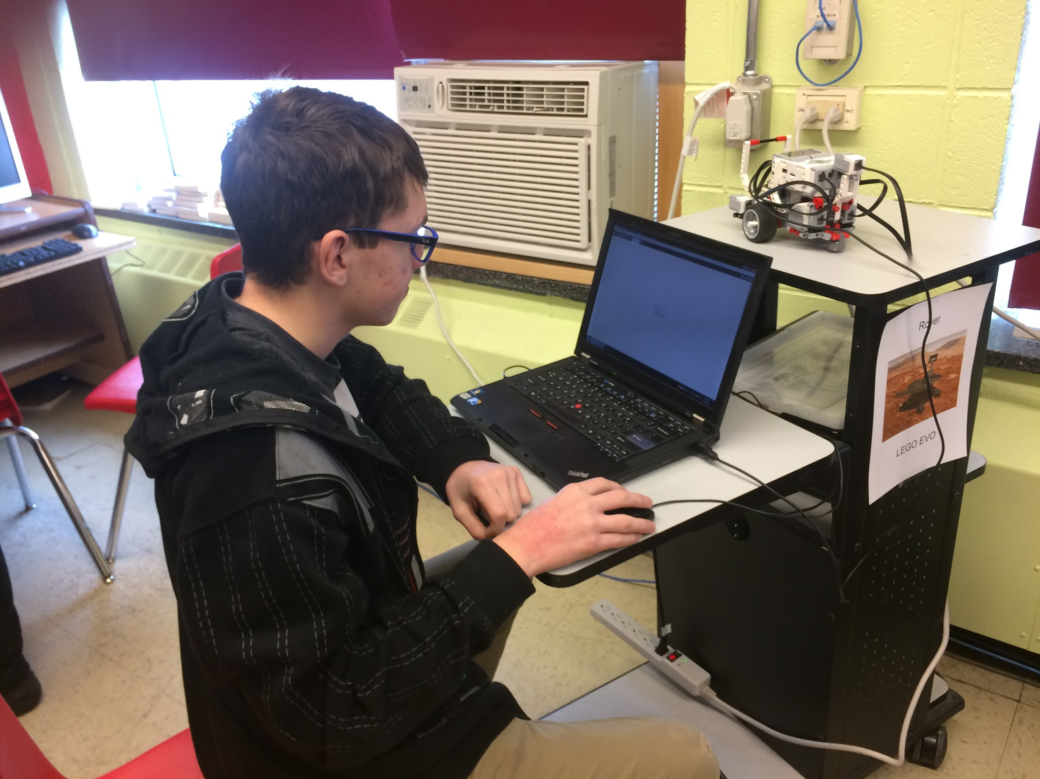
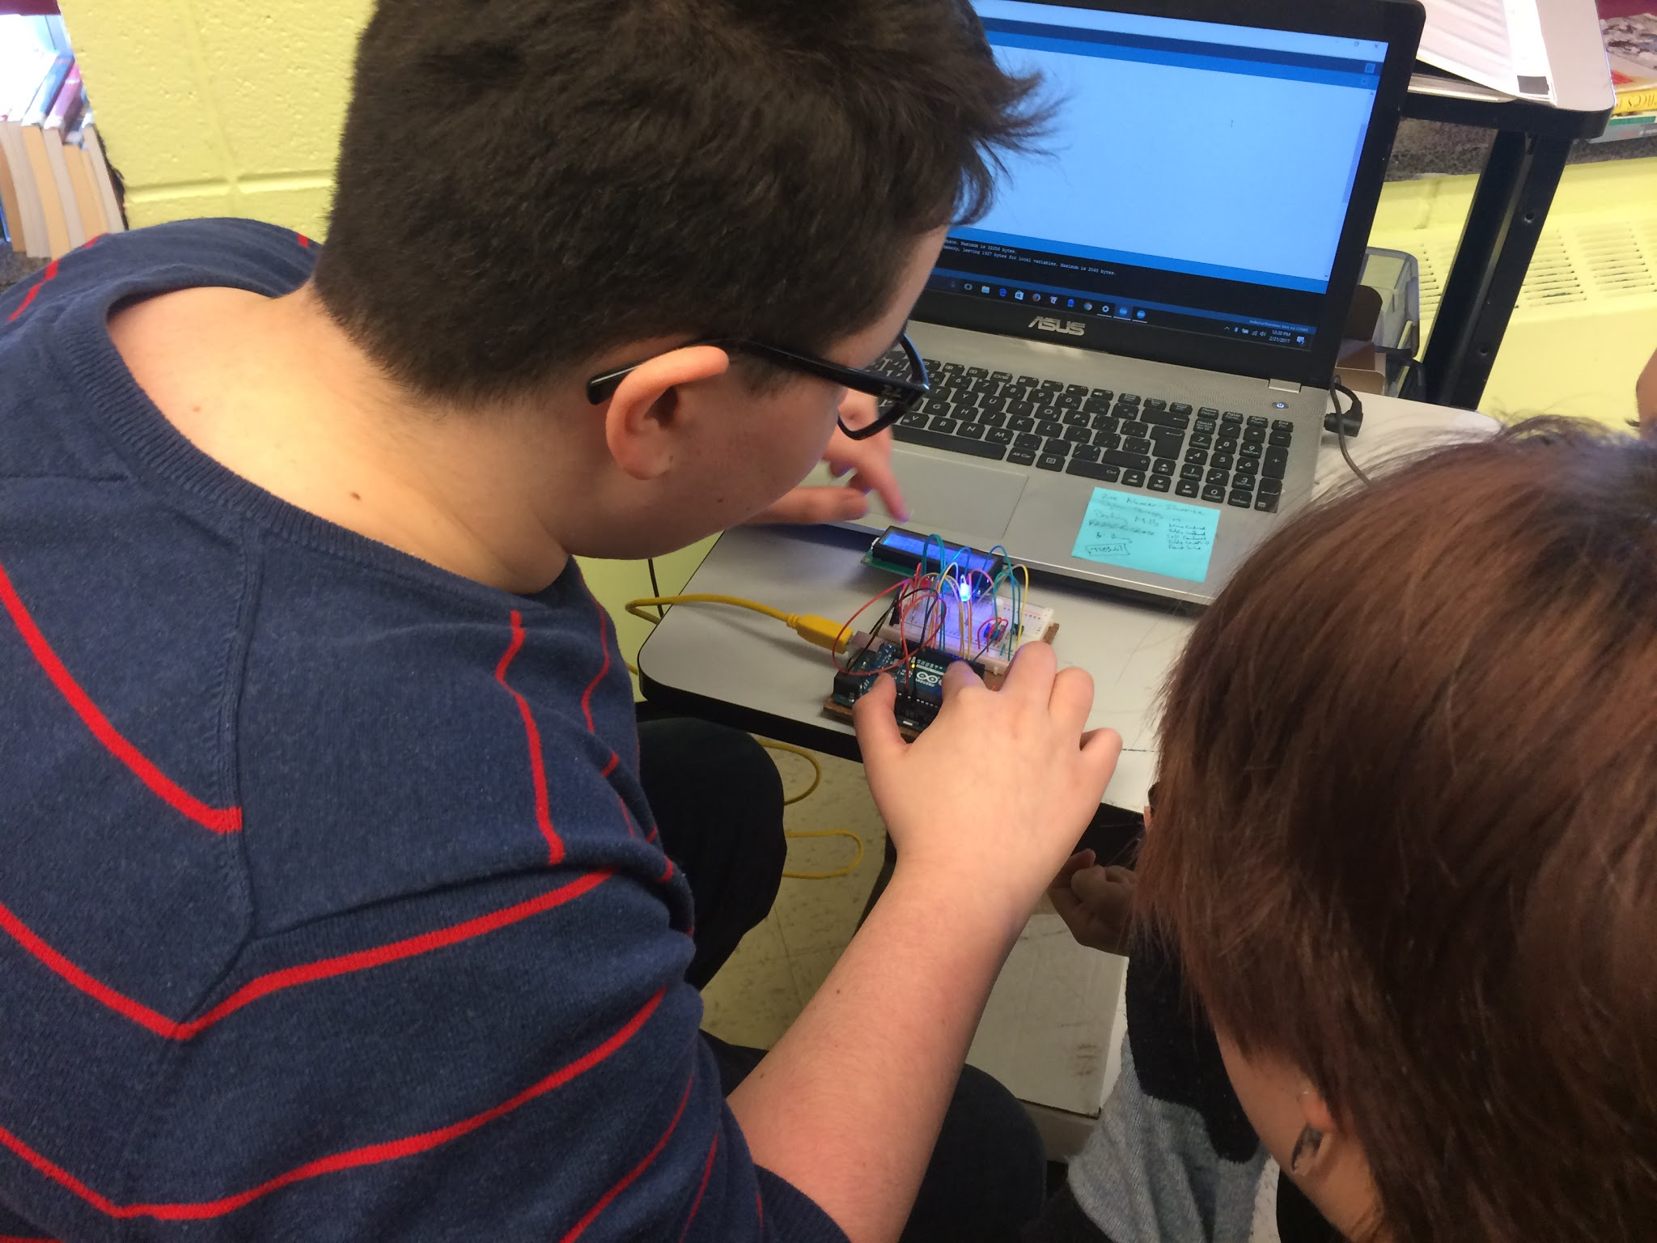
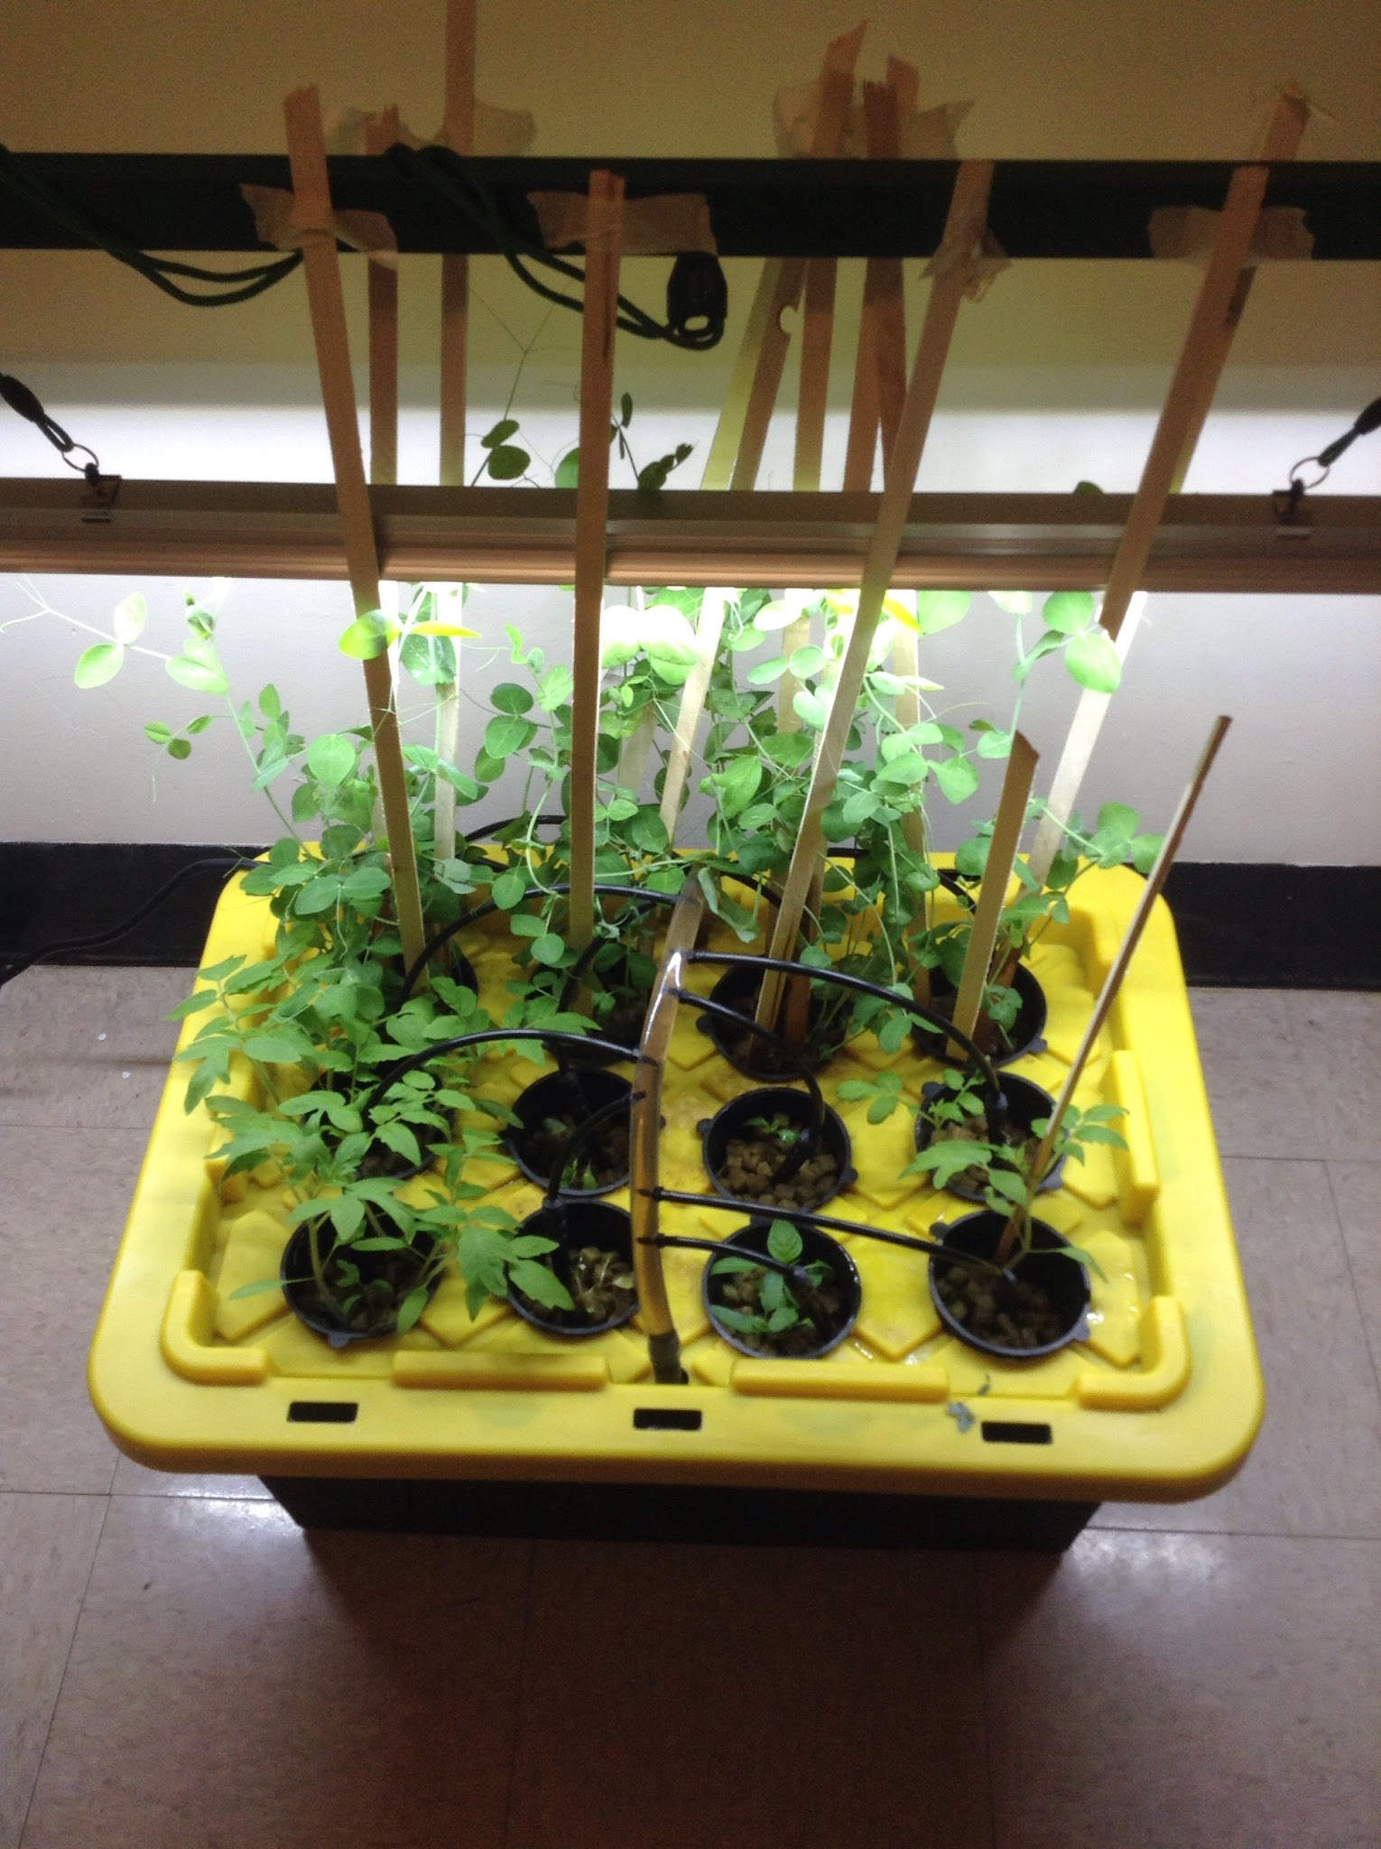
Implementation:

Slide 15
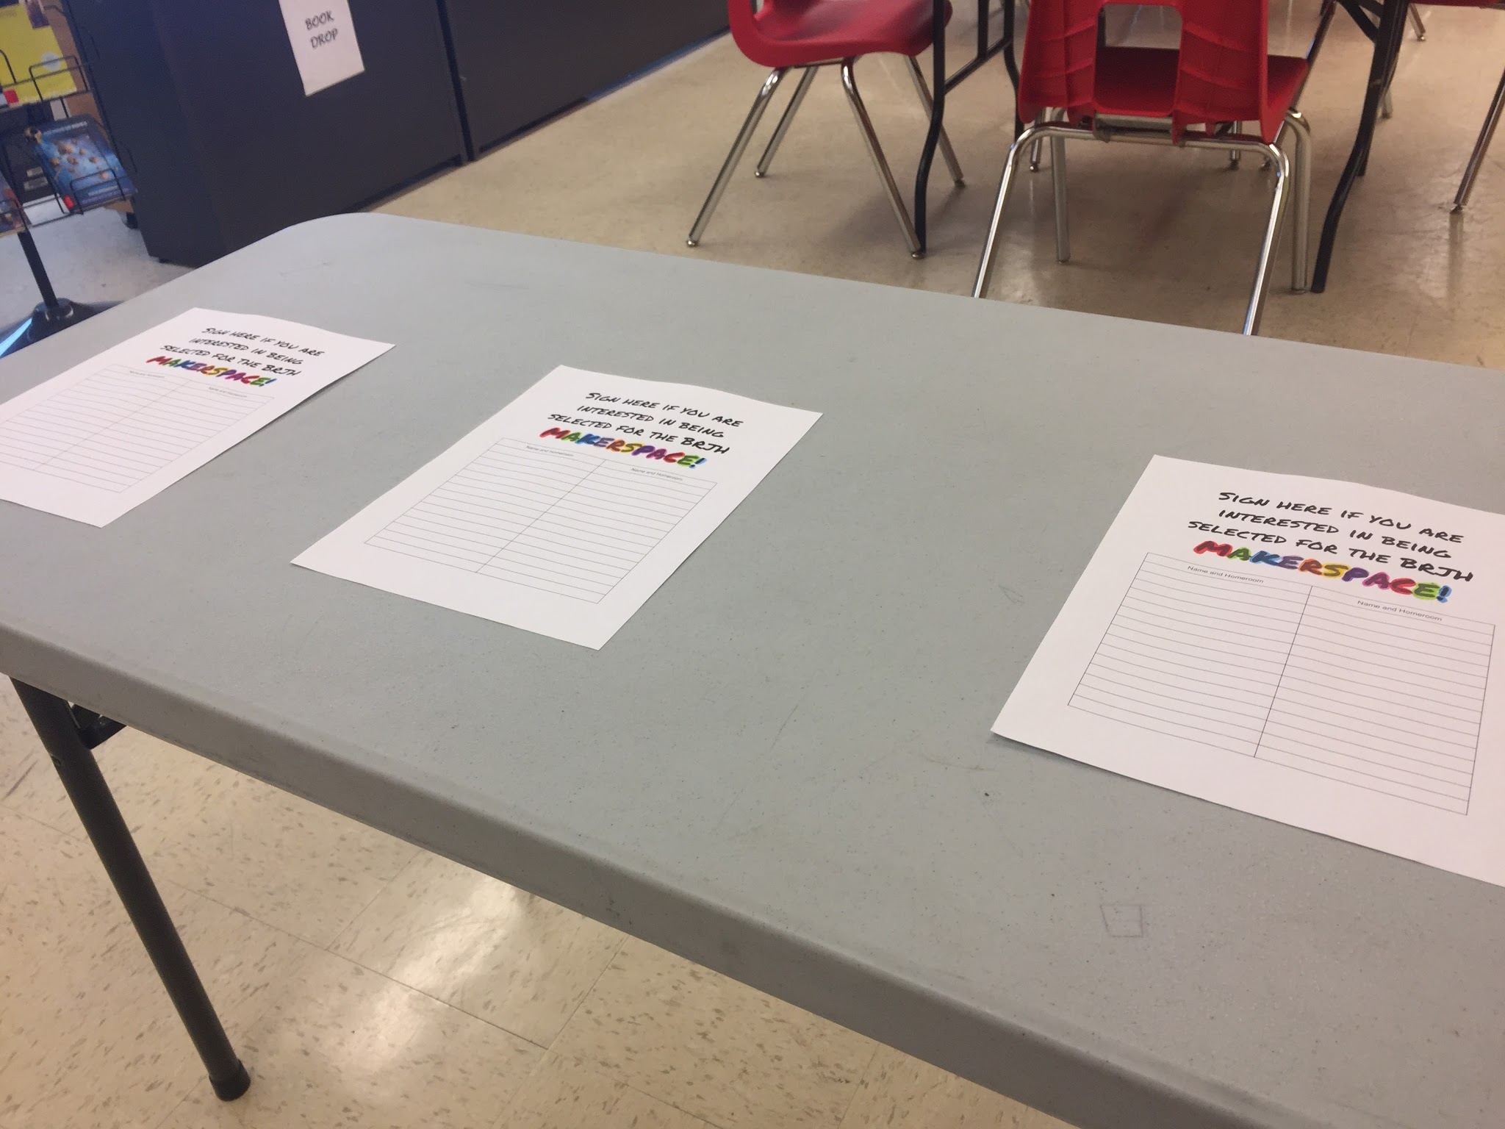
Data Collection and Analysis
Our research methods included student and teacher surveys, informal discussions with students, pictures and videos
We ensured our data was reliable by analyzing all aspects.In terms of qualitative data our project was very successful. The students who participated were engaged and interested.
We analyzed the data by examining student responses. Through student surveys and discussions they reflected a clear interest in science and exploration.

Slide 16
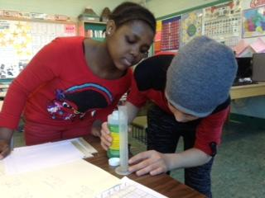
Results
As none of our team members have a science background, our project was ambitious, involving robotics, plants, programming, and literally, rocket science. We were learning how to get the project up and running. When MakerSpace started and the students got involved, they became the teachers.
Our LEARN class was more successful in the inquiry based learning aspect of the project since the classroom environment was more conducive to the goals of the project.
Common Themes:
The ability to learn and explore without direction is lacking. Students want freedom, however when they get frustrated, they do not have the skill set to determine the next steps. (They often did not try to overcome obstacles.)

Slide 17
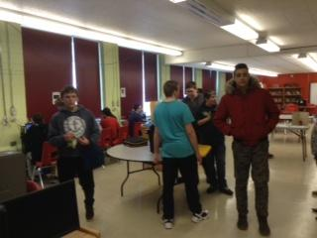
Results
Students didn’t express the level of interest we had hoped. The open house garnered a lot of interest, but it wasn’t sustained. We were competing with other lunchtime activities, and with improving spring weather.
The schedule that was implemented didn’t work out as we thought. Students who wanted to do the project were either in other lunchtime activities that sometimes conflicted or they had challenges following the 7 day supervision schedule (forgot to attend; wanted to go outside; etc.).

Slide 18
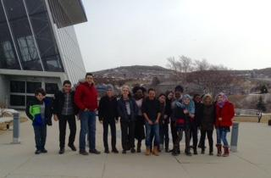
The Future
For most of us, our classroom practice hasn’t changed. We are a diverse group of teachers and none of us are in a traditional classroom setting (LEARN teacher, Technology Education Specialist, Special Services teacher, Fine Arts Specialist). However, the LEARN teacher was able to shift from desiring to engage in more hands-on science and action research, to actually doing it, overcoming such hurdles as apprehension, lack of time and resources, and “making mountains out of molehills”.
We believe that the project has opened us up to new interests and topics that we would have not normally been exposed to. In terms of the long-term impact, this exposure to different topics are things that we are able to bring back to students in our classrooms.
The LEARN teacher looks forward to continuing to engage in more inquiry based scientific learning and utilizing the momentum developed this year.

Slide 19
Teacher Inquiry:
“...focus on providing insights into teaching in an effort to make change…”
Dana & Yendol-Hoppey, 2014, p. 9

Slide 20
Understanding of Teacher Inquiry / Action Research
INITIAL
Only one teacher had prior knowledge of teacher inquiry/action research; the others were completely unfamiliar with the concept.
FINAL
Significant growth in understanding and appreciation; experiential learning is powerful and effective!
Increased understanding of:
→ What is teacher inquiry / action research?
→ How can we use it effectively?
Commitment to ongoing teacher inquiry in future.
We think that our understanding of teacher inquiry/action research has changed a lot. We have an improved understanding of what it is and how it can be most effective.
How did your understanding of teacher inquiry/action research change?

Slide 21
Teacher Inquiry
Strengths
Strengths Grounded in reality Rooted in classroom practice Learner has control Systematic, deliberate Reflective Teacher empowerment Teacher as: Participant Collaborator Active agent for change Intrinsic, and not “top down”
What are the strengths and challenges associated with teacher inquiry?

Slide 22
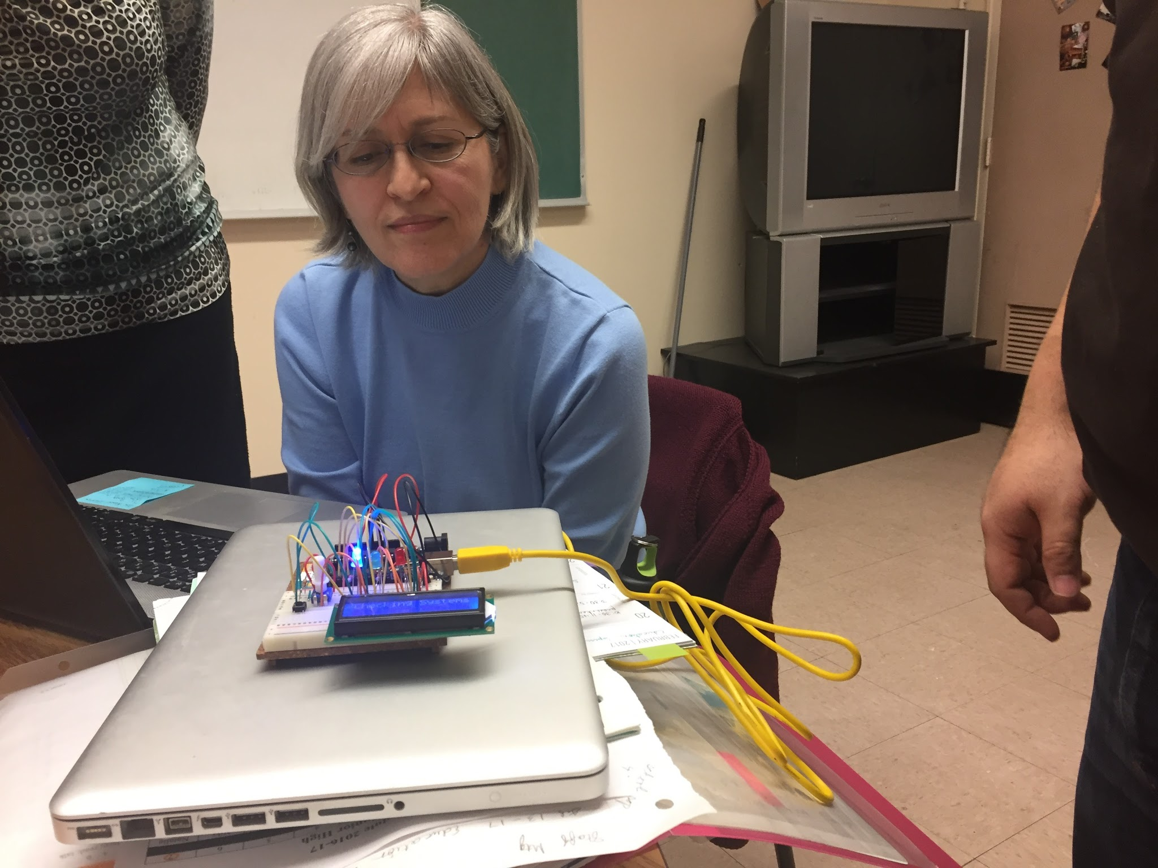
Challenges
Even with release time there remained challenges of having adequate time to truly engage in professional learning. For example, we initially intended to thoroughly read and digest The Reflective Educator’s Guide to Classroom Research, but this fell by the wayside as the school year unfolded and we were caught up in meeting the myriad challenges of daily teaching.
Occasionally, we felt our release days hinged on the completion of specific project tasks, instead of allowing us time to engage in teacher directed learning.
Although we enjoyed and benefited enormously from the TIA days, sometimes it felt we had to work a “double shift” preparing lessons for substitutes, then bringing needed energy to the project.

Slide 23
The Future?
How will exploration and utilization of Universal Design for Learning affect student learning?
How will the shift from delivery of prescribed Science courses by Science teachers to LEARN students, to the delivery of Science by the LEARN teacher alter students’ understandng of, and engagement in, Science?
Are there aspects of teacher inquiry you will continue to use in your teaching?
YES!

Slide 24
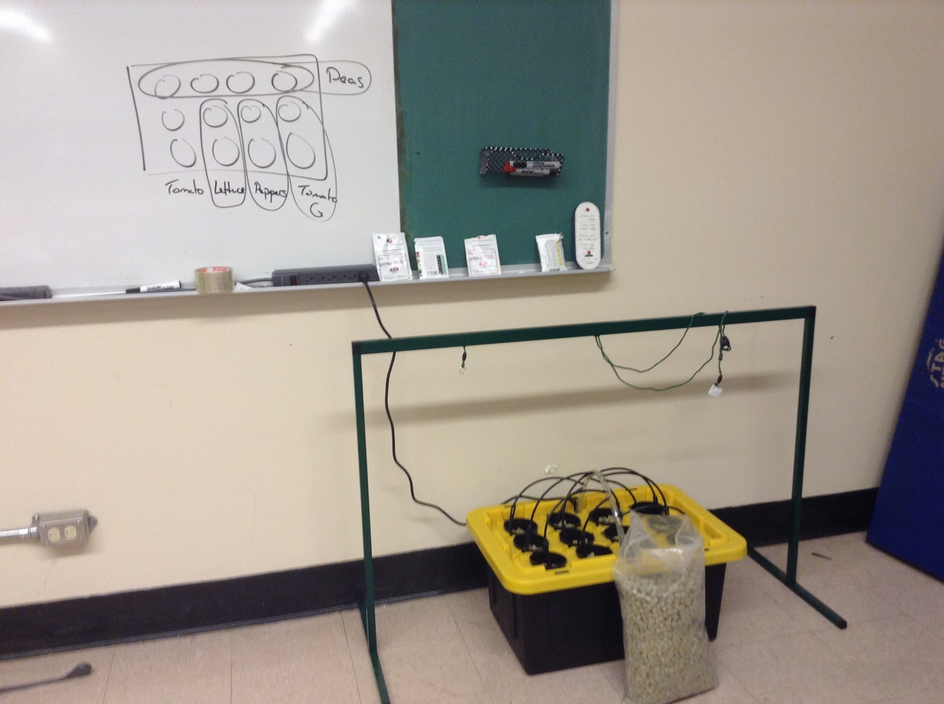
Intended Goals
To gauge the impact of MakerSpace on student engagement and learning
To engage in action research
To rekindle our passion and relight our “fire” for teaching
To effectively change content delivery of Science and Math in the LEARN classroom

Slide 25
Project Success
“Since I came to Brother Rice, I have been very happy and my marks have gone up.”
Grade 7 student
mid-year transfer from rural NL
“This is the first time in the history of LEARN that students have participated in an extracurricular activity other than Friendly United Nations (FUN Club) and the soccer team.”
LEARN teacher
Engagement of diverse students:
Notes:
Self-identified “geeks”, isolated, intellectual, iconoclastic, newcomers, transfer students, etc.

Slide 26
Project Success
We were able to watch students learn and explore new projects they were interested in.
Students learned and taught us new things.
MakerSpace will continue! → begin in September and designate a day
The LEARN classroom was transformed by the scientific method and research inquiry. The initial question of, “Can plants grow in water?” segued into, “Will plants grow in water if we feed them nutrients (hydroponics)?”, to “Let’s observe and compare how plants grow in soil to hydroponics.”

Slide 27
Teacher
Inquiry:
How did the project meet your professional learning needs?
We feel this project has encouraged and challenged us to move beyond our comfort zones and explore areas that we would not normally explore.
How did the project help you create student-centered learning environments?
This project provided an opportunity to create student-centered learning environments in which students could learn and grow and have fun at the same time.

Slide 28
Do you have any new questions about your teaching that you would like to explore?
Explain/elaborate.
How will engaging in inquiry based/ action research impact students’ language learning and conceptual understanding?
Will LEARN students continue to nurture their new-found love of Science and Math?

Slide 29
References
Fichtman Dana, N. & Yendol-Hoppey, D. (2014) The Reflective Educator’s Guide to Classroom Research (Third Edition). Thousand Oaks, CA: Corwin.
Fitzgerald, Scott, and Michael Shiloh. The Arduino Projects Book. Torino: Arduino, 2012. Print.
Kurti, R.S., Kurti, D., & Fleming, L. (2014). Practical Implementation of an Educational Makerspace. Teacher Librarian, 42:2, p. 20-24.
MUN Botanical Gardens
"WELCOME TO SIMPLY HYDROPONICS and ORGANICS." Hydroponics Systems from Simply Hydro - Buy Online and Save. N.p., n.d. Web. 15 June 2017. <http://www.simplyhydro.com/>.
The Seed Company by E.W. Gaze (formerly Gaze Seed Co Ltd)

