Slide 1
e-Portfolios in Elementary Science
by Line Daly

Slide 2
Background Information
Grade 6 French Immersion teacher at
Vanier Elementary School
14 years teaching experience
Junior High Math and Science in French
Immersion
Taught Grade 2, 3, 5, and 6 in past six years
2nd year in Grade 6
75% teaching duties, 25% administrative duties

Slide 3
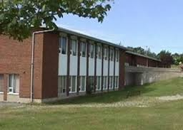
Vanier Elementary
K-6 school in the east end of St. John’s
315 students and approximately 30 teachers and support staff
Inclusion Phase School in the 2014-2015 school year
Two stream school: one English and one French Immersion (ICF offered in Grade 6)

Slide 4
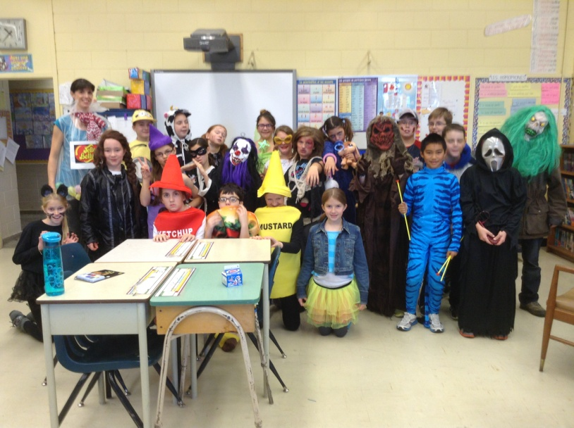
La classe de Mme Daly
25 students : 10 boys, 15 girls
Wide range of interests, abilities,
learning readiness, and learning
styles/preferences
Very friendly students who get
along well with one another
Two students have IEPs and receive special services support in Math and Language Arts
Most enjoy reading, playing chess, playing sports, and socializing

Slide 5
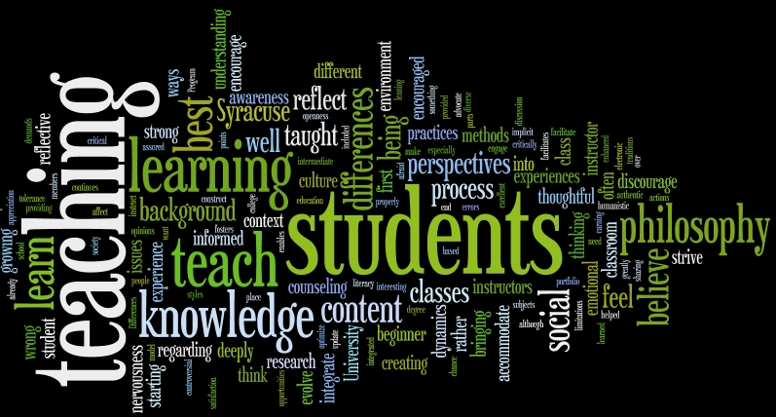
Beliefs about Teaching and Learning
I believe that…
…all students can learn and may require a different path to achieve learning outcomes.
…students need to be interested and engaged in what is being taught in order to learn.
…in order for learning to occur, students need to be able to connect that learning to their own experiences.

Slide 6
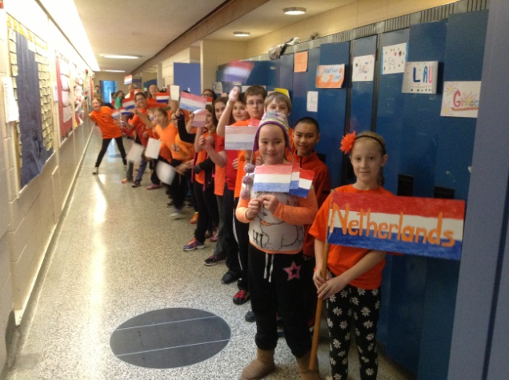
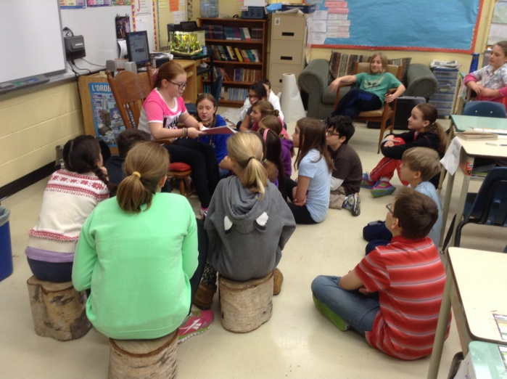
Beliefs about Teaching and Learning
…teachers need to first make personal
connections with students to
understand who they are and what
excites them so that lessons are
interesting, engaging, and meaningful for all.
…teachers can foster lifelong learning
in students by providing them with
opportunities in which they must
assume responsibility for their own
learning.

Slide 7
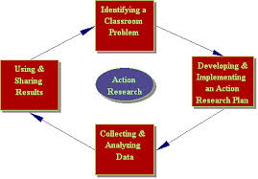
Why Teachers in Action?
Learned about Teacher Inquiry as a method of research while completing my Masters program.
See teacher inquiry as valuable professional development since it is specific to my professional growth needs towards meeting my students’ learning needs.
Always wanted to try teacher inquiry and this provided the perfect opportunity to fuse this desire with my interest in incorporating e-portfolios in my classroom.

Slide 8
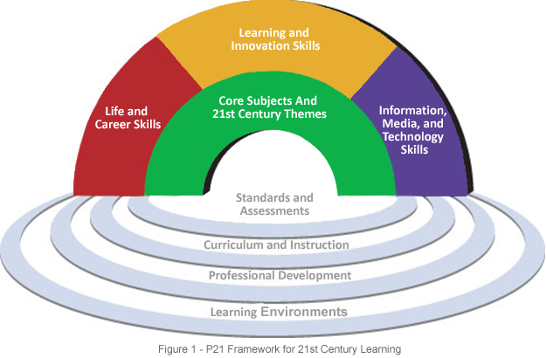
Why e-Portfolios?
In line with 21st Century
Learning Principles
Communication
Collaboration
Critical Thinking
Creativity
They offer an alternative way for:
Students to produce and showcase their learning in an authentic way
Teachers to provide feedback to students
Students to share work with their peers
Students to provide feedback to their peers
Teachers to assess student work

Slide 9
Why e-Portfolios?
They allow students to assume more responsibility for their own learning by helping them understand their strengths and needs in order to set learning goals.
They provide a history of student growth over time
They provide an opportunity for students to reflect on and edit their work.
Abrami, Wade, Pillay, Aslan, Bures, & Bentley, 2008

Slide 10
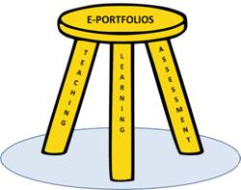
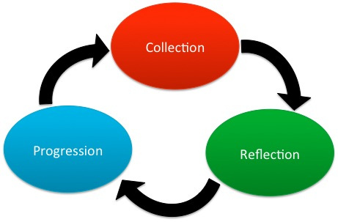
Focus Area
Through the Science unit on Electricity, I wanted to focus on 2 things:
Determine how students respond
to feedback through use of
e-portfolios
Foster assessment as learning
so that students become more
responsible learners through the
use of e-portfolios

Slide 11
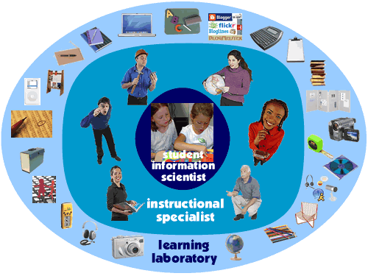
Focus Area
After doing some preliminary reading in preparation for my project I decided to add a 3rd focus:
3) Determine the effectiveness of using student inquiry to teach Science

Slide 12
Research Questions
1) How do students respond to the feedback given by the teachers through the medium of e-Portfolios?
What kind of feedback am I providing students?
Is it effective in fostering more responsible learners who set goals for themselves toward improvement?

Slide 13
Research Questions
2) How effective are e-portfolios in fostering assessment as learning in fostering responsible and self-regulated learners?
Do students become more aware of feedback given by the teacher?
What are the best approaches and strategies that foster self-assessment?
What are the best approaches to use in the context of our unit?

Slide 14
Research questions
As the implementation of my project unfolded some questions around using student inquiry as a teaching strategy developed:
3) How effective is student inquiry in fostering excitement and curiosity in Science and how will this inform my practice?
How effective is student inquiry in improving student learning?

Slide 15
Ethical Considerations
Under the guidance of the Teachers In Action Team, an informed consent letter from MUN as well as a consent and information letter about my project was sent to parent.
Through e-mail and my website, parents were informed that students would be using the iPad app called OpenSchool e-portfolio throughout my action research.
Consent forms were returned and response was positive as most parents consented to their child’s participation in this project.
Work samples, photos, and videos presented in this and any other presentation created as a result of my project does not reflect any student whose parents refused consent for their participation in the project.

Slide 16
Planning
In preparing for my project I attended a professional development session facilitated by MUN’s Teachers in Action Team where I learned about the components of Teacher Inquiry and had the opportunity to collaborate with other teachers involved in this initiative.

Slide 17
Planning
Reading and research was used to inform:
the platform I chose to create student e-portfolios
the type of feedback that would be most effective in fostering responsible learners
the type of student inquiry I would use as a strategy to teach the outcomes delineated in the Electricity unit of the Grade 6 Science curriculum.

Slide 18
OpenSchool e-portfolio
http://www.openschooleportfolio.com/tour/

Slide 19
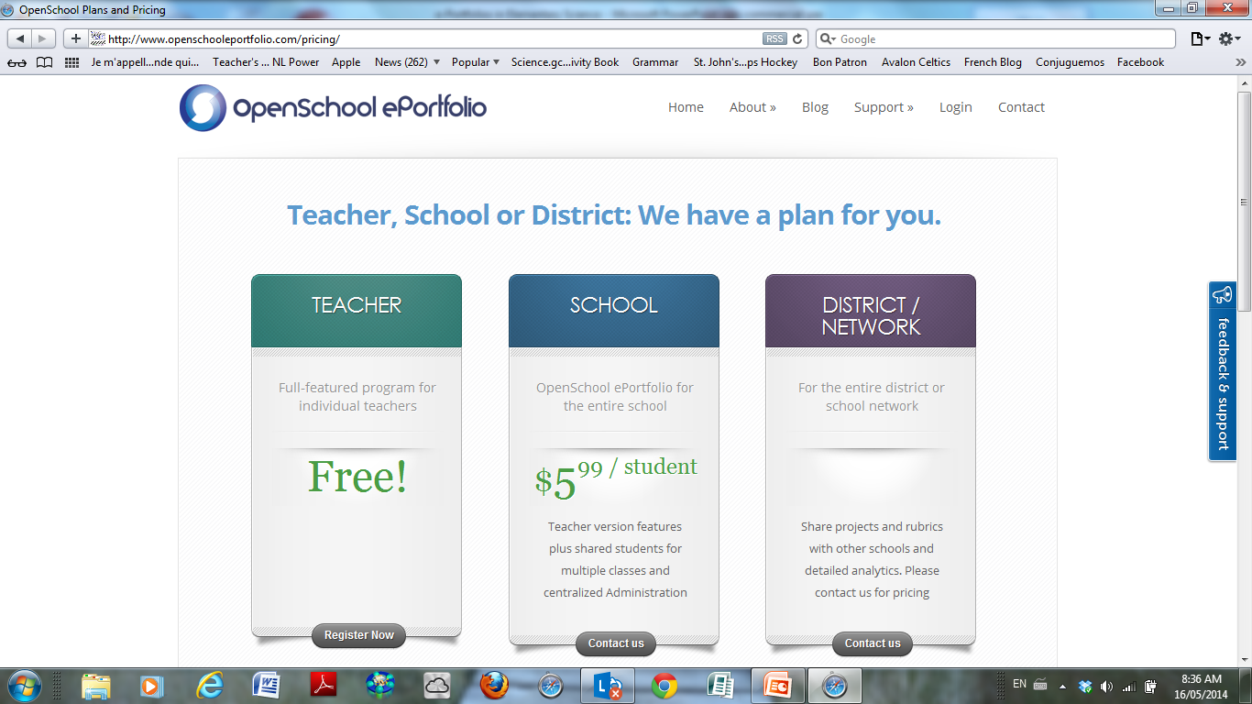

Slide 20
Implementation
Administered Survey to students
https://docs.google.com/forms/d/1aO1ozt-B7FoDAUcWEmAZYXIbWiNPKXcvsq136qMYlkk/viewform
Asked questions about…
How they feel about Science class
Their experience with e-portfolios
Their feelings and reactions about teacher feedback

Slide 21
Implementation
Introduced students to OpenSchool e-portfolio
Students able to see others’ portfolios but I did not allow them to leave comments, as I wanted to ensure validity in testing the effects of my feedback and not their peers’ on students becoming more responsible learners
Notes:
First project was to find out what they know about electricity and what are some of the questions they have around electricity
Feedback provided to encouraged students to add to their list of questions.

Slide 22
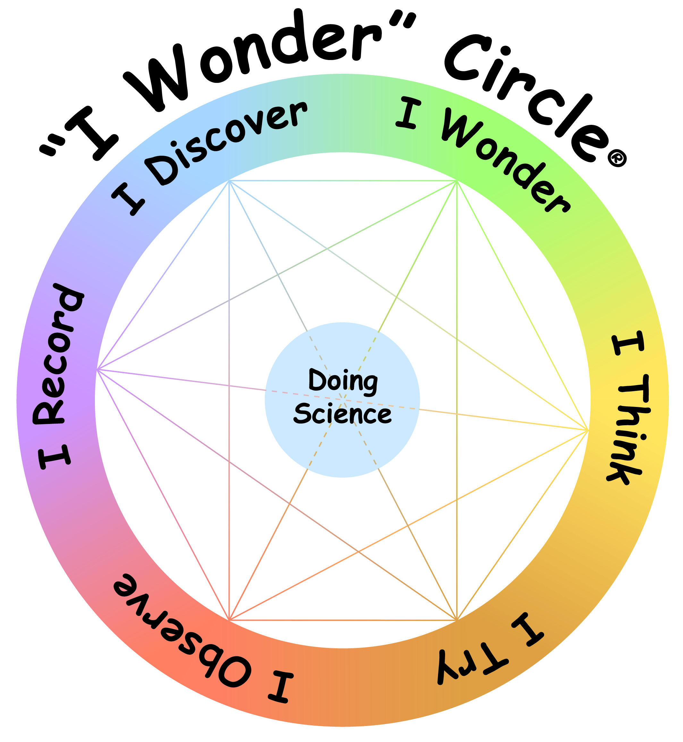
Student Inquiry Approach
Open Inquiry is the highest level of inquiry where “…students have the purest opportunities to act like scientists, deriving questions, designing and carrying out investigations, and communicating their results” (Banchi & Bell, 2008)
Students generate experimental
questions through “I wonder…”
statements
Used a cyclical approach to guide
students in achieving the different
knowledge outcomes while
incorporating routine in order to
meet skills and STSE outcomes

Slide 23
Teacher demonstration of scientific concept
Generate “I wonder” statements
Communicating and sharing findings
Derive scientific question
Cycle of Inquiry
Plan investigation or experiment
Analysis and interpretation of observations
Perform investigation and record observations

Slide 24
Open Inquiry Approach
Demonstration to introduce scientific concept and get student thinking about questions around the phenomenon.
Students individually and independently derived an “I wonder" statement that will lead to a scientific question about what they observed. This was done on Post-it notes.
Post-it notes were shared and organized by similarity in question (same things being changed). This was done as a whole class and organized on chart paper.

Slide 26
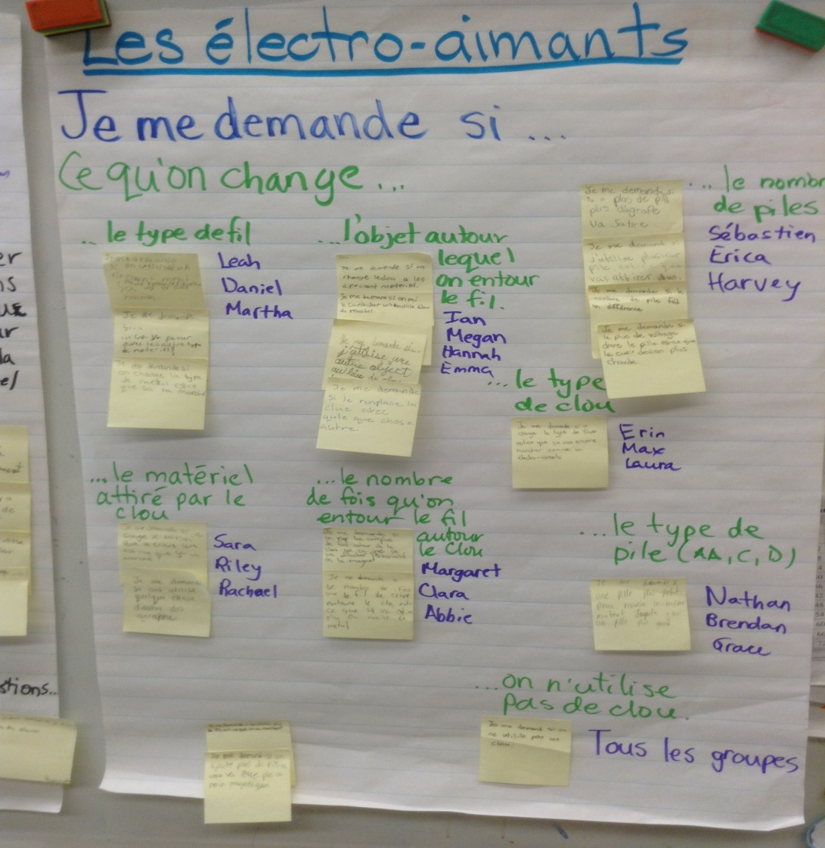
This resulted in the creation of several experiments generated by students’ wonderings.
8 experiments generated!

Slide 27
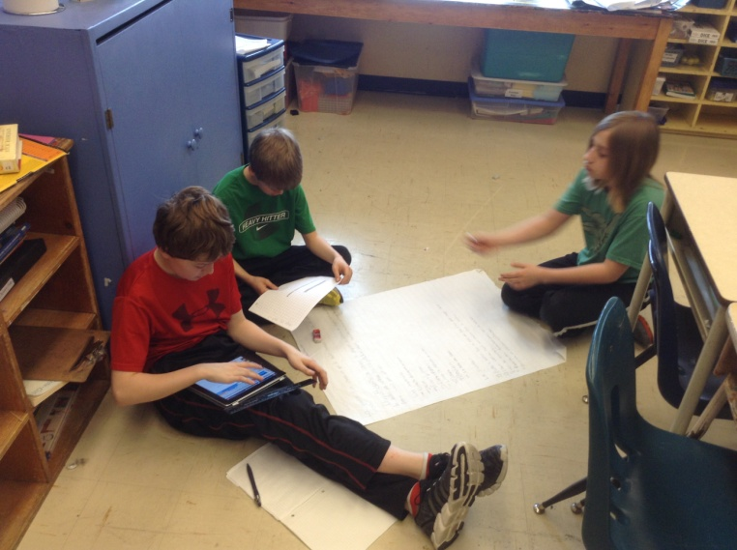
Open Inquiry Approach
Review of Scientific Method in planning, performing, recording, analyzing and interpreting was done before first experiments around static electricity.
Worked together as a group to formulate scientific question, hypothesis, plan materials and procedure, and create observation tables.

Slide 28
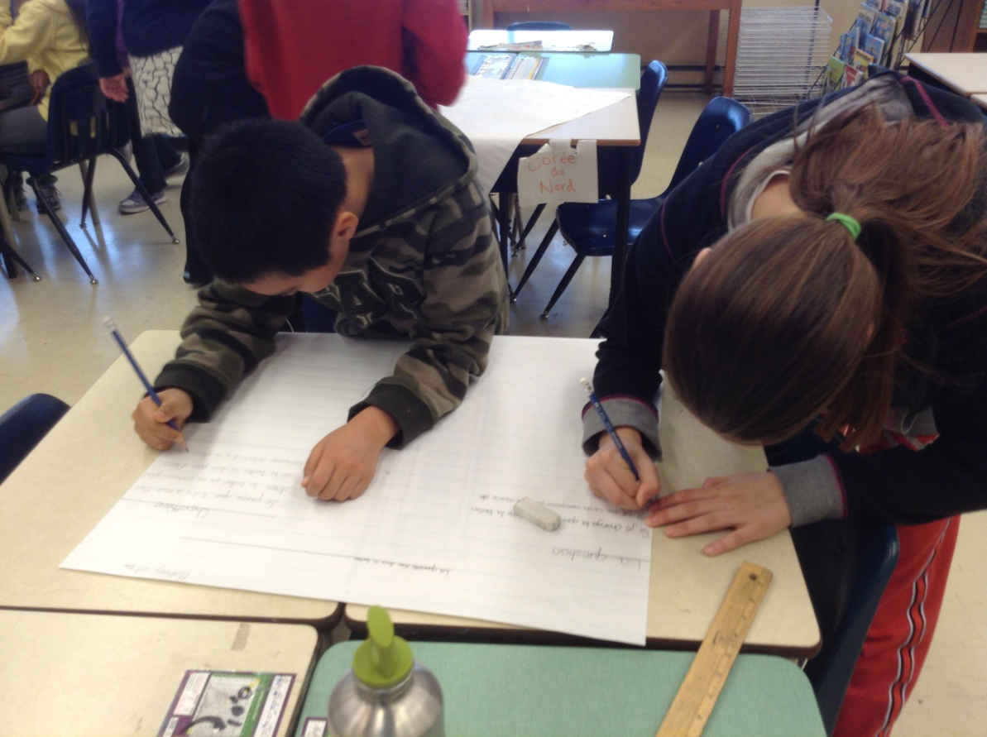
Open Inquiry Approach
Students recorded this planning stage in e-portfolio either by taking photo of paper/pencil work, typing directly in e-portfolio, or creating audio file.

Slide 29
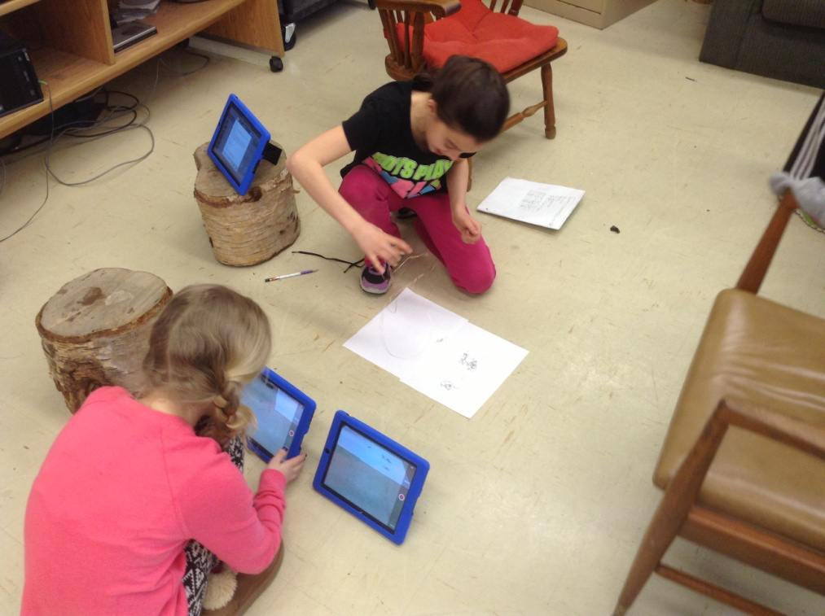
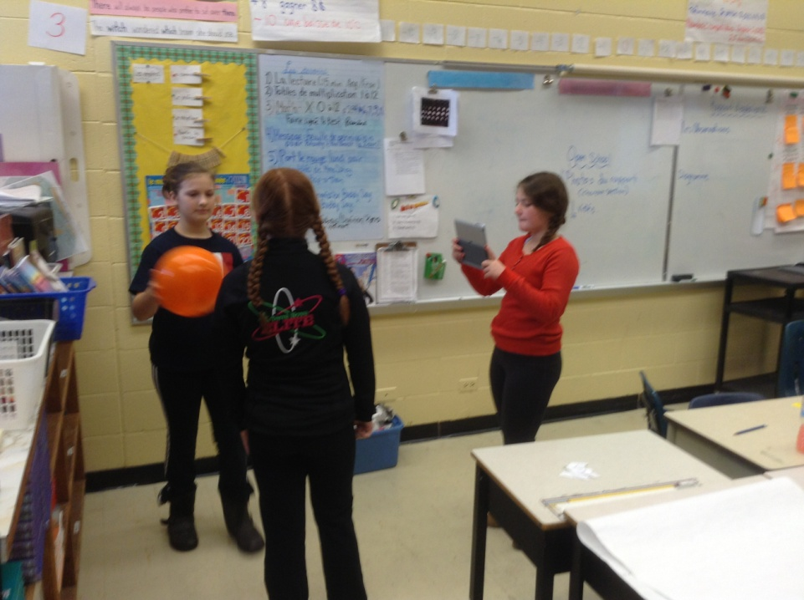
Open Inquiry Approach
Students carried out experiment and recorded data and observations on paper (table), video recordings, and photos.

Slide 30
Open Inquiry Approach
Students then worked together to graph their data and interpret the results in leading to the formulation of their conclusion
Students then shared their findings with classmates as a whole class presentation.
Throughout process, verbal feedback was provided to students to guide them as they produced their finished product in their e-portfolio
Notes:
Meeting math outcomes with graphing and interpreting
Conclusion included: which included a confirmation/rejection of their hypothesis, an answer to their scientific question, and possible explanations for varied results.

Slide 31
Open Inquiry Approach
Once project was submitted, I assessed the project and provided descriptive feedback, in line with what students expressed as valuable feedback in the pre-project survey
At times, students would respond directly to the feedback I provided them to improve the submitted work (most, as indicated in post-survey results, used it to improve on the next investigation.

Slide 32
Open Inquiry Approach

Slide 33
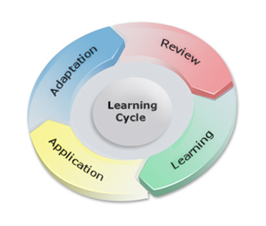
Results
This project enhanced my knowledge and understanding on in the following areas:

Slide 34
Instruction and Student Learning
Students enjoyed Science class
more after introducing
inquiry-based learning and
e-portfolios.
When rating how much they enjoy Science class on a scale of 1-5, 11% of students went from a 3 in the pre-project survey to a 4 or 5 in the post project survey
17% went from a 4 on the pre project survey to a 5 on the post project survey

Slide 35
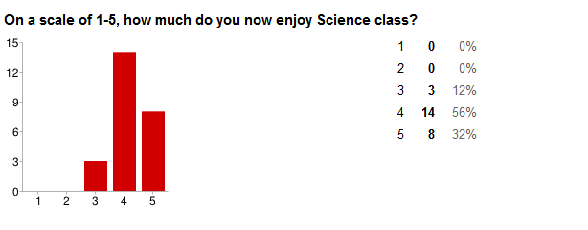
“How much do you enjoy Science class?”
Pre Project Survey
Post Project Survey

Slide 36
“How excited do you feel when you know you have Science that day?”
Pre Project Survey
Post Project Survey
34% more students feel excited when they know they have Science class that day.

Slide 37
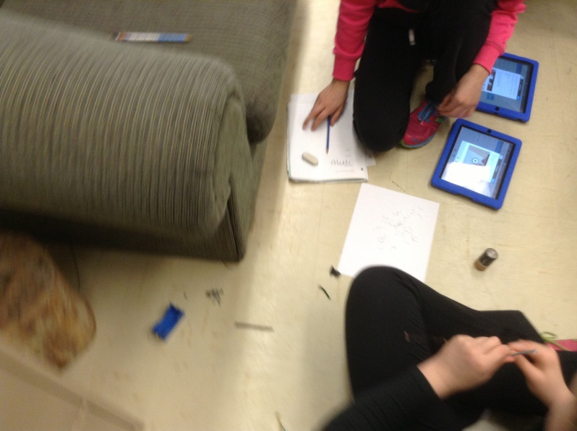
“Have you ever used an e-Portfolio?”
Pre-project survey indicated that no student had ever used an e-portfolio and 11% had never even heard of e-portfolios.
Post-project survey showed that 96% (24/25) of students liked using an e-portfolio in class.

Slide 38
Reasons why students liked using an e-portfolio in Science Class
Technology instead of paper:
“Because it makes it more interesting.”
“You can easily show your work with pictures…”
Fun:
“It’s a fun way to learn.”
“…we get to take photos and videos.”
“Because it’s simple and easy.”
Faster way to work:
“It’s very efficient.”
“…I think I work a lot faster.”
“…I really liked typing instead of writing because it’s faster…”
Organization:
“It keeps all your work in one place.”
“It’s an easier way to be organized”

Slide 39
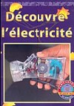
Instruction and Student Learning
I used to focus on the knowledge outcomes in hopes of students achieving some of the skills and STSE outcomes
Notes:
Use of textbooks provides already designed experiments that don’t allow students to explore their own questions or even promote critical thinking and problem solving in planning their own experiments. Everything is already controlled for them.

Slide 40
Skills Outcomes
Student Inquiry method of instruction touched on every skill outcome outlined in the curriculum guide and every student was able to show their understanding of this process in their e-portfolio

Slide 41
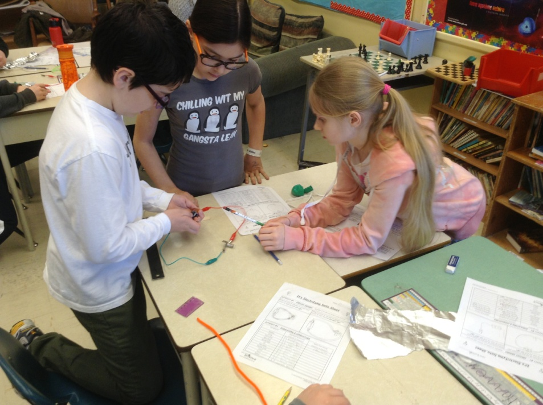
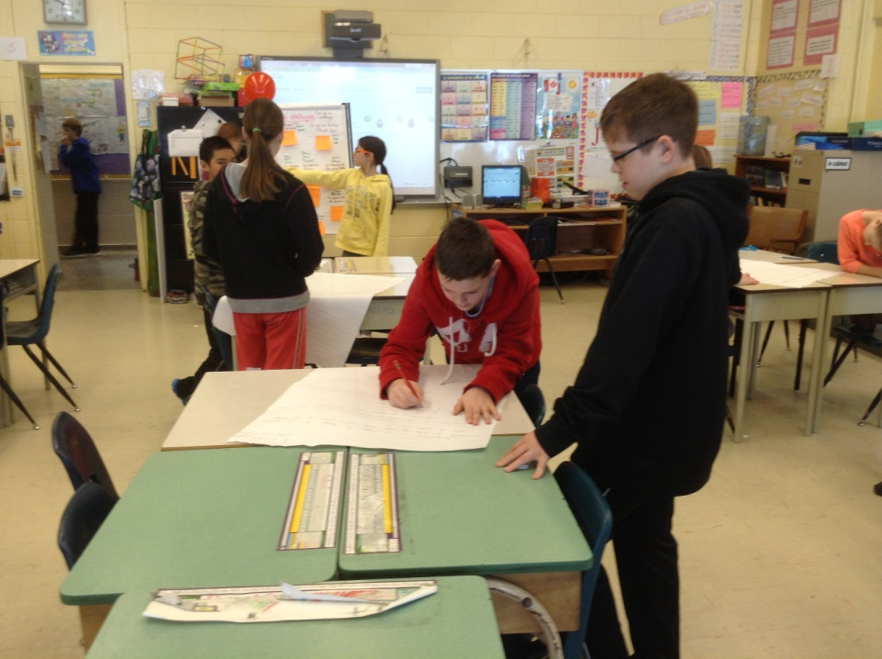
Student e-portfolios
https://app.openschooleportfolio.com/eportfolio/index/index/student/ny4
https://app.openschooleportfolio.com/eportfolio/index/index/student/dg27

Slide 42
Student e-portfolios

Slide 43
Student e-portfolios

Slide 44
Instruction and Student Learning
Student Inquiry also touched on more knowledge outcomes than I am usually able to cover.
As many as 8 experiments were going on at the one time and students shared results of experiments with class at the end of the cycle of inquiry.
“ I liked making our own projects. We got to learn about things I didn’t already know.”
“…multiple variables changed at the same time. It helps my learning x2”

Slide 45
Knowledge Outcomes

Slide 46
“Do you know what this is?”

Slide 47
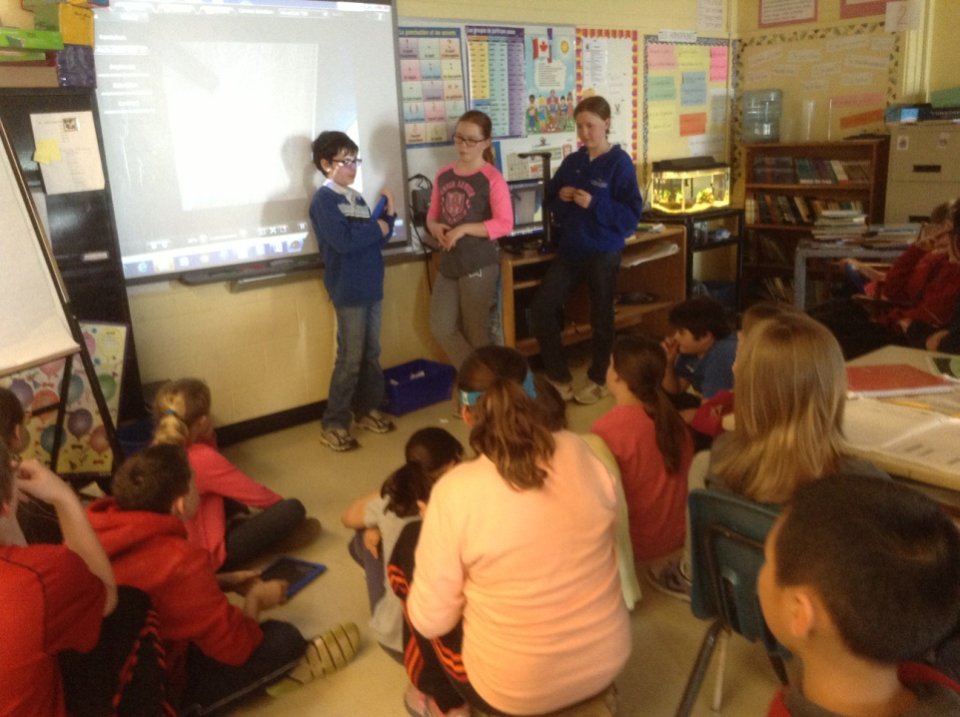
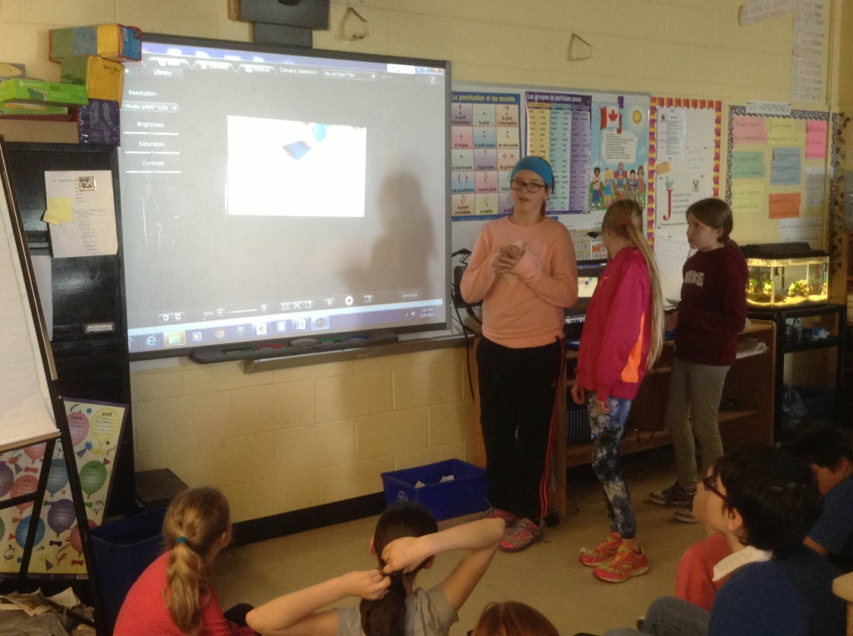
Instruction and Student Learning
Students shared findings of their experiment which continued the cycle of inquiry by inspiring more questions that could lead to further investigation.

Slide 48
Instruction and Learning
E-portfolios encouraged students take ownership of their learning.
Almost immediately after introducing the e-portfolio app, students personalized their page at home, on their own time, by adding a profile picture and many included a personal goal.

Slide 49
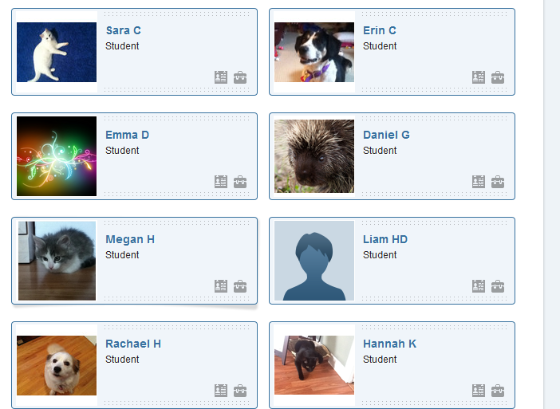
Instruction and Learning

Slide 50
Instruction and Learning

Slide 51
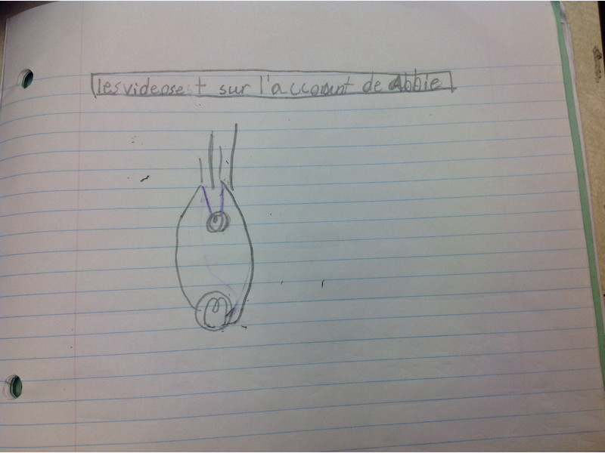
Subject Matter
Student investigations and explorations allowed me to learn more about some electricity concepts and see things from various perspectives through their experiences.
https://app.openschooleportfolio.com/eportfolio/index/index/student/ab106

Slide 52
Assessment of learning
E-portfolios are a great way to differentiate as they allow different ways for student to show their learning.
“…it helps you show your teacher what you learned by letting you take pictures and videos.”
“I felt it helped my learning because I was more excited for Science and wanted to use the iPad and be more part of the group.”
“… I was more interested in using e-portfolio and using the iPads instead of writing on paper and reading from a textbook.”
“ I can improve my work at home and show my parents.”

Slide 53
Assessment of Learning

Slide 54
Assessment for learning
Students appreciate descriptive feedback and use it to improve their learning
“…easy access from home and school so I could improve my answers at home and learn from my mistakes.”
“…your teacher can look at your work and leave comments on what you did good on and what you need to work on.”
“…if you don’t have something right the teacher will leave a comment on it and tell you what you did wrong or need to improve.”
“You can edit your work anywhere, not just at school.”
“I like that we can comment and learn from the teacher’s comments for future projects.”
“The teachers get to write more comments.”

Slide 55
Assessment for learning
92% of students felt that working with an e-portfolio has definitely motivated them to produce the best work possible.
Overall, 96% of students said they like e-portfolios.
Notes:
While the use of e-portfolios did not increase the percentage of students who reviewed their work to either see how they’ve improved or to make it better (over 90% felt they did this before using e-portfolios),

Slide 56
Assessment as learning
Students use e-portfolios to reflect on their own learning to identify areas of strength and need.
“ I like using an e-portfolio because you can always go back and look at your work and see how much you’ve improved.”
“I liked being able to go back to my work and improve on it.”
“…you get to see other people’s work”

Slide 57
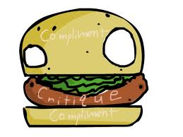
Feedback
The pre-project survey indicated that students preferred descriptive feedback that was like a “compliment sandwich” :
Something you did well
Something that needs to be improved
Something else you did well
Post-project survey showed a 12% increase in the number of students who used the feedback to improve their work.

Slide 58
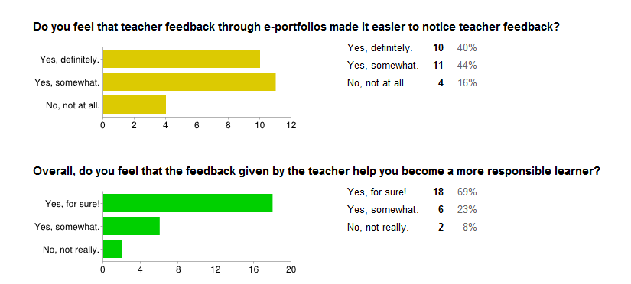
Feedback
84% of students felt that feedback given through e-portfolios made it easier to notice teacher feedback.
92% of students felt that the feedback given by the teacher helped them become a more responsible learner.

Slide 59
Recurring Themes

Slide 60
Collaboration
Students were more engaged and on task when working together in large and small groups.
Large group collaboration of generating different investigations helped them think more independently and encourage curiosity.
Each new inquiry, a greater percentage of students were able to generate an “I wonder” statement, telling me that this process fostered and developed inquiry).
60% of students during first collaboration compared to 80% during the last one.

Slide 61
Number of I wonder statements generated by students independently

Slide 62
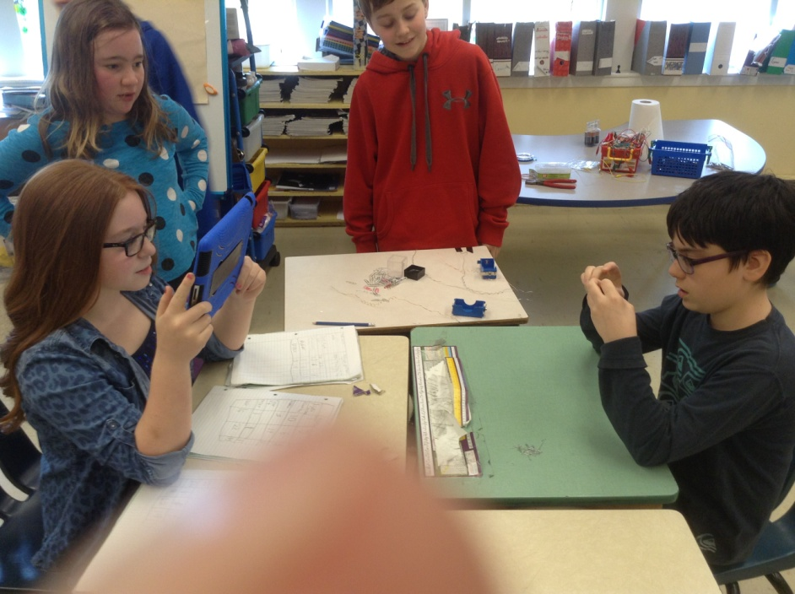
Collaboration
Small group discussions led students to:
more effectively problem-solve
use scientific language
the synergy of ideas
support one another
become risk-takers
Notes:
-fewer hands raised to answer questions
-proper terms were used “hypothesis”
-synergy: when planning experiment, different ideas came together to form a great experiment (materials used, ensure controls, tested validity through repetition, analysis of results)

Slide 63
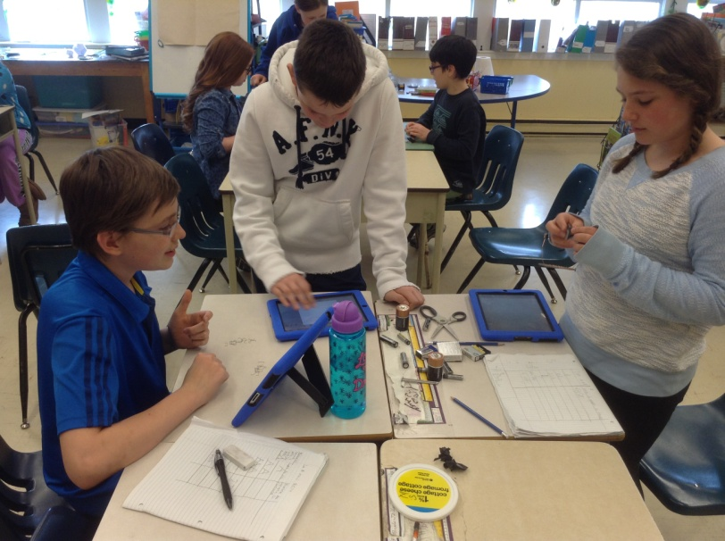
Collaboration
Post project survey focus groups and large group discussion revealed that students prefer working together.
“ Help from group members.”
“Fun and got work done, too.”
“Learn the same amount but didn’t have to do all the work yourself.”

Slide 64
Technology
The use of technology motivated student learning as students…
looked forward to Science class because they got to use iPads
were on task and were enthusiastic about showing their learning.
enjoyed being able to choose how to show their learning
liked being able to access their work from home to finish and/or edit their work
enjoyed reading teacher feedback and being able to respond immediately

Slide 65
Technology
Using e-portfolios promoted student responsibility of their own learning.
Post-project survey revealed that:
16% more students reviewed their work more often
74% of students went back to a submitted piece of work to make it better
12% more students said they used teacher feedback to improve their work
100% of students read the feedback
80% of student felt that the feedback was very helpful or invaluable.

Slide 66
Student Inquiry
Open inquiry instructional approach was preferred by students.
They were motivated to investigate their self-generated questions
They enjoyed the hands-on experimentation
100% student were engaged and participated
They liked going around to other groups to see what they were doing
They felt they were learning more

Slide 67
Long-Term Impact
This project will have a long-term impact on my classroom practice as it allowed me to step outside my comfort zone with regard to using technology as well as student inquiry to teach Science.
I have already been applying the principles I’ve learned about student inquiry in other subject areas.
Notes:
Social Studies: Letting students investigate main religions of middle east. Allowing them to choose what they are interested in and collaborating to get info
Math: Encouraging students to investigate their own answers to problems, such as “can similar surface area determine congruence of 2 triangles? “ Just the fact that this student, who NEVER asks questions in class, is a testament to the power of student inquiry on fostering inquisitive minds…

Slide 68
Long-Term Impact
Through this project I discovered that e-portfolios:
motivate student learning
foster inclusion through differentiation
are efficient and effective in collecting and assessing student work
make it easy to provide descriptive feedback to students
make it easy for students to receive feedback
fosters self-regulated learning and independent/responsible learners
Notes:
-Differentiation: options as to how to show learning (video, audio, text, photo)
-Easy: easier to type than write
-self-regulated learning: students read and use feedback, can work from home

Slide 69
Long-Term Impact
Through this project I discovered that student inquiry teaching approach fosters 21st Century Learning principles of:
student motivation and engagement
collaboration
questioning and problem solving
critical thinking
communicating and sharing
creativity
Notes:
Student motivation and engagement (integrating iPads increases motivation and engagement)

Slide 70
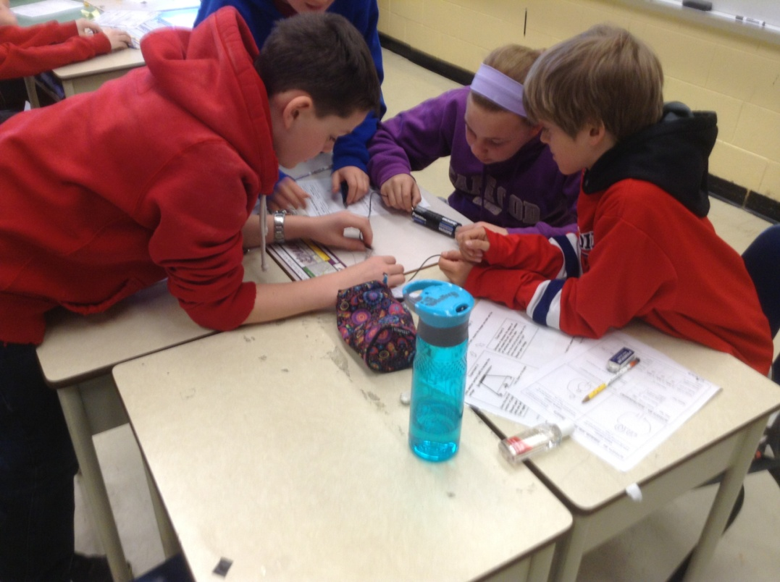
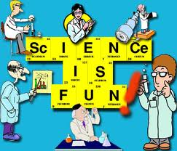
Long-Term Impact
More importantly, using student inquiry to teach Science makes it FUN for everyone!

Slide 71
Teacher Inquiry
My involvement in this project deepened my understanding of teacher inquiry and it’s value as a meaningful and powerful professional development for teachers
Because teacher inquiry starts with a question that is self-generated and rooted in a desire to increase student achievement, and is planned and carried out by the teacher himself or herself, it is a powerful learning tool that will most likely have a long-term impact on both teachers and their students.
The success I experienced with this project has excited me as a teacher to continue investigating new and different strategies and has motivated me to share my findings with colleagues.
Only one challenge associated with teacher inquiry: lack of TIME
Notes:
Lack of time to plan and formalize implementation and collection of data.
Reflect all the time mentally, but taking the time to write it down proved challenging.

Slide 72
References
Abrami, P., Wade, A., Pillay, V., Aslan, O., Bures, E., & Bentley, C. 2008 Encouraging self-regulated learning through electronic portfolios. Canadian Journal of Learning and Technology, 34(3) Fall.
Branchi, H., & Bell, R. (2008) The many levels of inquiry, Science and Children, October, 26-29.

