Slide 1



Creating Success for Students in Math
Angela Norman
Woodland Elementary
2013-2014

Slide 2
Angela Norman
Teaching experience – 9 years
Education Background – Masters of Education in Teaching and learning with a focus in Mathematics
Currently teaching Grade 5 at Woodland Elementary with 24 students (Co-teaching with IRT)
My Grade 5 classroom- contains a range of students / approx 8 students are receiving additional IRT support for Mathematics.

Slide 3
Teaching Beliefs-
  In the area of mathematics I have always believed that students needs to be interacting and making connections to their learning. Using activities that engage students, get them discussing concepts and using materials (ex. manipulatives) so that they can understand the basis of the mathematical concept.
Why a STEM Project?
  I have always been interested in idea of incorporating technology into my math classroom. I have attended in-services and training sessions dealing with math and technology. Being apart of this stem project has allowed me to avail of additional technology and the time to develop activities to bring technology into my math classroom.

Slide 4
Nctm- technology in mathematics
NCTM Position
“It is essential that teachers and students have regular access to technologies that support and advance mathematical sense making, reasoning, problem solving, and communication. Effective teachers optimize the potential of technology to develop students’ understanding, stimulate their interest, and increase their proficiency in mathematics. When teachers use technology strategically, they can provide greater access to mathematics for all students.”
Taken from: http://www.nctm.org/about/content.aspx?id=31734

Slide 5
NL Grade 5 Math Curriculum Guide
Technology contributes to the learning of a wide range of mathematical
outcomes and enables students to explore and create patterns, examine
relationships, test conjectures and solve problems.
Calculators and computers can be used to:
• explore and demonstrate mathematical relationships and patterns
• organize and display data
• extrapolate and interpolate
• assist with calculation procedures as part of solving problems
• decrease the time spent on computations when other mathematical
learning is the focus
• reinforce the learning of basic facts
• develop personal procedures for mathematical operations
• create geometric patterns
• simulate situations
• develop number sense.
Technology contributes to a learning environment in which the
growing curiosity of students can lead to rich mathematical discoveries
at all grade levels.
Taken from: http://www.ed.gov.nl.ca/edu/k12/curriculum/guides/mathematics/gr5_math_guide.pdf

Slide 6
My project and my school
Woodland Elementary has been focusing on the 4 C’s of Learning
  Collaboration
  Communication
  Creativity
  Critical Thinking
In my project I incorporated activities involving collaboration, communication and critical thinking.

Slide 7


My research questions:
Teacher Question
  How can the implementation of virtual manipulatives technology inform my teaching in a mathematics unit in fractions
Student Question
  How will the use of virtual manipulatives technology enhance student understanding of concepts in a fractions unit
Virtual manipulatives was changed to technology due to the fact that as my planning progressed in my project I found that I-apps and interactive whiteboard activities were able to provide the practice and exposure I was looking for- also virtual manipulative were limited and not always accessible and easily usable for students!

Slide 8
Project Description
My Grade 5 Students will take part in a pre-survey, post-survey, pre-test, and then complete a three week implementation of a fractions unit. During the implementation students will take part in various center activities that will focus on the curriculum outcomes.
Center Activities
  Hands on Manipulatives
  Technology – I-pads
  Technology- Interactive Whiteboards
  Paper & Pencil
  During the implementation students will also take part in personal reflections to show their personal thoughts about the incorporation of technology.

Slide 9
Planning for project
During planning day’s
  Creation of teacher and student questions
  Survey creation and analysis
  Pre-test creation
  Researching Apps for I Pads and Website for Interactive Whiteboards to match curriculum outcomes
  Consultation with teachers on their stem projects and their implementation process
  Creating lesson plans for implementation

Slide 10
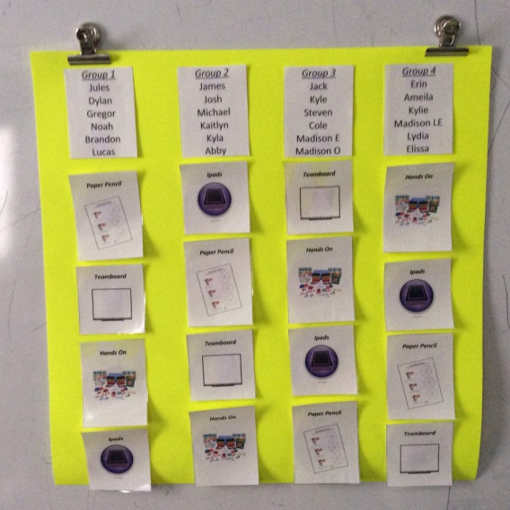
Implementation of Project
Organization of stations
  Before students moved into their stations a whole class instruction was given on the outcome/ concept and responsibilities of the students in each of the 4 stations. (more info on next slide)
  Each math session (1 hr) students completed each station, a time limit (approx 10-15 minutes) was placed on the session so that all students would be moving to their next station at the same time
  Students were grouped so that our classroom IRT was able to focus her attention on 2 groups that included her students that she works more one-on-one with.

Slide 11
Instruction - Mini Lessons…
Before sending students into their stations to complete activities on a particular concept a short 5-10 minute lesson took place as a whole group
  Example: Fractions what are they? (CoolMath4kids.com)
  Example : Equivalent Fractions (Lets Play Math- you tube)
This approach to my mini lessons was also new as it involved more technology through videos and websites. With such a large class- previous to this unit I often did lecture style teaching then moved into student practice.
I found this got the attention of my students- however, it would be used occasionally not for every lesson!

Slide 12
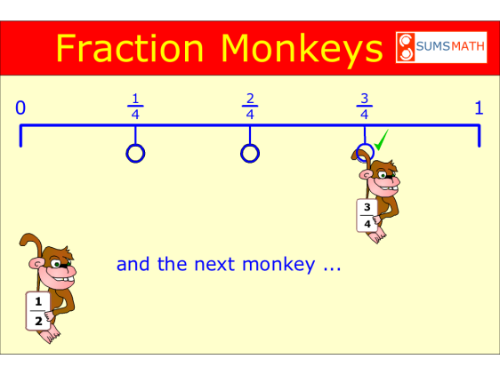
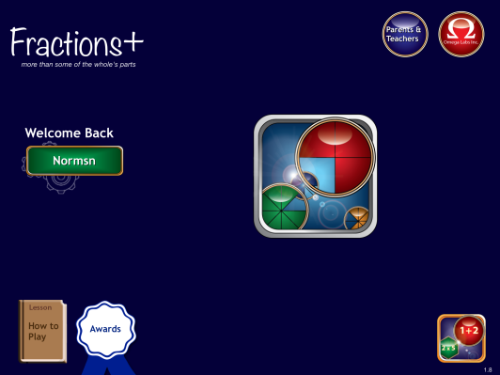
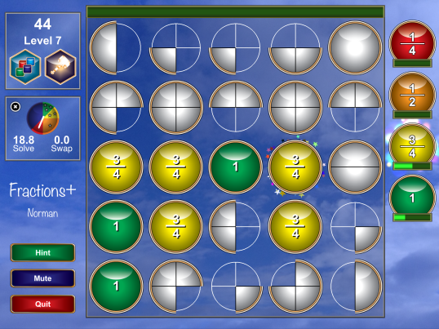
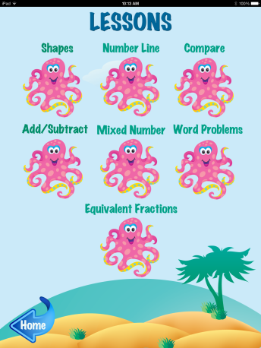
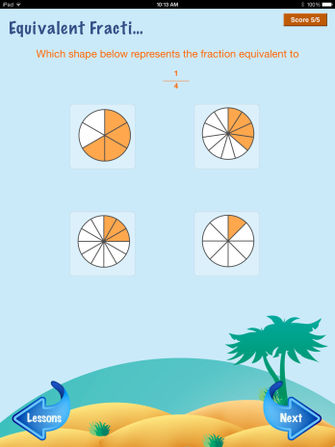
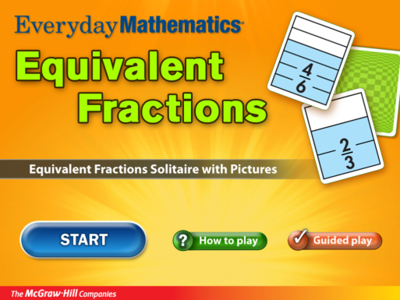
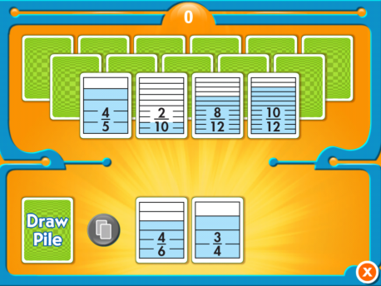
Sample Activities – I Pad
FRACTION MONKEY’S APP
FRACTIONS + APP
EQUIVALENT FRACTION APP
Z MATH APP (GRADE 3 VERSION)

Slide 13
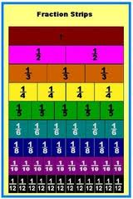
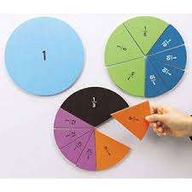
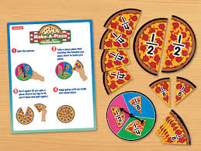
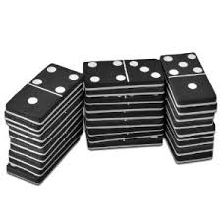
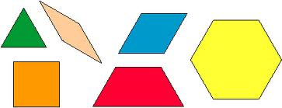
Sample Activities – Hands on Manipulatives
FRACTION PIE
FRACITON PIZZA GAME
FRACTION STRIPS
DOMINOS
PATTERN BLOCKS

Slide 14
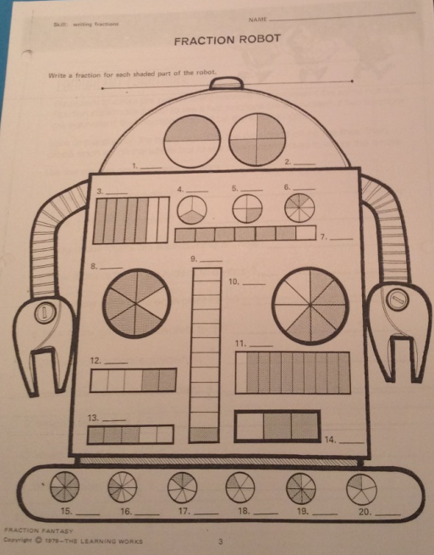
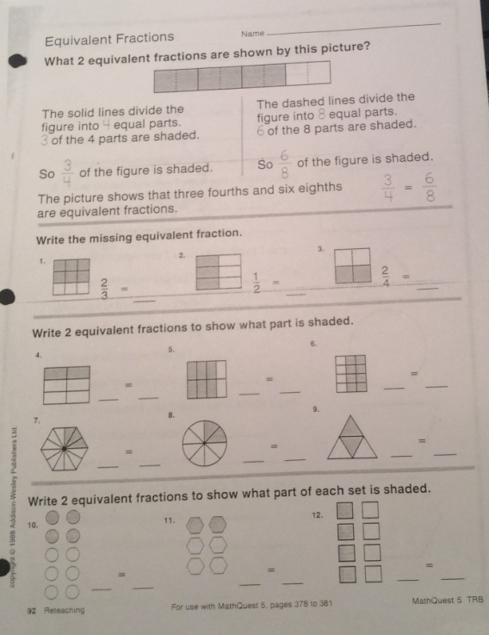
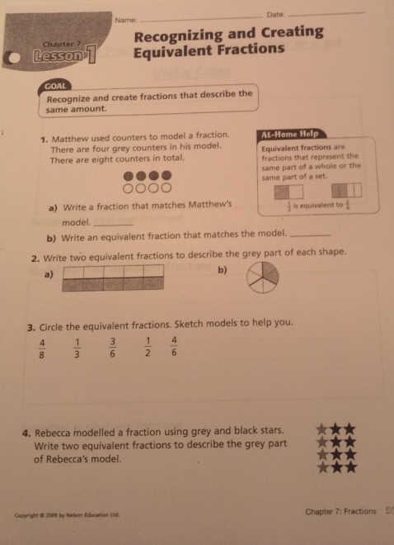
Sample Activities – Paper & Pencil

Slide 15
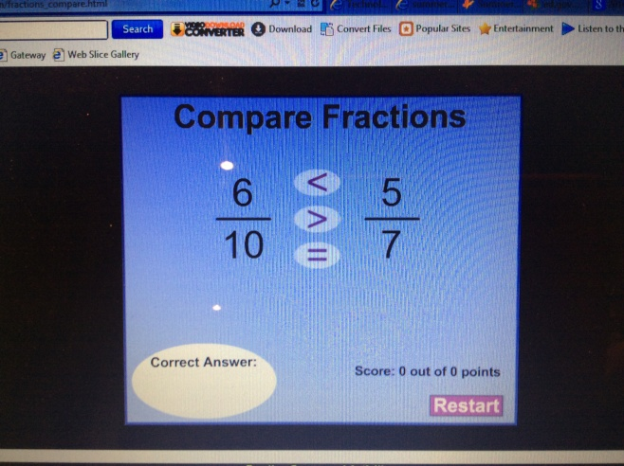
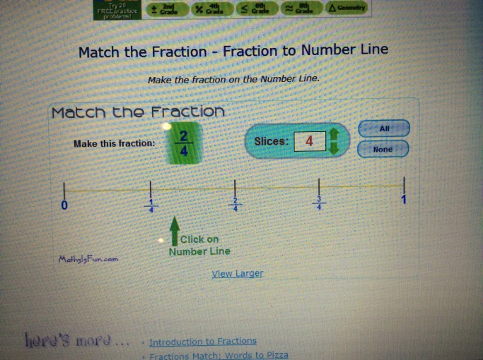
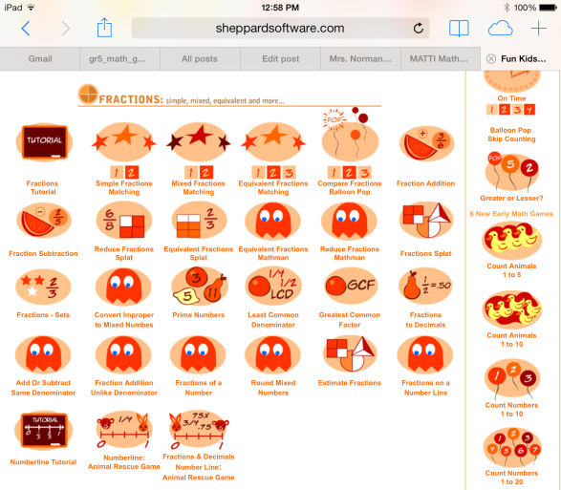
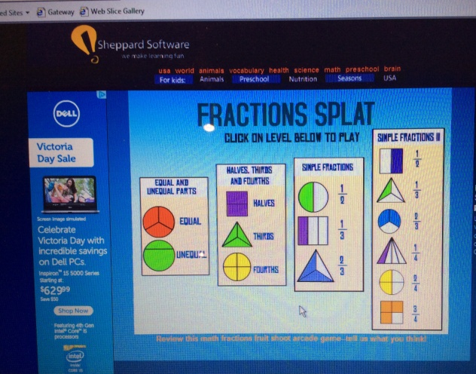
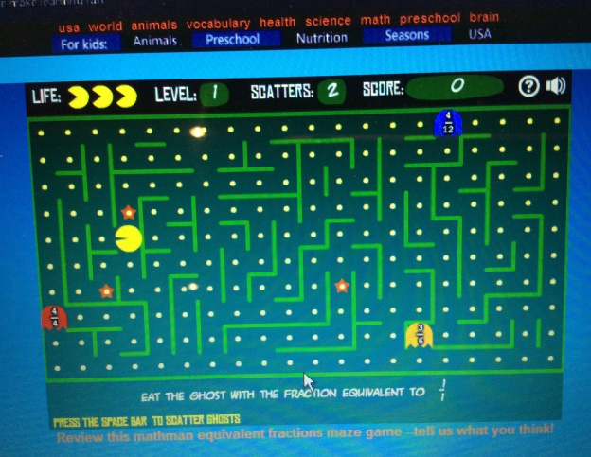
Sample Activities – Interactive Whiteboard
Mathplayground.com
mathisfun.com - Match the Fraction
Sheppardssoftware.com – Fractions Splat & Pac man

Slide 16
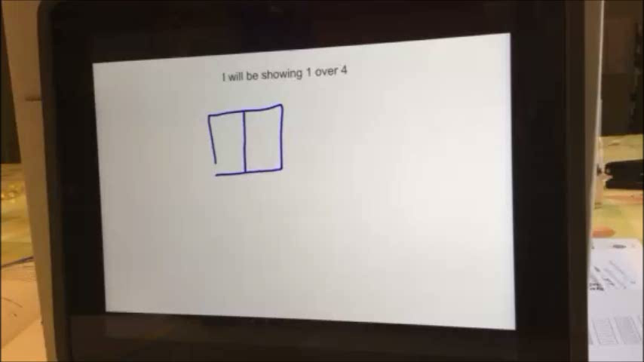
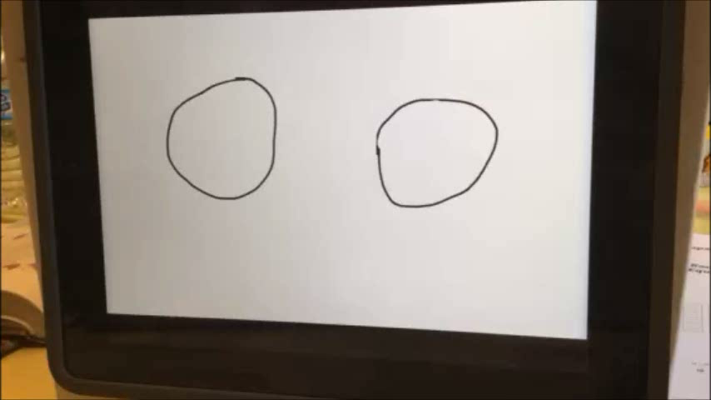
Assessment
Majority of my assessment during center work was through observation and the paper pencil activities.
Through the centers I was able to work with more students one-on-one in the various centers to assist them with their understanding of the topic/ concept
I also used a new program “Educreations” on the I Pad for students to communicate their understanding
  Equivalent Fractions – “Educreations”
  Fractions of a whole and fractions of a set- “Educreations”
Parts of a whole/ Parts of a set
Equivalent Fractions

Slide 17
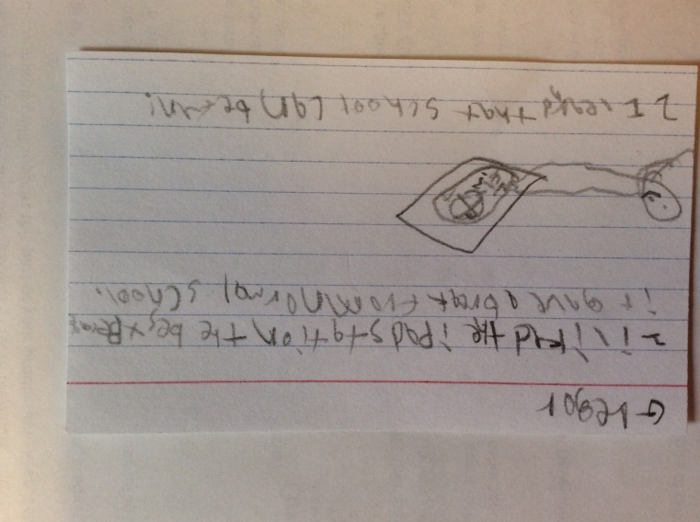
Findings from my action research…
Student personal reflections
  Exit Card by student
    “I liked the I pad station
    best because it gave a break
    from normal school”
    “I learned that school
    can be fun!”

Slide 18
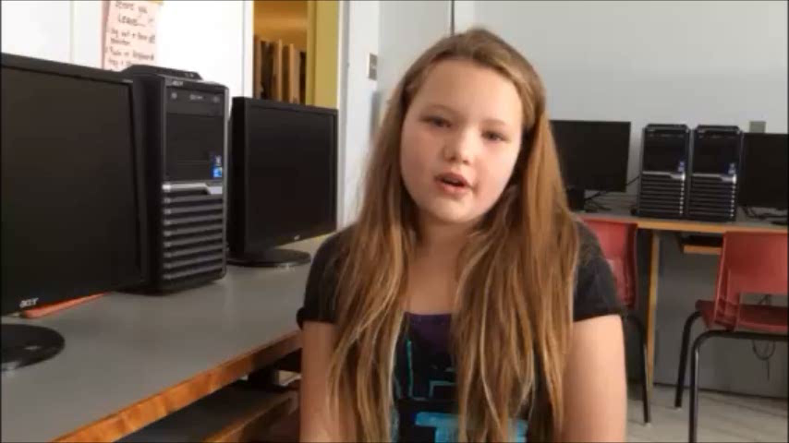
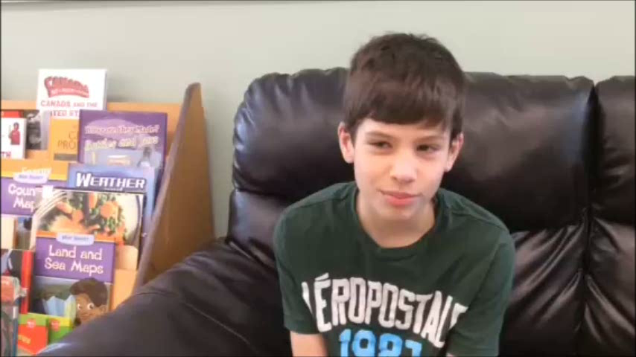
Student Interview- personal responses about technology in the math classroom
Video from Lydia
What most students response to
technology in the classroom was
after the implementation of the
fraction unit using technology based
activities in two of the 4 stations.
  Video from James
    Not quite what I was expecting
    after the activities that he took
    Part in math – I believe he was
    trying to answer the questions
    to please his teacher, what he
    thought I wanted to hear!

Slide 19
Findings cont…..
Personal reflections of Student Learning Process
  After the first session of stations I felt very excited about the project! All the technology based activities went without a hitch! The students were so involved in the activities that they didn’t want to end Math class!
  I had one student who often missed the first period of the day, which is math, once I had started the implementation of technology into my math lessons- he wasn’t late for school!
  When setting up my stations the next time I would have allotted more time for student completion- if often seemed like we were rushed to fit it all in the time I had allotted.
  Some students needed more guidance in the I pad apps, as when I visited them individually they were often guessing the answer till they clicked the correct one, instead of thinking through the problem and figuring out the answer.

Slide 20
  Station/ group work allowed for more collaboration in my Math classroom. Students were helping other students- allowing me to focus on individuals that needed a little more assistance or re-teaching
  Using a variety of ways to work with a particular fraction outcome, allowed students to feel success- some were stronger with the technology activities while others experienced success in the hands on or paper & pencil activities
  There were times that were frustrating as it seemed that the students were not understanding the outcome- and I questioned where they rushed, or was there enough explanation- they were getting a lot of exposure? Sometimes it took extra time to revisit the outcome to ensure student understanding!
  There were many factors that could have influenced the response of students and their reactions to the technology
  Limited time to use technology- as they only had 10-15 minutes
  The group they were assigned to for the unit (of course if this was implemented in various units grouping would change)
  The actual activities that were chosen – too difficult or too easy

Slide 21
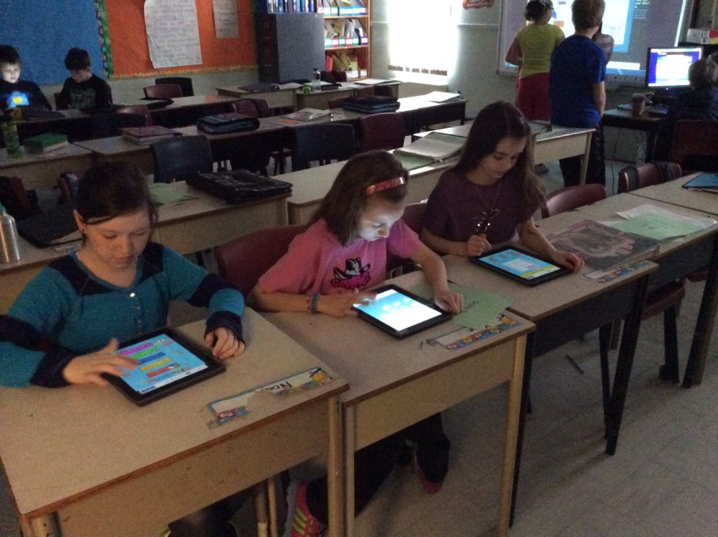
Hands on Technology- I PADS
PROS | CONS
- Immediate feedback of results (some provided explanation of answers) | - Limited number (10)
- Students helped others without being asked by teacher | - Students can get distracted from the concept they are practicing and just guess
- Student motivation
Students can obtain Apps on their I-pads to practice skills at home

Slide 22
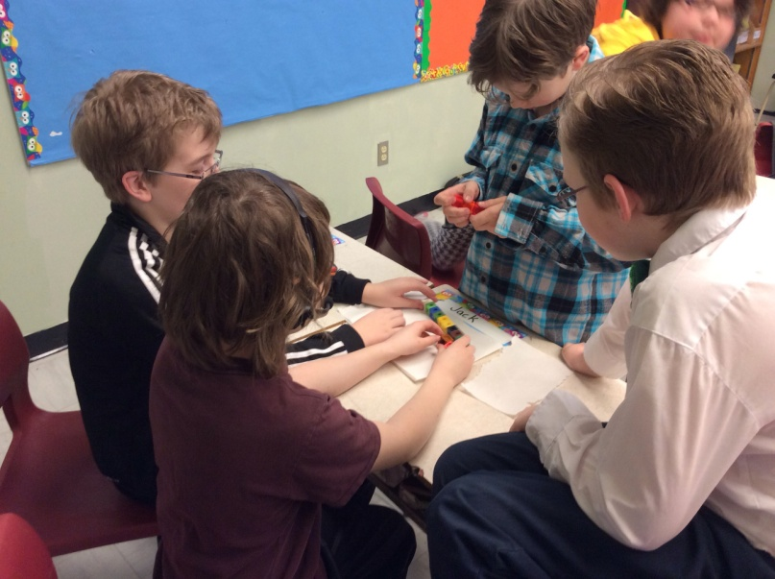
Hands on Manipulatives
PROS | CONS
- In smaller groups everyone had access to manipulatives (unlike a full class activity) | - Using Manipulative improperly (building, making patterns…)
- Students communicated more with their peers about what they were doing, and also with their teacher | - Difficult to make sure they were getting the most out of the task (I had to be rotating among groups)
- Allows the hands-on physical learners opportunity to succeed

Slide 23
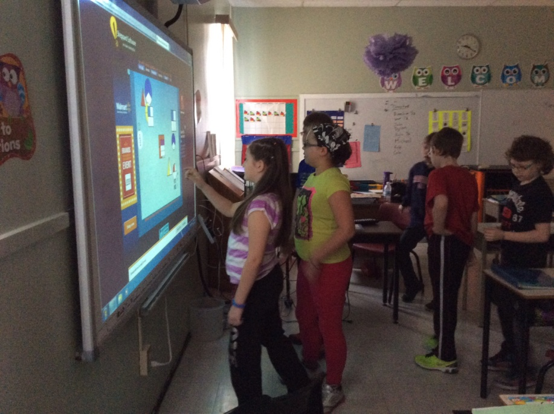
Team board / smart board
PROS | CONS
- Students work together to complete tasks | - Turn taking sometimes was an issue
- Immediate Feedback | - students could wait for others to solve the problem
- Interactive students are involved – attentive | - Finding Interactive activities for the outcome being covered
- Student Motivation
- Students can access websites at home to practice

Slide 24
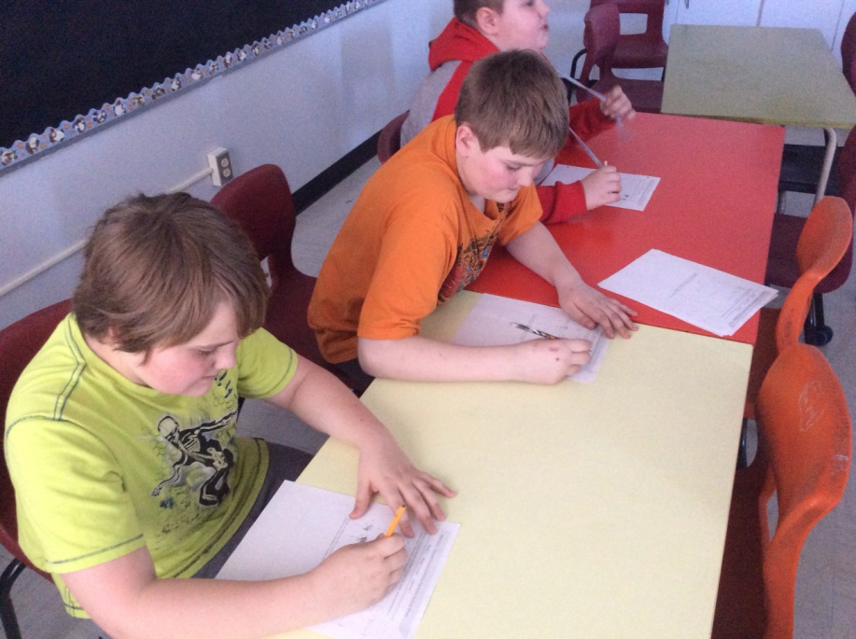
Paper & pencil activities
PROS | CONS
- Allowed for teacher assessment of skills learned | - Time allotment for some activities were too short/ too long
- Shows student understanding | - Students with language trouble needed more time and teacher intervention

Slide 25
Teaching Inquiry – My experience
Positive experience!!
Increased motivation for my students (notably those that struggle with Math)
Time management with stations is a learning curve and will change depending on the class make up
The variety of activities (mix of technology, hands on and paper/pencil) allowed students to learn in a way they were comfortable
Technology can be used a tool to help them learn Mathematics! (not a toy)
Station set up allowed multiple activities on the same outcome (more exposure/ more practice)

Slide 26
Would I Use this approach again?
YES!!!

