Slide 1
Vanier Grant Writing Workshop
School of Graduate Studies
The Writing Centre
Memorial University

Slide 2
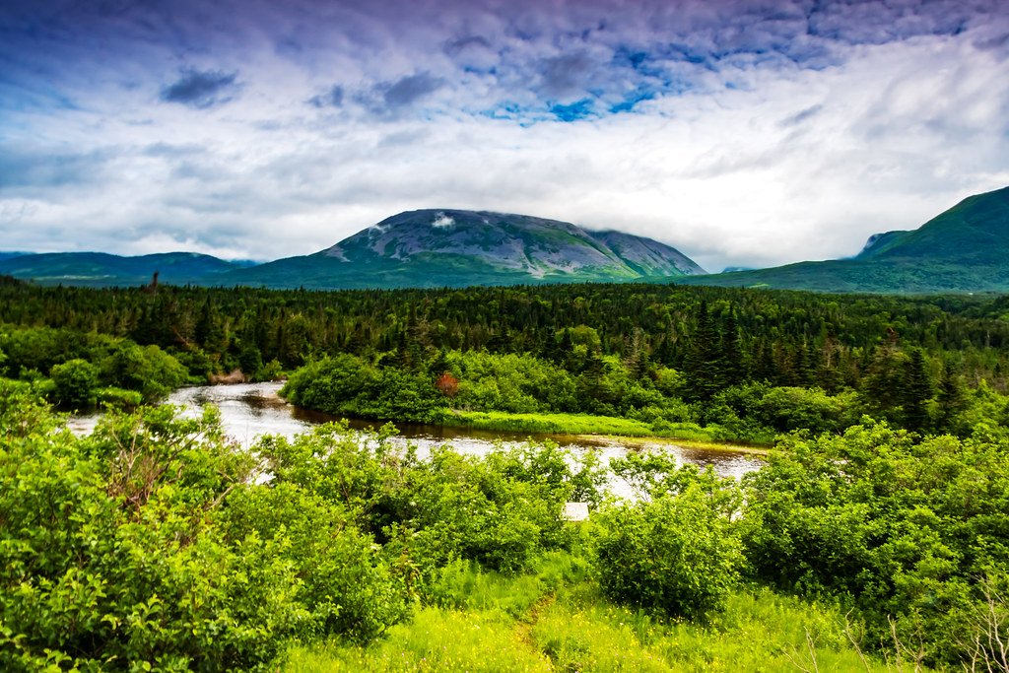
Land Acknowledgement
We respectfully acknowledge the territory in which we gather as the ancestral homelands of the Beothuk, and the island of Newfoundland as the ancestral homelands of the Mi’kmaq and Beothuk. We would also like to recognize the Inuit of Nunatsiavut and NunatuKavut and the Innu of Nitassinan, and their ancestors, as the original people of Labrador. We strive for respectful relationships with all the peoples of this province as we search for collective healing and true reconciliation and honour this beautiful land together.
We also encourage everyone here today to reflect on the lands where you are located, no matter where in the globe, and the Indigenous peoples for whom those lands are traditional territory

Slide 3
Overview
Eligibility and the Vanier Canada Graduate Scholarship
Grant do’s and don’ts
Vanier formatting criteria
Vanier application package
Dr. Badenhorst and the PPS&Q
How to build a research proposal
How to build a leadership statement
What goes into a research contribution page
Editing tips and tricks

Slide 4
Eligibility:
Canadian citizens/permanent residents, & students whose home country outside of Canada
Intent to pursue studies and research during summer semester at MUN or the academic year following the announcement of results
First Doctoral degree
Completed less than 20 months of doctoral studies (as of May 1st, 2022)
First class average in each of last 2 years of full- time study (MUN = 3.5 minimum)
Remain enrolled and demonstrate satisfactory progress
Cannot hold, or have held, doctoral funding from CIHR, NSERC, or SSHRC to pursue a doctoral degree
Have not received a previous, doctoral-level award from NSERC, SSHRC, or CIHR
Must be nominated by MUN (SGS)
Registered full-time

Slide 5
Reminders:
It is important to remember that departmental or SGS base funding will be replaced by Vanier yearly funding as well as a $5000.00 yearly Dean’s Excellence Award for successful candidates
You cannot hold MUN base funding in addition to the Vanier award and the Dean’s Excellence Award

Slide 6
Why do some applications receive funding over others?
Things you cannot control:
Who is on the Vanier review committee
Whether they are in a positive state of mind when they review your application
Whether they have the discipline specific knowledge to critique your application on presentation, idea, and disciplinary knowledge
Whether your research is considered a ‘hot topic’

Slide 7
Why do some applications receive funding over others?
Things you can control:
Whether you present your idea clearly and with sufficient detail
Whether your application is complete
Whether you have a unique idea that is achievable in the timeframe allotted (i.e. schedule)
Whether you have the necessary resources to complete the project in that time (i.e. resources and budget)

Slide 8
Grant writing: Do’s
The easier you make it for the reviewers, the more they want to fund you; Clarity is hugely important, Focus (avoid vagueness), Do-able/realistic idea (avoid overambitious research designs)
Captivate: something that will engage the reader (memorable); bring them in.
Should be a short narrative, but one that can be followed from beginning to the end (research narrative)
There must be order to the process: clear structure according to the selection criteria of the grant
In short, it should be a realistic, do-able topic that is highly focused and clear to the reviewers

Slide 9
Grant writing: Do’s
Become a student of grant; research what the sponsors strategic plan, research their mandate, know there mission statement, learn the grant specific guidelines, understand the eligibility criteria, and research previously funded projects.
It is always smart to give the sponsor their language back (i.e. if grant calls for innovative models, describe how your work includes innovative modeling).
Address fundamental research challenges
Discuss your quality contributions, when appropriate
Discuss impact of your research (does it build upon or expand our knowledge? is it capable of making a difference? i.e. breath and scope, advancement of knowledge, betterment of society, etc.,

Slide 10
Grant writing: Do’s
Organize the attachments using the proper formatting standards, and use section headings outlined in the instructions.
If it is a team based project, know your team and think though everyone’s responsibilities.
Test the waters by talking with peers, mentors, etc. Peer review should be completely understandable regardless of discipline (i.e. is it understandable, can you follow what is trying to be done, is it fully explained without reliance on high jargon)?
Only ever submit your best work – do not do a throw away proposal to see how you would do…

Slide 11
Grant writing: Do’s
If your research makes a clear contribution to Canada and/or to the betterment of society, make sure to highlight it! It is a good idea to review “Equity, diversity, and inclusion” section prior to writing your research proposal and addressing those aspects in your own research
In the Vanier Lay Abstract, summarize research in in clear, plain language to describe nature of the work to be done. Indicate why and to whom the research is important, anticipated outcomes, and how the research will contribute to field.
If your research involves and engages Indigenous communities, you must include the following text at the beginning of the abstract: “This research respectfully involves and engages Indigenous communities…”
Give yourself the necessary time to construct a strong application
Notes:
It is also a good idea to review the equity, diversity, and inclusion section of the Vanier Application/nomination process: https://vanier.gc.ca/en/equity_diversity_inclusion-equite_diversite_inclusion.html

Slide 12
Grant writing: Don’ts
Do not wait until the last minute to start your application – give yourself plenty of time (a month is good, 3 months is better)
Do not use jargon. Write for a well-educated person who may not be an expert in your field.
Do not include objectives that are too ambitious in scope and that do not match the objectives of the funding source.
Do not prepare a proposal with fifty pages of single-spaced text in courier font with no subheadings, bullets, or graphic elements that make a proposal look attractive. Make your proposal reader friendly. Use formatting tools to help break the monotony for the reader scoring your proposal.

Slide 13
Grant writing: Don’ts
Do not embellish the significance or feasibility of your research. Be honest. Be specific. Experienced grant readers will detect when your descriptions are vague or exaggerated. If you use qualifiers such as “significant,” “excellent,” or “extremely,” justify them with examples.
Do not submit proposals full of errors. Funders may think that your lack of care and attention to detail will also manifest itself in the implementation of the project. Always thoroughly proofread your proposal. Peer review panels are highly encouraged!
Do not wait until the last second to submit your application – submit 1-2 days in advance of the deadline to avoid submission issues.

Slide 14
Grant writing: Don’ts
Do not get discouraged if your proposal is not accepted by the funding source the first time. Reviewer’s comments are often available to help you strengthen your proposal for resubmission. Often you can make some minor revisions and resubmit successfully the next time around.

Slide 15
Vanier application: Formatting
Pages must be 8 ½" x 11" (216 mm x 279 mm).
Insert a minimum margin of 2 cm (3/4 inch) around the page (top, bottom and sides).
Use a minimum font size of 12-point black type. Maximum of six lines per inch. Do not use condensed/narrow font sizes, type density, or line spacing. Smaller text in tables, charts, figures, and graphs is acceptable as long as it is legible when the page is viewed at 100%.
Photo-reduce the supporting documents if the originals are larger than 21.25 x 27.5 cm / 8.5" x 11".
Any images, diagrams, technical drawings, or any other image must be contained within allowable page limits.

Slide 16
Vanier application: Formatting
Attachments must be uploaded in PDF format (unprotected).
The size of the attached document(s) cannot exceed 30 MB per document.
For documents prepared by the applicant: At the top of each page, indicate your name and the title of the document as it appears in the instructions.
For multi-page attachments, number the pages sequentially.
For more information about converting documents to PDF, please refer to Help with Accessibility page.

Slide 17
Vanier application package
ResearchNet application form
CCV
Transcripts
Project overview/details– Title of research proposal, Lay Title, Lay Abstract, etc.
Research proposal – maximum two pages (what, how, why)
Project references – maximum five pages (cited in research proposal)
Personal Leadership Statement – maximum two pages (impact of accomplishments, communication and leadership skills)

Slide 18
Vanier application package
Research contributions – maximum one page (impact & significance of contributions)
Special circumstances (optional) – maximum one page
Two Leadership reference Letters – maximum two pages each (written by someone who knows the candidate in a non-academic capacity – this letter is attached to the nomination by the candidate)
Two Academic reference Letters – three sections each (written by someone who knows the candidate in an academic capacity)

Slide 19
Cecile Bandenhorst and the Problem Purpose Statement

Slide 20
How to build a research proposal
Sections of a research proposal for Vanier:
Background: Provide background information to position your proposed research within the context of the current knowledge in the field.
Be as specific as possible while keeping in mind that Vanier CGS selection committees are multi-disciplinary. Wherever possible, use non-technical terms and avoid jargon. Define any technical or discipline-specific terms.
Research questions: State the objectives, hypothesis, research question and the roles and responsibilities of the applicant, the supervisor and/or other collaborators in the proposed research. If you are involved in a lab, be sure to outline your specific contributions to the overarching group project.
Discuss the significance of the research and how it addresses the knowledge gab you have identified. If possible, link that significance to Vanier’s mandate/strategic plan, etc.

Slide 21
How to build a research proposal
Sections of a research proposal for Vanier:
Methods and Theory: Methods/Theory: Outline the experimental or theoretical approach to be taken (citing literature pertinent to the proposal), the methodology to be used, and the contribution of the project to the advancement of knowledge.
Provide as much detail as possible to the committee regarding projected timelines for the research, including community consultation, plans for collaboration, and knowledge translation strategies.
Where applicable, address how your research complies with established research-related policies and protocols (e.g., protocols for conducting research respectfully involving and engages the First Nations, Inuit and Métis Peoples of Canada; approvals for research involving the use of humans, animals or biohazards, Sex and Gender based analysis)
See Task 10 of the Application/nomination instructions on the Vanier website for more details.

Slide 22
How to build a research proposal
Statement of “Institutional Fit”: Describe the benefit conferred by undertaking your research at the nominating institution (e.g. supervisor/departmental specialization, lab facilities, funding opportunities, support structures offered/in place, your own expertise to undertake the research).
If your potential or current PhD supervisor is unable to provide you with a reference letter, briefly explain why.
Statement of Research Significance: Briefly and clearly outline the potential outcomes and significance of your research:
Reiterate the knowledge gab
Describe (with slightly more detail than the purpose statement) how your research contributes to addressing that knowledge gab
Identify potential outcomes and their significance at the local, community, national, international, and academic stages

Slide 23
How to build a leadership statement
Personal Leadership statement (max 2 pages):
Be sure to outline not just your accomplishments, but how those accomplishments required you to leverage your leadership skills to achieve your goals.
When outlining leadership in volunteerism, excellence in sports or the arts, employment in Leadership positions, and other areas, be sure to outline how you have gone above and beyond the expected norms in order to overcome obstacles, foster others, spearhead change, or otherwise demonstrate leadership.
How have you fostered your ability to lead others, and how have you leveraged that skill?

Slide 24
How to build a leadership statement
Personal Leadership statement (max 2 pages):
Define your career goals and trajectory, and outline for the committee the ways in which you have created opportunities for yourself and others, how you have overcome obstacles to your vision, and how your PhD research, knowledge dissemination and mentorship activities will help accomplish those goals.
How has your life trajectory driven you to share and disseminate your research?
How does your nominating institution provide an environment that nurtures your leadership skills?
Your academic transcript, your CCV, and your reference letters will provide details of your commitments and accomplishments, but this essay gives you the opportunity to present the overarching narrative about your life, leadership accomplishments, and research goals.

Slide 25
How to build a leadership statement
Personal Leadership statement (max 2 pages):
What led you to doctoral research? How have your life experiences and personal circumstances (which may include administrative responsibilities, maternity/parental leave, childrearing, illness, cultural or community responsibilities, socio-economic context, trauma and loss, or health-related family responsibilities) shaped your academic, research, and leadership choices, challenges, and successes?
In order to assist the committee evaluate the relative merits of your accomplishments, be sure to include in this document information on any hurdles you may have overcome in your life and career. Committee members are entrusted with the responsibility to assess research productivity while taking into account the impacts of career interruptions as well as interpersonal, community, and career responsibilities.
The VBS asks its adjudication committees to take into consideration circumstances that may have affected the record of research achievement of candidates. In doing so selection committee members will be able to more accurately evaluate the productivity of each nominee.

Slide 26
What goes into a research contributions page
Research contributions (one page max): From the research contributions listed in your CCV (Vanier-Banting Academic template), choose up to five that you judge to be the most significant and relevant to your research proposal. For each of these contributions:
describe your role in the research, including by clarifying your contribution to collaborative research and to the actual writing of joint publications;
discuss the reasons for selecting the medium (e.g., journal article, conference presentation, etc.) for mobilizing the research, if appropriate;
indicate any collaboration with other researchers and/or with other knowledge users from outside academia;

Slide 27
What goes into a research contributions page
discuss the significance, relevance and impact of your work in relation to the social sciences and humanities, to the natural sciences and engineering, or to health-related fields and processes, if appropriate;
describe their significance in terms of demonstrating your research leadership and sphere of influence at the institutional level and beyond; and,
discuss the impact and importance of these activities in terms of your career aspirations.

Slide 28
Editing Tips:
Make sure to give yourself a few days just for editing. If possible, put aside your final draft for at least 24 hours, and re-read it after the break with fresh eyes.
Print your written work and read it slowly, out loud, pausing with the punctuation (half breath for commas, full breath for periods). This will help you to identify run-on sentences, improper punctuation, or incomplete ideas.
‘Tell it to Grandma’: This is the practice of refining your work using easily accessible language that a public audience, or grandma, or a child, would understand - put simply, stating your ideas or arguments in the clearest possible terms. Applying a ‘tell it to grandma’ approach can help you to better articulate your research findings to a larger audience but it also has the added benefit of helping you refine your own ideas about what you are doing.
Get feedback!!!

Slide 29
Reminders:
Always keep in mind the plethora of external funding outside of the Tri-council – they may not be prestigious but they can sometimes be easier to secure and money begets money.
You will fall off the horse, you will get dusty, get back up and try again = the more you apply, the more likely you will be to succeed
Writing numerous applications builds grant writing skills – also requires that you get really clear about your research

Slide 30
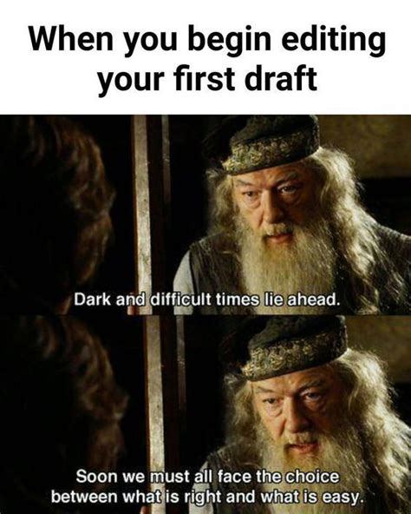
The Writing Centre offers peer writing tutoring sessions.
It is a free facility for all Memorial University undergraduate and graduate students who want help with their writing. Their tutors can help students at every stage of the writing process, from brainstorming, to revisions, style, and more.
Book your appointment through the online booking system on the Writing Centre website!

Slide 31
Thank you for joining us and all the best with your application preparation!

