Slide 1
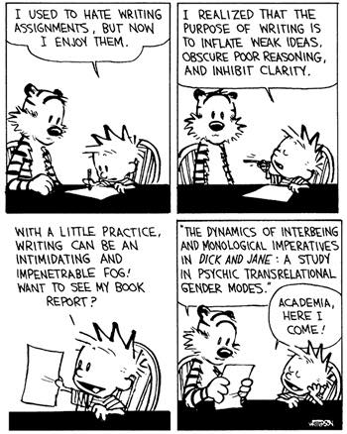
Grant Writing
Dr. Danine Farquharson, Associate Dean
School of Graduate Studies
daninef@mun.ca

Slide 2
Why apply for grants?
Money (funding begets funding)
In addition:
Improve your academic record
Impress potential supervisors/employers
Focus your ideas
Hone your writing skills
Grant writing is a transferable skill

Slide 3
Instruction pages are
YOUR FRENEMY

Slide 4
Top 5 Tips
Start early
Get advice from experts
Read all the instructions (then do it again)
Edit, edit, edit
Don’t give up

Slide 5
Advice from experts
“If you are excited about the research, that goes a long way.”
“Show that you know your field very well.”
“Illustrate your creativity and originality.”
“Use examples and details to show impact.”
“Always explain your own contribution to publications or posters.”
“We’re looking for leaders and great communicators.”
“I can’t emphasize enough how important presentation is.”
Source: NSERC video on application tips

Slide 6
Know your audience
You have two explicit audiences:
internal and external reviewers who likely know your field
the rest of an adjudication committee, who may have limited knowledge of your field
You have to reach both audiences – you must show deep knowledge and broad knowledge.
You ALWAYS have one implied audience: the general public

Slide 7
Reviewers want to know…
Who you are and what you bring to the table that makes you better than all of the other candidates that you’re up against.
What else do you have? Do you have experience with research, leadership, communication?
Why are you doing this research (impact/implications)?
How you are going to do the research?
How you feel about the research: why you’re excited about it, why this is an important problem that’s worth putting time and energy into.

Slide 8
Outline of Proposed Research
Provide a detailed description of your proposed research project for the period during which you are to hold the award. Be as specific as possible.
Provide background information to position your proposed research within the context of the current knowledge in the field.
State the objectives and hypothesis, and outline the experimental or theoretical approach to be taken (citing literature pertinent to the proposal), and
State the methods and procedures to be used.
State the significance of the proposed research to your field and beyond.

Slide 9
What: description and
background
Who: literature review
How: objectives, hypothesis, methodology, knowledge translation
Why: significance for
your field and for the
general public

Slide 10
Language Matters

Slide 11
Grant Getters: Big Picture
Address fundamental research challenges
Show quality contributions
Show impact
Are advancing knowledge
Have interdisciplinary/multidisciplinary approaches
Show breadth and scope
Have a deep level of inquiry

Slide 12
Grant Getters: Novelty
Innovative
Creative
Exciting
Transformative
Advance knowledge in the field
Challenging
Outstanding potential
Discovery
Critical importance

Slide 13
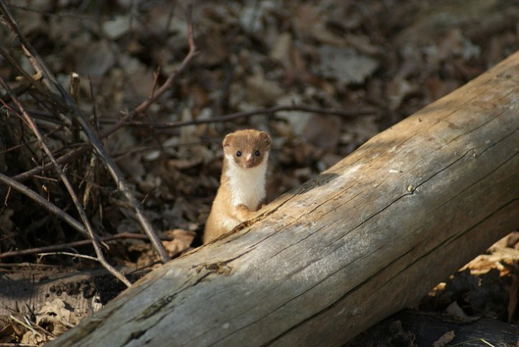
Don’t use weasel words

Slide 14
Passive Language
AVOID: may, might, could, would, seem, possibly and probably
Those words weaken your argument and make it sound like your study is not well designed enough to result in a definitive answer to your research question.
AVOID writing a proposal laced with uncertainties. Trust yourself to declare your hypotheses in clear and definitive terms.

Slide 15
First…
Have a good idea.

Slide 16
What’s a ‘good’ idea?
Is the problem significant?
Does your research directly address the problem?
How will knowledge be advanced (theory)?
Is it INNOVATIVE?
Does it build upon or expand our knowledge base?
Is it capable of making a difference?
Is it UNDERSTANDABLE?

Slide 17
What’s a ‘good’ title?
Clear and descriptive
Don’t use jargon/buzz words here
“Interdisciplinary and Innovative Research on …”
Make sure it fits the subject matter of the granting agency
Imagine it being read aloud in Parliament
"Woodpeckers and Head Injury”
"Effects of Backward Speech and Speaker Variability in Language Discrimination by Rats”
"Ovulatory Cycle Effects on Tip Earnings by Lap Dancers: Economic Evidence for Human Estrus?”

Slide 18
Organize the Proposal Pages
Use section headings (from the instructions)
Background information OR current knowledge in the field
Objectives and hypothesis
Outline of the experimental or theoretical approach to be taken
Methods and procedures

Slide 19
Use all available resources
Ask someone who does not know your area to read your proposal. Ask them if they understand
What you are proposing to do?
How you are proposing to do it?
Why you are proposing to do it?
Get feedback on clarity from multiple sources
Get feedback on scientific merit

