Slide 1
CHRSP: Evidence in Context Contextualized Syntheses to Support Decision Making An Innovative Newfoundland and Labrador Approach

Slide 2
About NLCAHR:
Our mission:
to contribute to the effectiveness of the health system of Newfoundland and Labrador and to the physical, social, and psychological health and well-being of the population by supporting the development and use of applied health research
Notes:
Essentially our mission is to support the development and use of applied health research, and by applied health research we essentially mean research into health services, technology, and policy, not biomedical or drug research
we have various lines of business for pursuing these goals, but today I’m only going to be telling you about one of these…

Slide 3
CHRSP
Contextualized
Health
Research
Synthesis
Program
Notes:
‘CHRSP’ stands for Contextualized Health Research Synthesis Program.
In a nutshell, what we do in CHRSP is prepare meta-reviews – that is, reviews of systematic reviews & HTAs – on topics identified by health system decision makers. The ‘C’ in CHRSP refers to contextualization, which is our process for assessing review findings in terms of their relevance to the requirements, resources, and circumstances of Newfoundland and Labrador. I’ll speak about this a little bit more in a moment.

Slide 4
What is CHRSP?
C = Contextualized
Questions and findings take into account the issues, challenges and capacities of NL
HR = Health Research
Topics come from health knowledge users
Systematic reviews, HTA’s, meta-analyses
S = Synthesis
Analysis and integration of high-level research

Slide 5
CHRSP Project Types
The ‘Evidence in Context’ Report
A full synthesis of research evidence on a topic identified through our solicitation process as being of high priority to decision makers in the province.
Deliverables include a 35 to 50-page full report, a four-page executive summary, a one-page lay summary, and other multi-media products

Slide 6
Expedited, brief synthesis of a high-priority research topic, including:
a statement of the issue
background
a description of the scope/nature of the literature;
a summary of the principal features of the available evidence;
a comprehensive list of research literature from the past five years, as well as policy reports and other grey literature on the issue; and
a brief analysis of the types of issues that might influence the applicability of the evidence to the Newfoundland and Labrador context

Slide 7
Steps in the Program

Slide 8
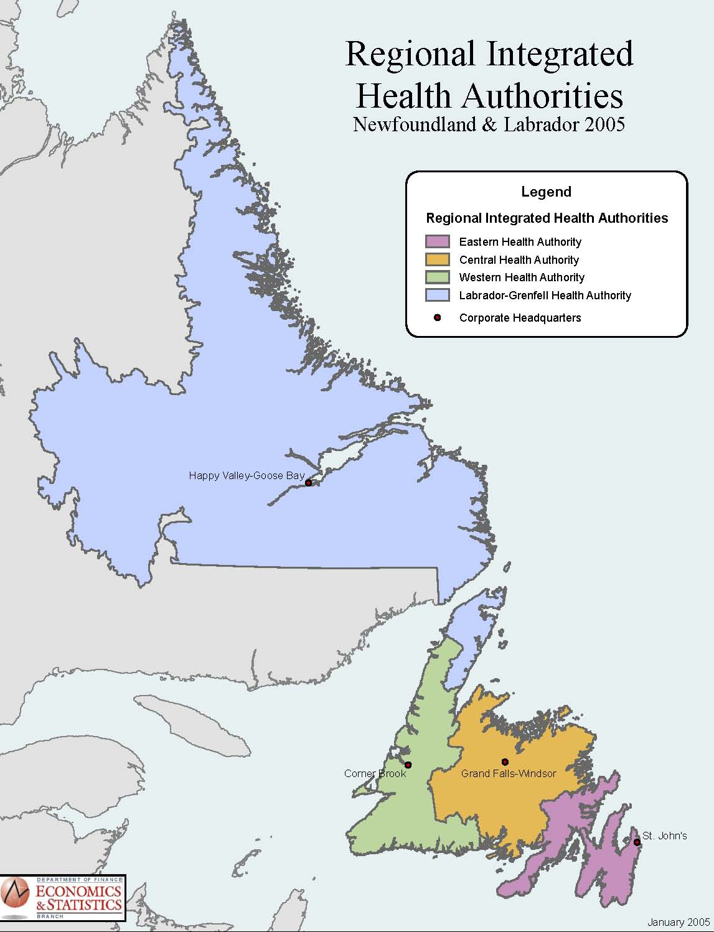
STEP 1: Organize a partnership
Built partnerships on previous relationships
Include all five health organizations in NL:
DHCS
Four RHAs
Introduced CHRSP Champions (2009) to play advocacy role
Notes:
Role of the Champions: Assist CEO/DM Health to…
Provide a liaison/linkage
Lead internal consultation on topic identification
Join a CHRSP Project team or suggest others
Identify ‘contextualization’ experts/factors/resources
Assist in dissemination of reports (KTE)
Provide feedback to improve the program

Slide 9
STEP 2: Identify & Prioritize Topics
Consult on regular basis
Facilitated by Champions
Solicit potential topics from each RHA and DHCS (criteria)
Share the complete list with all organizations
Priority setting process
End result:
High-priority topics are studied as ‘Evidence in Context Report’ or as ‘Rapid Evidence Report’
Notes:
Filtering criteria:
Importance
Population affected, potential to improve health outcomes, cost implications, importance identified by multiple stakeholders
Timeline
Semi-urgent: Need to know – but not yesterday!
Feasibility
Is it a researchable question? Can it be reformulated?
Availability of evidence
Is there sufficient high-level research evidence
Availability of a team
Team leader, local systems experts, context team

Slide 10
CHRSP: Filtering Process
~50 Topics Consultations within each RHA and DHCS, led by Champions
25 Topics max top 5 topics for each
Top 3 Topics overall
Final Priority Setting first two topics
Feasibility
Availability of Evidence
Availability of Research Team
Begin
Contextualized
Synthesis
Timing
Top 2 Topics
from preferential list
Importance

Slide 11
STEP 3: Build a Project Team
Members
Team Leader
CHRSP Program Coordinator
CHRSP Project Coordinator
Health System Co-investigator(s)
Local Academic Co-investigator(s)
Other Context Advisors
Expert(s) in research synthesis, HTAs, and systematic reviews
Health Economist
CHRSP Research Assistant
Initial Task:
Refine and shape the research question for NL
Notes:
So, the process employs both local and external experts in both the subject matter and methodology

Slide 12
STEP 4: Synthesize the evidence
Devise, execute a search strategy
Critically appraise & summarize the evidence
Quantity: Does it exist? Is it up to date? Is it on topic? Is it accessible?
Quality: How good is it? What is the methodological quality of the review literature? (AMSTAR)
Notes:
Devising a search strategy:
1. Translate the plain language question and parameters into search string: index terms, keywords and limits
•One search string for each periodical index
•Electronic search of periodical indexes
2. Hand-searches: internet, select databases, bibliographies, periodical index referrals
AMSTAR measurement tool:
One page survey
11 item checklist
Answer key: Yes = 1, No = 0, Can’t answer = 0, Not applicable = 0
AMSTAR items
1.Was an 'a priori' design provided?
2.Was there duplicate study selection and data extraction?
3.Was a comprehensive literature search performed?
4.Was the status of publication used as an inclusion criterion?
5.Was a list of studies (included and excluded) provided?
6.Were the characteristics of the included studies provided?
7.Was the scientific quality of the included studies assessed and documented?
8.Was the scientific quality of the included studies used appropriately in formulating conclusions?
9.Were the methods used to combine the findings of studies appropriate?
10.Was the likelihood of publication bias assessed?
11.Was the conflict of interest stated?

Slide 13
STEP 5: Contextualize the evidence
CHRSP tailors its synthesis to the context of Newfoundland & Labrador at all stages of the project
CHRSP identifies contextual factors.
Contextual factors may effect health outcomes and/or cost effectiveness.
CHRSP interprets findings in context.
Levels of Contextual Factors:
Patient populations
Site of service
and/or the service design,
Health human resources
Organization and delivery of services
Other System Factors
Economics
Politics
Labrador Grenfell Health
Topics of relevance

Central
Health
Western Health
More about context here:
www.nlcahr.mun.ca/research/chrsp/
Eastern
Health
Notes:
CHRSP tailors the synthesis to the context of Newfoundland & Labrador at all stages of the project:
Studies questions of direct relevance to health systems of NL
Interprets the findings in the context of the requirements, capacities, resources, and circumstances of NL
Identifies additional local contextual factors that may impact on the findings
Contextual Factors may have a positive or negative effect on the health and cost effectiveness of an intervention as it is reported in the scientific literature. These effects are a result of differences between the research settings and local conditions. Contextual Factors occur at many levels of the health system, and may relate to:
Patient populations, e.g., the demographic profiles and cultural backgrounds of the client population
Site of service and/or the service design, e.g., the location of a particular health technology
Health human resources, e.g., the potential for the province to train specialized staff
Organization and delivery of services, e.g., the coordination of a new service with other existing and related services
Other related systems, e.g., the integration of non-health system services including community programs, law enforcement and child, youth and family services
Health economics, e.g., out-of-pocket costs that discourage the appropriate use of a service
Politics, e.g., the public expectations of an intervention

Slide 14
STEP 6: Implications
Interpreting the evidence
Summarizing implications for decision makers
Notes:
Synthesizing the evidence is primarily the responsibility of the Team Leader

Slide 15
STEP 7: Validate & Disseminate
External review: validity
Report
Full report (25-35 p)
Executive summary (4 p)
Lay/media summary
Other multi-media products
Dissemination & uptake
Feedback
Notes:
Disseminate the report through in-person and video-conference meetings; written reports of CHRS; NLCAHR website, e-bulletins, newsletter; other websites, listservs, Published literature, CADTH

Slide 16
CHRSP projects: past & current
The provision of dialysis services in rural and remote NL
Interventions to prevent and treat childhood overweight and obesity in NL
The development of a PET/CT program in NL
Youth residential treatment options in NL
The reprocessing and reuse of single-use medical devices in NL
Hyperbaric oxygen therapy for problem wounds
Telehealth for specialist consultations in cardiology and dermatology
Interprofessional team-based care for chronic disease management
Age-friendly acute care
Community-based service models for seniors
Mobile mental health units for Western Health (RER)
Safe patient handling for Eastern Health (RER)

Slide 17
Impact of CHRSP
Capacity-building in Evidence Informed Decision Making in NL
Changes in the ‘push-pull’ relationship
Sharing of priorities amongst health organizations
Uptake of research evidence
External interest

Slide 18
Contact Us
www.nlcahr.mun.ca/research/chrsp/
Web: www.nlcahr.mun.ca
Phone: (709) 777-6993
Email: nlcahr@mun.ca
Location: 95 Bonaventure Avenue, Suite 300
Stephen Bornstein: sbornste@mun.ca

