Slide 1
Public engagement
At memorial
Senate Planning and Budget Committee
June 8, 2018
Office of public engagement
www.mun.ca

Slide 2
Mutual contributions. Mutual benefits. Mutual respect.
Partnerships supporting the academic mission of memorial

Slide 3
Overview
ope & Reporting units
Pef evaluation
Next steps
Office of public engagement
www.mun.ca

Slide 4
Overview
Ope & Reporting units
Pef evaluation
Next steps
Office of public engagement
www.mun.ca

Slide 5
Ope: programs
Funds and awards 2017/18
Supported 57 public/university partnerships through Quick Start and/or Accelerator funding
Celebrated 2 exemplary collaborations through the President’s Award for Public Engagement Partnerships
25 Years of Community-University Engagement at Ferryland
Barry Gaulton (Archaeology) and Jane Severs (Colony of Avalon Foundation)
Project SucSeed Expansion
Lynn Morrissey (Business) and Adam Smith (Choices for Youth)
Office of public engagement
www.mun.ca

Slide 6
OPE: strategic external Relations
Continues to support and coordinate COASTS and Innovation Initiatives
Supported successful industry-led Atlantic Canadian Ocean Super Cluster application
Office of public engagement
www.mun.ca

Slide 7
Harris centre
Developed new 5-year strategic plan, guiding operations from 2018-2023
Launched new community based regional economic development programs: Sustainable Northern Coastal Communities and the Thriving Regions Partnership Process
Released 4th annual Vital Signs report, in partnership with the Community Foundation of NL (including a province-wide media partnership with the Salt Wire Network)
Office of public engagement
www.mun.ca

Slide 8
Newfoundland quarterly
Successfully applied for $108,868 in funding through the Canada 150 program to create a special issue and to develop and launch a new online platform
Secured an ACOA grant of $32,500 to assess opportunities to develop and secure the future of NL’s longest running publication
Developed an online strategy leading to a significant increase in readership, including an increase of more than 500 followers on Facebook since Fall 2017
Office of public engagement
www.mun.ca

Slide 9
Botanical garden
Continued emphasis on enhancing links with the academy, through research and teaching & learning opportunities:
12 member Academic Advisory Committee formed in 2017
Facilitating multi-disciplinary Cannabis Working Group bridging research capacity and industry focus/interest
Joint-Faculty initiative working to established long-term research site at Garden
Increase in student supported research projects at the Garden
Increased use of Garden by Faculty for experiential learning opportunities
Office of public engagement
www.mun.ca

Slide 10
Botanical garden
Significant increase in annual attendance is translating into increased revenue, and new revenue streams, including holiday light festival
Office of public engagement
www.mun.ca

Slide 11
Battery facility
3rd year operating graduate student accommodations (near full-capacity)
Nearing completion of major construction on the main building
Dozens of event and conference bookings already booked for this fall and into 2019 and 2020
Office of public engagement
www.mun.ca

Slide 12
Alumni (new)
Moved from Development into Public Engagement
Conducted major consultation resulting in innovative alumni strategy with public engagement focus
Office of public engagement
www.mun.ca

Slide 13
Overview
Ope & Reporting units
Pef evaluation
Next steps
Office of public engagement
www.mun.ca

Slide 14
faculty survey (2017)
What:
In-house survey measuring faculty perceptions and beliefs around PE
Open: July-Aug 2017
Respondents: 304
Campuses: St. John’s 77%
Grenfell 18%
MI 5%
So what:
Overall, high ratings for the value of and need for PE
Higher ratings for leadership and strategic planning; lower for training and development
Substantial gaps were reported between actual and desired levels of PE in research and teaching
Vast differences observed between faculties
Office of public engagement
www.mun.ca

Slide 15
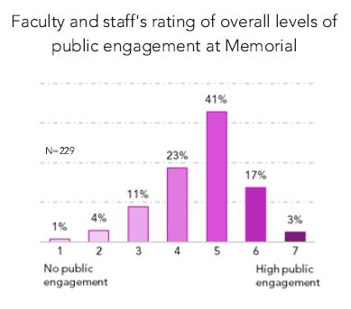
Faculty survey (2017)
office of public engagement
www.mun.ca

Slide 16
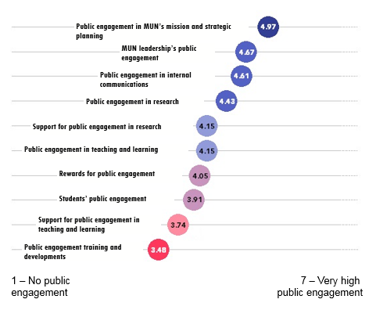
Faculty survey (2017)
office of public engagement
www.mun.ca

Slide 17
alumni survey (2017)
What:
EAi survey measuring attitudes, beliefs, and engagement of MUN alumni
Open: Oct-Nov 2017
Respondents: 3,539
Engagement sample size: 2,470
Confidential but not anonymous
Benchmarked against industry, peers, and previous years
So what:
5% increase in engagement score since 2013
MUN above average compared to peer sample
Alumni want online programming (51%), to contribute to projects in NL (37%) and outside NL (37%), and 41% are interested in being mentors while 29% would like to be mentored
Office of public engagement
www.mun.ca

Slide 18
Overview
Ope programs
Reporting units
Pef evaluation
Next steps
Office of public engagement
www.mun.ca

Slide 19
Next steps metrics. ope planning. building capacity. Conference.

Slide 20
Metrics: sample dashboard

Slide 21
Thank you.
Questions?
engagement@mun.ca
Office of public engagement
www.mun.ca

