Slide 1
Memorial University Board of Regents
May 9, 2019

Slide 2
Overview
Public Engagement (PE) at Memorial
PE Metrics for OPE, MUN, and beyond
Office of Public Engagement initiatives
PE Reporting Units
Metrics summary
Next steps

Slide 3
Overview
Public Engagement (PE) at Memorial
PE Metrics: OPE, MUN, and beyond
Office of Public Engagement initiatives
PE Reporting Units
Metrics summary
Next steps

Slide 4
Memorial’s Mission
“Memorial University is an inclusive community dedicated to innovation and excellence in teaching and learning, research, scholarship, creative activity, service and public engagement.
Memorial welcomes and supports students and scholars from all over the world and contributes knowledge and expertise locally, nationally, and internationally.”

Slide 5
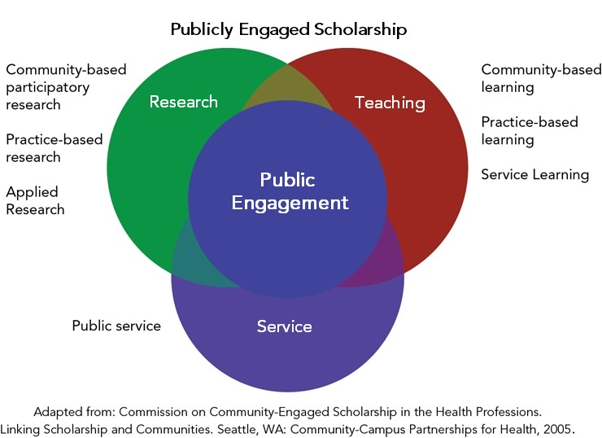
Public Engagement is:

Slide 6
PRESIDENT
President's External Relations Advisory Team:
Executive Director, Office of the President
Executive Director, Office of Development
Executive Director, Marketing & Communications
AVP (Public Engagement and External Relations)
Vice-President (Research)
Associate Vice-President
(Public Engagement and External Relations)
Innovation Steering Committee
(VPR Chair)
Strategic External Relations
COASTS
Steering Committee
(President Chair, VPR Co-chair) COASTS
Advisory Committee
Secretary
COASTS
Federal
Deputy Minister Champion
Alumni Engagement
Harris Centre
Ofﬁce of Public Engagement
Newfoundland Quarterly
Signal Hill Campus
Johnson GEO CENTRE, Signal Hill Campus
Botanical Garden
Alumni
Innovation Advisory
Director (Interim)
Director
“Chapters”
(under development)
Advisory Board
Expert Working Group
Editorial Advisory Board
Emera Innovation Exchange
Accomodations
Assistant Director
Committee (VPR Co-chair)
Academic Advisory Committee
Friends of the Garden
Staff
Staff
Staff
Staff
Conference Services
Staff
Staff
2004
2012
2013
2017
2019

Slide 7
Overview
Public Engagement (PE) at Memorial
PE Metrics: OPE, MUN, and beyond
Office of Public Engagement initiatives
PE Reporting Units
Metrics summary
Next steps

Slide 8
PE Metrics: OPE, MUN, and beyond
OPE
Public
MUN
OPE: $ flowed to academy for PE
OPE: Faculty/staff supported
OPE: External partners by sector
MUN: PE in Teaching & Learning
MUN: PE in Research
Public: Alumni engagement
Public: Direct external funding

Slide 9
Overview
Public Engagement (PE) at Memorial
PE Metrics: OPE, MUN, and beyond
Office of Public Engagement initiatives
PE Reporting Units
Metrics summary
Next steps

Slide 10
www.mun.ca/publicengagement/pppconference

Slide 11
PPPE Conference: by the numbers
First PE conference held at Signal Hill Campus
Received 127 submissions to present
100% of the 45 sessions had Memorial faculty/staff/student presenters, and 91% had external presenters
170+ full registrants, plus ~100 public participants in free sessions
92% were satisfied or very satisfied with the conference overall
Partners included Parks Canada, the Government of Newfoundland and Labrador, Research Impact Canada, Swearer Centre at Brown University, Johnson Insurance Inc., Alt Hotels, and Memorial University

Slide 12
OPE Funds for Public Engagement
Quick Start
Up to $1000
Accelerator
Up to $10,000

Slide 13
OPE Funds
Quick Start
186 projects funded since 2014 for a total of $203,768
Partnerships have leveraged over $365,000 in additional funds
Over 244 external organizations have collaborated
Accelerator
83 projects funded since 2015 for a total of $856,760
Partnerships have leveraged over $1,072,000 in additional funds
Over 169 external organizations have collaborated

Slide 14
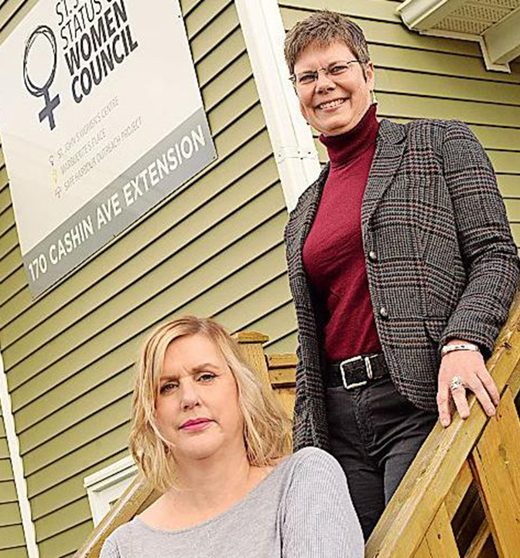
Project Impact
Women’s drop-in counselling
"There is nothing like this. This needs to be a forever thing”
“I was at rock bottom, suicidal... I received help at this clinic that I have never received anywhere else”
“This saved my life today”
Jenny Wright, Executive Director of the St. John’s Status of Women Council, and Dr. Catherine de Boer, photo from the Telegram

Slide 15
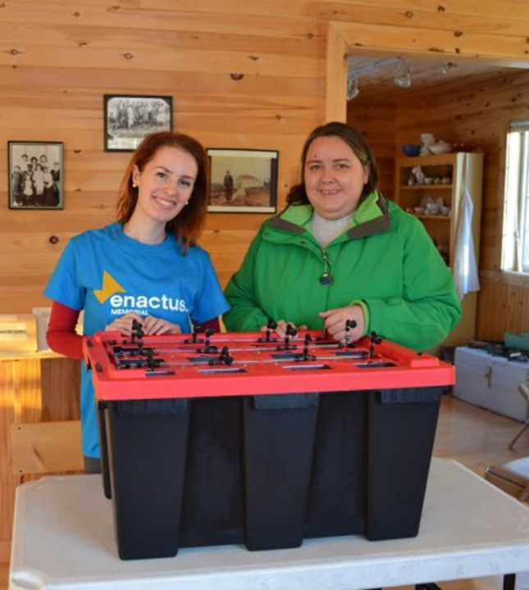
Accelerator
Impact
"The Accelerator funding came at a critical time in our project, and gave us the opportunity to pilot SucSeed in a real way...
It enabled a successful launch of the project that helped shape where SucSeed is today.“
Lynn Morrissey, Assistant Professor and Enactus Memorial Faculty Advisor
Notes:
The quote is an example of Project SucSeed impacts.
Project SucSeed is an award-winning food security project led by Enactus Memorial.
The project creates jobs for at-risk youth, while increasing access to fresh, affordable produce in the North.

Slide 16
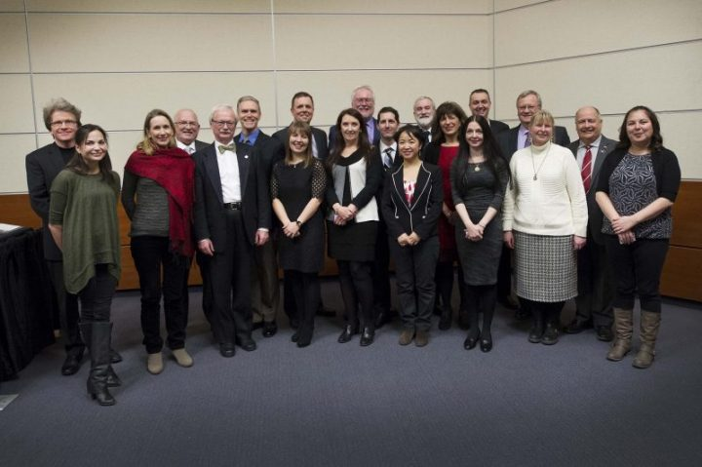
President’s Award Winners
The Shea Heights Community Alliance (2015)
NunatuKavut Research Ethics Project (2015)
Double Mer Point: Implementing the Rigolet Inuit Community Government's Tourism Strategy (2016)
Extra Judicial Measures (2016)
The Colony of Avalon (2017)
Enactus Memorial’s Project SucSeed (2017)
Young Adult Cancer Canada (2018)

Slide 17
Metrics: OPE Funds
Since inception, over $1,000,000 flowed through to academic/public partnerships
Over 265 faculty, students, and staff supported
More than 300 external partners supported
Funds leveraged at a ratio of approximately 2.5 : 1

Slide 18
Strategic External Relations Impacts
Assisted in securing over $350 million in COASTS related funding since 2015, including:
$100 Million for Core Science Facility
$240 Million for Ocean Frontier Institute (w/ Dalhousie and UPEI,) anticipated to create 147 new positions (post-doctoral fellows, doctoral students, and master’s students)
Assisted on successful applications to the post-secondary Strategic Innovation Fund:
$15 Million for Animal Care Facility
$8.6 Million for Battery Facility

Slide 19
Strategic External Relations Impacts
Supported successful industry-led application to develop Canada’s Ocean Supercluster, to improve competitiveness in Canada’s ocean-based industries, including fisheries, oil and gas, and clean energy.
$300,000,000 announced: $153,000,000 awarded from federal government with bid and investor commitment of approximately $125,000,000
Notes:
The Quick Start Fund for Public Engagement supports small projects such as preliminary meetings, events and service learning projects that are in keeping with the goals of Memorial’s Public Engagement Framework. The fund offers up to $1000. Proposals may be initiated by a faculty or staff member, a university organization (including student unions and societies) or an academic unit, administrative unit, department or faculty at Memorial University.

Slide 20
Overview
Public Engagement (PE) at Memorial
PE Metrics: OPE, MUN, and beyond
Office of Public Engagement initiatives
PE Reporting Units
Metrics summary
Next steps

Slide 21
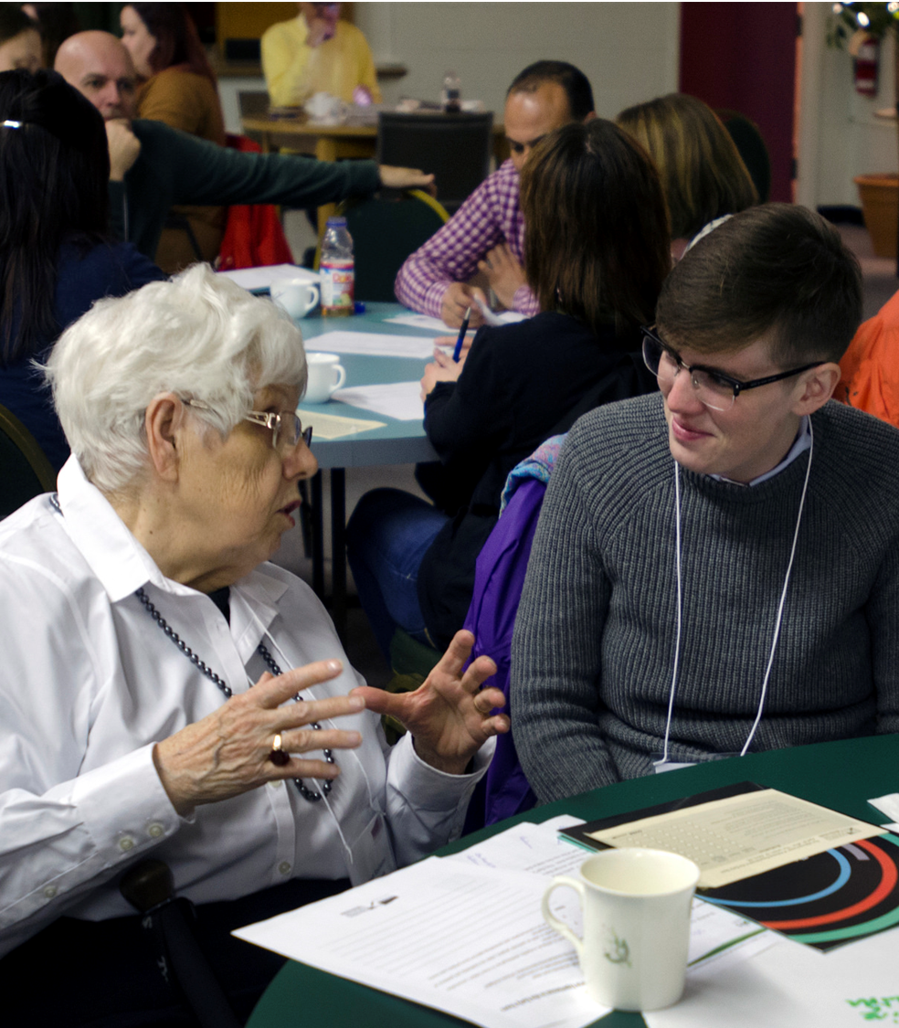
The Leslie Harris Centre of Regional Policy and Development

Slide 22
Harris Centre: by the numbers
Public Events
Over 275 events (including Memorial Presents, Synergy Sessions, Regional Workshops)
Over 16,000 participants across NL
Applied Research Funds
173 projects funded
Over $2,750,767 flowed to support applied research into topics relevant to NL
Budget funds have been leveraged at a 1.5:1 ratio so far this year

Slide 23
Harris Centre Impacts
“The biggest benefit is that we have knowledge, and we can use that information as municipal leaders to look forward and make plans, now.”
Karen Oldford, President of Municipalities NL
Notes:
More capacity and willingness to engage in regional policy and development in NL by MUN
More engaged and better informed public in NL
Emergence of the Harris Centre as a trusted and independent “honest broker”
Supporting evidence-based decision-making on regional development and public policy issues across NL
Leveraging each dollar received from Memorial at a 1:5 ratio
17 other units have visited MUN or paid for us to visit them to share HC model.
More than 100 reports published (132)

Slide 25
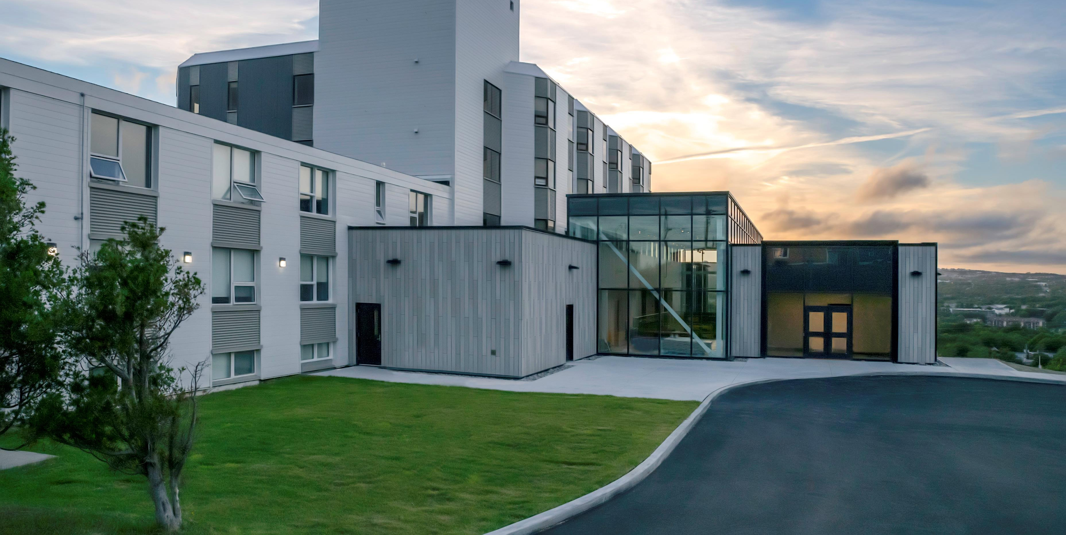

Slide 26
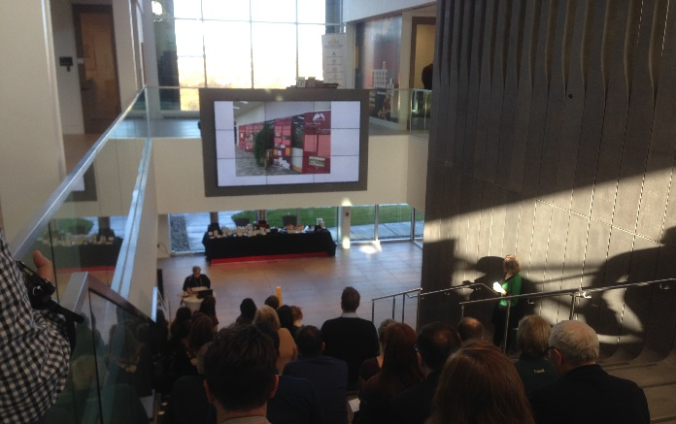
Conference Centre (Fall 2018)
37 separate events over the course of the Fall
5 Symposia
5 Conferences
14 Public Events
1 Workshop
7 Receptions
5 Board-style Meetings
7000 attendees (approximate)

Slide 27
Signal Hill Campus: milestones and successes
Public engagement and innovation sections (EIX) opened Fall 2018, on time and on budget
External Funding
$4.2 Million – ACOA Innovative Communities Fund
$4.4 Million – Post-secondary Strategic Infrastructure Fund (Federal)
$100,000/yr for 10 years – Corporate contribution from Johnson Insurance Inc.
$7 Million – Corporate contribution from Emera
Minimum of $400,000 annually for student innovation and entrepreneurship programming

Slide 28
Johnson GEO Centre
The Johnson GEO Centre Foundation has donated to Memorial University the infrastructure and assets of the Johnson GEO Centre, including GEO Park and other adjacent lands under lease from the provincial government, effective April 1, 2019.
The Centre, now part of Signal Hill Campus, draws approximately 35,000 visitors each year and is the site of about 130 events annually.
The value of the Johnson GEO Centre and assets is estimated at more than $20 million, making it the largest single gift ever received by Memorial University.
The Centre will spend the next year reorienting to Memorial’s mission and linking to the three frameworks, and will continue to function as one of the province’s top cultural attractions, becoming another public access point to the university.

Slide 29
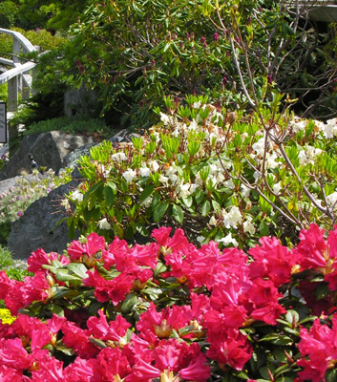
MUN Botanical Garden and Newfoundland Quarterly
Both SIEs returned to Memorial governance with support through the Office of Public Engagement
New strategic plans have been developed for both, with new structures and policies implemented
Initiation of an academic research advisory committee at the Garden
Launch of a successful new online platform (NQOnline.ca) for Newfoundland Quarterly

Slide 30
Faculty PE Survey (2017)
Method
In-house survey conducted by OPE measuring faculty perceptions and beliefs around PE
Open: July-Aug 2017
Respondents: 304
Campuses: St. John’s 77%
Grenfell 18%
MI 5%
Results
Overall, high ratings for the value of PE
Substantial gaps were reported between actual and desired levels of PE in research and teaching
Differences observed between faculties

Slide 31
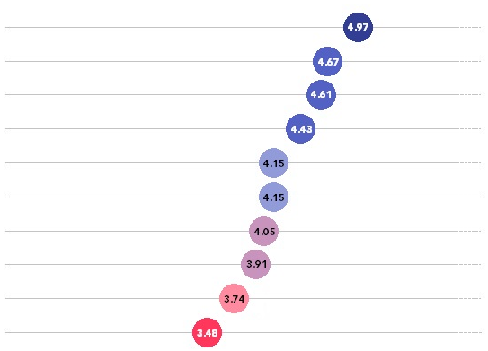
Perceptions of PE
Higher ratings were given to leadership and PE in strategic planning
Lower ratings for PE training and development
Public engagement in MUN’s mission and strategic planning
MUN leadership’s public engagement
Public engagement in internal communications
Public engagement in research
Support for public engagement in research
Public engagement in teaching and learning
Rewards for public engagement
Students’ public engagement
Support for public engagement in teaching and learning
Public engagement training and development
1 – No public engagement
7 – Very high public engagement

Slide 32
Perceptions: PE in Teaching and Research
Faculty report a 15% gap between current and ideal levels of publicly engaged teaching
Using averages, gap calculated as 25% (ideal) – 10% (actual) = 15%
Faculty report a 20% gap between current and ideal level of publicly engaged research
Using averages, gap calculated as 50% (ideal) – 30% (actual) = 20%

Slide 33
Public PE Survey (2019)
Method
In-house survey conducted by OPE measuring public perceptions and beliefs around PE
Open: March 2019
Respondents: 335
Regions: St. John’s metro 62%
Eastern 13%
Central 7%
Western 9%
Labrador 2%
Results
Analysis is underway
Only 14% of respondents have never been involved with the university
Other streams of questioning captured responses from individuals currently involved with the university as students, faculty, or staff (N = 267)

Slide 34
Alumni Engagement Strategy
The Steering Committee worked with internal and external advisory groups between Summer 2017 and Spring 2018
Over 200 alumni participated in-person
Local and away advisory groups
Focus groups: Ottawa, Toronto, Halifax
Open sessions: St. John’s, Corner Brook
Over 3500 participated in an online survey
Strategy approved by Board of Regents in July 2018

Slide 35
Alumni Survey (2017)
Method
EAi survey measuring attitudes, beliefs, and engagement of MUN alumni
Open: October - November 2017
Respondents: 3,539
Engagement sample size: 2,470
Benchmarked against industry, peers, and previous years
Results
5% increase in engagement score since 2013
2017: Engagement score of 65.0
Memorial above average compared to peer sample
Alumni want online programming (51%), to contribute to projects in NL (37%) and outside NL (37%), and 41% are interested in being mentors, while 29% would like to be mentored

Slide 36
Alumni Engagement Strategy
Vision
Our vision is for Memorial and its alumni to actively engage through the people and work of the university for personal and collective benefit.
Goals
Mobilize Memorial to engage with alumni
Empower alumni to engage with Memorial
Facilitate connections among alumni
Inspire students to become engaged alumni

Slide 37
Overview
Public Engagement (PE) at Memorial
PE Metrics: OPE, MUN, and beyond
Office of Public Engagement initiatives
PE Reporting Units
Metrics summary
Next steps

Slide 38
PE METRICS SUMMARY
Over $800,000 flowed through to academic/public partnerships
Approximately 225 faculty and staff supported
More than 300 external partners supported
Funds leveraged at approximately a 2.5:1 ratio
Gap: 15% in publicly engaged Teaching and Learning
Gap: 20% in publicly engaged Research
Alumni engagement score of 65.0
Direct external funding
See www.mun.ca/publicengagement/memorial/impacts for more details

Slide 39
Overview
Public Engagement (PE) at Memorial
PE Metrics: OPE, MUN, and beyond
Office of Public Engagement initiatives
PE Reporting Units
Metrics summary
Next steps

Slide 40
Next Steps
Public Engagement education and training programming for faculty, students, staff, and external partners
Conference Fund: Global Issues, Local Application
Innovation Fund leveraging
Alumni Engagement strategy implementation
Mobilizing Public Engagement survey results

Slide 41
Interested in learning more?
Visit www.mun.ca/publicengagement
or see our data and impacts site:
https://goo.gl/J8mmT7
:

