Slide 1
Choosing the Right Career
Dr. Teri Stuckless, Director of MedCAREERS

Slide 2
https://www.keirsey.com/

Slide 3
Objectives
Review the CaRMS process and recent match statistics
Provide an overview of the career advising tools available through AAMC CiM website
Highlight factors that may influence career choice
Encourage students to think strategically about career options

Slide 4
This session is a part of your
Career
Advising Program
Career Options
Applying to Residency

Slide 5
Career Options
Applying to Residency
MedCAREERS_I
Shadowing Orientation
Clerkship Preparation Course
CaRMS Document Preparation
Choosing the Right Career
(formerly Challenges & Choices)
MedCAREERS_II
Early Prep for THE MATCH
OR Scrub Course
Year 1
Year 2
Year 3
Year 4
Phase 1
Phase 2
Phase 3
Phase 4
Pre-core Electives Discussion
(including international electives)
Elective/Selective Advice
(and introduction to online portal)
Choosing Electives
Notes:
Here we are in Phase 1 – applying to residency is still 3 yrs away. This is the time to start thinking about what makes you tick, what areas of medicine you might be interested in:

Slide 6
MedCAREERS
Phase 1
Phase 2
Phase 3
Phase 4
Understanding
Yourself
Exploring
Options
Choosing a
Specialty
Getting into
Residency
*modelled after Careers in Medicine
Notes:
Right now, most of you should be thinking about “what makes you tick” and, in general, what kind of pratice you picture yourself in when you are done. Do you like working along, or in a group? Do you like urban vs rural living? Do you need to make a lot of money? Do you like to ruminate over theories, or get your hands dirty?
At the same time, you should be exploring the many options that are open to you right now. You can be anything from a neurosurgeon to a geriatrician to a labortaory medicine expert. Many of you are probably not aware of all the options.

Slide 7
Royal College Specialty Programs
Anatomical Pathology | Nuclear Medicine
Anesthesiology | Obstetrics and Gynecology
Anesthesiology - Clinician Investigator Program | Ophthalmology
Cardiac Surgery | Orthopedic Surgery
Dermatology | Otolaryngology – H&N Sx
Diagnostic Radiology | Otolaryngology – H&N Sx Research Track
Emergency Medicine | Pediatrics
Family Medicine | Pediatrics - Clinician Investigator Program
Family Medicine- Care of the Elderly | Pediatrics - MD-PHD stream
Family Medicine- Emergency Medicine | Physical Medicine & Rehabilitation
Family Medicine- Research | Plastic Surgery
General Pathology | Plastic Sx - Clinician Investigator Program
General Surgery | Plastic Surgery - Research Track
Hematological Pathology | Psychiatry
Internal Medicine | Psychiatry - Research Track
Medical Genetics and Genomics | Public Health and Preventive Medicine
Medical Microbiology | Public Health and Preventive Medicine including Family Medicine
Neurology | Radiation Oncology
Neurology - Pediatric | Urology
Neuropathology | Vascular Surgery
Neurosurgery
Notes:
There are 41 different residency programs available through the Royal College. It may be a challenge to know which area of medicine will offer you the most rewarding career. With that said, many of you would likely find satisfaction in a number of different roles.

Slide 8
Some of you may already be thinking about specialty choice and success in the CaRMS match
Lets look at the numbers
https://www.carms.ca/en/data-and-reports/r-1/r-1-match-reports-2017/

Slide 9
Notes:
The CaRMS match last year, in the first round, included almost 3000 Canadian graduates, 46 US medical grads and over 1800 IMGs.

Slide 15
Least competitive 2019

Slide 16
Most competitive 2019

Slide 17
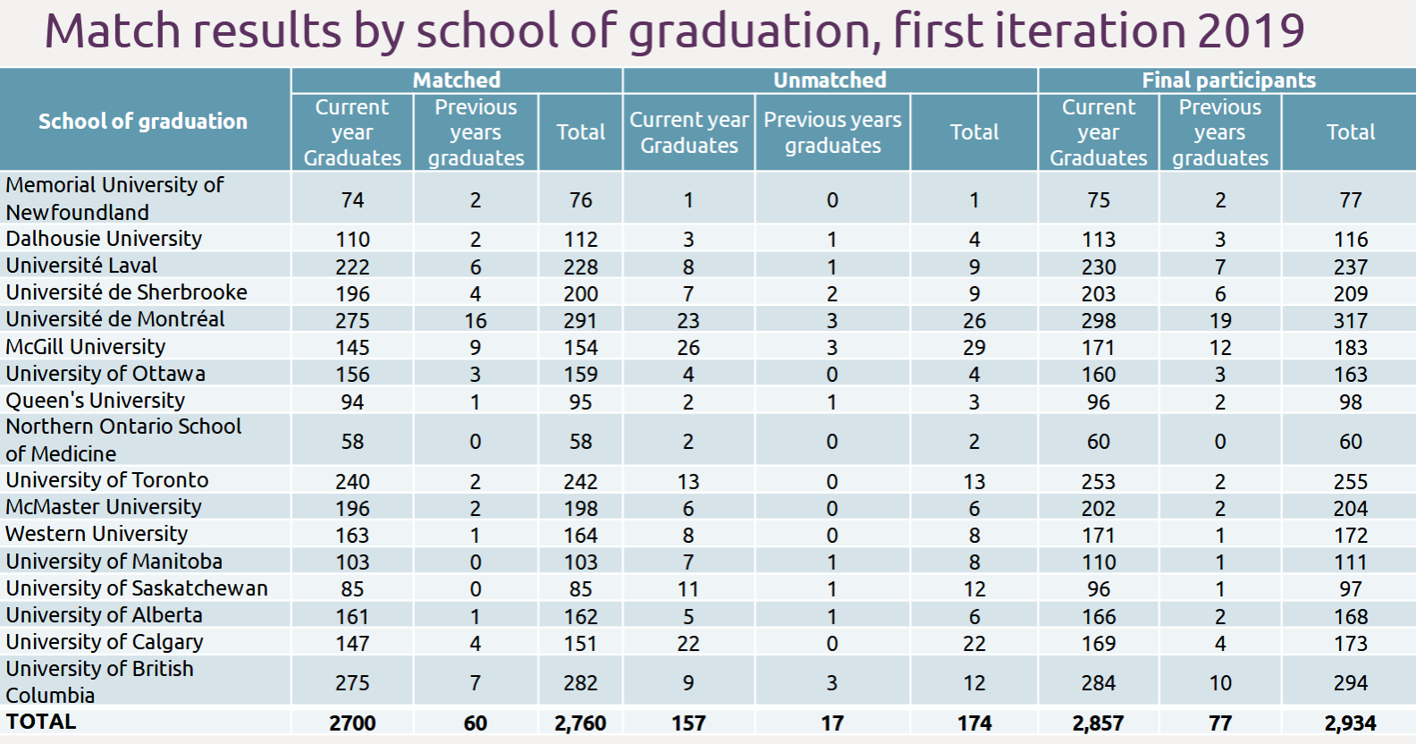
Notes:
Last year, our overall match rate was 96.25%. 3 out of 80 students failed to match in the first round, though one of those students matched successfully in the second round. So, in the end 97.5% of students matched.
89.7% ultimately matched to their first choice discipline.

Slide 18
MedCAREERS
Support
Finding and understanding meaningful experiences.
Developing career management skills.
Notes:
The MedCAREERS program aims to help you through this process. We want to help you find yourself and meaningful clinical experiences. We also aim to give you some of the practical skills you will need to get throught the CaRMS match and into residency.

Slide 19
https://www.med.mun.ca/Student-Affairs/MedCAREERS/Phase-1.aspx

Slide 20
Choosing the right career
Ultimately, planning your career is your responsibility.
We will guide you.
Career advising
Faculty members
Staff
Residents, students
Lectures, shadowing, specialty night, electives, counselling, on-line resources, etc…

Slide 21
MedCAREERS
Career Counselling
Exploring your options
-early clinical experience
-academic content
-physician shadowing
-specialty night
-talking with faculty
-electives/selectives
Choosing a specialty
-electives/selectives
-lifestyle factors
-family commitments
-geographic considerations
-remuneration
-job availability
Applying to residency
-CV preparation
-CaRMS application
-Understanding the match
-Reference letters
-Interview skills
-MSPR

Slide 22
AAMC: Careers in Medicine
https://www.aamc.org/cim/specialty/understandyourself/

Slide 23
CiM: About self-assessment
AAMC CiM website

Slide 24
CiM Self Assessment Tools
AAMC CiM website

Slide 25
AAMC CiM website

Slide 26
AAMC CiM website

Slide 27
https://residentdoctors.ca/resources/resident-profiles/
Notes:
79% were matched to one of their top three programs (for both site and discipline) overall.

Slide 28
CMA Specialty Profiles
https://www.cma.ca/En/Pages/specialty-profiles.aspx

Slide 29
Factors influencing specialty choice
Personality fit
Specialty content
Role model
Work/life balance
Family plans
Fellowship training options
Remuneration
Competitiveness
Length of training
Family expectations
Student debt
AAMC GQ

Slide 30
Determinants of physician satisfaction
Hours worked per week
On call requirements
Academic involvement
Practice population, geography
Remuneration
Collegiality
Autonomy/control
EMR use
Work – life balance

Slide 31
Common myths about the residency matching process: https://www.afmc.ca/etools/demystifying-residency-matching-process

Slide 33
Questions?

