Slide 1
Environmental Fate of Pesticides
Dr. Cora J. Young
Assistant Professor
Department of Chemistry
Memorial University

Slide 2
What are Pesticides?
Diverse chemical structures
Used to manage
insects
, weeds
, fungi
Mirex
DDT
Imadocloprid
Atrazine
Glyphosate
Trifluralin
Chlorothalonil

Slide 3
What Happens in the Environment?
We use pesticides in targeted areas, but they rarely stay where they were applied.
Can move into:
Air (hoppers)
Soil/biota (accumulators)
Water (swimmers)

Slide 4
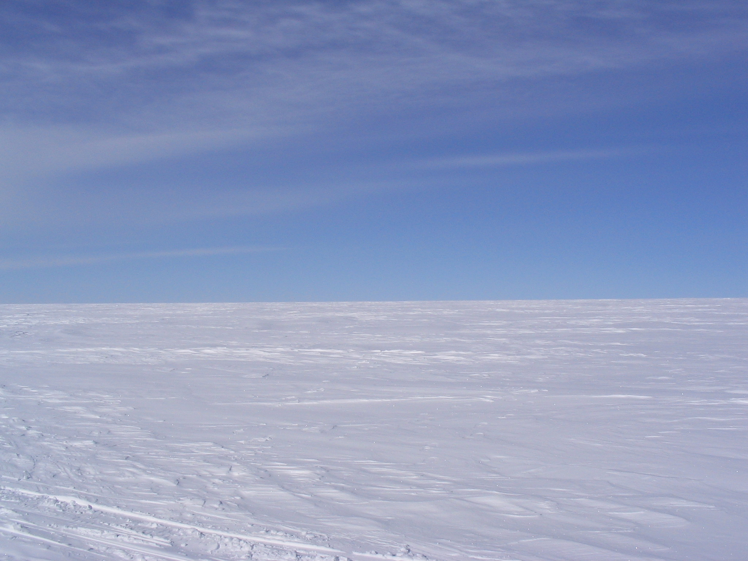
Pesticides Get Around:
Hoppers
The long-range transport of hoppers occurs through a process known as the “grasshopper effect”.

Slide 5
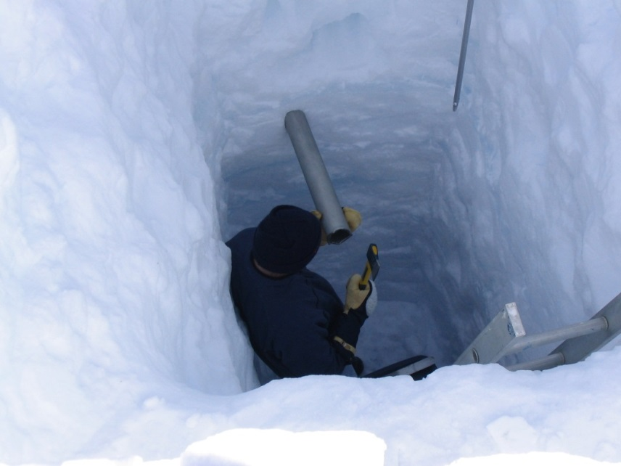
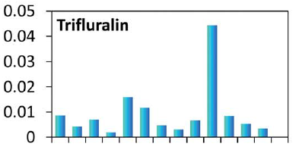
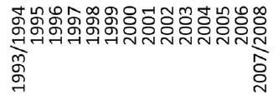
Pesticides Get Around:
Hoppers
Hoppers have been measured all over the world, including in remote regions such as the Arctic.
Nine current use pesticides measured on the Devon Ice Cap.
Organochlorine pesticides detected in recent air samples taken in Greenland.
Deposition flux (pg/cm²/yr)
Deposition year
Zhang et al. 2013 Environ. Sci.: Processes Impacts 15: 2304; Bossi et al. 2013 Environ. Sci.: Processes Impacts 15: 2213

Slide 6
Pesticides Get Around:
Accumulators
Pesticides can sorb to soil particles, which can be transported or consumed by organisms.

Slide 7
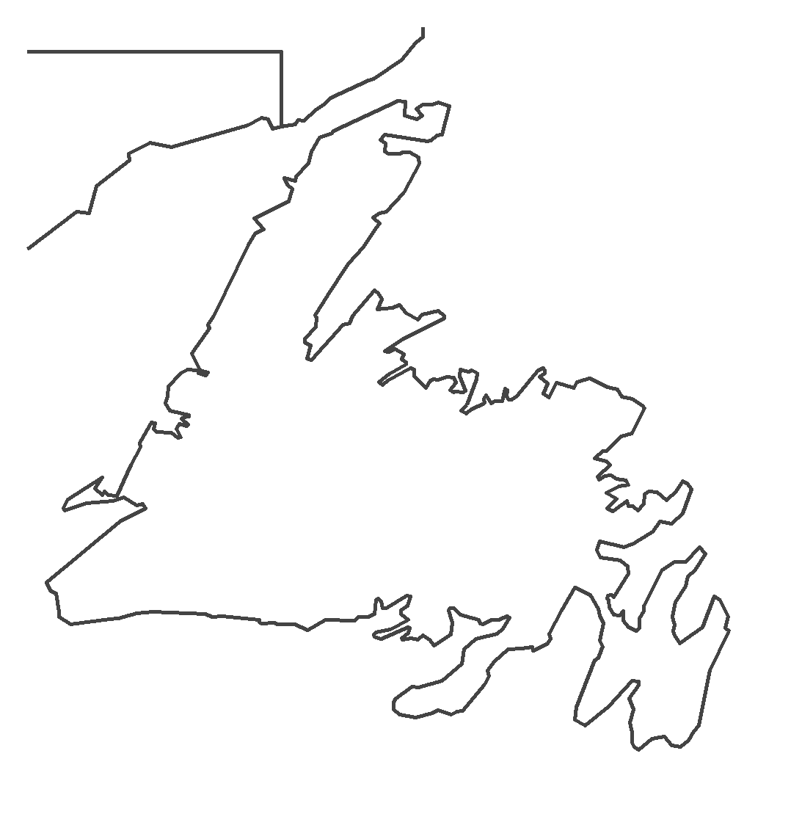
Pesticides Get Around:
Swimmers

Slide 8
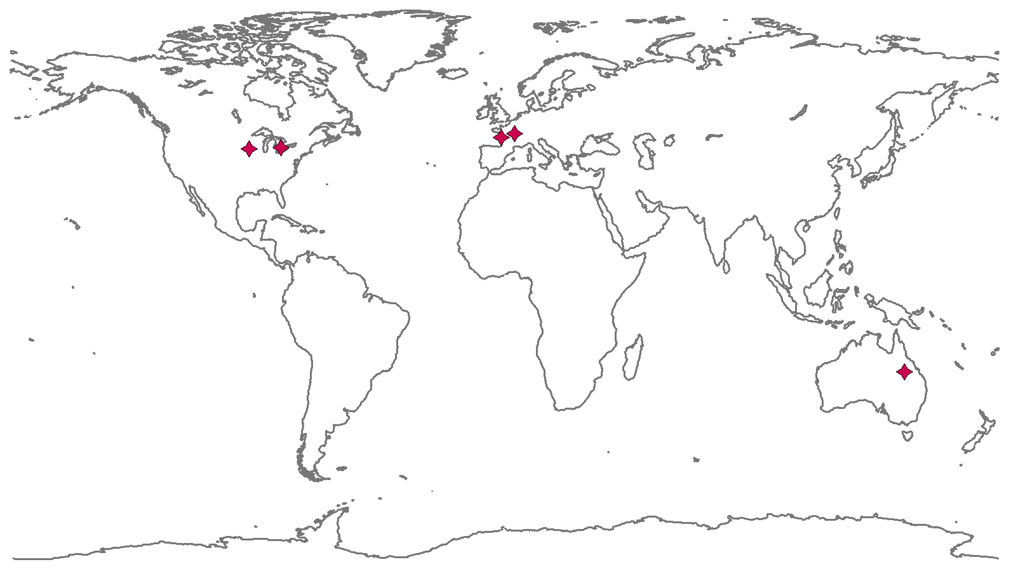
Pesticides Get Around:
Swimmers
By design, most pesticides are not swimmers.
Notable exception: glyphosate.
Glyphosate is often detected in surface seawater.
Mercurio et al. 2014 Mar. Poll. Bull. 85: 385

Slide 9
Pesticide Toxicity
A common issue with pesticides is effects on non-target organisms.
Sometimes due to unintended exposure (e.g. neonicotinoids and bees).
Sometimes totally different mechanism of action (e.g. reported feminization of frogs by atrazine).
Godfray et al. 2015 Proc. Royal Soc. B 281: 20140558; Hayes et al. 2010 Proc. Natl. Acad. Sci. USA 107: 4612

Slide 10
Pesticides Don’t Always Stay the Same
Legacy pesticides have long environmental lifetimes.
More modern pesticides tend to have shorter lifetimes in the environment.
Biota
H₂O
In some cases, products can have similar or greater toxicity than the original compound.

Slide 11
Required Data for Market
A large amount of environmental data is required before governments will approve market usage.
Physical properties
Environmental fate data
Toxicity to certain species
Large amount of useful data typically not required.
Products of environmental degradation
Toxicity of degradation products
Toxicity in concert with other chemicals
Even with the best lab data, predicting the full extent of pesticide impacts on the environment is virtually impossible.

Slide 12
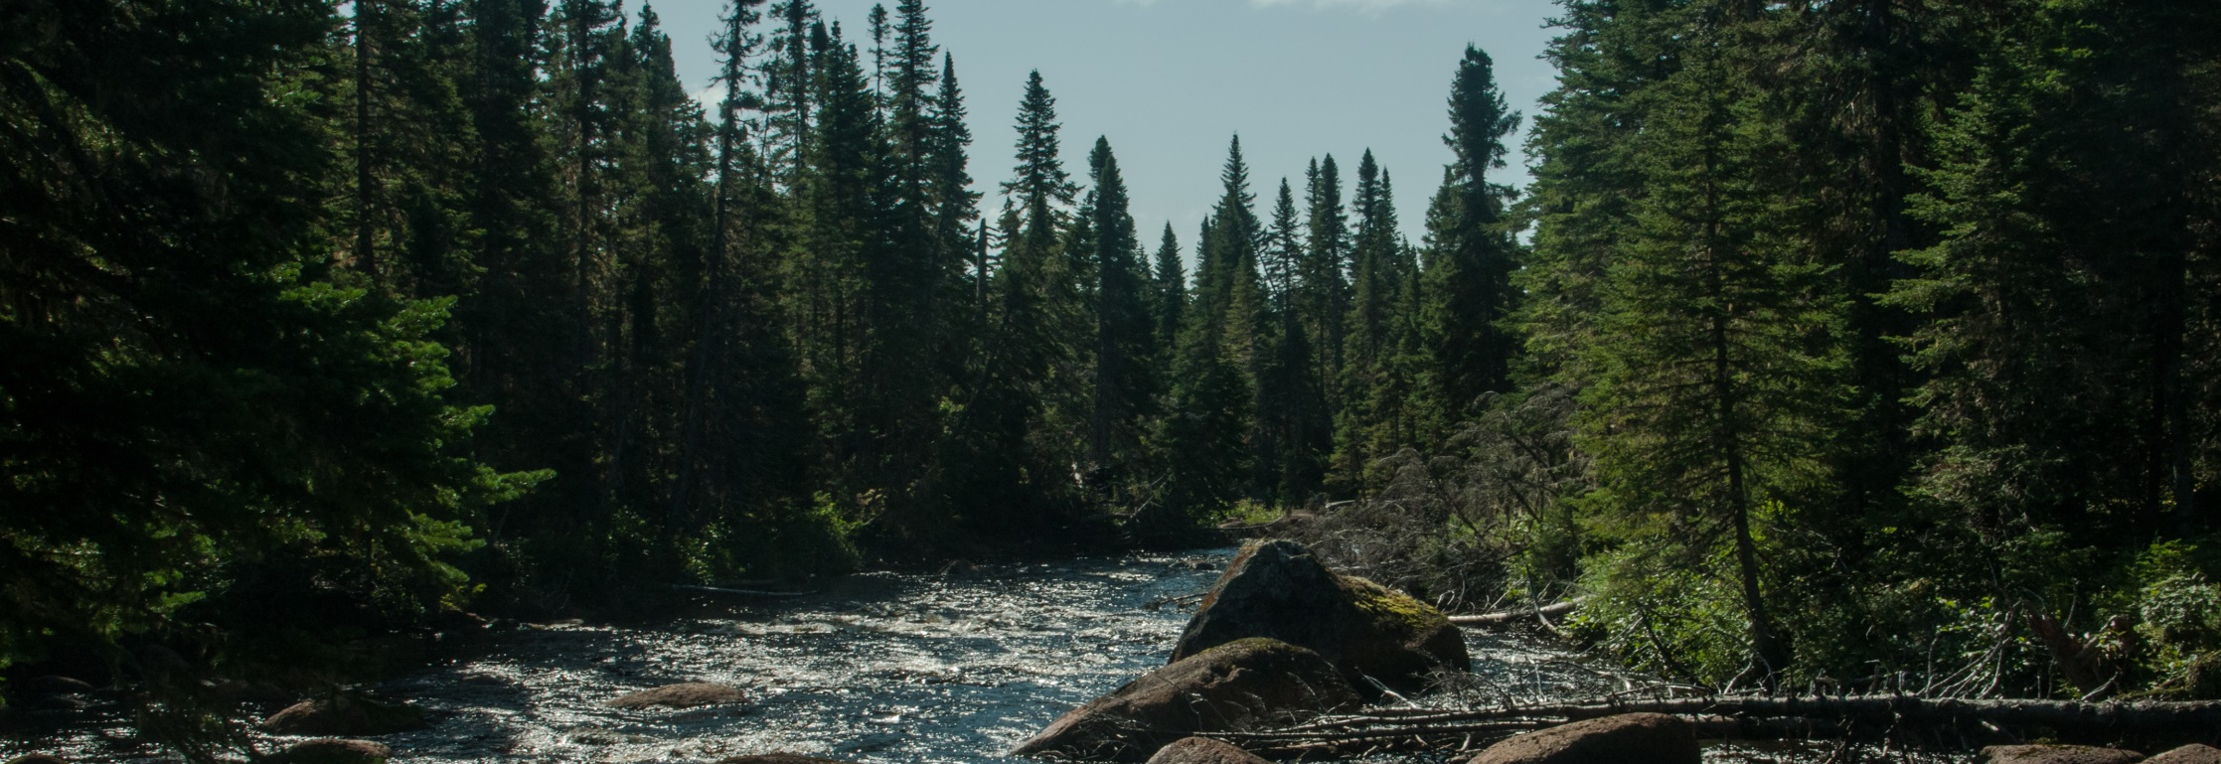
Pesticides in Newfoundland and Labrador
The province has been largely unaffected by pesticides compared to many other areas.
Herbicides are often used when mechanical clearing could be equally effective.
To maintain the pristine environment and key resource industries of Newfoundland and Labrador, pesticide use should be limited to essential applications.

