Slide 1
Pesticides – how we control their use (or don’t)
and why that matters to human and ecosystem health
Harris Centre, Memorial University of Nfld
Feb.12/16
Warren Bell BA MD CM CCFP FCFP
Past Founding President
Canadian Association of Physicians for the Environment
Salmon Arm, BC

Slide 2
The Harris Centre’s vision for Newfoundland and Labrador is of a vibrant democracy with informed citizens actively engaged in realizing a prosperous and sustainable society which values individual and collective responsibility for decision-making and development, true to our unique culture and identity.
The mission of the Harris Centre is to encourage informed public policy and regional development in Newfoundland and Labrador by supporting communication and collaboration between Memorial University and the people of this province.

Slide 3
The Harris Centre’s vision for Newfoundland and Labrador is of a vibrant democracy with informed citizens actively engaged in realizing a prosperous and sustainable society which values individual and collective responsibility for decision-making and development, true to our unique culture and identity.
The mission of the Harris Centre is to encourage informed public policy and regional development in Newfoundland and Labrador by supporting communication and collaboration between Memorial University and the people of this province.

Slide 4
The Harris Centre’s vision for Newfoundland and Labrador is of a vibrant democracy with informed citizens actively engaged in realizing a prosperous and sustainable society which values individual and collective responsibility for decision-making and development, true to our unique culture and identity.
The Mission of the Harris Centre is to encourage informed public policy and regional development in Newfoundland and Labrador by supporting communication and collaboration between Memorial University and the people of this province.

Slide 5
Player #3

Slide 6
Canadian Association of Physicians for the Environment

Slide 7
CAPE works to protect human health
by protecting the planet
We seek to better understand how environmental degradation affects human health and to be a resource to others.
We educate our members, other physicians and health professionals, the public, and policy-makers about environmental health issues
We take actions that will contribute to the protection and promotion of human health by addressing issues of environmental degradation
We collaborate with other organizations, nationally and internationally, that share our concerns and values.

Slide 8
CAPE and pesticides
$150K

Slide 9
Player #2

Slide 10
The Health Canada Pest Management Regulatory Agency (PMRA) is responsible for pesticide regulation in Canada. Created in 1995, this branch of Health Canada consolidates the resources and responsibilities for pest management regulation.
Pesticides are stringently regulated in Canada to ensure they pose minimal risk to human health and the environment. Under authority of the Pest Control Products Act, Health Canada:
registers pesticides after a stringent, science-based evaluation that ensures any risks are acceptable;
re-evaluates the pesticides currently on the market on a 15-year cycle to ensure the products meet current scientific standards; and
promotes sustainable pest management.
~$50M

Slide 11
Player #1

Slide 12
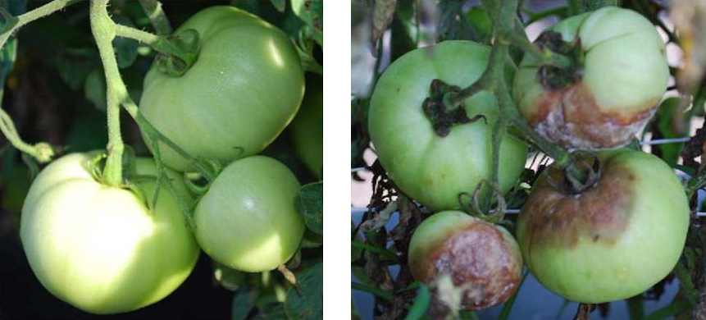
No financial info
Pesticides!
No pesticides!

Slide 14
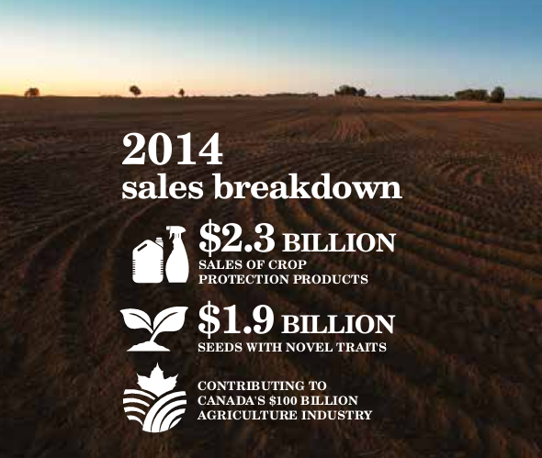
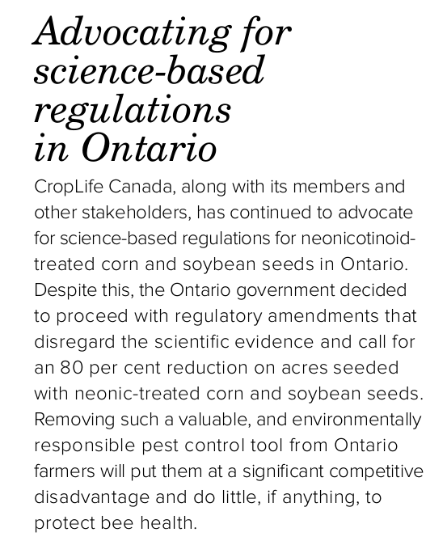

Slide 15
Commissioner of the Environment and Sustainable Development, Judy Gelfand – part of the Office of the Auditor General of Canada
January 26, 2016
http://www.oag-bvg.gc.ca/internet/English/att__e_41031.html

Slide 16
A classic PMRA story
Decision pending….
6.0 Proposed Special Review Decision for Atrazine
Evaluation of available relevant scientific information related to the aspect of concern, indicates that atrazine and its chlorinated transformation products do not pose unacceptable risks to human health and the environment, with respect to drinking water, taking into account the current conditions of use. On this basis, the PMRA, under the authority of the Pest Control Products Act, is proposing to confirm the current registration of pest control products containing atrazine for sale and use in Canada.

Slide 17
Let’s take a real-life example, and see how it plays out….
Neonicotinoids
(insecticides)

Slide 18
“AgInfomatics Identifying the Benefits of Insecticides” (neonicotinoids in particular)
“There are four companies that have come together to fund the studies including Syngenta, Bayer, Valiant and Mitsui. AgInfomatics is doing the research and then it will be given to the companies who will they give the research to the regulatory agencies.”
“[Aginfomatics] are focusing on two agencies. In the United States its the Environmental Protection Agency (EPA) and in Canada it is the Pesticide Management Regulatory Authority,” explained [an Aginfomatics spokesperson]. “They are looking at neonicotinoids now as part of a registration process and they realize we just don’t have good data on the benefits; how important these insecticides are.” [emphasis added]

Slide 19
Update on Neonicotinoid Pesticides and Bee Health
In 2012, 2013 and 2014, reported incidents related to planting of treated corn and soybean seed were limited to intense corn-growing regions of southern Ontario, with fewer incidents in corn growing regions of Quebec and Manitoba
Based on a thorough evaluation, Health Canada's PMRA concluded that neonicotinoids present in dust generated during planting of treated corn and soybean seeds contributed to the reported bee mortalities in 2012 and 2013.

Slide 20
A Common Pesticide Decreases Foraging Success and Survival in Honey Bees
Mickaël Henry¹,² et al
Science 20 Apr 2012: Vol. 336, Issue 6079, pp. 348-350 DOI: 10.1126/science.1215039
Abstract
Nonlethal exposure of honey bees to thiamethoxam (neonicotinoid systemic pesticide) causes high mortality due to homing failure at levels that could put a colony at risk of collapse. Simulated exposure events on free-ranging foragers labeled with a radio-frequency identification tag suggest that homing is impaired by thiamethoxam intoxication. These experiments offer new insights into the consequences of common neonicotinoid pesticides used worldwide.

Slide 21
Researchers confirm that neonicotinoid insecticides impair bee's brains
February 5, 2015
Research at the Universities of St Andrews and Dundee has confirmed that levels of neonicotinoid insecticides accepted to exist in agriculture cause both impairment of bumblebees' brain cells and subsequent poor performance by bee colonies Read more at: http://phys.org/news/2015-02-neonicotinoid-insecticides-impair-bee-brains.html#jCp

Slide 22
Finally….
Roundup (glyphosate)
(a herbicide)
Glyphosate-containing products are the most widely sold pesticides in the world – 718,600 tonnes in 2012 – sprayed on 65 million hectares of GM “Roundup Ready” crops in the US alone, especially since the introduction of these glyphosate-resistant plants.

Slide 23
Friends of the Earth found glyphosate residues in the urine of 44% of individuals tested, from 18 European countries.

Slide 24
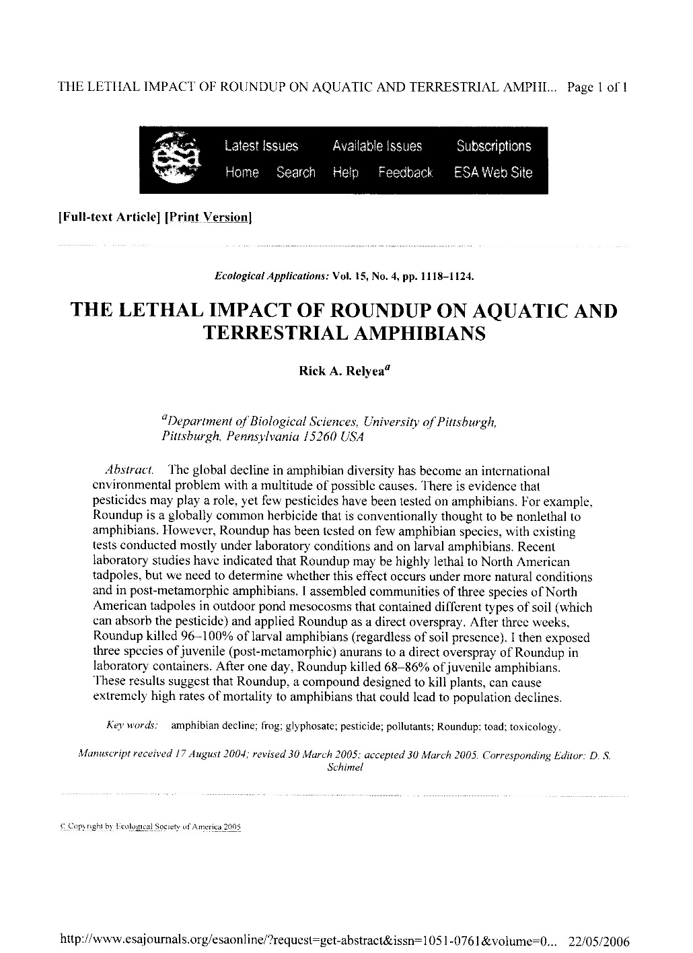
Proposed Re-evaluation Decision PRVD2015-01, Glyphosate
The environment
“Certain glyphosate formulations include a surfactant composed of POEA compounds. At high enough concentrations, POEA is toxic to aquatic organisms but is not expected to persist in the environment. While, in general, glyphosate formulations that contain POEA are more toxic to freshwater and marine/estuarine organisms than formulations that do not contain POEA, they do not pose an unacceptable risk to the environment when used as directed on the label. …glyphosate formulations pose a negligible risk to freshwater fish and amphibians….”
2005
Notes:
This guy has done lots of studies – it’s worth it to Google him. Monsanto hates him (need I say more?!)

Slide 25
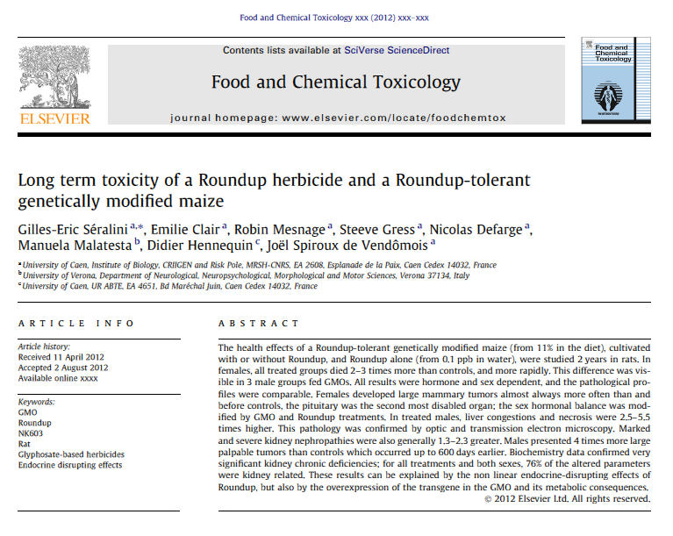
“Short and long term (lifetime) animal toxicity tests…were assessed for the potential of glyphosate to cause neurotoxicity, immunotoxicity, chronic toxicity, cancer, reproductive and developmental toxicity, and various other effects. The most sensitive endpoints used for risk assessment included clinical signs of toxicity and developmental effects. There was no indication that the young were more sensitive than the adult animal. The risk assessment approach ensures that the level of exposure to humans is well below the lowest dose at which these effects occurred in animal tests.”
Mammals
Proposed Re-evaluation Decision PRVD2015-01, Glyphosate
Gilles-Eric Séralini

Slide 26
What Séralini found
Gilles-Eric Séralini tested Sprague-Dawley rats in a replication of a pivotal Monsanto experiment, but with a lifetime exposure (2 years) instead of a shorter duration
Study published August, 2012 after secret research program
Showed significantly increased tumour formation and widespread kidney disease in rats exposed to GM corn (and Roundup alone) vs control
Study withdrawn in Nov/13 after firestorm of industry-led criticism – and after a veteran Monsanto executive joined editorial board of journal
International outcry from global scientific community – not related to GM experiment, but to lack of grounds for withdrawal (no fraud, methodology satisfactory – just “inconclusive” – which authors had clearly acknowledged)
Study republished in 2014 (although 4-5 offers, Seralini et al chose journal with open access) with expanded background information

Slide 27
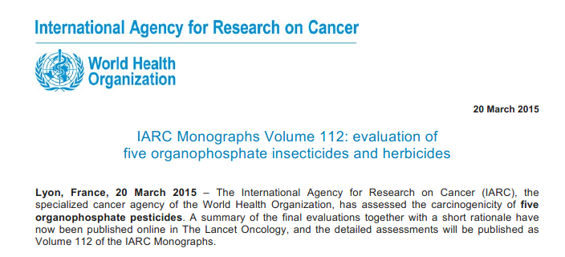
Humans
Proposed Re-evaluation Decision PRVD2015-01, Glyphosate
“The World Health Organization's (WHO) International Agency for Research on Cancer (IARC) recently assigned a hazard classification for glyphosate as "probably carcinogenic to humans". It is important to note that a hazard classification is not a health risk assessment. The level of human exposure, which determines the actual risk, was not taken into account by WHO (IARC). “

Slide 28
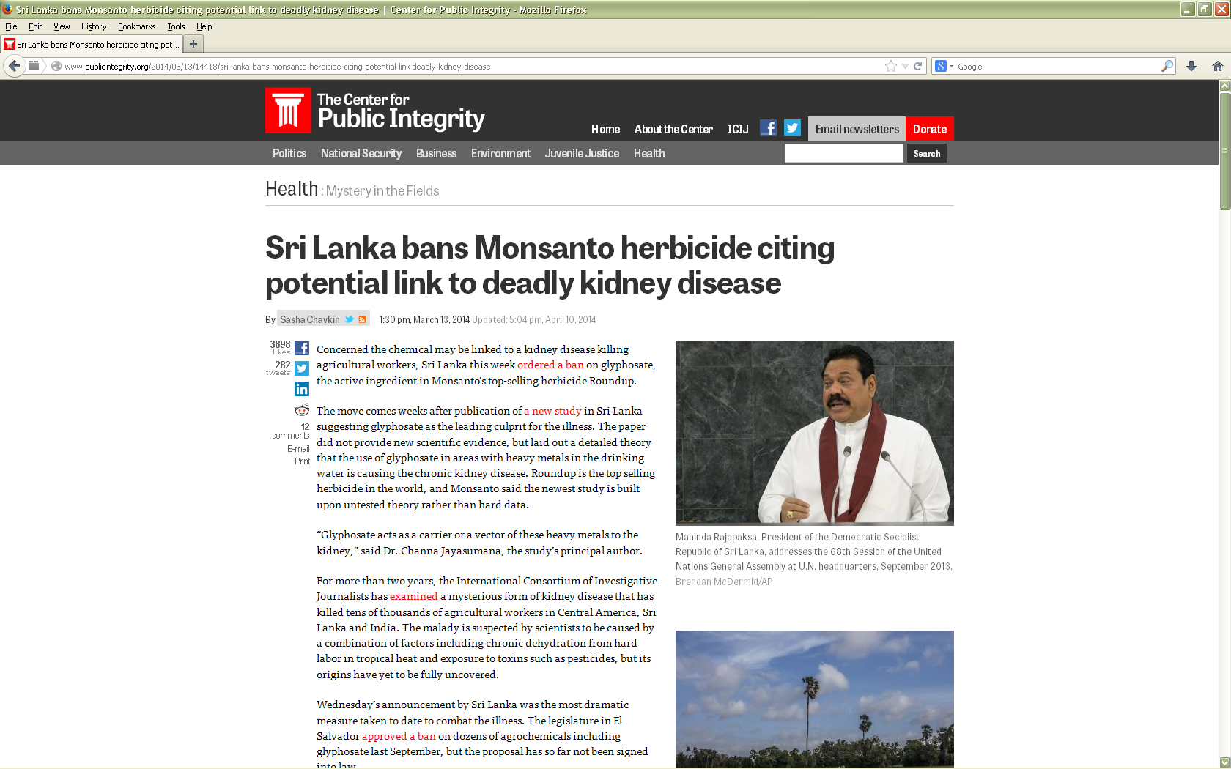
Humans

Slide 29
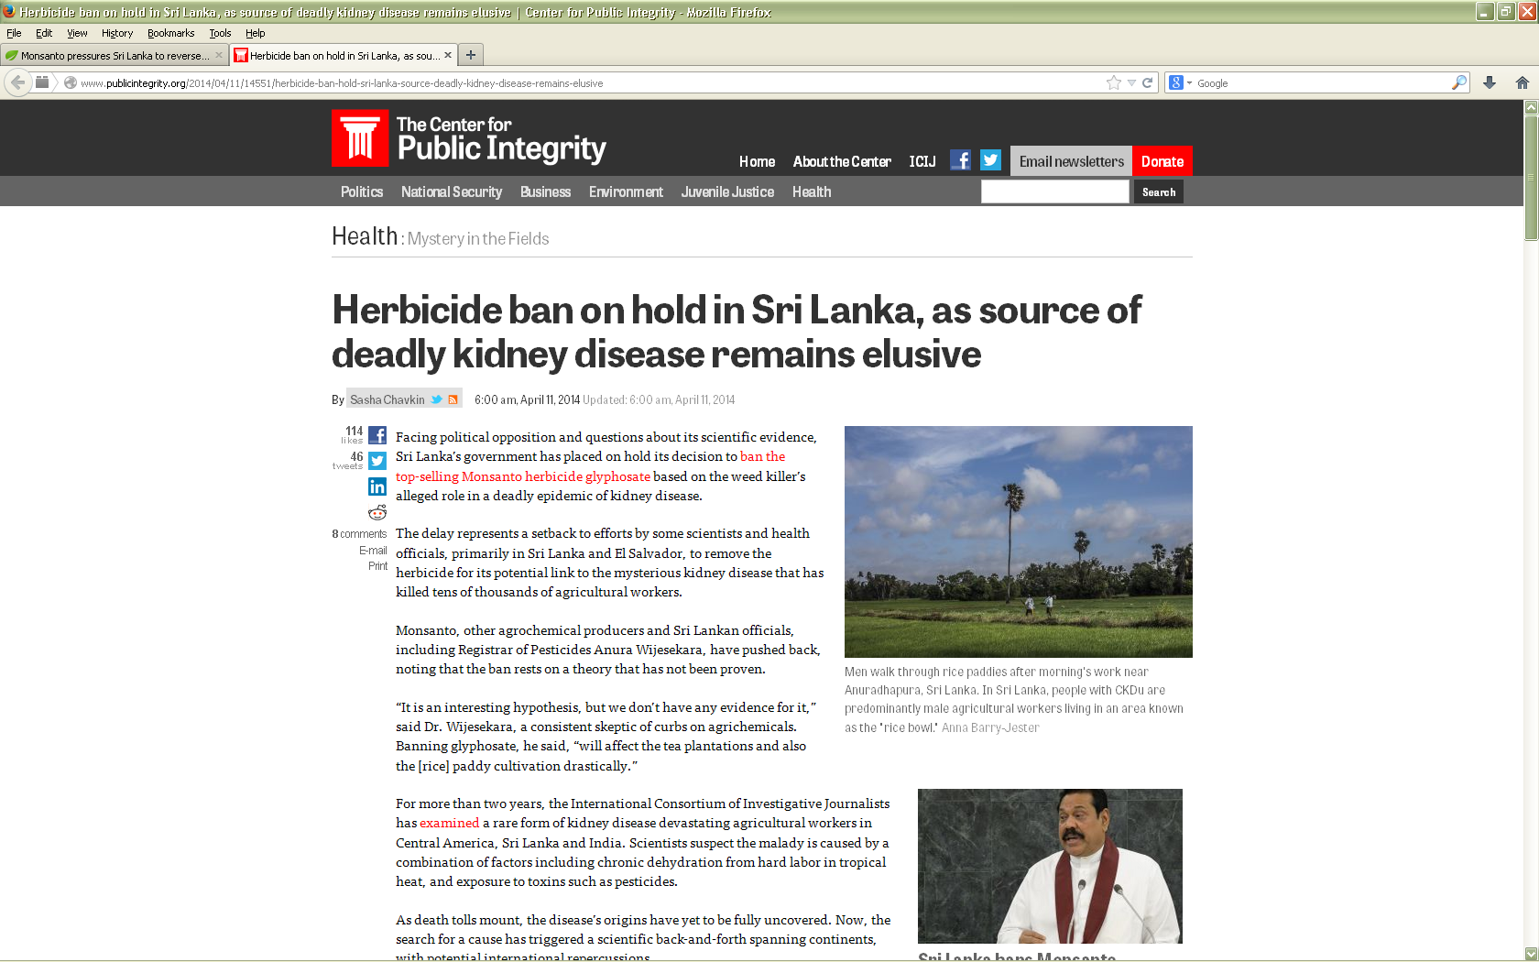
Humans

Slide 30
Humans
Sublethal Exposure to Commercial Formulations of the Herbicides Dicamba, 2,4-Dichlorophenoxyacetic Acid, and Glyphosate Cause Changes in Antibiotic Susceptibility in Escherichia coli and Salmonella enterica serovar Typhimurium
“Herbicide concentrations needed to invoke the maximal response were above current food maximum residue levels but within application levels for all herbicides.”
“The magnitude of the induced response may undermine antibiotic therapy and substantially increase the probability of spontaneous mutation to higher levels of resistance.”
http://mbio.asm.org/content/6/2/e00009-15

Slide 31
A few final comments about the PMRA
Roughly 30% of PMRA revenue comes from industry (so-called “cost recovery”)
Most research reviewed by the PMRA comes from industry – federal science labs were closed two decades ago
No full preparations are analyzed – only “active” ingredients are tested
Canadian law forbids disclosure of all other ingredients – formerly called “inerts”, now called “formulants”
No active ingredients are tested in combination
No pesticides are tested in combination with other common chemicals (e.g. personal care products, detergents, solvents, flame retardants, medications, etc), even though, on average, the human body contains traces of 40-60 industrial chemicals.
Even though the PMRA approves a product, provinces and municipalities have the right, in law, to enact legislation to protect the health of their citizens.

Slide 32
Takeaways…
Pesticide regulation in Canada is porous, and tends to favour industry priorities
Health testing for humans and the ecosystem is grossly incomplete, and much past research is industry-sponsored
New evidence, long overdue, overwhelmingly identifies new hazards rather than dismissing previous ones.
New policy must be based on independent research, not sponsored studies.
Policy-makers must expect and plan for sharp resistance from industry if they are to make headway in reducing the mostly long-term dangers posed by pesticides.
Collaboration with and buy-in by “civil society” organizations affords a way to accelerate the process of policy change.

Slide 33
The health of citizens of Newfoundland and Labrador will be secure, if new polices incorporate the protection of human and ecosystem health as essential guiding principles.
www.cape.ca/
https://www.facebook.com/capedoctors/

