Slide 1
Pesticides and human health: old and emerging issues
Dr. Atanu Sarkar MBBS, PhD, MES
Assistant Professor
(Environmental and Occupational Health)
Division of Community Health and Humanities
Faculty of Medicine
Memorial University
Synergy session
Organized by Harris Centre
12th Feb, 2016

Slide 2
Systematic Review of Pesticide Health Effects (2012) – Ontario College of Family Physicians (based on 142 studies since 2003)
Some excerpts

Slide 3
Reproductive health outcomes
Fetal growth retardation
Low birth weight, preterm birth
Congenital anomalies (hypospadias, neural tube defects, and congenital diaphragmatic hernia)

Slide 4
Neurodevelopmental/behavioral health
Affecting reflexes
Mental development and Psychomotor development
Attention deficit hyperactivity disorder (ADHD), low IQ, autism

Slide 5
Respiratory health outcomes
Atopic asthma (occupational, domestic and environmental)
Chronic bronchitis

Slide 6
Emerging issues

Slide 7
Busting Myth – No Worries
Low dose exposure
Living in safer place
Banned – safe forever

Slide 8
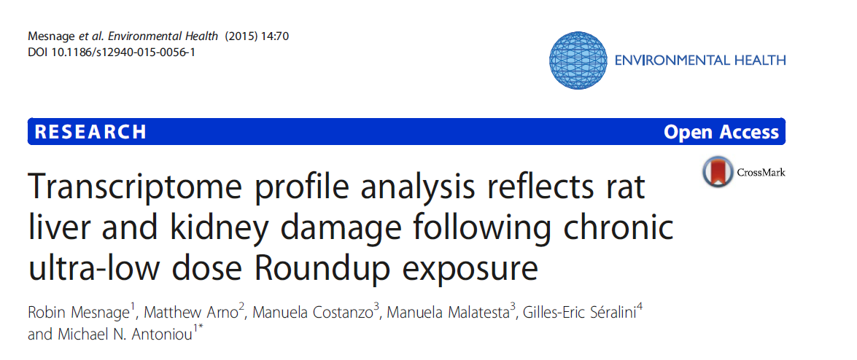
Low dose exposure

Slide 9
Low dose exposure
Glyphosate acceptable daily intake (ADI), which is currently set at 0.3 mg/kg body weight /day within the European Union and 1.75 mg/kg body weight /day in the USA based on hepato-renal toxicity measurements after chronic exposure in rats
Current study 4 ng/kg body weight /day of glyphosate
1 mg = 1000000 ng

Slide 10
Living in safer place

Slide 11
Living in safer place

Slide 12
Banned – safe forever

Slide 13
Banned – safe forever
Observations indicate ancestral exposure to DDT can promote obesity and associated disease trans-generationally.

Slide 14
?

