Slide 1
Safety Moment
Working Alone
Officer of the chief Risk officer
www.mun.ca

Slide 2
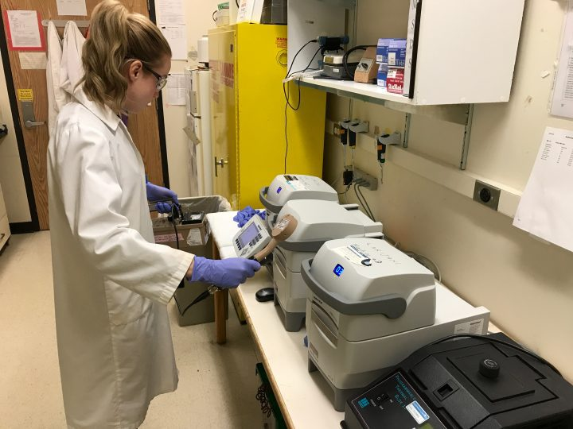
What is Working Alone?
NL OHS Regs, Section 15 defines working alone or in isolation as circumstances where assistance would not be readily available to the worker:
(a) in case of an emergency; or
(b) in case the worker is injured or in ill health.
In general, employees should not work alone in any situation involving the use of hazardous materials, high voltage, confined spaces, or other high hazard activities.

Slide 3
New MUN Safe Feature
Available to all MUN Safe Users
Communication Tool that will enable any person to schedule automated check in times with their choice of emergency contact.
Uses the push notifications on your phone to alert the individual to check in.
Calls the emergency contact with an automated phone message within 5 minutes, if the person fails to check in.
Office of the Chief Risk officer

Slide 4
Simply enter the contact information for you and your emergency contact, then start your session.
TIP: Ensure that your contact is aware that you are working alone and ready to respond in an emergency.
Tip: Keep your phone with you at all times! You must respond in 5 minute of the push notification.
Tip: In an Emergency situation – Dial CEP or 911 directly

Slide 5
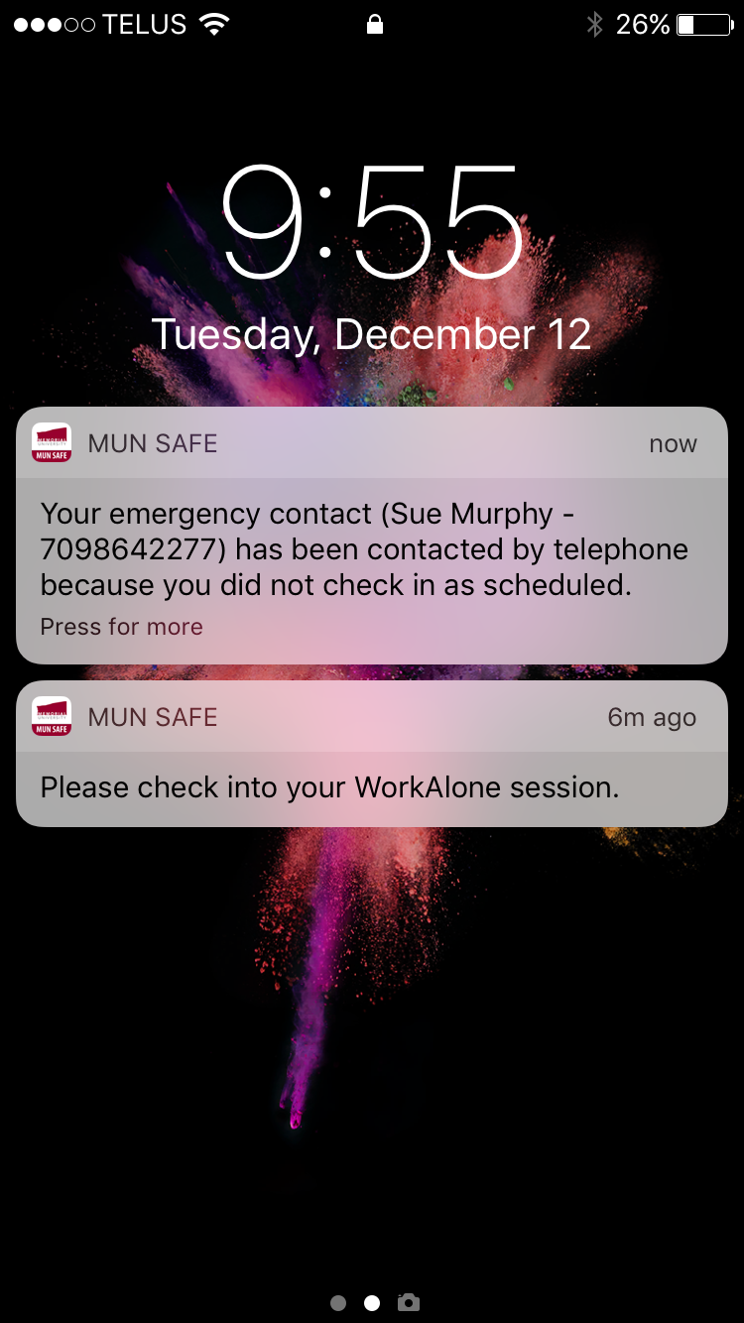
You will be notified if your emergency contact has been called.
Automated Emergency Voice Call
Office of the Chief Risk Officer

