Slide 1
Food Security and Sustainability

Slide 2
MUN Botanical Garden Food Security and Sustainability
Where does our food come from in Canada?
VIDEO

Slide 3
MUN Botanical Garden Food Security and Sustainability
How about Newfoundland:
Where does our Food Come From?

Slide 4
MUN Botanical Garden Food Security and Sustainability
Food First NL
Our province faces many challenges including:
NL produces only 10% of the fresh vegetables we consume and have only a 2-3 day supply of fresh vegetables available;
Average age of farmers in the province is 55 and rising;
Difficult to get local seafood, 80% of local seafood is exported;
Lowest consumption of fresh vegetables in Canada;
Highest rate of food bank usage in Canada (1/20);
Highest rate of obesity & diabetes in Canada
84% of communities have no grocery store

Slide 5
MUN Botanical Garden Food Security and Sustainability
Food First NL: 10 Ways to Eat Local Food

Slide 6
MUN Botanical Garden Food Security and Sustainability
FFNL: 10 Ways to Eat Local Food
Learn What’s in Season: FFNL: Resources

Slide 7
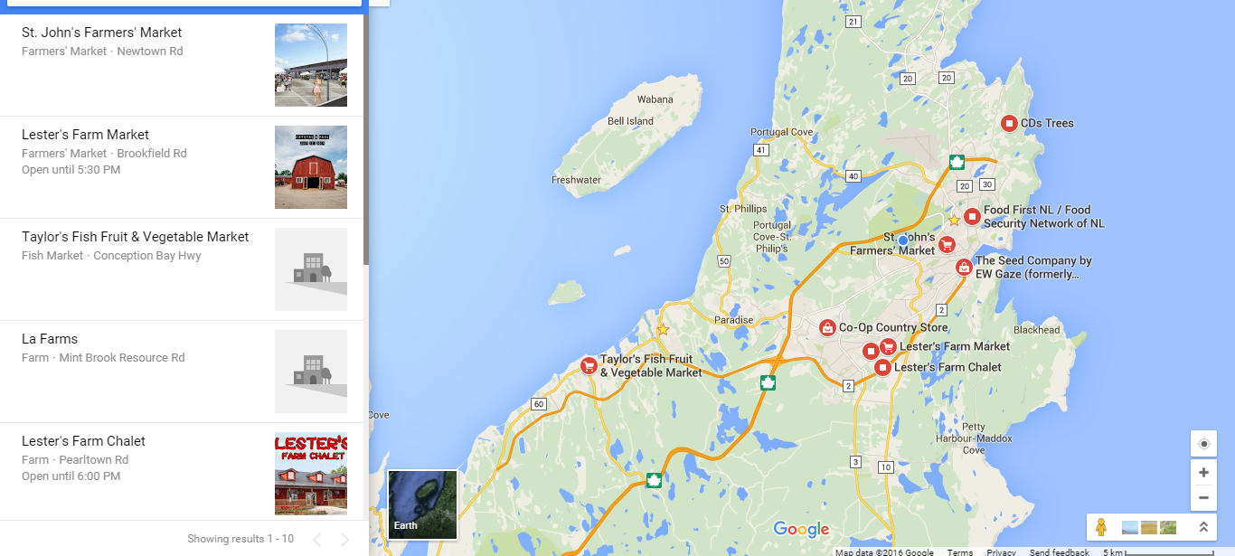
MUN Botanical Garden Food Security and Sustainability
FFNL: 10 Ways to Eat Local Food
2. Find a Farm or Local Food Retailer

Slide 8
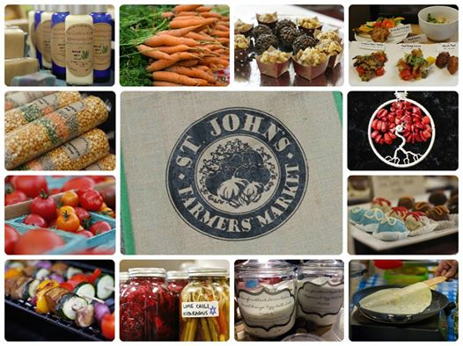
MUN Botanical Garden Food Security and Sustainability
FFNL: 10 Ways to Eat Local Food
3. Visit a Farmers’ Market

Slide 9
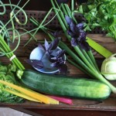
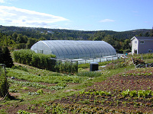
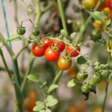
MUN Botanical Garden Food Security and Sustainability
FFNL : 10 Ways to Eat Local Food
4. Join a Community Supported Agriculture Program (CSA)
(Consumer Shared Agriculture)
Small bag is $448.00 for 14 weeks, $32 per week average.
Large bag is $616.00 for 14 weeks, $44 per week average.
Covers cost of everything The Organic Farm needs for farming: labour, fuel, equipment purchases and repairs as well as soil building materials. Payment can be by 4 post dated checks, but full amount up front helps cover labour costs early in the season before their crops are sufficient for group picking and distribution in the Veggie Coop.

Slide 10
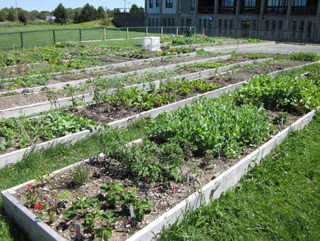
MUN Botanical Garden Food Security and Sustainability
FFNL : 10 Ways to Eat Local Food
5. Start Gardening

Slide 11
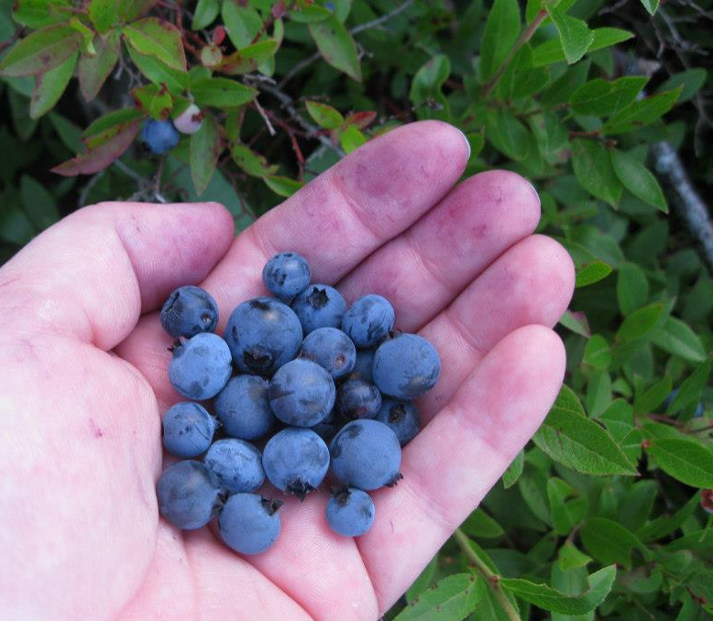
MUN Botanical Garden Food Security and Sustainability
FFNL : 10 Ways to Eat Local Food
6. Go Berry Picking

Slide 12
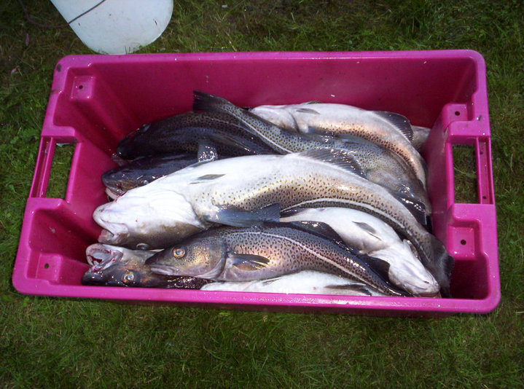
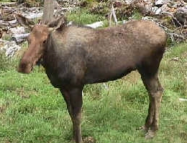
MUN Botanical Garden Food Security and Sustainability
FFNL : 10 Ways to Eat Local Food
7. Wild Harvesting

Slide 13
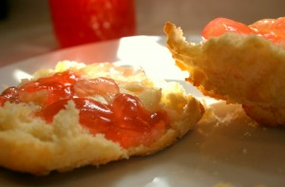
MUN Botanical Garden Food Security and Sustainability
FFNL : 10 Ways to Eat Local Food
8. Preserve the Harvest

Slide 14
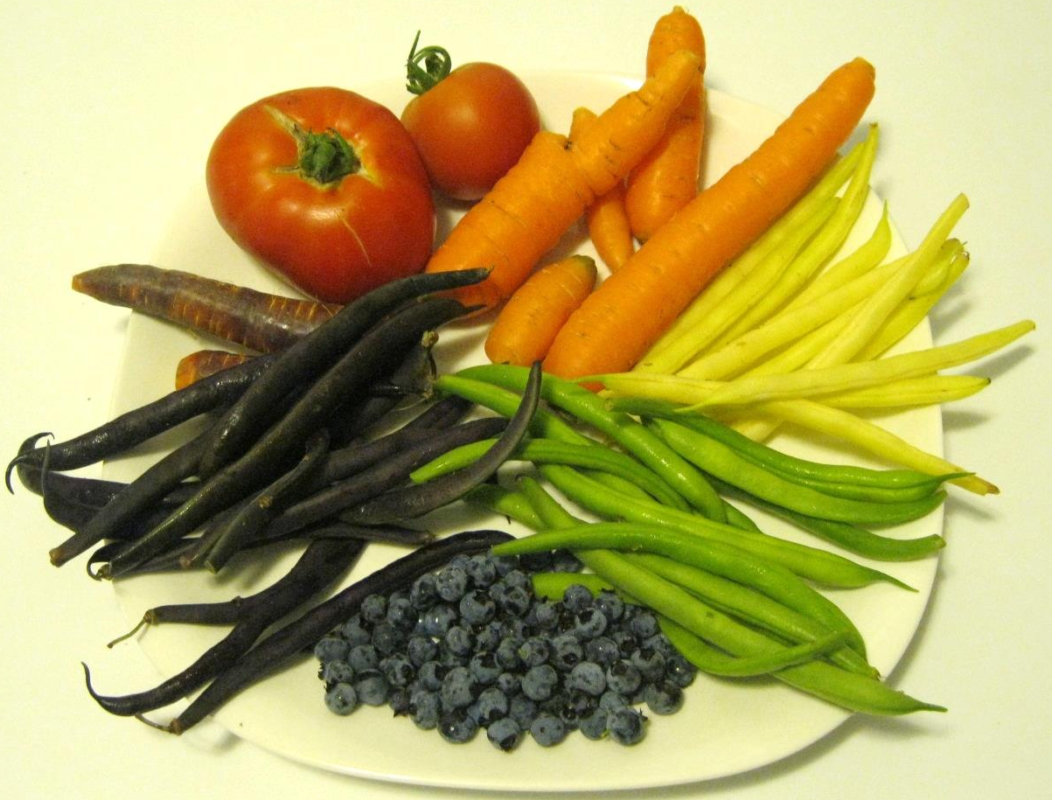
MUN Botanical Garden Food Security and Sustainability
FFNL : 10 Ways to Eat Local Food
9. Support Restaurants That Source Local Food

Slide 15
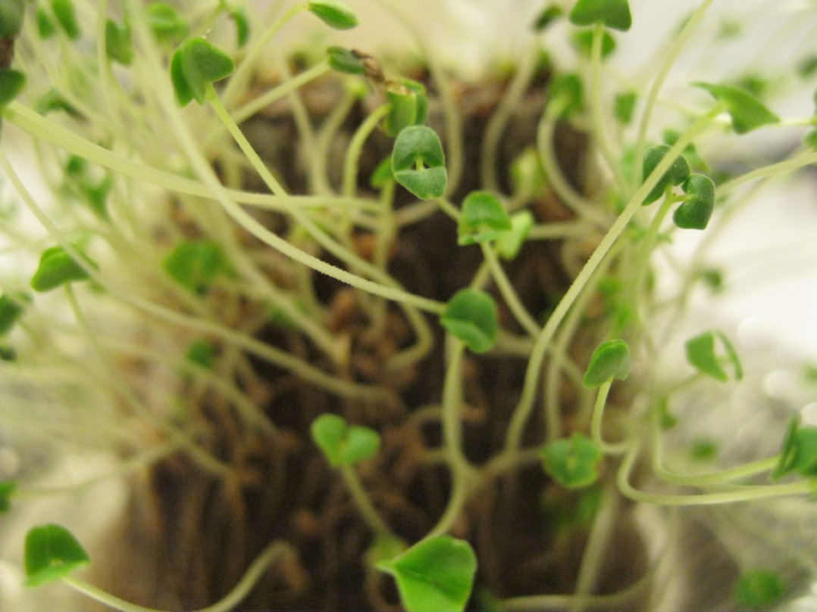
MUN Botanical Garden Food Security and Sustainability
FFNL : 10 Ways to Eat Local Food
10. Sprout!

Slide 16
MUN Botanical Garden Food Security and Sustainability
Food Ethics:
Vote with your fork
“Food justice seeks to ensure that the benefits and risks of where, what and how food is grown, produced, transported, distributed, accessed and eaten are shared fairly. Food justice represents a transformation of the current food system, including but not limited to eliminating disparities and inequities.”
Robert Gottlieb & Joshi Anupama, Food Justice

Slide 17
MUN Botanical Garden Food Security and Sustainability
Why choose Organic
Strict limits and prohibitions on the use of:
toxic and persistent pesticides
synthetic fertilizers
the routine use of drugs, antibiotics or synthetic hormones
animal cloning
genetic engineering (“GMOs”)
sewage sludge (“biosolids”)
Irradiation
Organic standards also forbid the use of:
artificial food colours
artificial flavours
artificial sweeteners
Preservatives
many other processing aids and ingredients in processed foods.

Slide 18
MUN Botanical Garden Food Security and Sustainability
What is Fairtrade?
Fairtrade is an independent, third party certification system for goods that are produced in the Global South. Its mission is to:
Ensure better prices
Decent working conditions
Support local sustainability for farmers and workers
Fairtrade requires companies to pay sustainable prices.

Slide 19
MUN Botanical Garden Food Security and Sustainability
Learn More
Read a good book:
Animal Vegetable Miracle, by Barbara Kingsolver (Eating local, gardening, cooking with recipes, and biology)
The Omnivore's Dilemma: A Natural History of Four Meals, by Michael Pollan (Discussion on where our food is grown, produced, and the health and ethics involved)
Edible Plants of Newfoundland and Labrador, by Peter Scott
The Botany of Desire: A Plant's-Eye View of the World, by Michael Pollan (How we use plants, and have changed them, but how we are influenced by them as well)

Slide 20
MUN Botanical Garden Food Security and Sustainability
Learn More
Watch:
All Around the Table: Preserving and Celebrating Seniors’ Food Knowledge, produced by the Food First NL
Botany of Desire (2009), (The history of four plants, each of which found a way to make itself essential to humans, thus ensuring widespread propagation)
Food, Inc. (2008), (all that is wrong in America’s industrialized food system; Michael Pollan)
To Make a Farm, (2011) (Young Canadians who want to start a farm) (available on TVO.org until May 15, 2018)
Learn:
Food and Climate Change, David Suzuki Foundation

Slide 21
MUN Botanical Garden Food Security and Sustainability
The Assignment

